Slide 1
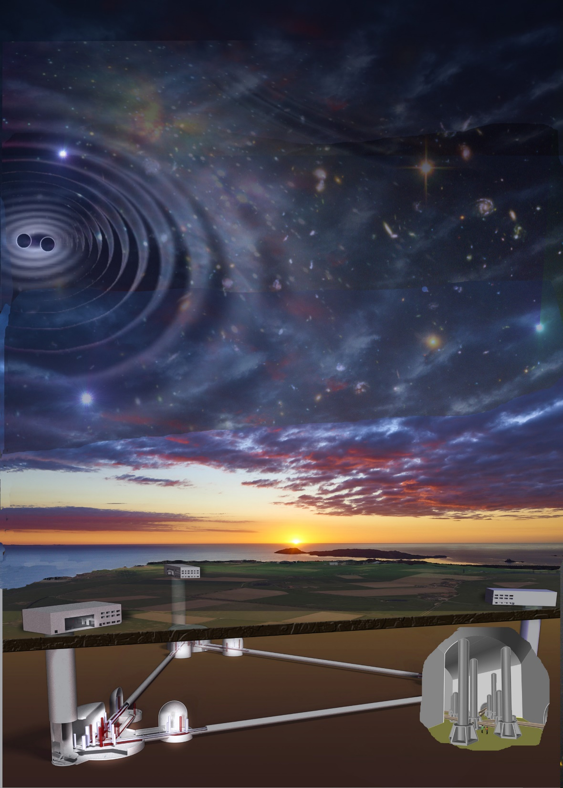


SOS-Enattos: the ideal site of 3G GW observatory:
The Einstein Telescope
SOS-Enattos:
the ideal site of 3G GW observatory:
The Einstein Telescope

Slide 2
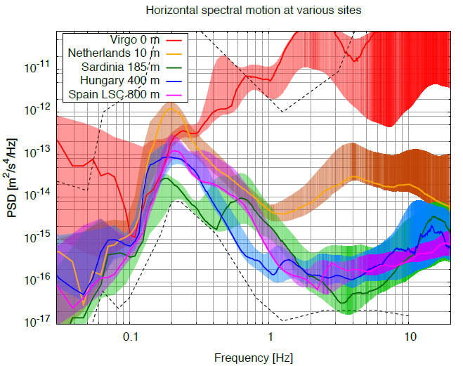
Underground Seismic noise Measurement
Underground sites are the candidates for a very quiet site
Credits: J.v.d. Brand

Slide 3
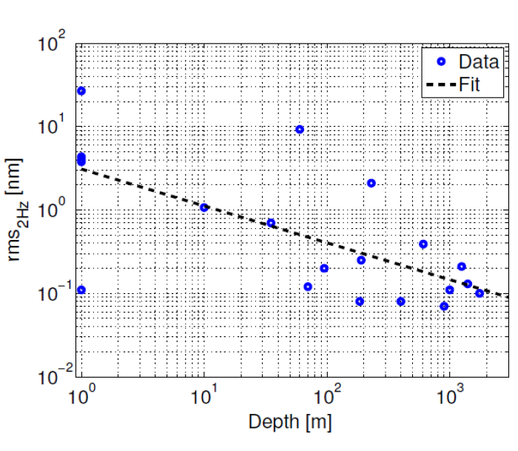
Underground Seismic noise Measurement
Underground sites are the candidates for a very quiet site
Credits: J.v.d. Brand

Slide 4
ET @SOS ENATTOS
The idea of having ET in Sardinia originates from the peculiar characteristics of the area
  seismically quiet
  not urbanized/industrialized (one of the least populated areas in Europe)
  long mining history
We have studied the placement of the ET detector in the SOS ENATTOS area, fulfilling the following requirements:
  Vertexes are placed in solid rock
  Access to caverns through tunnels rather than shafts

Slide 5
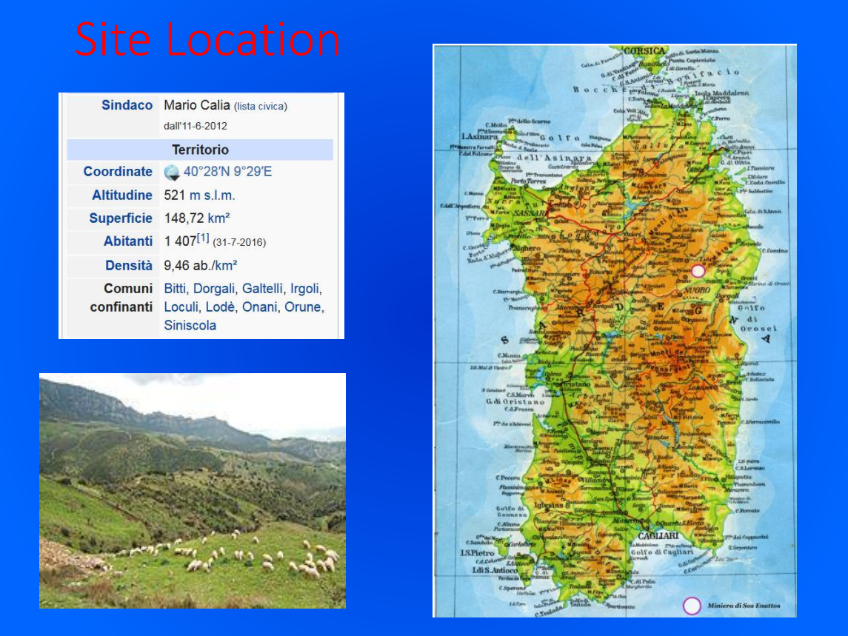

Slide 6
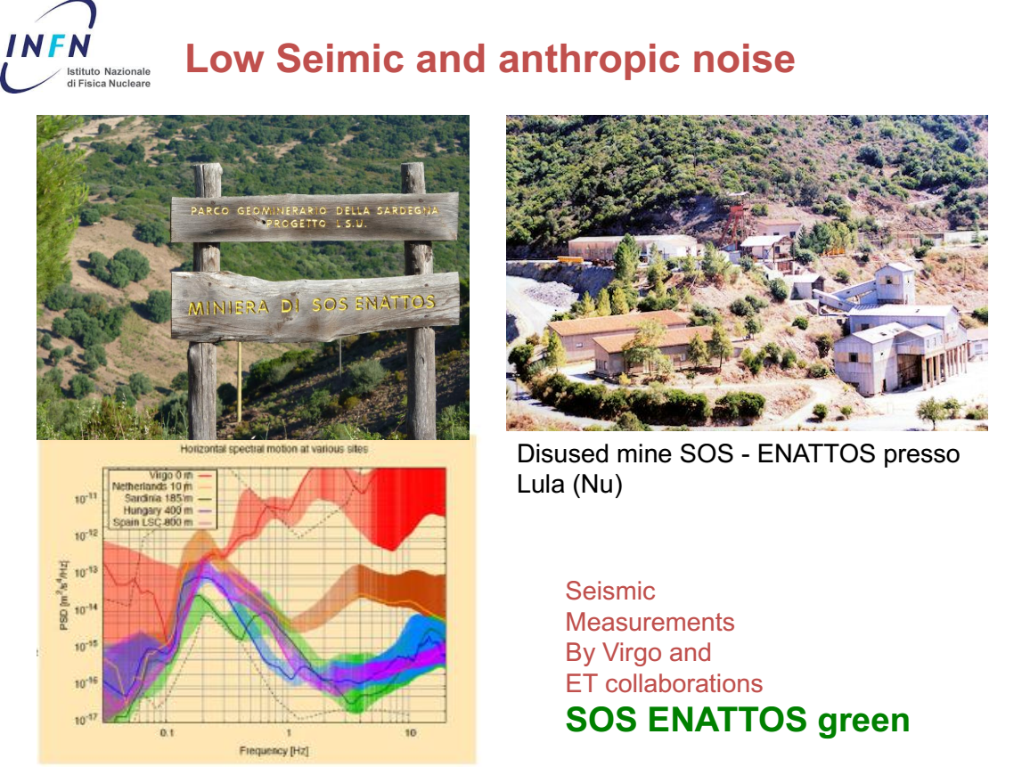

Slide 7
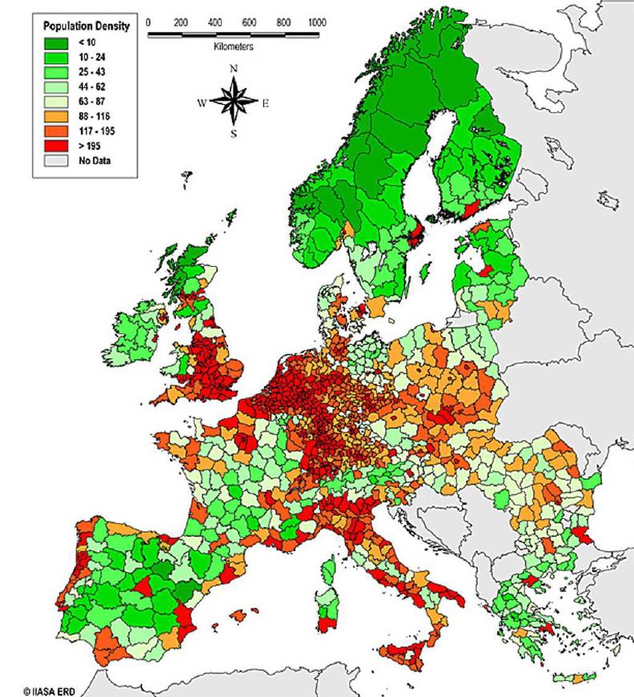
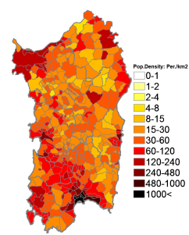
POPULATION DENSITY

Slide 8
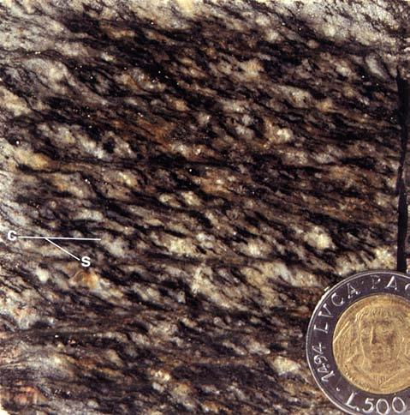
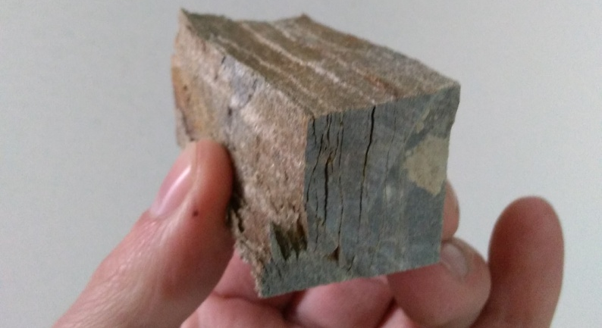

LOCAL GEOLOGY
Lodè
Buddusò
Orthogneiss “Lodè type”
UCS: 92.6/60.8 MPa
Micaschist – Paragneiss - Quartzite
UCS: 9.9/8.8 MPa
Bitti
Lula
10 km
Granodiorite “Bitti type”
UCS: 72.1 MPa
*UCS: Uniaxial Compressive Strength

Slide 9
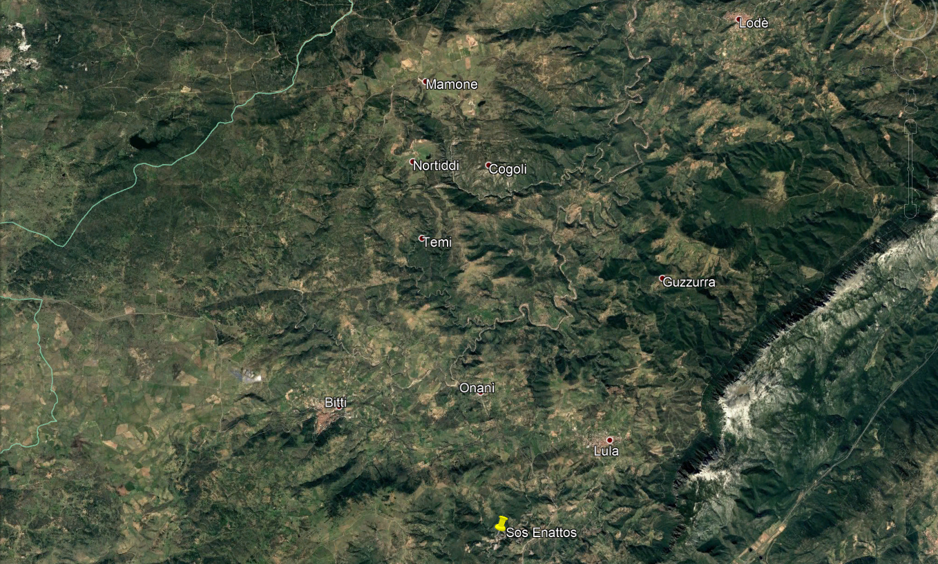
FIRST STUDIES: LOCATION

Slide 10
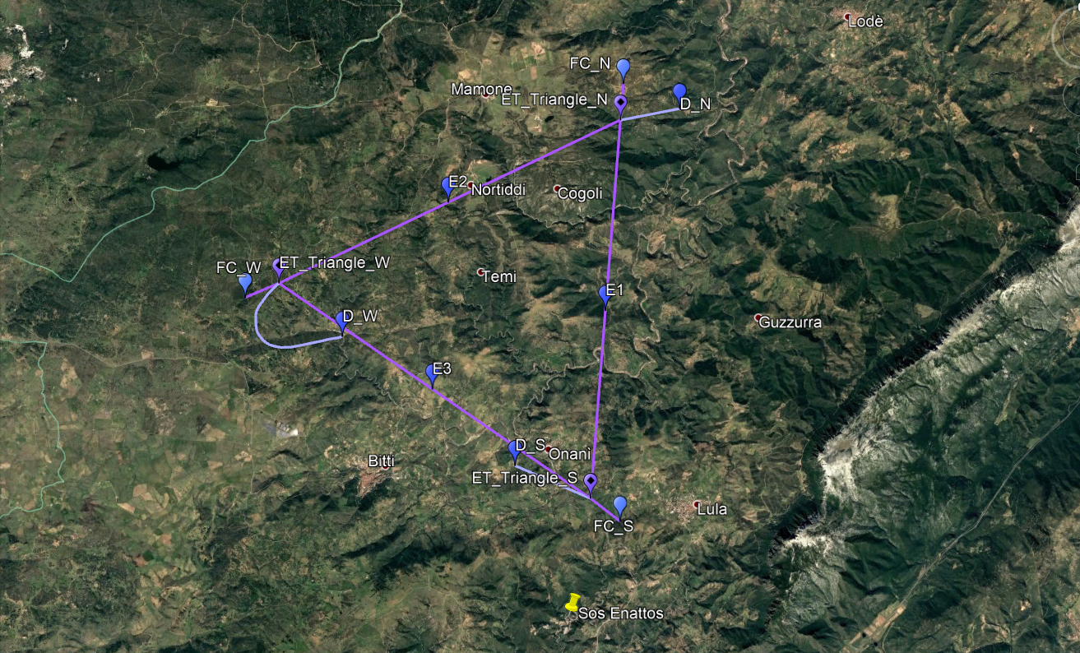
LOCATION - TRIANGLE

Slide 11
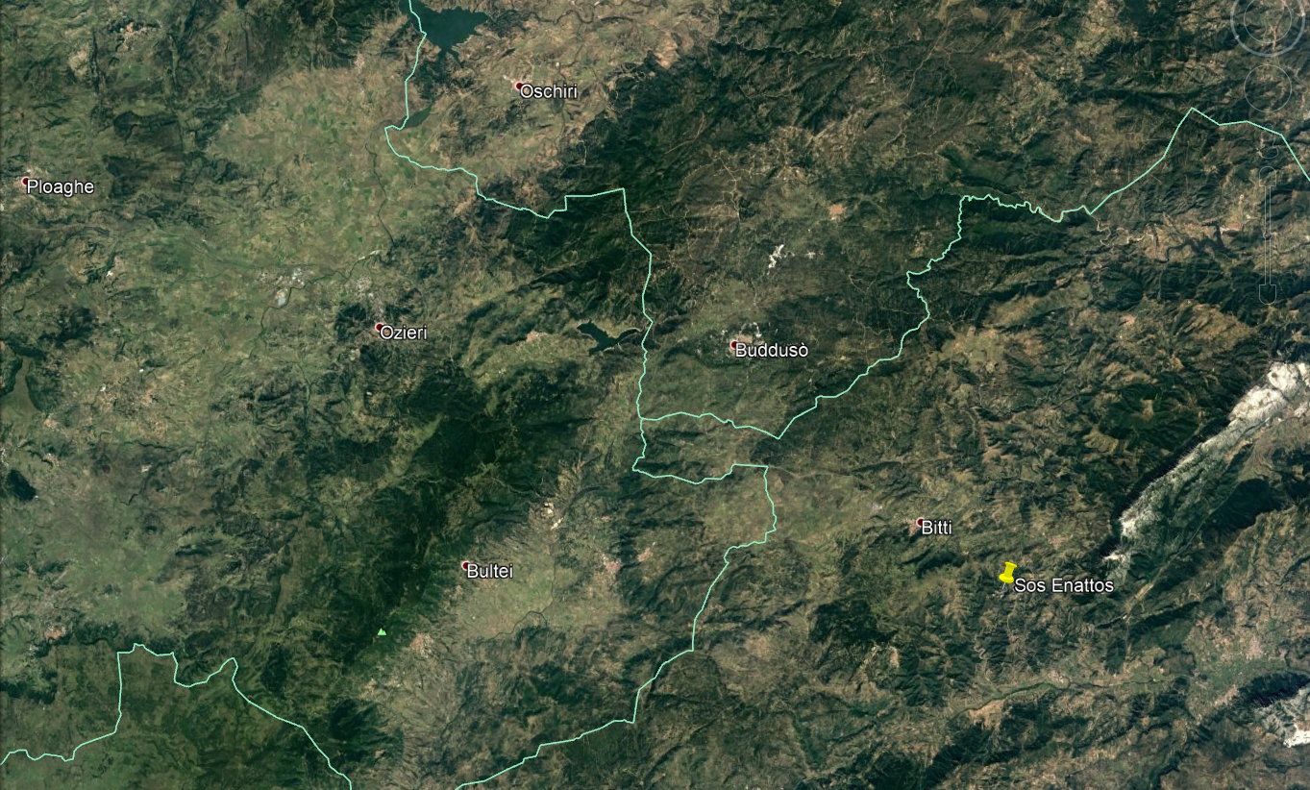
LOCATION - L

Slide 12
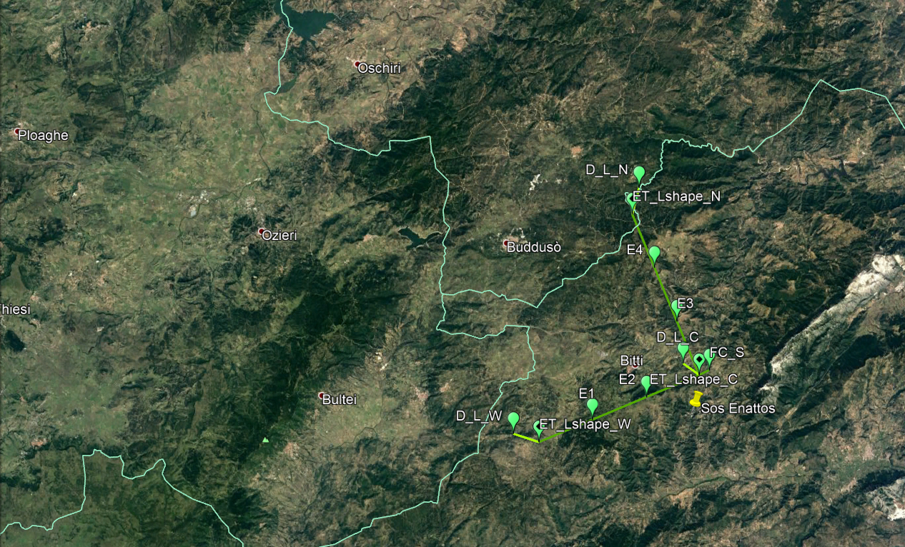
LOCATION - L
15 km

Slide 13
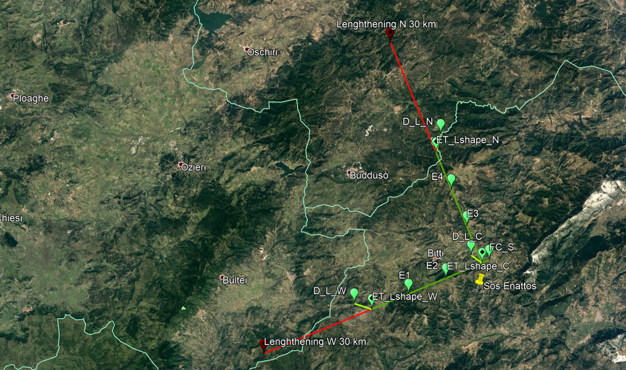
LOCATION - L
Extensible to 30 km
15 km
Considering the geodetic azimuth, ET L Topology is rotated 41.9° counterclockwise respect to Virgo.

Slide 14
Very Next Steps all over the site
1) Geological explorations – rock analysis, compatible with costs, but at least in the three vertex locations (contribution of geo-physicists from Uniss)
2) Extensive study of seismic and newtonian noise in the whole site
3) Socio-economic impact – a team is being formed – contributions of economist from Uniss)

Slide 15
The SAR-GRAV laboratory in
SOS-Enattos

Slide 16

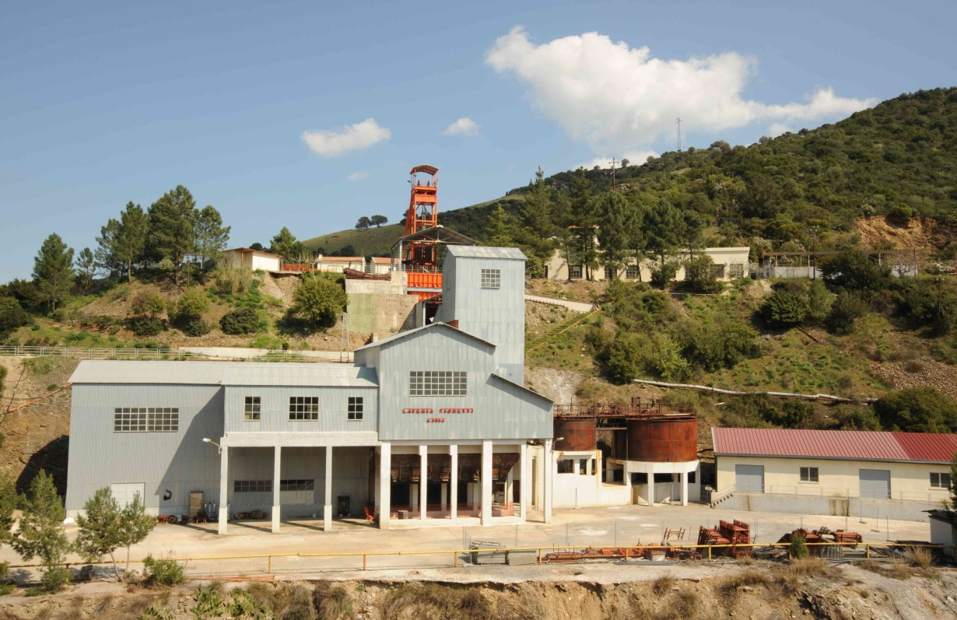
Agreement INFN with Regione Sardegna and IGEA
An agreement as been signed to create the SAR-GRAV Laboratory. The mine is property of Regione Sardegna throught the consortium IGEA. The infrastrucure has been funded by regione Sardegna and INFN and INGV (Istituto Nazionale Geofisica e Vulcanologia) will use it.
The underground laboratory will be approximately 200 m². The design of the laboratory is done in collaboration among the civil engeneering of IGEA and INFN scientists. The laboratory will host experiments in gravitation that need a seismically site.

Slide 17
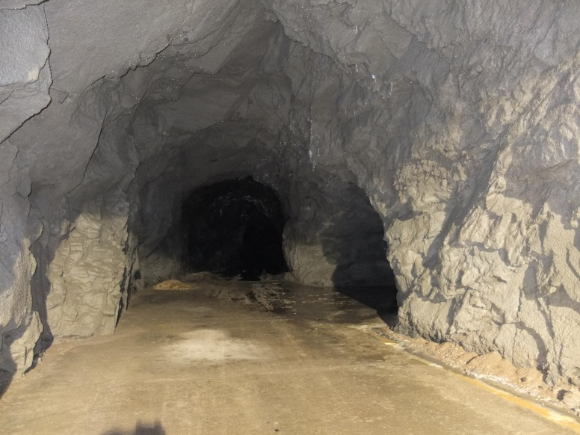
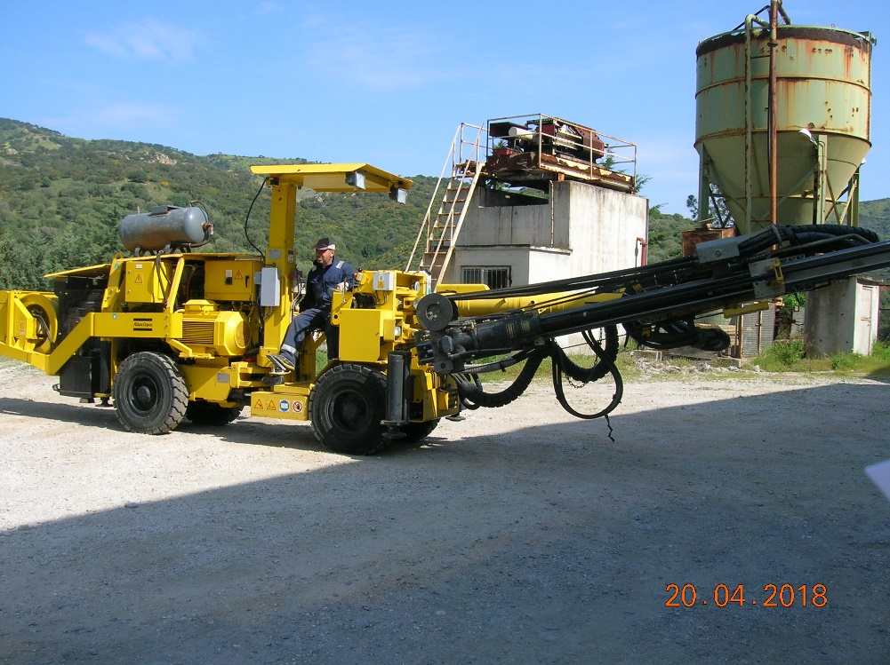
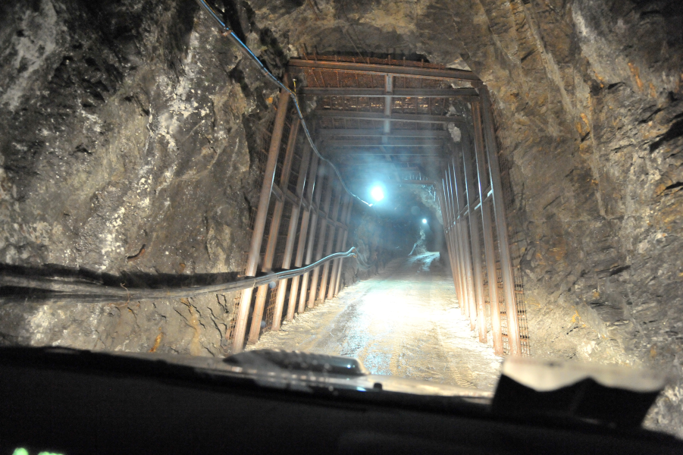
SAR-GRAV LAB
Works have started on surface building – enlargement of the cavern expected to start in few weeks from now
Caverna 110 m sotto terra raggiungibile
con auto.

Slide 18
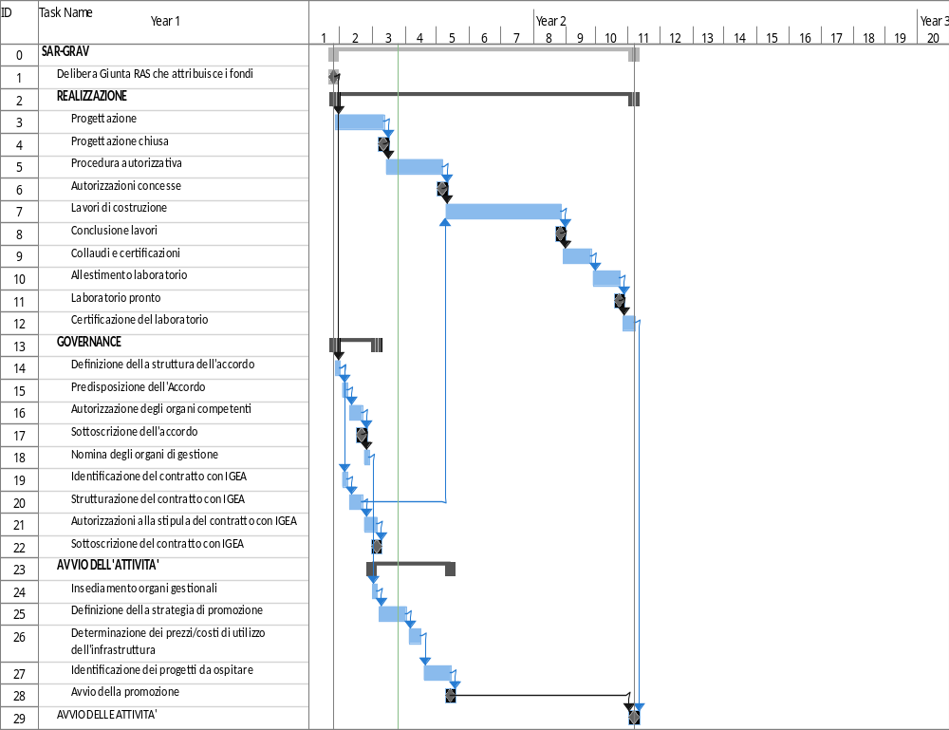
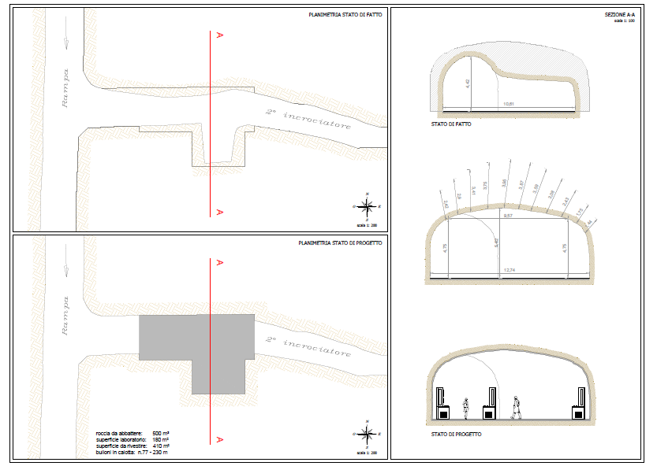
SAR-GRAV TIMELINE
The first experiment – Archimedes – is expected to bring in Sos-Enattos the main chamber of the apparatus within next summer (2019)

Slide 19
The candidature

Slide 20
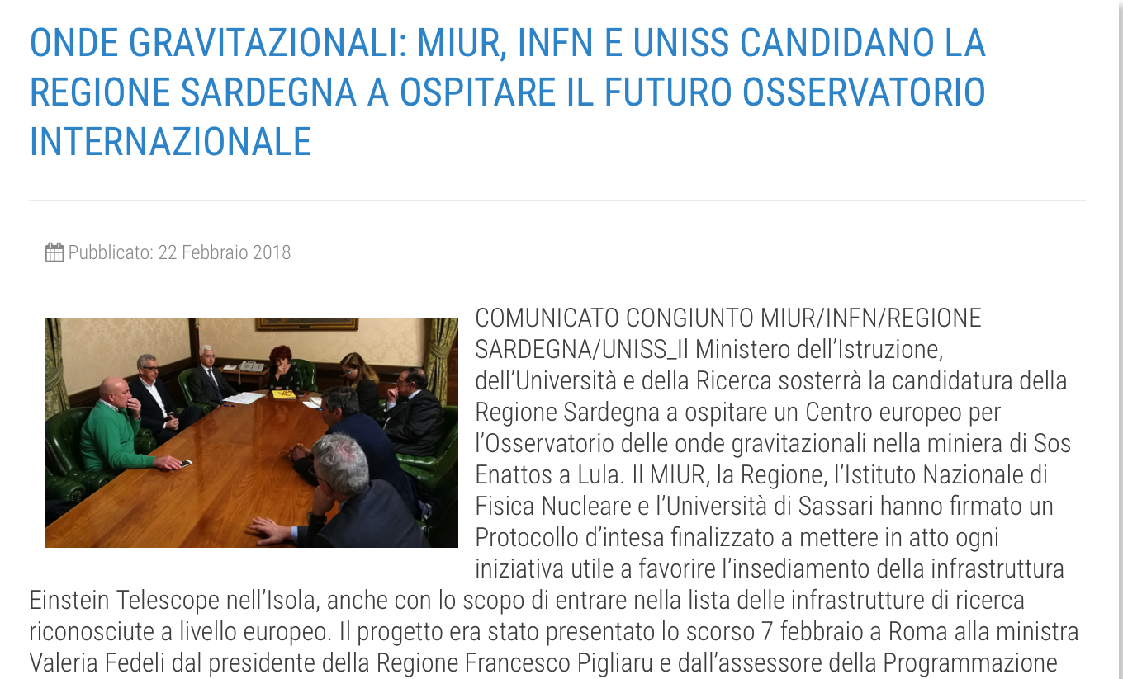




ITALY GOVERNMENT SUPPORT
17 Meuros for AdV+, ET R&D and support of the Sos Enattos candidature

Slide 21
REGIONE SARDEGNA COMMITMENT
Regione Sardegna has promised to realized all the roads and the auxiliary surface infrastructure required by ET
Regione Sardegna is surveying the territory and preparing to propose sites for the disposal of the large amount of excavated rock (several millions of m³)

Slide 22
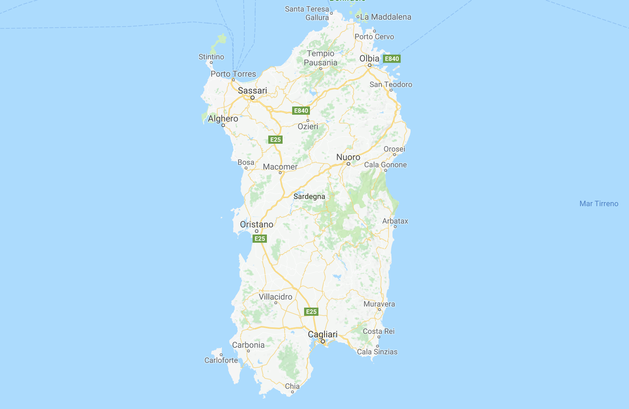

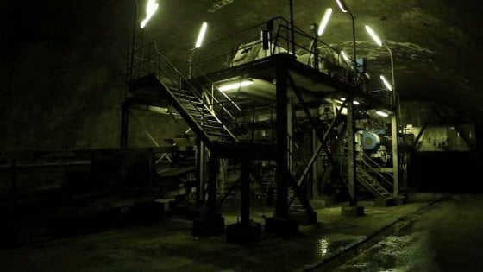
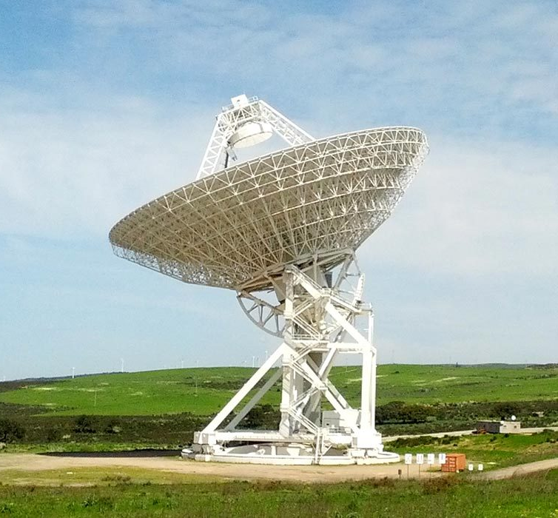

A NEW MISSION FOR SARDINIA
50’ drive from Olbia airport to
the Sos Enattos mine (85 km)
Sardinia Radio Telescope
“ARIA” PROJECT
(for the Gran Sasso Dark Side
DM detector)

