Slide 1
Conceptual design of a New Experimental Building on EGO site
F. Frasconi – INFN Pisa
Kick-off meeting on ET Detector
Cascina , June 20, 2018

Slide 2
A New Building on EGO site
A New experimental Building for future R&D activities on 3rd Generation of interferometric Detectors for Gravitational Waves is needed to:
  Create on EGO Site an Infrastructure Facility to be used for the development of 3rd generation GW interferometric Detectors;
  Develop the New Generation Superattenuators (NGSA) to be installed in an underground observatory with improved attenuation performance in the low frequency region (moving the cut-off frequency down to 1 Hz).

Slide 3
Filtering Seismic Noise
Even if the 3rd generation Detector will be installed in an underground Laboratory, seismic noise represents an important limiting noise source on the detector sensitivity;
As reported in the “ET Conceptual Design” document, the AdV Superattenuator scheme is considered the reference solution for Next Generation SA (NGSA) with the possibility to extend the detection band down to 1 Hz:
  SA 17 m high has been considered (conservative solution)
  Full scale NGSA prototype construction needed
  Last Stage suspension at cryogenic temperature

Slide 4
Starting points for NGSA
A few important issues to be considered in the design of NGSA
Importance of the Passive Performance of the system
Hybrid solution is considered important: active damping below a cut-off frequency (possibly around 1 Hz)
- Magnetic Anti-Spring (MAS) system on vertical d.o.f.
- IP as pre-attenuation stage (with equipped Top Stage)
- Equipped Bottom ring for active control purpose
- Alternative solutions to compact the mechanical structure
- ……………..

Slide 5
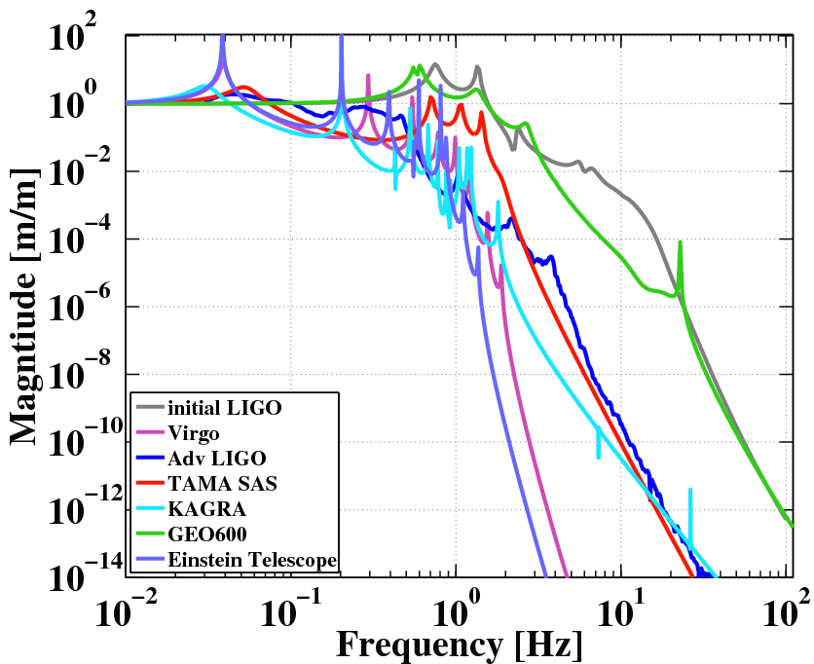
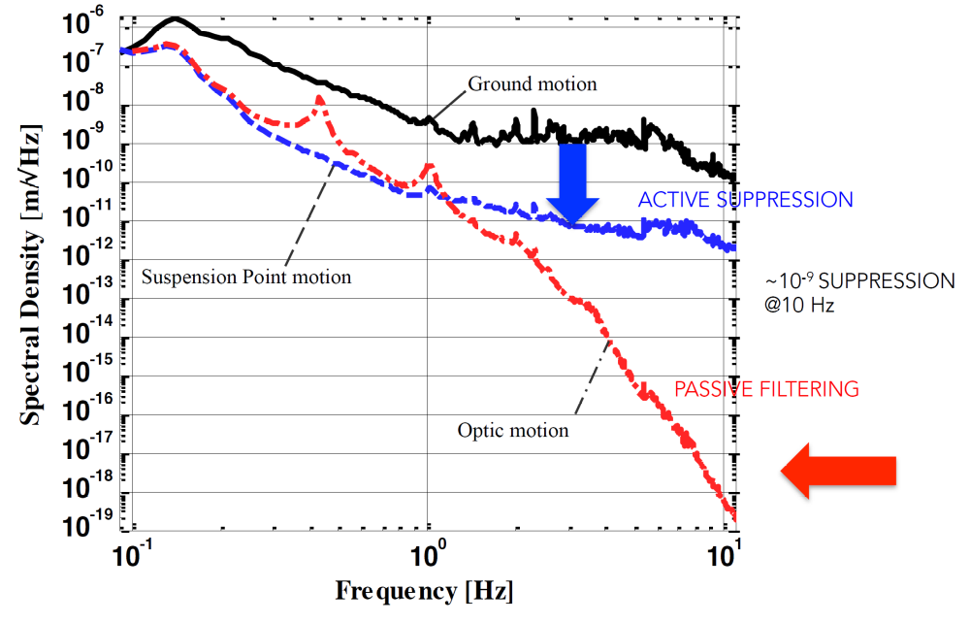
Comparison among different existing solutions

Slide 6
A new building on EGO site
Since April 2004 a “Construction Permission” for new infrastructures is available for three different zones: North End area, West End area and Mid West area (North side);
The last one seems to be the best one (the largest one) with minor impact also during the ITF data taking:
- this area is also accessible from outside with almost zero impact on the
standard activities on EGO site

Slide 7
The selected area: near Mid West station
Easy access area from outside with minimum impact on ITF data taking during the construction
Possibility to connect the new area with the existing one: gate available
Wide space for infrastructure construction and parking area

Slide 8
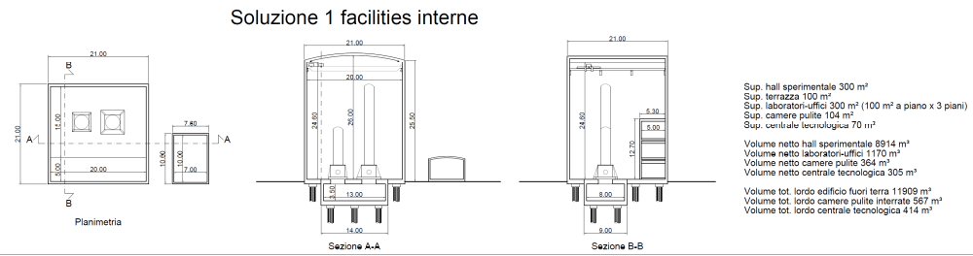
New Experimental Building
- A possible solution: preliminary exercise in progress (thanks to A. Paoli and L. Paoli)
- Documents collection in progress to present as soon as possible a preliminary project to “Comune di Cascina”

