Slide 1



ET Project
Vacuum System Challenges
C.Bradaschia, A.Pasqualetti, A.Buggiani, T.Zelenova and several other contributors
Virgo Experiment / EGO – VAC team
GW meeting, Hannover, Jun 2018

Slide 2
Summary
Starting from the 2011 study - DS - as basis of discussion toward a preliminar design.
Vacuum apparatus of present GW detectors
Vacuum apparatus of ET – basic requirements
ET – arm tubes (technologies, bake-out issue)
ET – mirror chambers systems (‘ towers’)
ET – cryogenic pumping
ET – special issues (safety, contamination, materials, quality)
ET – budget considerations
Conclusions

Slide 3
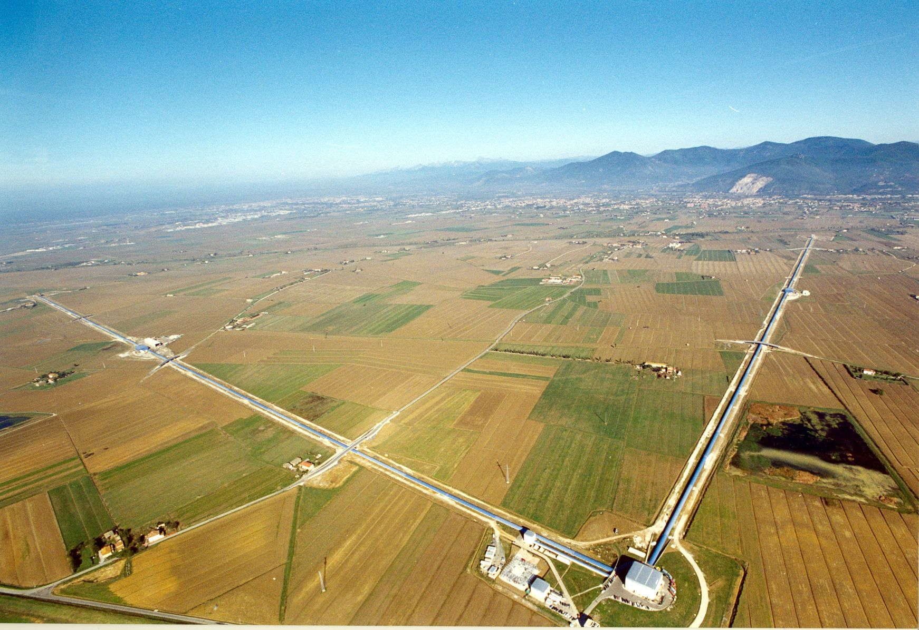
2G VACUUM SYSTEM
Optics and laser beam are under vacuum to avoid perturbations
up to ≈ 9000 m³ – 29000 m²
2 UHV arms Ø=1.2m x 3 ÷ 4 km
Large chambers at arms extremities
Cryogenic pumps
Virgo Site, Cascina (PI)

Slide 4
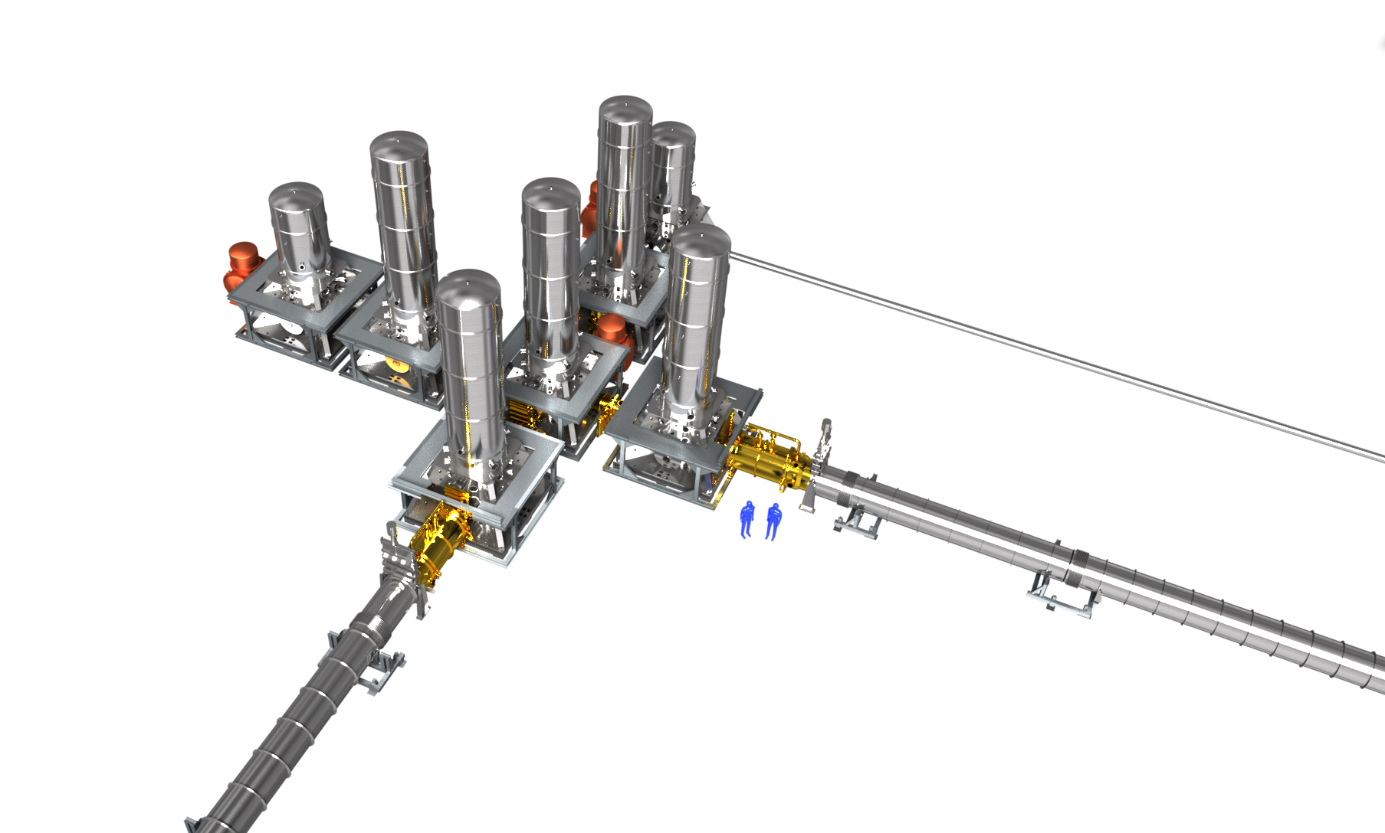
2G VACUUM CHAMBERS
Main chambers
one per core optics
Vacuum valves up to 1m diameter
77K cryostats to pump water vapor
Arm tubes

Slide 5
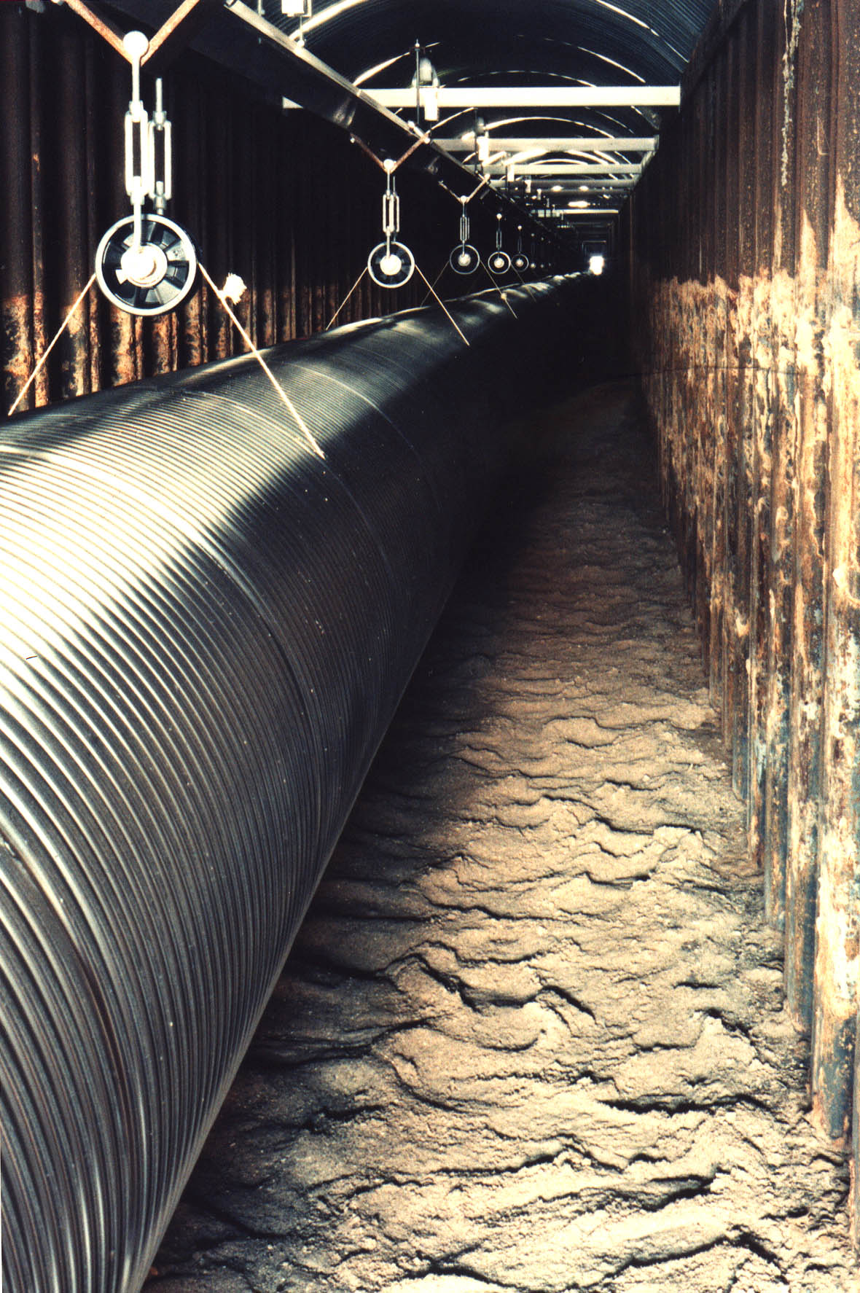
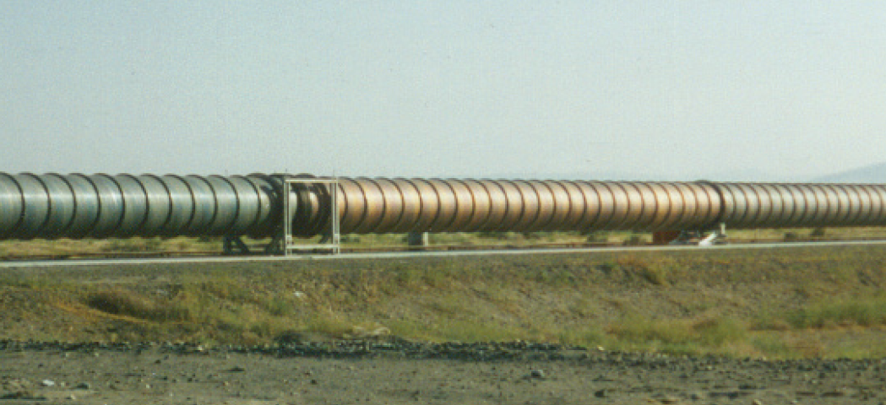
2G VACUUM TUBES
They contain ‘only’ optical baffles and the laser beam
≈ 10⁻⁹ mbar, H₂ prevalent (baked).
GEO600
304L plain wall (3.2 or 4 mm thick), stiffeners and bellows (Virgo and LIGO)
corrugated wall, 0.8 mm thick (GEO600)
LIGO (installation phase)
Credits: LIGO team
Credits: GEO team

Slide 6
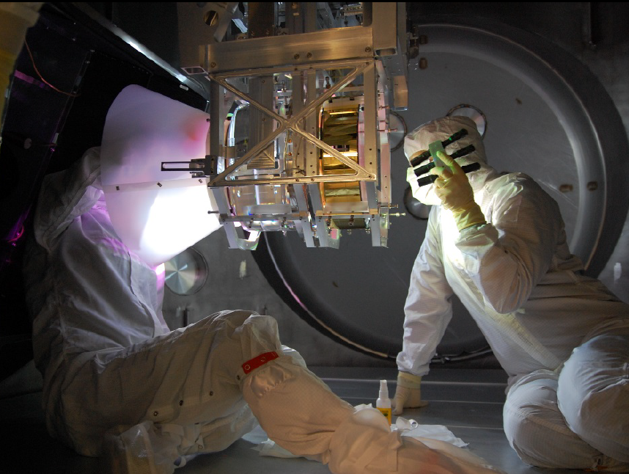
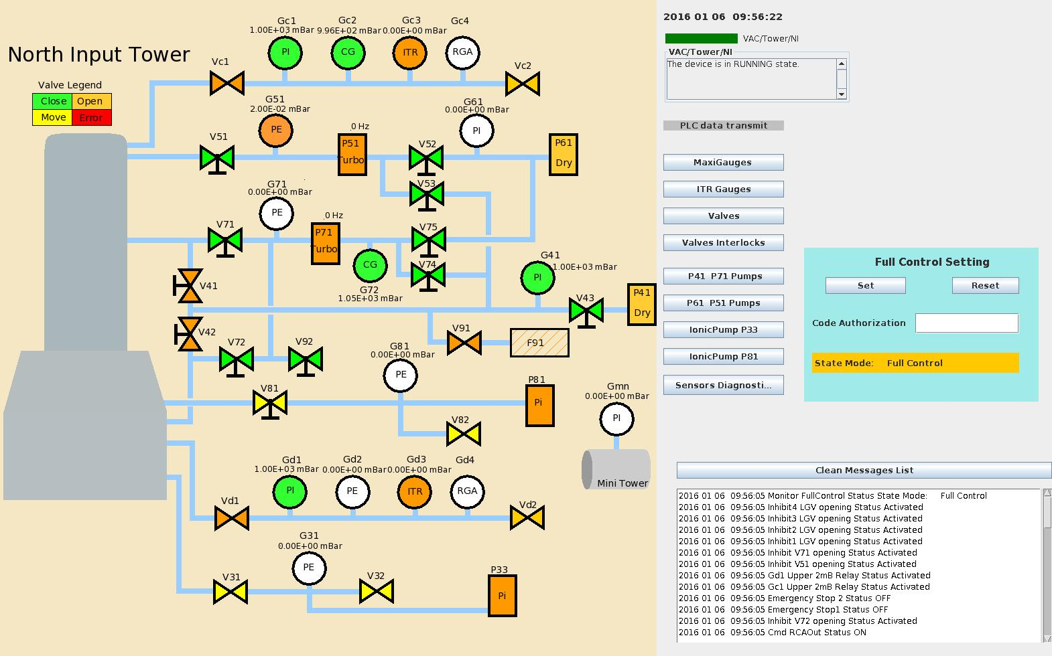
2G ‘MIRROR’ CHAMBERS
Function: house main optics and complex mechanics. Often accessed for tunings.
Ø ≥ 2m, up to 11m high, 20-30 ton.
≈ 10⁻⁸ mbar, H₂O prevalent (unbaked). Divided in two (three) compartments.
Metal or double o-ring seals, single o-ring for HV compartments
Inside a mirror chamber (LIGO)
Synoptic (VIRGO)

Slide 7
2G VACUUM Construction
Virgo case (apparatus)
Construction schedule
... Early studies and prototypes
1994 – Virgo project official startup
1996 – Design finalization
1997 – Tube contracts setup
– Towers construction
1999 – CB towers site qualification tests
– begin of tube construction
2001 – begin of tube installation
2002 – completion of vacuum enclosures
2003 – full ITF
Vacuum and Civil installations in parallel
Construction Costs
75 M€ - Nov.2000 Council report (apparatus)

Slide 8
ET Vacuum – 2G -> 3G
Outstanding new challenges of 3G Vacuum are:
Size
Underground realization and operation
Improved vacuum level (arms)
Cryogenics
Budget
Engineering, Logistic

Slide 9
ET Vacuum – ‘size’
ET triangular - DS
3 x (HF+LF) 10 km arms
(+ filter cavities)
Virgo
3 km arms
(+ 300m FC)
ET -L (credits GL et al. Symp.18)
1 x (HF+LF) 15 km arms
(+ filter cavities)

Slide 10
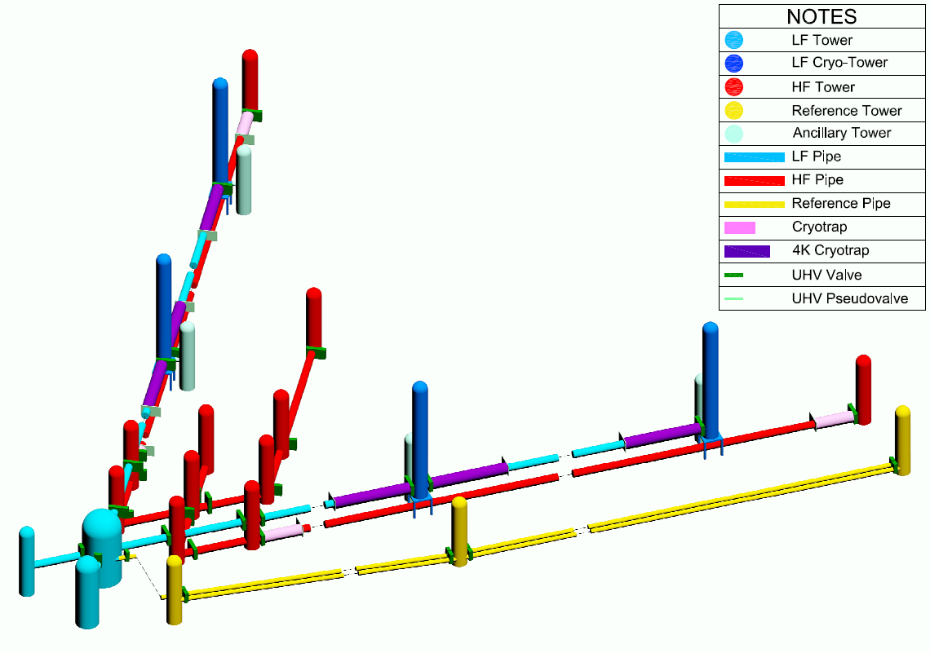
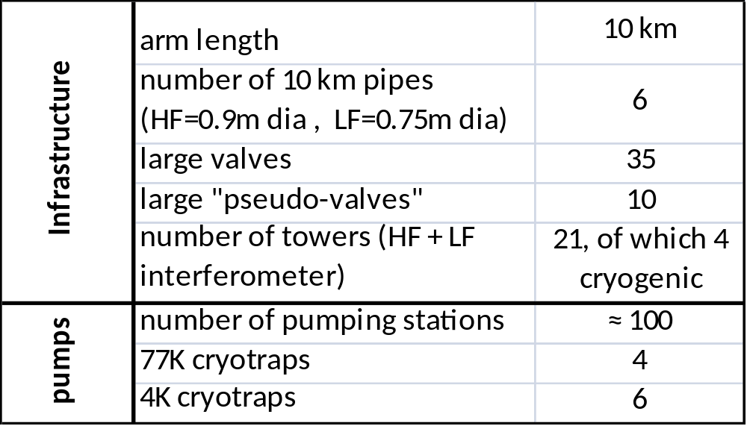
ET – 1/3 of the chambers (DS)
2 x 10 km HF pipes
2 x 10 km LF pipes
2 x 1 km cavities
35 Large valves
4 cryogenic + 4 ancillary towers
6 long cryotraps + 4 short cryotraps
17 towers

Slide 11
Vacuum tubes

Slide 12
ET – Arm tubes selected req.ts (DS)
Mechanical
Diameter: ø = 0.9m (LF) and 0.75m (HF) to be refined by optics/scattering studies and inner baffles design.
Length: 60 km L _Symp.2018
120 km DS (+ Reference Cavities, LF=10÷1 km, HF=300 m).
Joint design: welded (lip or butt type).
Bellows: maximum withstanding temperature to be studied.
Supports: needed adjustment range?
Vacuum
Leak rate: 1E-10 mbar l s⁻¹ per module (1E-09 mbar l s⁻¹ per 1 km section).
Pressure: UHV level E-10 mbar (H₂ prevalent)
Contamination: heavy-organics ‘free’ (goal ≤ 1E-14 mbar).
Sub-sections: pseudo-valves concept to be exploited .
Lifetime
Structural aging: 30 years (undergorund corrosion effects?)
Scientific obsolescence: ultimate vacuum performances to be evaluated

Slide 13

ET – Arms pressure requirements
Residual gas noise: statistical fluctuations of the number of molecules along the laser beam
given beam profile and gas specie
DS baseline = 1.5E-10 mbar [H₂+ Σ(H₂O, ...)]
margin factor ≈ 4 (> 10 on pressure)
challenging
3G Facility limits (ET+...)
Larger margin need / feasibility
HF arms only ?
DS 2011
DS 2011
Notes:
Virgo tube qualifications: H2 a few E-10mbar and water CO entrambi sui 5E-12 mbar (CO da RGA o reale? Da accumulo si vede, ma chi prova sia reale?, qCO=E-16 mbar.l/s.cm2= qWater) è un upper limit.

Slide 14
ET Arm tubes: AIR BAKE-OUT
At these pressures the prevalent gas specie is H₂ , the main source is the material of the chamber ( 2G = 30000 m²). Conditioning is required to meet vacuum goals.
baking at 400°C in air involves a simple oven and reduces the walls outgassing by over a factor 100 (strongly reducing the H₂ content of bulk ordinary sites).
q < 2E-14 mbar l s⁻¹cm⁻² @ 20°C
Specifications control: QC.

Slide 15
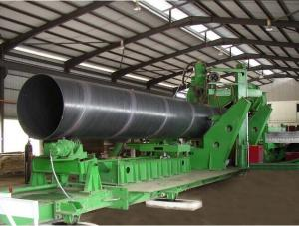
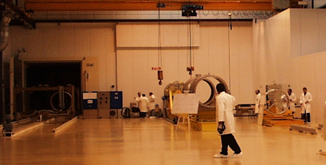
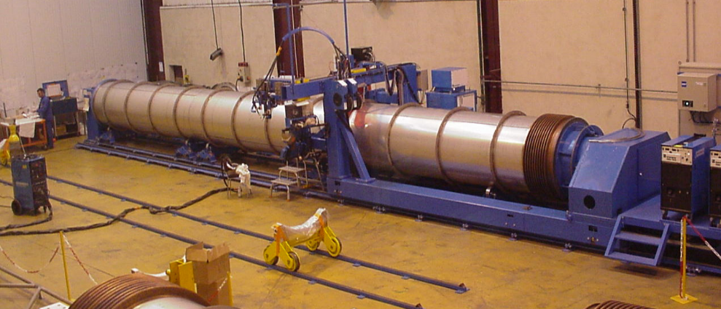
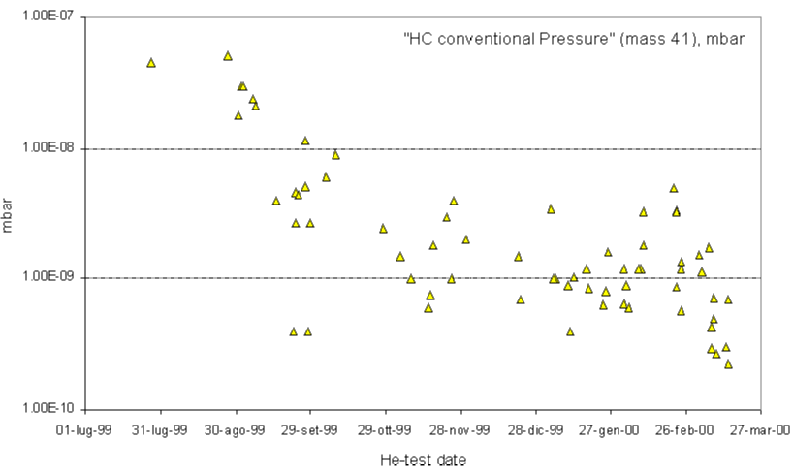
ET - Tubes manufacturing
Different industrial processes to be examined. Fabrication includes cleaning stages, air bake-out, leak tests.... Rates > 100 m / day (i.e. 2 years per single detector).
Organization: fabrication on site.
Spiral welding (LIGO/oil industry)
Workshop clean areas
Rolled sheets welded longitudinally
VIRGO: assembly inside ‘tunnel’

Slide 16
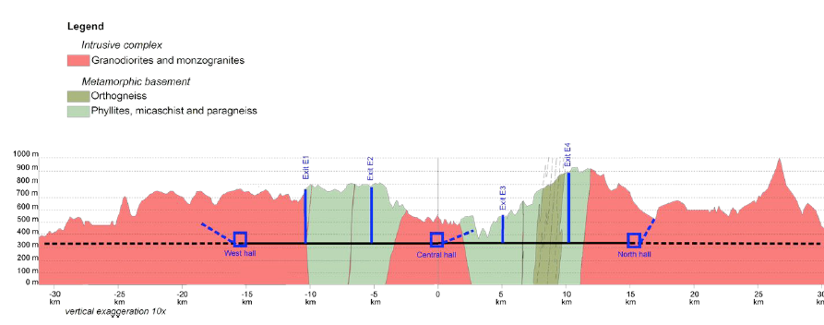
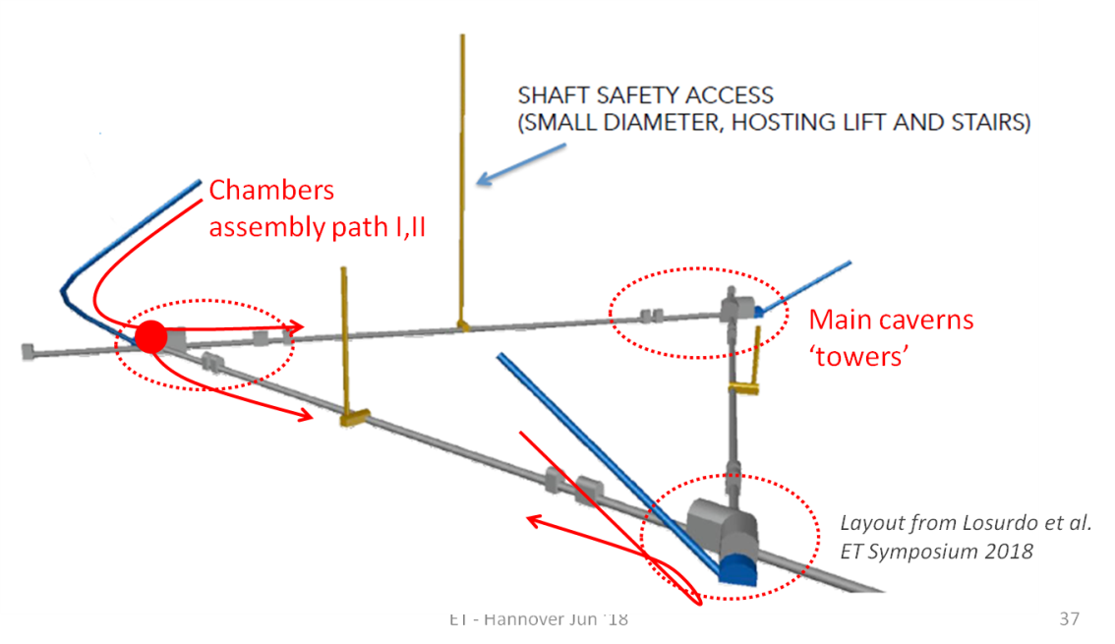
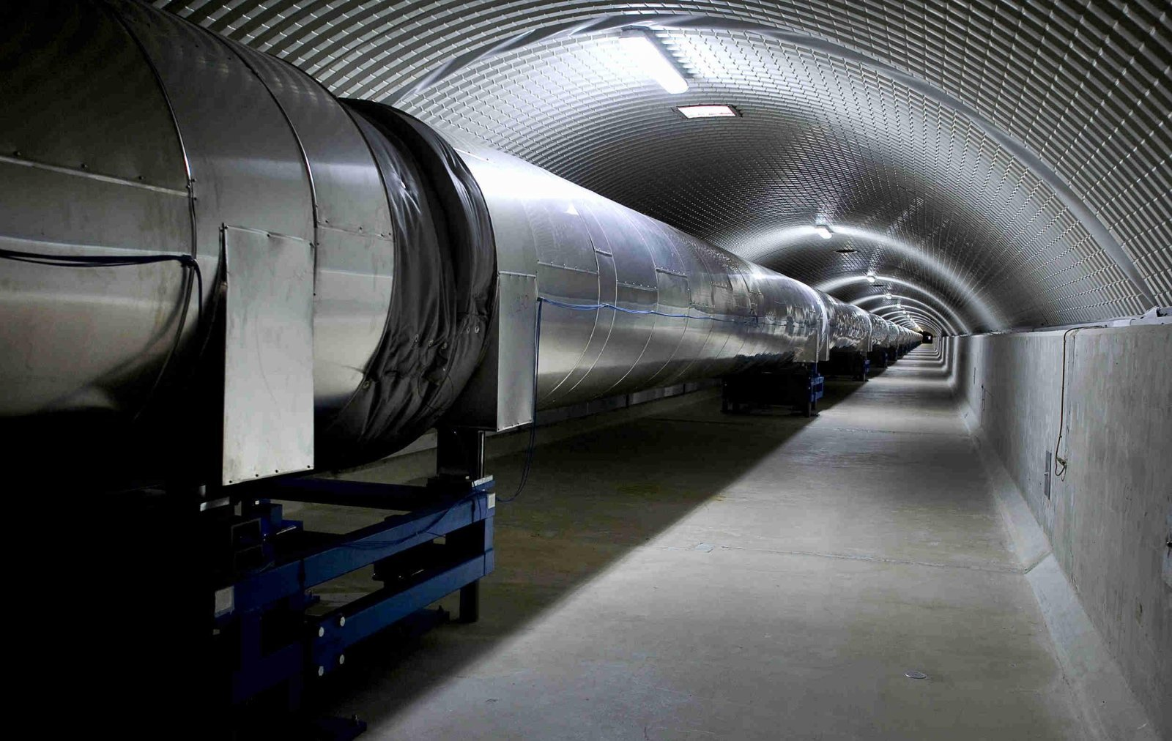
Arms assembly
Arms realized by assembling modules 15 m to 20 m long (2G).
2G Rate = 1 to 2 modules / day (production, installation) to be increased for ET
Impact on site infrastructure design (costs)
credits GL et al. Symp. ‘18
Virgo: assembly inside tunnel

Slide 17
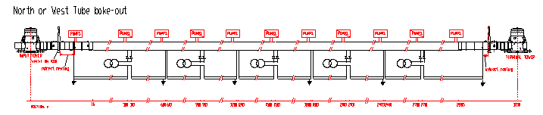
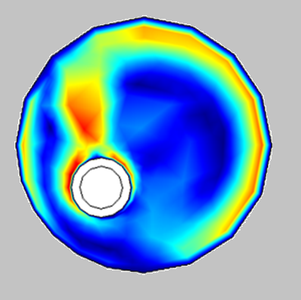
ET – Arm tubes: bake-out in situ
Bake-out considered necessary to desorb water molecules (< 1E-15 mbar l s⁻¹cm⁻²). Normally to be performed just one time.
Electrical distribution, fumes and heat exhaust to be addressed (typical dissipation ~ 250 W/m @ 150°C).
Shorter sections and efficient thermal insulation will help.
Alternative ‘sound’ method for water outgas reduction?
direct Joule effect by > 1000 A DC

Slide 18
ET – Arm tubes budget challenge
Estimate 2010 (2 large companies + 2G experience) - coarse update 2018
Vacuum tube (installed) = 95 M€ - Single detector (xylophone HF+LF) - DS topology
≈ 50% of the total vacuum cost (crude estimate)
estimated raw material incidence < 20% of the installed pipe cost. Other factors: fabrication process, installation tools and manpower, baking supplies ...

Slide 19
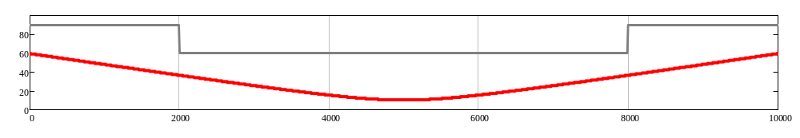
Tubes: Budget reduction thoughts
Circulating ideas among the ET community: ‘’Single ø≈2m pipe’’ , “double wall pipe”, ‘’Scaled pipe’’(*) , cheap raw material alternative to 304L , arms lenght optimized ... ?
Already assumed savings = narrow ø pipes vs 2G detectors (tube and tunnels). To be confirmed along with inner baffles design (optics).
(*) To be evaluated also vs light scattering performances
Tube profile
Given beam profile
example
Arm lenght [m]

Slide 20
Mirror chambers

Slide 21
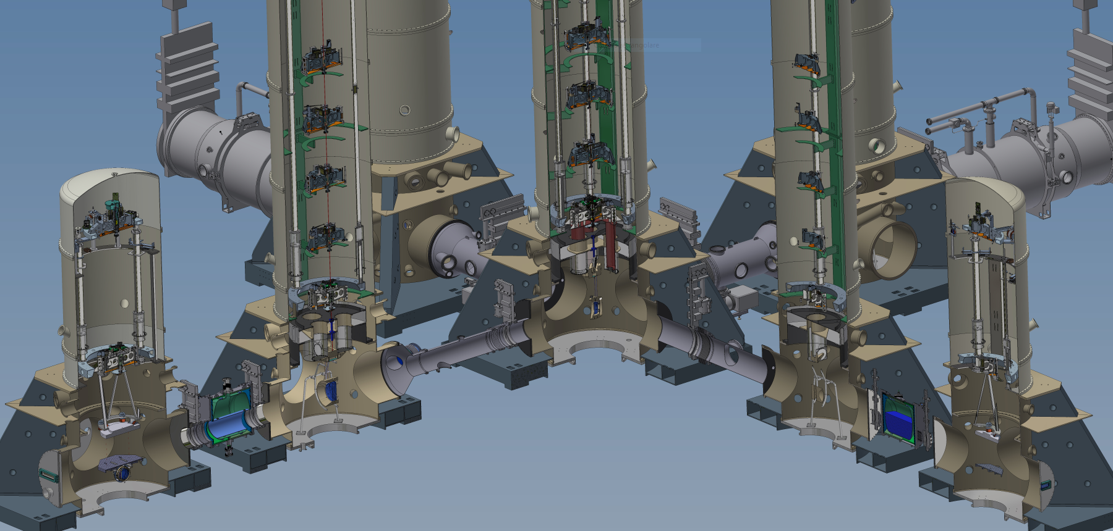
ET – Towers requirements
Design depends on anti-seismic suspension. Improvements of 2G (Virgo):
Cryogenic: incorporating cryostat @<10K (4 chambers / LF) 2.5G KAGRA experience
Commissioning: thermal (vacuum) recovery times !
Pumping: no permanent mechanical pumps running (turbos in the Virgo case); Cryogenics will help for ET.

Slide 22
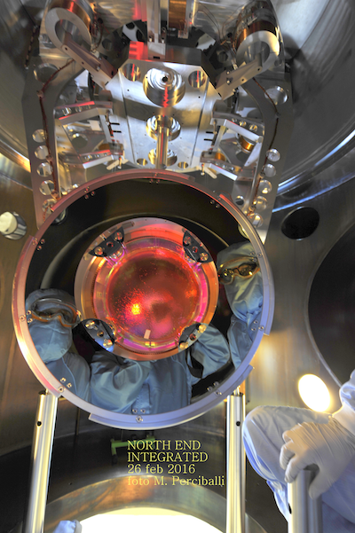
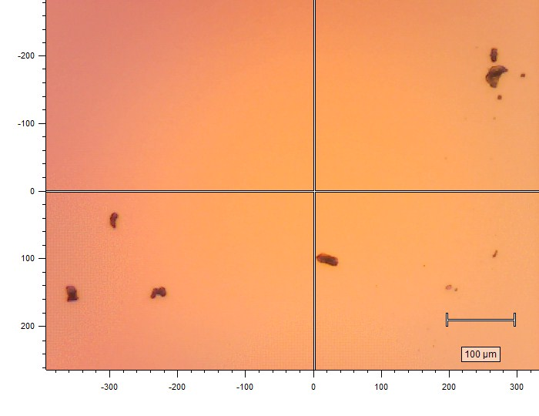
GW chambers requirements
Optics degradation risks
Heavy organics: materials screening and pre-baking (1E-13 mbar level AB). Specificity missing.
Cleanroom class ≈ 100 (w/out laminar flow). Control of (larger) particles on chambers walls
Electropolishing, air-baking, baking in situ before optics inserption
Dust particles a few µm size as the
cause of quartz fibers damages

Slide 23
Cryostats (Vacuum service)

Slide 24
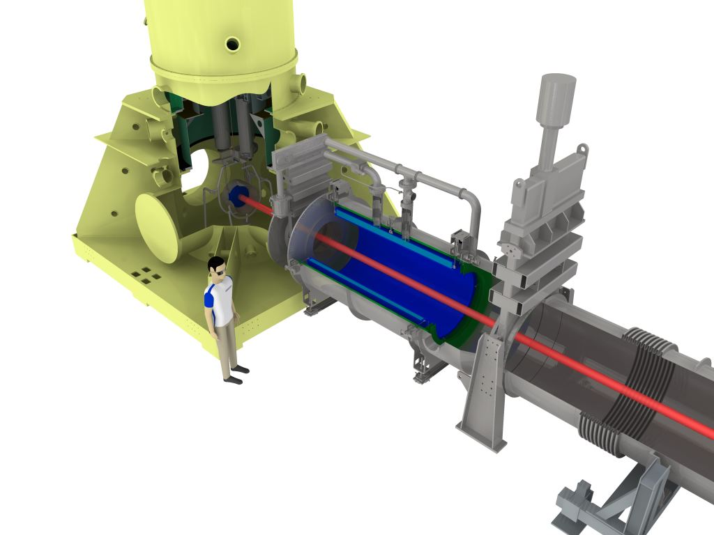
2G Cryogenics traps
Large cryogenic pumps between unbaked ‘towers’ and baked ‘tubes’
HV tower
Water vapor from towers is condensed on cylindrical sections 2m long cooled by liquid nitrogen at 77K
(molecules escaped from ‘towers’ to ‘tubes’ = 3% ).
Laser beam
77K Cryostat
Consumption LN2 6 lt/hr
UHV tube 3km

Slide 25
ET – Cryogenics (for vacuum)
3G Cryogenic traps: 77K and <20K sections for WATER and AIR pumping (+ thermal shielding )
Refrigeration needs: estimated magnitude 10 W @<20K; 10 kW @77K (transfer lines and storages excluded, possibly large).
Supply via liquid cryogen or cryocoolers? Choice not driven by Vacuum needs
6 x [50m@77K + 5m@<20K] LF
4 x [10m@77K + 1m@<20K] HF

Slide 26
Remarks

Slide 27
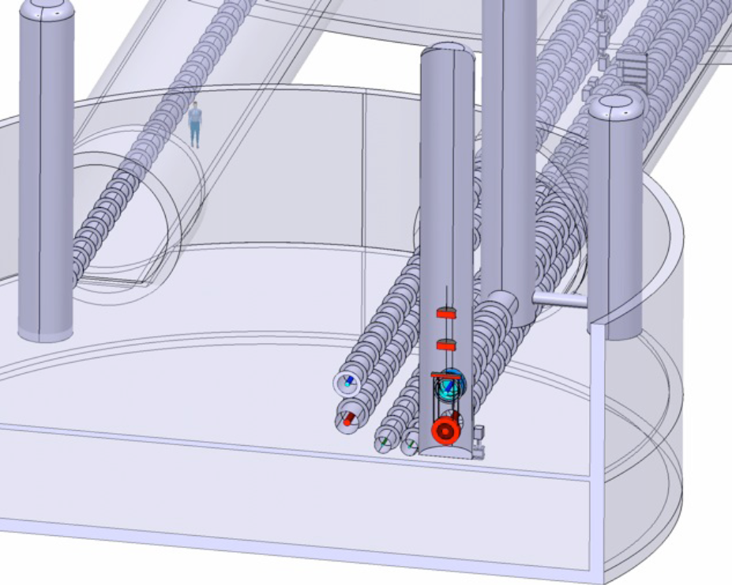
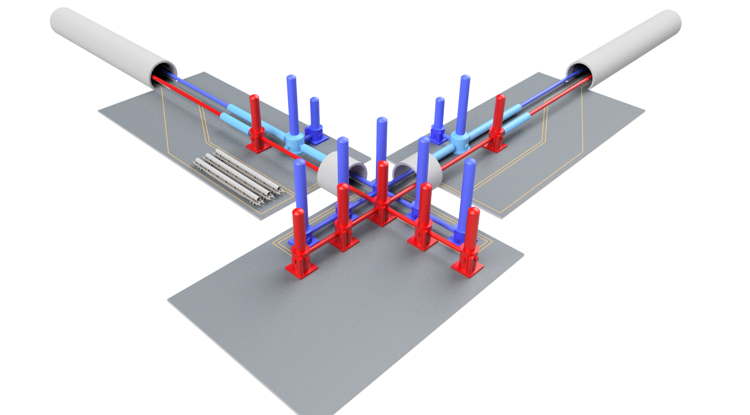
ET – ‘CB’ area chambers
Vacuum chambers study shall progress iterating with underground engineering
aim is to save cavern and tunnel excavation with affordable complexities
2010 Concept

Slide 28
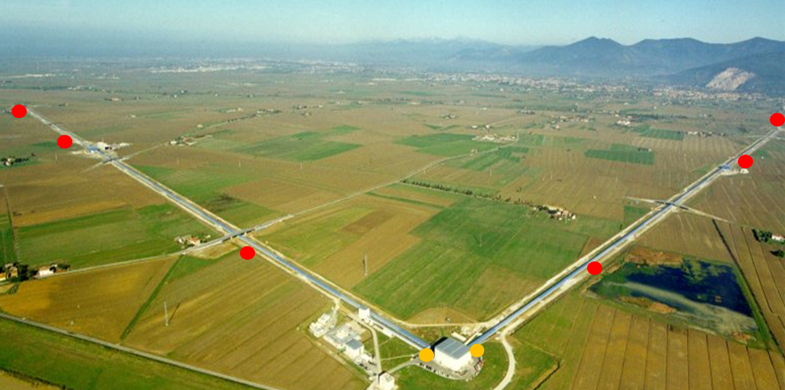
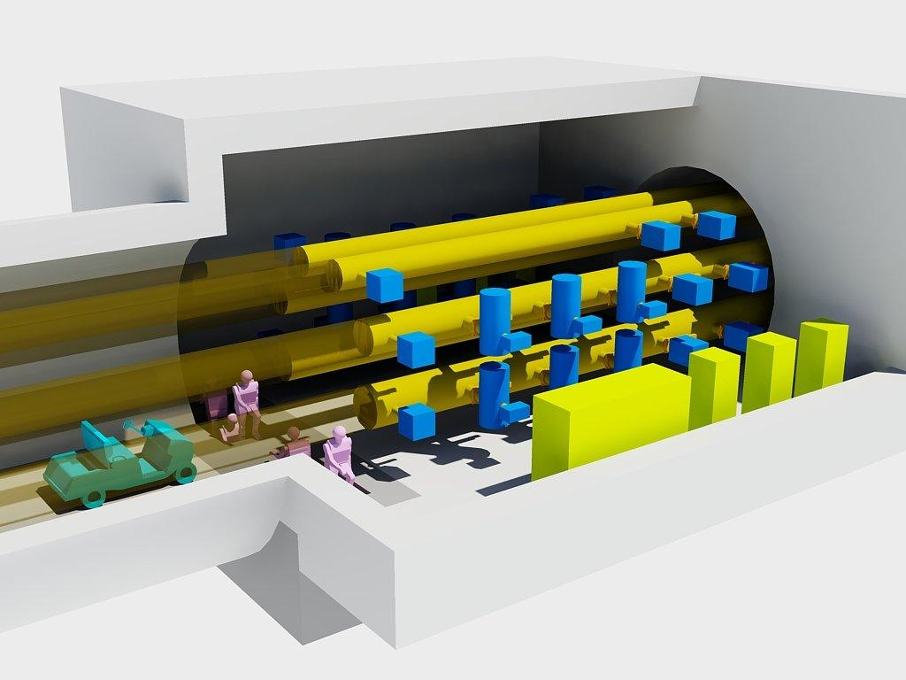
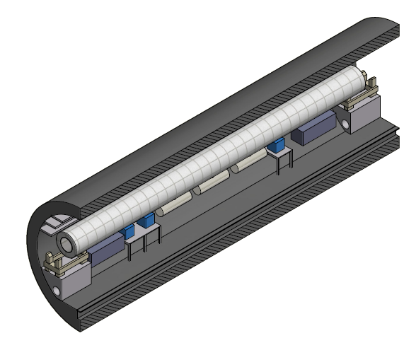
ET – Arm tubes: pumping stations
Spaced and fast pumps following 2G solution
DS: stations @ 500m (spares @ 250m). NEG/TSP/Ions 5000 l/s H₂ (TMPs for baking).
Redundancy : operation, maintenance
Distributed pumping: an option to be explored. CERN, SAES, ...
  normally needed to push the vacuum limits
  implementation in a ‘big’ GW pipe is to be studied.
A sufficiently large tunnel (or less dense) could avoid extra-excavation .
Dedicated rooms
Notes:
In Virgo si ottiene circa 1E-9 (N2 eq.) unbaked, a torri isolate, staz. attive circa ogni 1000m

Slide 29
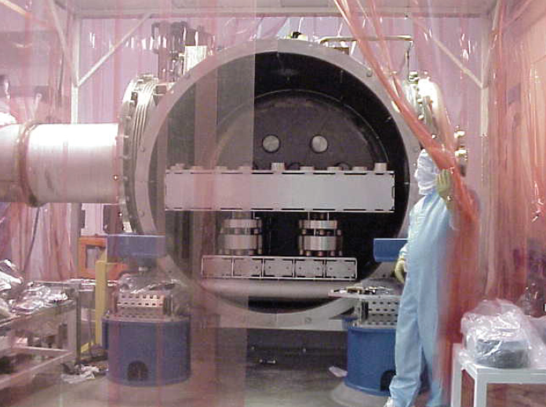
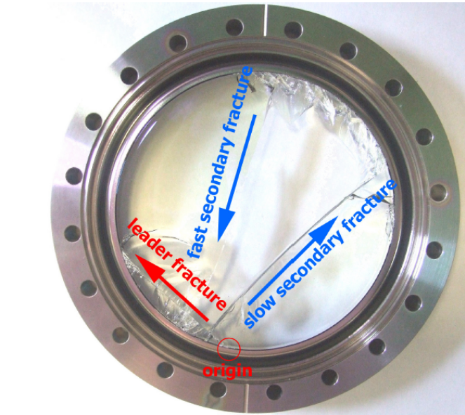
GW Vacuum – Special issues
Apparatus safety: huge volume + inner fragile components = risks of damage.
Viewports: order of 100 viewports/ITF; dedicated policy against breaking risks
Leaks: arm tubes exposed tens of years in a humid and poorly aereated environment
Materials compatibility: compromises in designing in-vacuum equipment.
Ligo picture leaking pipe?
Credits: LIGO
Risk = defect + stress x time

Slide 30
ET Vacuum – Conclusions
Some steps toward a 3G design
Tubes technology:
Baseline: engineering studies of manufacturing and installation along with underground design definition.
Explore alternative proposals (timeline)
Cryogenics (for vacuum): support the definition of the refrigeration technique
Pumping system: NEG option
Tower chambers: start reviewing 2G design to converge on ‘tunnel’ layout

