Slide 1


5th
Einstein Telescope
Symposium
Hannover, October 22-23, 2013

Slide 2

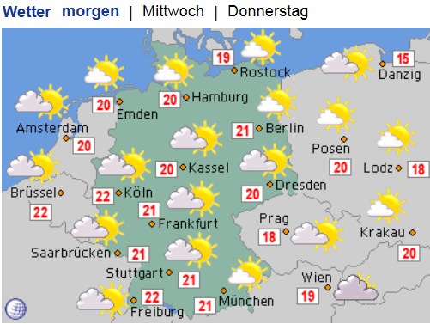
Boundary conditions
heute

Slide 3



goals of the meeting
Scientific exchange within
the ET community
How to prepare for
the future?
Status of ET
- current activities

Slide 4


Current Projects
ELiTES
ET R&D, addresses long term R&D needs
GraWIToN (FP7-PEOPLE-2013-ITN, Marie Curie Actions)
  Optics, Simulation, High power lasers, Data Analysis

Slide 5
GW Timelines
You are here
 | ´06 | ´07 | ´08 | ´09 | ´10 | ´11 | ´12 | ´13 | ´14 | ´15 | ´16 | ´17 | ´18 | ´19 | ´20 | ´21 | ´22 | ´23 | ´24 | ´25
Virgo
GEO
LIGO
KAGRA
E.T.
´26
´27
Virgo+
Advanced Virgo
GEO 600
Hanford
E-LIGO
Advanced LIGO
LIGO 3G?
Livingston
India
DS
PCP
Site Prep.
Construction
Comm.
data
1st Generation
2nd Generation
3rd Generation

Slide 6
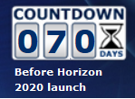


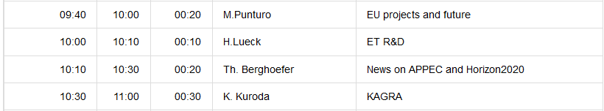
Next steps…
Prepare for the
Horizon 2020 call

Slide 7

„networking“
Organisational Topics:
Preferably use „eduroam“
Or use the ticket you got from IT and follow the instructions
  Should you have trouble connecting patiently await the coffee break and contact IT then

Slide 8
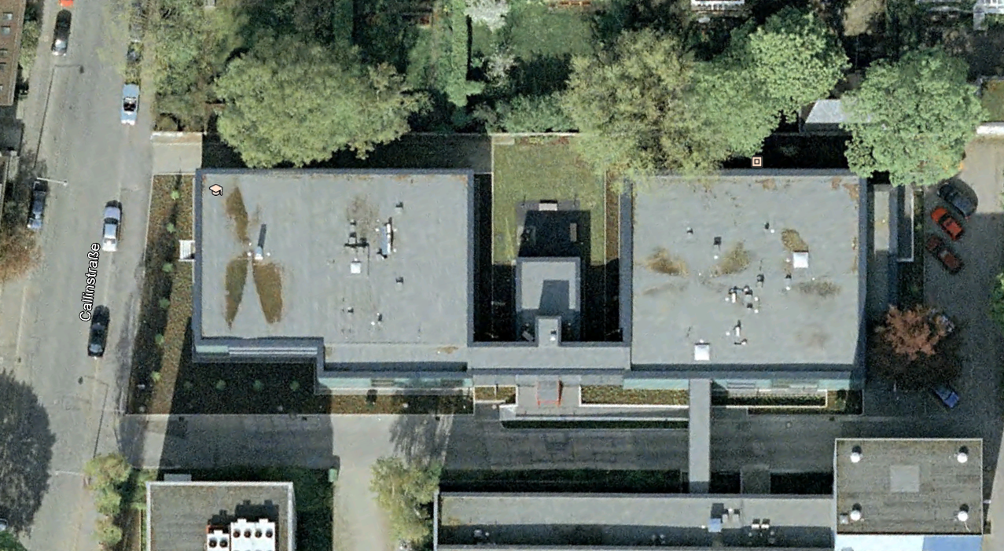

If you did not pay yet
We collect a conference fee of 50€ for lunches
Please see Gina in the coffee break; room 119
You are here

Slide 9
Travel support
Those who get travel support from AEI
please send a travel reimbursement claim including copies of your receipts (airfare, hotel, transportation, conference fee, etc, excl. meals) to
office-hannover@aei.mpg.de
with cc to
harald.lueck@aei.mpg.de

Slide 10


If you need a TAxi
ask Sabine Rehmert in the secretariat (#121)
or call (+49 511) 3811
3811

Slide 11

Lunch
Will be served in the foyer close to the entrance of the institute

Slide 12
Posters
We will have posters on display
on the ground floor „behind“ the stairs

Slide 13
Labs
10m Prototype
High power lasers
ATLAS computing cluster
GEO 600 (requires about 3 hours)
Other optics labs…
visits are not foreseen by default,
but individual arrangements can be made

Slide 14
presentations
Please
  Copy your presentations onto a USB stick or via a USB stick onto the meeting computer
  send your presentations (ppt, pptx, pdf) to
  harald.lueck@aei.mpg.de if you agree to put them onto the ET codifier (https://tds.ego-gw.it/ql/?i=ET) with public access.

