Slide 1
Status of Advanced Virgo and its Injection system
Eric Genin
European Gravitational Observatory on behalf of the Virgo collaboration

Slide 2
Outline
What is Advanced Virgo?
Advanced Virgo project status
  Construction progress
  Subsystems progresses
  Project planning
INJ subsystem status
  Overview
  IMC locking.
  Pointing and automatic alignment control loops
  IMC cavity characterization: absorption, Free spectral range, Finesse, Round trip-losses
  Reference cavity (RFC) locking.
  What next?
Conclusion

Slide 3
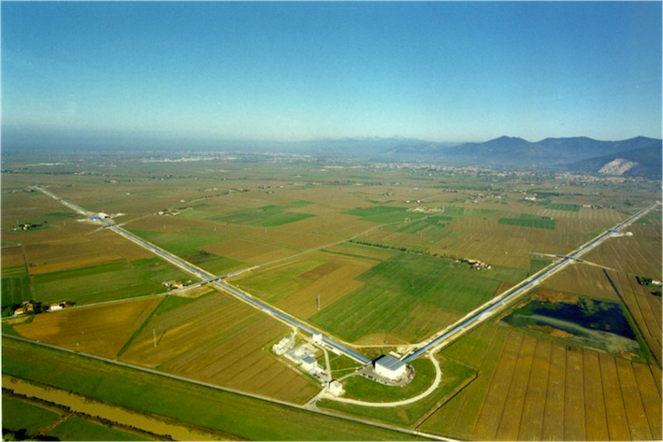






What is ADVANCED VIRGO?
5 European countries
19 labs, ~200 authors
Advanced Virgo (AdV): upgrade of the Virgo interferometric detector of gravitational waves
Participated by scientists from Italy and France (former founders of Virgo), The Netherlands, Poland and Hungary
Funding approved in Dec. 2009
Construction in progress. End of installation: Fall 2015
First science data in 2016
APC Paris
ARTEMIS Nice
EGO Cascina
INFN Firenze-Urbino
INFN Genova
INFN Napoli
INFN Perugia
INFN Pisa
INFN Roma La Sapienza
INFN Roma Tor Vergata
INFN Trento-Padova
LAL Orsay – ESPCI Paris
LAPP Annecy
LKB Paris
LMA Lyon
NIKHEF Amsterdam
POLGRAW(Poland)
RADBOUD Uni. Nijmegen
RMKI Budapest

Slide 4
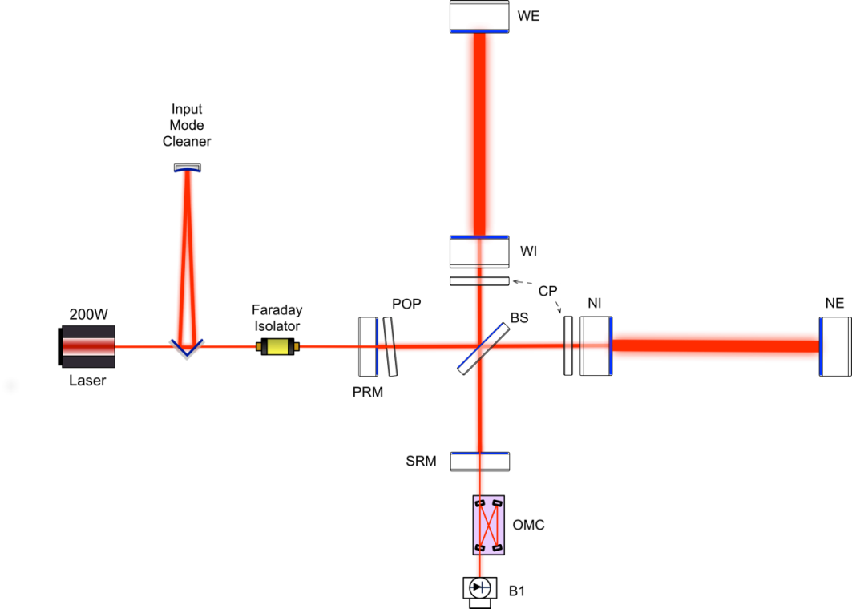
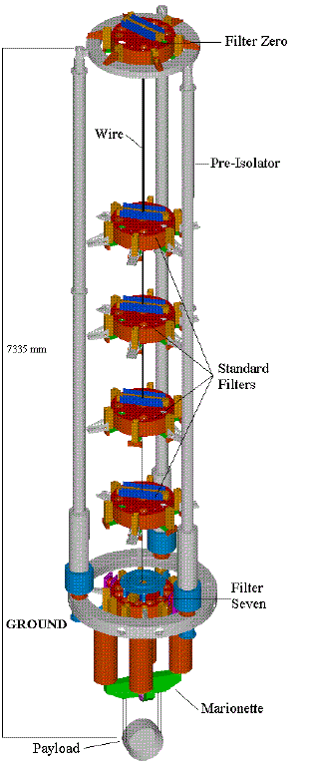
Detector design: Main changes respect to Virgo
Heavier mirrors
and higher quality optics
Larger
beam
Higher power
laser
Signal recycling
mirror
Photodiodes
suspended
under vacuum
Virgo super-attenuator kept
unchanged (already compliant)

Slide 5
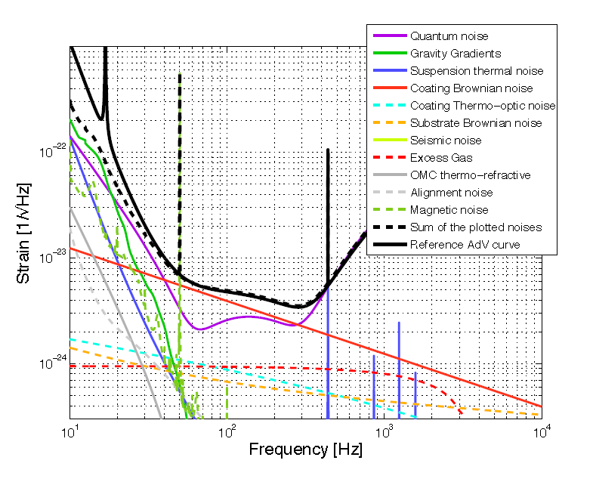
Some news on the detector design sensitivity
Since the TDR release some progress has been made on the design of the detector and the modeling of the noise.
  New payload without recoil mass
  Experimental tests showed that mechanical dissipation at the level of the marionette is lower than assumed
  → new modelling of the suspension thermal noise
  The gravity gradient noise model has also evolved. It uses the typical seismic noise spectrum measured
  on the Virgo site.
  We have started to add some of the technical noises that we know how to model to the noise budget.
  → slight improvement below 40Hz
For more details see AdV reference paper
arXiv:1408.3978v3

Slide 6
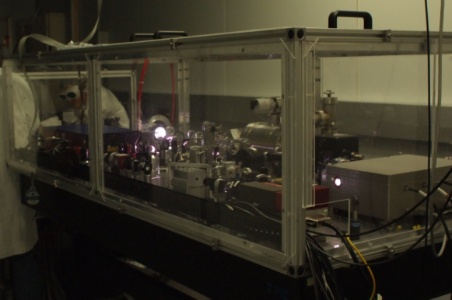
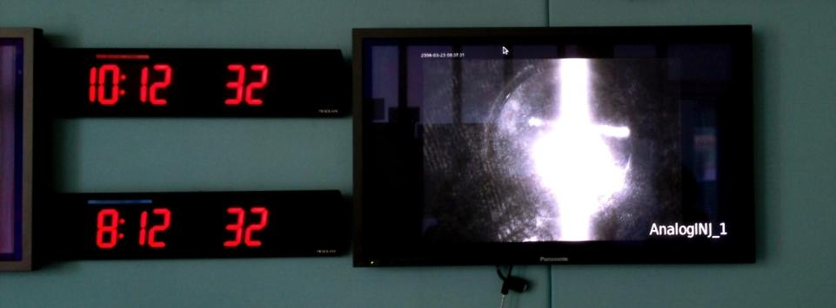
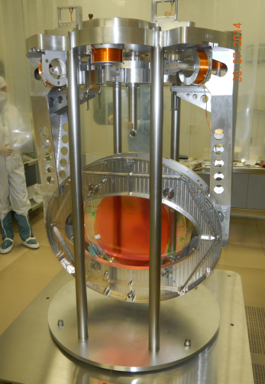
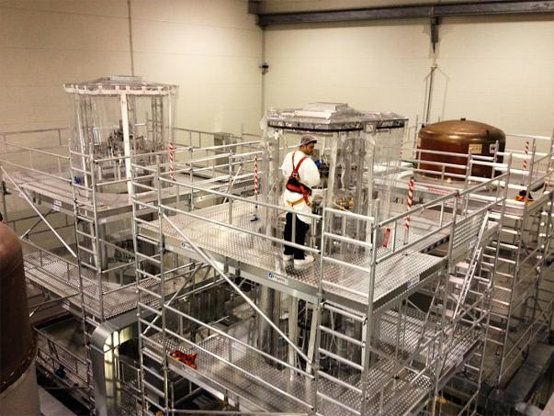
Construction highlights
Input mode cleaner locked on Jun 19
First top level milestone achieved on schedule
Virgo+ Laser bench re-installed
BS suspension upgraded
WI suspension close to completion.
BS payload ready
for integration

Slide 7
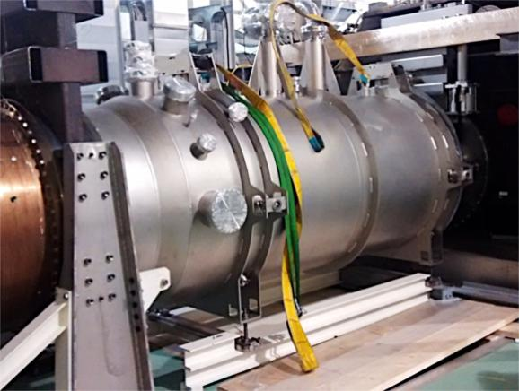
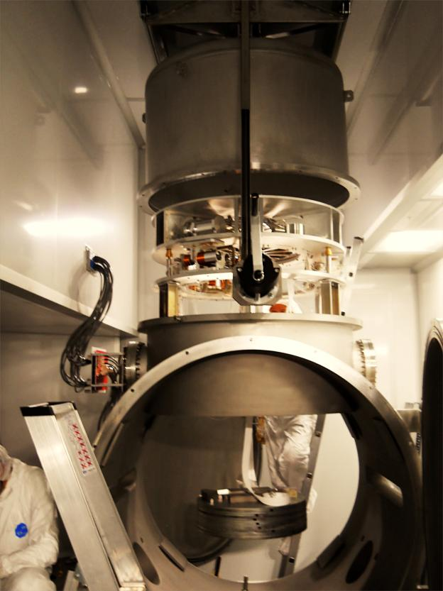
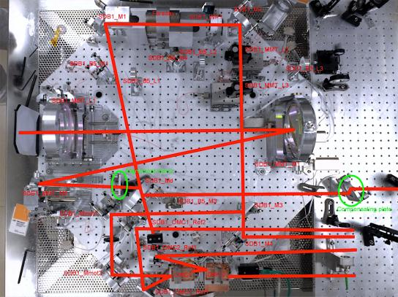
Construction highlights
3 mini towers installed
2 Multi SAS(MSAS) installed
(SIB2-SDB2)
Pre-commissioning started.
2nd CRYOTRAP installed (North End building)
Installation of output optics has started
(Suspended Dectection Bench 1)

Slide 8
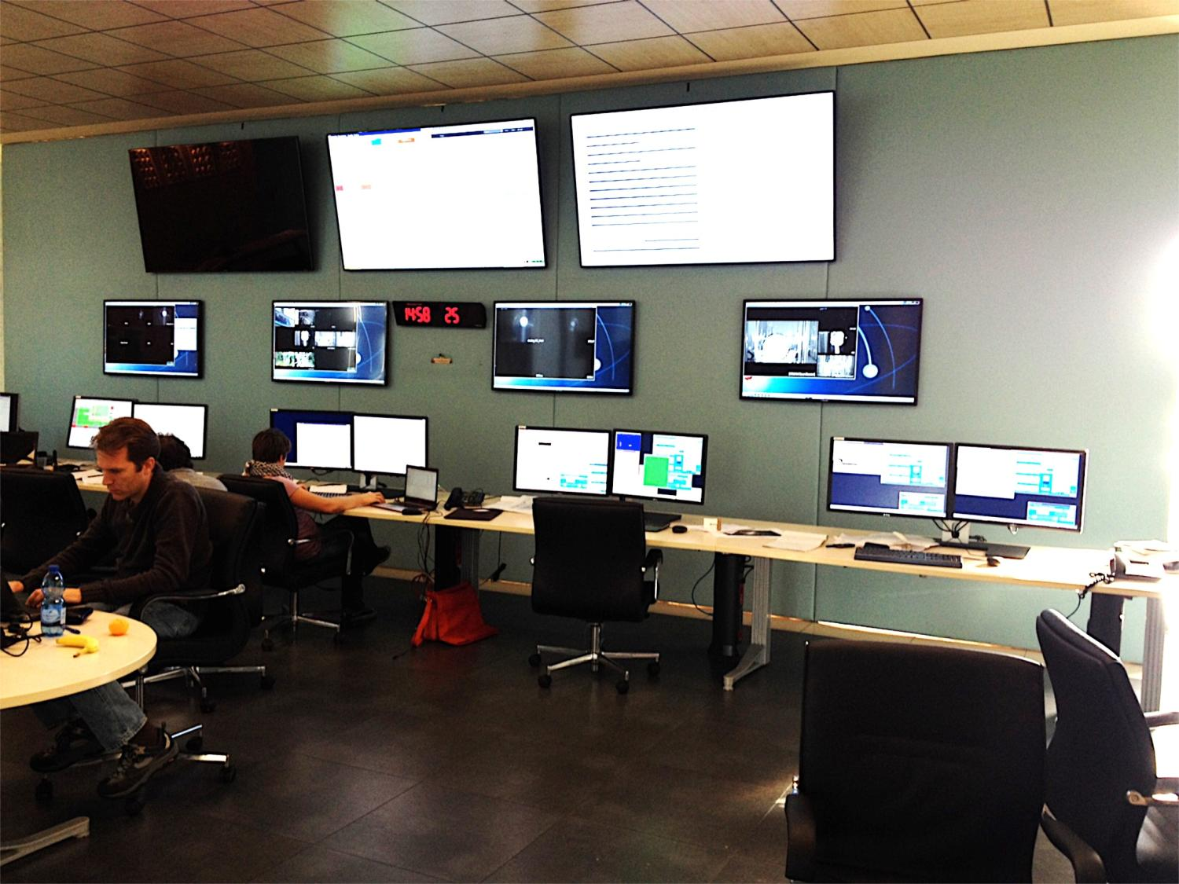
The control room is now fully operational again
New computers, new screens and new chairs have been installed

Slide 9
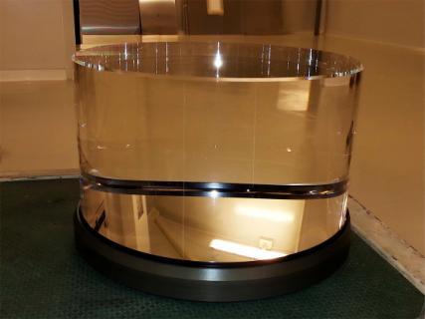
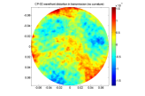
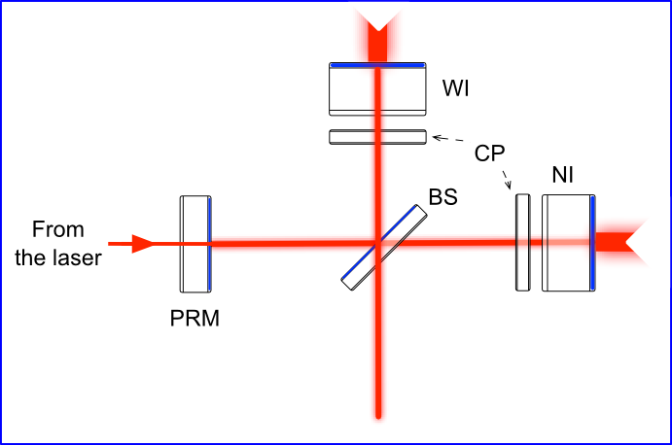

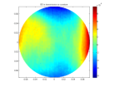
MIR/OSD
All substrates delivered. Figures better than specs
New wavefront metrology bench now available at LMA
Large Beam Splitter coating (June)
  55cm diameter, largest parts ever coated.
Coating of two input test masses (Oct-Nov)
  Final characterization in progress
  Avg scattering: 3ppm, avg absorption: 0.2ppm, AR reflexion: 32ppm
Selection of the parts to be coated supported by OSD (simulation) and followed by the Internal project review board.
Prediction of the interferometer performance
is being carried with 2 different FFT codes
A new polished substrate at LMA

Slide 10
ISC
Re-evaluation of max locking force required for dimensioning the actuators
Defined software requirements for fast and slow control loops. Developed a program that can interface user algorithms with live data from the interferometer, for implementing slow automation tasks (slow servos, lock acquisition sequencing, phase camera analysis, ...)
Started preparing simulations for CITF (PRMI)
Simulation of lock acquisition of Power recycled ITF, work on auxiliary lasers is ongoing.

Slide 11
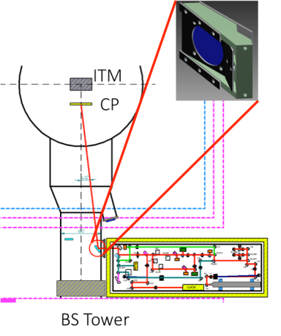
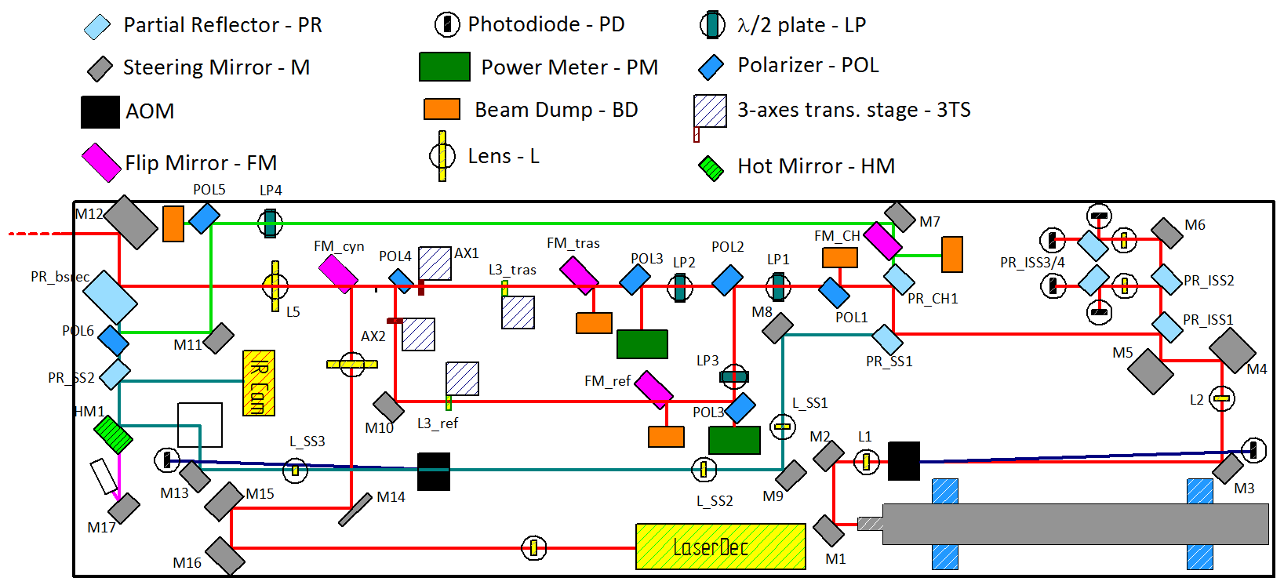
TCS
Optical layout of CO2 benches finalized. Components procurement close to completion. Acoustic enclosures ready to be ordered
Installation to start at the end of November
On going tests at Tor Vergata facility (compensation tests will start soon)

Slide 12
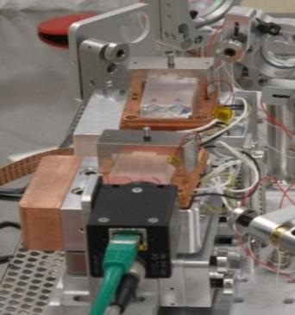
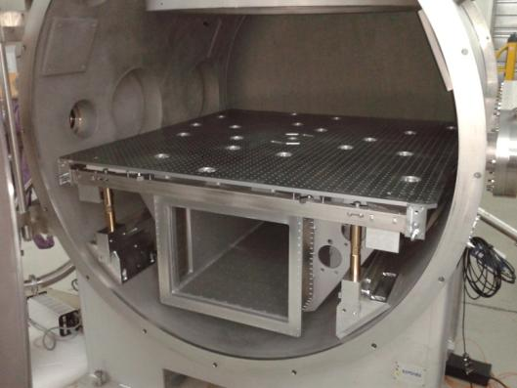
DET
Output mode cleaner
  4 cavity tested, Finesse 15% lower than target. No impact expected on the sensitivity
  Mechanics being improved to avoid birefringence in the cavity
  Two cavities in series locked (test over 24h)
SDB1 assembling at the site has started
Photodiodes electronics: in production
Phase camera: Prototype tests in progress
Installation expected to start by the end of the
year
Minitower suspended benches:
  one bench delivered, insertion tool prepared
2 OMC cavities
New suspended bench in a minitower

Slide 13
DAQ
General purpose electronics: DAQ-box
  Some components are available and are being tested,
  The rest is currently being produced
Interface between real-time PC and data network
  Design of PCIe boards and selection of new real-time PC on going
Electronics for environmental monitoring
  Slow monitoring: boards production completed, installation to start
  Fast monitoring: boards production completed, purchasing the sensors
General infrastructure
  Rack being installed upon needs (INJ/PSL/SBE/DET/TCS)
  DAQ running for PSL, INJ, SBE
Software framework
  Process monitoring web interface widely used
  Upgrade of dataDisplay and the main control packages in progress
  Finalizing the estimates of the EGO machines for DAQ

Slide 14
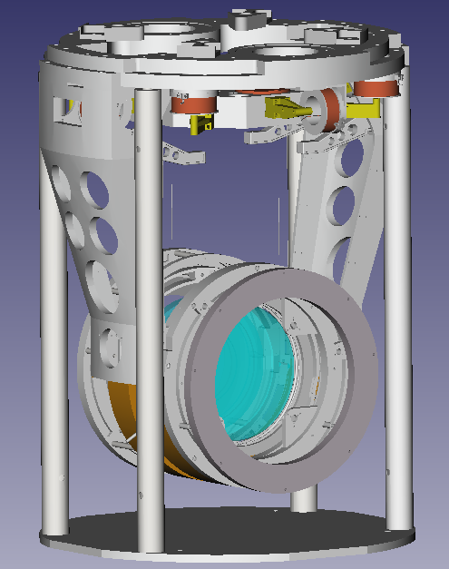
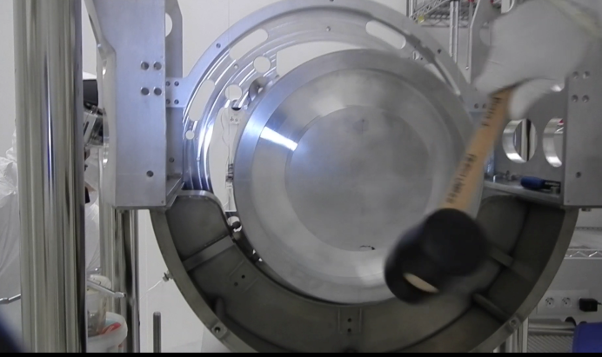
PAY
Beam Splitter payload ready to be suspended
Input payload #1 under tests (monolithic suspension
assembling procedure has been validated)
Input payload #2: in production
PR payload: in production
End mirror payload #1 ordered
End mirror payload #2 and SR payload ordered
by the end of the year
PR payload
Hammering on dummy test mass

Slide 15
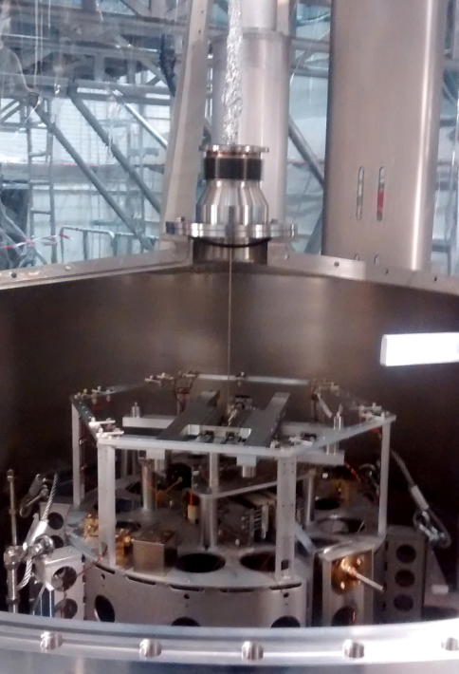
SAT
Beam Splitter
  Tower opened in July. Upgrade being completed.
West Input
  Assembly of the new (lighter) F7 being completed
  Integration of F7 and suspension of the payload
  with a dummy mirror scheduled at end of November
Control electronics
  4 boards under extensive testing (no issues so far)
  Porting of the control software complete
  Large orders being placed
BS filter 7 (last suspension stage) and
intermediate vacuum chamber

Slide 16
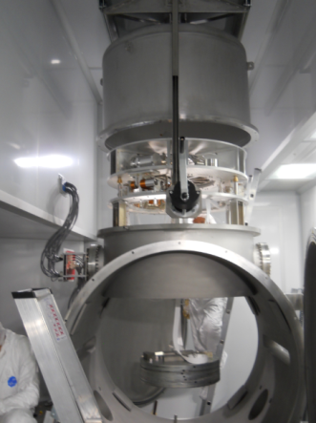
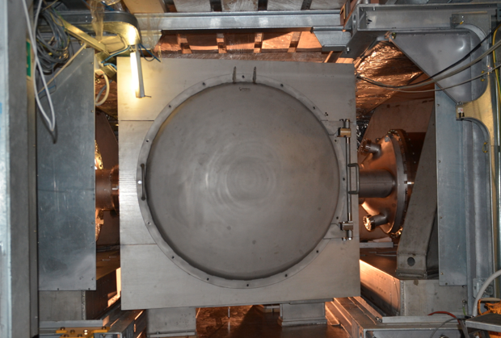
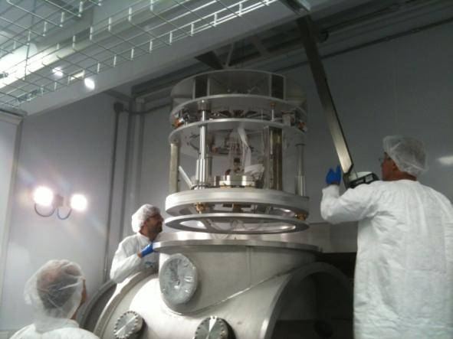
SBE
Production and installation
  All 3 central building minitower installed
  2 MSAS installed, one more in early December
Tests
  MultiSAS thermal shield designed and tested at Nikhef
  Pre-commissioning of installed multiSAS in progress
  MultiSAS/bench control integration studies ongoing at Nikhef
SIB2 MSAS
SPRB minitower
SDB2 MSAS

Slide 17
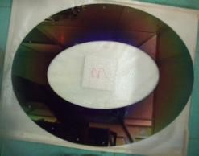
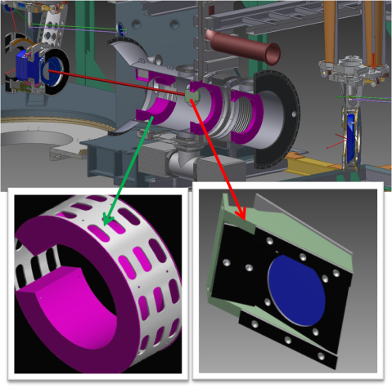
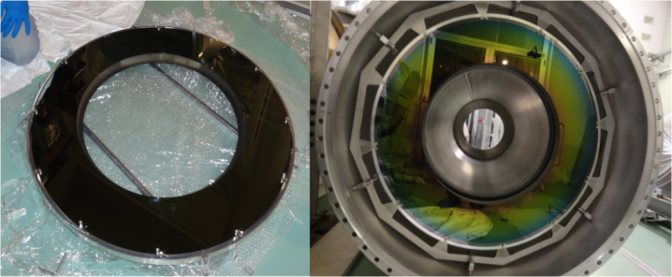
SLC
Cryotraps: installation of NE cryotrap baffles completed. Procurement of parts for the remaining two cryotraps in progress
Beam splitter: baffles produced.
The technique of AR coating on steel has been validated and becomes the
new baseline
Central links: steel substrates produced, to be coated soon
DET baffles and diaphragms: production started
Input mirrors: relevant interface with PAY/TCS. Design being completed
BS baffle
Delicate integration with TCS in WI-BS link
Baffling NE arm cryotrap

Slide 18
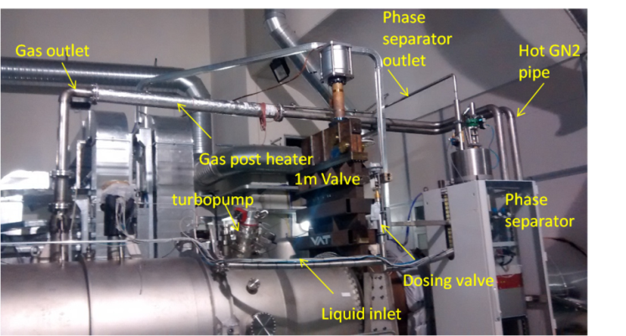
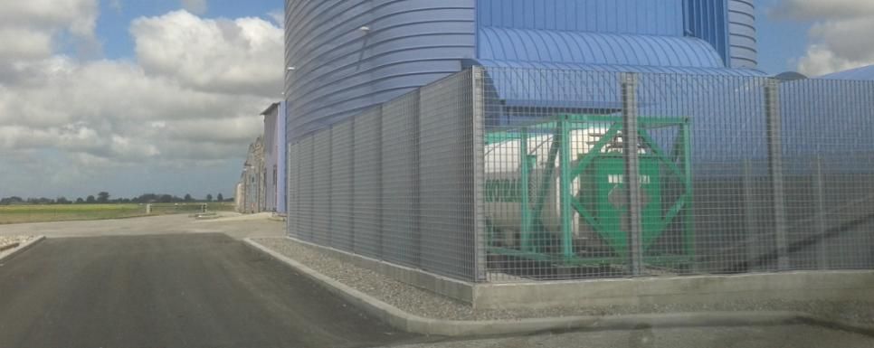
VAC
WE cryotrap in vacuum since June. NE cryotrap installed, NI to be installed in mid-december
LN2 reservoir installed at WE building
IMC cavity in vacuum since months
Main parts of new central links installed
First racks of new control system in operation
All Intermediate Vacuum Chambers produced. Main parts installed for NI, WI, BS, SR
“Small” cryotraps for injection/detection towers in construction
Procurement of VAC parts almost complete

Slide 19
INF
Foundations for the LN2 tanks completed
Preparatory works for the new data cable/power distribution in the central building completed
Structural modifications in the end buildings for the minitower installation: executive design completed
HVAC in the central building: modification proposed to improve the cleanliness. Change request accepted
Topographic activity for positioning/alignment of the towers
Installation of the rails for the SIB2/SDB2 minitowers
Executive design for the enlargement of the 1500W clean room completed

Slide 20
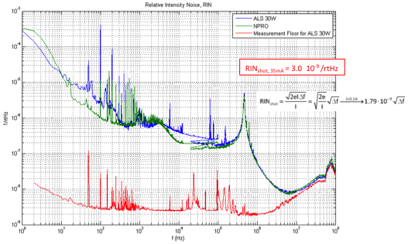
PSL: High power fiber amplifier
ALS 50W fiber amp under test at Nice
  Designed for 9.5A pumping diodes, Seed Laser power is 30 mW
Experimental setup for measuring the noise figures while monitoring the power output
→ More than 700 hrs of operation at 90% of nominal values
→ No sign of non-linear effects
Roadmap
  The team considers that these results are
  promising
  Starting to study the scheme for the coherent summation of several laser amplifiers to reach the required power
  At the same time look carefully at the developments done in other labs
ALS fiber ampli
NPRO
Measurement floor

Slide 21
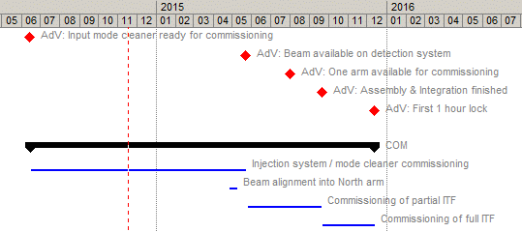
Planning: top level milestones
The interferometer is expected to be operational by the end of 2015

Slide 22
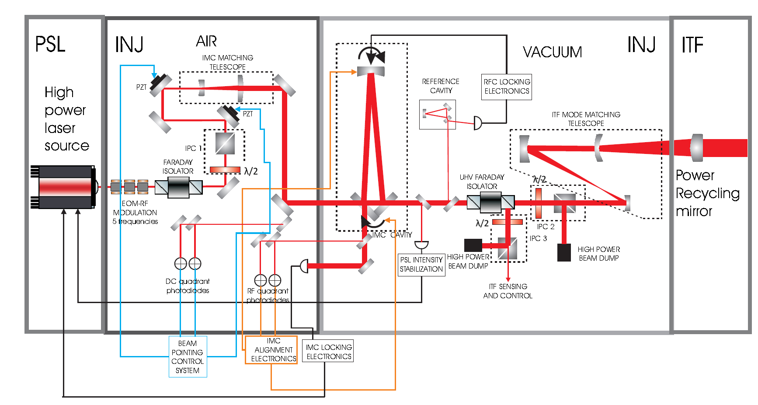
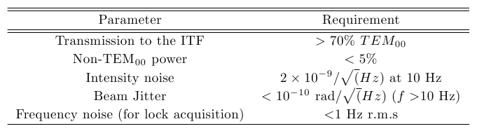
INJ overview
Requirements from the Technical report

Slide 23
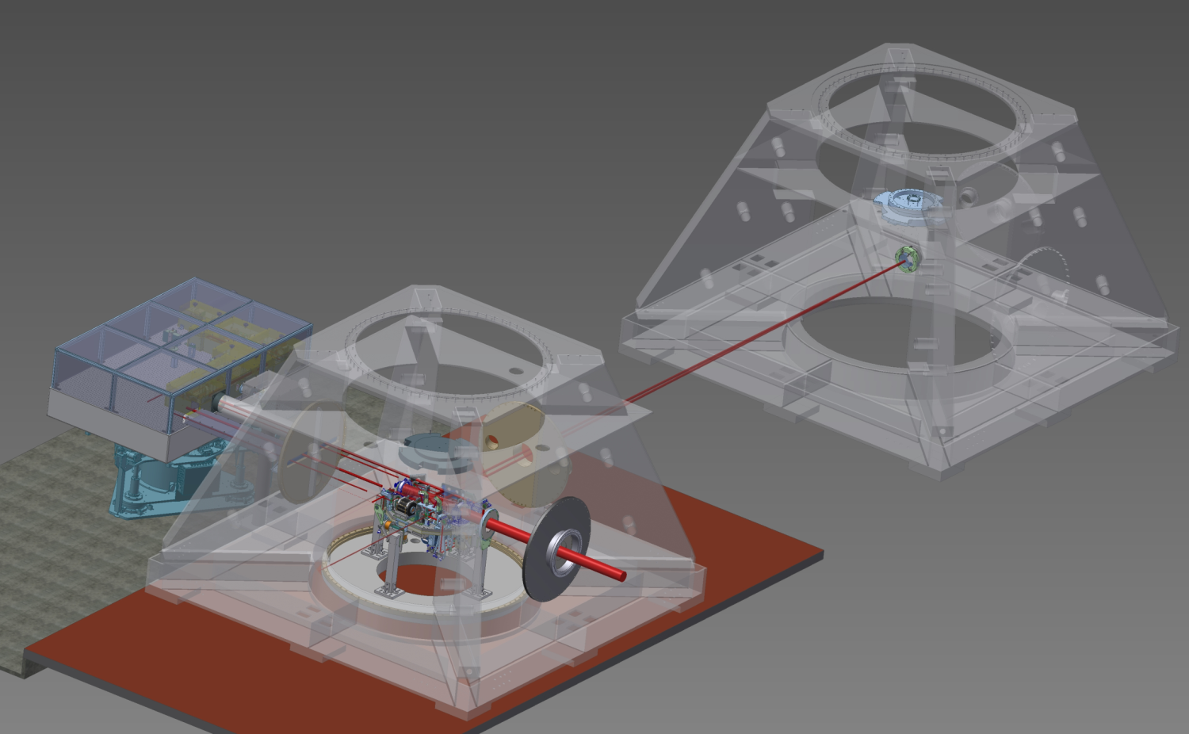
Installed so far
IMC
end mirror
EIB
SIB1

Slide 24
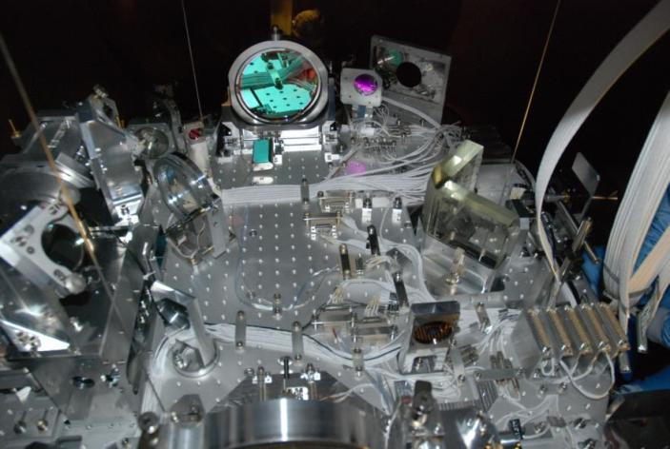
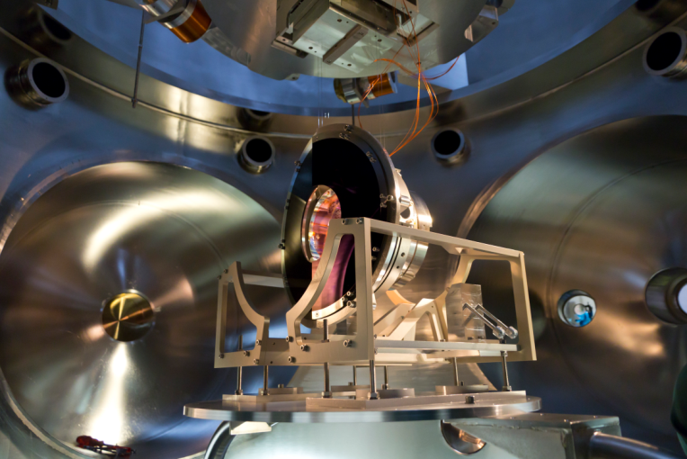
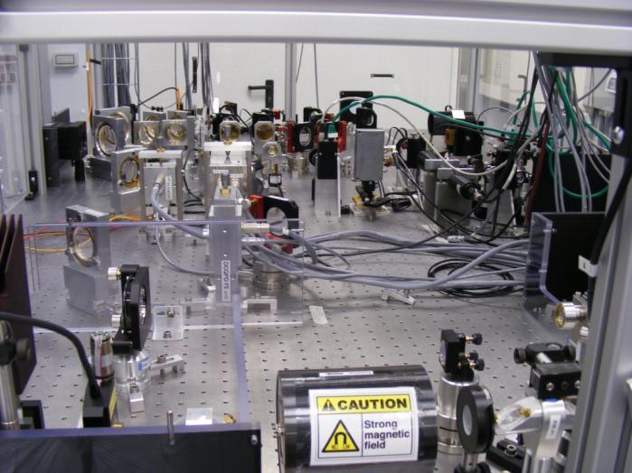
A few pictures of INJ benches and optics
SIB1 bench in IB tower
MC payload in MC tower
A view of the EIB in the Laser lab

Slide 25
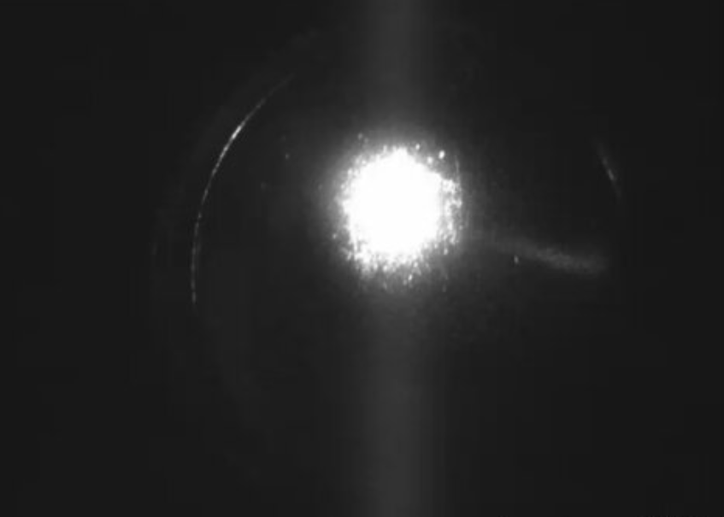
IMC lock
Virgo+ laser system has been re-installed at the beginning of 2014 and delivers up to 45W (output of the PMC).
INJ components have been assembled and installed starting from January 2014
The IMC cavity has been locked on June 19.
→ The first project milestone has been achieved on time.
IMC end mirror view (inside the IMC cavity)

Slide 26
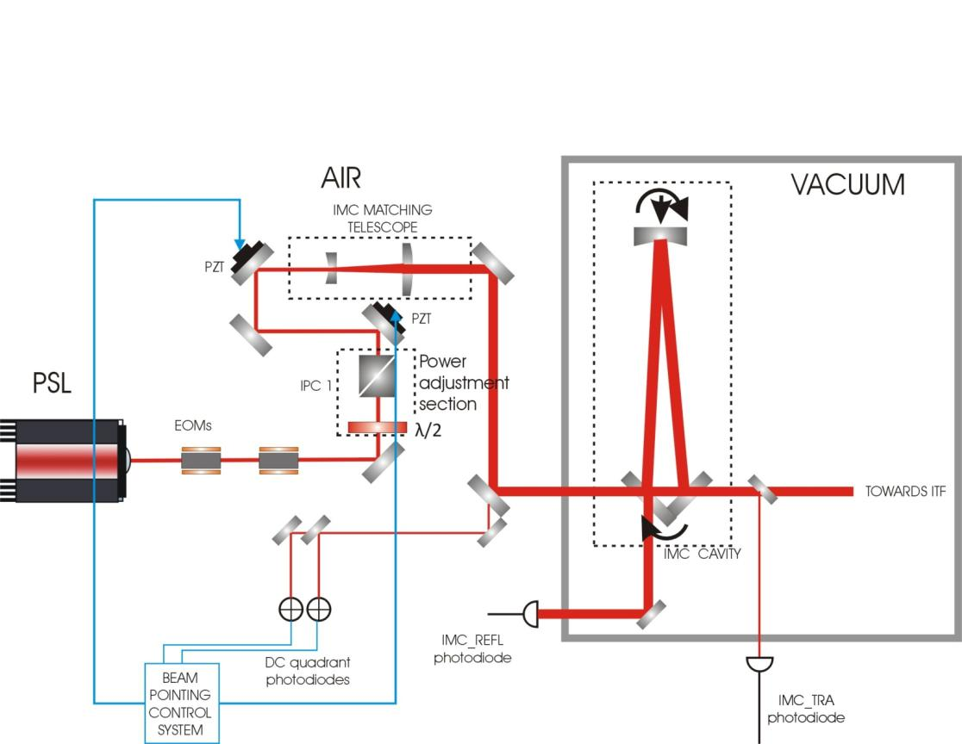
Beam Pointing Control
The BPC aims to mitigate (at low frequency) and monitor (in the detector bandwidth) the beam jitter at the entrance of the IMC.
B. Canuel, E. Genin, M. Mantovani, J. Marque, P. Ruggi, and M. Tacca, "Sub-nanoradian beam pointing monitoring and stabilization system for controlling
input beam jitter in gravitational wave interferometers," Appl. Opt. 53, 2906-2916 (2014).

Slide 27
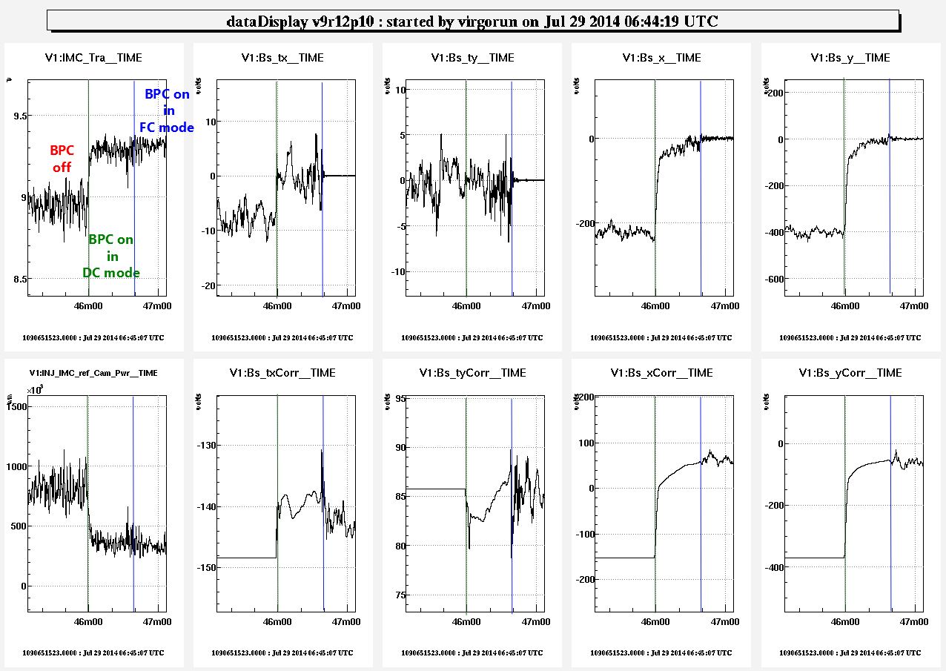
Beam Pointing Control

Slide 28
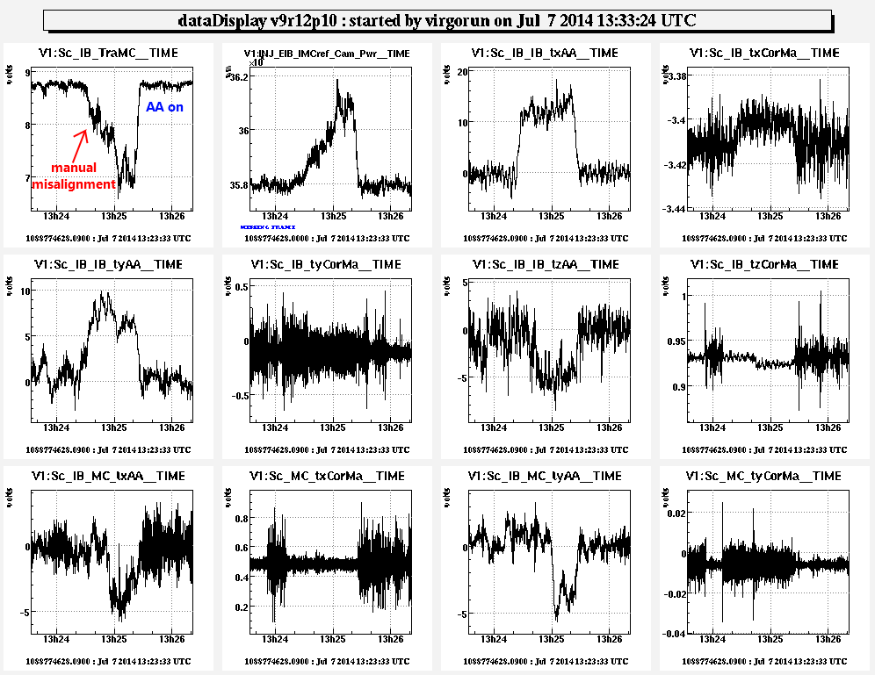
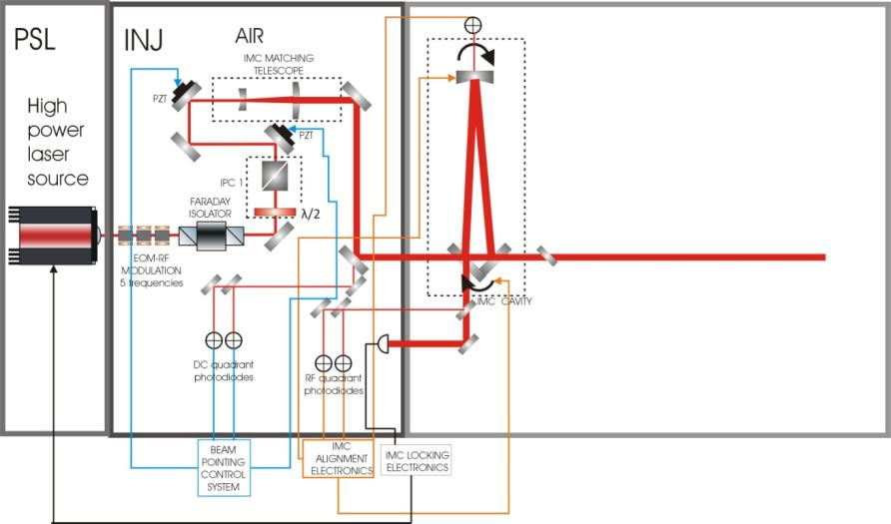
IMC Automatic Alignment
The cavity global alignment system has been implemented.
6 dofs are controlled using 2 RF quadrants and 1 DC quadrant.
After misalignment of the cavity closing the AA we recover quickly the right alignment

Slide 29
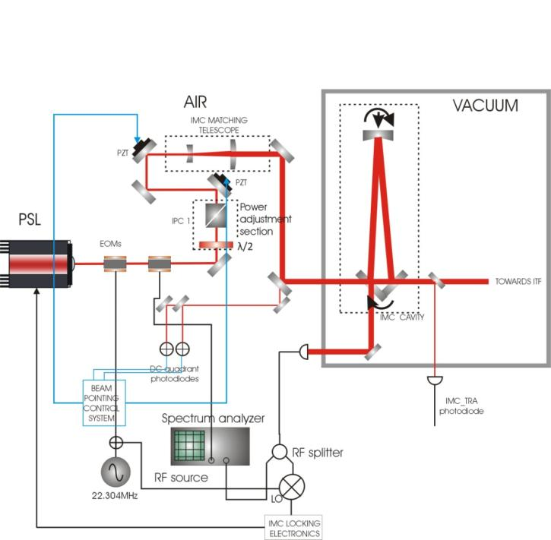
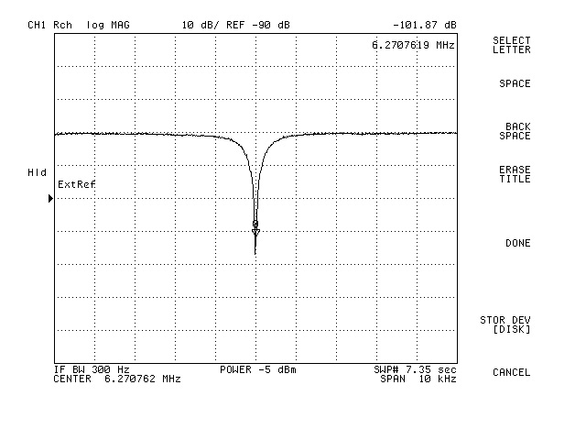
IMC cavity characterization
Keeping the IMC cavity locked, we scan it using a second phase modulator
→ we used this method to measure the free spectra range of the cavity and the position of HG01 and HG10 modes to estimate the absorption of the cavity mirrors.
Dip in IMC reflection at 6.2707619MHz (6*FSR)
FSR=1.045127MHz L_IMC=143.424m
f_{mod} =22.304MHz and f_{mes} the frequency of the modulation applied
on the second EOM

Slide 30
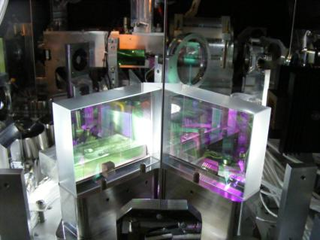
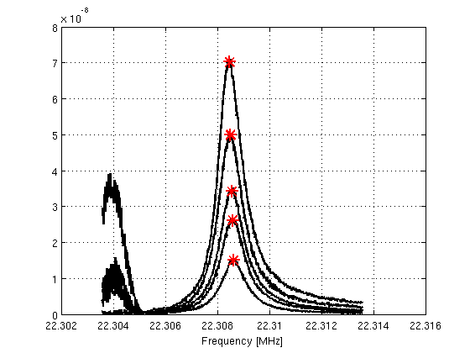
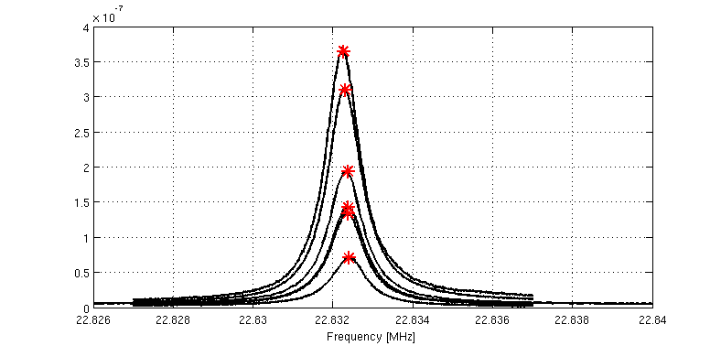
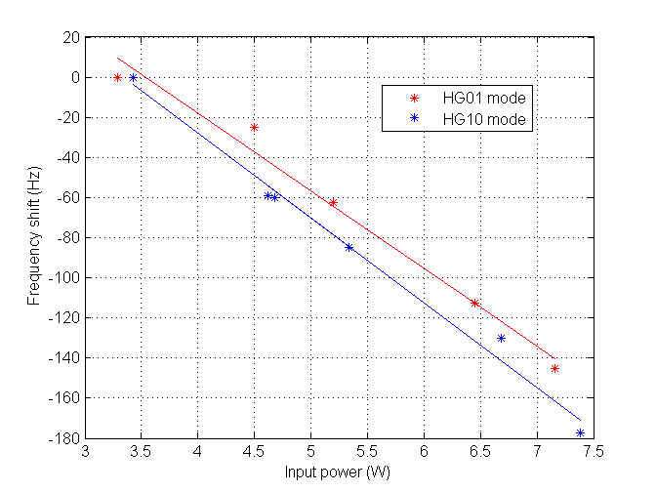
IMC cavity characterization: HG01 and HG10 frequency shift vs input power
First, the cavity is properly aligned using AA system. Then, the input beam is misaligned adding some offset on BPC error signals.
Those measurements have been carried out with 2 different dihedrons (input and output flat mirrors). In this way, we could understand from where the absorption is coming from.
IMC dihedron on SIB1
Hermite-Gauss 01 mode
Hermite-Gauss 10 mode
The absorption of the dihedron mirrors looks negligible.
The absorption of the end mirror seems of the order of 3ppm.

Slide 31

IMC cavity characterization: cavity pole measurement
Cavity pole measurement (for more details see Virgo internal document VIR-0232A-10).
  We have injected a white noise at the level of the laser system.
  We compute the transfer function between IMC transmitted beam and the IMC input beam
 | Cavity pole measurement
Parameter | Dihedron #1 | Dihedron #2
Cavity pole (Hz) | 452.7 +/- 2 | 520+/-2
Finesse | 1156 +/- 5 | 1005+/-5
Example of Transfer Function obtained for the cavity pole measurement.

Slide 32


IMC stability and noise hunting
Since the IMC cavity has been locked,
it stayed in the condition for more than
70% of the time.
Recently, we have made some
big progress reducing the IMC output
power fluctuations (the beam is
now completely protected from air
turbulences from the laser bench
to IB tower).
The noise hunting activity has
restarted
The noise budget is being prepared too
Example of IMC lock stability during a week-end

Slide 33


Reference cavity locking and SIB2 installation
The Reference cavity (RFC) has been very
recently locked (last week) → the control loop
is being improved. We are now aiming to
demonstrate that the frequency noise can be
brought down to a few Hz r.m.s as required.
The last INJ bench (SIB2) is expected to be
installed in its minitower in January/February 2015.
RFC lock acquisition phase
CAD view of SIB2 bench with its optics

Slide 34
Conclusion
Realize a competitive detector joining the international network in 2016 remains the goal of AdV (even if the schedule is tight).
Tough integration/installation phase will be carried out in the next months
An impressive amount of work from different groups has been carried out at the site and in the labs in the last year.
The commissioning activity is ramping up and the control room is back to standard operation.

