Slide 1
ASPERA / ApPEC
Thomas Berghöfer
ASPERA Coordinator
BMBF/PT-DESY ● Germany

Slide 2

Coordinating Astroparticle Physics in Europe
  Achievements of 6.5 years of ASPERA
  From ApPEC with ASPERA to a new ApPEC
ApPEC:
- what can E.T. and other projects expect?
- what should we do together?

Slide 3
Achievements of 6.5 years of ASPERA
  ASPERA-1: 2006-2009
  - networking of funding agencies in Europe
  - derived a status in methodology and funding in ApP
  - first European roadmap in ApP
  - first common call
  ASPERA-2: 2009 – 2012

Slide 4
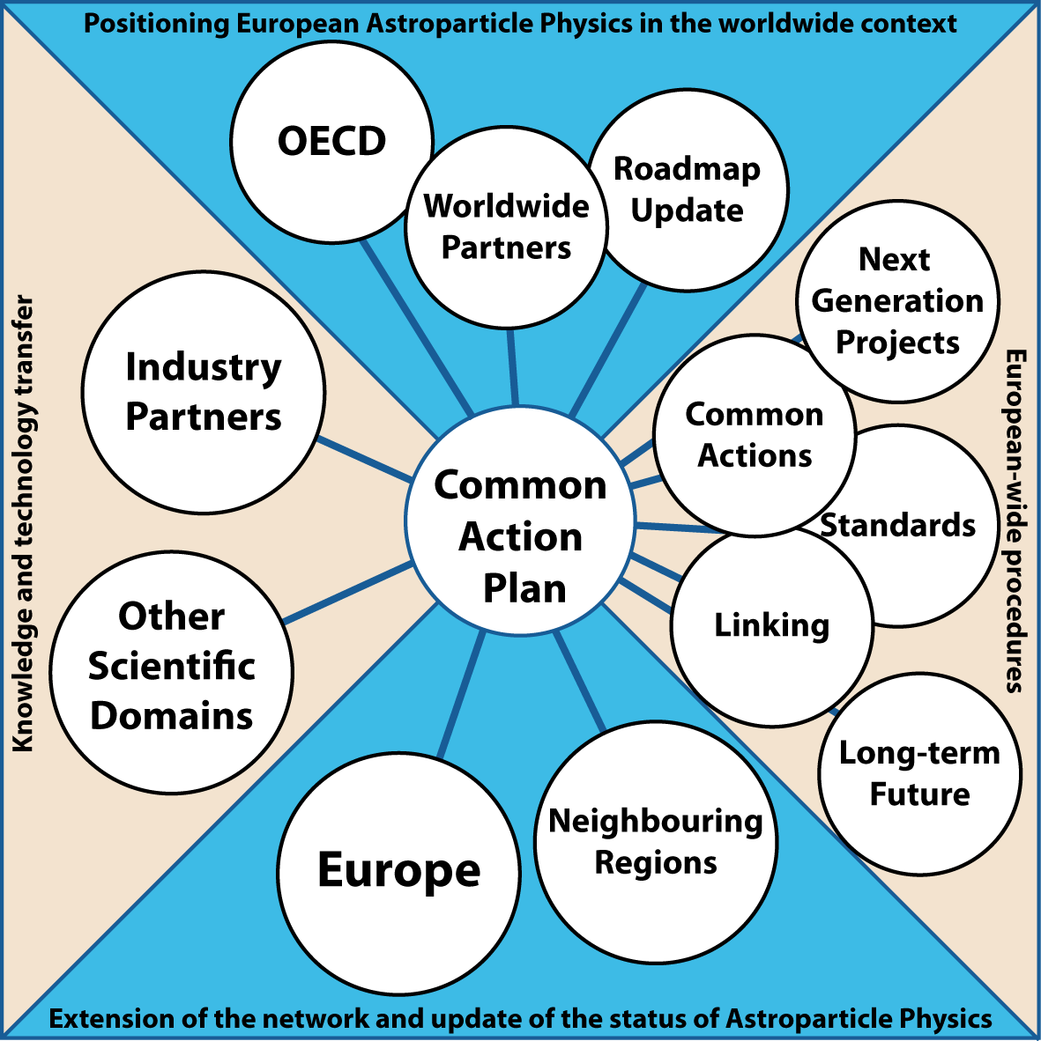
ASPERA-2 programme

Slide 5
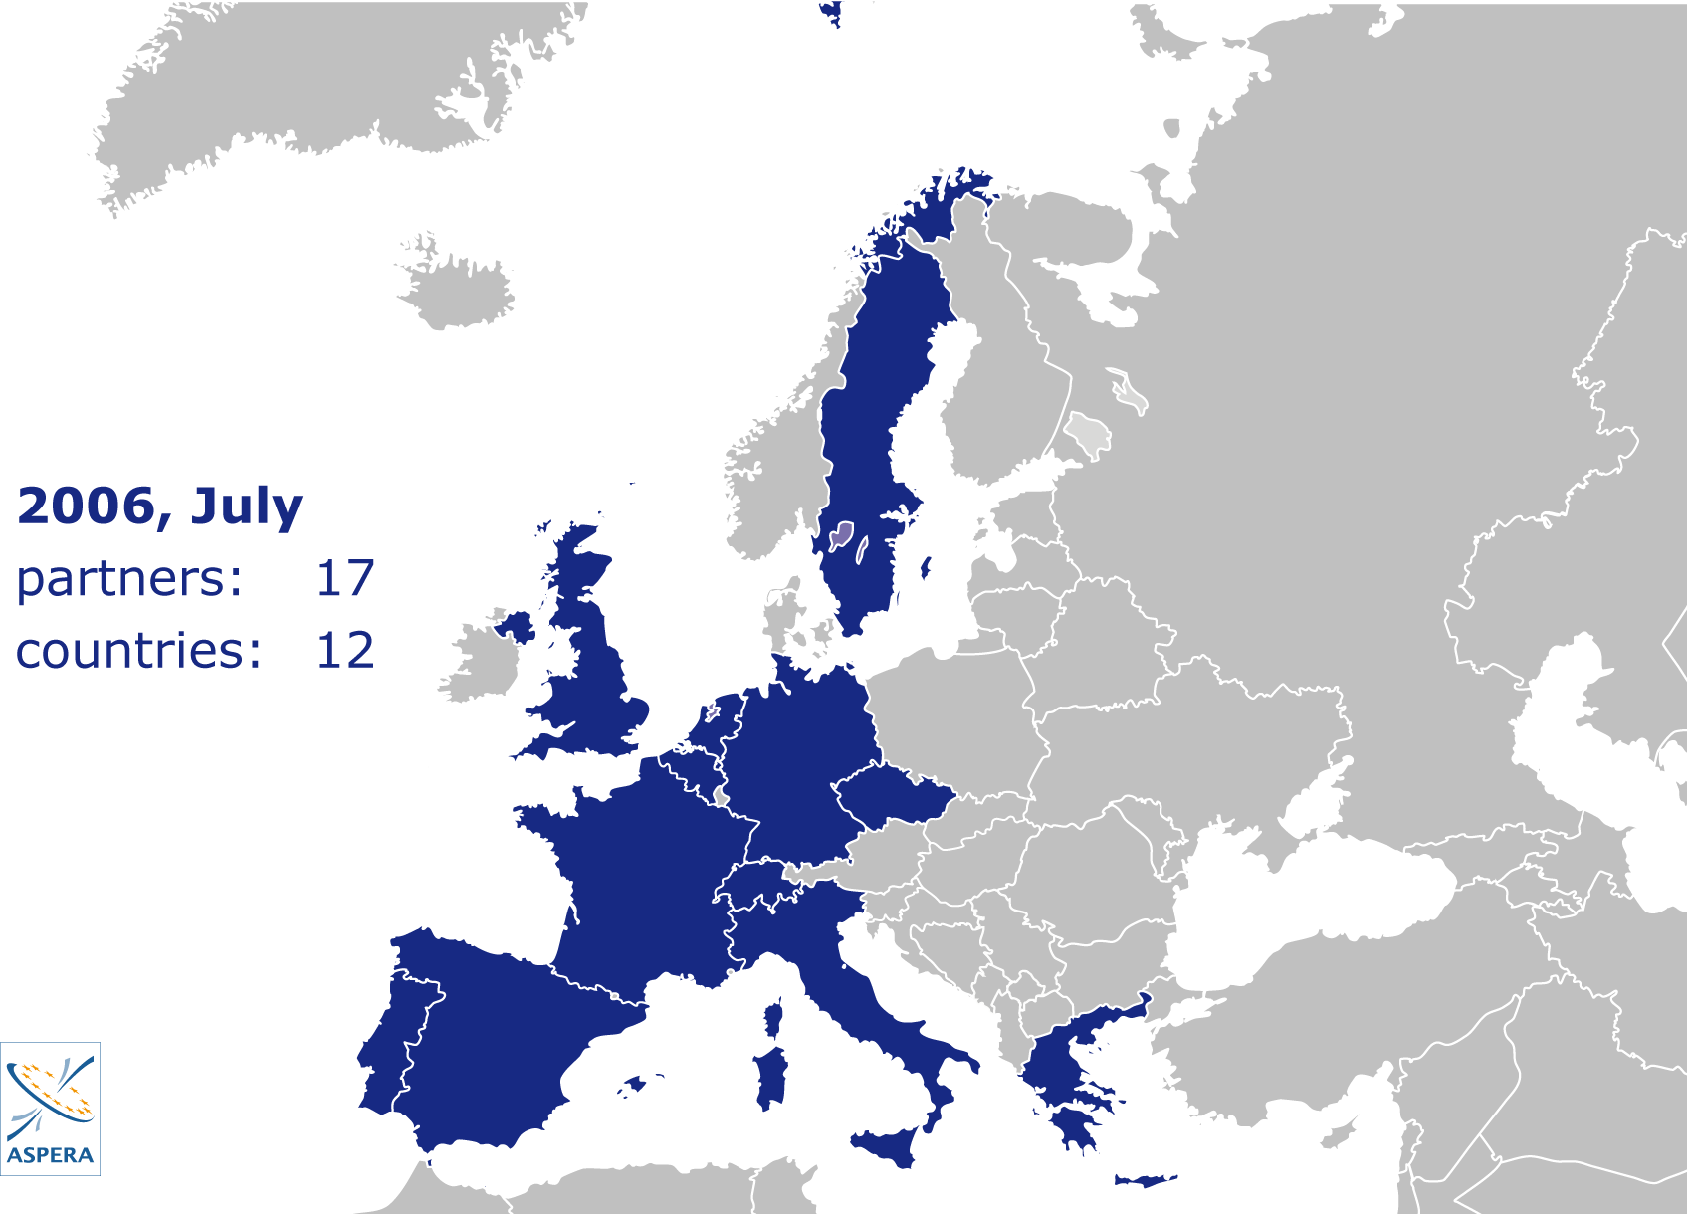

Slide 6
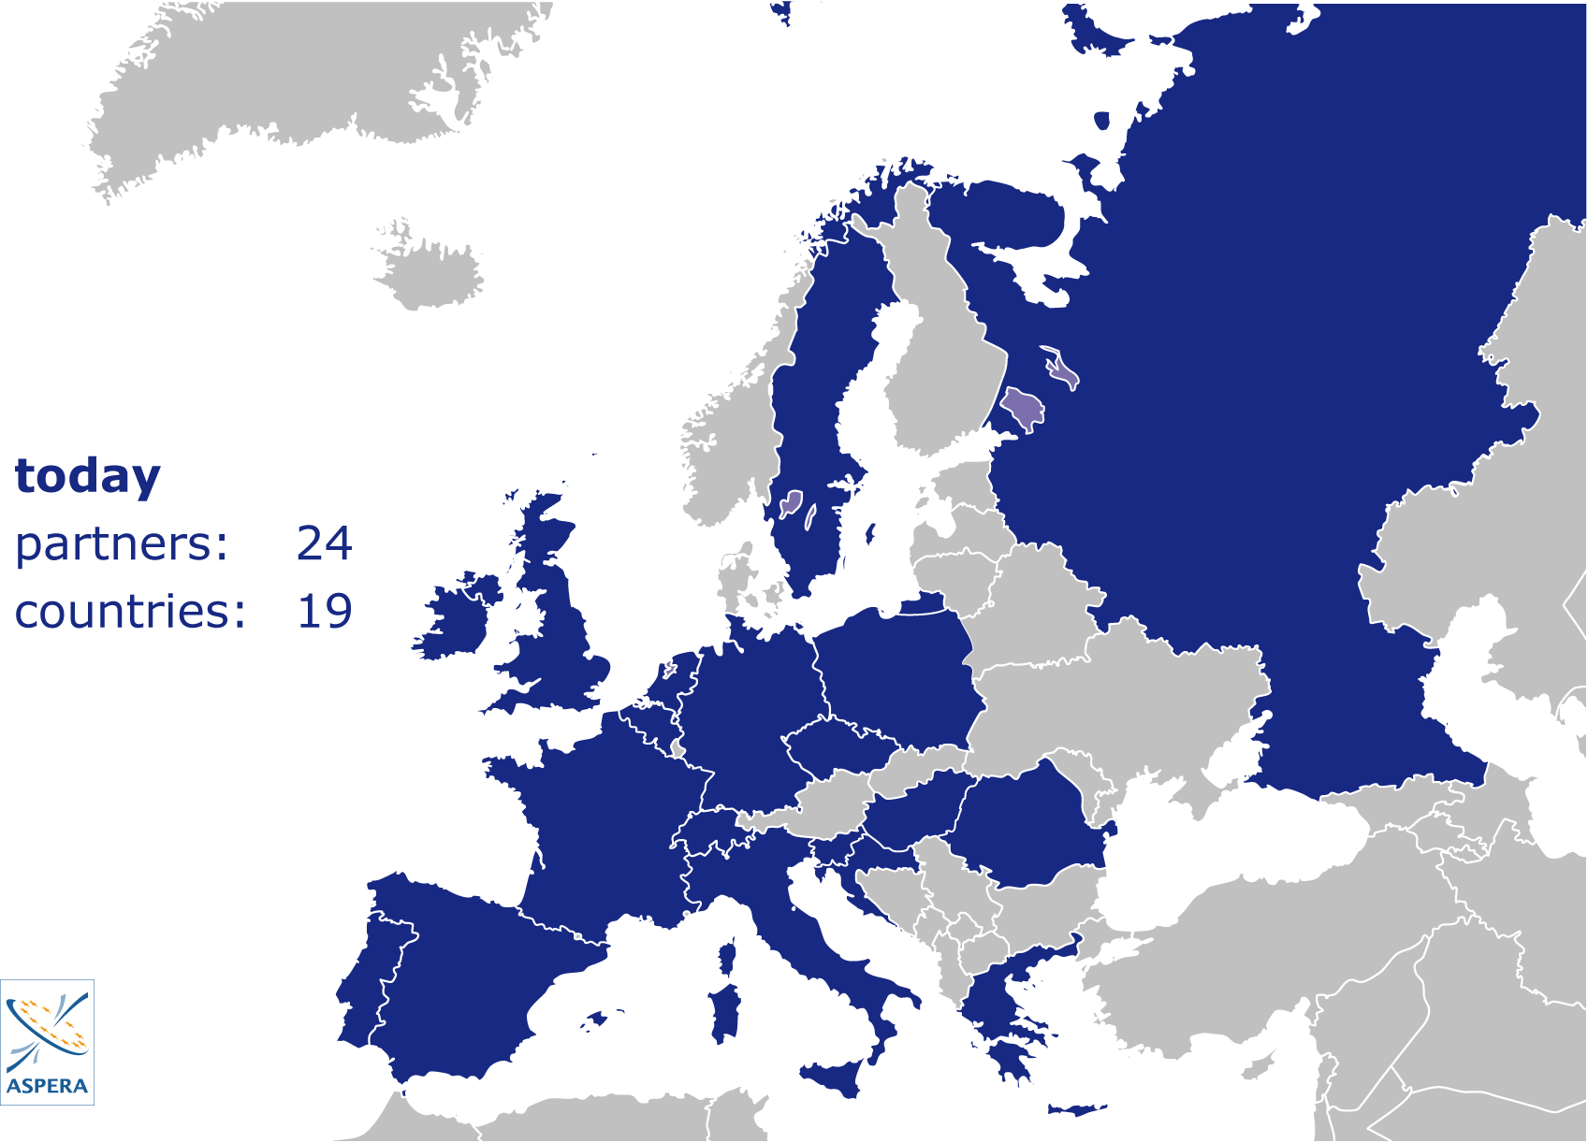

Slide 7



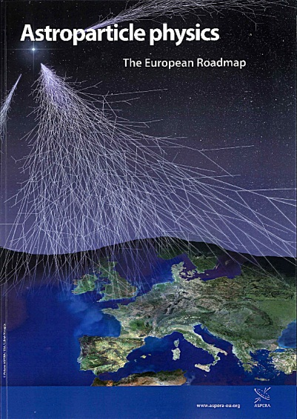
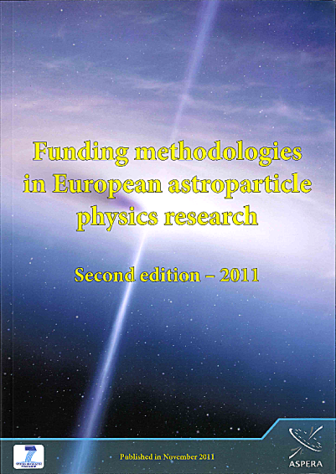



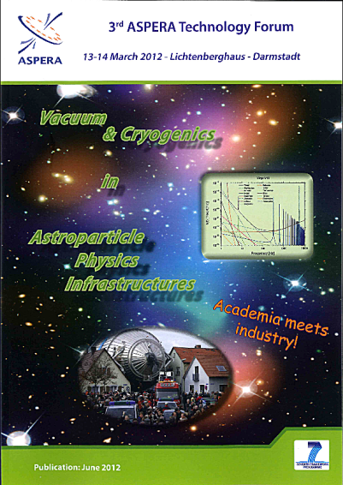


Broschures – TOP10
Roadmap 1
Roadmap 2
Roadmap 3
Census
Networking
ATF 1
ATF 2
ATF 3
Synergies
Outreach

Slide 8
Achievements of 6.5 years of ASPERA
  Networking of 24 partner in 19 countries
  Links to essentially all global players (APIF)
  3 common calls (3rd on GW and Neutrinos)
  Links to industry
  Links to other scientific domains
  Steps towards a common computing model
  Standards: PM handbook, synchronization of projects (comparable to space projects)
  New structure (ApPEC)

Slide 9
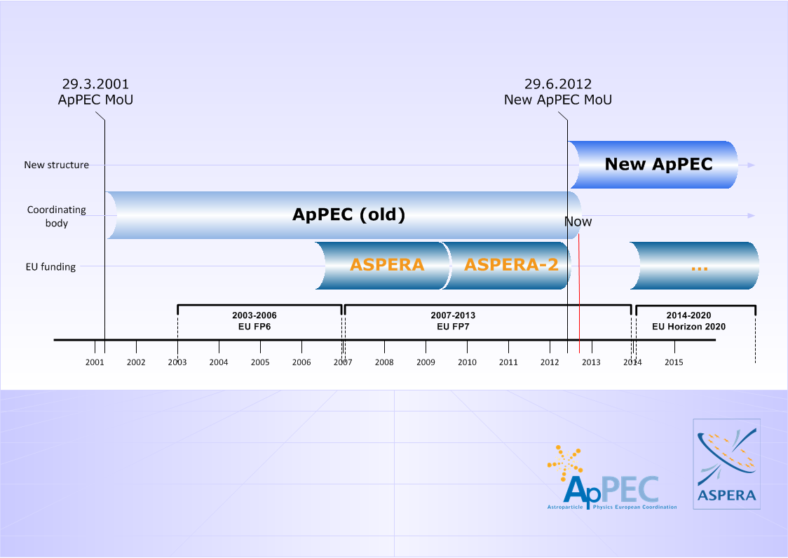
  From ApPEC with ASPERA to a new ApPEC

Slide 10
New ApPEC – MoU : Partners
  Ministries, funding agencies responsible for policy and/or providing funding in ApP research at the national or international level, or their designated institution with legal status, are eligible partners
  Signed by 11 partners (June 2012):
  CEA, CNRS (France); DESY (+BMBF Germany);
  FOM (Netherlands); FWO (Belgium); CSF (Croatia); IFIN-HH (Romania); INFN (Italy); NCN (Poland); RIA (Ireland); STFC (UK)
  + more to come

Slide 11
New ApPEC – MoU: Strategic objectives
  Provide a discussion forum for the coordination of European Astroparticle Physics
  Develop and update long term strategies
  Participate in the European scientific strategy
  Develop closer relationships with organizations
  involved in Astroparticle research
  such as CERN, JINR, ESA and ESO
  Express collective views on Astroparticle Physics in international

Slide 12
New ApPEC – MoU: Implementation objectives
  Facilitate and enhance coordination between existing/developing national activities
  Develop a common action plan for large Astroparticle Physics infrastructures
  Facilitate the convergence of future large scale projects/facilities
  Provide organizational advice for the implementation of future large scale projects/facilities, for instance initiate and/or accompany the creation of resource review boards for international collaborative projects where the national funding agencies are involved
  Launch common actions including common calls funded by a virtual common pot
  Initiate and guide activities funded by the European Commission (ERA-NET, Prep-Phase, FP)

Slide 13
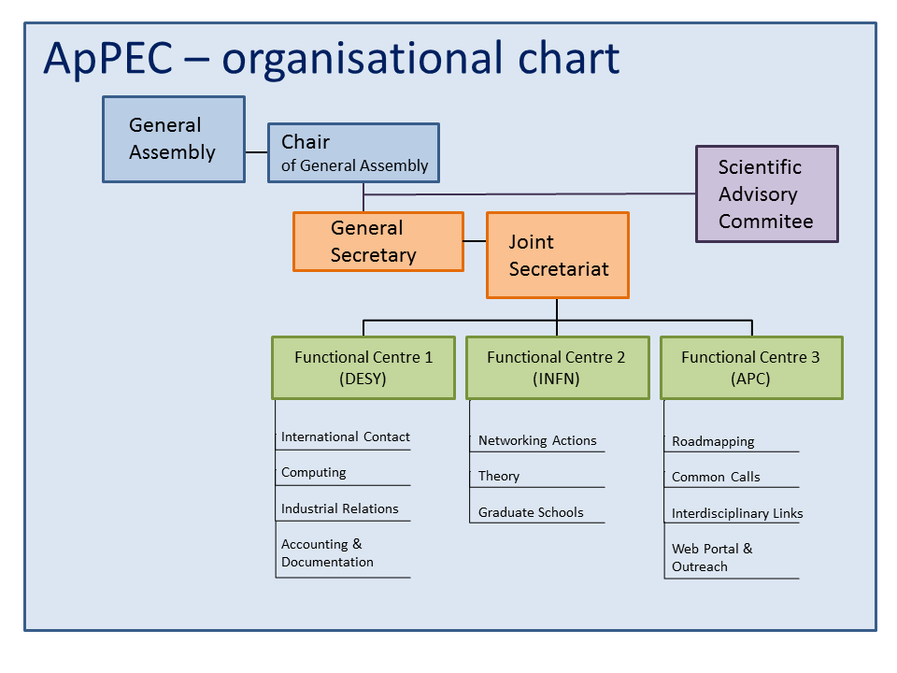
Stavros
Katsanevas
Thomas
Berghöfer

Slide 14
New ApPEC: 3 functional centers
International Contact, Computing and Industrial Relations
DESY
Germany
Networking, Theory and Education centre
LNGS
Italy
Strategic Actions, Interdisciplinarity and Outreach
APC
France
7 officers
+
annual common fund ≈ 60 KE

Slide 15
ApPEC:
What can E.T. and other projects expect?
- links to agencies and organisations on the European
and international level
- links to industry and other scientific domains
- organizational advice for the implementation of RI
- common calls
- …
what should we do together?
- Computing model
- Horizon 2020
- …

Slide 16
.
Thanks for your attention!
ApPEC
Per ASPERA ad astra

