Slide 1
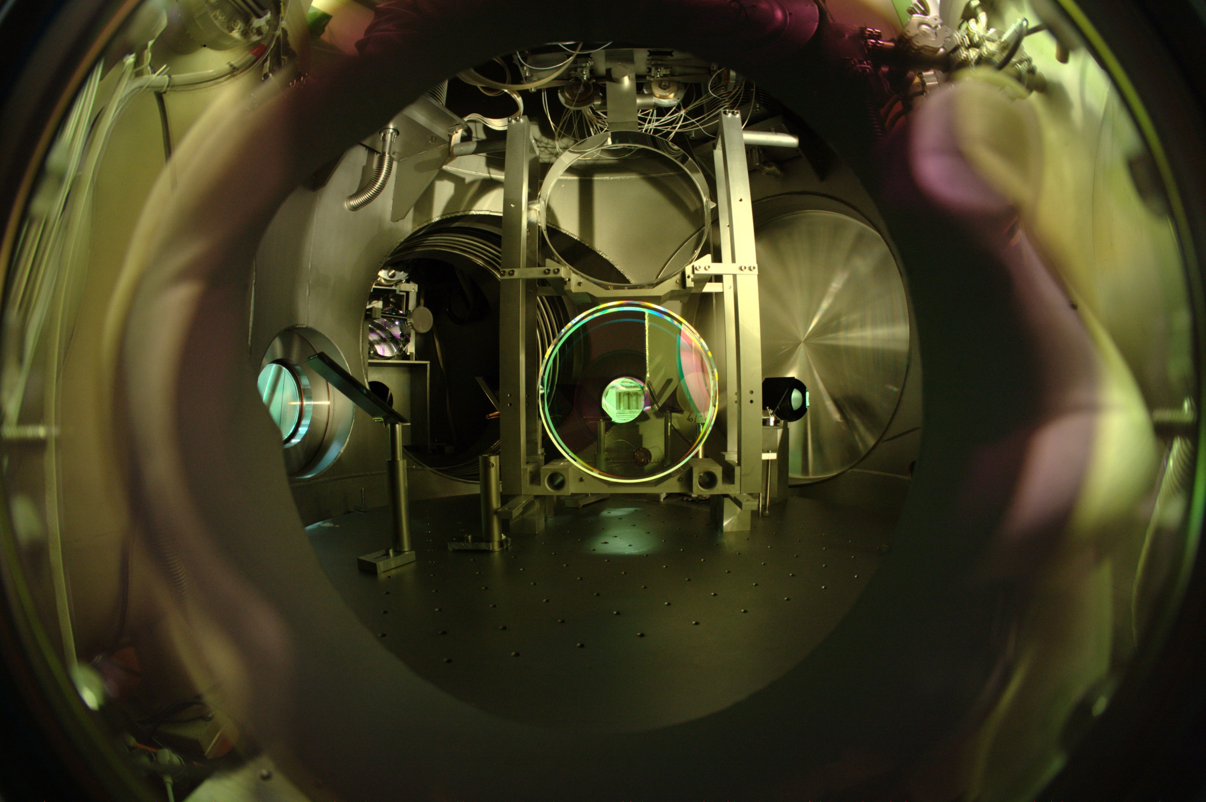


GEO600 Beam Tubes
Harald Lück
Leibniz Universität Hannover
&
Max Planck Institut für Gravitationsphysik
Albert Einstein Institut

Slide 2
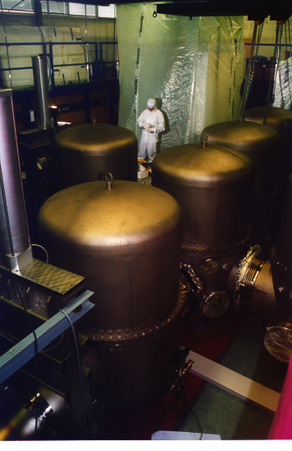
GEO600 vacuum system
Dimensions:
  Volume:400m³/ Surface:4000m²
  Tubes: 2x600m, ∅ 60cm
  11 Vacuum Tanks: 2m tall, 1m ∅
Pumps:
  5 Scroll (25 m³/h, 10⁻² mbar)
  4 Turbo-Pumps (maglev, 1600 l/s for N_{2,}
  1000 l/s for H₂ )
  2 Turbo-Pumps (maglev, 180 l/s)
Pressures:
  Tubes : < 1*10⁻⁸ mbar
  Tanks : 3 *10⁻⁹ - 3*10⁻⁸ mbar

Slide 3
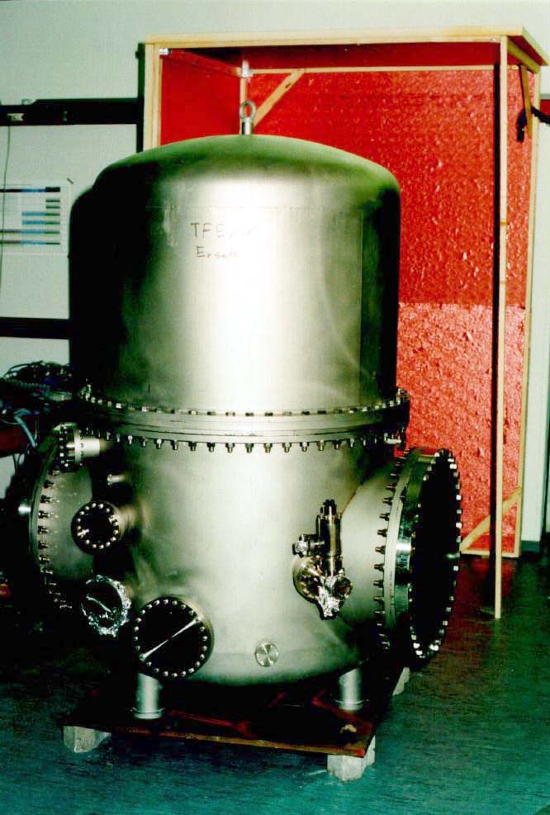
Vacuum Tanks
Dimensions:
  2m tall, 1m ∅ (9x)
  0,7m ∅(2x)
Materials:
  Stainless 1.4404 ,
  1.4435, 1.4429 (Flansche); glas bead blasted
gaskets:
>250mm COF
≤ 250mm Conflat
24h „Air-bake“ @200°C
„Vacuum-bake“ 48h @ 80°C
Outgassing rates ca. 1E-13 mbar l/s cm²

Slide 4
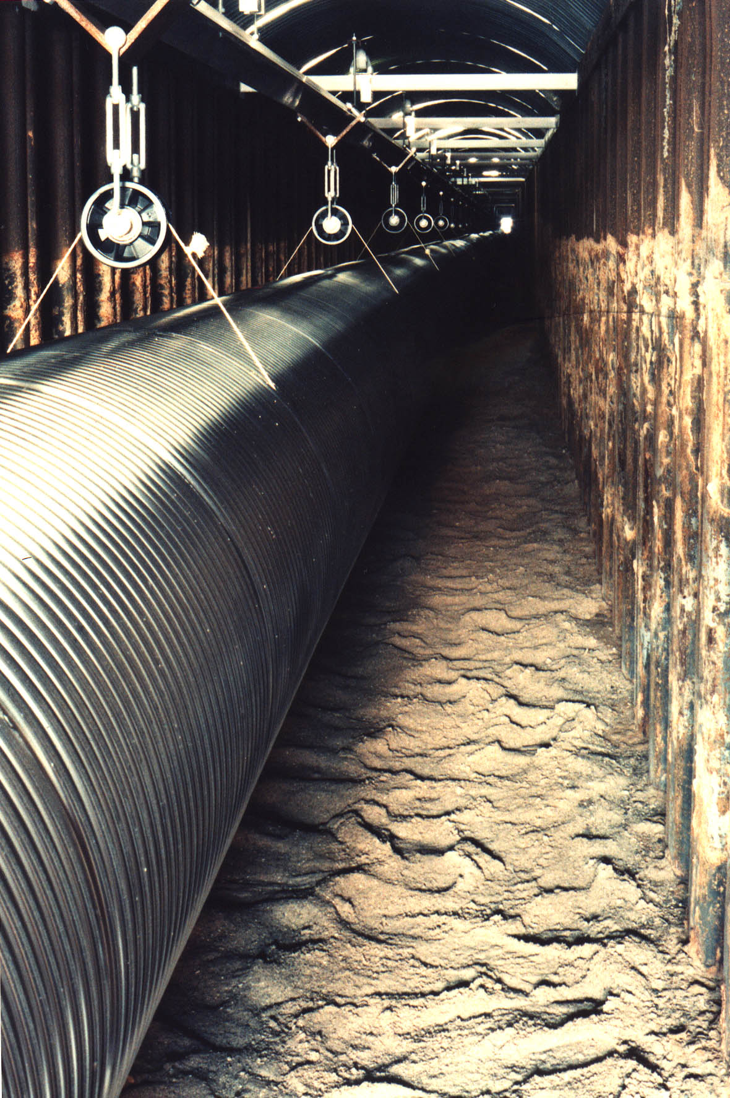
Beam Tubes
Stainless Steel
1.4429 (316LN), cold rolled
60 cm ID
2* 133* 4,5m segments (~85kg each)
[8E-4*pi*0.6*4.5*8000*pi/2]
0,8 mm wall thickness
30 mm wave period; semi-circular
total weight 2* 12 t
Notes:
316LN 1.4429 (UNS S31653) is a lowcarbon (1.4404, 316L), nitrogen-enhanced version of Type 316 molybdenum-bearing austenitic stainless steel. The Type 316 alloys are more resistant to general corrosion and pitting/crevice corrosion than the conventional chromium-nickel austenitic stainless steels such as Type 304. They also offer higher creep, stress-rupture and tensile strength at elevated temperature. The nitrogen in Type 316LN adds additional resistance to sensitization in some circumstances.

Slide 5
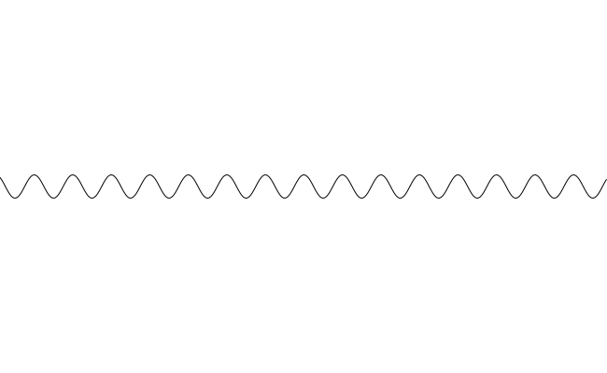
Making the Beam Tube segments
Manufacturing steps:
Bend to form tube,
weld longitudinally
Corrugate
Clean, leak test
Lip weld sections
3cm

Slide 6
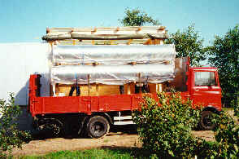
Installation of the beam tubes
Transport (> Mai 1996)

Slide 7
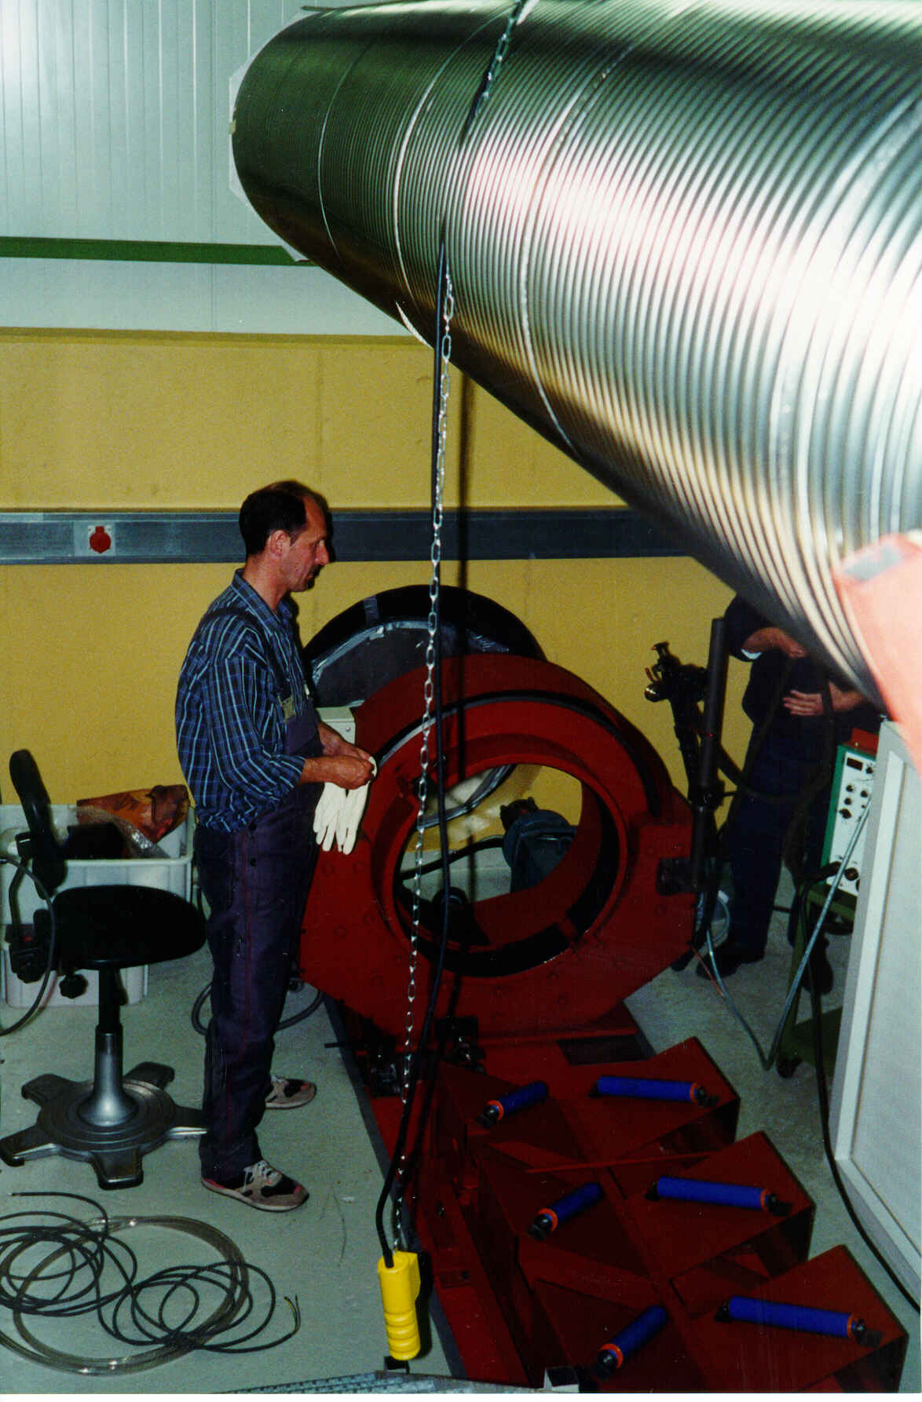
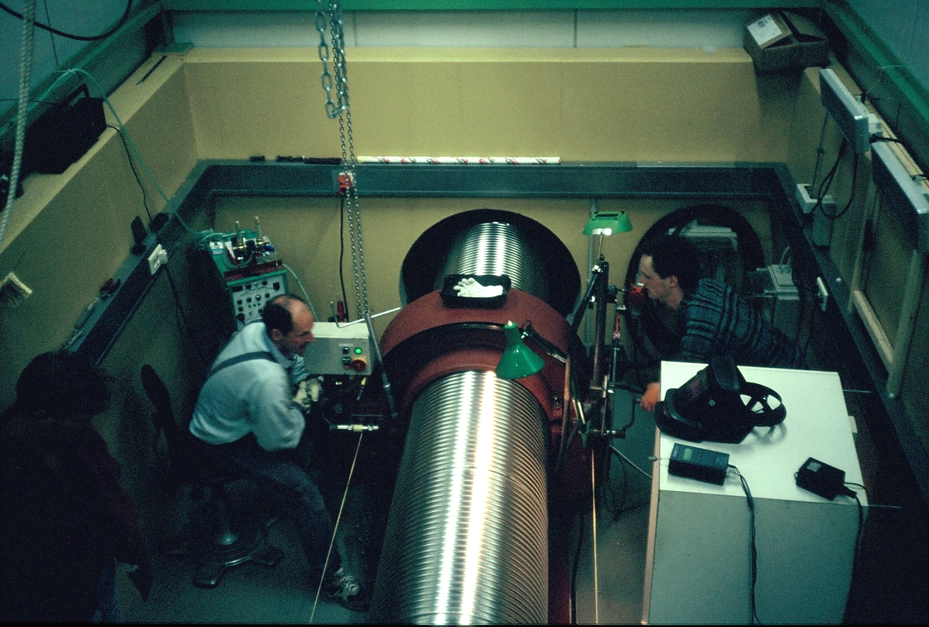
Joining the segments

Slide 8
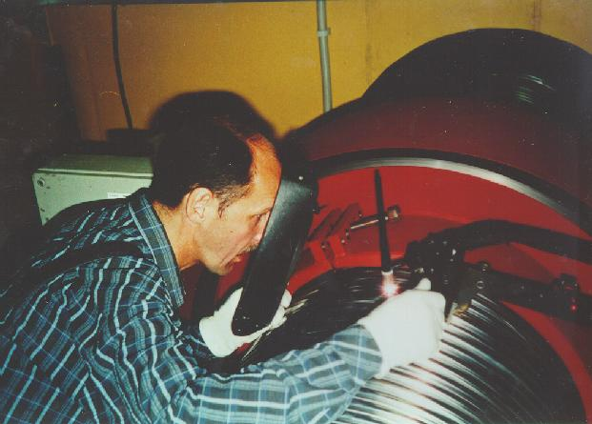
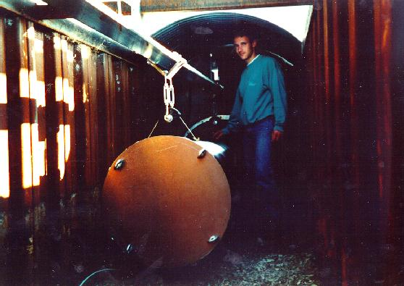

Slide 10
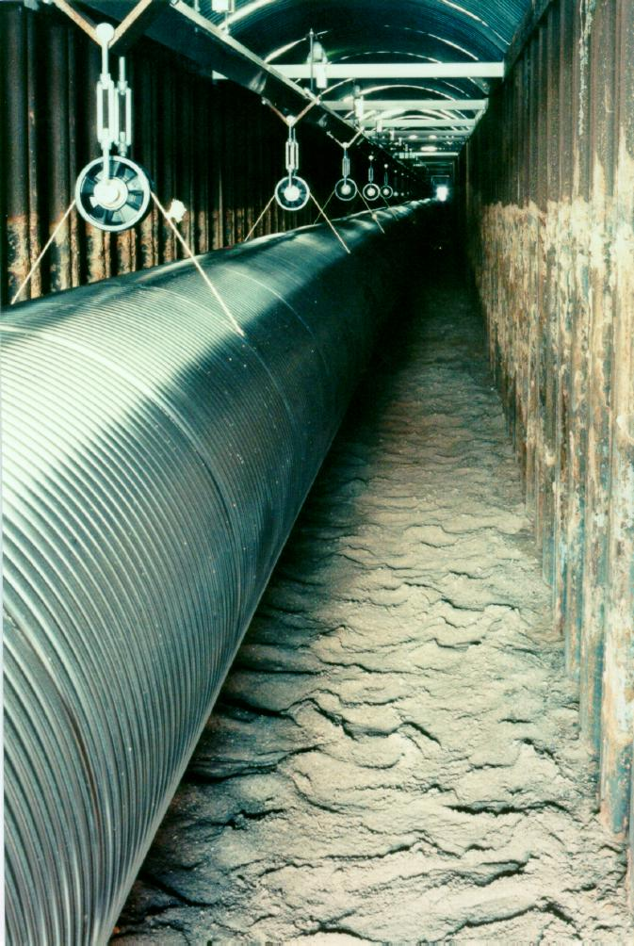
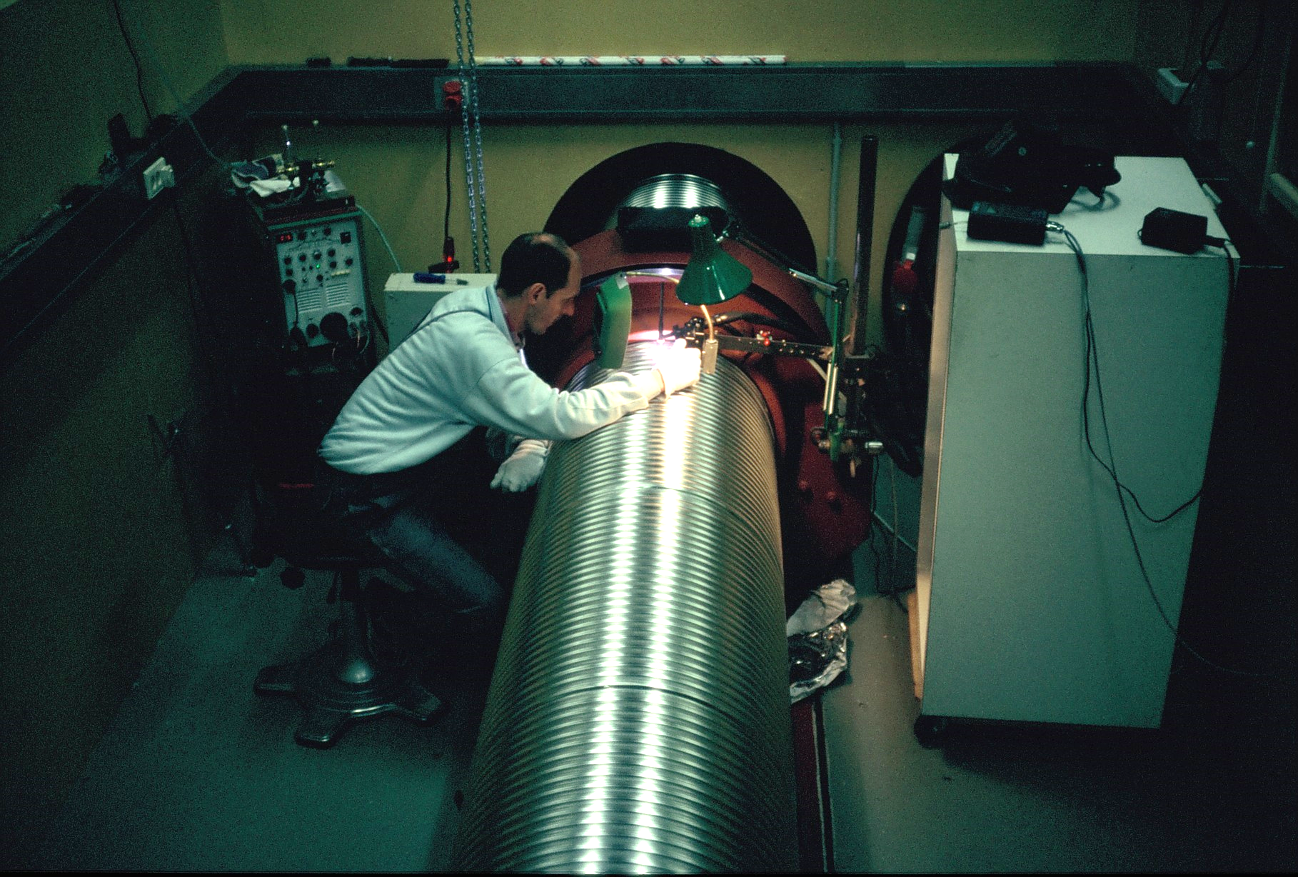
A year of welding

Slide 11
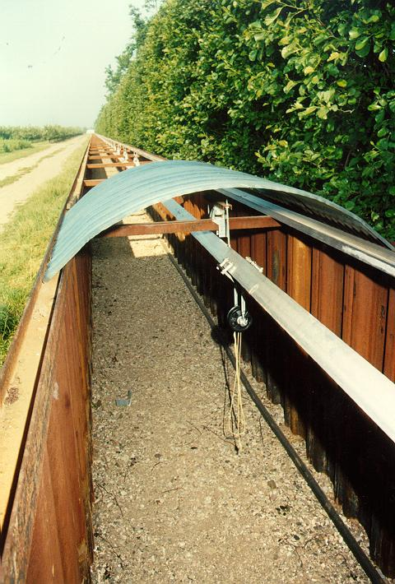
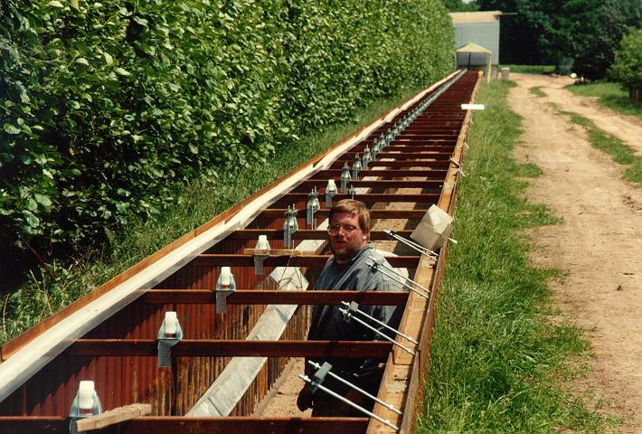
Installation of the tubes
June 1996
600m rail
(later used as current return path)

Slide 12
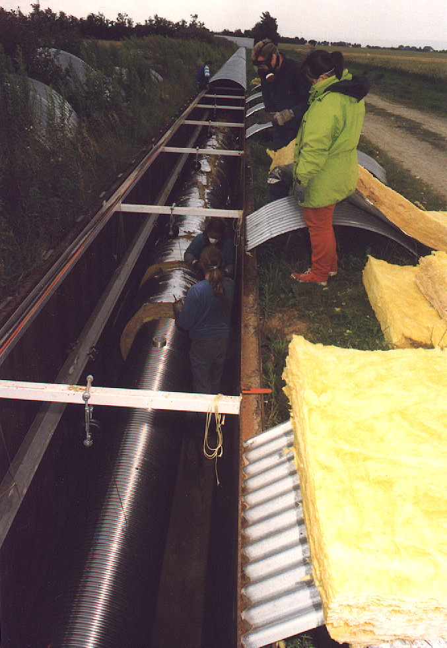
Baking the tube
Isolation: 20cm rockwool Heating: 300V/600A DC
0.5 Ohm/ 600m
→ 800 mΩ/km
= 180kW → 300W/m
Passivation in air
(dried with silica gel):
2 days @ 200°C
Vacuum bake:
5 days @ 250°C

Slide 13
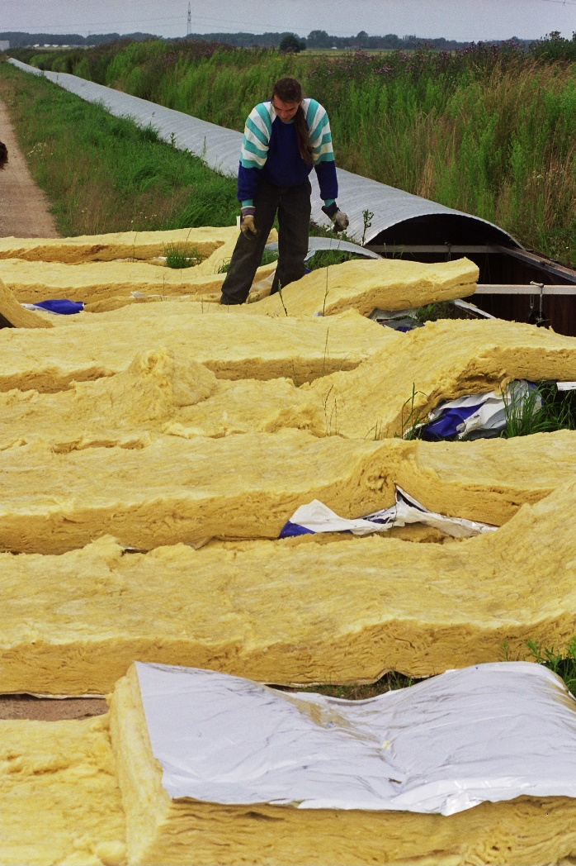
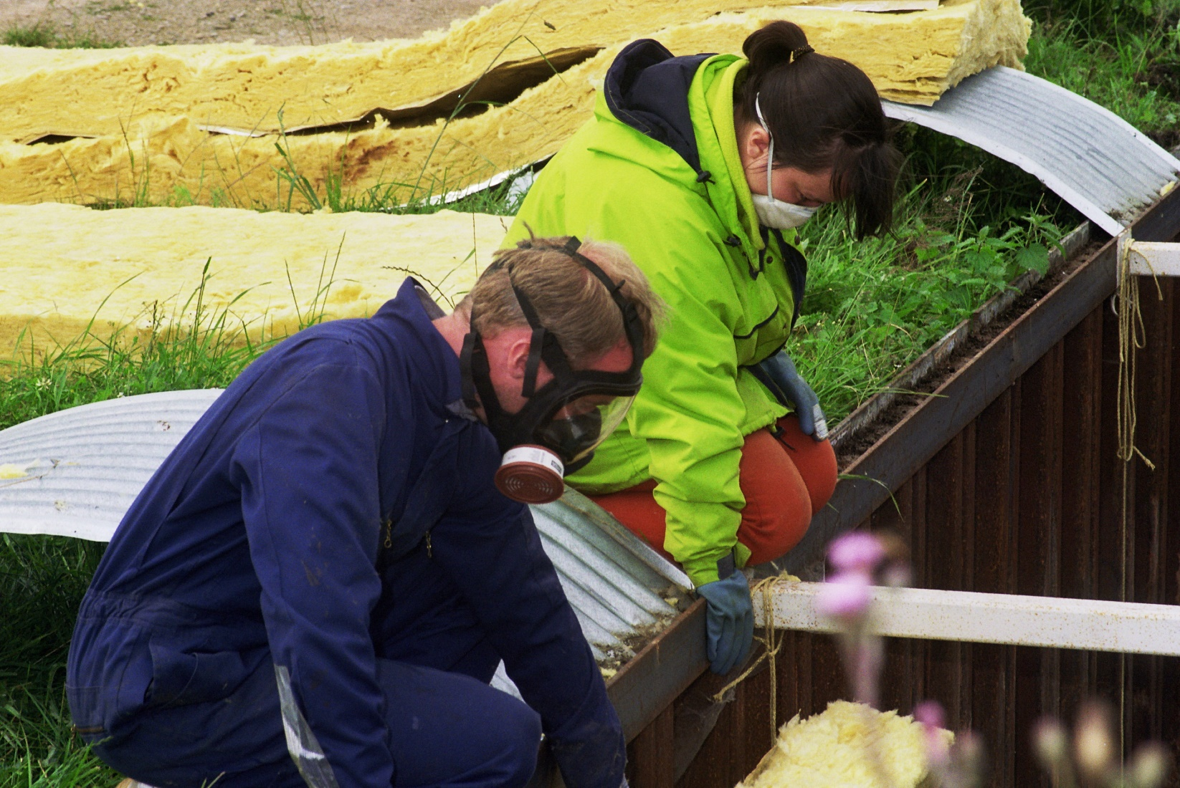
Insulating the tube

Slide 14
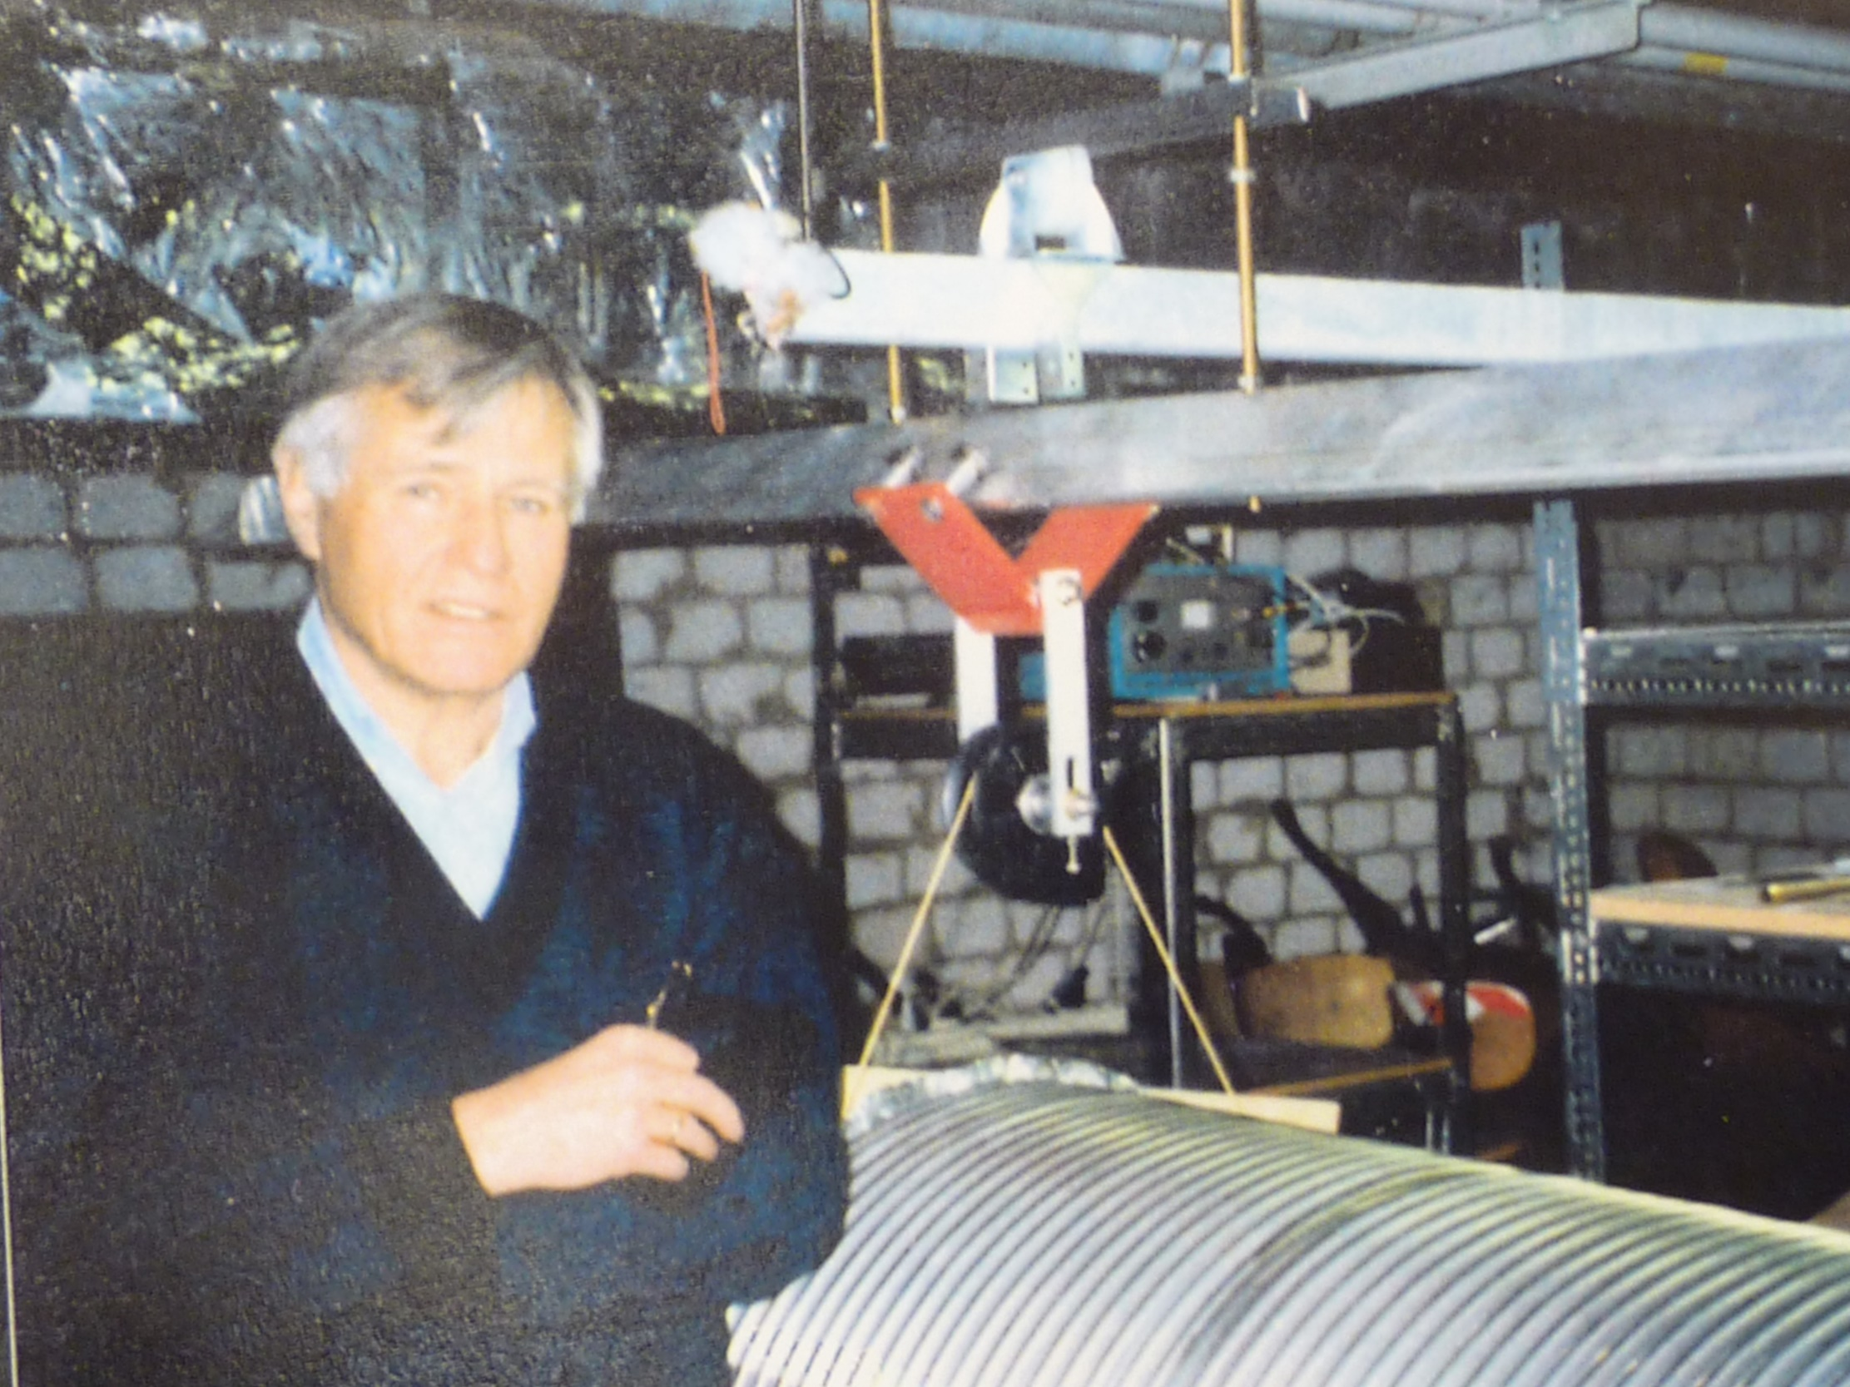

Slide 15
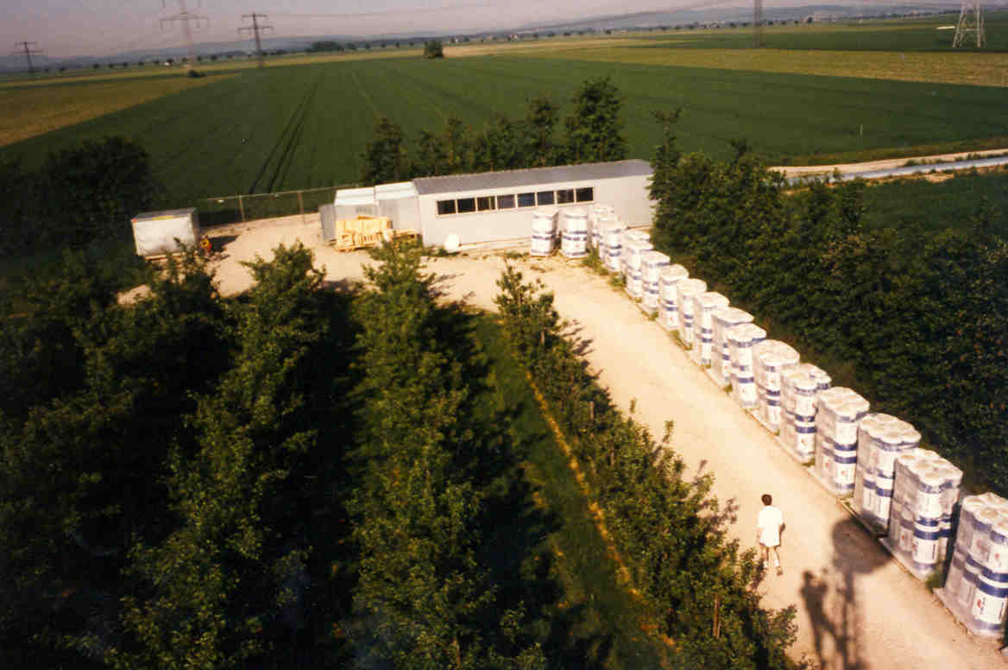

Slide 16
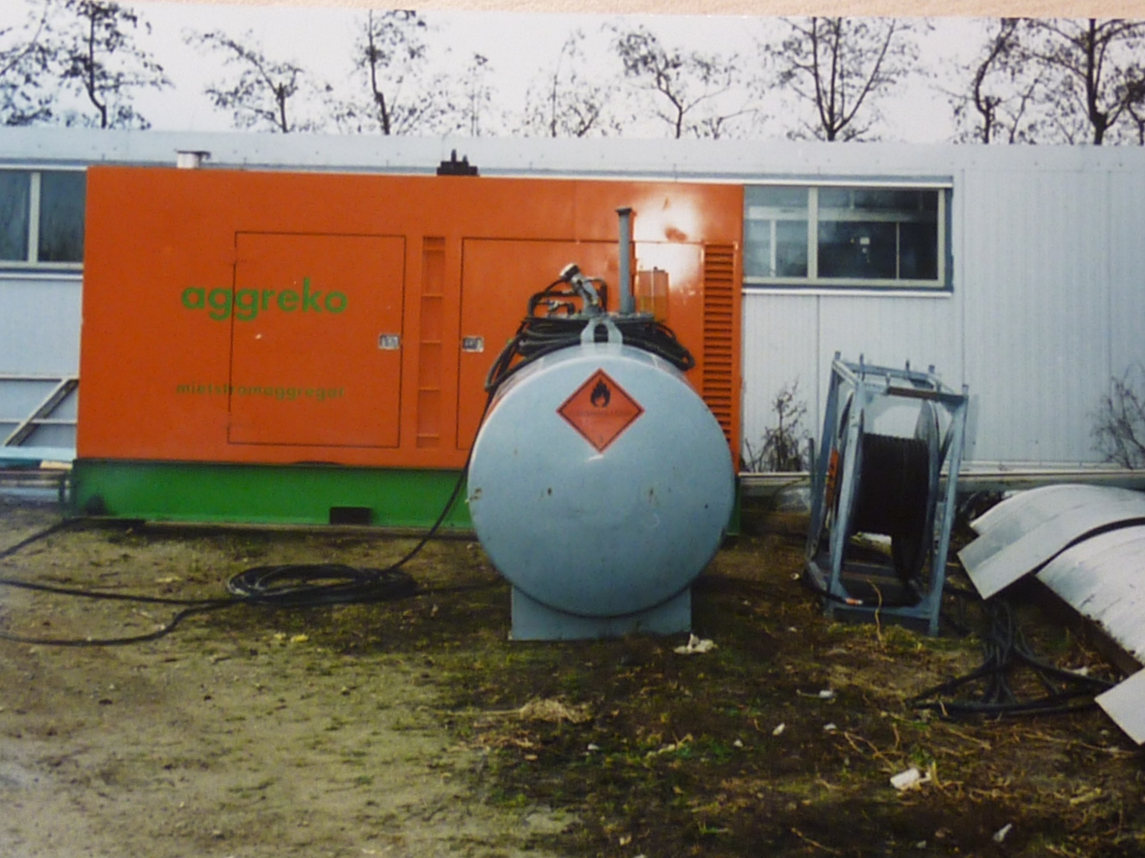
Baking
Emergency Diesel
350kW

Slide 17
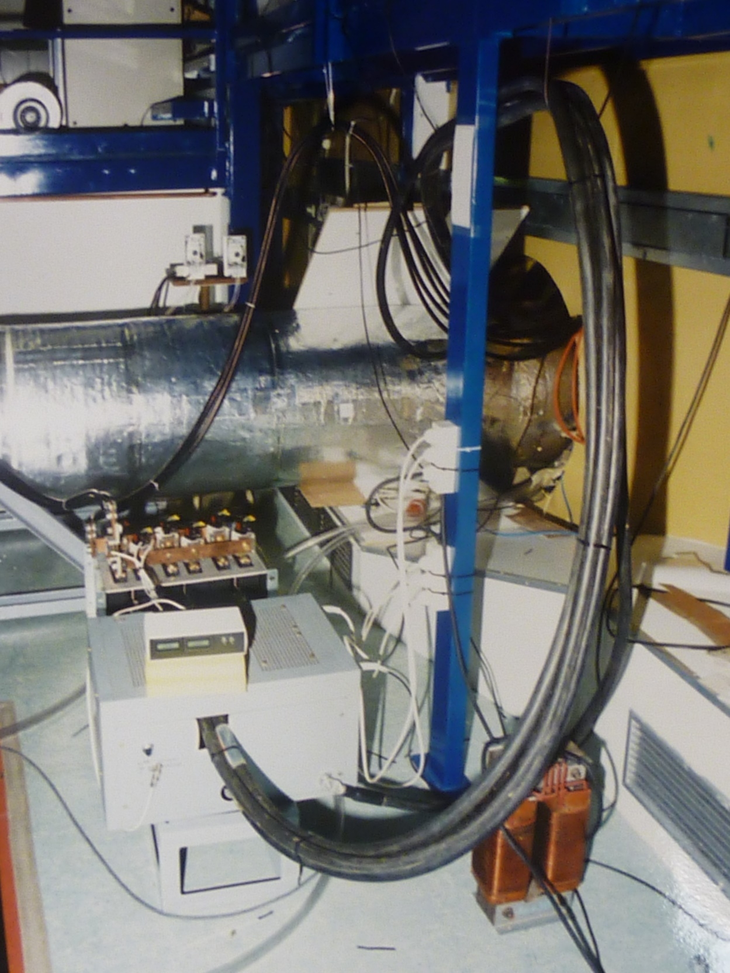
Rectifier & Current control

Slide 18
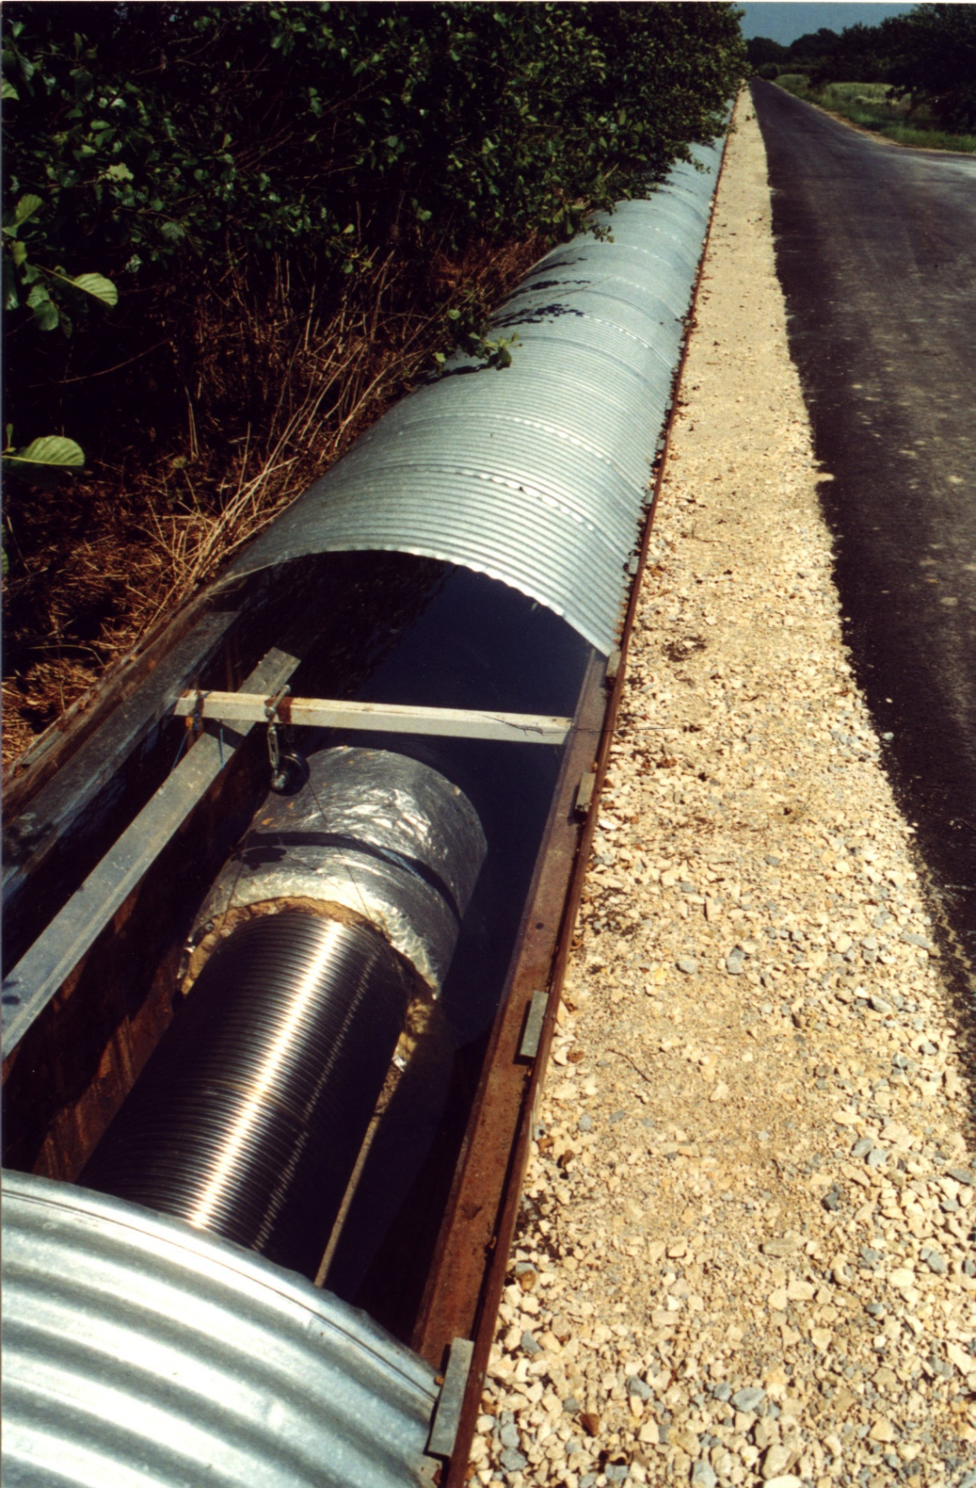
In situ Leak check
Wrap 3m section of plastic foil around the tube
and flush with He.
Observe with RGA @ tube ends.
Reaction time < few seconds. Very sensitive…
5 leaks in total.
Fixed with Ceramabond. Some welded? TBC
two subsequent leaks after ca. 20 years:
MIC on top of tube. Marten droppings.
Corrosion @ SS304 (1.4301) hand valve in trench
304 much less corrosion resistant than 316LN
under GEO600 trench conditions!

Slide 19
GEO600 Beam Tubes
Pros:
weight →
  simpler handling
  simpler mounting
less material -> low costs / good material affordable
axial elasticity → no need for bellows
high electrical resistance → lower current for baking required for same power/length
Cons:
not bulletproof (US criterion)
factor p/2 surface increase (can be lowered by shallower corrugation)
More challenging to clean in situ due to corrugation

Slide 20
Partialdrücke im Ostrohr (unkalibriert)
Pressure in East Tube
27.01.2000
RGA only calibrated to total pressure gauge!
1E-08
Rohr
Some remaining leaks in tank cluster sections.
Tubes leak free.
Lecks
1E-09
Wasser
Filamente
1E-10
Pressure [hPa]
1E-11
1E-12
1E-13
1E-14
1
11
21
31
41
51
61
71
81
91
Mass [amu]

Slide 21
Ausgasraten im Ostrohr
27.01.2000
1E-12
Rohr
Lecks
1E-13
Wasser
Filamente
1E-14
Ausgasrate [mbar l/s cm²]
1E-15
1E-16
1E-17
1E-18
1
11
21
31
41
51
61
71
81
91
Masse [AME]

