Slide 1
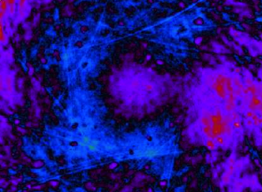

Surface distortions and optical losses
Charlotte Bond
University of Birmingham
ET meeting, Hannover,
December 2012

Slide 2
Overview
Types of mirror distortion
Modeling real mirrors in simulations
Describing the effects of surface distortions
LG₃₃ investigation: coupling approximation
Testing results: FFT simulations
Testing results: future experiments

Slide 3
What are mirror surface distortions?

Slide 4
Mirror surface distortions
The deviation of a mirror surface from an ideal surface can be divided into different categories:
  Measured deviation from perfect sphere.
  Environmental effects (thermal effects, gravity sag etc).
  Scratches and point defects.
Our aim is to model realistic mirror surfaces and understand the effect these will have on the detectors.
  Simulations for Advanced LIGO commissioning.
  Derivation of requirements for future detectors.

Slide 5
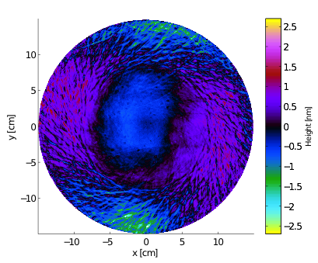
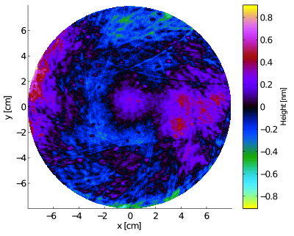
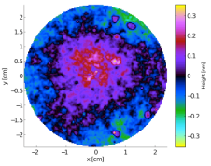
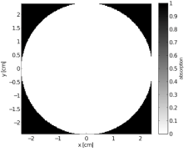
Advanced LIGO mirror maps
Measured mirror maps representing mirrors from the Advanced LIGO project are now available (GariLynn Billingsley).
High quality polishing results in extremely low rms figure error.
The mirror maps can be used easily in simulations.
aLIGO map ETM08:
central 30cm
rms = 0.52nm
Mirror maps
Phase maps:
Surface height data
Optical center (x₀,y₀)
Scaling of x- and y-axis
Points defined outside the mirror
The term ‘mirror map` refers to a grid of data describing an optical property over the surface of a mirror.
Different types of mirror map: phase (surface height) maps, absorption maps and reflectivity maps.
aLIGO map ETM08:
central 16cm
rms = 0.17nm
Phase map
Aperture maps:
Absorption data (complete absorption outside aperture)
Optical center (x₀,y₀)
Scaling of x- and y-axis
Aperture map
Notes:
Extensive work carried out to characterize surface defects of aLIGO mirrors
Result: Mirror maps which detail the surface height of the mirror and can be used in our simulations.

Slide 6
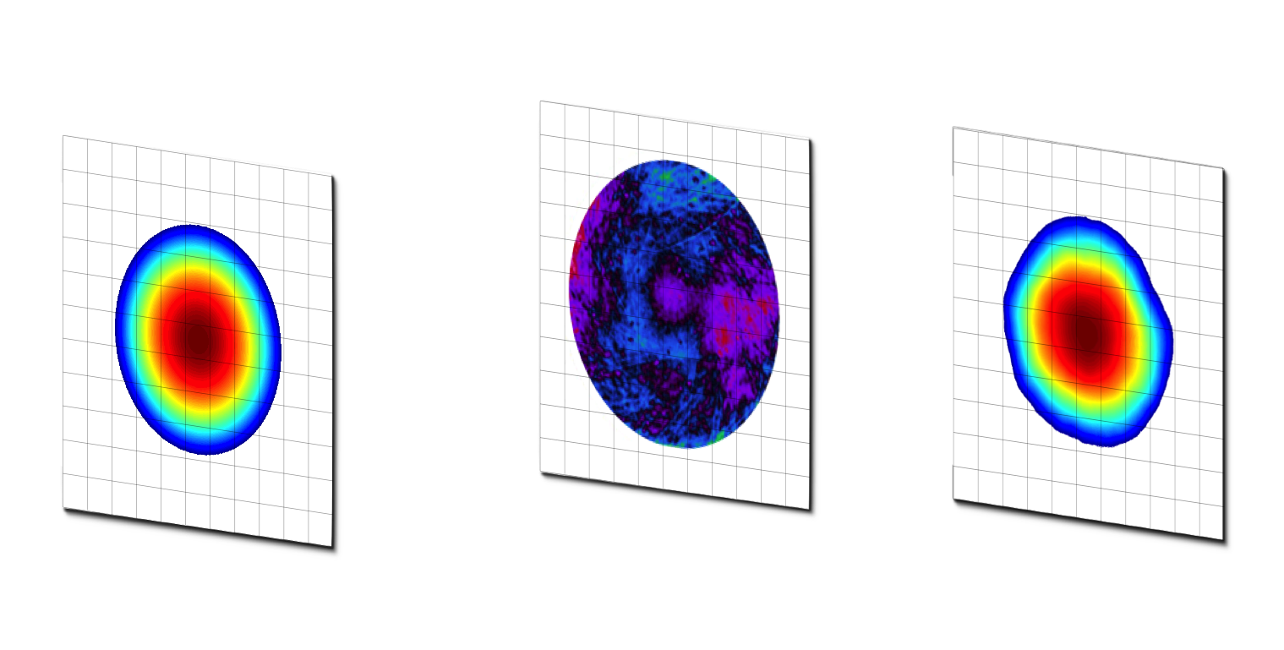
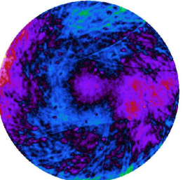
Using mirror maps in simulations
FFT codes
input field
mirror surface
output field
The effect of a mirror surface is computed by multiplying a grid of complex numbers describing the input field by grid describing a function of the mirror surface.
Modal models
input field
output field
Coupling coefficients
mirror map
Matrix of coupling coefficients calculated from the mirror map transform the input field described by HG amplitudes into the output field described by HG amplitudes.

Slide 7
Our approach: Modal methods
FINESSE

Slide 8
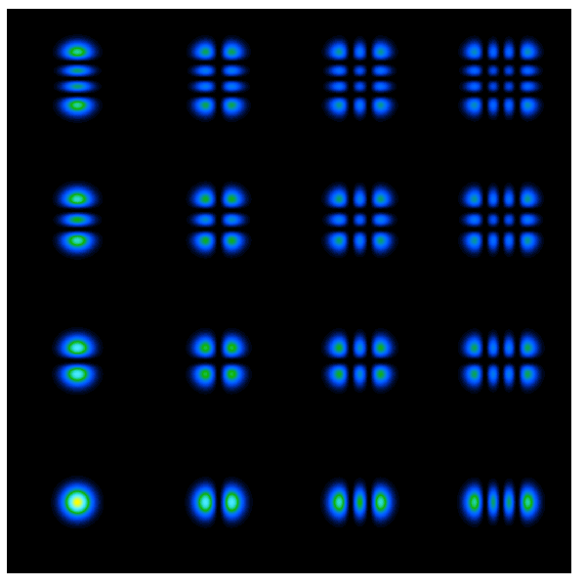
Modal models
Modal models exploit the fact that a well behaved interferometer can be well described by cavity eigenmodes.
Light fields with different spatial distortions can be described by a series expansion:
m
u_{nm} are HG modes in Finesse
n
Hermite-Gauss modes: Complete set of functions which describe beam shapes with rectangular symmetry of cavity eigenmodes.
Maxtem: Value in Finesse specifying the
number of modes to be used.
Notes:
Complicated light fields can be described by a sum of modes
In theory need infinite modes, in practice can describe very complicated ilght fields with limited modes (maxtem <10)

Slide 9
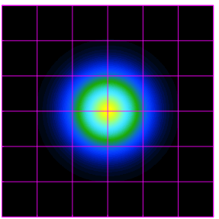
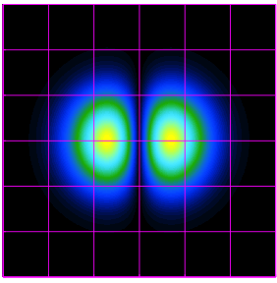
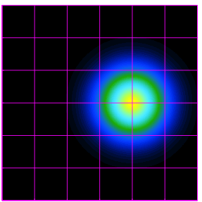
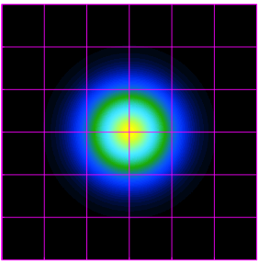
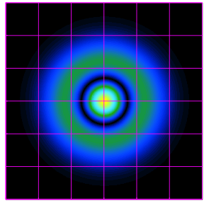
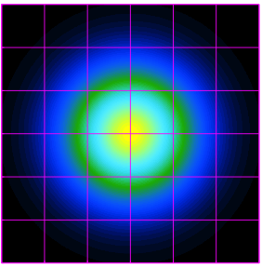
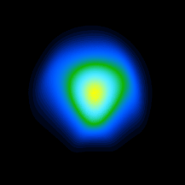
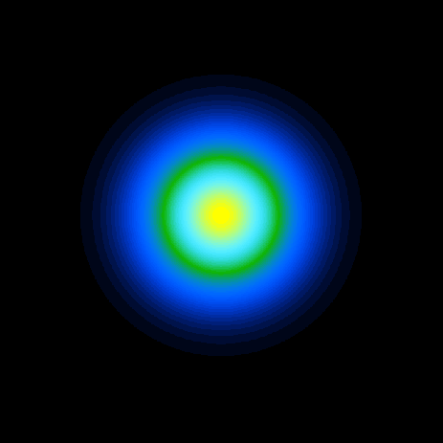
Describing effects with modes
Beam shift
small misalignments
of the beam
Beam size
small curvature
mismatch between
beam and mirror
Surface distortions
Edge effects
Order 1
Simple, small effects can be described well with just one HOM.
HG00
HG10
Shifted HG00
Order 2
LG00
LG10
Large LG00
Order 1 - 10
More complicated effects require more modes.
Order 1 - 15+

Slide 10
Let’s look at an example using the higher order mode LG₃₃

Slide 11
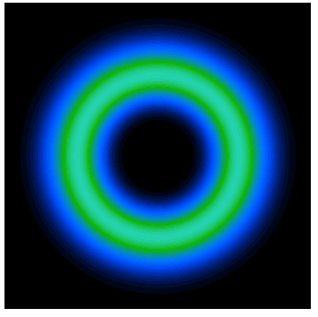
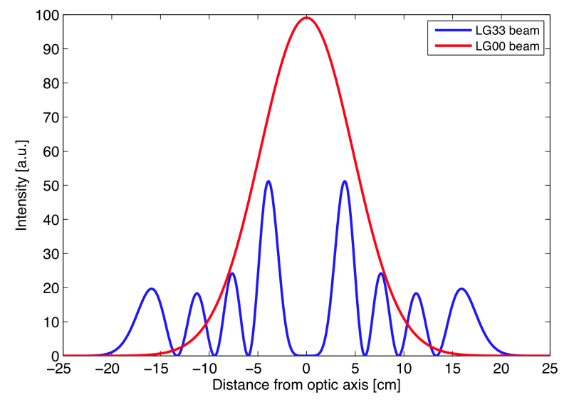
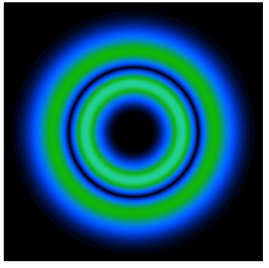
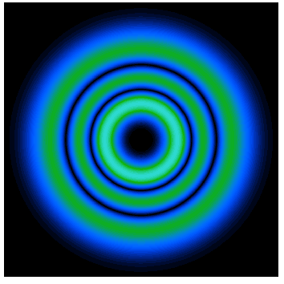
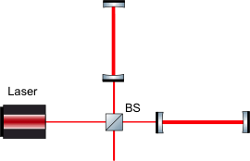
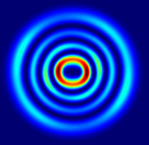
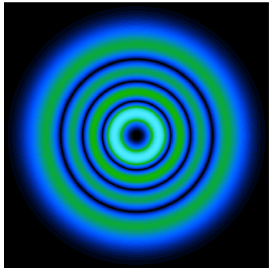
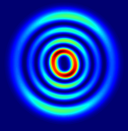
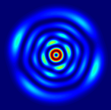
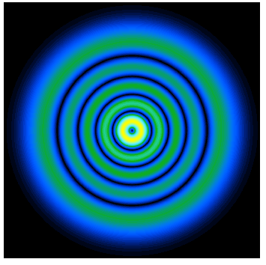
Example: LG₃₃ investigation
LG0±9
Higher order mode degeneracy
LG₃₃ mode proposed for its potential to reduce the thermal noise of the test masses.
10 modes of order 9 which will all be resonant in the arm cavities.
LG1±7
LG2±5
Potential problem
Coupling into the order 9 modes leads to highly distorted circulating beams.
Surface distortions and modes will be different in each arm, potentially resulting in an unacceptably high contrast defect at the output.
LG3±3
LG4±1

Slide 12
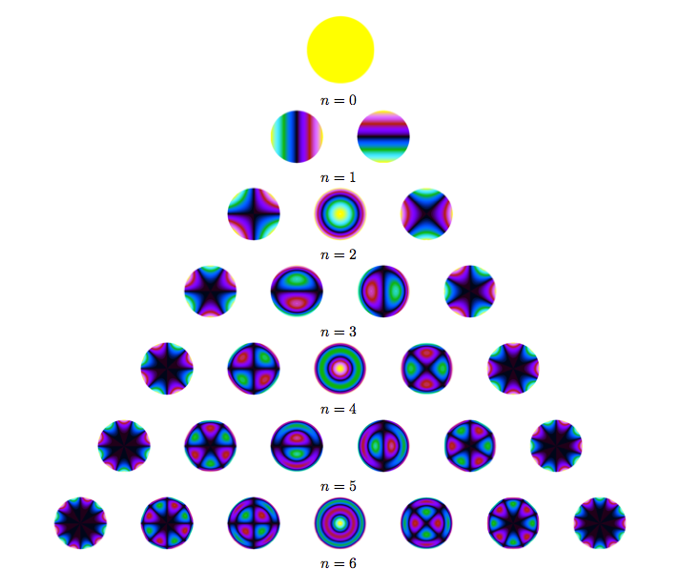
Coupling approximation: Zernike polynomials
Zernike polynomials, Z_{n,m}, form a complete set of orthogonal functions which describe wave fronts over a unit disc. Defined by radial index (n) and azimuthal index (m).
n
Coupling coefficients from individual polynomials are calculated:
Mode | m
2, 5 | 2
4, 1 | 2
1, 7 | 4
4, -1 | 4
0, 9 | 6
3, -3 | 6
2, -5 | 8
1, -7 | 10
0, -9 | 12
Solving an approximation of k we get an azimuthal condition for coupling:
m required for coupling from LG₃₃ to the other order 9 LG modes

Slide 13
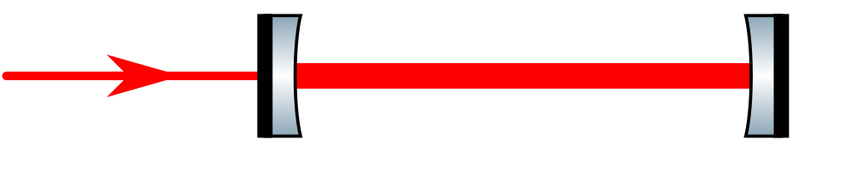
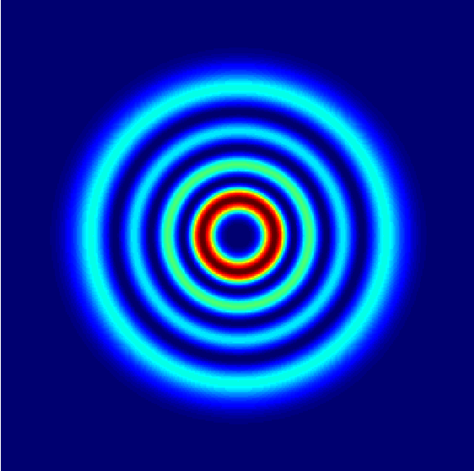
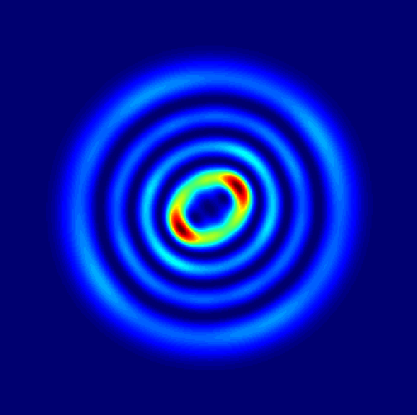
LG₃₃ investigation: results
High finesse cavity simulated with an LG₃₃ input beam and aLIGO map applied to ETM.
ITM
ETM
Mode | Power [%]
3, 3 | 88.6
4, 1 | 5.70
2, 5 | 5.02
4, -1 | 0.333
1, 7 | 0.313
other | < 0.05
Direct coupling from etm08 calculated using Zernike approximation.
Polynomial | 2, 2 | 4, 2 | 4, 4 | other
Amplitude [nm] | 0.908 | 0.202 | 0.231 | -
Power [ppm] | 4.66 | 0.331 | 0.0431 | < 0.01
We expect LG₄₁ and LG₂₅ to have large amplitudes in the cavity
Large presence of LG₄₁ and LG₂₅ in the circulating beam in Finesse model agrees with the prediction by the coupling approximation.
Pure LG33 input beam
Circulating field with ETM08

Slide 14
LG₃₃ investigation: mirror requirements
Coupling approximation is used to derive mirror requirements.
Requirement: power coupled from individual polynomials < 0.01 ppm.
For the ETM08 example:
Polynomial | 2, 2 | 4, 2 | 4, 4
Amplitude [nm] | 0.042 | 0.035 | 0.10
 | Original ETM08 | Adapted ETM08
Direct coupling into order 9 [ppm] | 6.8 | 0.043
Circulating field impurity [ppm] | 114,000 | 815
See Ludovico Carbone’s talk on ‘Higher order Laguerre-Gauss modes for future GW detectors’
[1] See Bond et al. Phys. Rev. D, 2011, 84, 102002

Slide 15
Checking modal results against FFT:
Thermal challenge by Hiro Yamamoto

Slide 16
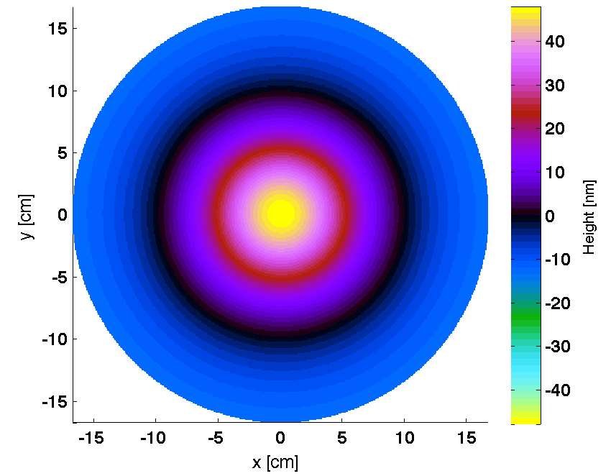
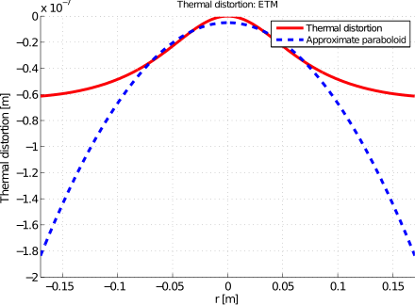
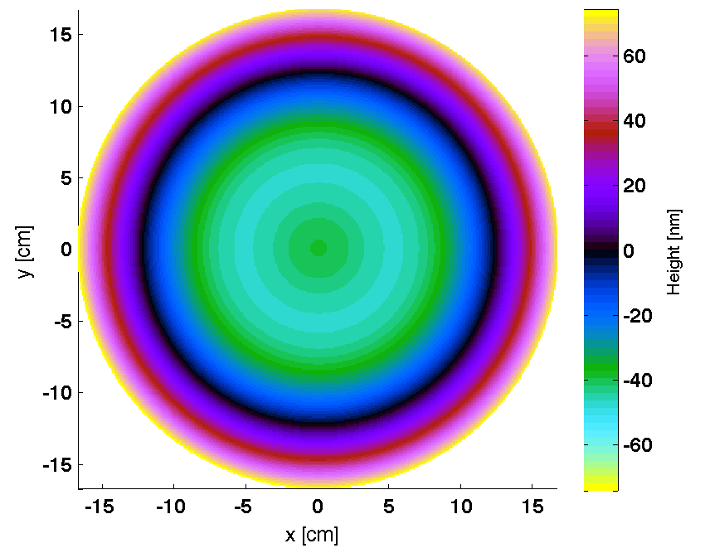
Thermal distortions as mirror maps
ETM thermal map
Challenge: compare results of FFT with Finesse with maps representing thermal distortions.
To represent the thermal distortions in Finesse mirror maps were created using the Hello-Vinet formula.
ETM thermal map with curvature removed

Slide 17
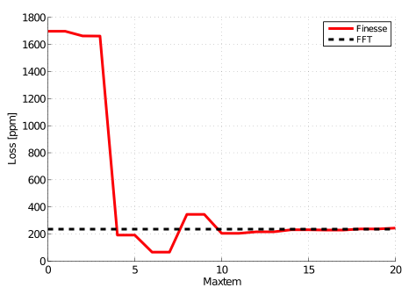
Thermal distortions: comparing with FFT
Plot comparing round trip loss from Finesse and FFT models for the case of thermal distortion of the ETM.
Conclusion: the modal modal converges towards the FFT result. Good agreement is reached when modes up to order 10 - 15 are used.

Slide 18
Future experimental investigations: comparing simulation with experiment

Slide 19
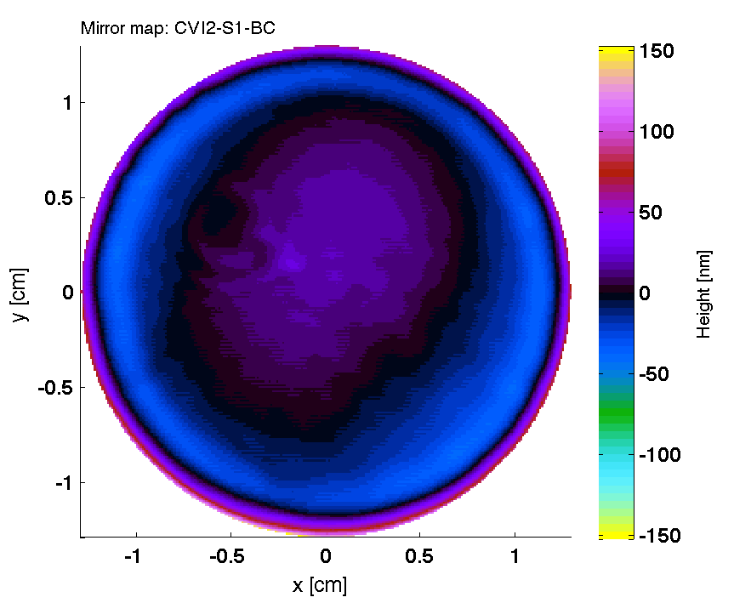
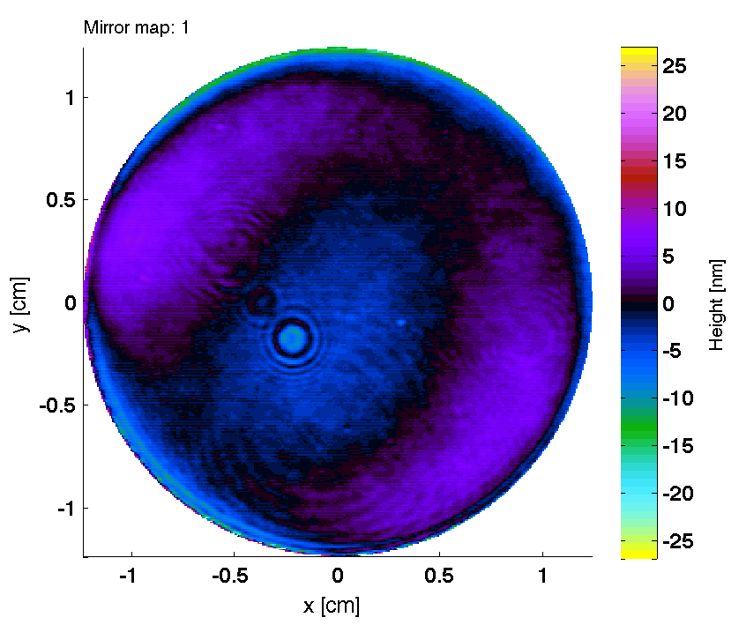
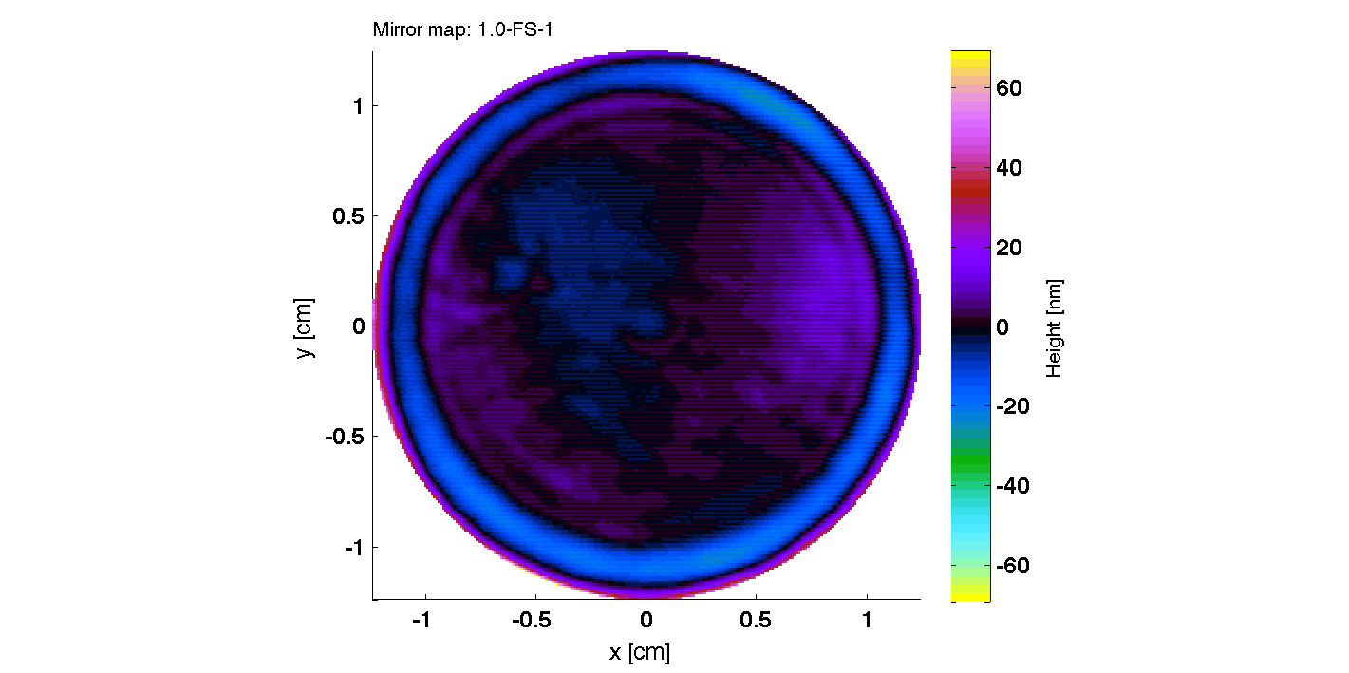
Experimental work: using mirrors with known maps
We want to measure losses in a cavity with known surface distortions for comparison with simulations.
A range of cavity mirrors from Coastline Optics with different specifications.
Mirror maps provided before coating (Coastline Optics).
We will carry out tests using different beam spot sizes to thoroughly test the effects of different distortions and compare them with simulations using the relevant maps.
We will also carry out tests using an LG₃₃ input beam.
End mirror on rail to experiment with different beam sizes.

Slide 20
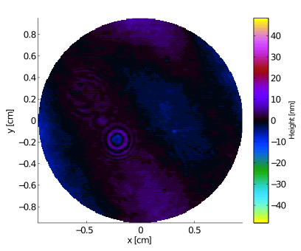
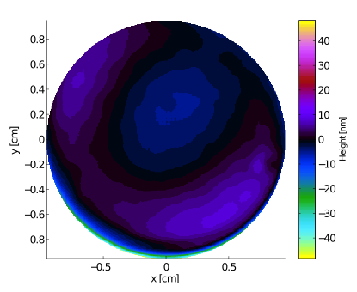
Mirror distortions: before and after coating
For the flat mirrors we have maps before coating (Coastline Optics) and after coating (LMA). We can analyze how the coating process effects the shape of the mirrors.
Before coating
After coating

Slide 21
Summary
Mirror distortions and thermal effects need to be better understood to increase the sensitivity of the detectors.
We have developed the analytic and simulation tools needed to analyze these effects.
Our next step is to help characterize the mirror distortions for Advanced LIGO commissioning.
Finally these tools and experience can be used to derive mirror requirements for future detectors, such as ET.

Slide 22
Thank you for listening

Slide 23
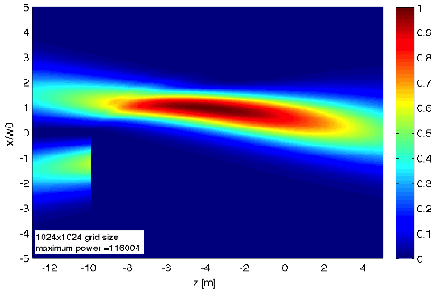
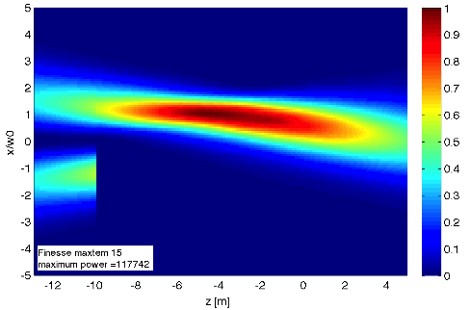
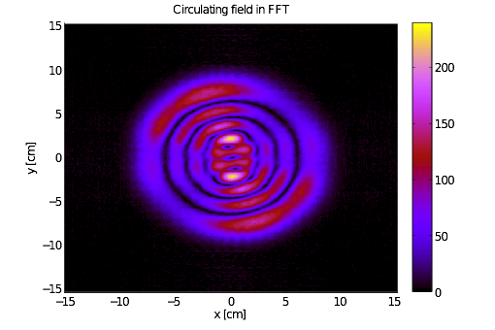
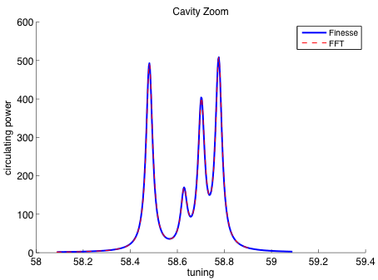

Other examples
Edge effects
LG₃₃ with mirror maps
FFT
Finesse
FFT
LG₃₃ in triangular cavities
Finesse

Slide 24
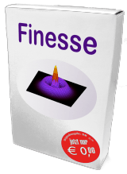
Finesse available as open source
Main page: http://www.gwoptics.org/finesse/
  Executable
  Documentation
  Finesse examples
  Simtools
  Links to . . .
Source code: http://kvasir.sr.bham.ac.uk/redmine/projects/finesse
  Source code
  Forum
  Bug reports

Slide 25
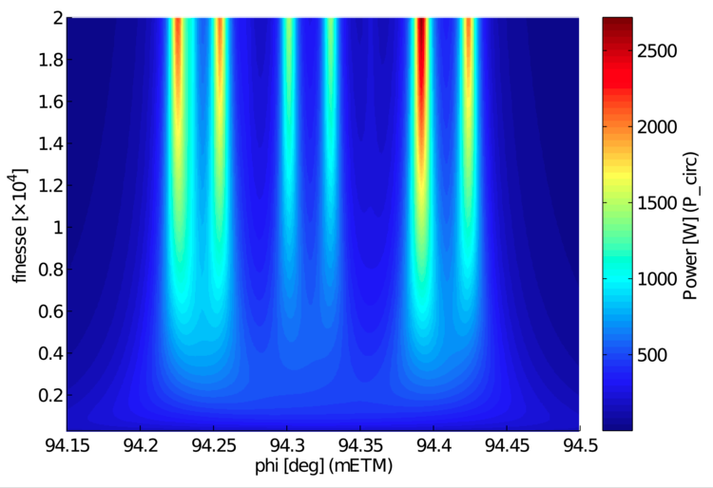
LG₃₃ investigation: frequency splitting

Slide 26
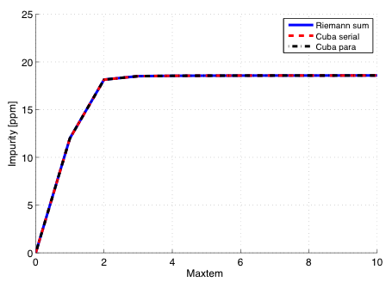
Maxtem
Same results for different routines
Don’t need high maxtem to achieve the right result

Slide 27
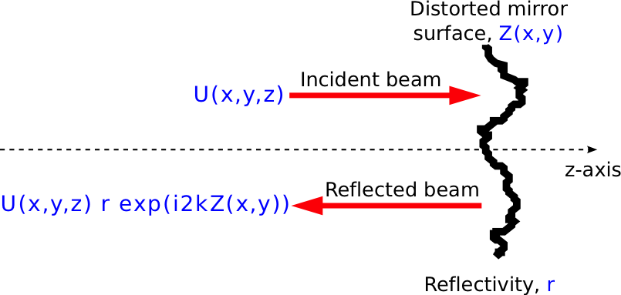

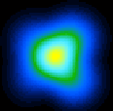
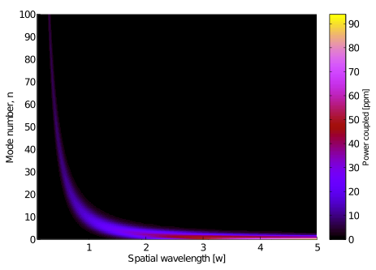
Describing effects of spatial distortions
We are interested in how distortions affect the shape of the beam.
The coupling from one mode to another is described via coupling coefficients:
Input Gaussian beam
Input beam
Distorted output
beam
Output beam
Approximation of scattering into higher order modes described by Winkler [1]
Λ the spatial wavelength, w the beam spot size and A the amplitude of the distortion.
[1] Winler et al, Light scattering described in the mode picture, 1994

Slide 28
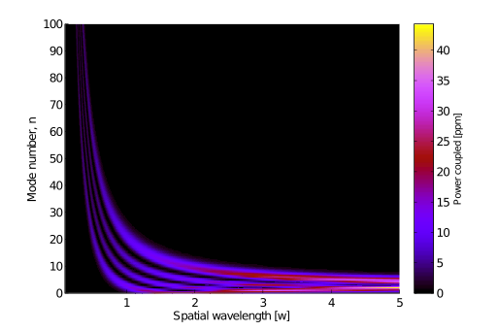

Coupling approximation for LG₃₃
Winkler coupling adapted for incident modes other than n = 0.
Higher order HG modes show more opportunity for coupling.
n = 3
n = 9
Not so suitable for analysis of LG modes.
Consider 2D distortions rather than 1D to try and identify ‘bad’ shapes for order 9 modes.

