Slide 1


4th
Einstein Telescope
Symposium
Hannover, December 4-5, 2012

Slide 2
Symposium [sɪmˈpəʊziəm]: (wikipedia)
The Einstein Telescope Symposium is a key networking event. It is a forum for scientists to debate, plot, boast, or simply celebrate scientific successes with each other.
The Greek symposium was a key Hellenic social institution. It was a forum for men of good family to debate, plot, boast, or simply to revel with others. …
… The participants, or "symposiasts", would recline on pillowed couches arrayed against the three walls of the room away from the door. Due to space limitations the couches would number between seven and nine, limiting the total number of participants to somewhere between fourteen and twenty seven … If any young men took part they did not recline but sat up.
… The men apart of the symposium would discuss a multitude of topics—from philosophy to love and the differences between genders.
… the symposiasts sit at desks lined up in the middle of the room. Due to space limitations the desks number about 25. If young people take part they use chairs without desks and leave the desk places to the seniors.
… the participants discuss a multitude of research topics – from cosmology to their love of science and the difference between theoretical simulations and experiments.

Slide 3
Drinking
Lunch and coffee will be served
Food and wine were served.
A symposium would be overseen by a "symposiarch" who would decide how strong the wine for the evening would be, depending on whether serious discussions or merely sensual indulgence were in the offing. The Greeks and Romans customarily served their wine mixed with water, as the drinking of pure wine was considered a habit of uncivilized peoples …
In keeping with the Greek virtue of moderation, the symposiarch should have prevented festivities from getting out of hand.
The Einstein Telescope Symposium sessions are lead by chairpersons who oversee the presentations, which will be a mixture of serious reporting and exciting graphs and pictures.
The chairperson should prevent the presentations getting out of control, i.e. over time.

Slide 4
Entertainments
Poetry and music were central to the pleasures of the symposium…
Symposiasts might also compete in rhetorical contests.
Feel free to continue this tradition and present your talk as you prefer.

Slide 5
The goal of the meeting
Key questions to be answered
Who are we? (Networking)
Where are we? (Status)
Where do we go? (Goals)
How do we get there? (Future)

Slide 6
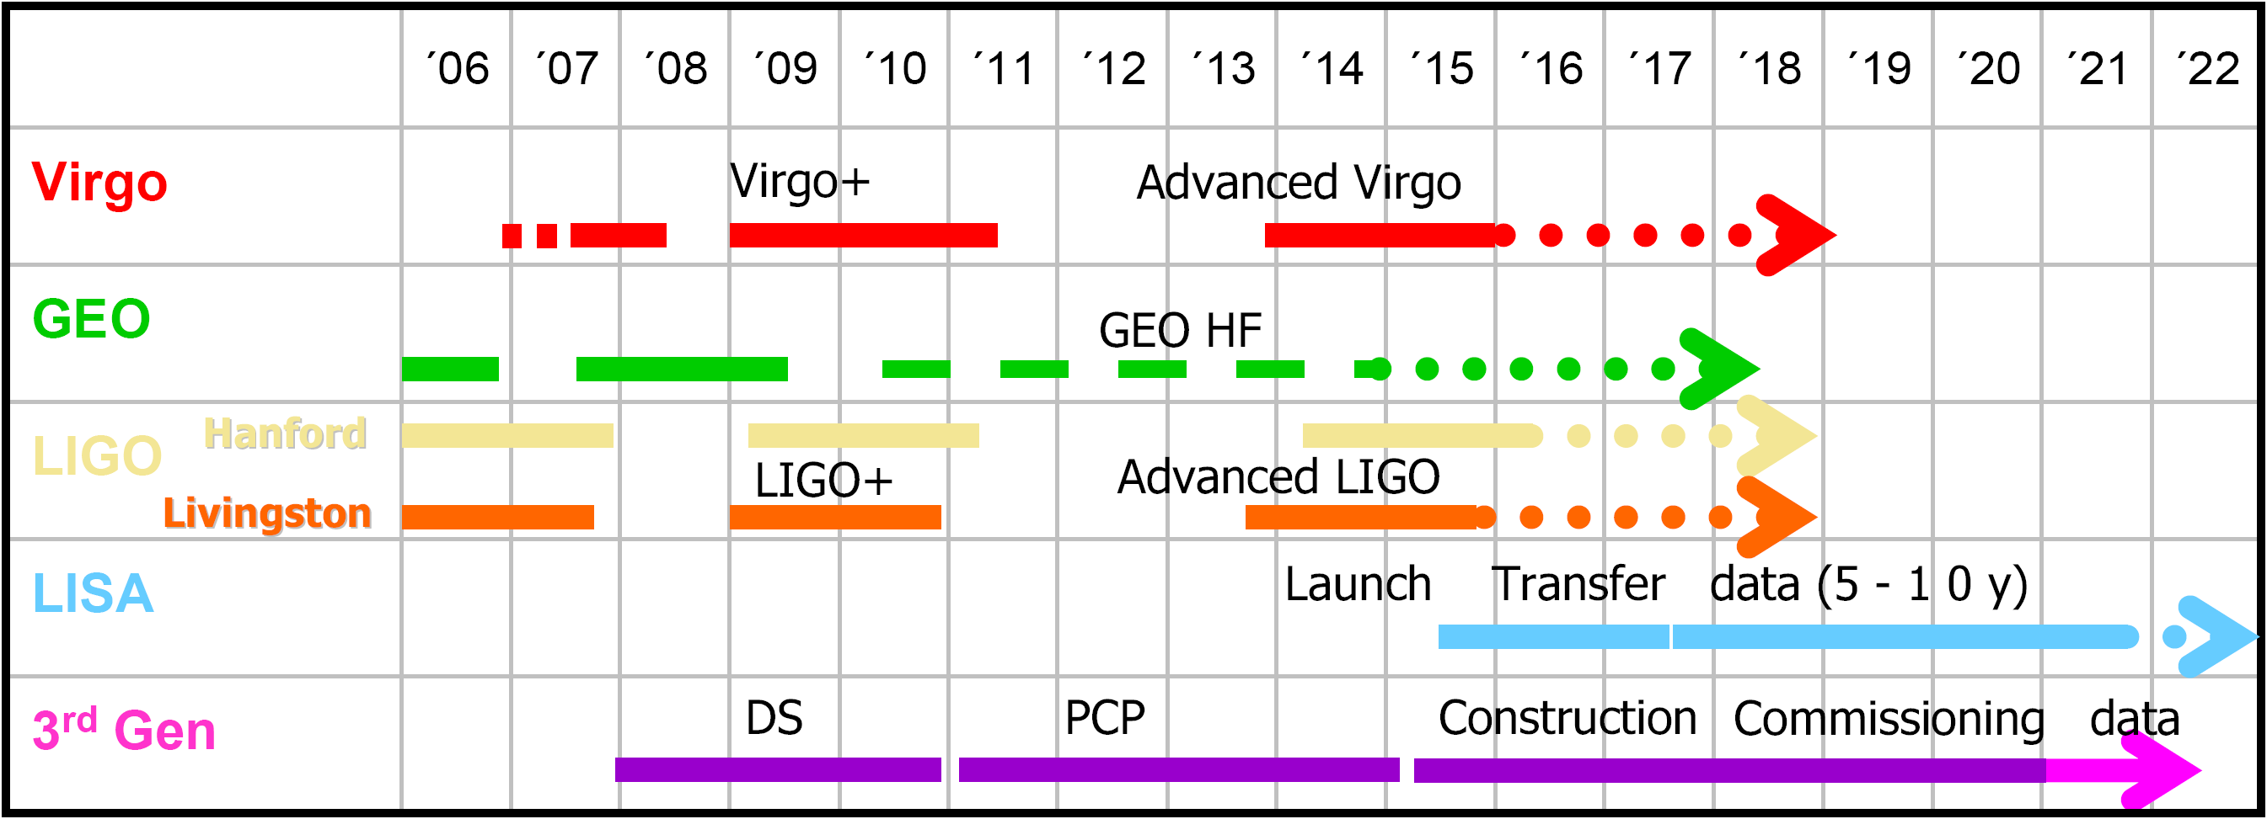
Timelines in early 2007
E.T.

Slide 7
Timelines in late 2007
You are here
 | ´06 | ´07 | ´08 | ´09 | ´10 | ´11 | ´12 | ´13 | ´14 | ´15 | ´16 | ´17 | ´18 | ´19 | ´20 | ´21 | ´22
Virgo
GEO
LIGO
LISA
E.T.
Virgo+
Advanced Virgo
GEO HF
Hanford
LIGO+
Advanced LIGO
Livingston
Launch Transfer data
DS
PCP
Construction
Commissioning
data
1st Generation
2nd Generation
3rd Gen.

Slide 8
GW Timelines
You are here
 | ´06 | ´07 | ´08 | ´09 | ´10 | ´11 | ´12 | ´13 | ´14 | ´15 | ´16 | ´17 | ´18 | ´19 | ´20 | ´21 | ´22 | ´23 | ´24 | ´25
Virgo
GEO
LIGO
KAGRA
E.T.
LISA
Virgo+
Advanced Virgo
GEO 600
Hanford
Hanford
E-LIGO
Advanced LIGO
LIGO 3G
Livingston
Livingston
India
DS
PCP
Site Prep.
Construction
Comm.
data
Launch Transfer
1st Generation
2nd Generation
3rd Generation

Slide 9
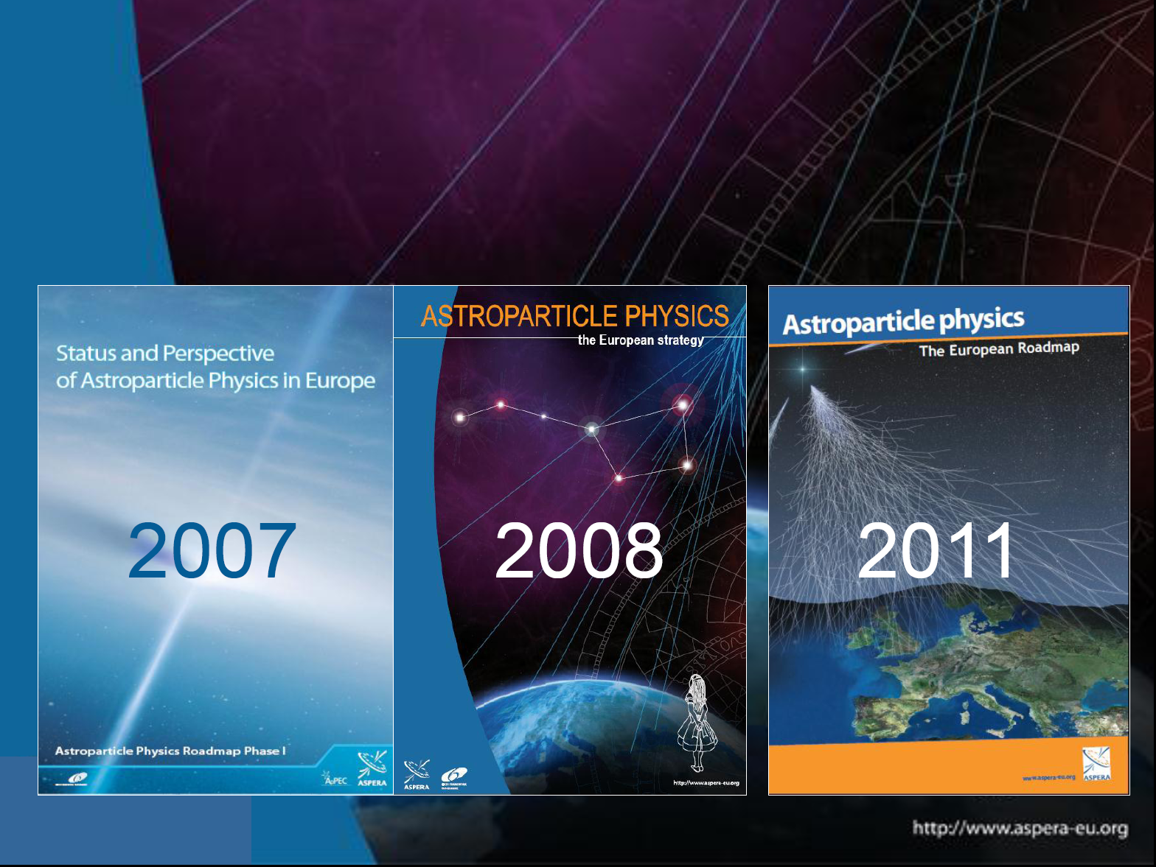
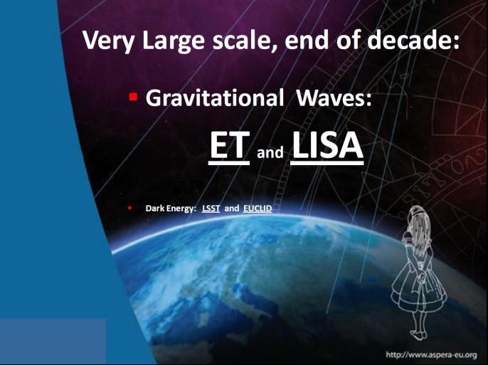
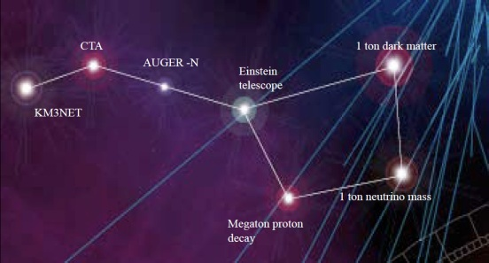
ASPERA Roadmap
Magnificent Seven
includes
ET: Einstein Telescope

Slide 10
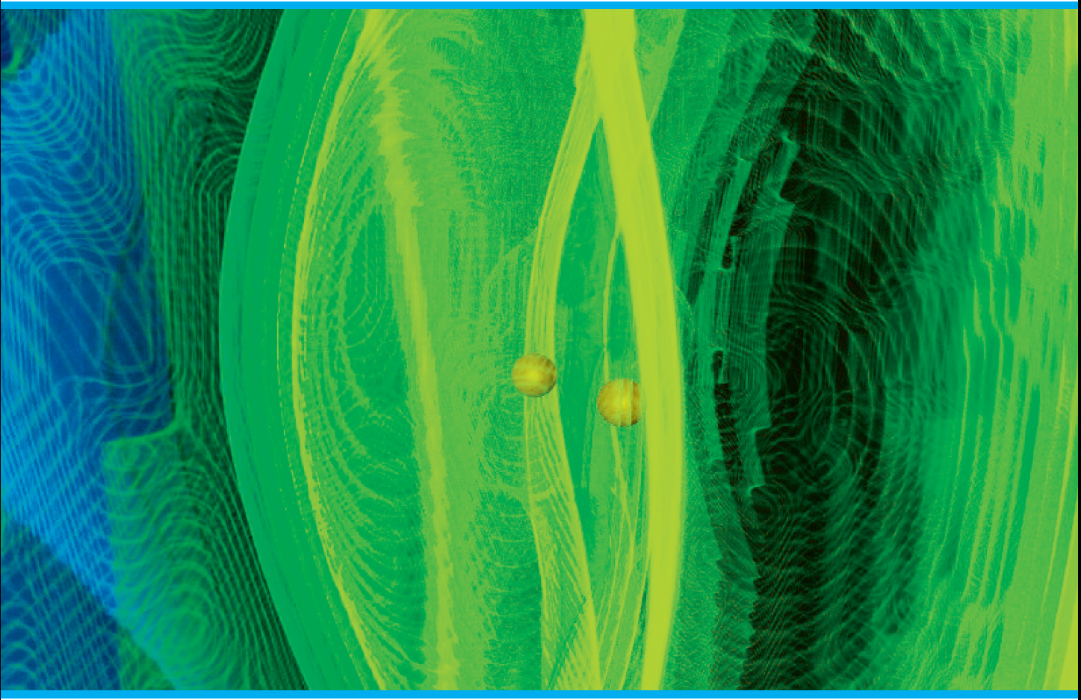


Slide 11
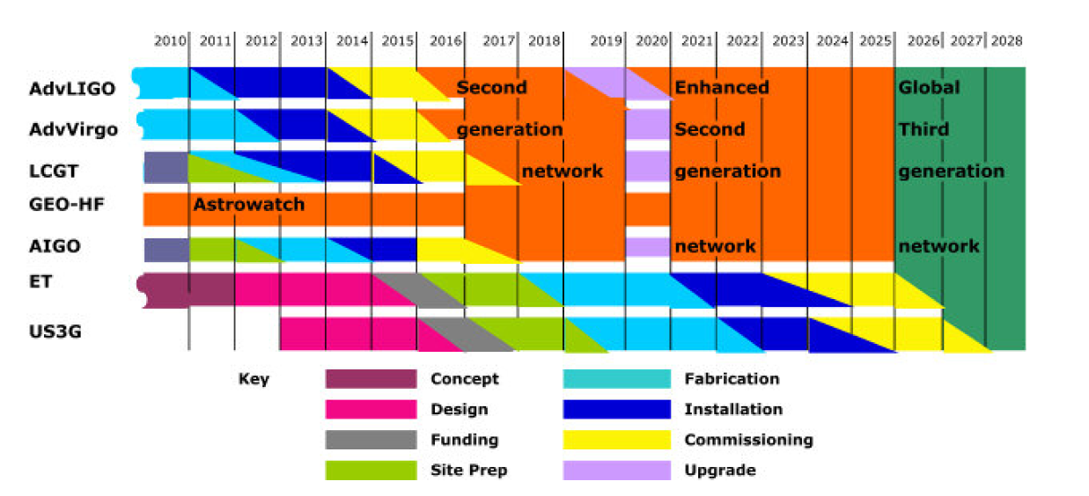
GWIC roadmap 2010

Slide 12

Einstein Telescope Conceptual Design Study
supported by the European Commission under the FP7-design studies framework
May 2008 – May 2011
Pan European effort
Science Team = ca. 250 members
Keep the momentum, the coherence and enthusiasm!

Slide 13

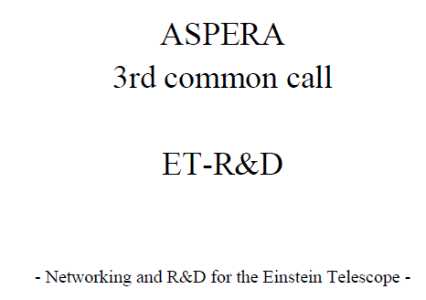
Next steps…
ELITES
ASPERA 3rd common call…
  Addressing R&D needs
    ET‘s scientific potential
    Long term seismic &GGN studies
    Optical properties of silicon @ cryo T
    ET Control systems
Next…?

Slide 14
The „other networking“
Organisational Topics:
Preferably use „eduroam“
Or use the ticket you got from IT and follow instructions

Slide 15
If you did not pay yet
Conference fee of 50€
Please see Gina in the coffee break

Slide 16
Travel support
Those who get support from AEI
please send a travel reimbursement claim including copies of your receipts (airfare, hotel, transportation, conference fee, etc, excl. meals) to
office-hannover@aei.mpg.de
with cc to
harald.lueck@aei.mpg.de

Slide 17
If you need a TAxi
Ask Gina Gerlach in room 119 next door ww
Or call (+49 511) 3811 yourself

Slide 18
Lunch
Will be served in the foyer close to the entrance of the institute

Slide 19
Posters
We will have posters on display
first floor above the entrance

Slide 20
Lab visits
10m Prototype
High power lasers
ATLAS
GEO 600
Other optical labs…
not foreseen by default,
but individual arrangements can be made

