Slide 1
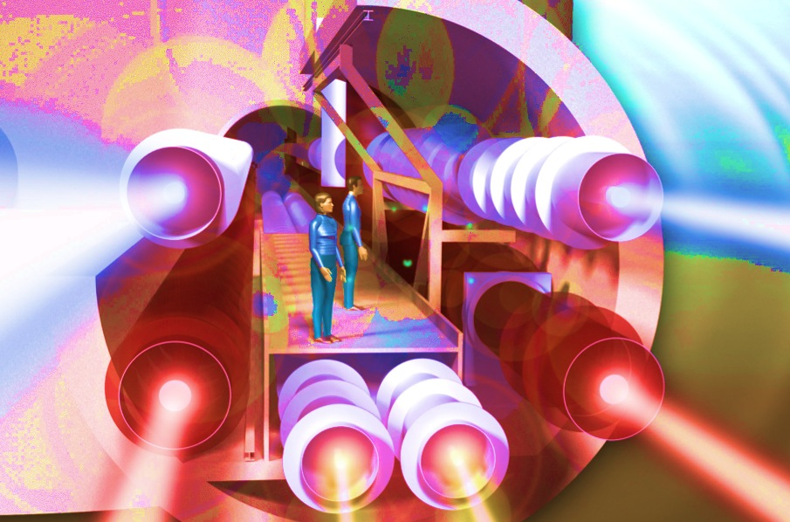
Interferometry beyond the Standard Quantum Limit using a
Sagnac Speedmeter
Stefan Hild
ET general meeting
Hannover, December 2012

Slide 2
Overview
What is a speedmeter and how does it work?
Could a Sagnac Speedmeter be used to enhance ET?
What will our Proof-of-Principle experiment look like?
What can we learn from this experiment for ET?

Slide 3
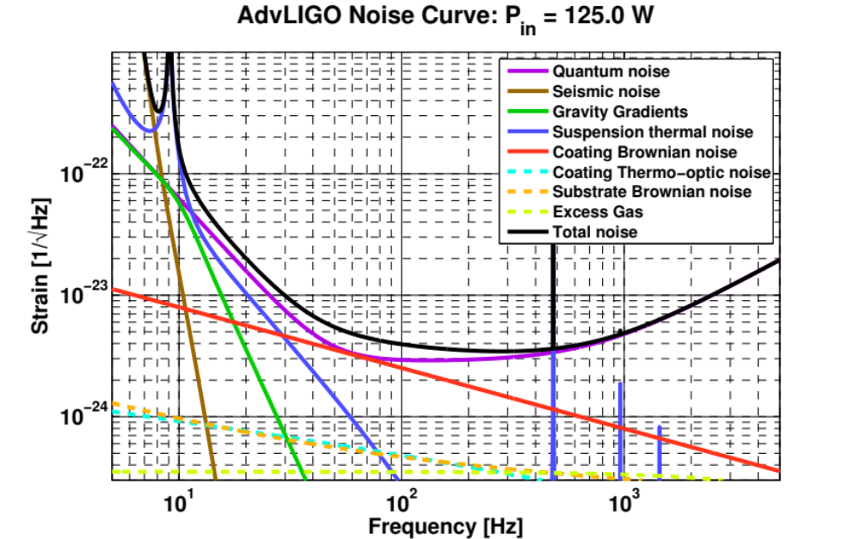
Two principles of how to build a GW detector
First you need to make your test masses quieter than what you want to measure.
Secondly, you need to readout out the strain to the required precision without (!) introducing ‘too much’ additional noise.
State of the Art detectors are limited by quantum noise nearly over their entire detection range. Need to find ways to improve!

Slide 4
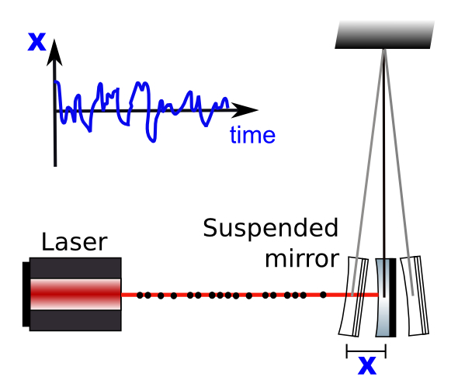
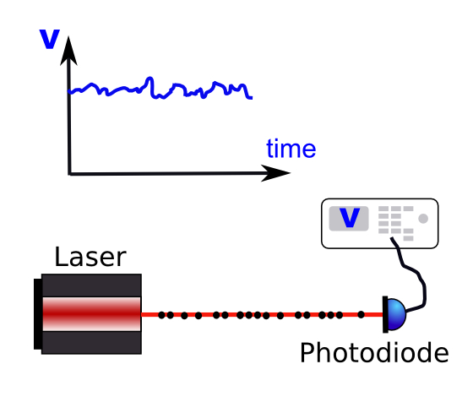
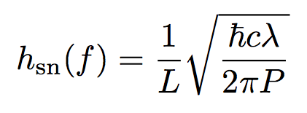
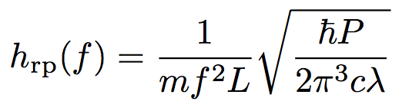
Quantum has two components?
Quantum noise is a direct manifestation of the Heisenberg Uncertainty Principle.
It is comprised of photon shot noise (sensing noise) at high frequencies and photon radiation pressure noise (back-action noise) at low frequencies.
wavelength
optical
power
Mirror mass
Arm length
photon radiation pressure noise
photon shot noise

Slide 5
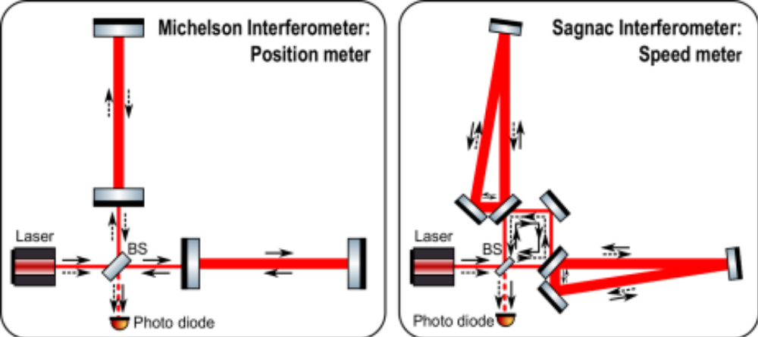
How can a Speedmeter help?
So far we used Michelson interferometers to derive strain, by continuously measuring the displacement of the mirrors.
However, quantum mechanics limits the accuracy of the measurement:
However, already in 1930s John von Neumann told us that there are observables which can measured continuously without encountering the Heisenberg uncertainty. For example the momentum or speed of a testmass in our case.

Slide 6
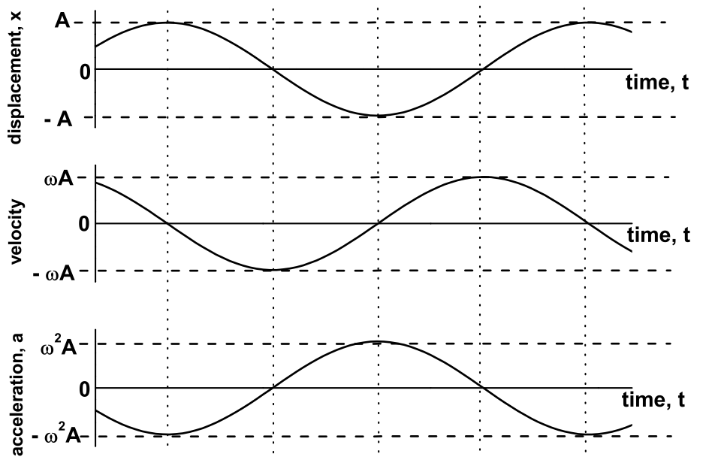
How to get strain from test mass speed?
What we really want to measure is not displacement or position, but strain h(t).
We can derive the strain information from velocity as well as from position (for all frequencies above DC).
Example: Simple Harmonic Oscillator
Can integrate over the speed to get the AC-position.

Slide 7
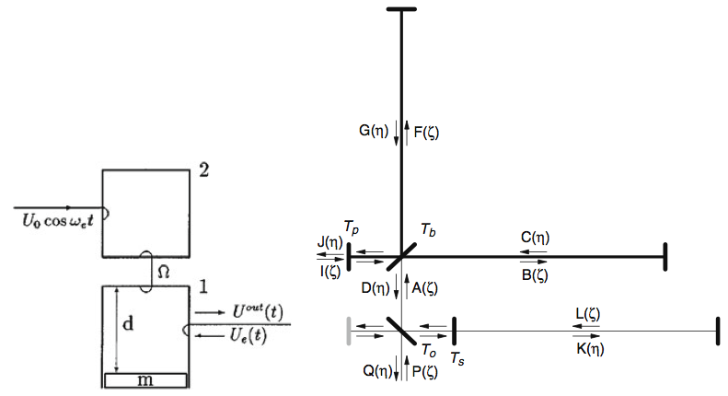
Speedmeter is not a new idea!
Speedmeter originally suggested by Braginsky and Khalili in 1990.
First suggestion to implement in a Michelson Interferometer (shloshing cavity) was in 2000 by Braginsky, Gorodetsky, Khalili and Thorne.
Part of the signal is send back into the interferometer to cancel out displacement infromation.
Purdue and Chen further developed shloshing cavity approach (2002).
In 2003 Chen showed that a Sagnac interferometer is a speedmeter.

Slide 8
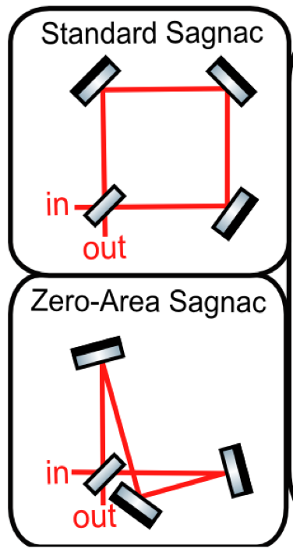
Sagnac Interferometer
Sagnac interferometer traditionally used for measuring rotation. See laser gyros etc.
However we can build a zero-area Saganc interferometer. Rotation signals cancels out.
Actually a zero-area Sagnac can be used to measure GW! (Lots of research at Stanford and ANU until about 10 years ago)
Also Zero-Area Sagnac fits into the usual L-shaped vacuum envelop of GW detectors.

Slide 9
Sagnac as Speedmeter
A Sagnac interferometer measures only (!) the speed of the mirrors, from which we can obtain the strain h(t). => No quantum limit.
y(t)
Each mirror is 'sensed' twice:
y(t₁)
x(t₁)
x(t)

Slide 10
Sagnac as Speedmeter
A Sagnac interferometer measures only (!) the speed of the mirrors, from which we can obtain the strain h(t). => No quantum limit.
A Sagnac speedmeter can avoid back action noise and therefore be limited entirely by shot noise. (= no quantum radiation pressure noise!)
y(t)
Each mirror is 'sensed' twice:
y(t₁)-y(t₂)
x(t₁)-x(t₂)
Therefore on the photo diode we only have information on the mirrors velocity, but not their displacement.
x(t)

Slide 11
Overview
What is a speedmeter and how does it work?
Could a Sagnac Speedmeter be used to enhance ET?
What will our Proof-of-Principle experiment look like?
What can we learn from this experiment for ET?
YES

Slide 12
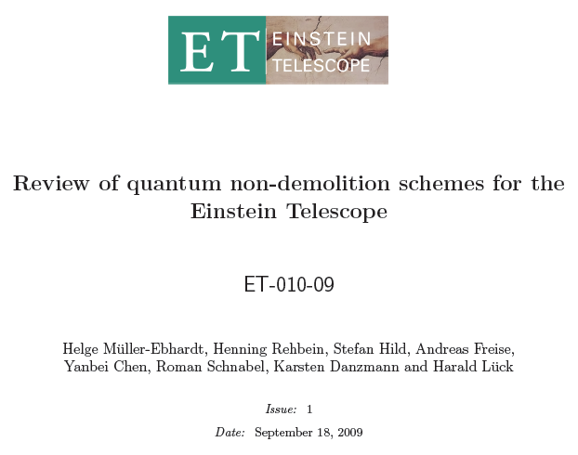
Quantum noise in ET
In 2009 Helge Mueller-Ebhardt et al carried out a review of the Quantum noise in ET.
He compared various quantum noise reduction techniques using identical instrument parameter (losses etc)
Let’s have a look at the findings!

Slide 13
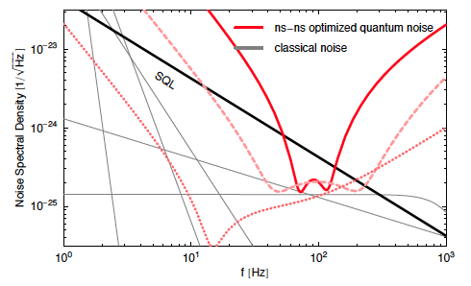
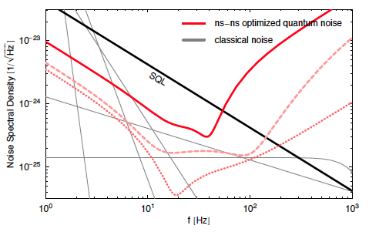
Positionmeter versus Speedmeter
Michelson
Sagnac
Solid line = standard quantum noise, dashed line = with frequency dependent squeezing (dotted line = variational readout + squeezing)
Theoretical analysis showed that speedmeter can give significantly better sensitivity than positionmeter, especially in terms of low frequency sensitivity and also bandwidth.

Slide 14

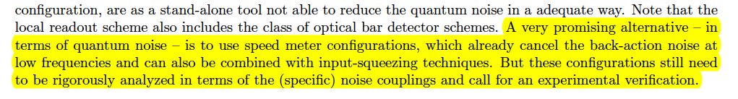
Conclusion of Helge’s review
So, we know that the speedmeter theoretically outperforms a Michelson interferometer.
However, as we are lacking the experimental verification, the ET standard design (ET-D) uses Michelson interferometers for both the LF and HF interferometers.
Since autumn this year the experimental verficiation is on the way as we started to build a proof-of-principle experiment of a Sagnac speedmeter in Glasgow.

Slide 15
Overview
What is a speedmeter and how does it work?
Could a Sagnac Speedmeter be used to enhance ET?
What will our Proof-of-Principle experiment look like?
What can we learn from this experiment for ET?

Slide 16

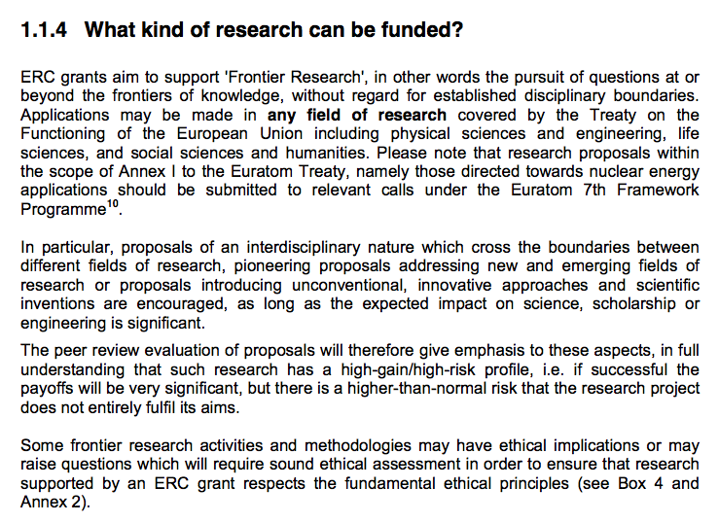
ERC Starting Grants
Obtained 1,400,000€ from the ERC for the period of 2012-2017 to proof the speedmeter concept.
Sufficent funding for required equipment + 4.5 FTE.

Slide 17
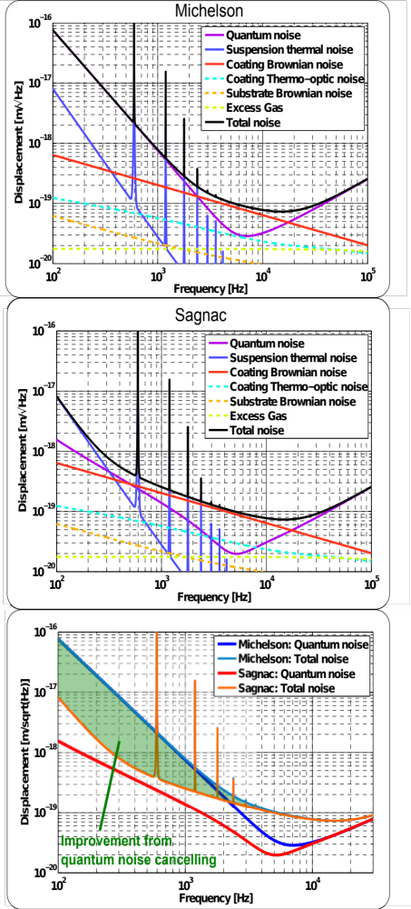
What are the aims of the project?
Plan to setup an ultra-low noise Sagnac interferometer with high optical power and low-weight mirrors in order to demonstrate reduction/absence of back action noise and to test the Sagnac configuration for potential problems.
Design optimised to achieve a factor 10 better sensitivity in the few 100Hz range, than an equivalent Michelson interferometer could achieve.
Proof of the speedmeter concept.
Notes:
A factor 10 improvement in sensitivity is equivalent to a factor 1000 in eventrates.

Slide 18
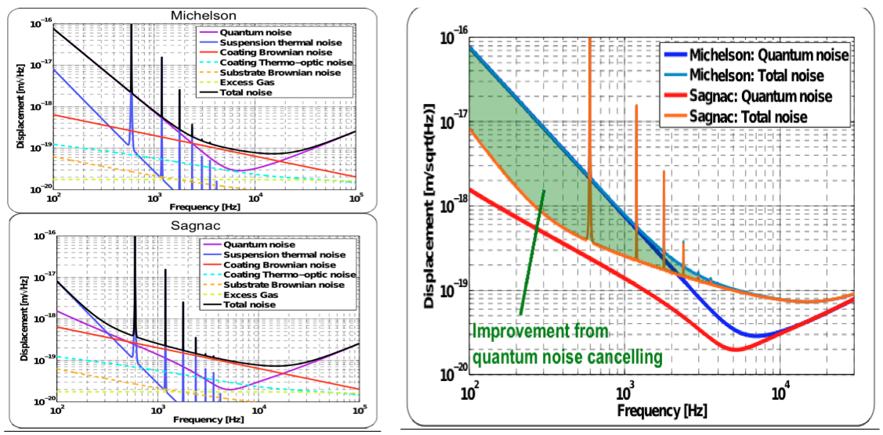
Aim of the Project
1g mirrors suspended in monolithic fused silica suspensions.
1kW of circulating power. Arm cavities with finesse of 10000. 100ppm loss per roundtrip.
Sophisticated seismic isolation + double pendulums with one vertical stage.
Large beams to reduce coating noise.
Armlength = 1m. Target better than 10⁻¹⁸m/sqrt(Hz) at 1kHz.
In the initial stage no recycling and no squeezing will be used.
Really just want to show the reduction of radiation pressure noise in a speedmeter compared to Michelson.

Slide 19
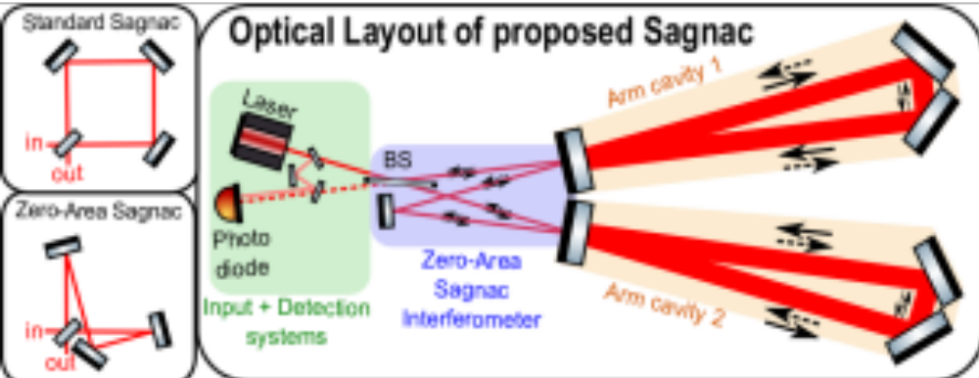
Aim of the Project
1g mirrors suspended in monolithic fused silica suspensions.
1kW of circulating power. Arm cavities with finesse of 10000. 100ppm loss per roundtrip.
Sophisticated seismic isolation + double pendulums with one vertical stage.
Large beams to reduce coating noise.
Armlength = 1m. Target better than 10⁻¹⁸m/sqrt(Hz) at 1kHz.
In the initial stage no recycling and no squeezing will be used.
Really just want to show the reduction of radiation pressure noise in a speedmeter compared to Michelson.

Slide 20
Overview
What is a speedmeter and how does it work?
Could a Sagnac Speedmeter be used to enhance ET?
What will our Proof-of-Principle experiment look like?
What can we learn from this experiment for ET?

Slide 21
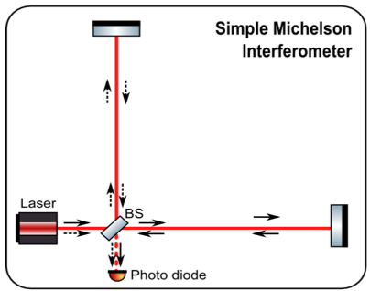
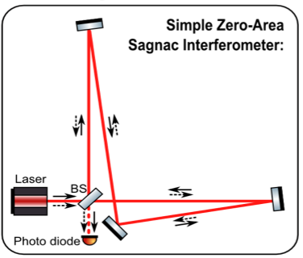


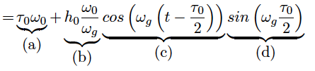
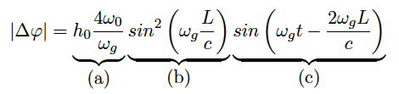
Different transfer functions
A Michelson and a Sagnac have very different transfer functions from differential armlength to signal on the photodiode.

Slide 22
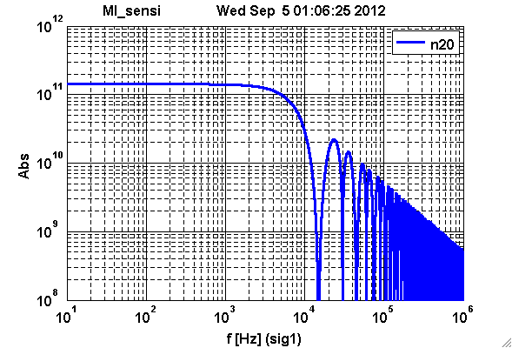
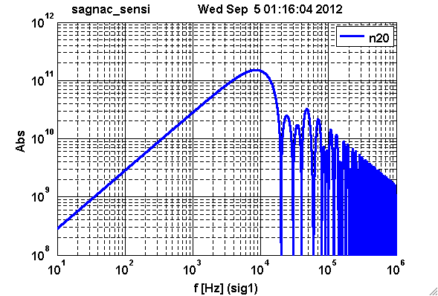
Will we be able to cope with vanishing signal at low frequencies?
For a Sagnac the optical gain (TF from differential arm length to voltage on readout photodiode) goes down towards lower freqs.
Need to make sure that signal is still above the electronic noise for all frequencies of interest.

Slide 23
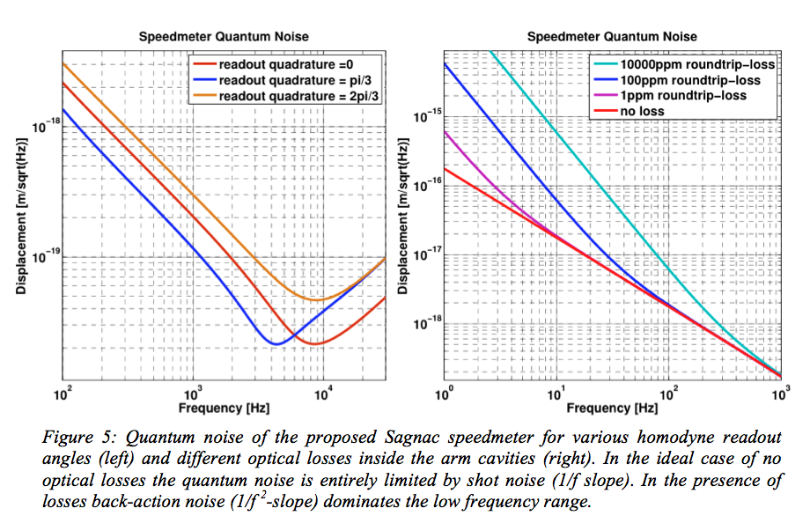
Will Homodyne Readout at audio frequencies work?
Sagnac automatically on dark fringe. Cannot introduce dark fringe offset for DC-readout.
Plan to try a real homodyne readout.
Requires ultra-low noise and stable local oscillator path.
Not been demonstrated so far!

Slide 24
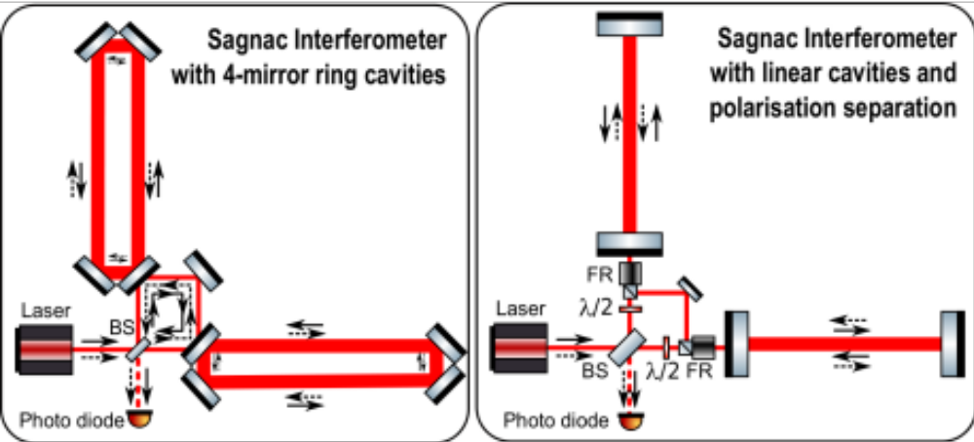
Arm cavity design
Two different approaches under investigation:
  3-4 mirror ring cavities
  Linear cavities using polarisation optics
So far not clear which concept would work better in a 10km interferometer.
Mirrors under 45 deg
ROCs astigmatic
Incoupler needs astigmatic lens
Each beam needs to pass through:
4x Faraday rotator
4x PBS
2x half-wavelength plate

Slide 25
How do losses degrade the speedmeter performance?
Losses degrade the speedmeter sensitivity.
Losses introduce back-action noise again and we obtain again a quantum noise falling with 1/f².
Want to investigate how losses in different parts of the interferometer contribute.

Slide 26
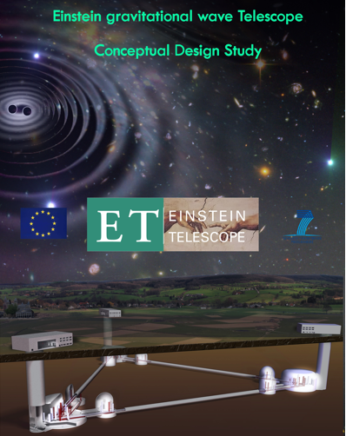
Summary
So far Michelson interferometers have been sufficient.
However, we start to hit the quantum limit now.
For the future measuring displacement would be the 'wrong measurement'!
Now is the right time for an exciting speedmeter experiment.
Let’s have some fun …
If we do not find any showstoppers during our tests than it seems likely that over the next 10 years the Sagnac speedmeter will supersede the Michelson interferometer as state-of-the-art instrument for ultra-high sensitivity lengths measurements.

Slide 27
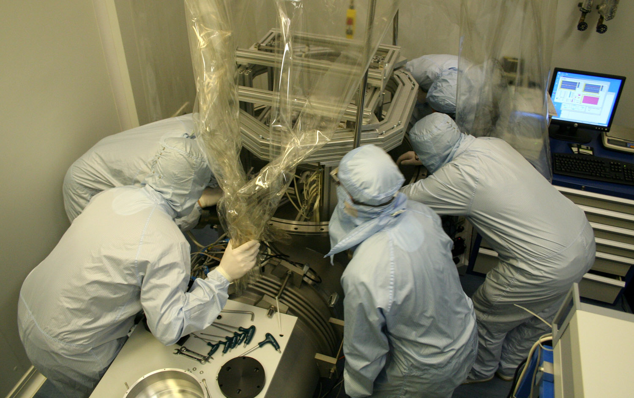
Please join if you are interested !!!
If you want to join this exciting project with your expertise you are more than welcome!
There is quite a lot of work involved in this project, - definitely more than my team on its own will be able to manage.
So everybody is welcome to join. Send us your interested students and postdocs or come along for a visit yourself. ☺
Also the ERC and NSF just initiated a program which allows NSF career awardees and NSF postdoctoral fellows to join ERC starting grant projects for periods from months up to a year.

Slide 28
Thanks for your attention !

Slide 29
EXTRA SLIDES

Slide 30
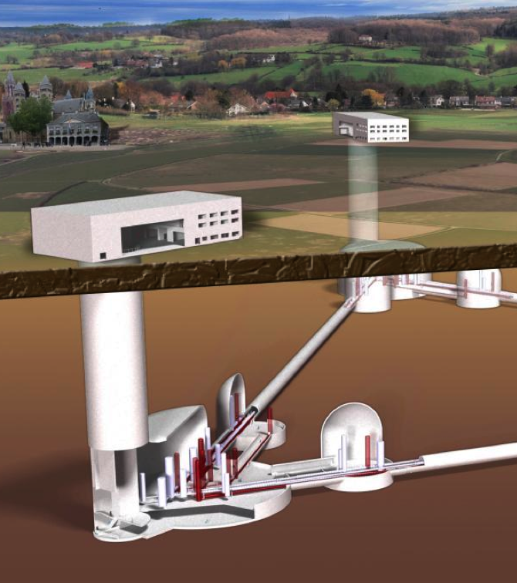
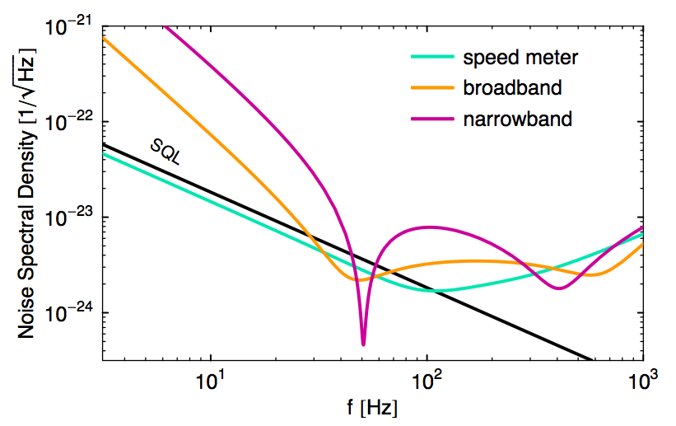
Speed meter for ET ?
Image: H. Mueller-Ebhardt, PhD thesis
In ET context the speed meter has be shown to give in principle the best broadband sensitivity of all interferometry configurations.

Slide 31
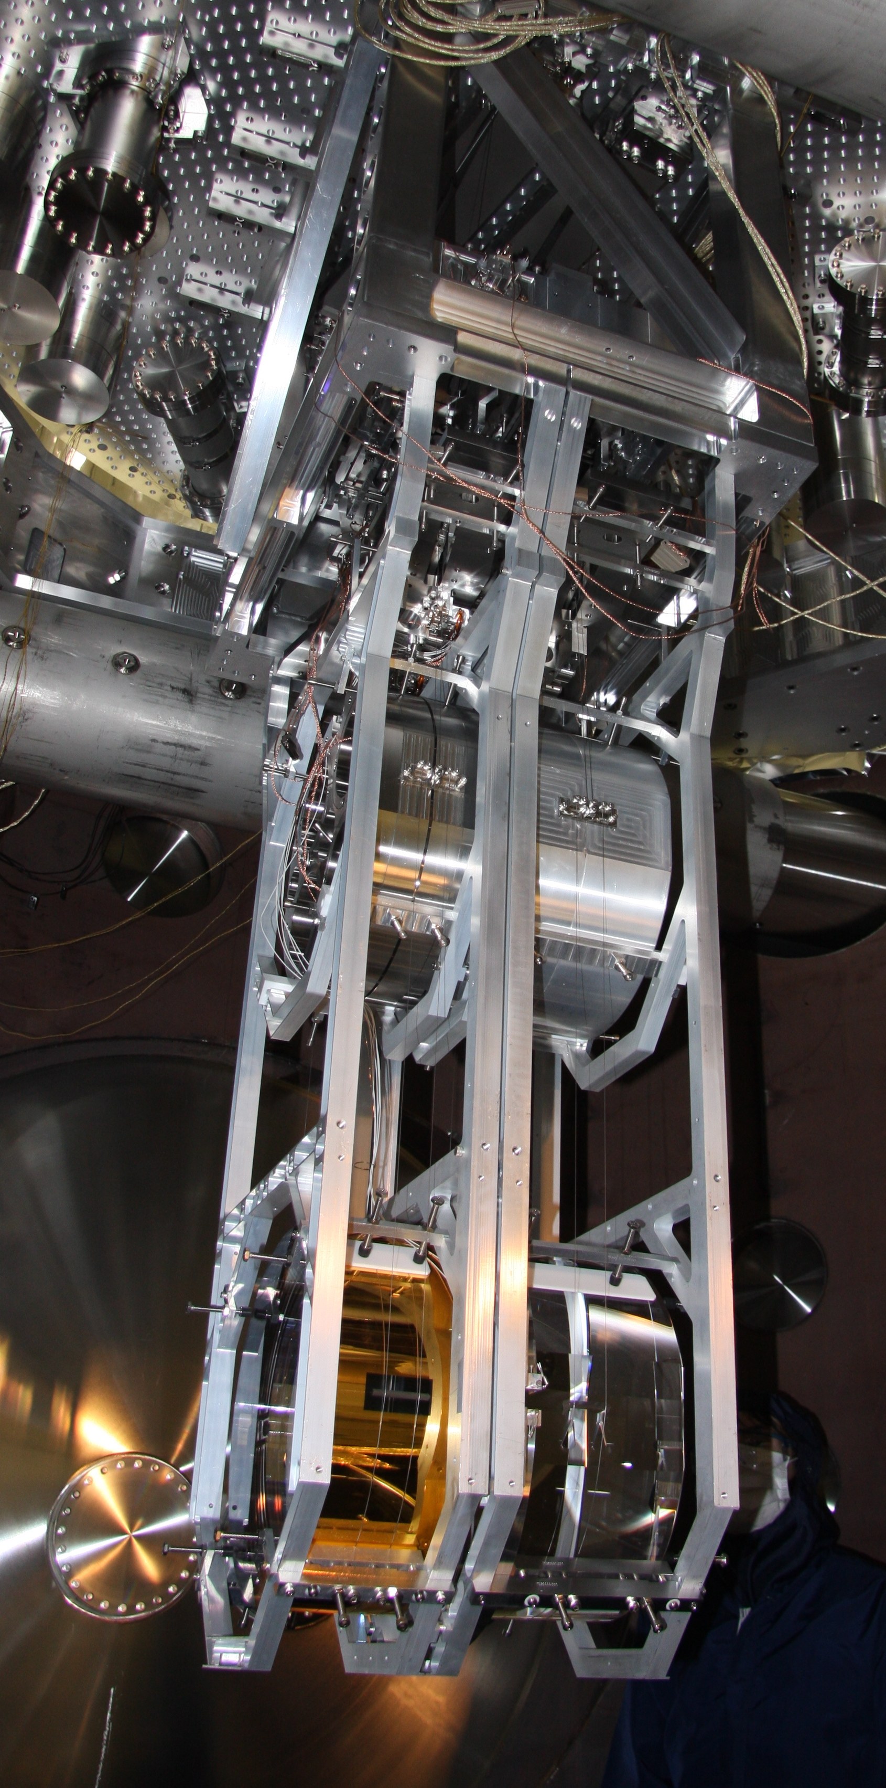
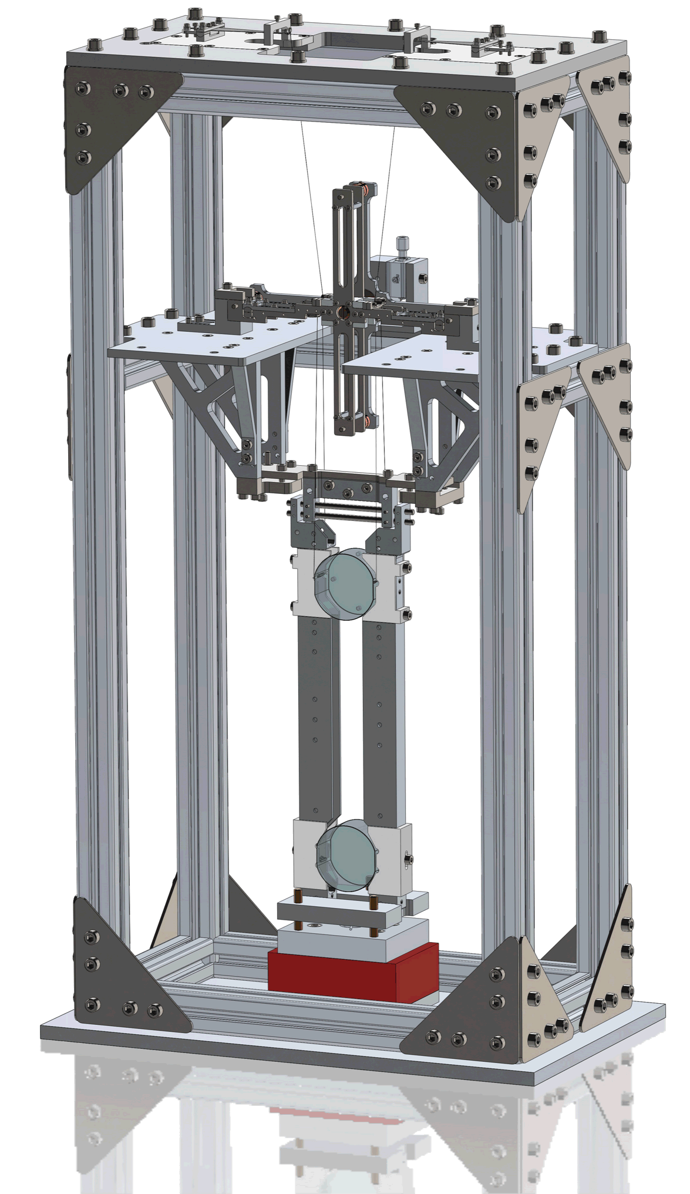
Monolithic 1 gram suspensions
ALIGO = 42kg
AEI-10m = 100g
Speedmeter = 1g
2 orders of magnitude
2.5 orders of magnitude

Slide 32
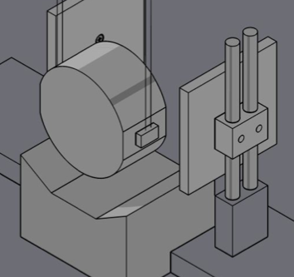
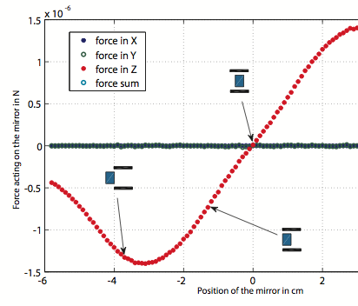
ESD actuators
New ESD concept. Force on mass only dependent on voltage and not distance between ESD and mirror.
Investigated this concept for AEI-10m, but it will be even more useful for the speedmeter as it use lighter mirrors.

