Slide 1
Cryogenic Silicon Suspensions
Giles Hammond¹, A. Cumming¹, R. Douglas¹, K. Haughian¹, J. Hough¹, I. Martin¹, R. Nawrodt², S. Rowan¹, C. Schwarz², A. A. Van Veggel¹
¹ SUPA, Institute for Gravitational Research, University of Glasgow
² Friedrich Schiller University, Jena
4th Einstein Telescope Symposium, Hannover, 4-5th December 2012

Slide 2
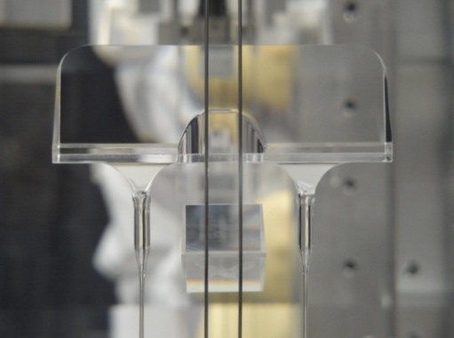
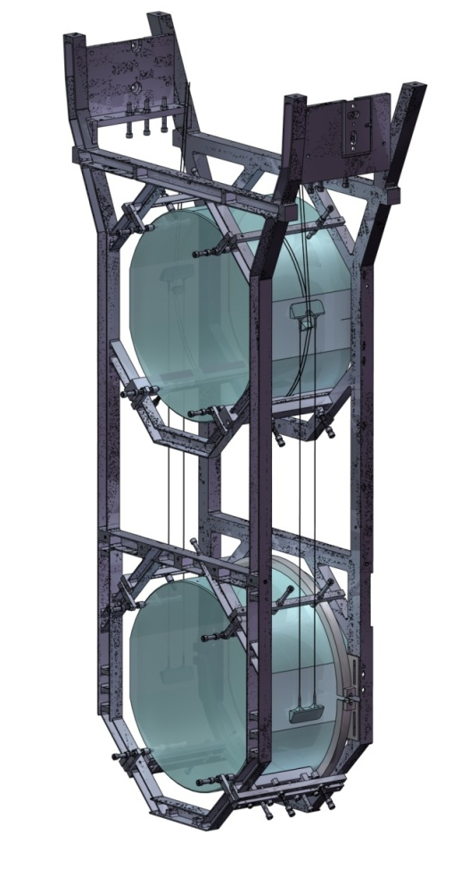
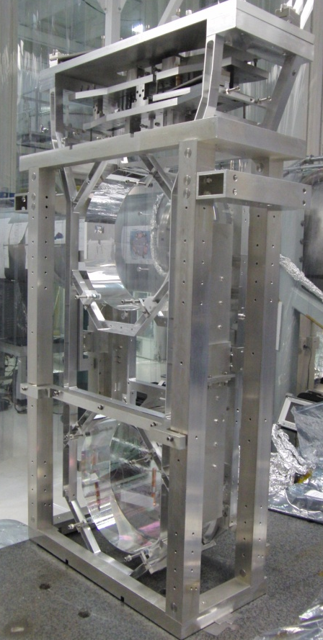
Introduction
Future detectors will need careful design of the test mass mirrors and suspensions to provide suitably low thermal noise
One possible way to reduce thermal noise is to cool test masses and suspensions
Suspension thermal noise originates from materials that make up the test masses, suspension fibres and their attachments, so use ultra-low mechanical loss materials
Silicon is one proposed low mechanical dissipation material for future detectors
Analysis of the limitations of silicon and the performance gains we can expect are crucial
aLIGO lower monolithic silica stage
1
Notes:
1

Slide 3
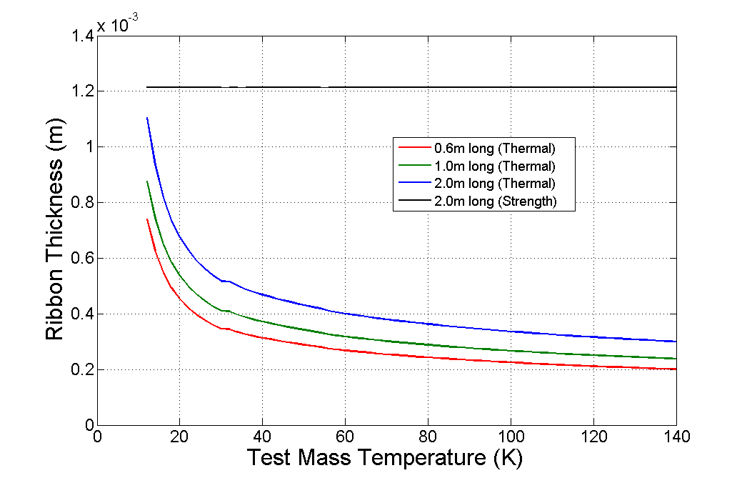
Low Temperature Operation
For low temperature operation of the test mass (<50K) any heat input by the detector laser beam will be extracted via conduction up the suspension fibres
This places a limit on the fibre diameter (and therefore the ultimate suspension thermal noise performance) – too thin results in a heat bottleneck
  Penultimate mass at 4K, 18 kW laser power with 1 ppm absorption

Slide 4
Case Study: Loss Terms
Consider the following case study:
  200 kg test mass, 18 kW laser power, with 1 ppm absorption, ribbon geometry fibres (width w, thickness t), penultimate mass at 4 K
Calculate the minimum suspension fibre area to hold the test mass at a given temperature and compare with the thermal extraction limit.
Suspension thermal noise is then calculated from the standard loss terms:
Thermoelastic loss:
Surface loss:
Bulk loss
fitted from McGuigan (78)
Total mechanical loss:
with dissipation dilution:
Thermal noise power spectral density:
A.M. Gretarsson et al., Phys. Rev. A, 2000
G. Cagnoli and P.A. Willems, Phys. Rev. B, 2002
A. Cumming, et al., CQG, 26 215012, 2009
D.F. McGuigan et al. J. Low Temp. Phys. 1978
R. Nawrodt et al. submitted CQG, 2012

Slide 5
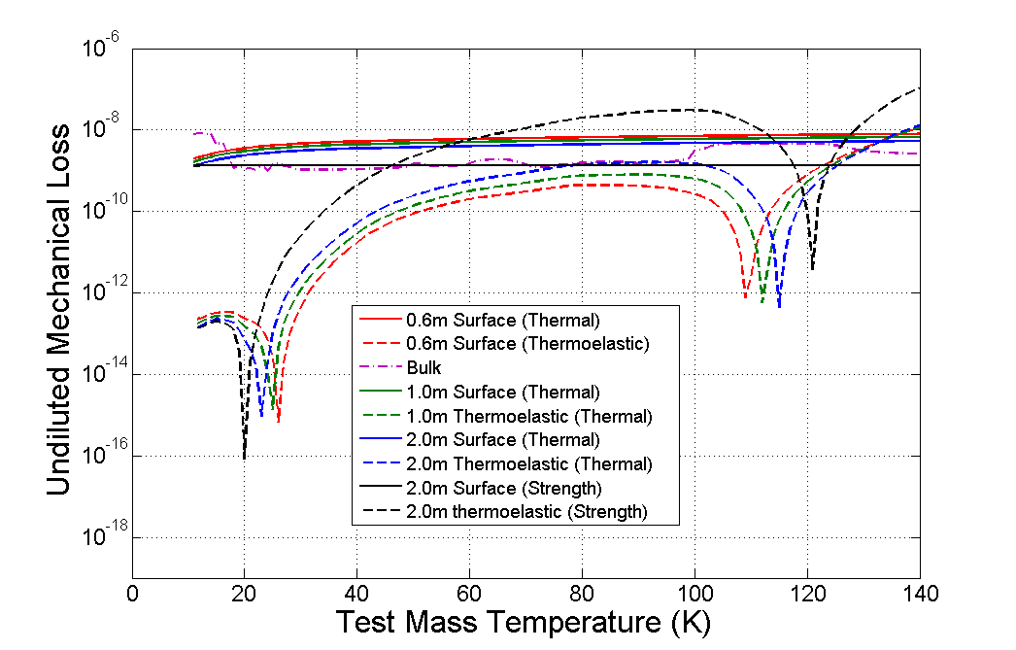
Case Study: Mechanical Loss
Longer suspensions have lower surface loss (fibres thicker to maintain heat extraction)
Below ~50K the dominant loss term is surface loss and bulk loss
Thermoelastic loss rapidly becomes insignificant with decreasing temperature, due both to temperature and thermoelastic null at ~18K.

Slide 6
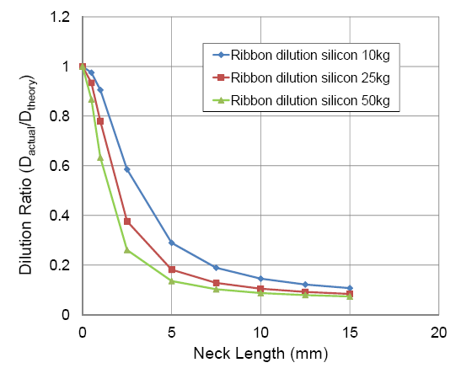
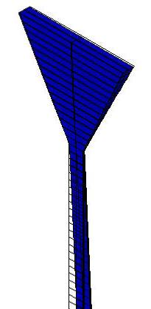
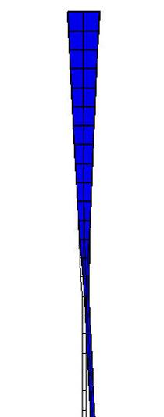
Case Study: Dilution
In cases where fibres terminate in rigid attachment points the dilution is
This is an approximation as real suspensions do not terminate at an infinitely stiff attachment
Use ANSYS to predict stored energy and compare with idealistic case
In the MATLAB model (1/D) is multiplied by a factor 10 to account for this effect.
Vary
length

Slide 7
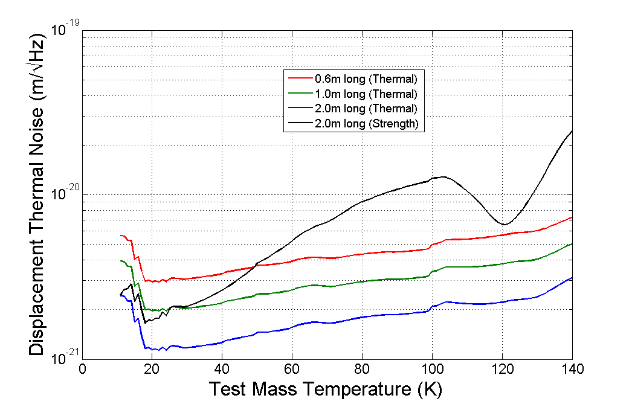
Case Study: Thermal Noise @10Hz
Longer suspensions improve the noise performance due to better dissipation dilution
The remainder of the talk will focus on the test mass at 20K

Slide 8
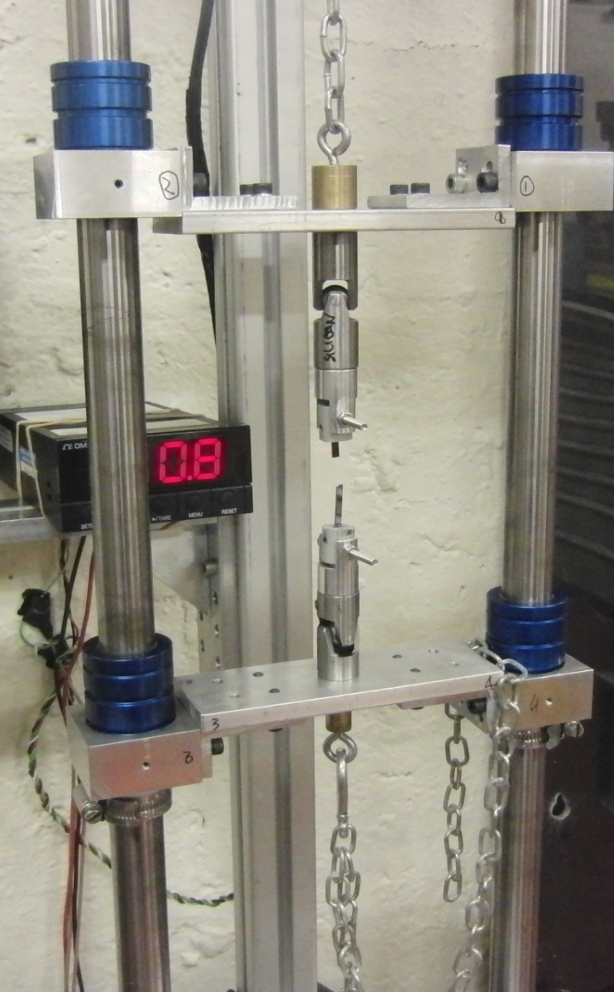
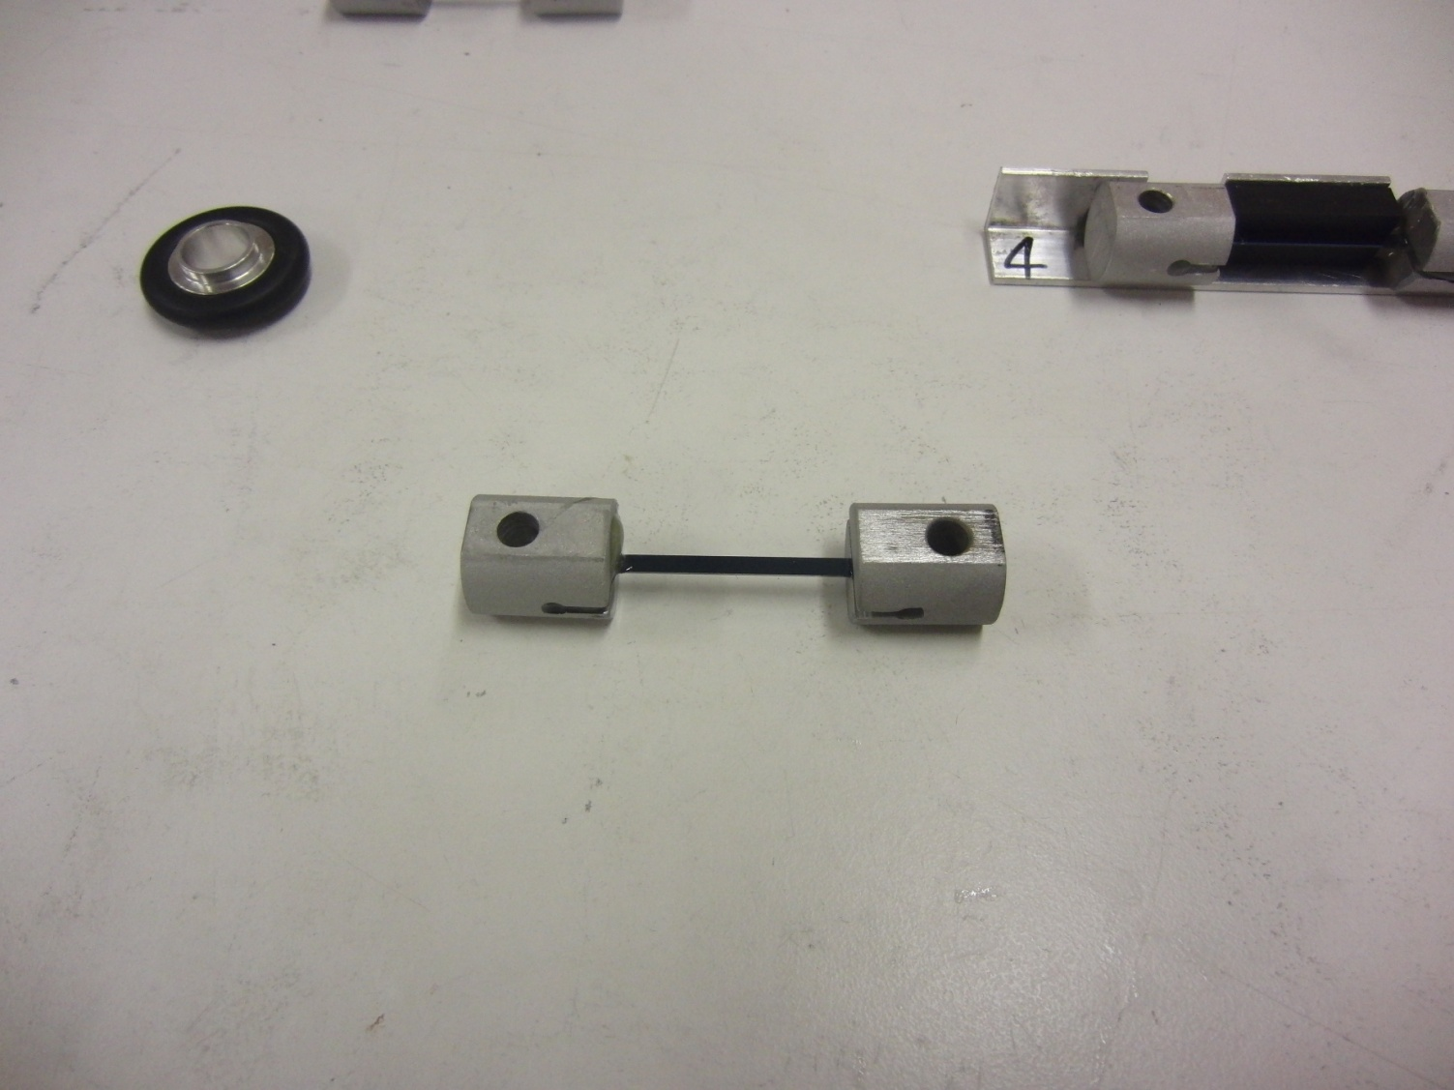
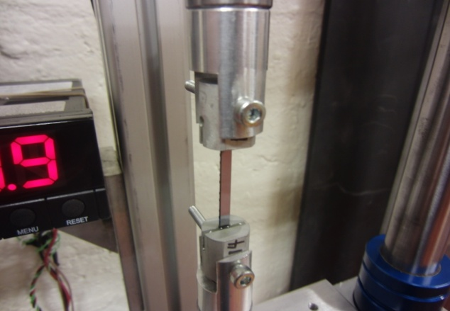
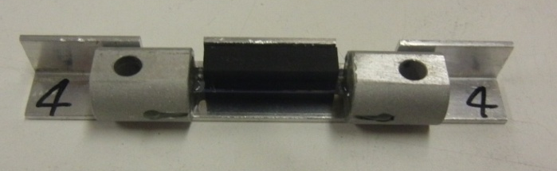
Strength of Silicon
These proposed suspensions rely on the structural strength of silicon being at appropriate levels – e.g. absolute minimum strength of 200 MPa in the case study (650 MPa with a safety factor of 3)
Tensile strength tests have recently undertaken on silicon samples with different surface treatments – polished, etched, Si₃N₄, wet oxidised ^{[1]}
Samples 45mm x 3mm x 0.5mm, and 45mm x 2.2mm x 0.5mm
Articulation via universal joints top and bottom, to ensure force along axis of sample
Silicon sample
Sample bonded between metal attachment pieces with Araldite 2012 epoxy
Silicon sample
Simple alignment jig from aluminium angle, to ensure sample centred and aligned parallel to fuse ends while curing.
Lower joint free to rotate to allow sample to experience minimal torsional forces on sample
Applied force
[1] K. Petersen, Proceedings of IEEE, 70, 5 pp420 (1982)

Slide 9
Measured Strengths
<110>
<100>
<100> Etched
<110> Si₃N₄
<100> Si₃N₄
<100> Oxidised
<110> Oxidised
<110> Si₃N₄ Oxidised
<100> Si₃N₄ Oxidised

Slide 10
Conclusions from Strength Tests
Some clear trends can be seen:
  Etched samples are ~×2 stronger than those with mechanically polished edges – likely due to higher quality surfaces, with less polishing damage
  Si₃N₄ coated samples are no stronger than the equivalent untreated silicon (<100> seems weaker, unknown why) – implies the edge surface quality (where no Si₃N₄ present) is limiting factor
  All oxidised samples show improvement in strength (~factor of 2), and oxidised samples are those that have exhibited the highest absolute strength values
No current trend can be seen with oxide thickness (not enough statistics)
Scatter of data is large – consistent with expectation for brittle materials
The largest load supported was 660N
There is a possibility to improve the strength through surface treatment

Slide 11
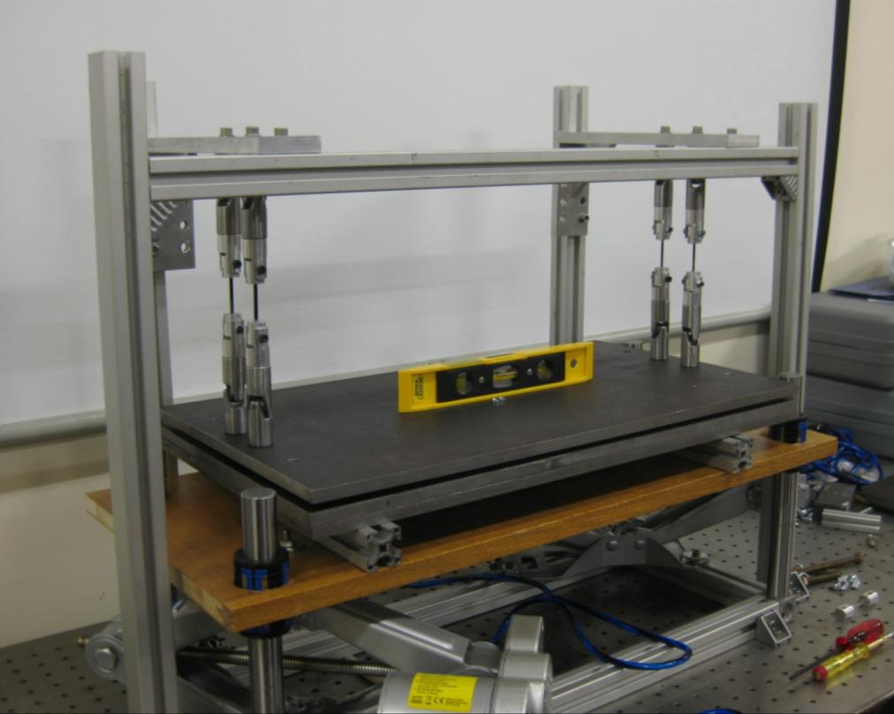
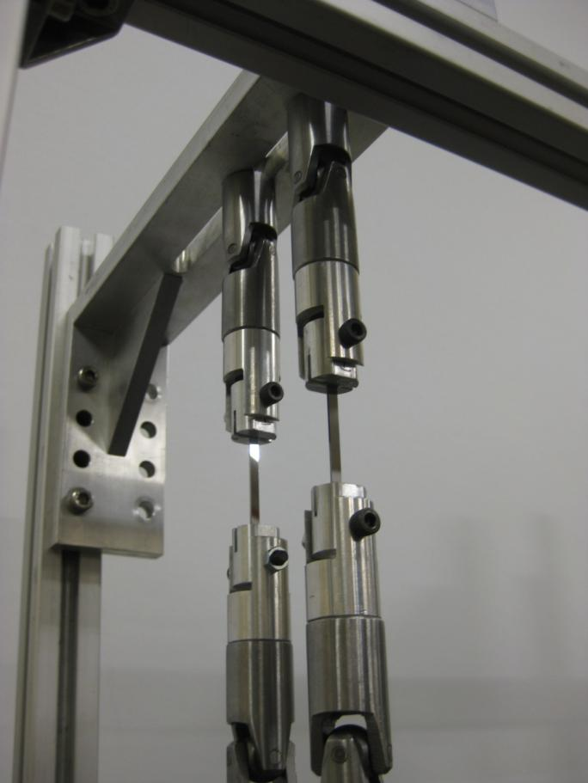
Additional Tests - Hanging a Mass
A 4 ‘fibre’ test suspension was also constructed
39kg, 52kg, 65kg, 78kg suspensions hung successfully
Maximum demonstrated 126MPa on 4 fibres (90kg on 4 x 45mmx3.5x0.5mm ‘fibres’) – hung for ~3 hours before failure (likely failure due to heavy vibration in the laboratory)
This is a very encouraging first test
Universal joints top and bottom, to minimise bending stress on silicon
Mild steel plates, 13kg each
Silicon
Jack

Slide 12
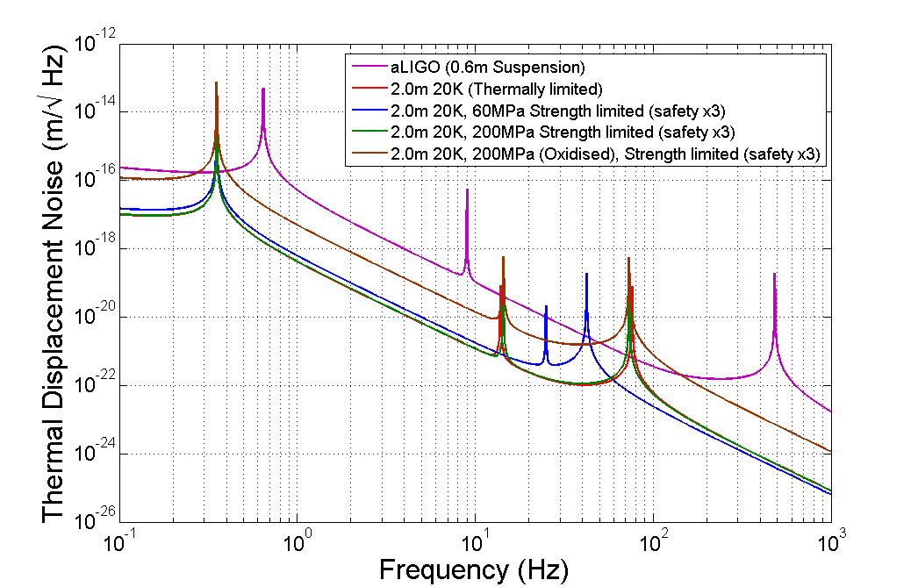
Performance of a 20K Silicon Suspension
Oxidised strength is higher allowing a thinner fibre (higher dissipation dilution) but surface loss is significantly higher at 10⁻¹⁰ [1]
Pendulum resonances
Vertical resonances
Violin modes
0.7mm thick ribbon is limiting case – thinner fibres would not be able to extract the heat deposited by laser
[1] B. E. White Phys Rev Let 75 (24), pp4437 (1995)

Slide 13
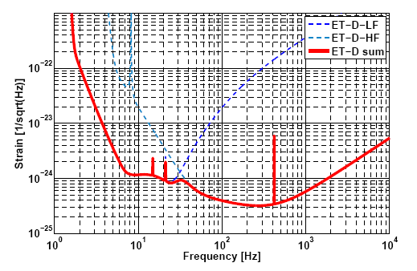
Performance of a 20K Silicon Suspension
Oxidised strength is higher allowing a thinner fibre (higher dissipation dilution) but surface loss is significantly higher at 10⁻¹⁰ [1]
Pendulum resonances
Vertical resonances
Violin modes
0.7mm thick ribbon is limiting case – thinner fibres would not be able to extract the heat deposited by laser
[1] B. E. White Phys Rev Let 75 (24), pp4437 (1995)

Slide 14
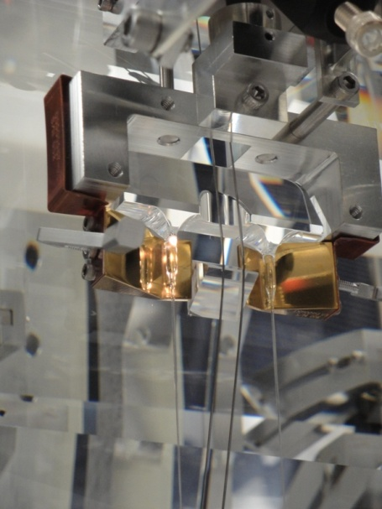
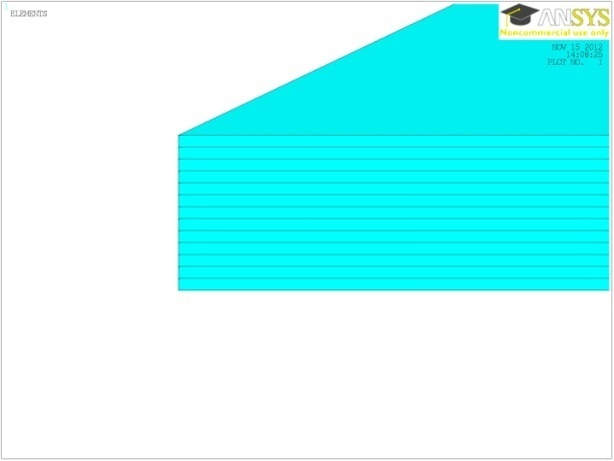
Suspension Design Drivers
Vertical compliance:
The aLIGO design utilises laser heating to soften the 3mm diameter fused silica stock and adjust the stock angle and mirror pitch
This is not possible with Silicon so another method to add vertical compliance is necessary => Silicon cantilever springs. This has the benefit of applying additional vertical isolation to the suspension chain.
Fibre Attachment
A reproducible and removable method to attach of attaching fibres to the mirror and penultimate mass is required
Need to be careful that attachment method does not compromise the thermal noise
  bonded interface
R&D and additional loss measurements are needed to develop the optimum approach

Slide 15
Conclusion
Silicon is a promising prospective material for future detector suspensions offering improvements of the order 70x aLIGO room temperature silica
The limiting dissipation is surface and bulk loss at low temperature (<50K)
The stronger silicon can be made, the greater the performance gain
Silicon strength has been demonstrated to be improved with suitable surface treatment of the material
Future work includes deeper investigation of surface treatments of silicon, aiming to improve strength, reliability and mechanical dissipation, including:
  Apply oxide to etched samples
  Investigating strength as function of oxide layer thickness
  Application of Si₃N₄ to all surfaces of samples
  Finite Element Analysis of the full suspension including bonded interfaces
Additional R&D is needed to:
        Provide vertical compliance via cantilever springs
        Demonstrate repeatable attachment of fibres to the mirrors

Slide 16
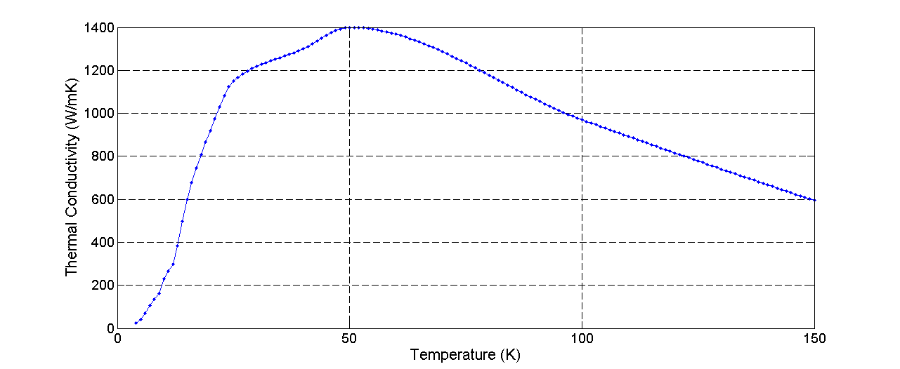
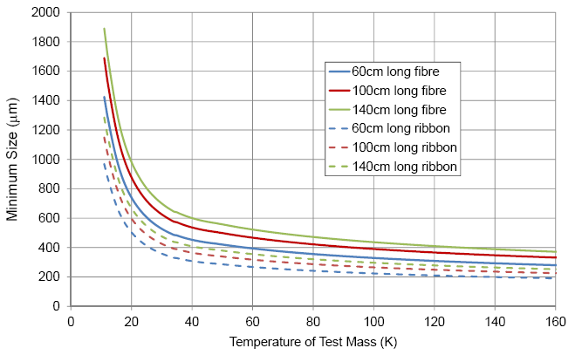
Extra Slide

