Slide 1
Grating reflectors for future GWD
S. Kroker¹, T. Käsebier¹, D. Heinert², R. Nawrodt², E.-B. Kley¹, A. Tünnermann¹
¹ Friedrich-Schiller-University Jena, Institute of Applied Physics
² Friedrich-Schiller-University Jena, Institute of Solide State Physics

Slide 2
Grating reflectors for future GWD
Outline
Introduction/ Functionality of grating reflectors
New results on 2D-gratings
Fabrication
Scattering – what do we know so far?
Thermal noise of grating reflectors
Summary & Outlook
Notes:
RWG mirrors … advanced grating concepts?

Slide 3
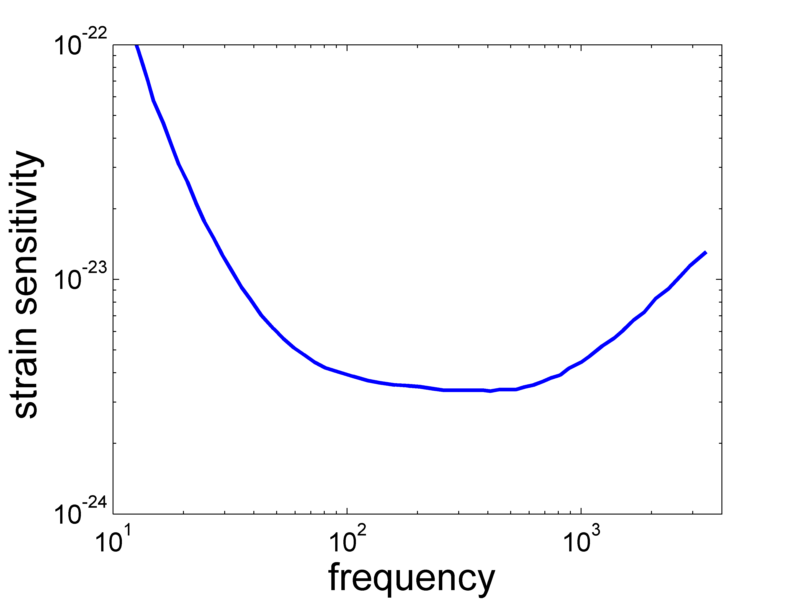
Grating reflectors for future GWD
Introduction
Introduction – coating thermal noise
seismic /
radiation pressure
strain sensitivity
shot noise
coating thermal noise
frequency
Notes:
„Brownian“ in Überschrift?

Slide 4
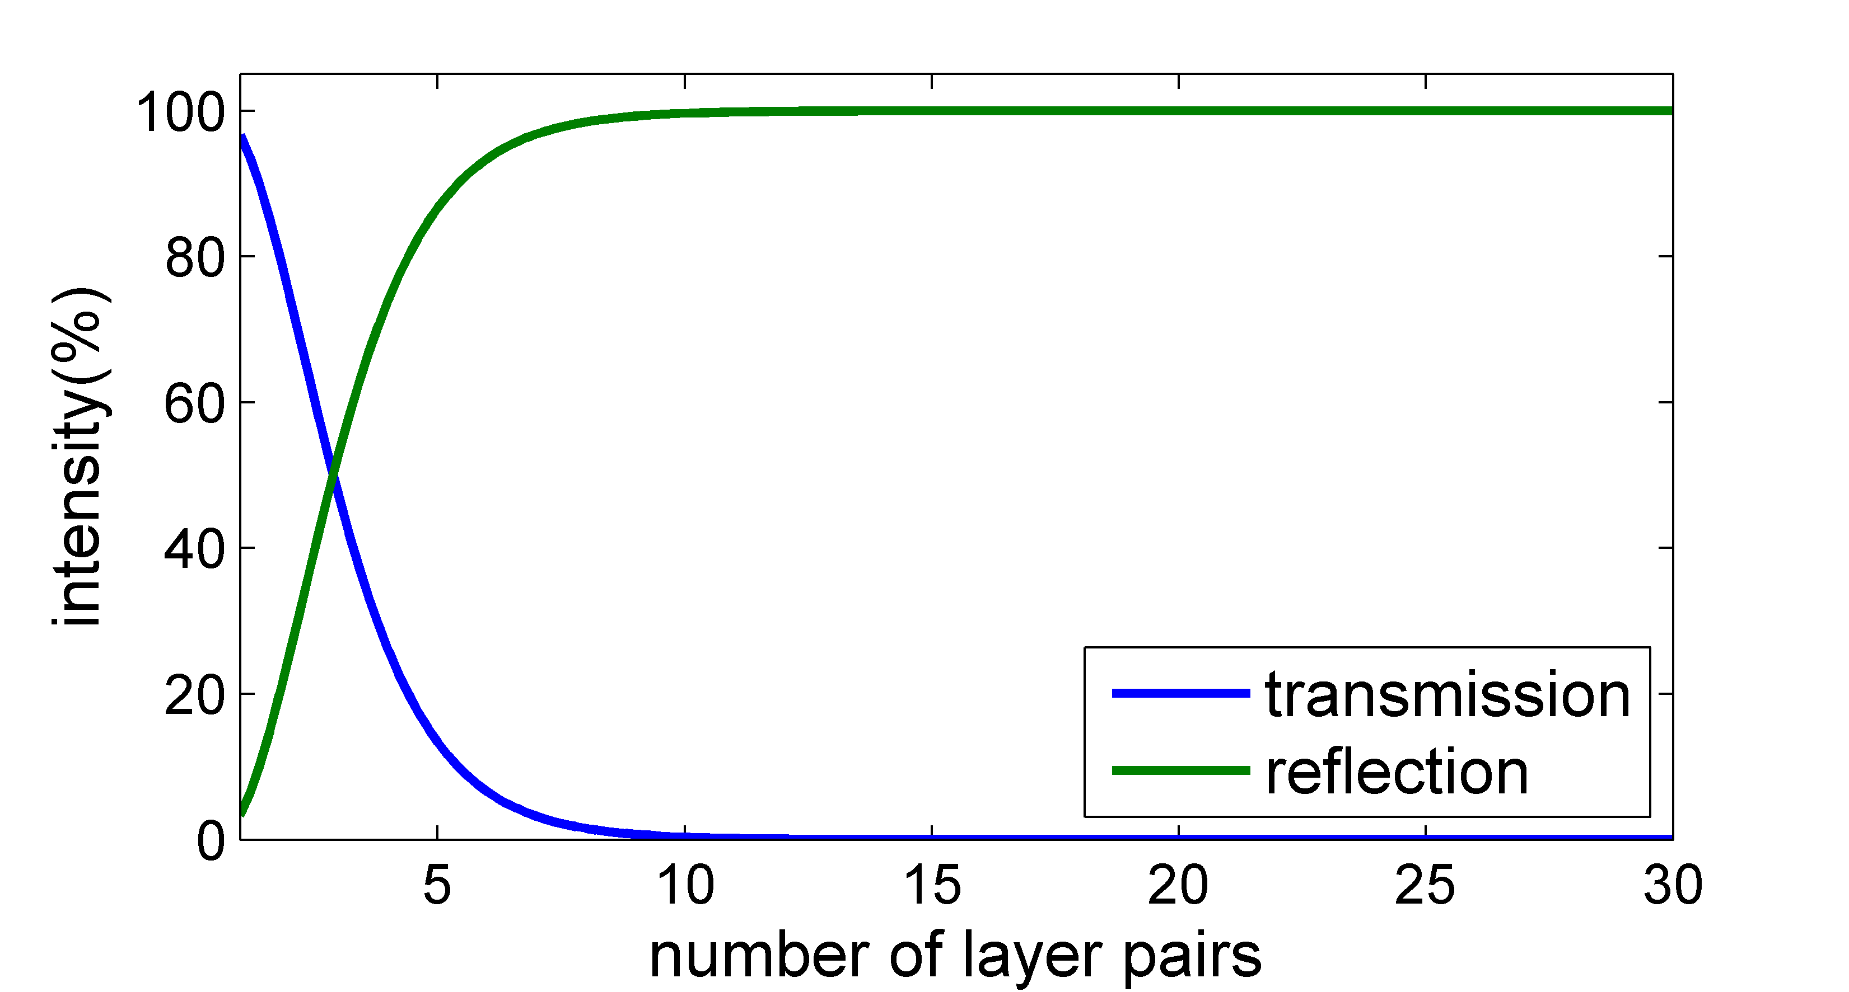
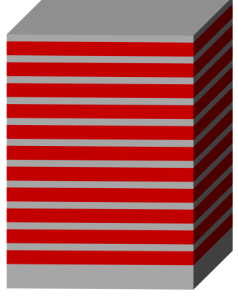
Grating reflectors for future GWD
Introduction
Introduction – reducing coating thermal noise
crystalline
conventional: dielectric amorphous multilayer stack
multiple beam interference:
SiO₂/Ta₂O₅
~3…8 µm
99.996% reflectivity
Harry et al. , CQG (2002)
reflectivity
Brownian coating thermal noise
1st approach: use crystalline materials
2nd approach: use alternative optical concepts

Slide 5
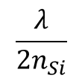
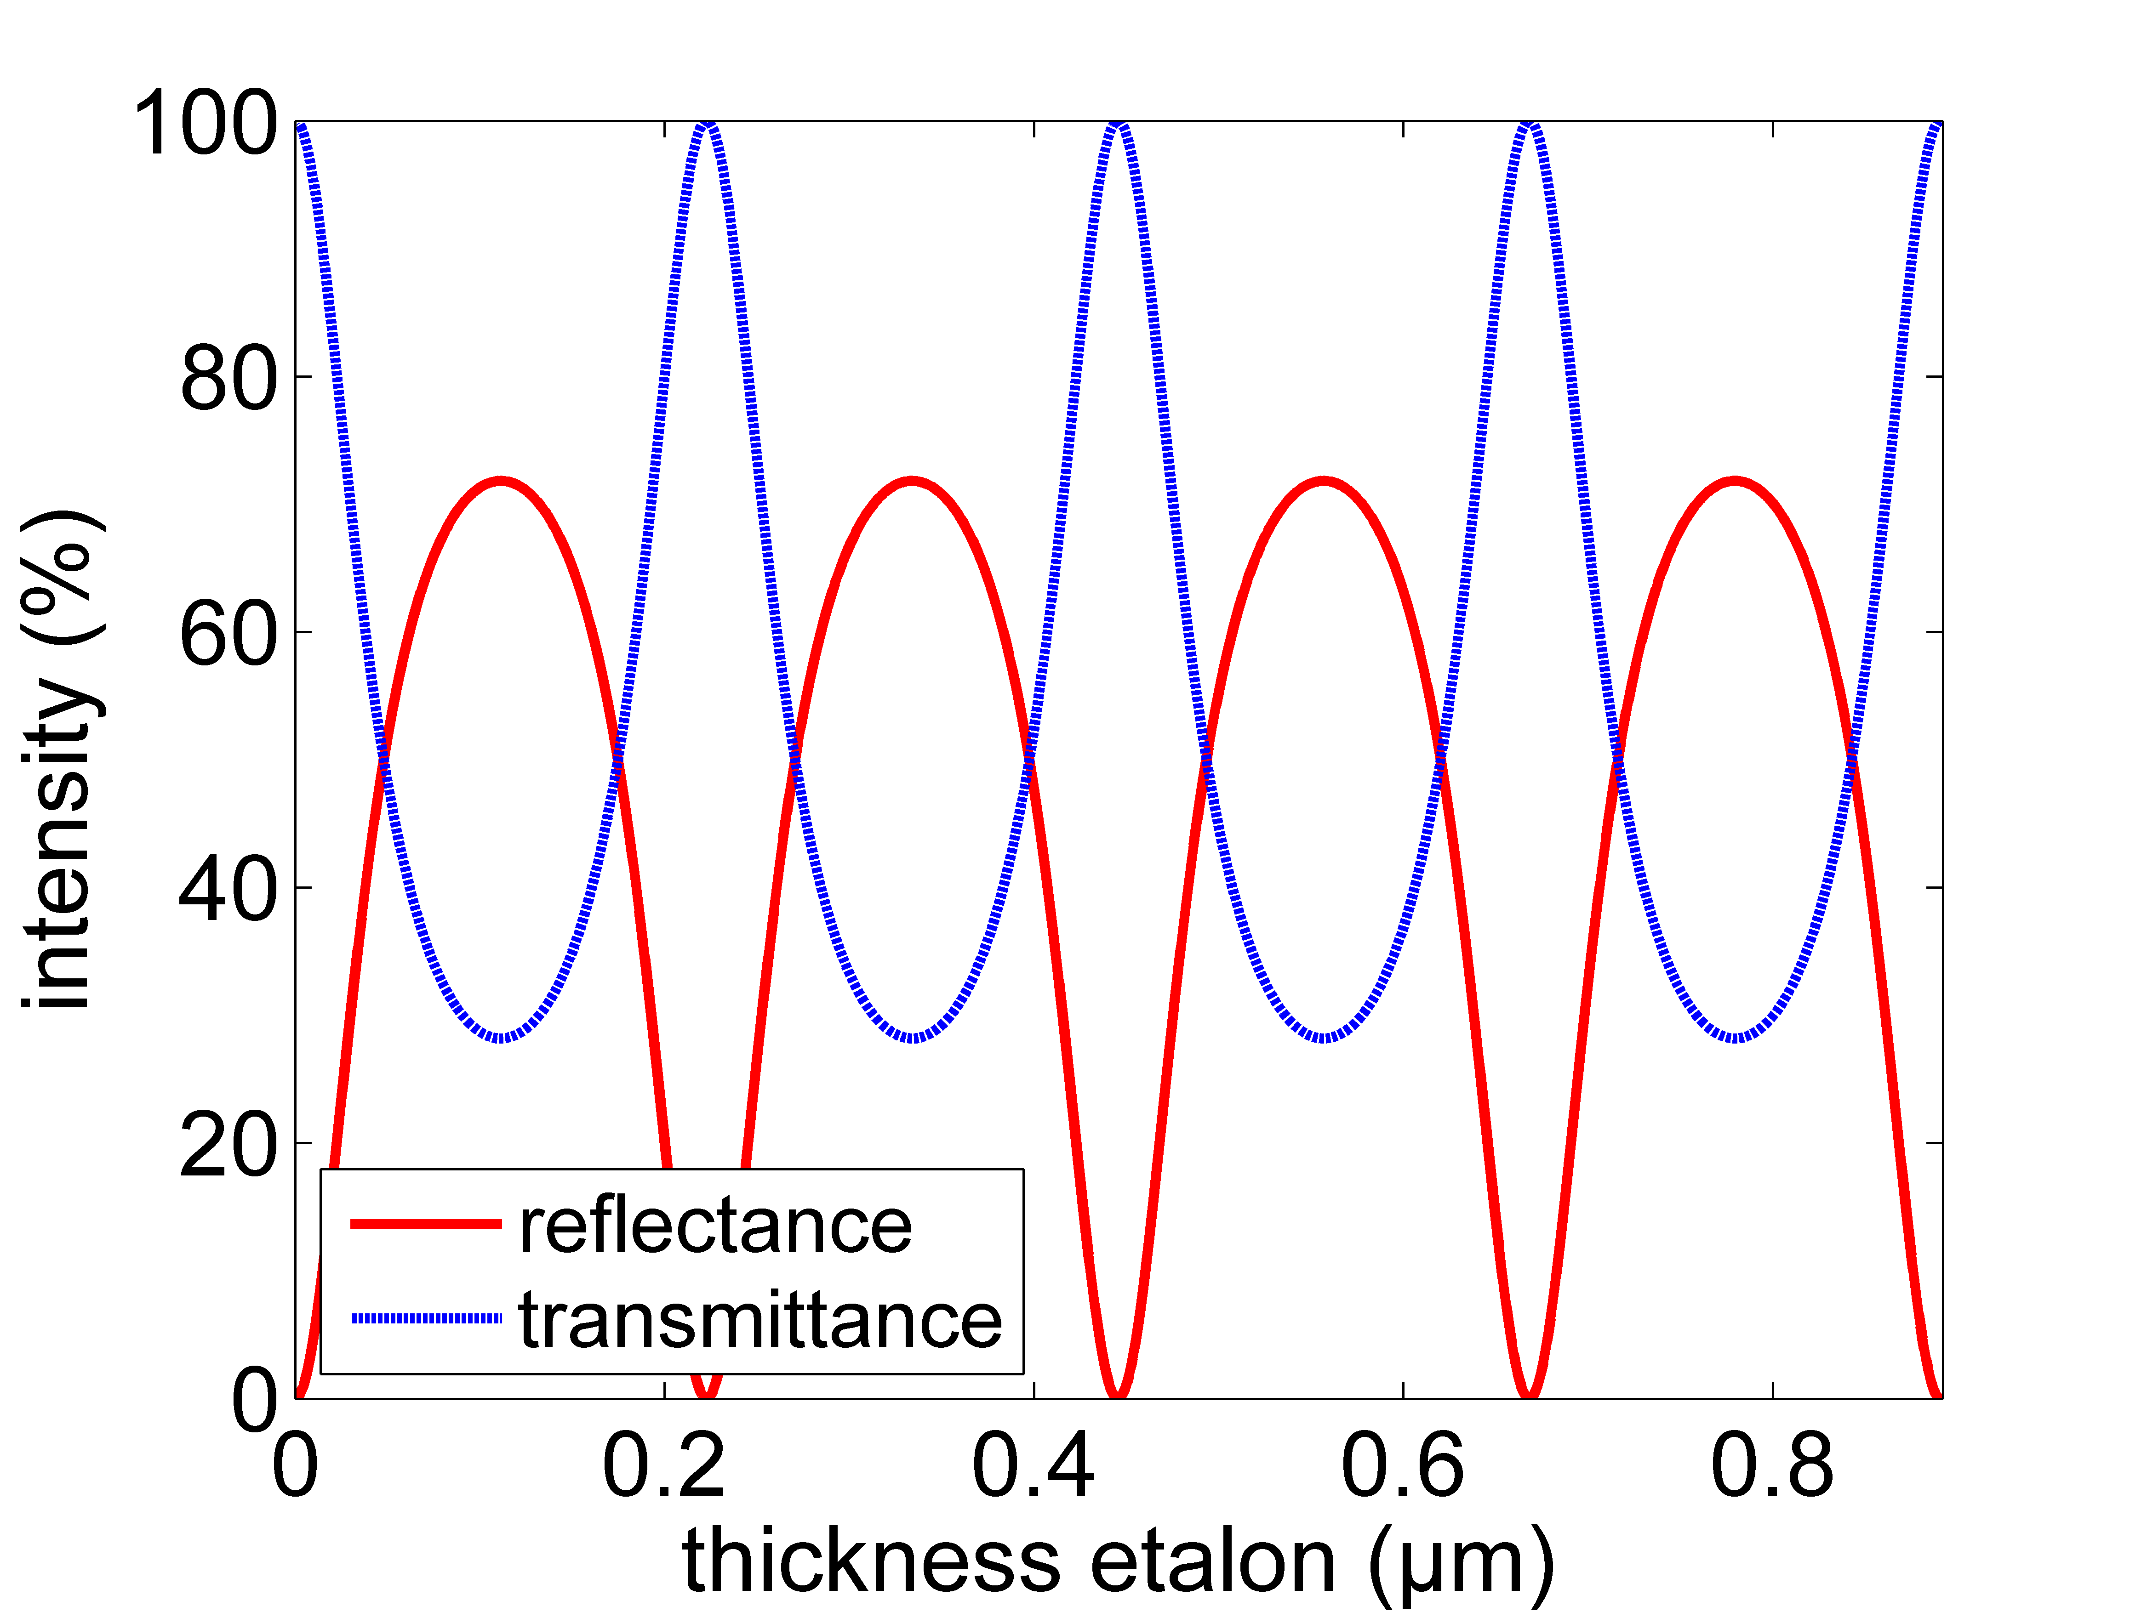

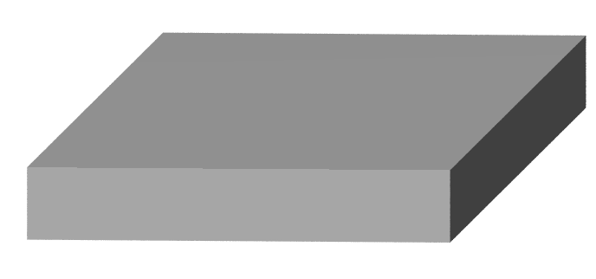



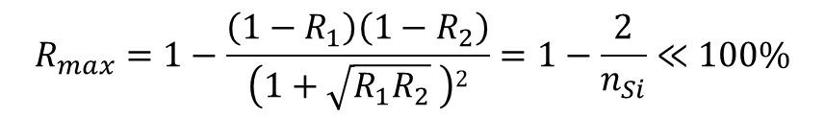
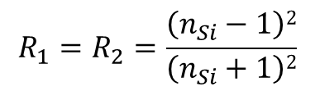
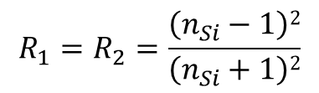

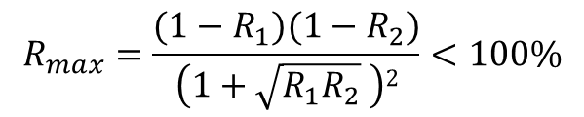
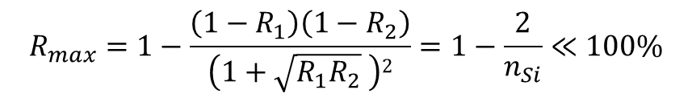

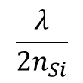
Grating reflectors for future GWD
Functionality of grating reflectors
$$\frac{λ}{2n_{Si}}$$
Single -Mode Fabry-Perot
homogeneous layer
$$R_{1}=R_{2}=\frac{\left(n_{Si}−1\right)2}{\left(n_{Si}+1\right)2}$$
$$R_{max}=\frac{(1−R_{1})(1−R_{2})}{\left(1+\sqrt{R_{1}R_{2}} \right)2}<100\%$$
$T_{min}$=28%
$$n_{Si}=3.48$$
$$Rmax=72\%$$
$$R_{max}=1−\frac{\left(1−R_{1}\right)\left(1−R_{2}\right)}{\left(1+\sqrt{R_{1}R_{2}} \right)2}=1−\frac{2}{n_{Si}}≪100\%$$
Notes:
Brauchen was kristallines mit hoher Brechzahl-> evtl. noch Alternativen (zumindest vom rein optischen Standpunkt)?-> Kramers-Kronig, R=99.5% Brechzahl von 400! ☺

Slide 6
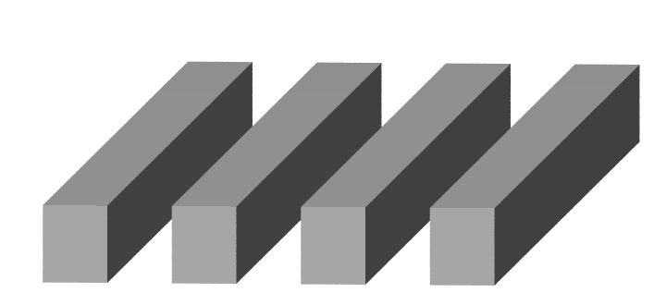
Grating reflectors for future GWD
Functionality of grating reflectors
Multi-Mode Fabry-Perot
Periodic structure = array of slab waveguides:
continuous spectrum of modes
number of excited propagating modes
dependent on:
structure (grating period, fill factor)
illumination (wavelength, angle of
incidence, polarisation)
limit number of propagating modes to 2
Notes:
Geometry of slabPeriodische Struktur -> kontinuierliches Spektrum -> durch Beleuchtung spezielle diskrete auswählt

Slide 7
Grating reflectors for future GWD
Functionality of grating reflectors
Two-Mode Fabry-Perot
incident
light
reflected light
light
incident
light
fundamental
mode
first mode
mechanism for R=100%:
phase difference due to different effective indizes (different k_{z,} interference),
reflection+ coupling at boundaries
amplitudes of grating modes need to cancel out: both cavities in antiresonance + destructive interference of amplitudes at bottom

Slide 8
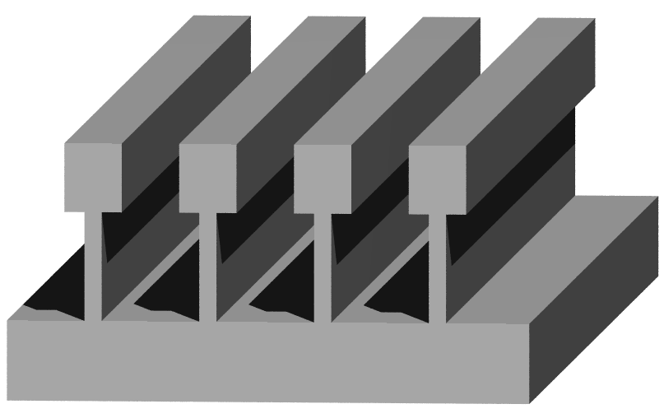
Grating reflectors for future GWD
Functionality of grating reflectors
For Scalability:
keep optical function of
free ridges:
only one mode in lower grating
(thin ridges ~ effective medium)
2 grating (Bloch-) modes
1 grating (Bloch-) mode
~ homogeneous layer
- Supporting structure no optical function – inhibits coupling of grating to substrate

Slide 9
Grating reflectors for future GWD
2D Periodicity for focusing mirrors
Add spatially changing phase to reflected wave

Slide 10
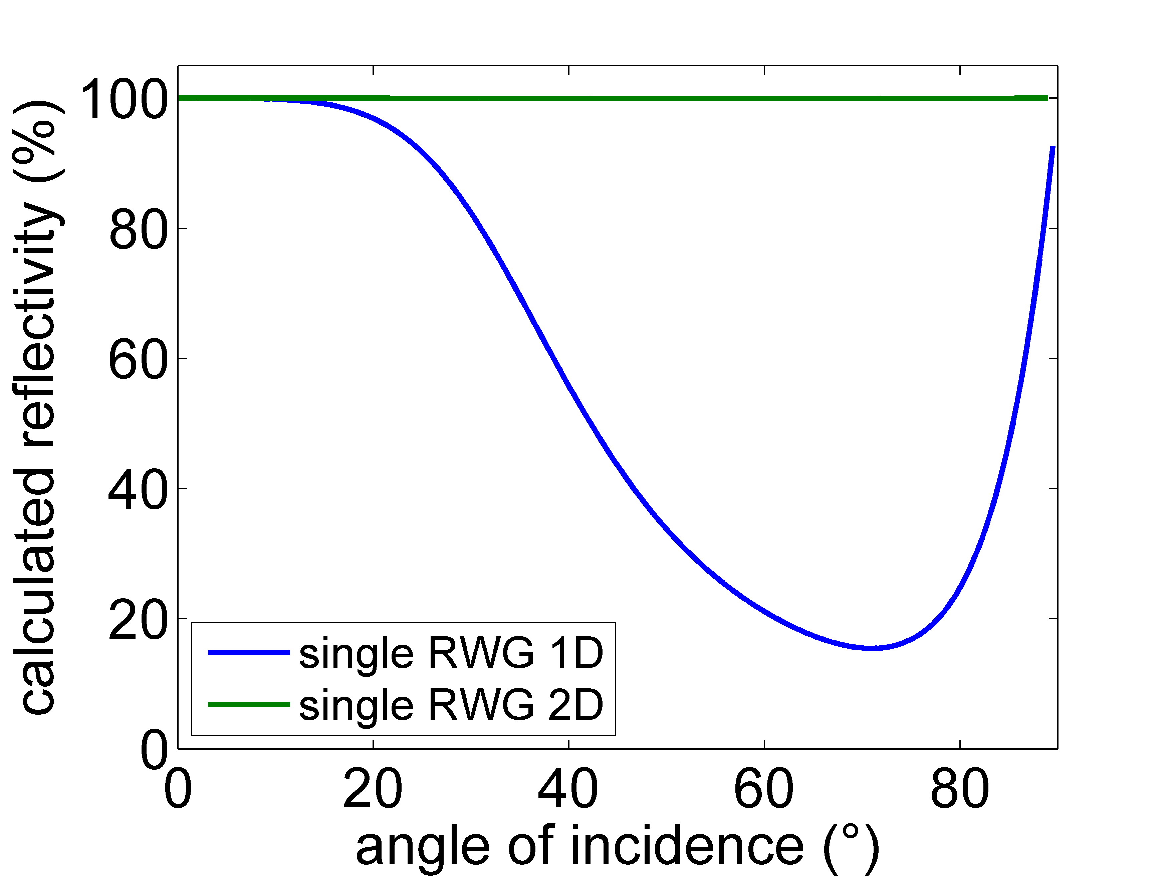
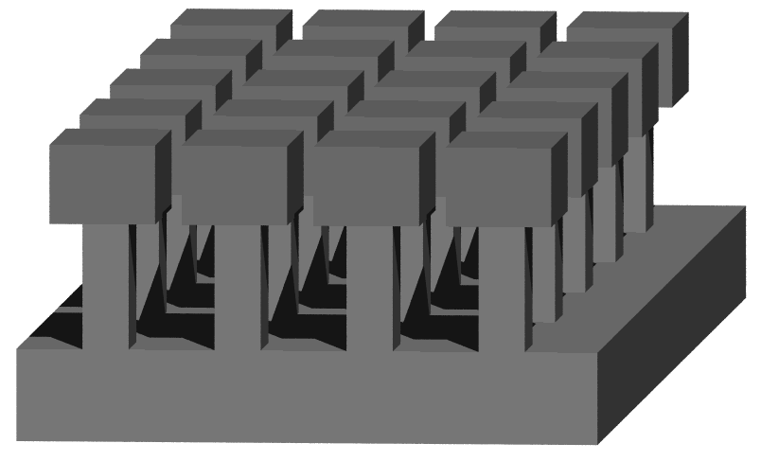
Grating reflectors for future GWD
2D Periodicity for focusing mirrors
Grating reflectors with 2D periodicity

Slide 11
Grating reflectors for future GWD
2D periodicity for focusing mirrors – current results
Experimental implementation
1. non-monolithic realization
λ=1550 nm
- interesting for filter applications, compatible to semiconductor industry

Slide 12
Grating reflectors for future GWD
2D Periodicity for focusing mirrors - Current results
2. monolithic realization
α=5°, TE
λ=1550 nm

Slide 13
Grating reflectors for future GWD
2D Periodicity for focusing mirrors - Current results
λ=1550 nm
maximum reflectivity
shifted to 1536 nm
more precise loss characterization to be done (polished backsides)

Slide 14
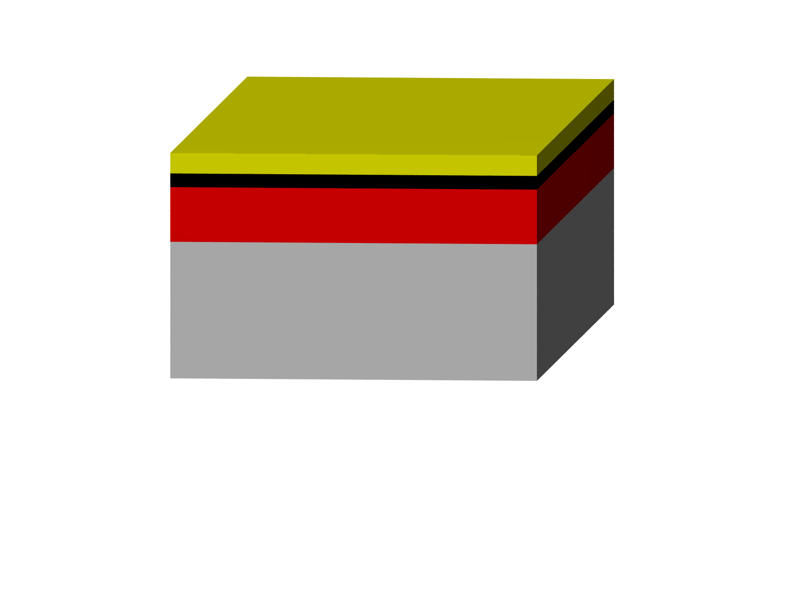

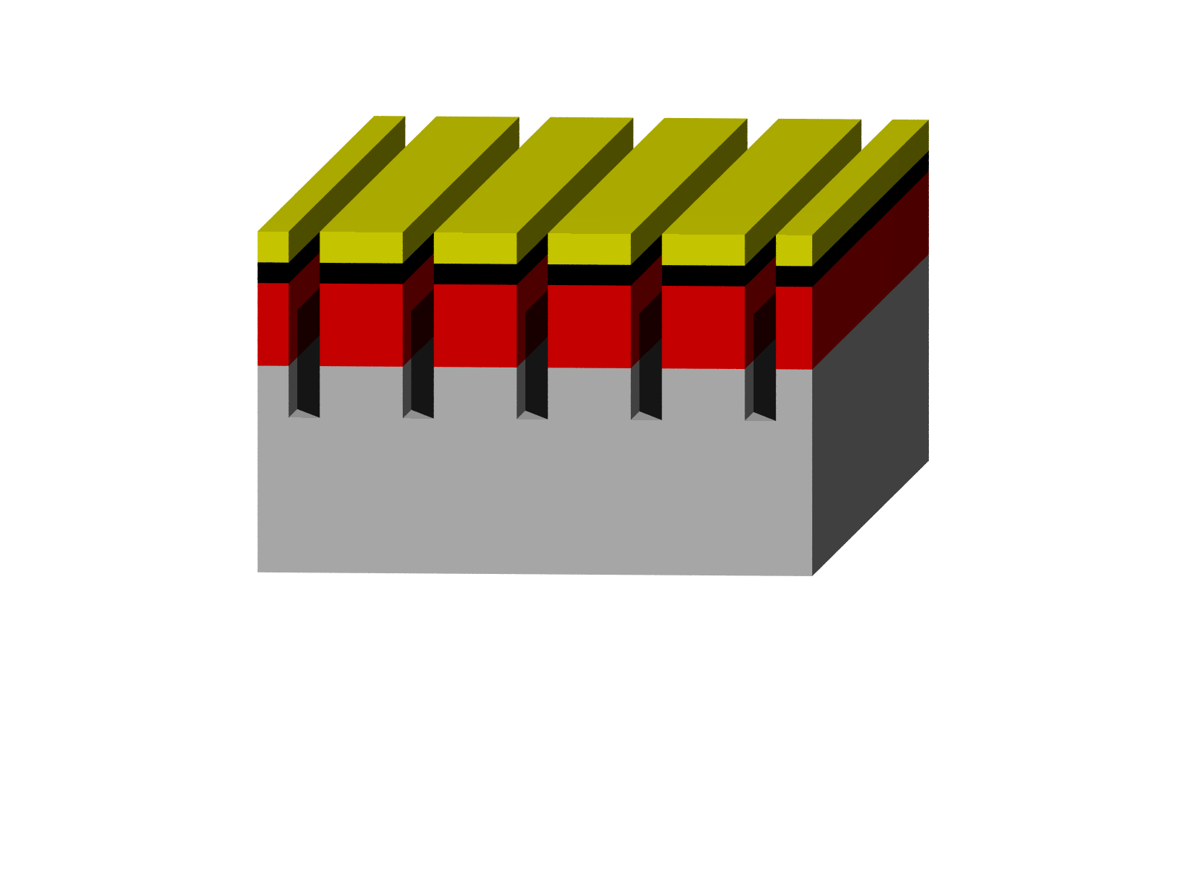
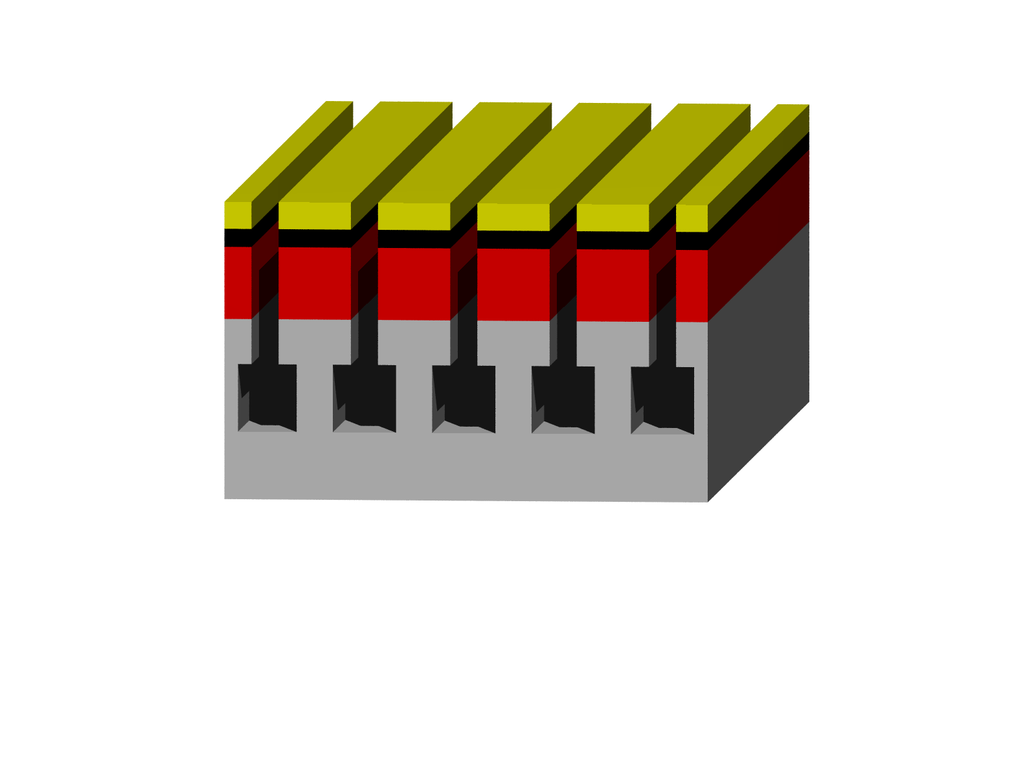
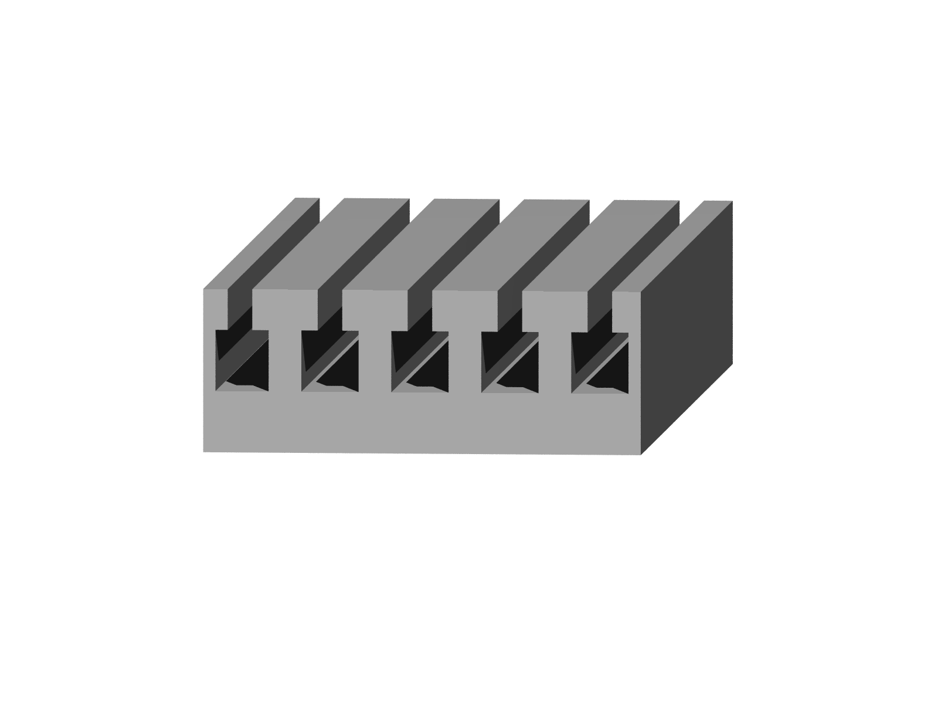
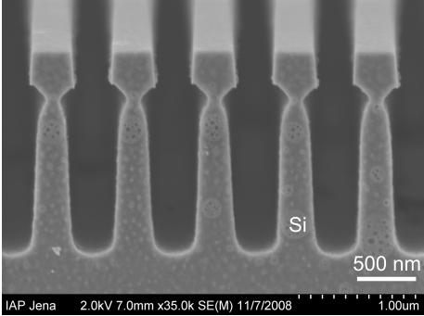
Grating reflectors for future GWD
Fabrication
Fabrication
anisotropic etching
process+
sidewall
passivation
isotropic
etching process
electronbeam-
lithography +
development
electron-
beamresist
silicon
SiO₂
chromium

Slide 15
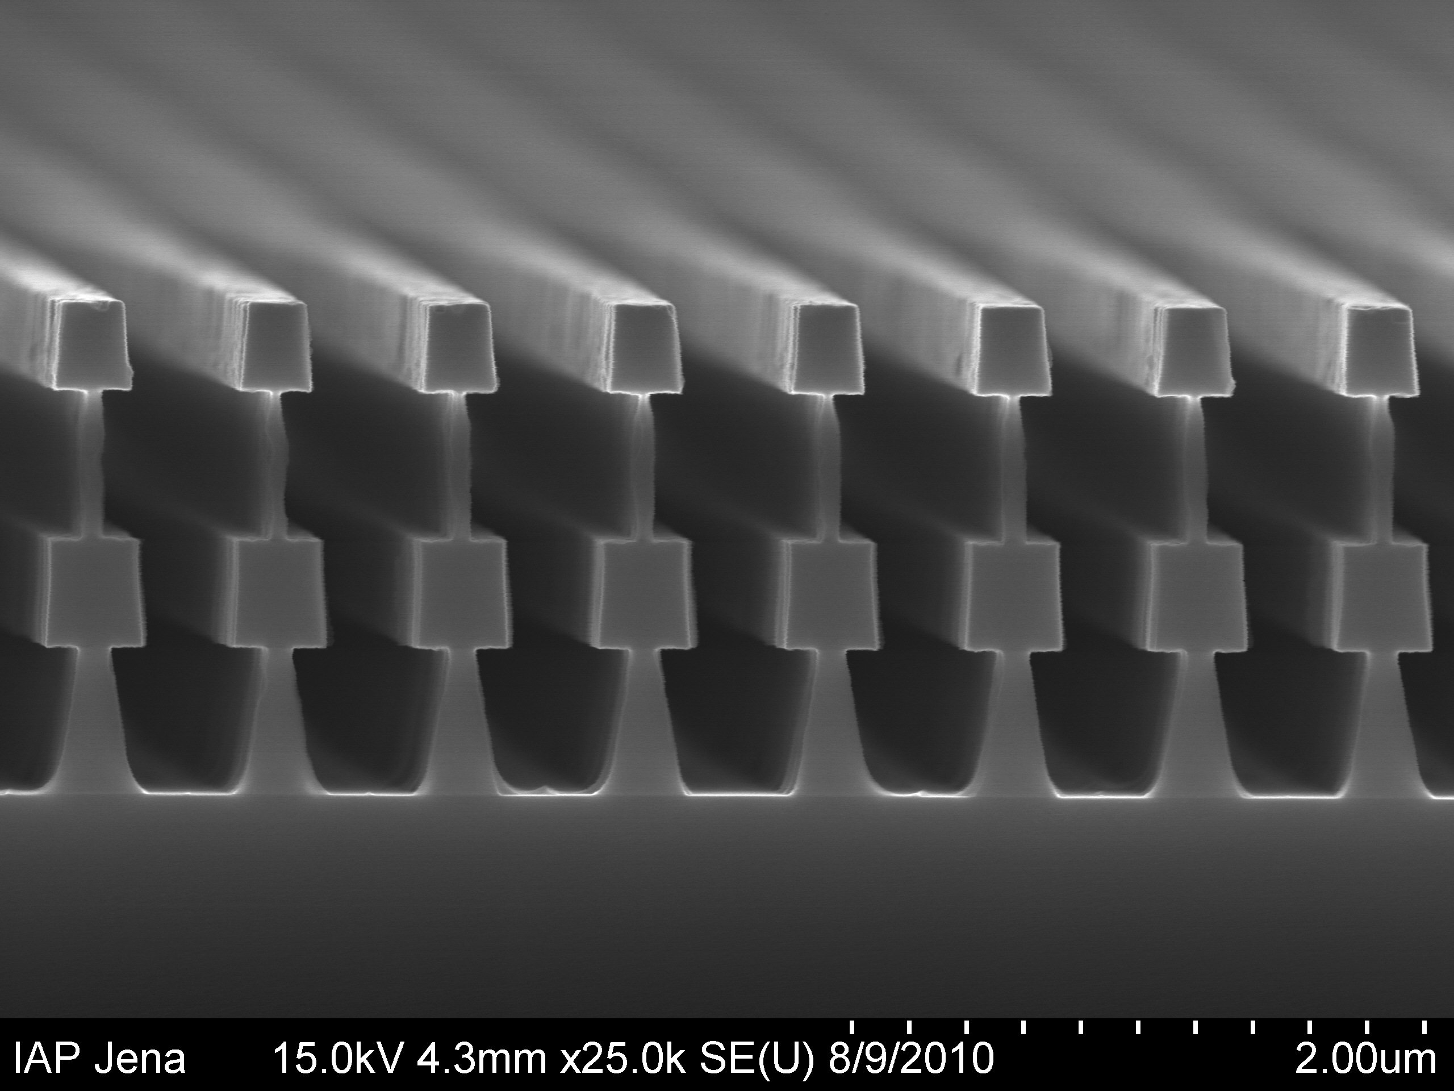
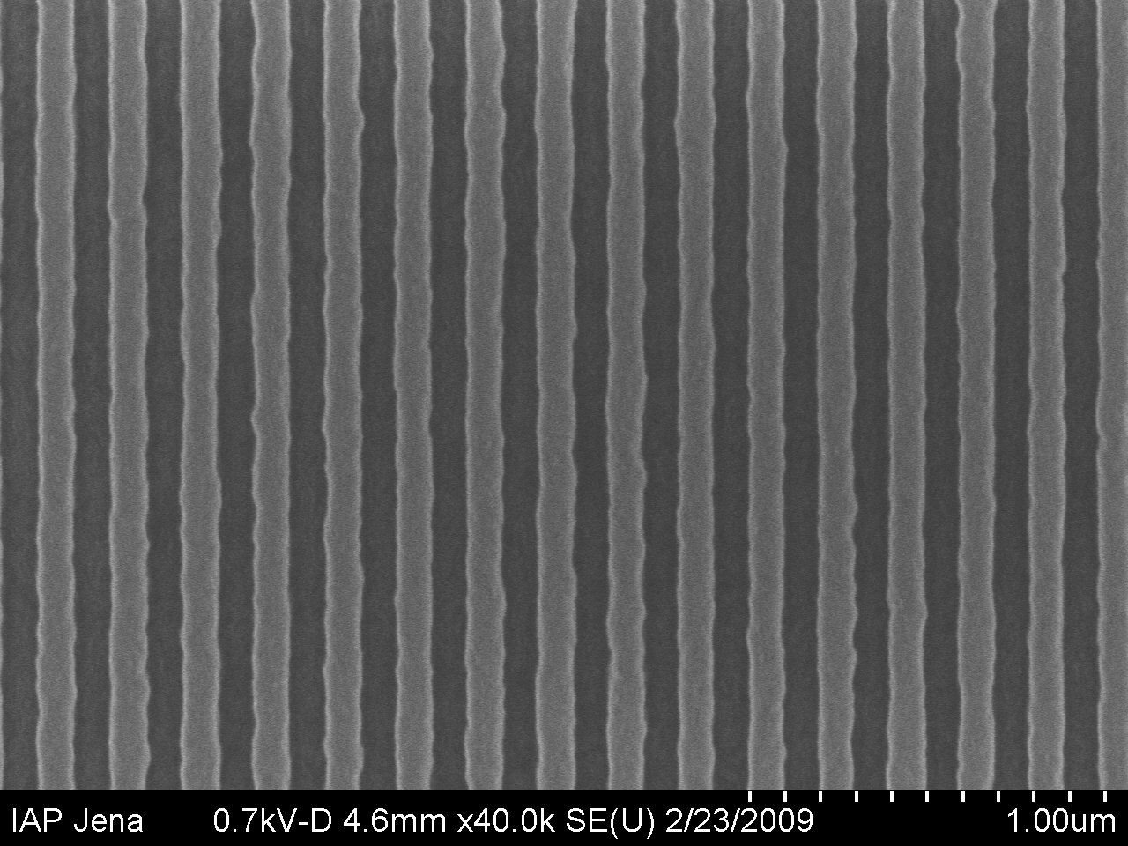
Grating reflectors for future GWD
Optical losses
Where is the missing light?
R=(99.8±0.01)%
scattered
light
absorption
transmission
material properties
structure
deviations
systematic
(ridgewidth/-depth)
stochastic
(roughness)
2 µm
Notes:
Strukturen… Kantenrauhheit… Resist.. lack

Slide 16
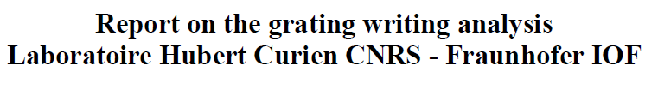
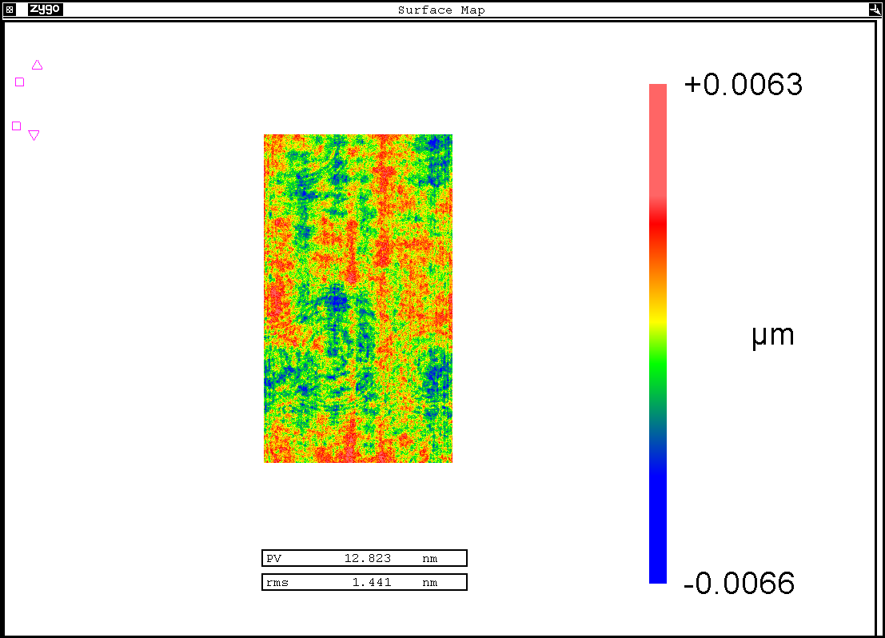
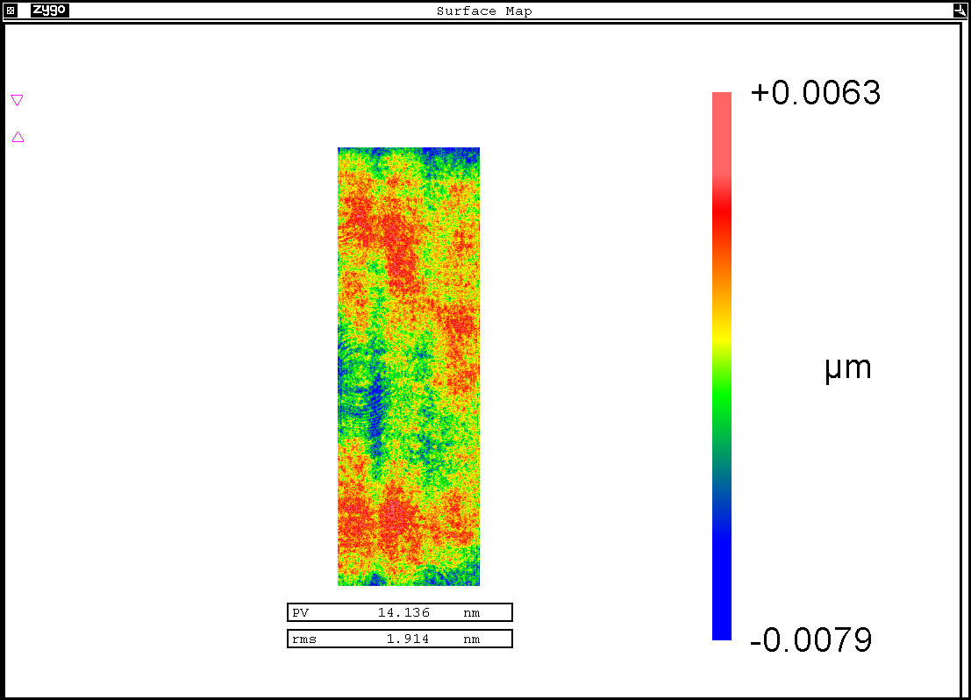
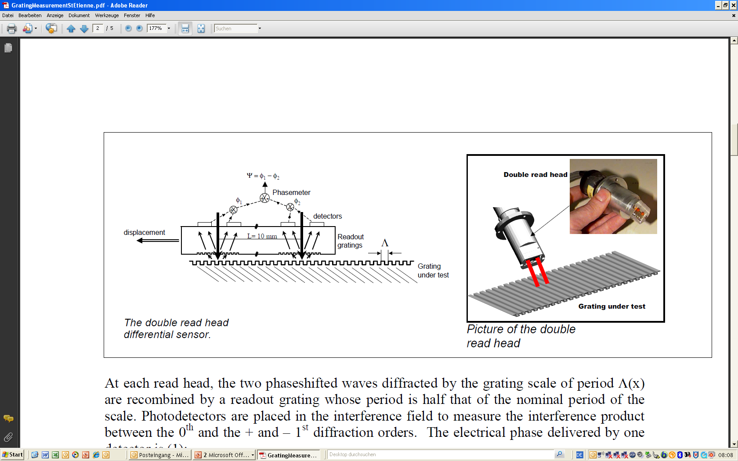
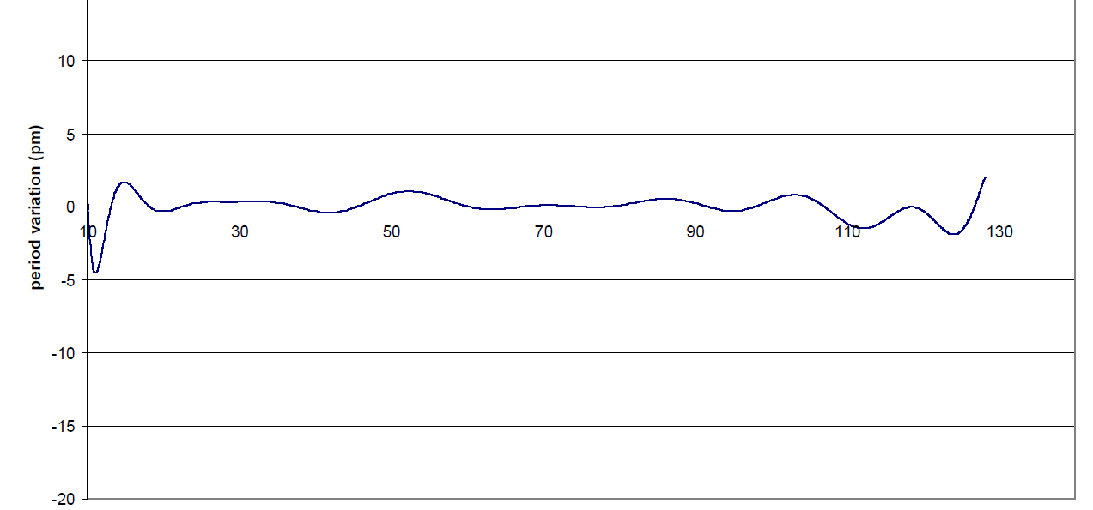
Grating reflectors for future GWD
Optical losses
Grating accuracy
wave-front measurement (1 µm period grating + technology, Littrow-Mount, λ=633 nm)
19 mm
+ 6.3 nm
50mm
- 6.6 nm
 | wavefront | placement
PV | 12.8 nm | < 10.3 nm
rms | 1.4 nm | < 1.1 nm
period variation (pm)
position [mm]
significantly better than interferometric gratings
period variation < 5 pm

Slide 17
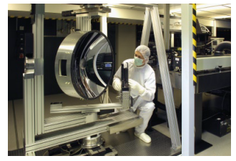
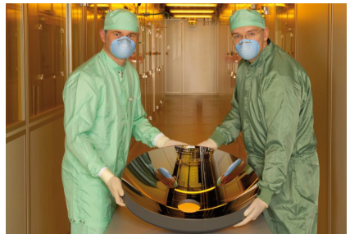
Grating reflectors for future GWD
Setup for measurement of scattered light
Sophisticated setup for measurement of scattered light ALBATROSS
at Fraunhofer Institute IOF
First measurements of scattered light at 1550 nm performed.

Slide 18
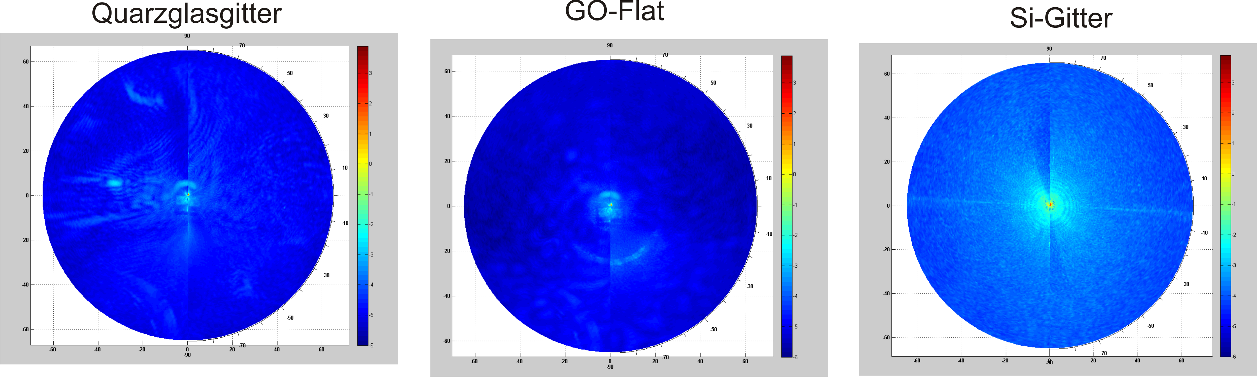

Grating reflectors for future GWD
First scattering measurements
reference flat
Total integrated scattering @ 1550 nm:
$$S_{grating}=2.5×S_{flat}$$
grating
more measurements on more samples
necessary
- TIS measurement sensible at all?

Slide 19
Grating reflectors for future GWD
Origin of scattered light
Where does scattered light mainly come from inside the structure?
Substrate roughness
Roughness in grooves
(~3x substrate roughness)
Line edge roughness

Slide 20
Grating reflectors for future GWD
Origin of scattered light
Scattered light dependent on energy density
no energy in grooves .
no scattering contribution
small field in upper parts
very small contribution from
substrate roughness
Main contribution: line edge roughness from lower part of optical grating

Slide 21
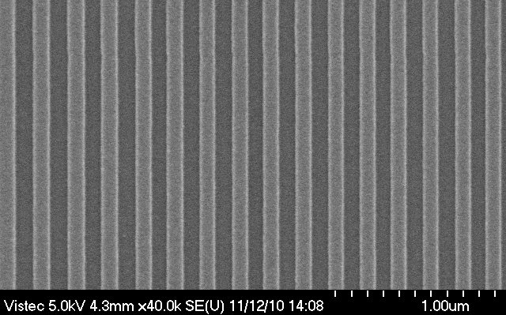
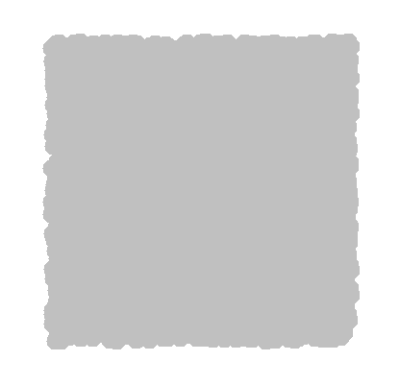
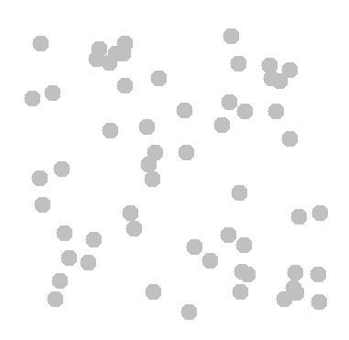
Coating-reduced interferometer optics
Optical losses
Line edge roughness due to particle statistics in the lithographic process
electron impacts
low sensitivity
(8000 e⁻/100 nm²)
HSQ (1300 µC/cm²)
100 nm ridges and grooves
10nm
FEP 171 (9.5 µC/cm²)
high sensitivity
(60 e⁻/100 nm²)
10nm
M. Heusinger, diploma thesis (2011)

Slide 22
Grating reflectors for future GWD
Possiblity for scattering reduction
What can we do to fight scattered light?
alternative writing strategies with electron-beam lithography
less sensitive resists
annealing processes for etching masks (low pass for
spatial frequencies)
revision of grating topology: roughness <-> energy density

Slide 23




Grating reflectors for future GWD
Thermal noise of grating reflectors
Collaboration to evaluate thermal noise of gratings
D. Heinert
S. Kroker
R. Nawrodt
S. Vyatchanin
K. Yamamoto
D. Friedrich
S. Hild
I. Martin

Slide 24
Grating reflectors for future GWD
Thermal noise of grating reflectors
Using Levin‘s scheme – how to apply virtual forces?
One single interface/ layer stack
grating structure
Levin, PRD 1998
several interfaces to be
considered

Slide 25



Grating reflectors for future GWD
Virtual forces on monolithic gratings
p
b=f x p
General properties
grating period p | 688 nm
Refractive index n_{Si} | 3.48
Reflective grating
depth h | 350 nm
fill factor f | 0.5643
Supporting Structure
depth h_{s} | 800 nm
fill factor f_{s} | 0.25
h
b_{s}=f_{s} x p
e₁/b
Rigorous-Coupled-Wave Analysis (RCWA) results:
e₁/h
e₂/(b-b_{s})
$${e1=0.019}_{}$$
$${e2=−1.019}_{}$$
e_{s}
$${eS=0.63}_{}$$

Slide 26
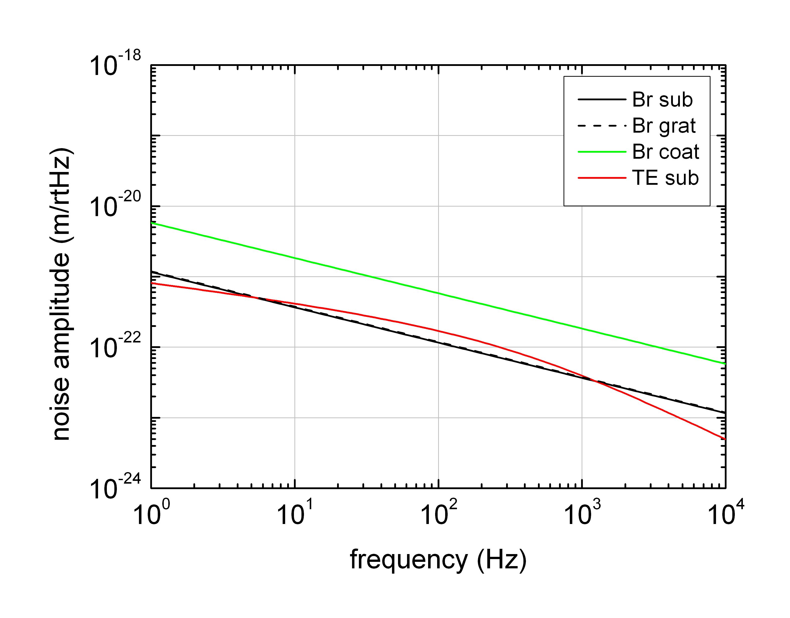
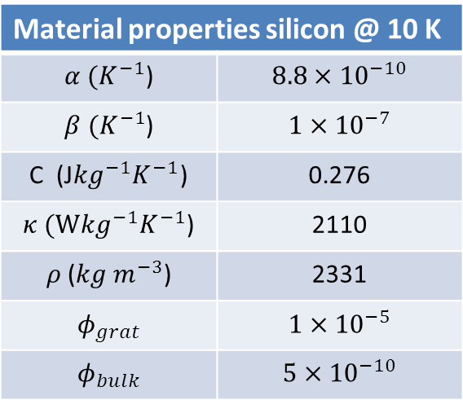
Grating reflectors for future GWD
Thermal noise of monolithic gratings
Thermal noise of monolithic grating @ 10 K
- thermo-optic noise negligible
Material properties silicon @ 10 K
$α (K^{−1}$) | $$8.8×{10}^{−10}$$
$β (K^{−1}$) | $$1×{10}^{−7}$$
C (J${kg}^{−1}K^{−1}$) | 0.276
$κ (W{kg}^{−1}K^{−1}$) | 2110
$ρ$($kg m^{−3}$) | 2331
$$φ_{grat}$$ | $$1×{10}^{−5}$$
$$φ_{bulk}$$ | $$5×{10}^{−10}$$
Substrate/Beam sizes according to ET-LF

Slide 27
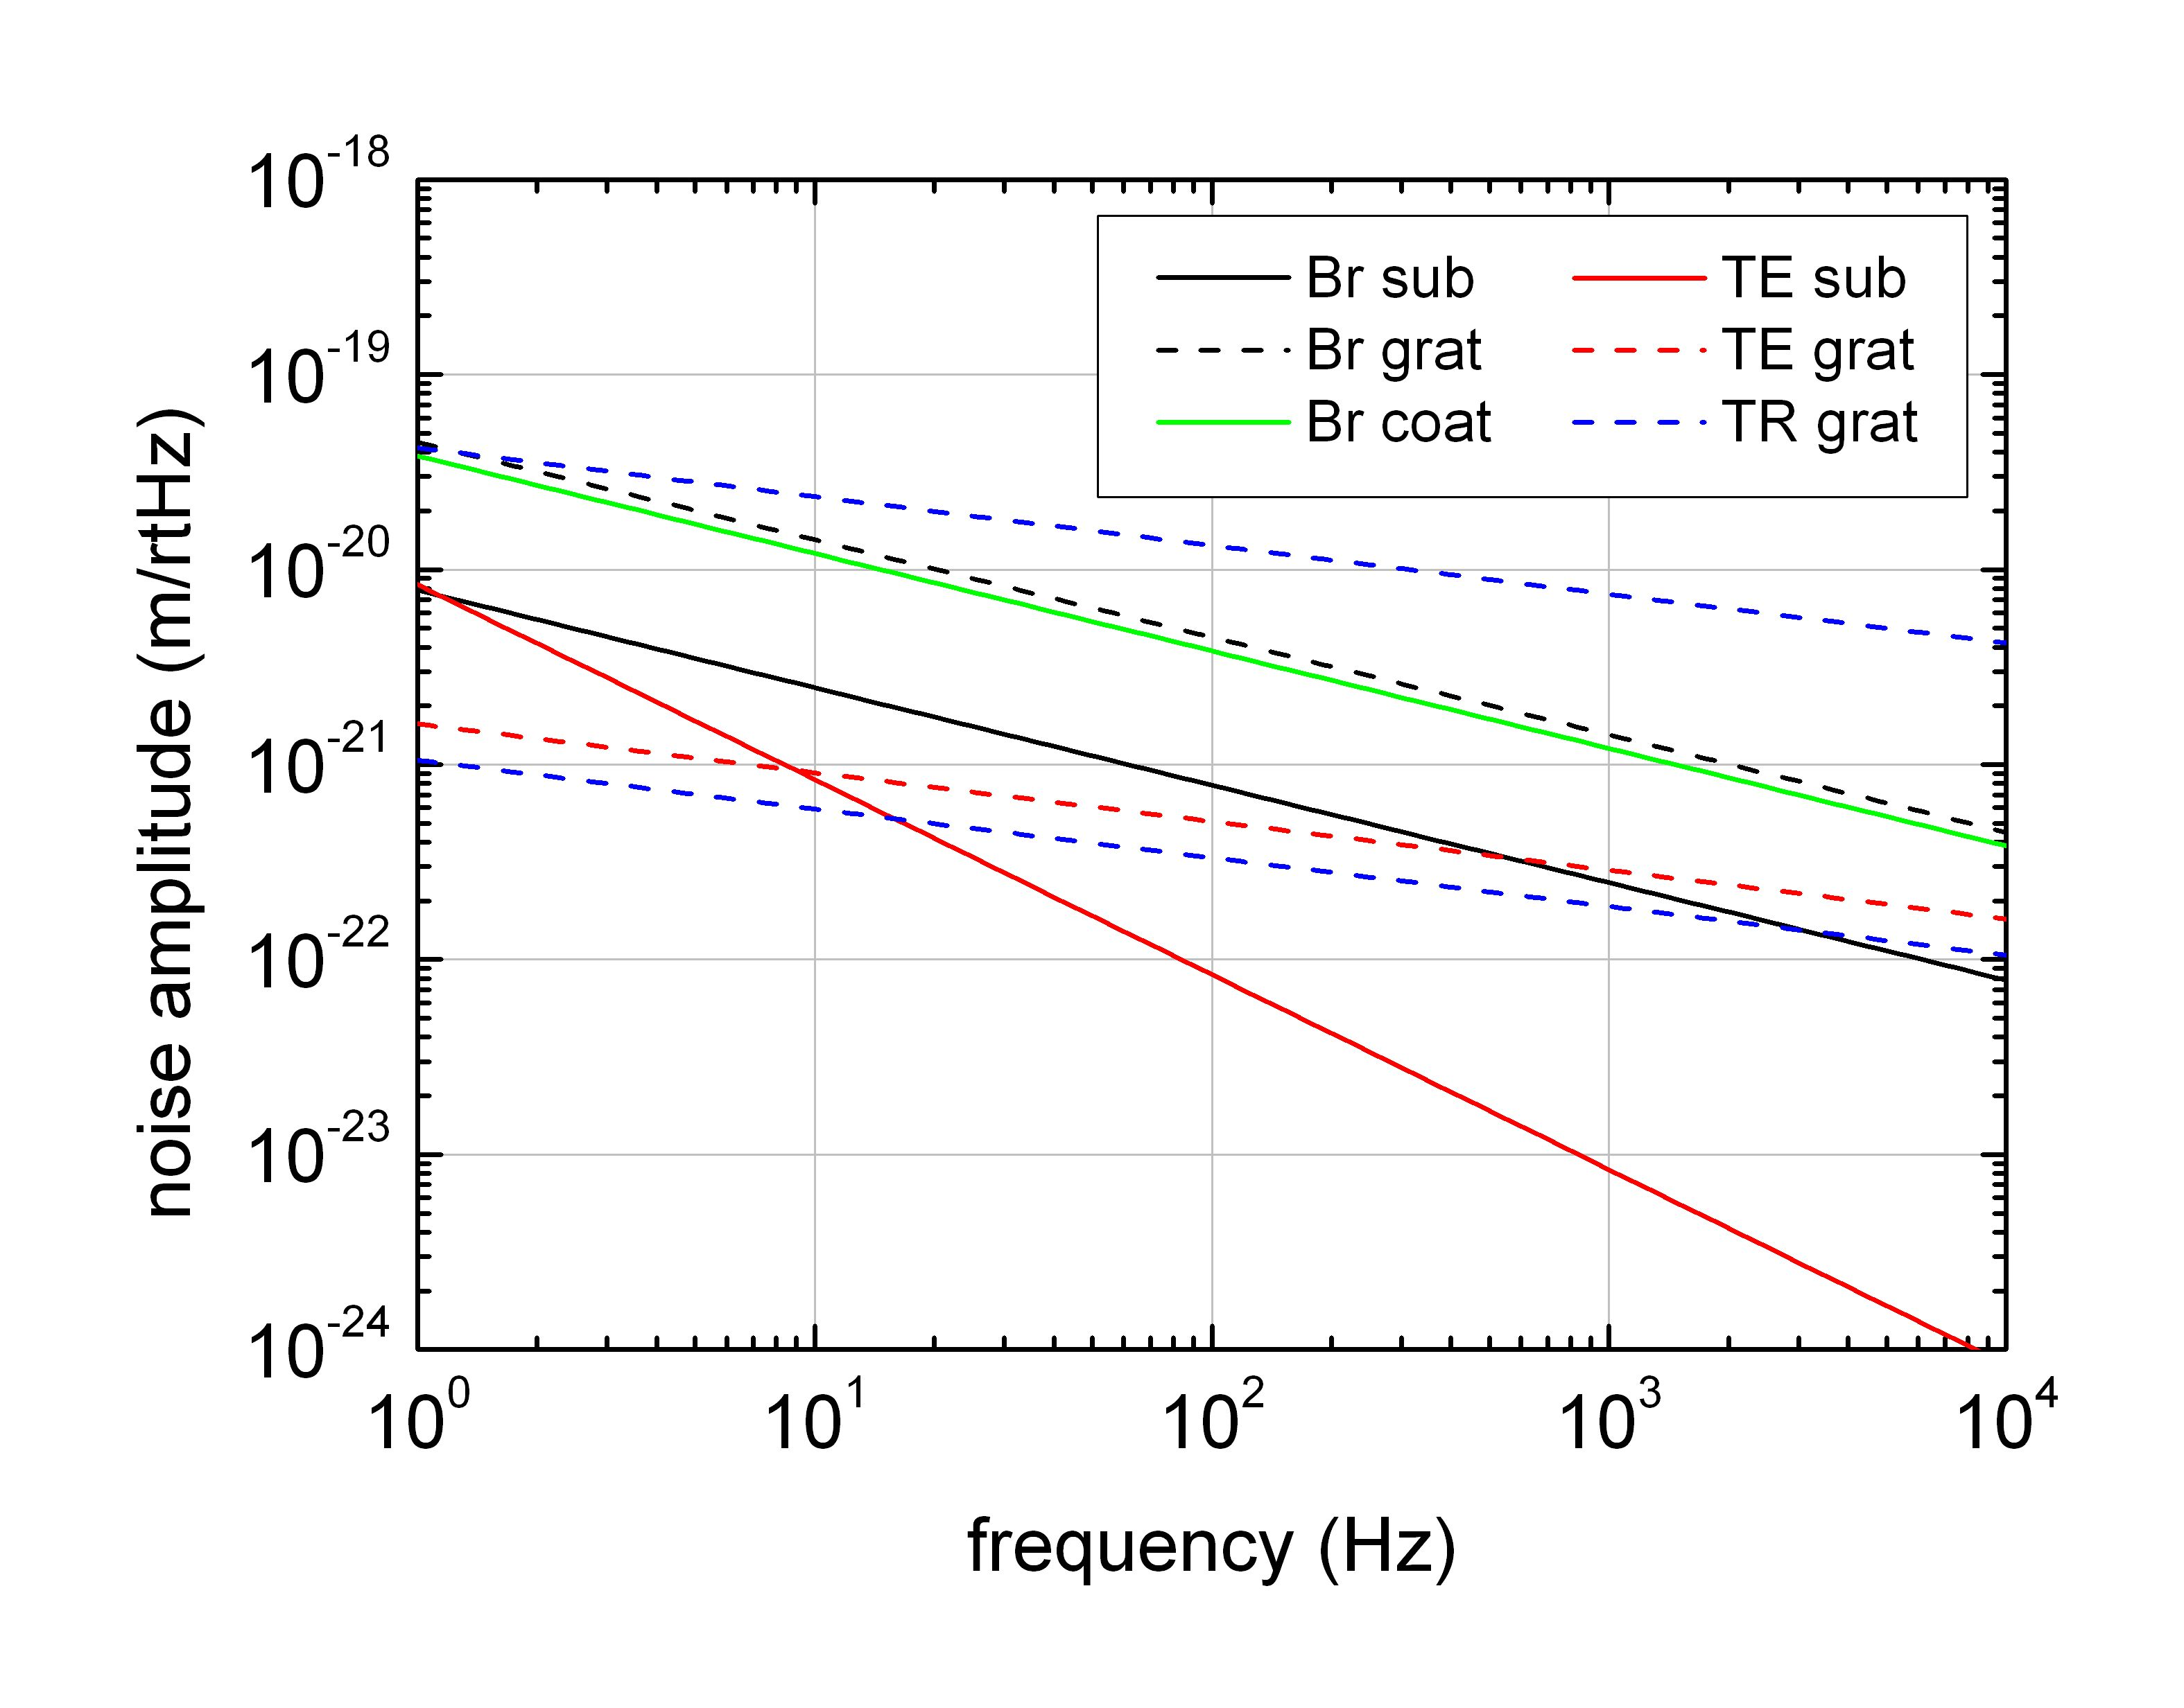
Grating reflectors for future GWD
Thermal noise of tantala gratings
Thermal noise of tantala grating @ 300 K, 1064 nm
Ta₂O₅
SiO₂
General properties
grating period p | 680 nm
refractive index n_{Si} | 2.1
Reflective grating
depth h | 570 nm
fill factor f | 0.52
For considered grating
configuration no noise
reduction
compared to layer stack !
Substrate/Beam sizes according to Advanced LIGO

Slide 28
Coating-reduced interferometer optics
Summary
Summary
Sucessfully fabricated highly-reflective 2D gratings.
Thermal noise of silicon reflectors is fine.
Tantala reflectors structure optimization to be
investigated. – It is not just all about scaling down
amorphous layer thickness.
Work on scattered light in process. Most critical
grating regions identified.

Slide 29
Acknowledgement:
This research is supported by the Deutsche Forschungsgesellschaft (DFG)
within Sonderforschungsbereich Transregio 7.

