Slide 1


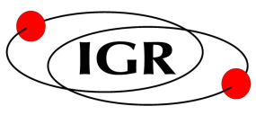
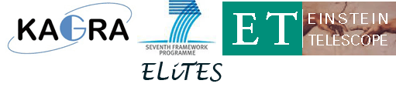
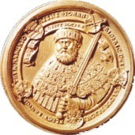

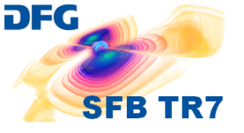


Silicon Research for the
Einstein Telescope
Ronny Nawrodt
G. Hofmann, D. Heinert, C. Schwarz, J. Komma, P. Pastrik, S. Kroker (FSU)
I. W. Martin, L. E. Wittrock, E. Wisniewski-Barker, A. Cumming, K. Haughian, P. Murray, G. D. Hammond, M. Abernathy, K. Craig, A. A. v. Veggel, N. Beveridge, J. Hough, S. Rowan (IGR)
S. Reid (UWS)
4th general ET meeting
Hannover 04.12.2012

Slide 2
Overview
Introduction (Why cryogenics and silicon?)
Properties we know
Unknown parameters and future work
Summary

Slide 3
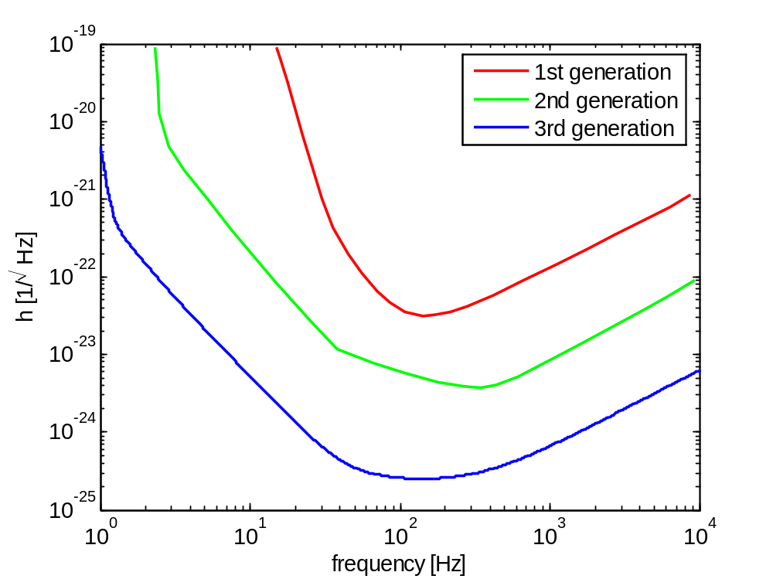
Increased sensitivity of ET
aim: 10x increased sensitivity between generations
x 10
x 10

Slide 4
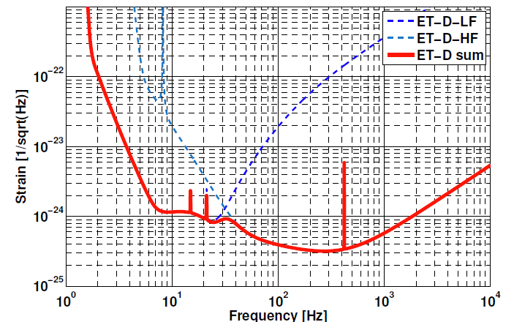
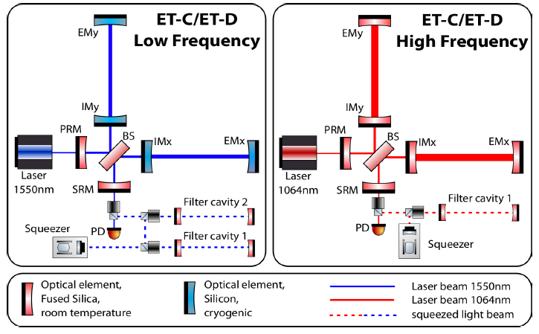
Increased sensitivity of ET
[S. Hild et al., CQG 27 (2010), ET-0135B-10, ET Design Study]

Slide 5
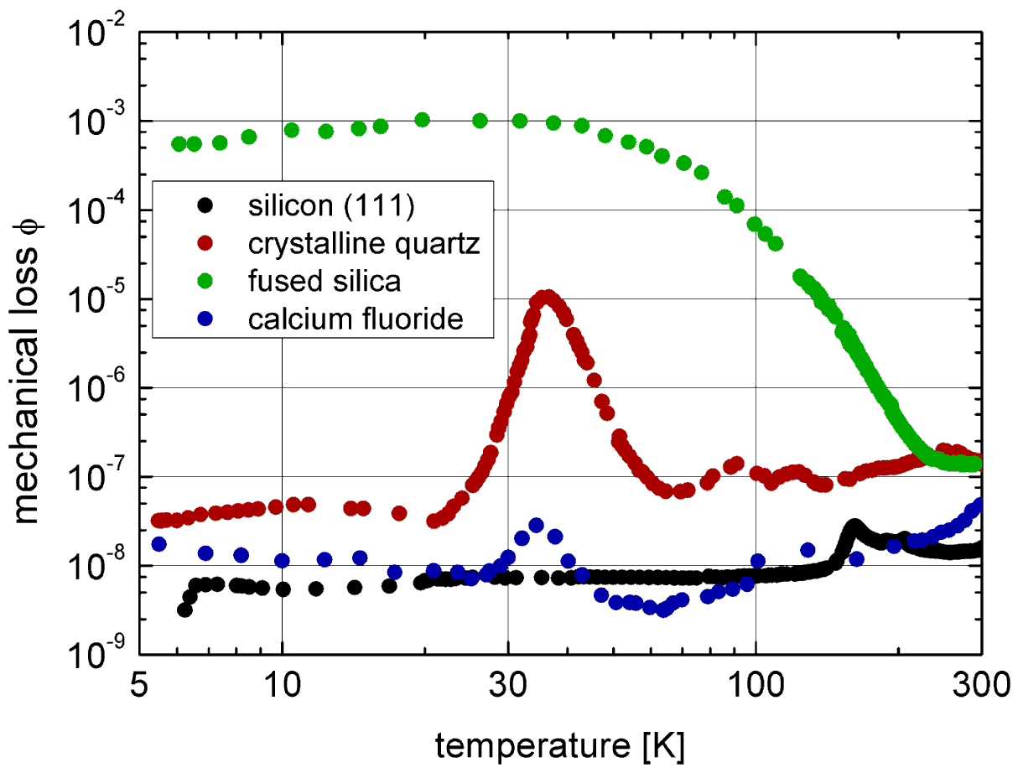
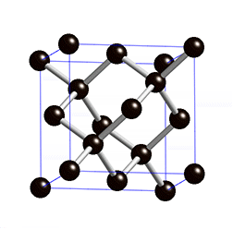
Cryogenic Mirrors / Suspensions
Brownian thermal noise (mirror, suspension) ~ T×ϕ
-> low temperatures AND low mechanical loss needed
amorphous materials
(e.g. fused silica):
loss peak at cryogenic
temperatures
crystalline materials:
low mechanical loss at
low temperatures

Slide 6
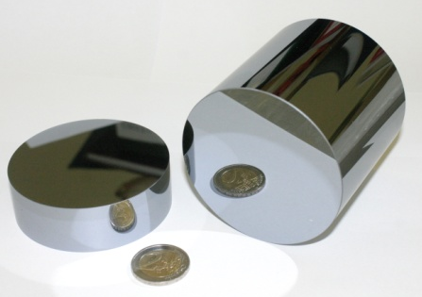
Cryogenic Mirrors / Suspensions
Why Silicon as test mass material?
  large beam diameters needed to reduce thermal noise → large substrates needed (up to 450-500 mm)
  only a few crystalline materials available with such a size → currently probably JUST silicon
intensive studies of parameters needed
  see talks/contributions at this meeting

Slide 7
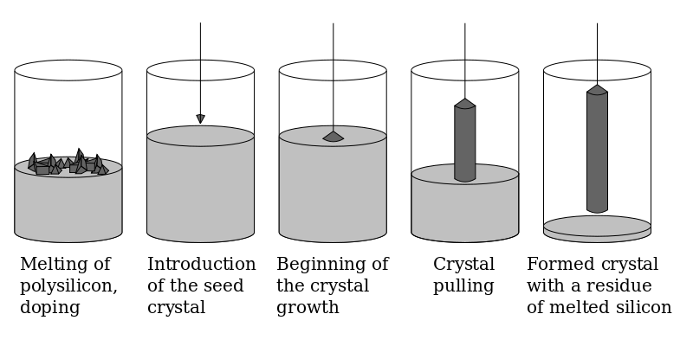
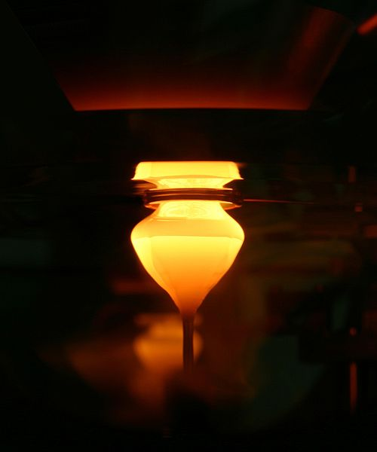
Silicon Crystal Production
Czochralski method (CZ)
Float Zone method (FZ)
Matthias Renner
other methods available but less common

Slide 8
Silicon Impurities vs. Growing Method
Czochralski method:
  large diameters possible (up to 450mm already demonstrated)
  silica crucible introduces impurities (mainly oxygen)
  large interest from semiconductor industry as oxygen impurities are electronically not active
Float Zone method:
  smaller samples (up to 200mm in production)
  limited general interest (e.g. selected optical applications and high power devices)

Slide 9
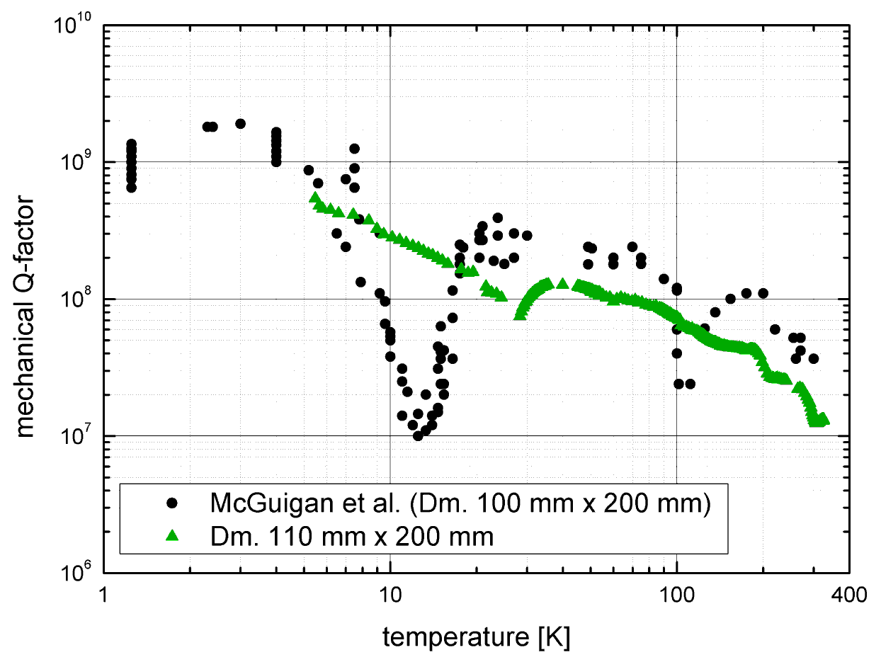
Silicon – Mechanical Loss
very high Q-factor at low temperatures
dips in curve related to impurities
current high quality material shows high Q-factor without dips

Slide 10
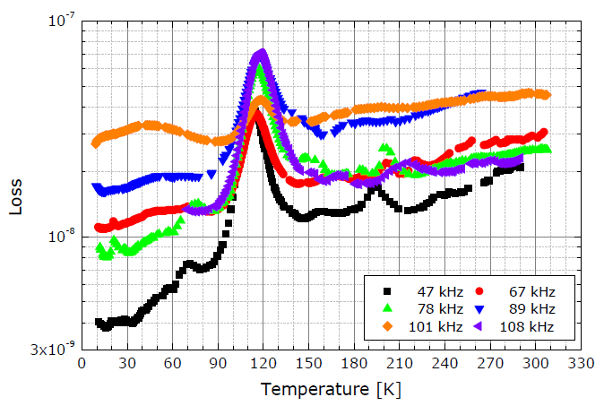
Silicon – Mechanical Loss
detailed study of impurities: oxygen in silicon
mechanical loss peak at around 120K → important for LIGO3?
no influence at estimated operating temperature of ET (10-20 K)
both CZ and FZ usable for ET from mechanical loss point of view
details: poster by G. Hofmann et al.

Slide 11
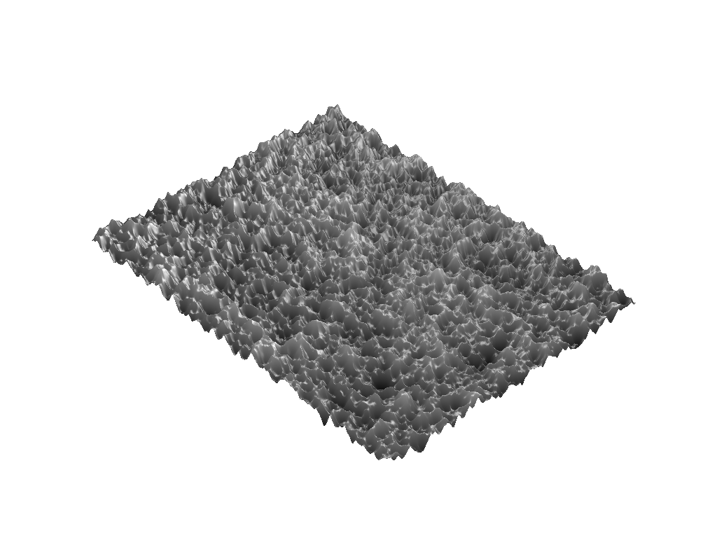
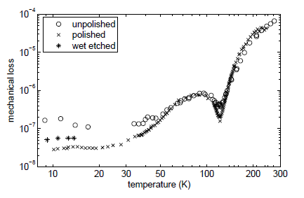
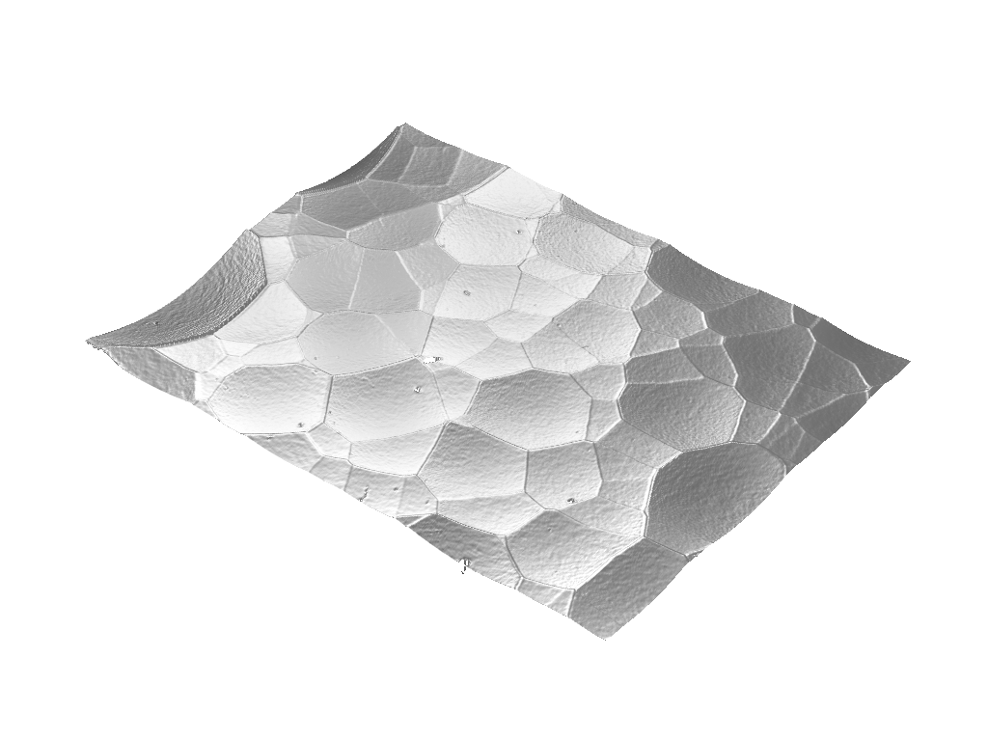
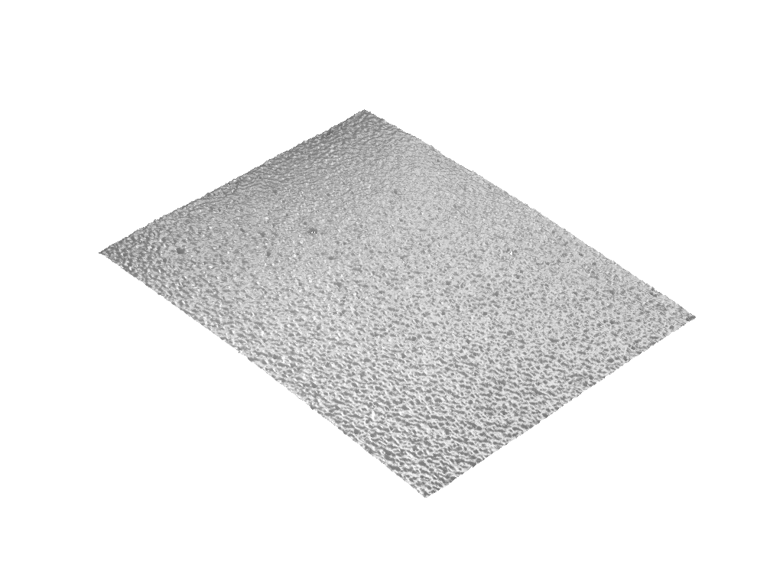
Silicon – Mechanical Loss
strong contribution from surfaces and their roughness
„rough“
„smooth“
example: Si flexures

Slide 12
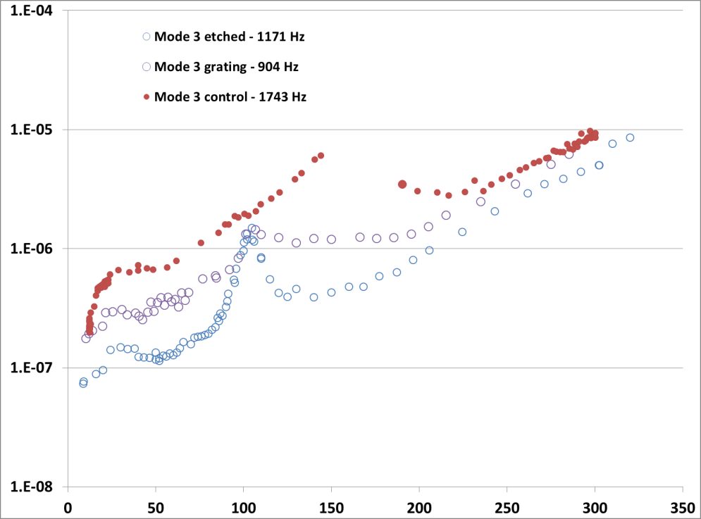
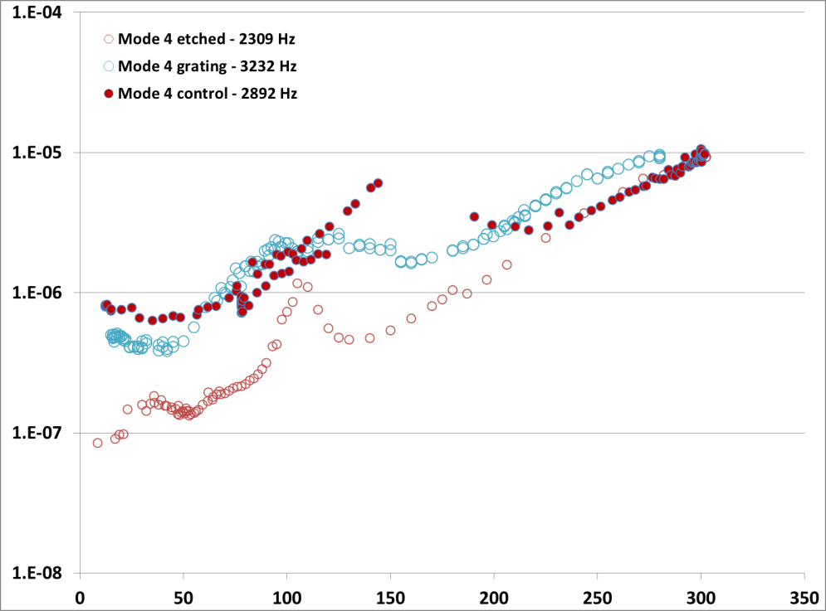
Silicon – Surface Loss
mechanical loss (surface loss)
origin of occuring peak so far unclear:
- lower underground loss might reveal a hidden loss peak
- loss peak is accociated with the etching-process -> surface effect? radiation damage?

Slide 13
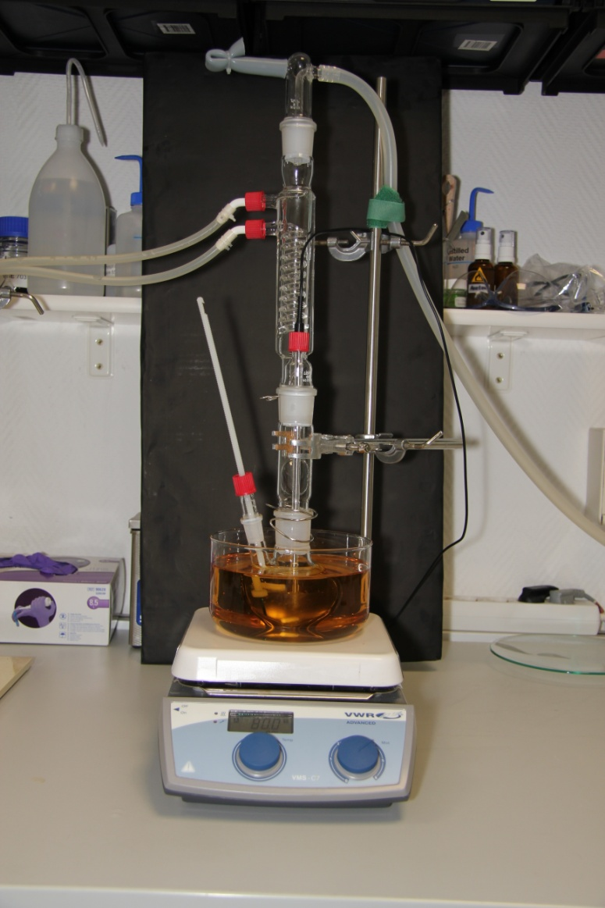
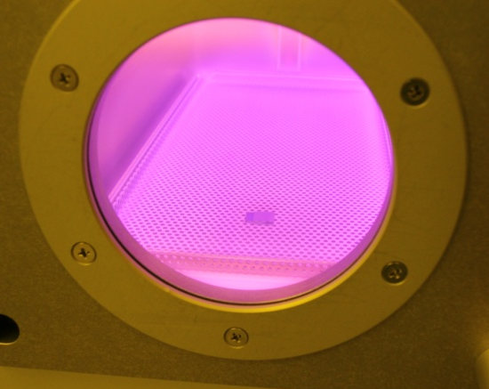
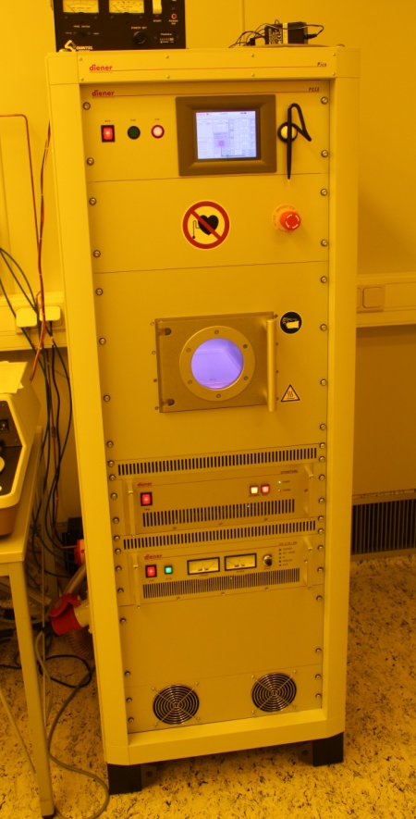
Silicon – Surface Treatments
surface treatments
plasma treatment
(etching, termination)
selective wet chemical
etching

Slide 14
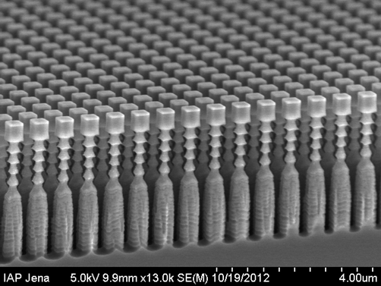
Silicon – Surface Treatments
Why is a surface treatment and its understanding important?
  reduction of mechanical loss of bulk
  strong influence in suspension design (small structures)
  see talk by:
  G. Hammond (suspensions), K. Haughian (silicate bonding)
  special treatments to realize grating structures
  see talk by S. Kroker

Slide 15
Silicon as an optical material
silicon not transparent at 1064nm (about 10cm⁻¹) → change of wavelength needed towards longer wavelength
telecom wavelength around 1550nm well suited as lasers/optics exist
several optical parameters need to be studied (e.g. n(T), dn/dT, optical absorption, etc.)

Slide 16
Silicon – Optical Absorption
energy gap absorption
free carrier absorption
E_{photon} > E_{gap}
additionally: phonon emission/absorption for conservation of momentum
no minimum energy (always present!)
carrier density strongly temperature dependent
CB
CB
VB
VB

Slide 17
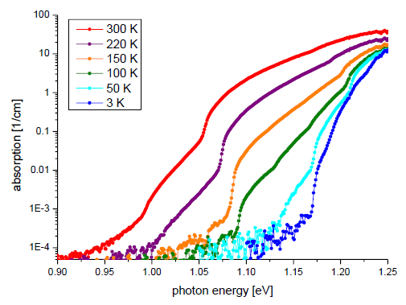
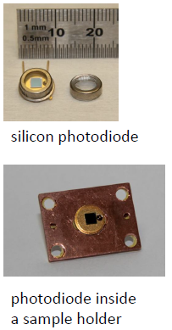
Silicon – Optical Absorption
electronic contribution (gap absorption)

Slide 18
Silicon – Optical Absorption
free carrier contribution
but: initial measurements at Stanford showed 35 ppm/cm or ~200 ppm/cm at Hannover at room temperature
more news: see talk by J. Degallaix (LMA)
fibre amplifier demaged

Slide 19
Silicon
Does high absorption rule out silicon?
input mirror of arm cavities are the only transmissive silicon mirrors
moderate laser power
due to high thermal conductivity and low thermo-refractive index thermal lensing is reduced
not hunting for 1ppm/cm
heat extraction through suspension will set limit

Slide 20
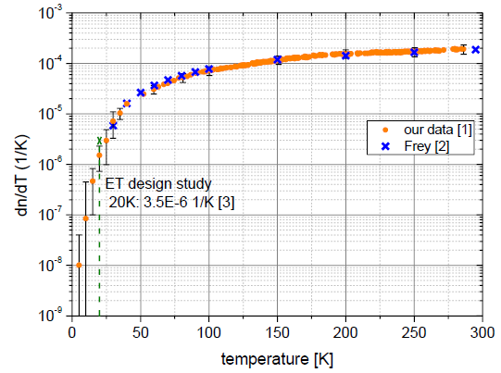
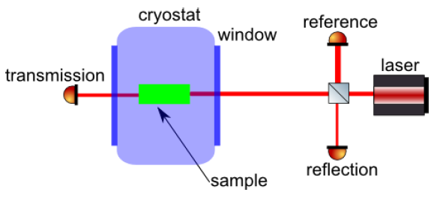
Silicon – thermo-refractive index
→ very low dn/dT at low temperatures
→ limitation for all phase change based absorption techniques (deflection, PCI, etc.)

Slide 21
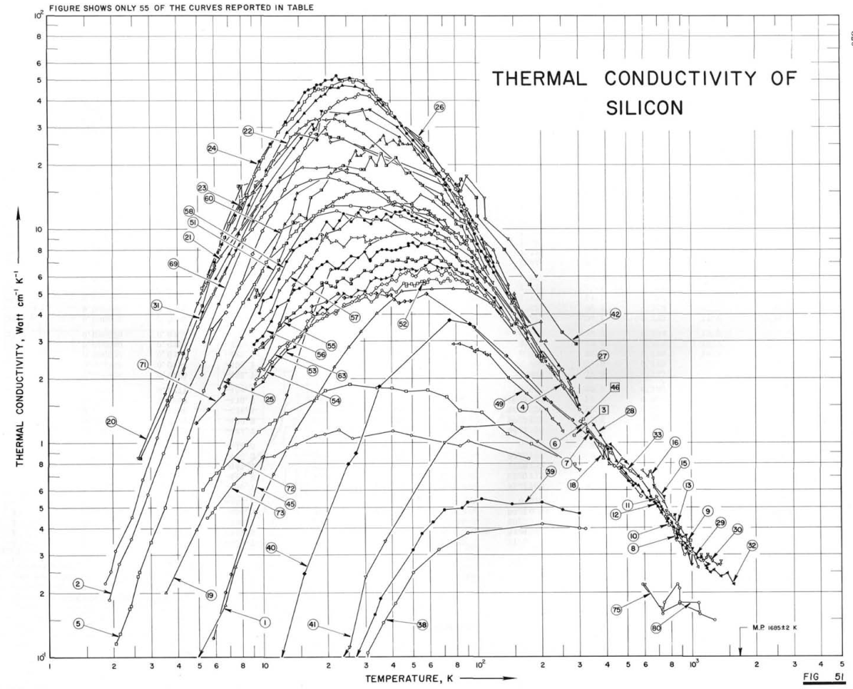
Silicon – Thermal Properties
thermal properties (overview)
well studied property
strongly size dependent
also: dependent on surface quality (roughness)
[Touloukian 1972]

Slide 22
Silicon – some future work
further studies of optical properties of silicon towards real sized mirrors:
  homogeneity of optical properties
  stress induced birefringence
  „natural“ birefringence (e.g. from crystal pulling technique)
content of the joint Aspera proposal

Slide 23
Link to Kagra Community
operation of cryogenic detector -> technology transfer (ELiTES project)
exchange of knowledge on mechanical loss (Sapphire, Silicon), suspension design and lots of technological issues
currently: visits ongoing (Japan -> Europe)
status of the work: see poster by R. Douglas and talk by Y. Sakakibara

Slide 24
Summary
silicon as mechanical and optical material for future GW detectors
promising parameters
ongoing research:
  breaking strength
  optical absorption -> Which level can be tolerated? -> suspensions
  homogeneity of optical parameters
  thermal conductivity vs. surface treatment
  mechanical loss vs. surface treatment

