Slide 1


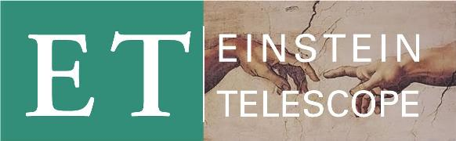
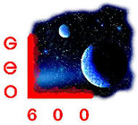

Thin film deposition and characterisation facilities available in the University of the West of Scotland
5th December 2012
14:10-14:30
Stuart Reid

Slide 2


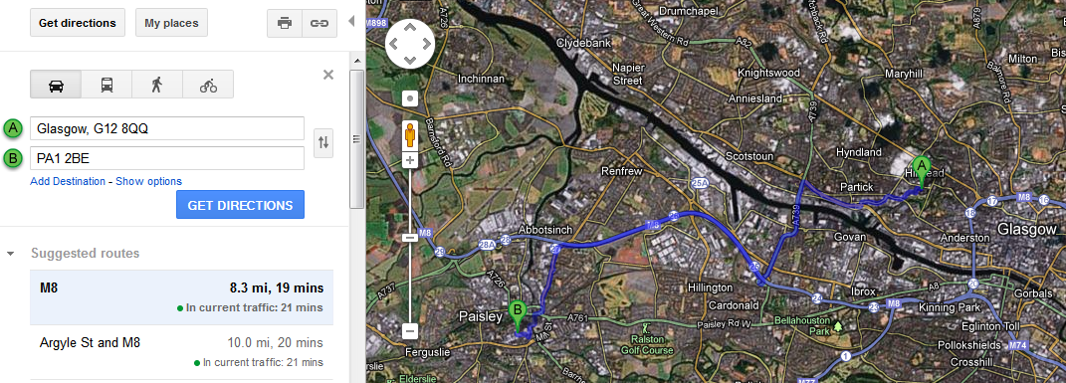
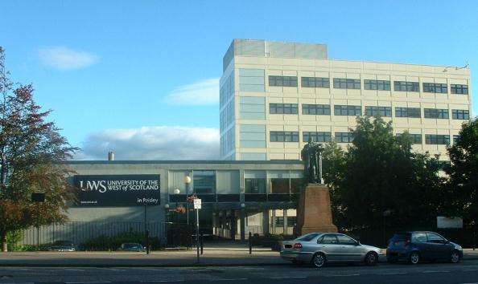
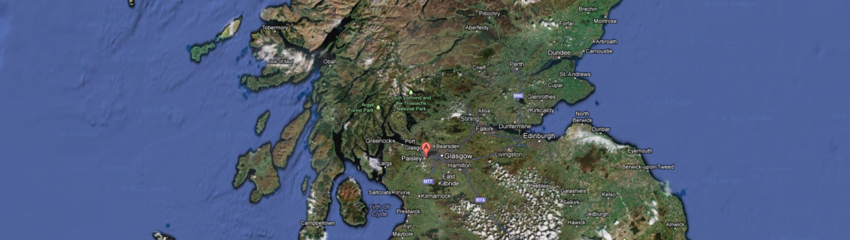
UWS
1600 staff
20,000 students
400+ PhD students
4 campuses

Slide 3
Thank you
Thank you to the various GW collaboration networks that have supported UWS membership and involvement
  Participant in ASPERA proposal, submitted 03/09/2012
  GEO membership 06/09/2013
  LSC membership 12/09/2013
  ELiTES membership 19/09/2013

Slide 4
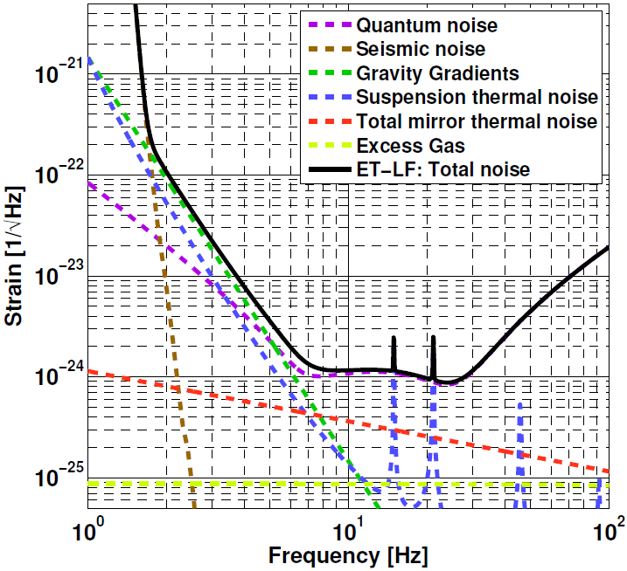
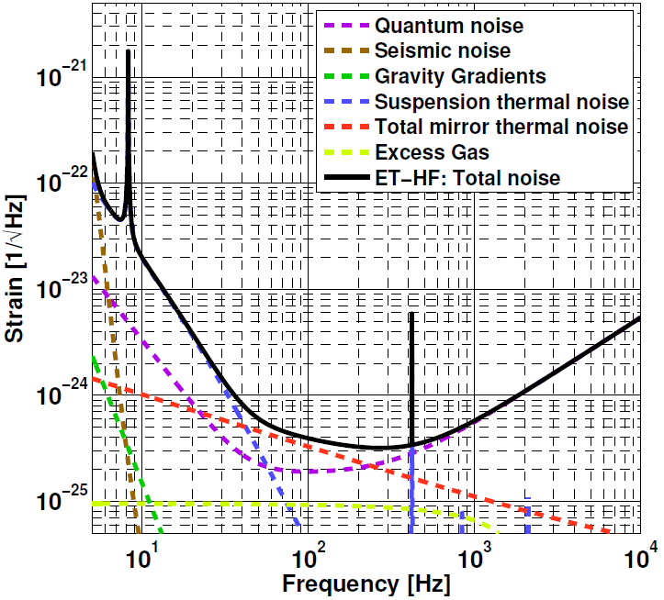
Motivation
Developing the mirror coatings for ET is critical:
  Will limit the astrophysical reach at ∼50 to 200 Hz

Slide 5
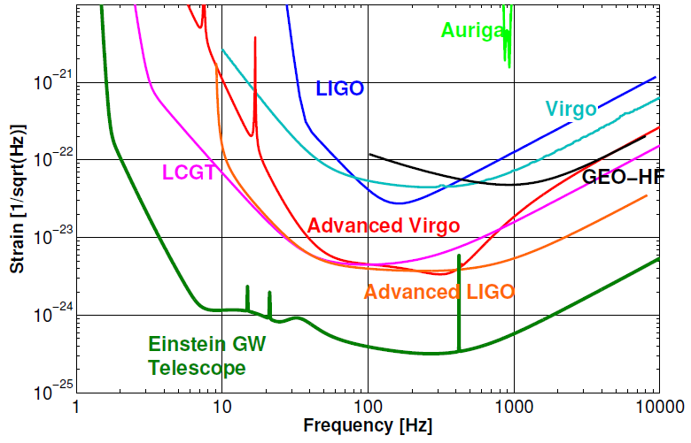
Motivation
Combined strain noise for ET-LF and ET-HF

Slide 6
Motivation
Combined strain noise for ET-LF and ET-HF
ET-LF suspension
ET-HF coating

Slide 7
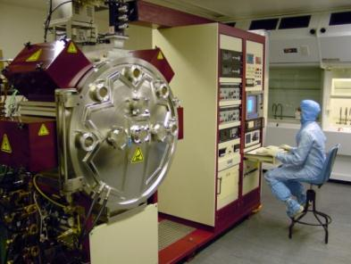
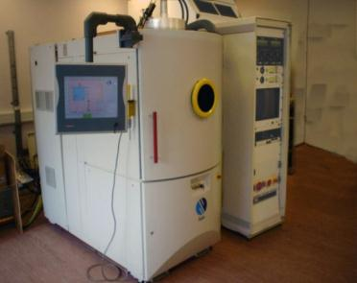
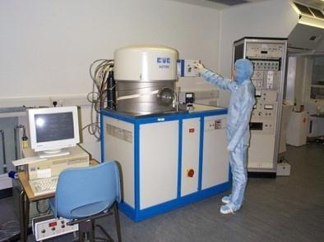
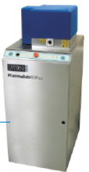
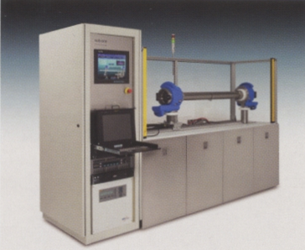
Thin Film Centre
Deposition facilities
Microwave-activated reactive sputtering
Plasma-assisted e-beam
RF sputtering (with ion-assist)
PECVD
Strong links with industry
e.g. industrial collaborator
Thin Film Solutions (based in the
West of Scotland Science Park)
have strong expertise in MBE
for growing crystalline coatings.
Bid was placed for IBS system for GW research and for developing HQ optical filters.

Slide 8
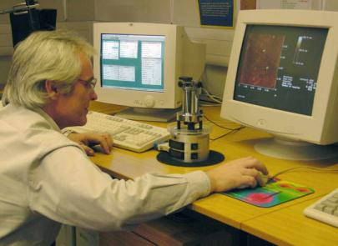
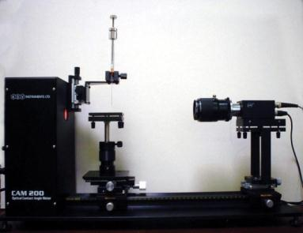
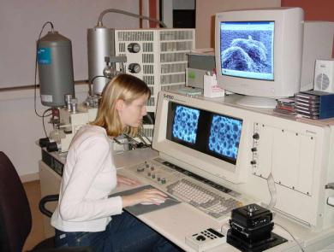
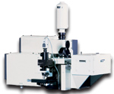
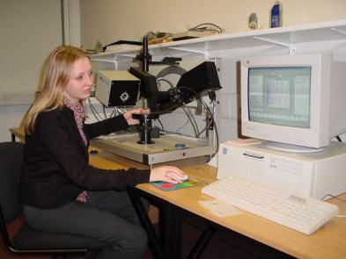
Thin Film Centre
Characterisation facilities
Nanoindentor/AFM
Optical contact angle meter
SEM/EDX
Horiba Raman Spectrometer
Ellipsometer
XRD (X-ray Diffraction)
UHV Kelvin Probe
Microindentor/hardness/scratch/adhesion
Room temp UHV system for Q
measurements (borrowed from
IGR group in Glasgow)
New Raman Spectrometer just arrived

Slide 9
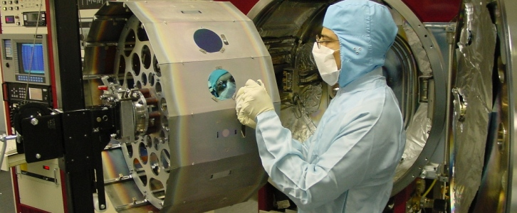
GW Research Plans
General goal is to provide a fast-turnaround for the fabrication and characterisation of coatings for use within the GEO and LSC collaborations, and associated networks e.g. ET, ASPERA, ELiTES etc.
Primary focus will be on characterising and developing mirror coating technologies in collaboration with the University of Glasgow and wider LSC groups and ET groups.

Slide 10
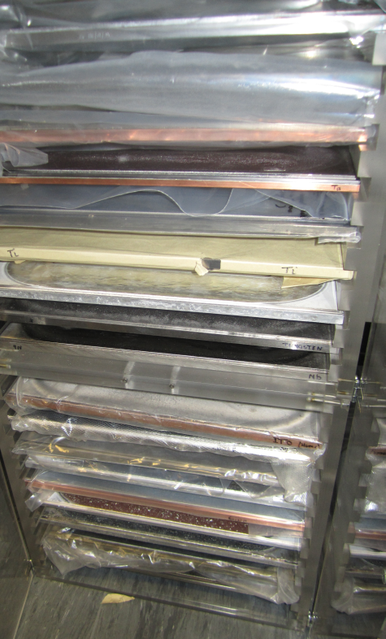
Specific research plans (1a)
HR mirror coatings
  Studying different deposition techniques (sought after within LSC Optics WG for several years, in order to understand and correlate differences in mechanical loss and structure)
  Investigating different coating materials and different material mixes/doping (particularly studying materials that are predicted to be interesting as a results of Glasgow-Stanford atomic modelling analysis)
Target materials available for Microdyn

Slide 11
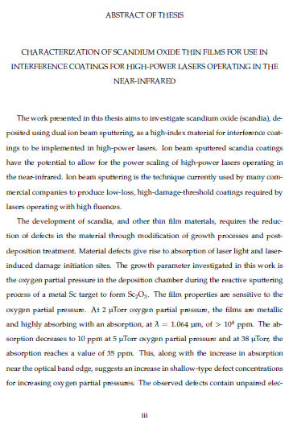
Specific research plans (1b)
HR mirror coatings
  Identifying alternative coating materials from other application, e.g. high power laser damage threshold.
  Thesis from Colorado State University (right) found IBS deposited scandia had absorptions down to 10ppm prior to any heat treatment (200nm scandia on fused silica)
  Scandium metal is a rare earth and very expensive, UWS-TFC has a small quantity that can be deposited using e-beam deposition.

Slide 12
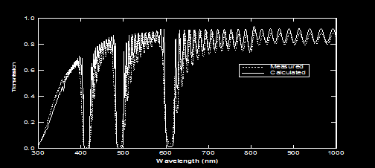
Specific research plans (1c)
HR mirror coatings cntd
  Examining interface effects, e.g. fabricating and characterising difference between standard multilayers and rugate coatings, where interfaces are “blurred”.
  Note: UWS is the only University in the world owning a Microdyne® reactive sputtering system (microwave-activated reactive sputtering), for sputtering high-quality amorphous oxides, nitrides, ITO and semiconductor materials (e.g. silicon).
Gou & Placido, Aluminum oxynitride rugate filters grown by reactive rf sputtering, Proc. SPIE 4086, 791, 2000

Slide 13
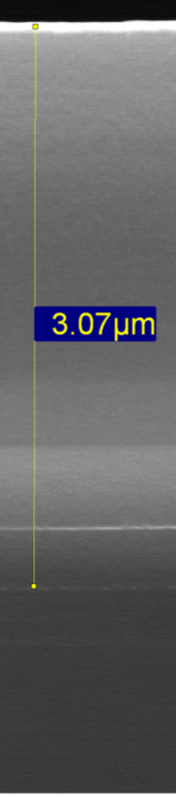
Specific research plans (2a)
Protective and conductive coatings
  Investigate the use of diamond-like carbon (DLC) thin films on silica/silicon suspension elements and/or silica/silicon cantilever springs.
    Can DLC be used to protect silica suspension wires from damage and microcracks that are detrimental to strength?
    Or fill in microcracks on micromachined (dry/wet etched) silicon suspensions?
    Can DLC be used to protect upper suspension stages (e.g. cantilevers springs) to provide durability and possibly allow silica/silicon components to jointed using standard bolts and clamps?
    The high emissivity of DLC may also be highly beneficial for cryogenics too (KAGRA are proposing to coat baffle tubes with DLC for this purpose).
    Note: UWS can fabricate pinhole-free, thick DLC using a hollow cathode CVD technique, that is licensed to SubOne
    (California-based company). We are the only University in the world with such a system.
SEM image:
DLC
SiC
Si
Si substrate

Slide 14
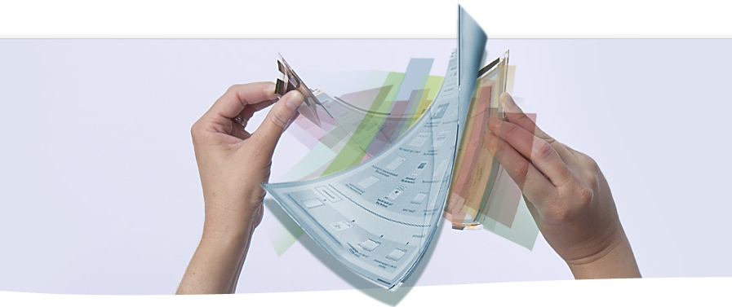
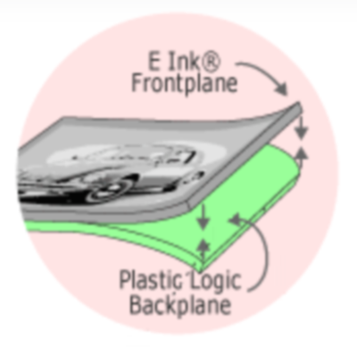
Specific research plans (2b)
  Alternative conductive coatings
    Building upon past experience of developing advanced thin film technology for electrical device applications:
      e.g. flexible displays developed between Dupont-Teijin Films, Plastic Logic and TFC.
      e.g. photovoltaic devices (zinc oxide stacked nanowire backfilled with copper oxide and silica)
    In addition to studying the use of DLC for protecting suspension components, other electrically conductive materials can be investigated, e.g. ITO (Indium Tin Oxide), gallium oxide (very good optical transmission at 1um).

Slide 15
Conclusions
Wide array of deposition facilities available at UWS – both for developing HR mirror technology in addition to suspension and cryogenic coating applications
  Currently replacing magnets on Microdyn system and start making test coatings of silica and tantala for initial characterisation in Glasgow
  Compare mechanical and optical losses from different deposition techniques
  DLC coated silicon cantilever sent to Glasgow to study mechanical loss measurements at low temperature + investigate DLC coated Si suspensions
  Improve deposition and adhesion of DLC films on fused silica
Wide array of material characterisation facilities
  Working within LSC to investigate the best calibration procedures for Young’s Modulus measurements using nanoindentation
  Provide fast and reliable turn-around of Y measurements for LSC and ET groups
  Investigate use of Raman Spectroscopy to investigate atomic structure in amorphous coatings

Slide 16
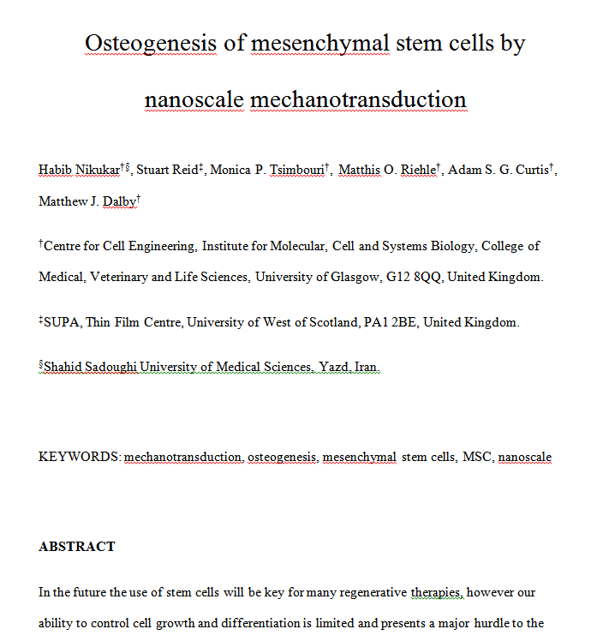
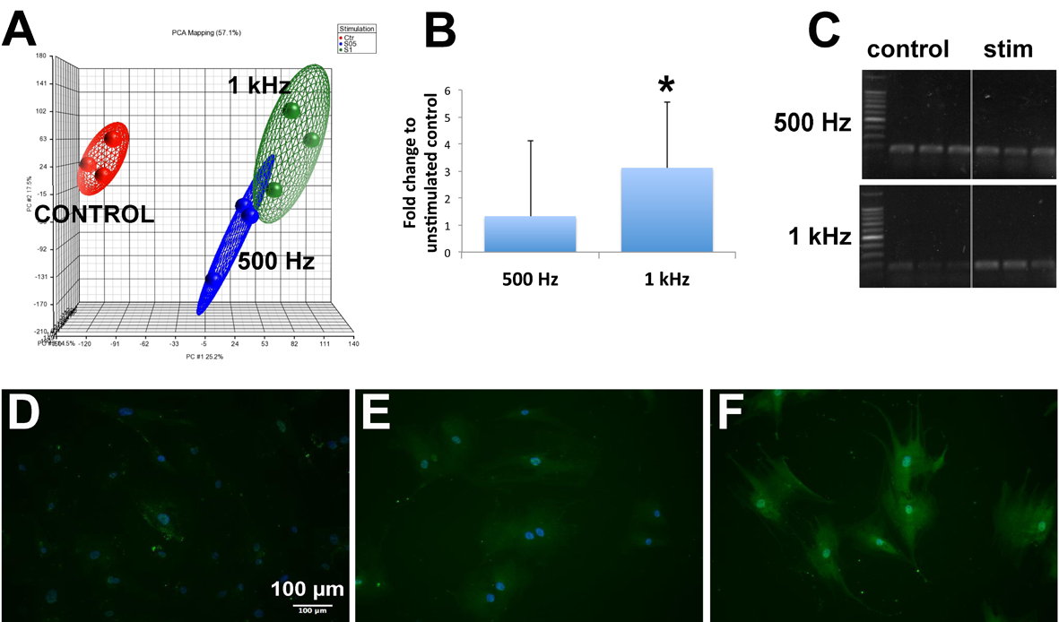
“Gravitational Waves save lives”
Characterising nanoscale vibrations applied to mesenchymel stem cells that induce osteogensis (bone formation)
Using common techniques within GW community (precision measurement, principle component analysis…)

Slide 17
Conclusions
Wide array of deposition facilities available at UWS – both for developing HR mirror technology in addition to suspension and cryogenic coating applications
  Currently replacing magnets on Microdyn system and start making test coatings of silica and tantala for initial characterisation in Glasgow
  Compare mechanical and optical losses from different deposition techniques
  DLC coated silicon cantilever sent to Glasgow to study mechanical loss measurements at low temperature + investigate DLC coated Si suspensions
  Improve deposition and adhesion of DLC films on fused silica
Wide array of material characterisation facilities
  Working within LSC to investigate the best calibration procedures for Young’s Modulus measurements using nanoindentation
  Provide fast and reliable turn-around of Y measurements for LSC and ET groups
  Investigate use of Raman Spectroscopy to investigate atomic structure in amorphous coatings

