Slide 1
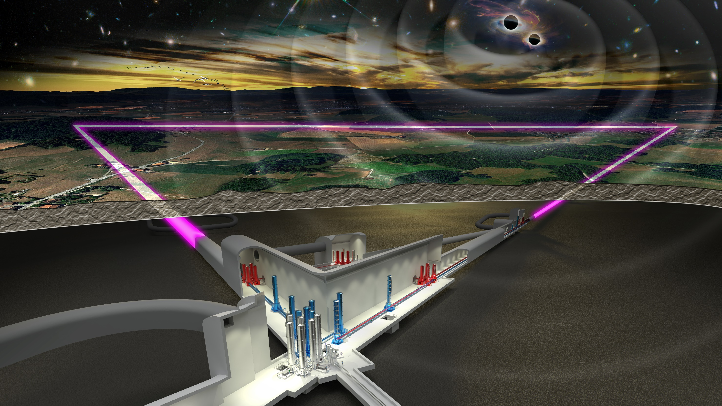



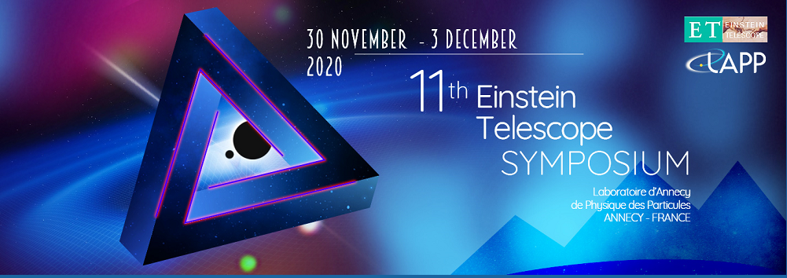
The Einstein Telescope
Status
Harald Lück
Leibniz Universität Hannover
Institut für Gravitationsphysik
and
Albert Einstein Institute
Max-Planck Institute for Gravitational Physics

Slide 2
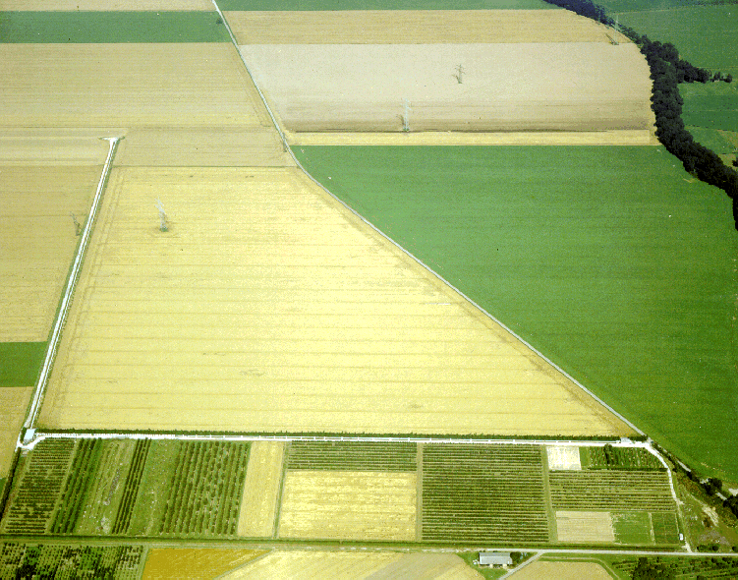
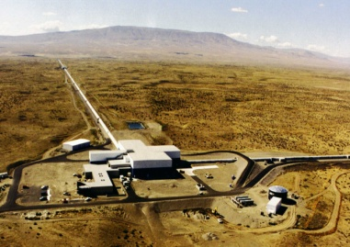


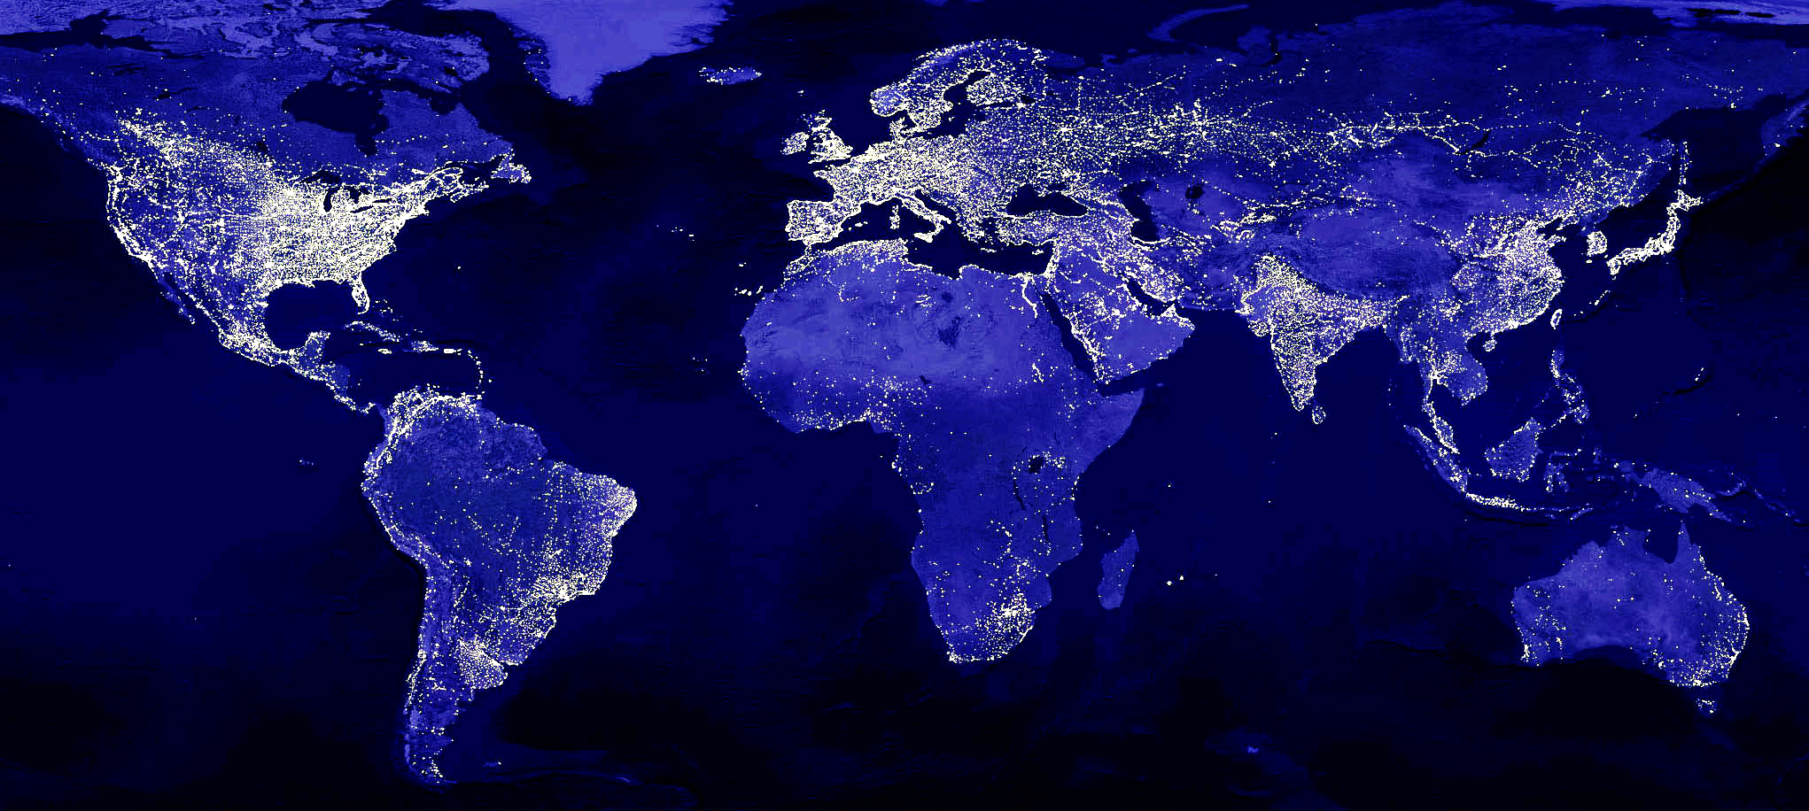
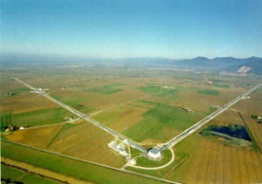
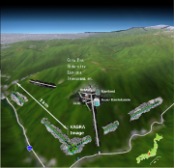

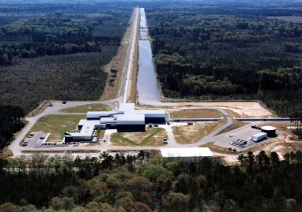
The advanced GW Network
Advanced LIGO Hanford, 2015
GEO600, 2011
Advanced LIGO
INDIA, 2024
Advanced Virgo
2016
KAGRA 2018
Advanced LIGO Livingston, 2015
Notes:
The gravitational Network today consists of
Two advanced LIGO detectors, the advanced Virgo detector
GEO600 (although with a significantly lower sensitivity esp. at low frequencies)
And the underground KAGRA detector, which joined the GW network last spring

Slide 3
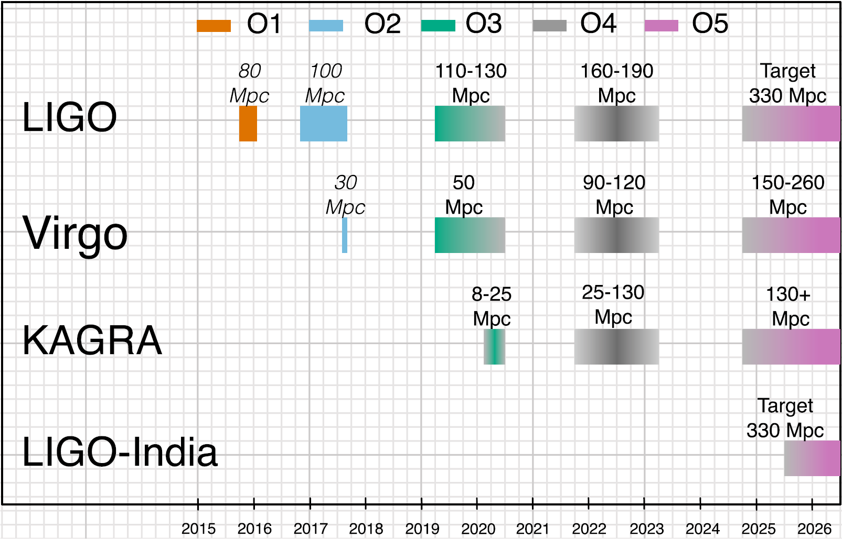
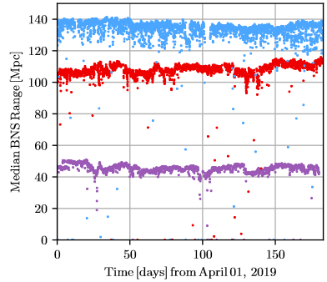
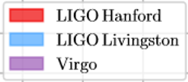
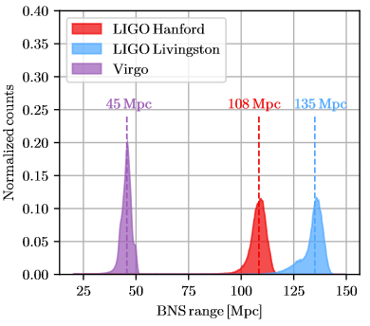
LVK Observation runs
O3a detector range
SNR8, 30–30M⊙ BBH
LIGO-P2000061
Notes:
With the advanced detectors three observation runs have been performed.
The last one O3 was cut about a month short due to the Corona crisis.
It consisted of two parts, called O3a and O3b.
The data of O3a have been analysed and a GW catalog has been published

Slide 4
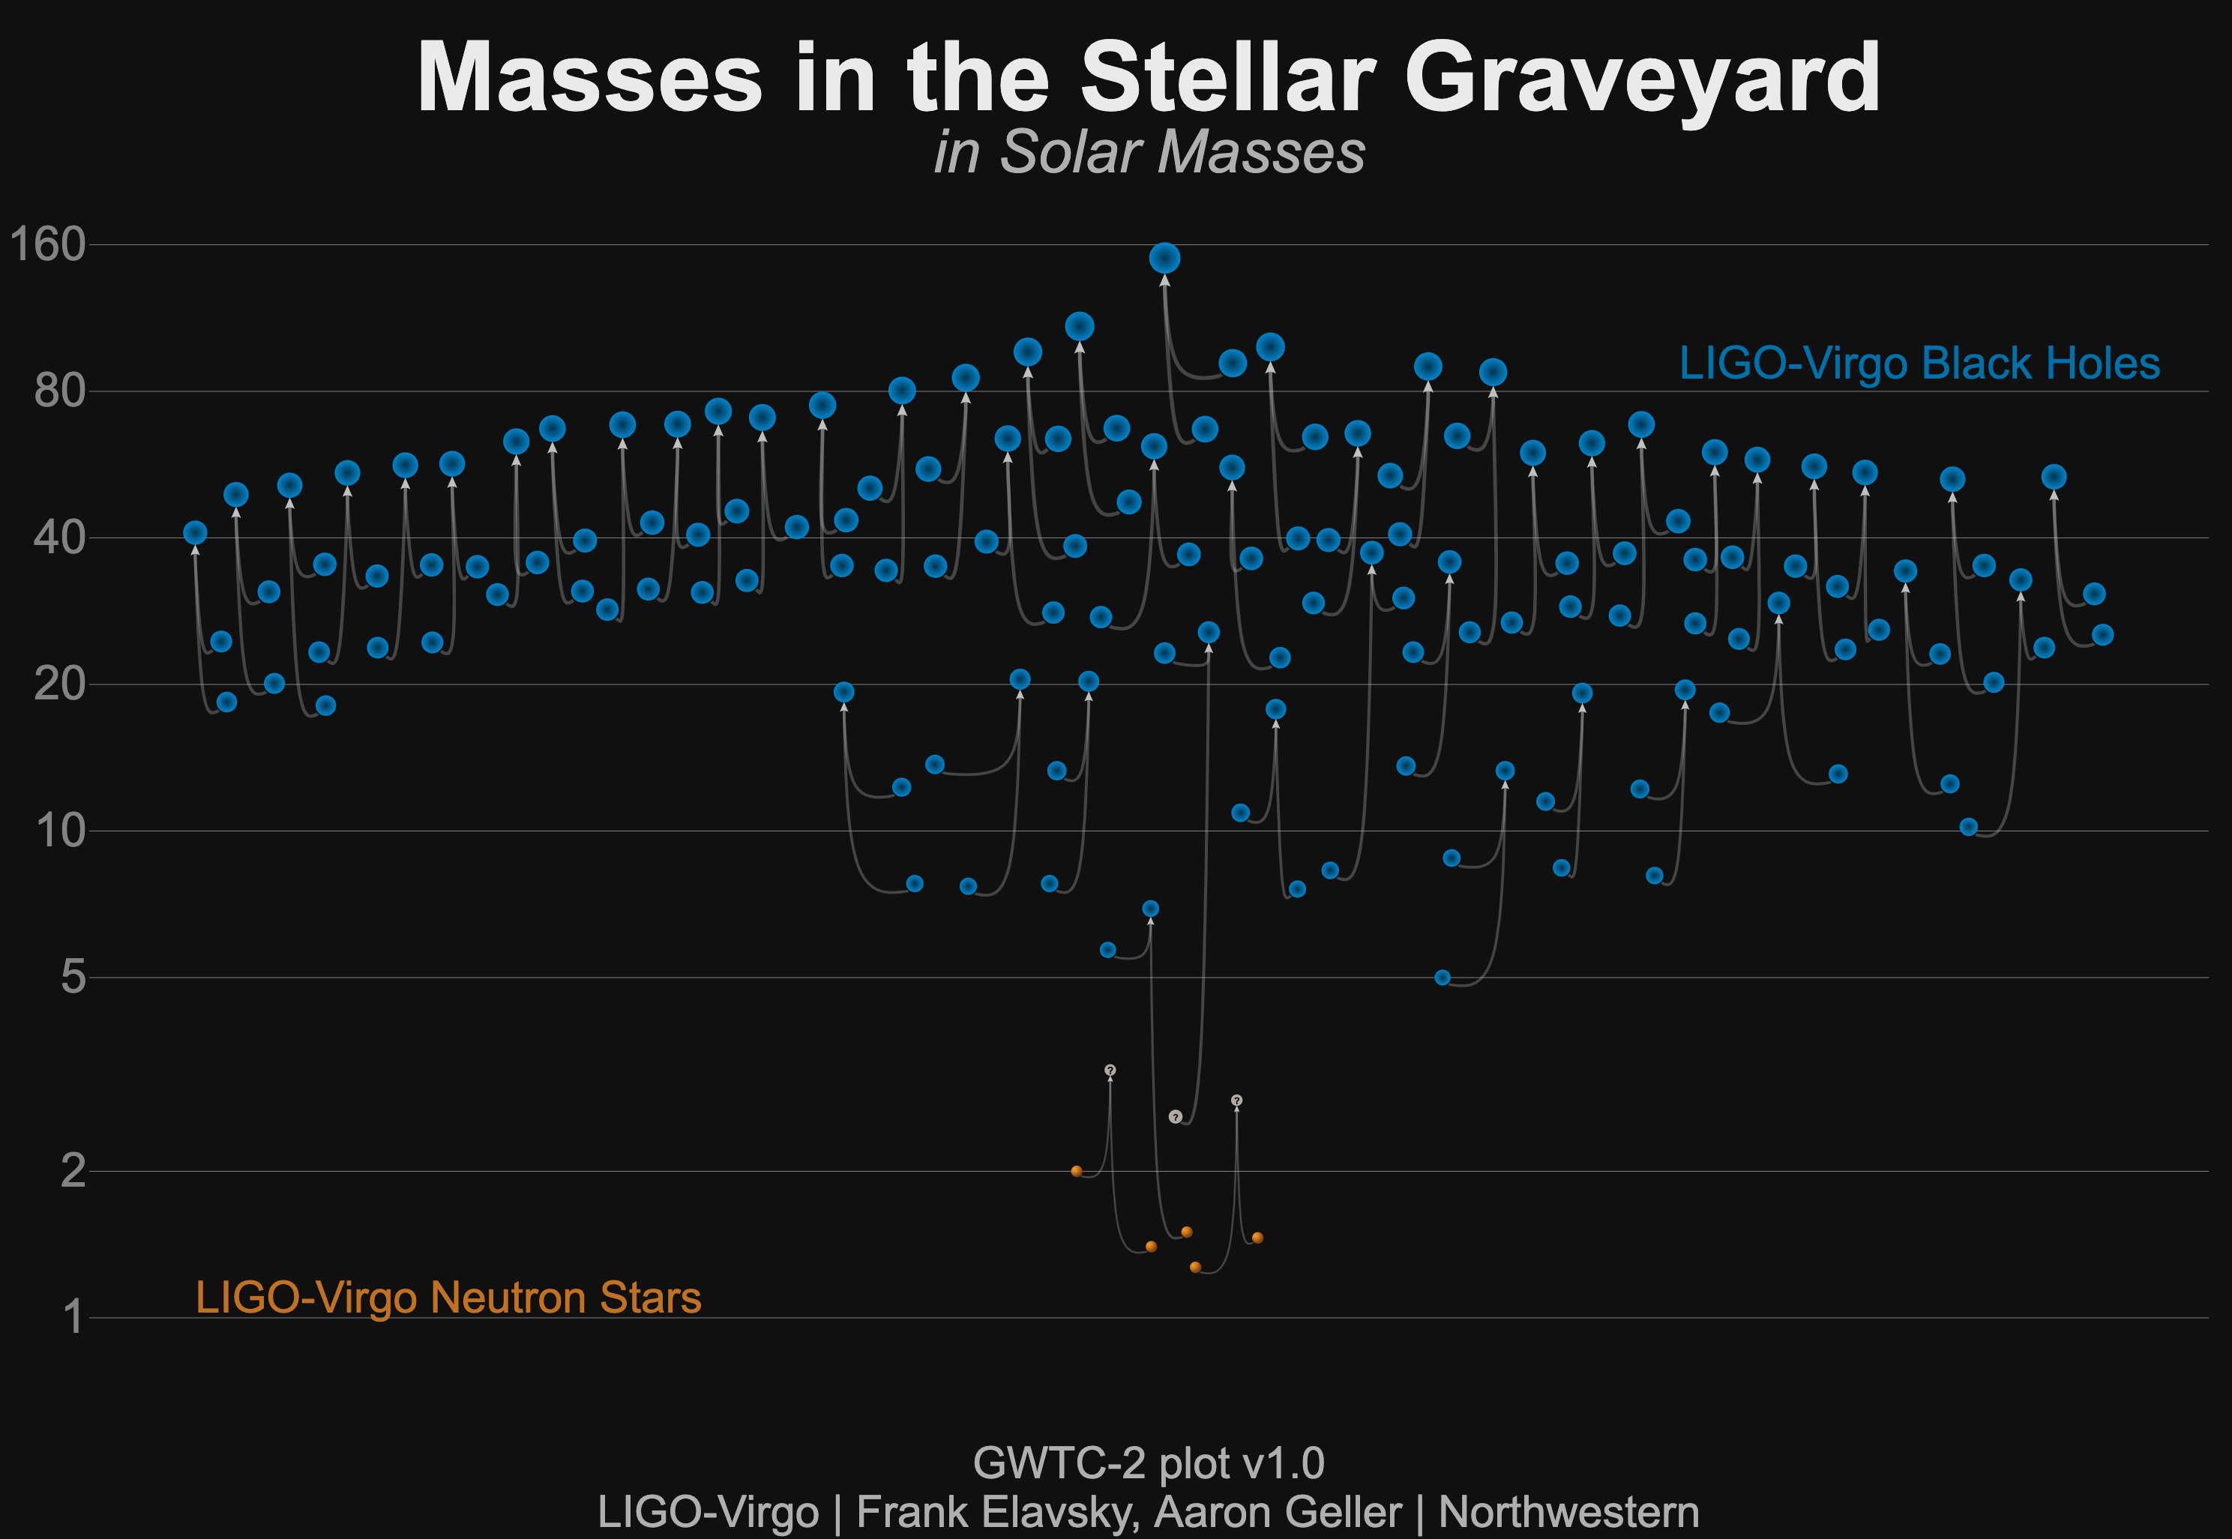

Coalescing binaries observed so far O1 – O3a
150M⊙
NS? BH?
LIGO-P2000061-v10
2.6M⊙
Notes:
There are 11 observations from the first two runs and 39 new ones from the third run. The detectors now observe coalescing binaries at a rate of about 1 per week.
The mass of oberserved object range form Neutron stars with about 1.5 solar masses to a final one with 150 solar masses.
Interesting events: GW190814 high mass NS or low mass BH?
GW190425: 2nd BNS merger after GW 170817
GW190521 was an especially heavy system resulting in a BH of 150 solar masses.
Some asymmetric mass ones, like GW190412, allowed some parameters like spin to be more tightly constrained.

Slide 5
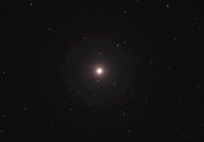
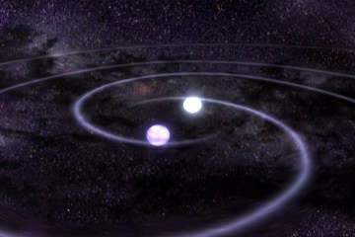
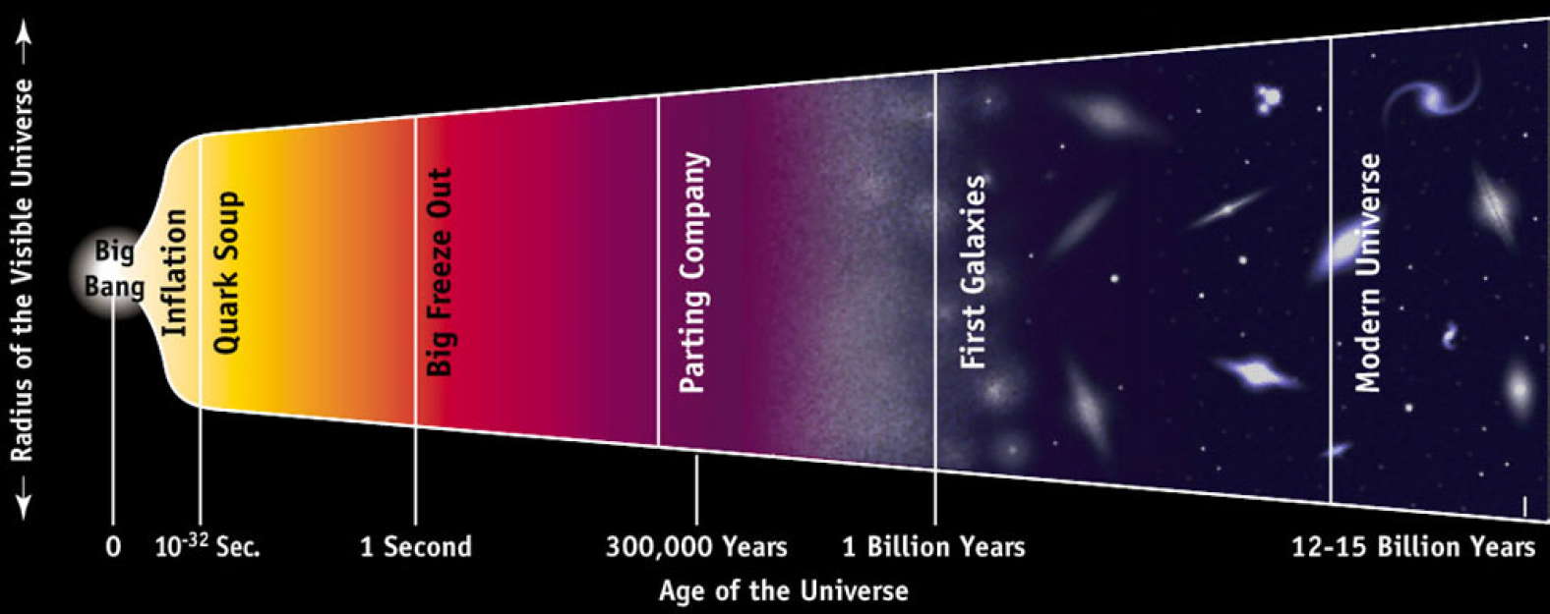
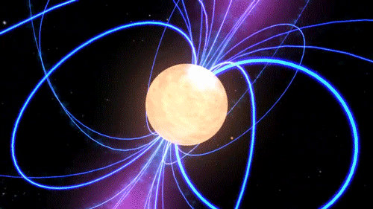
More sources out there…
Supernova
CBCs
NASA's Goddard Space Flight Center
spaceplasma.tumblr
g
ν
γ
NASA's Goddard Space Flight Center
https://doi.org/10.12942/lrr-1998-2
Pulsars
Star quakes
Stochastic GW background

Slide 6
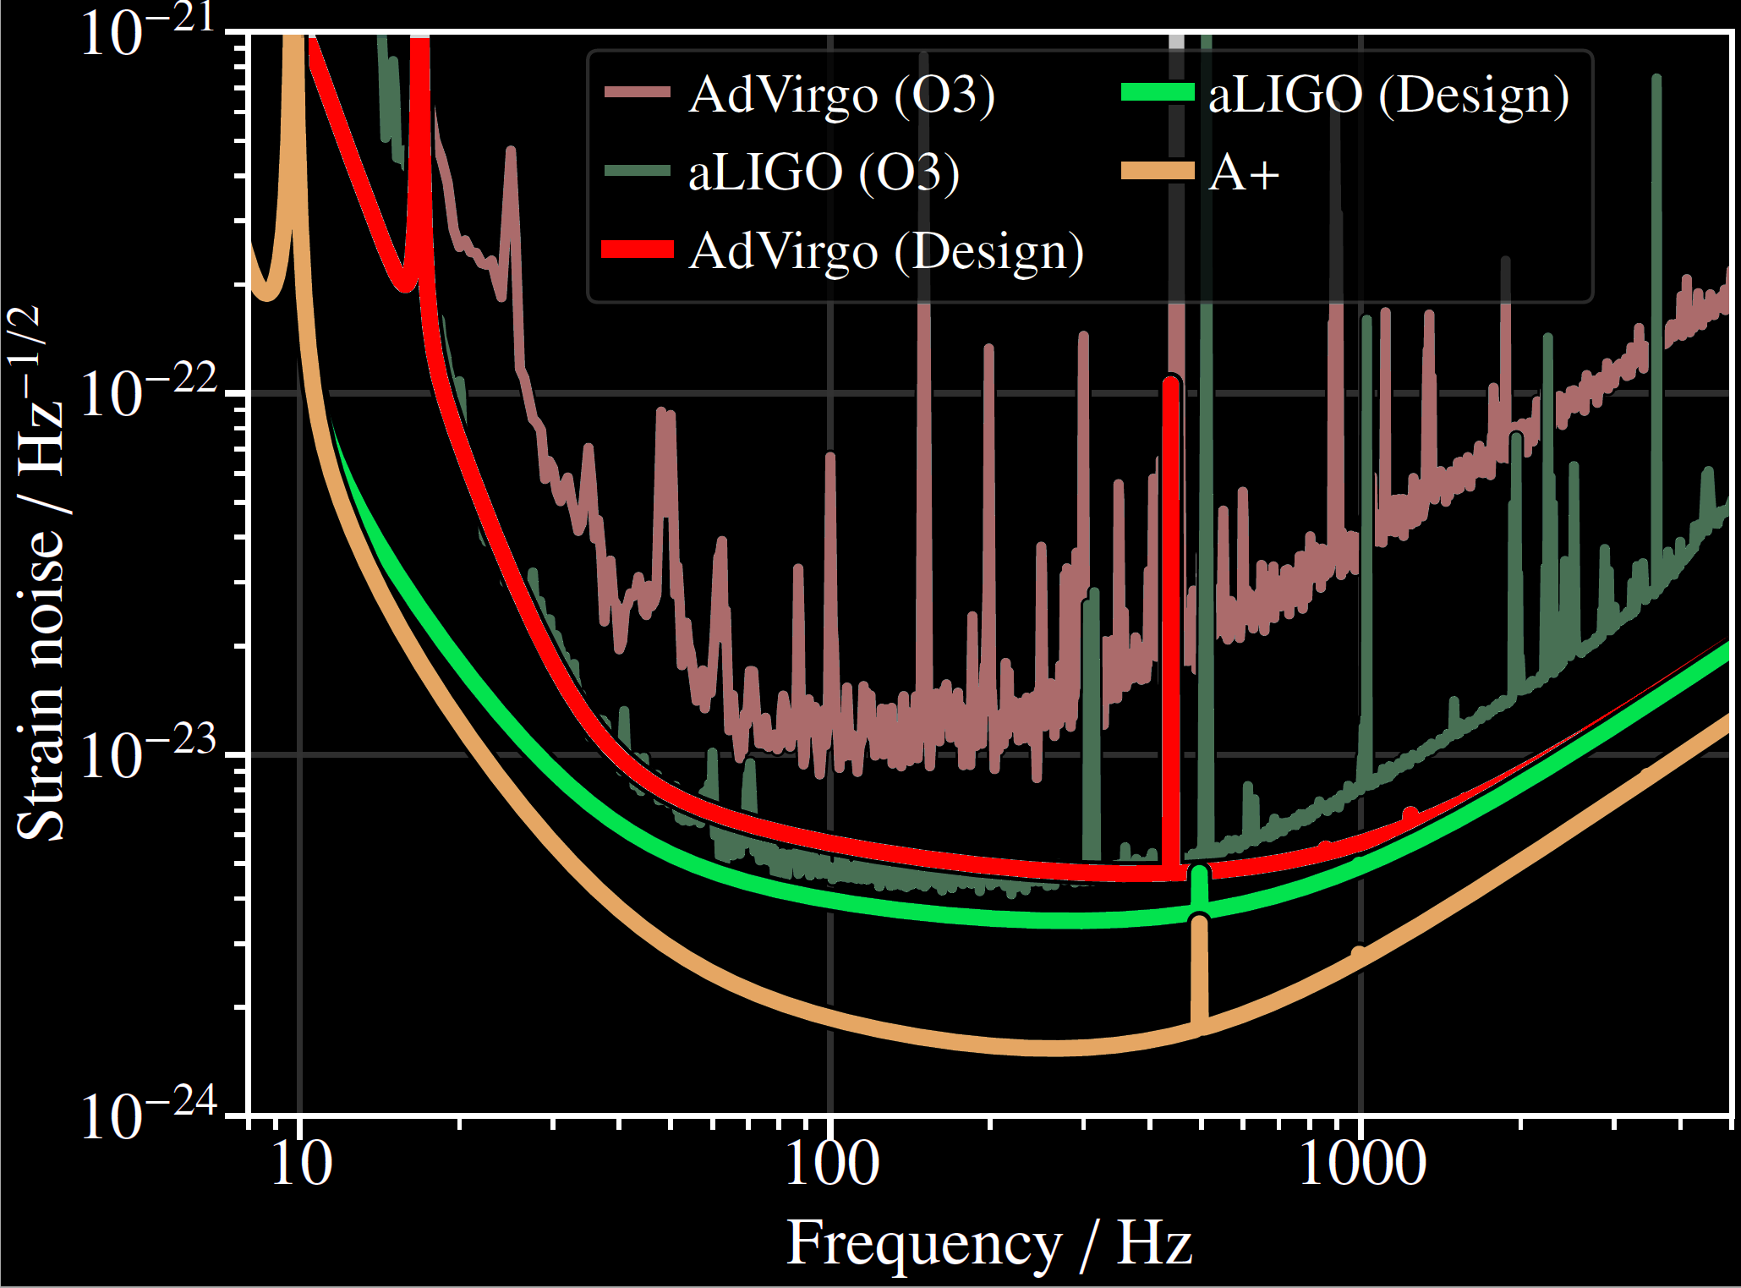
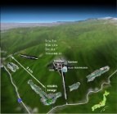
Sensitivities 2nd generation
Advanced LIGO Hanford, 2015
GEO600, 2011
Advanced LIGO
INDIA, 2024
Advanced Virgo
2016
KAGRA 2018
Advanced LIGO Livingston, 2015
Notes:
Even with the sensitivites of the A+ generation we can not see all the source we intend to observe.

Slide 7
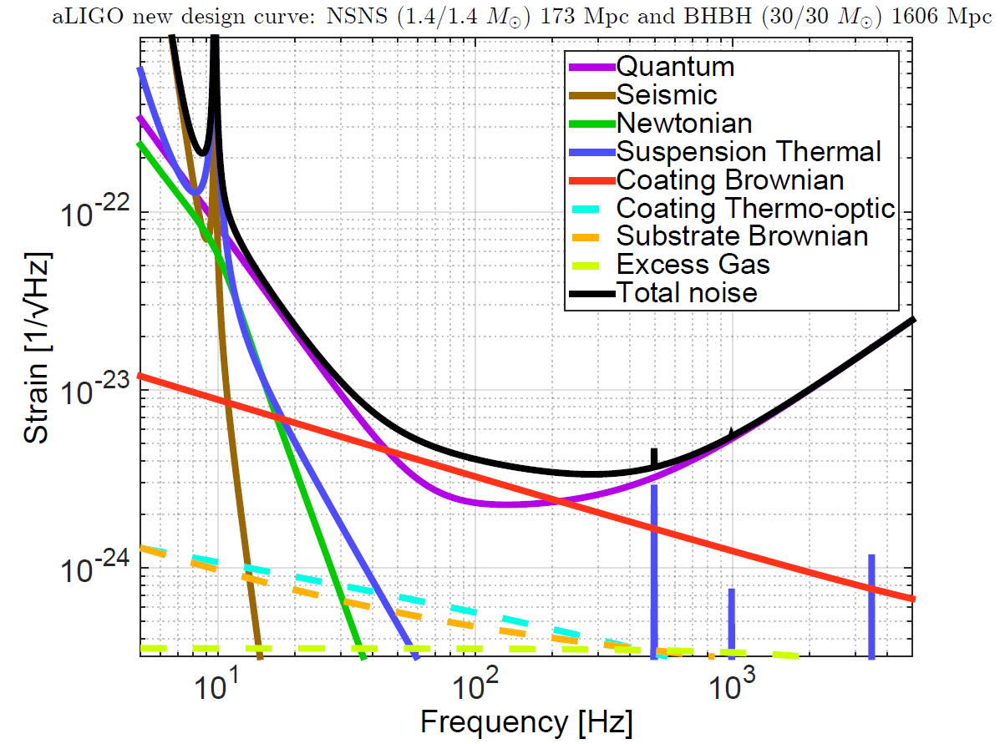
Noise Budget (aLIGO example)
Limiting noise sources:
High frequencies
  Shot noise
Mid frequencies
  Shot + Rad.Pres. noise
Low frequencies
  Radiation pressure
  Seismic
  Suspension thermal
  Newtonian
  + Control Noise
LIGO-T1800044-v3
Notes:
The greatest need for upgrading subsystems can be seen from the noise budgets of the current advanced detectors.
Here an example of advanced LIGO
In the future one of the toughest challenges will be the low frequency region, where the Einstein Telescope specialises on.

Slide 8
Detector Subsystems
ETMy
Cryo
Cooler
Cold
link
Chain
L_{y}
Vacuum tank
ITMy
Mirror
suspension chain
sideview
displayed only
for one mirror
for clarity
LASER
BS
L_{x}
PR
ITMx
ETMx
Control
SR
IMC
Faraday
Isolator
Faraday
Isolator
Filter Cavity
Colours for subsystems:
Core optics, coatings
Light sources
Quantum Enhancements
Auxiliary optics
Sensing and Control
Seismic Isolation & Suspensions
Cryogenics
Plot(data)
Squeezer
Computer
OMC
Sensing
PD
Notes:
The upgrades are affecting almost every subsystem of the detectors.
Each of the subsystems has ist own challenges and some of them have to be pushed to the pysical limits possible.

Slide 9
LVK Observation runs
Between the observation
runs
→
stepwise upgrades
A+
the advanced Plus
Detectors
Infrastructure will reach an
end of lifetime and
a limit in performance
(self noise, size)
→ New infrastructures
Living Reviews in Relativity volume 23, Article number: 3 (2020)
Notes:
Between the observation runs the detectors will be upgraded.

Slide 10
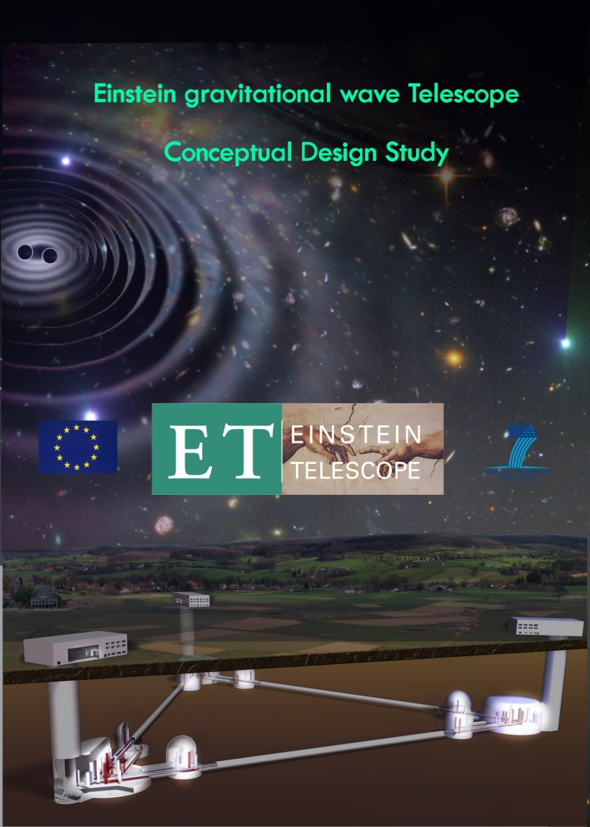
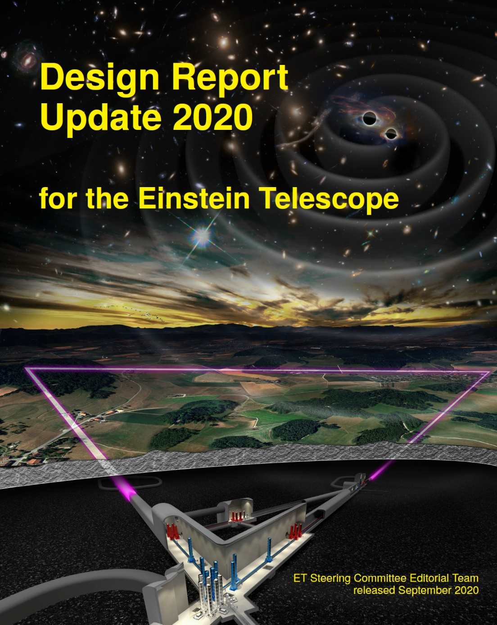
Updated Documents
http://www.et-gw.eu → Relevant ET Documents
Einstein Telescope:
Science Case, Design Study and Feasibility Report
Science Case for the Einstein Telescope
ET cost book
Socio-economic impact of the Einstein Telescope
Einstein Telescope: An assessment of its economic, social and environmental impact in Sardinia
Management structure of the ET Collaboration
2008 – 2011

Slide 11
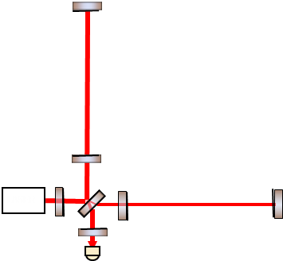
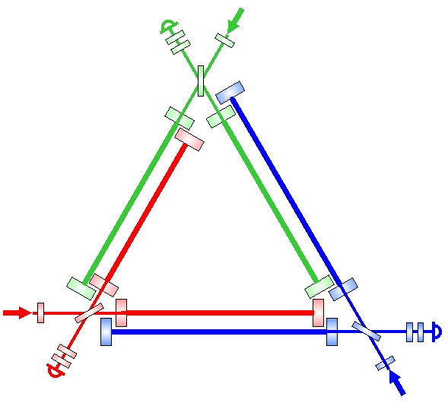
The Size
Einstein Telescope 10 km
Advanced LIGO
4 km
Cosmic Explorer will have 40 km arms
→ gain a factor 10 w.r.t. advanced LIGO
3 Interferometers resolve polarisation

Slide 12
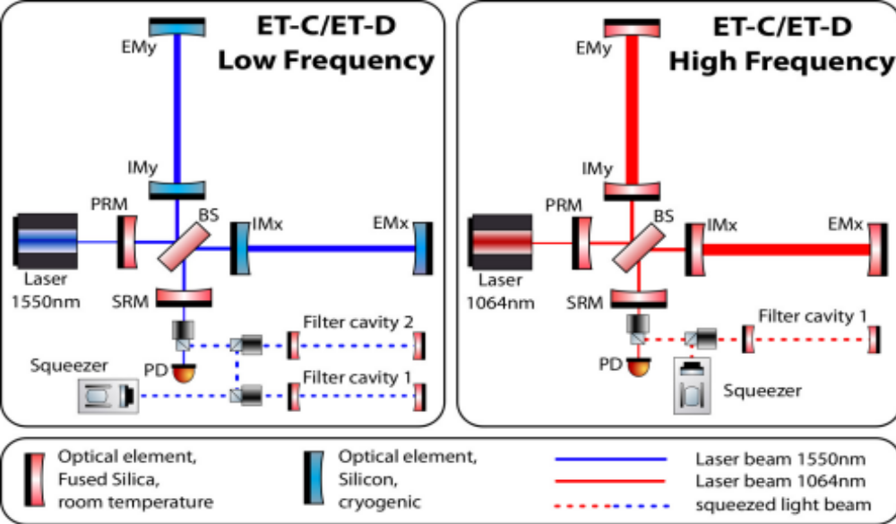
ET - Xylophone Concept
ET - LF
low-power, cryogenic
low-frequency detector
ET – HF
high-power, room-temperature
high-frequency detector
300 K
  ET-HF:
  High power laser
  High circulating light power
  Thermal compensation
  Large test masses
  New coatings
  Frequency dependent squeezing
10 – 20 K
  ET-LF:
  Cryogenics
  Seismic suspensions
  Silicon (Sapphire) test masses
  Large test masses
  New coatings
  New laser wavelength
  Frequency dependent squeezing, Filter cavities

Slide 13
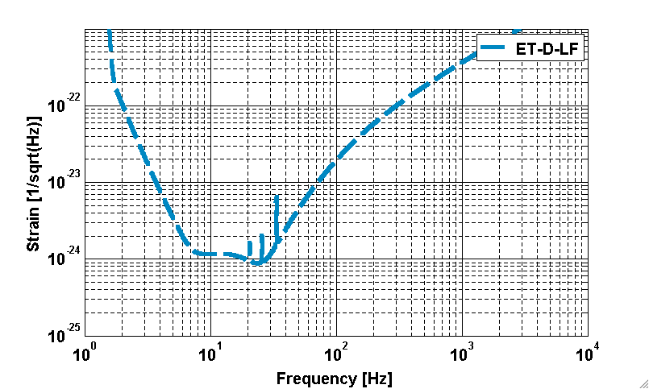
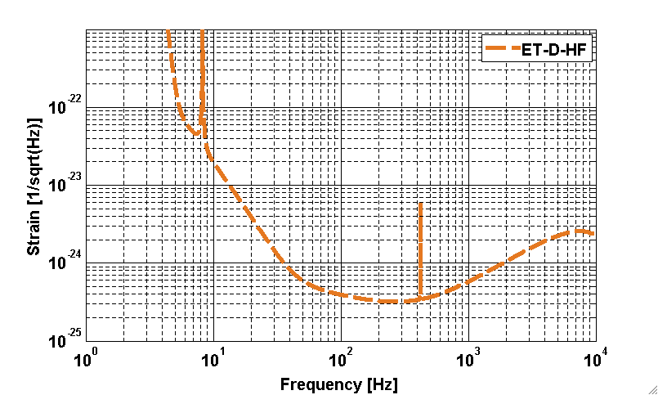
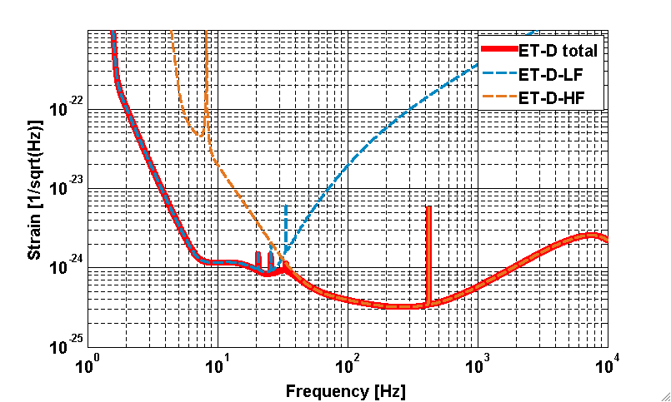
ET Xylophone Sensitivity
ET - LF
ET - HF
ET-LF
ET-HF
ET Total
ET – LF
ET - HF
Subdividing the
task
Notes:
Technical details in the instrument science sessions

Slide 14
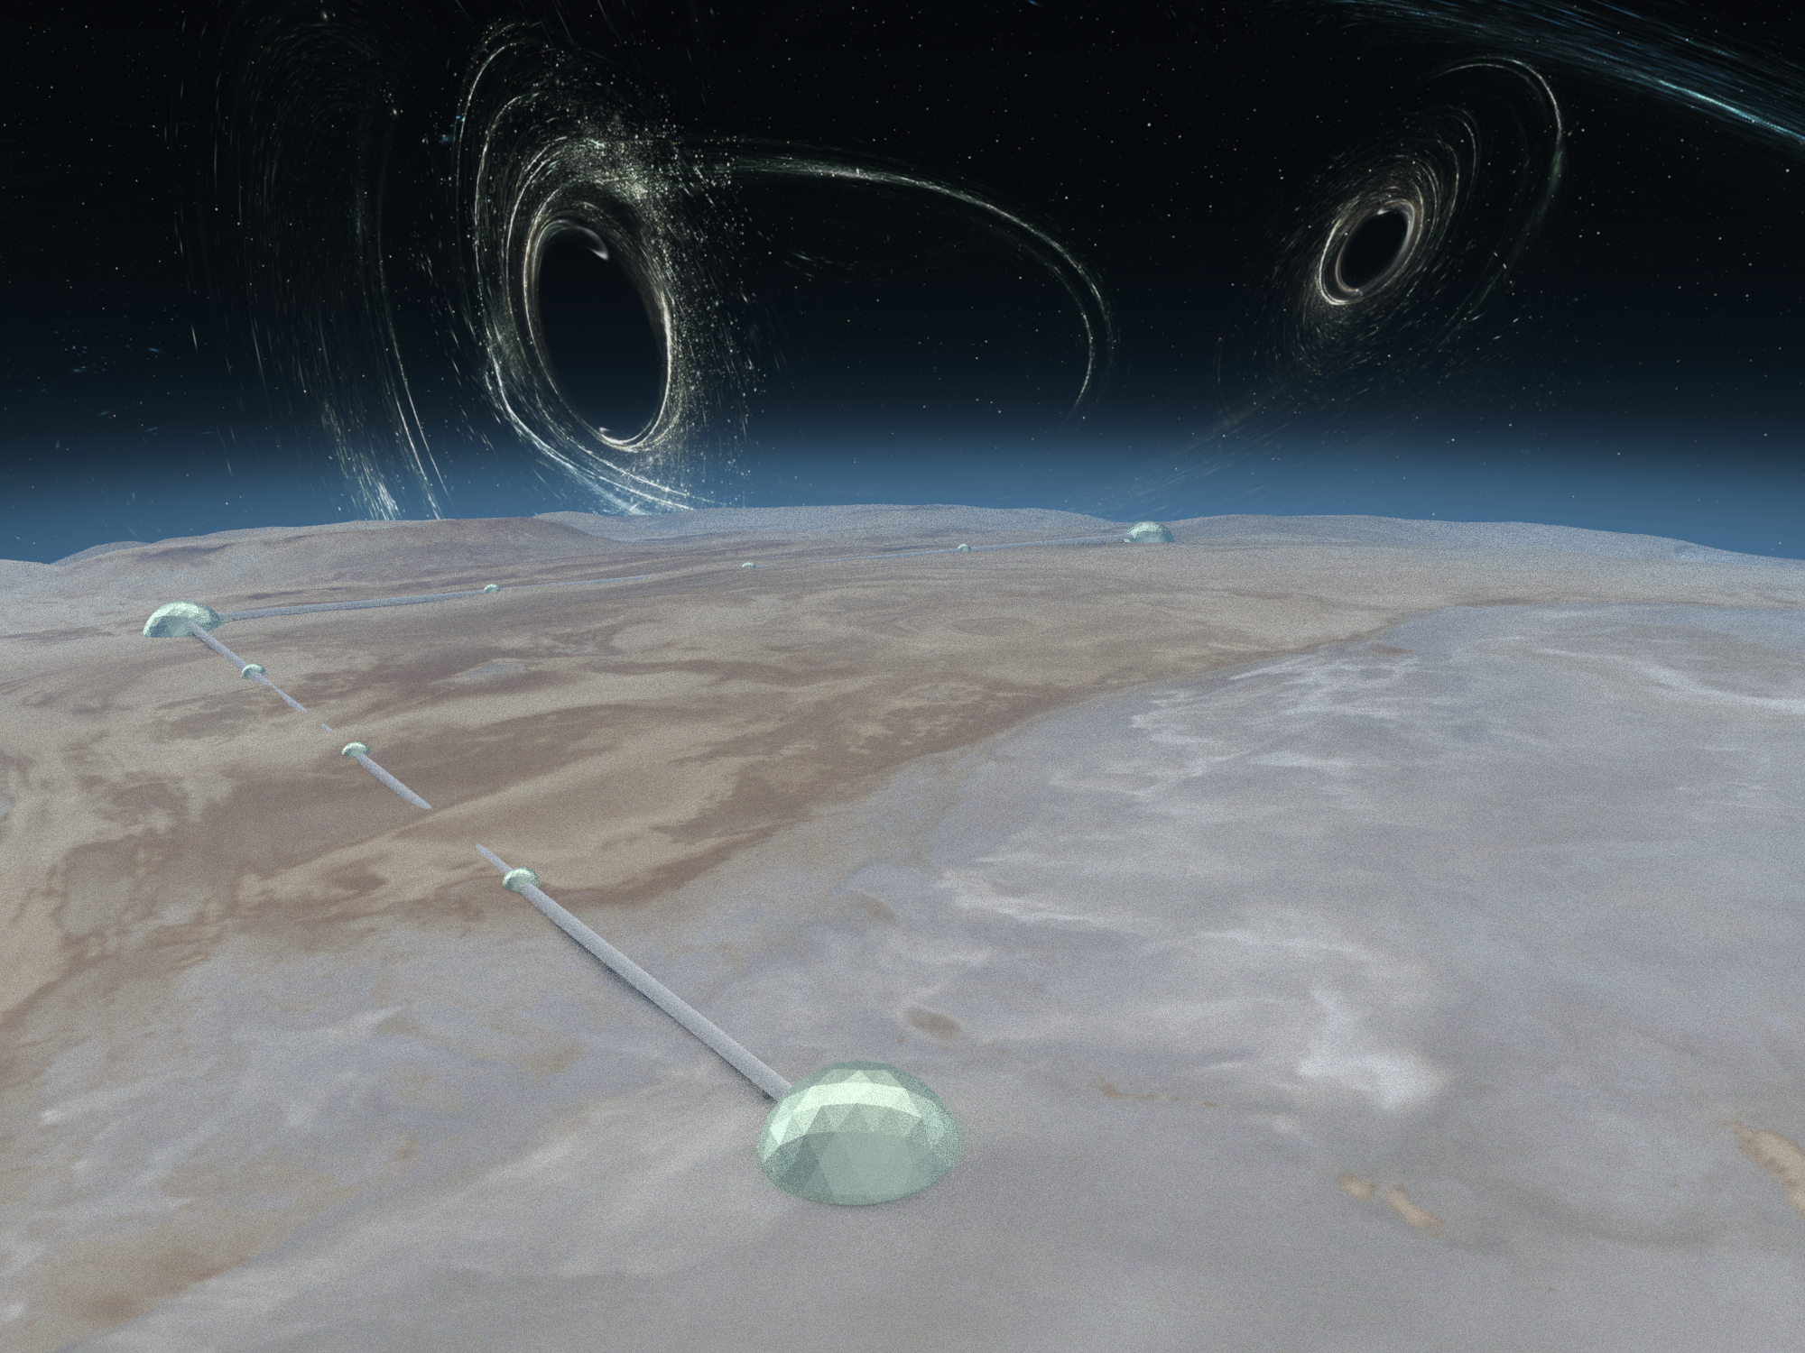
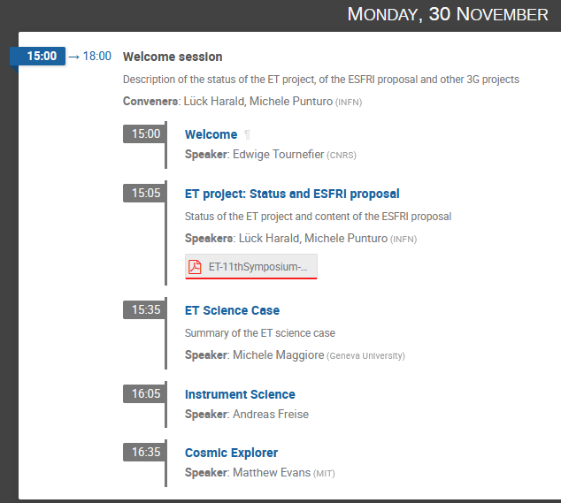
40 km
40 km
Cosmic Explorer

Slide 15

The 3G GW Network (2035→)
aLIGO+
KAGRA
aLIGO+
INDIA
AdV+
aLIGO +
3G south/
NEMO

Slide 16
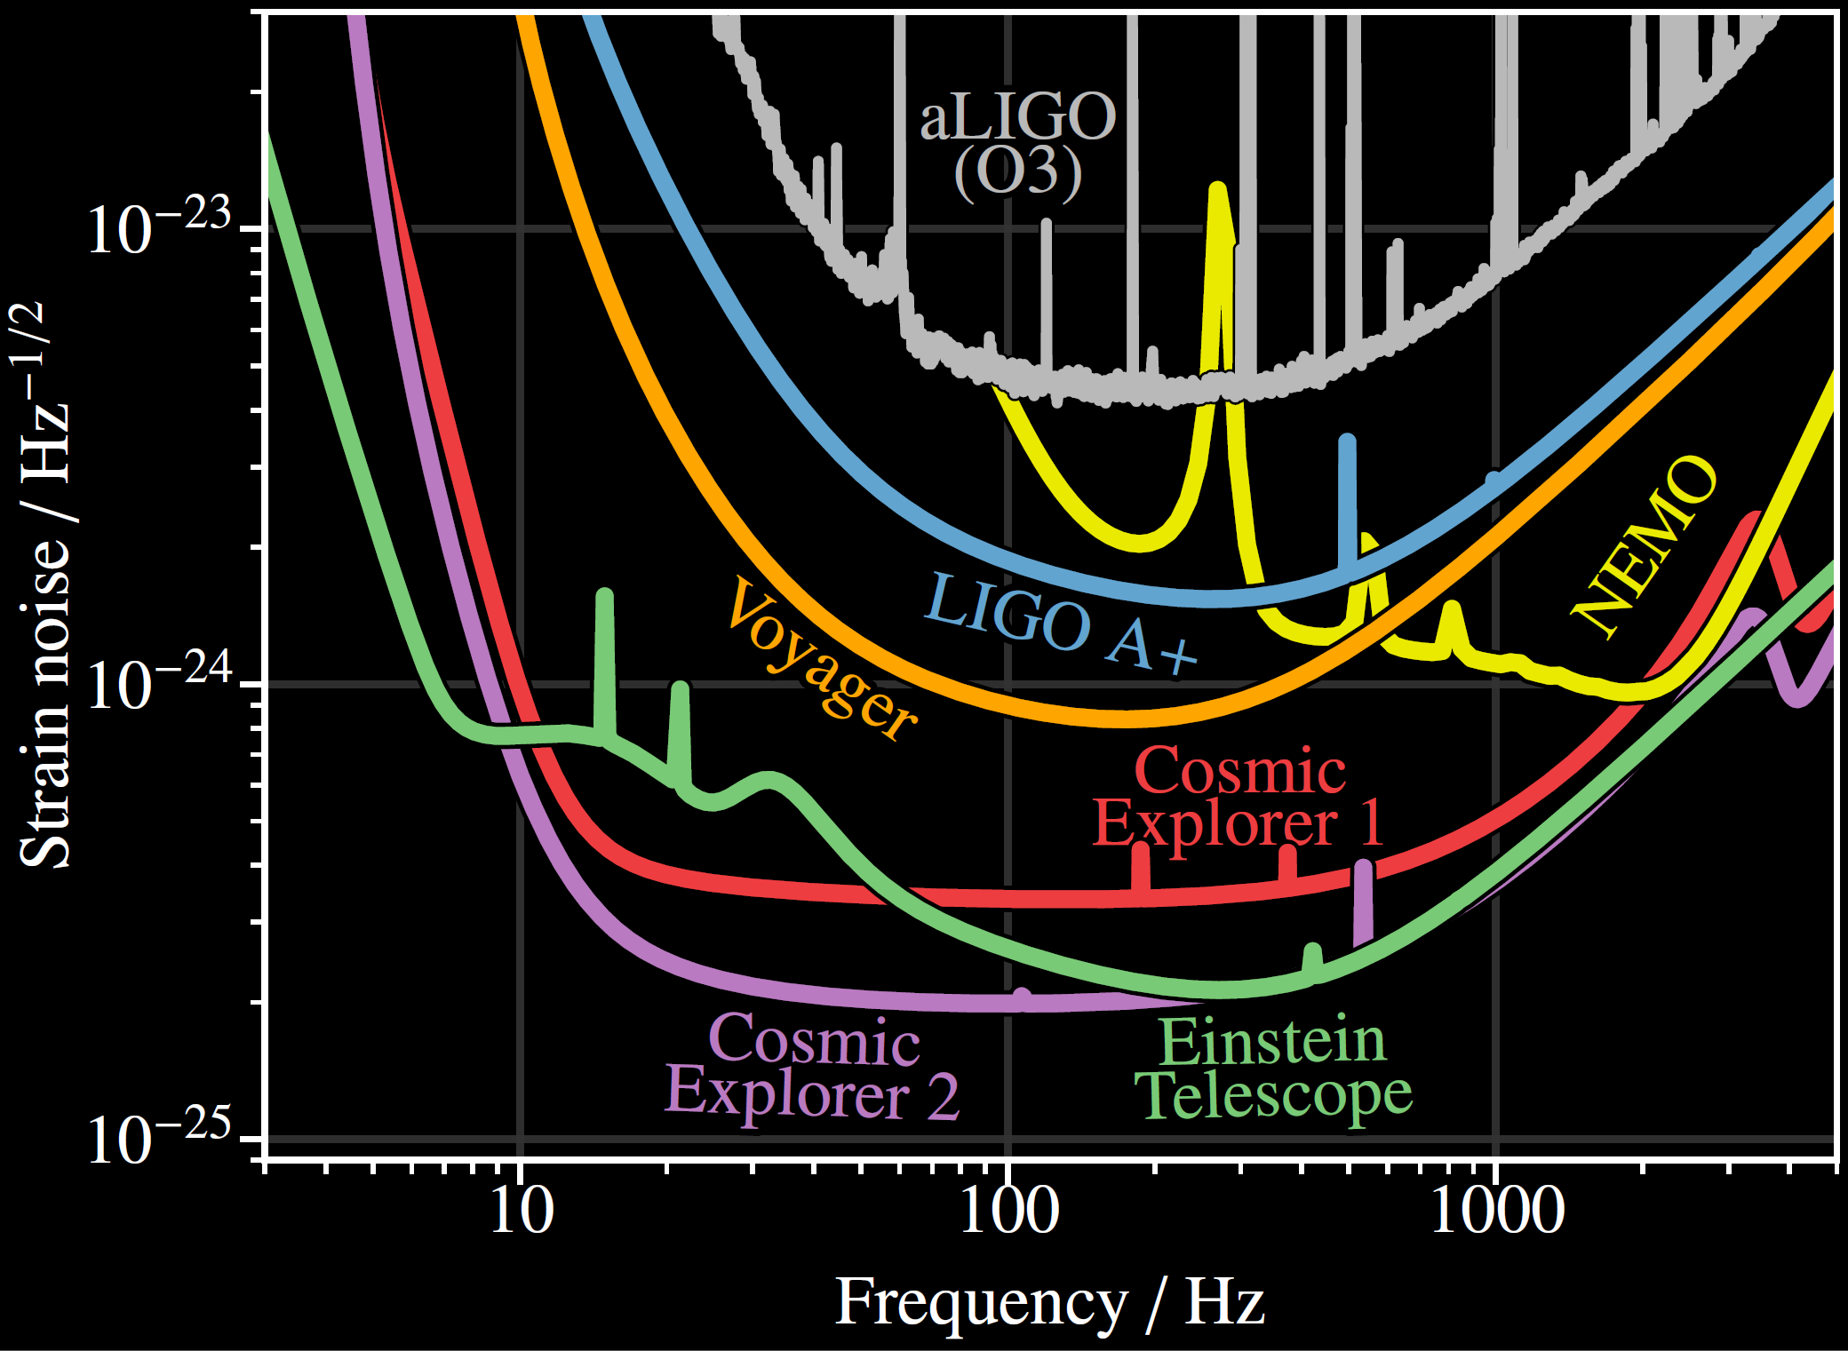
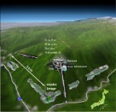
Sensitivities in the 3G era
aLIGO+
KAGRA
aLIGO+
INDIA
AdV+
aLIGO +
3G south/
NEMO

Slide 17
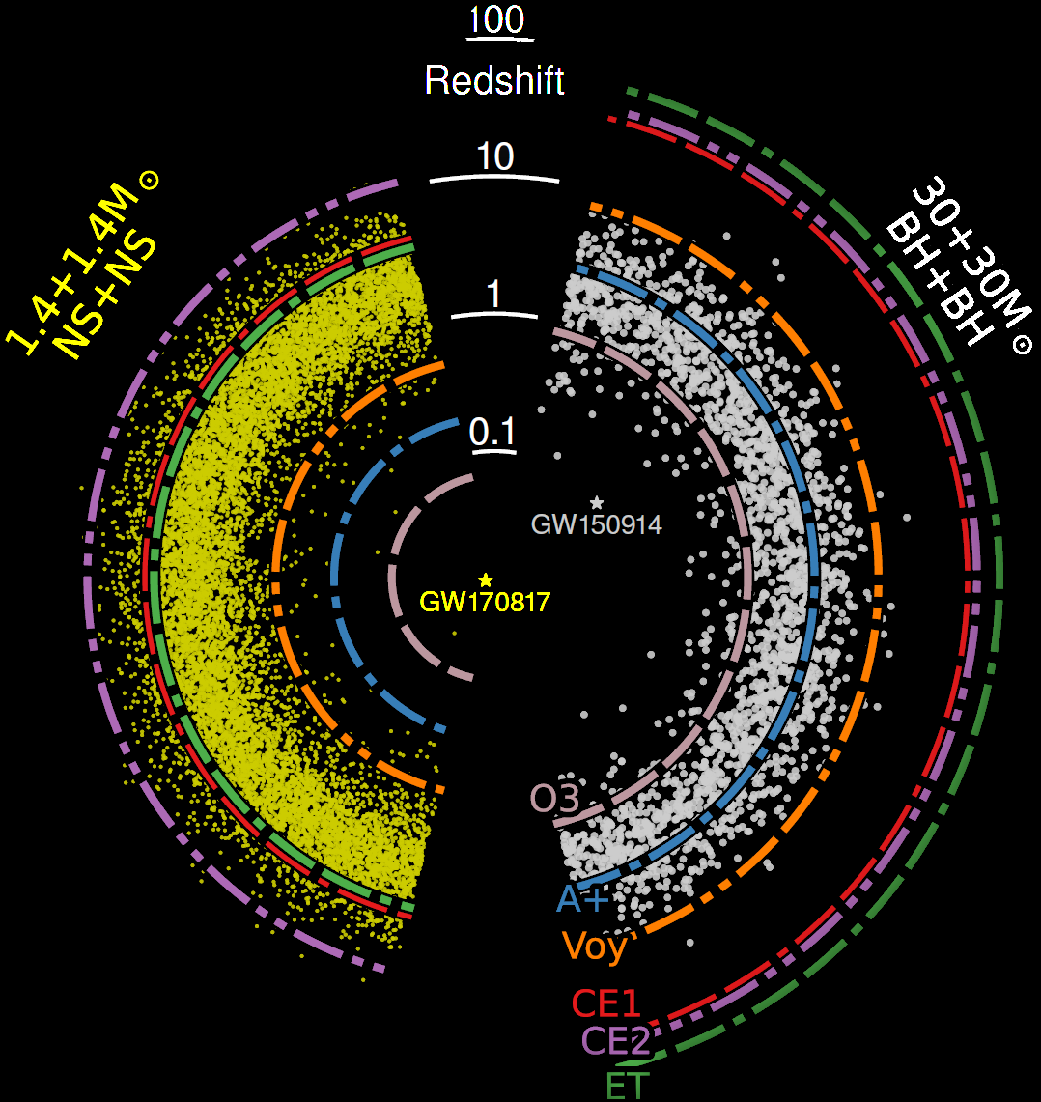
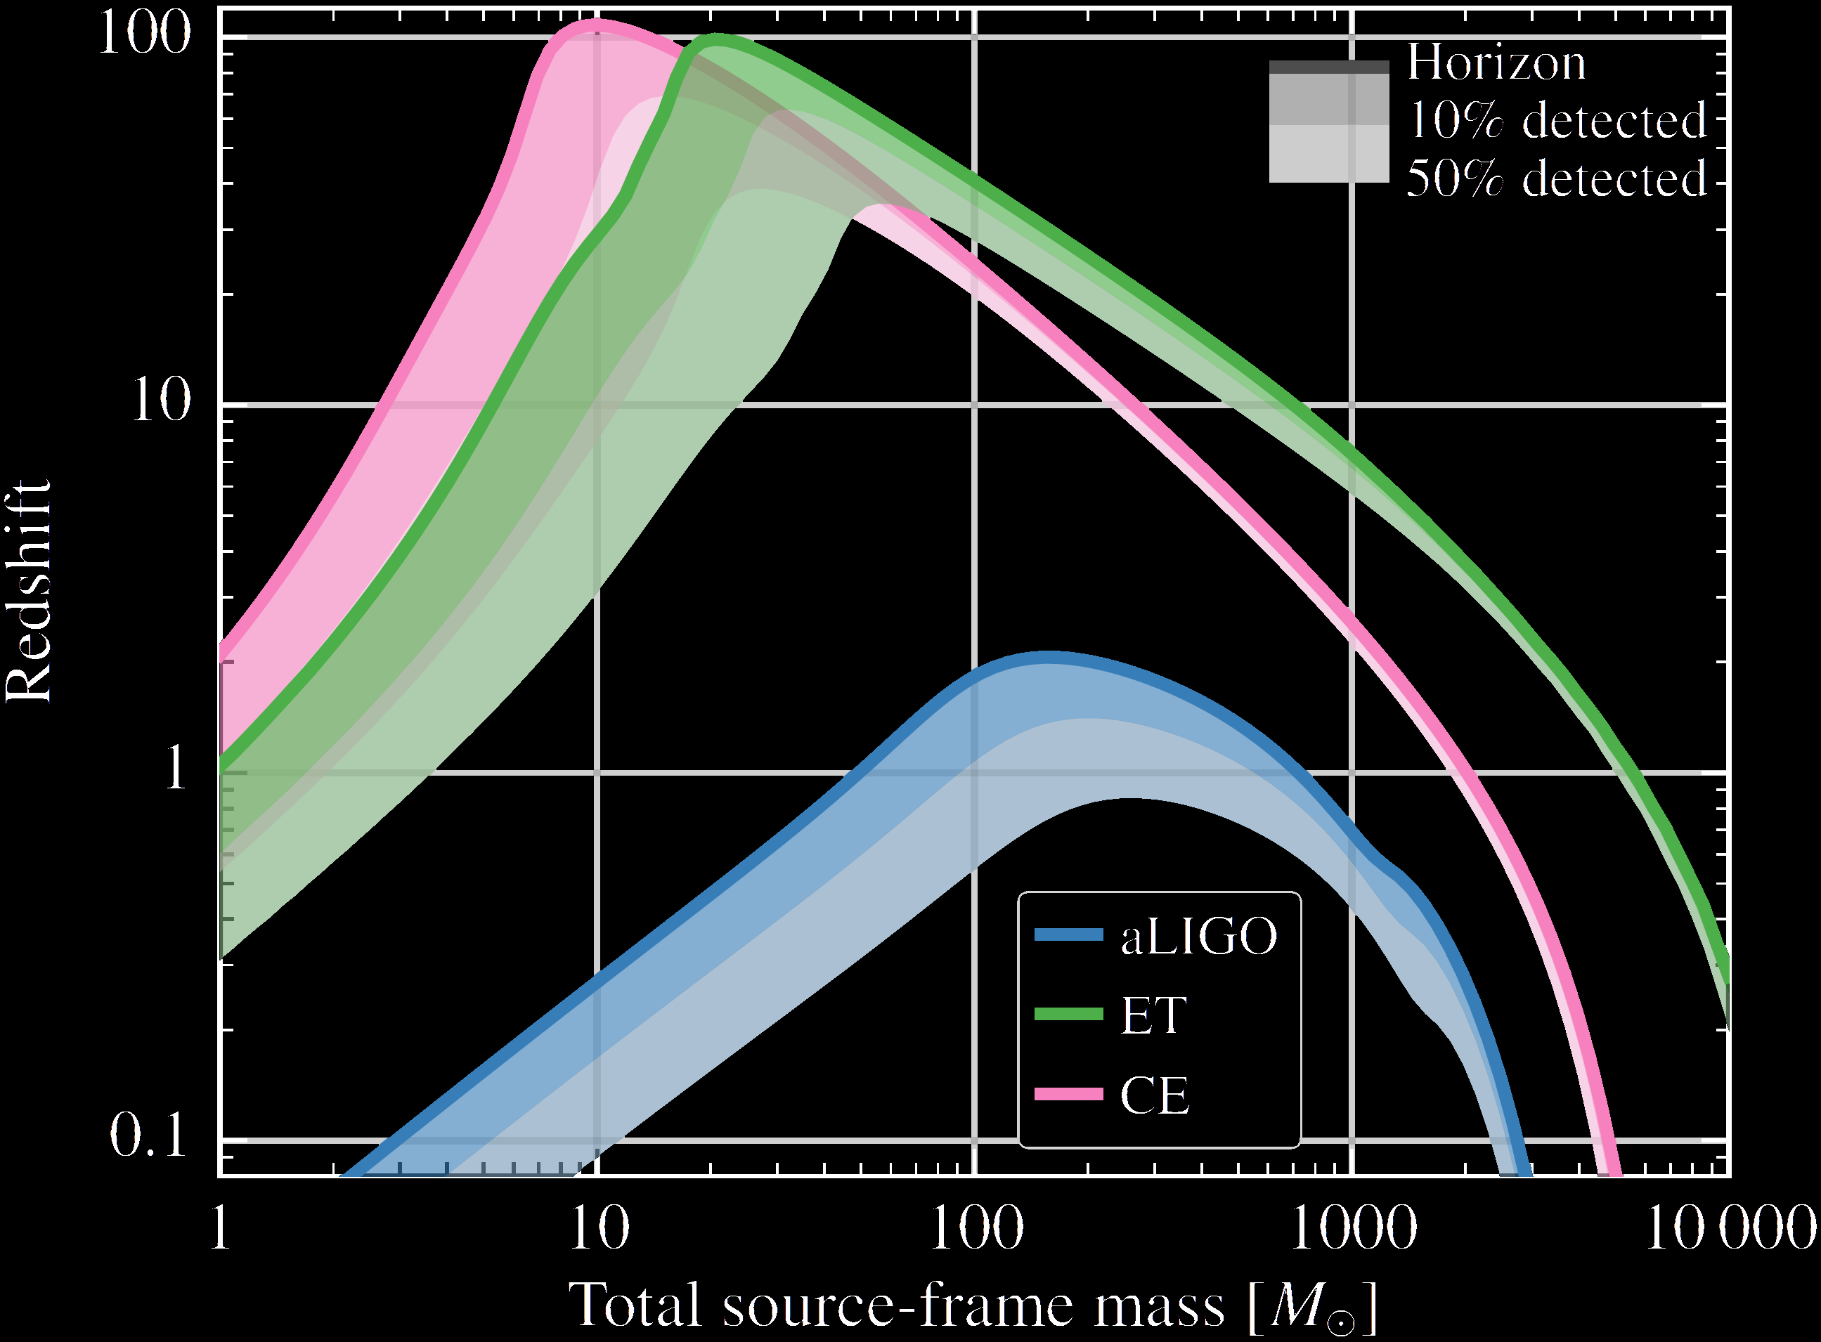
Hearing the „whole universe“…
CBC Sources throughout the universe
Credit: E. Hall (MIT)

Slide 18
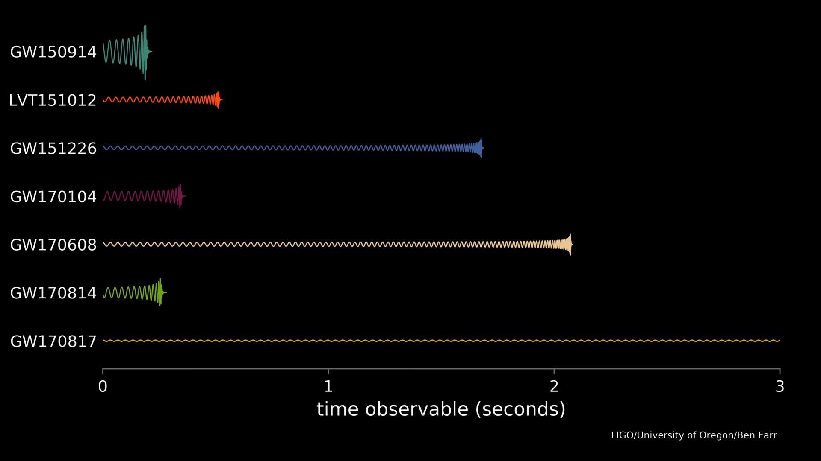
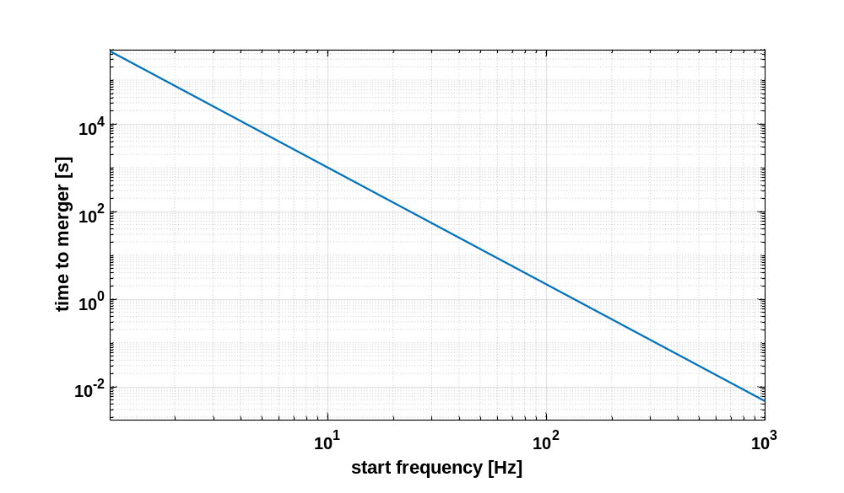
Published sources O1 & O2
1 day
1 hour
1 min

Slide 19
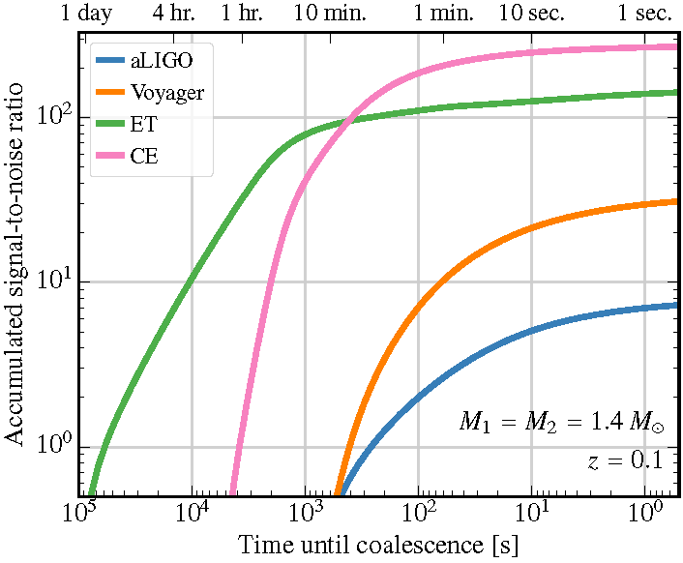
NS-NS „In Band“ duration
BinaryNeutronStar
pre-warning time
with
3G instruments
Credit: Evan Hall
~3h
~30min

Slide 20
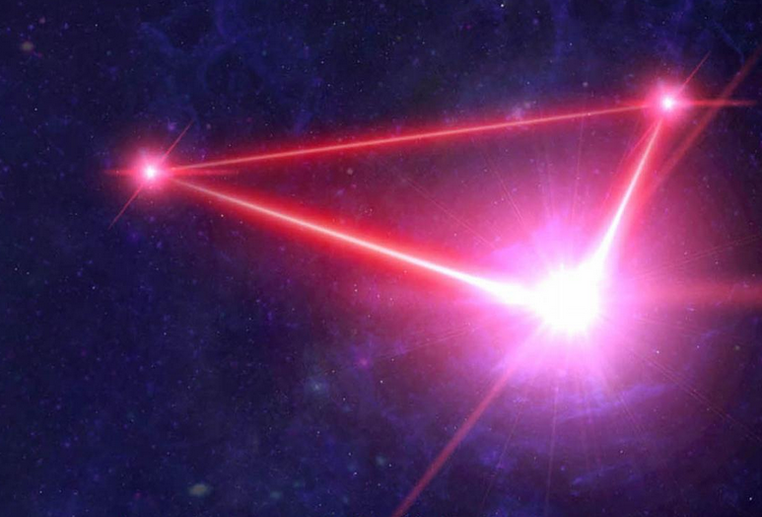
Gravitational wave astronomy
In the late 30‘s
www.elisascience.org
aLIGO+
KAGRA
aLIGO+
INDIA
AdV+
aLIGO +
3G south
Notes:
Countries represented: 15

