Slide 1
ET-ISB workshop 29 & 31 March (2021)
Low-Frequency noise
How far have we come since then?

Slide 2
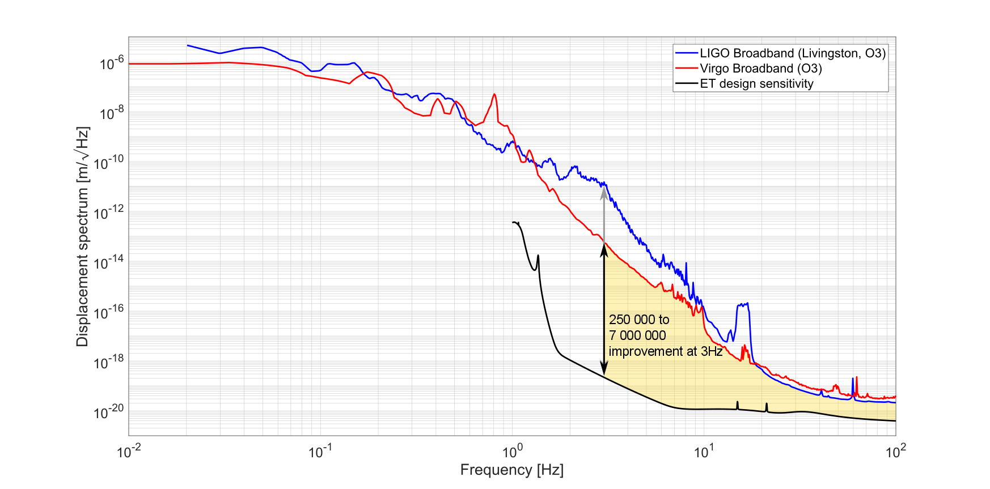
Low-frequency noise
ET is not 10x better than 2nd gen detectors, it is a million times better at 3Hz.
We need to systematically identify and mitigate LF noise by reducing
RMS motion
Actuation forces
A2L couplings
… and many more

Slide 3
Spanning (at least) 4 divisions
Breakout Rooms:
Suspension
Angular controls
Interferometer Requirements
Optics
Myriad couplings to DARM
Low-f noise
Interferometer
Achievable isolation
Residual differential motion & scatter
Active Noise Mitigation
Environmental noise

Slide 4
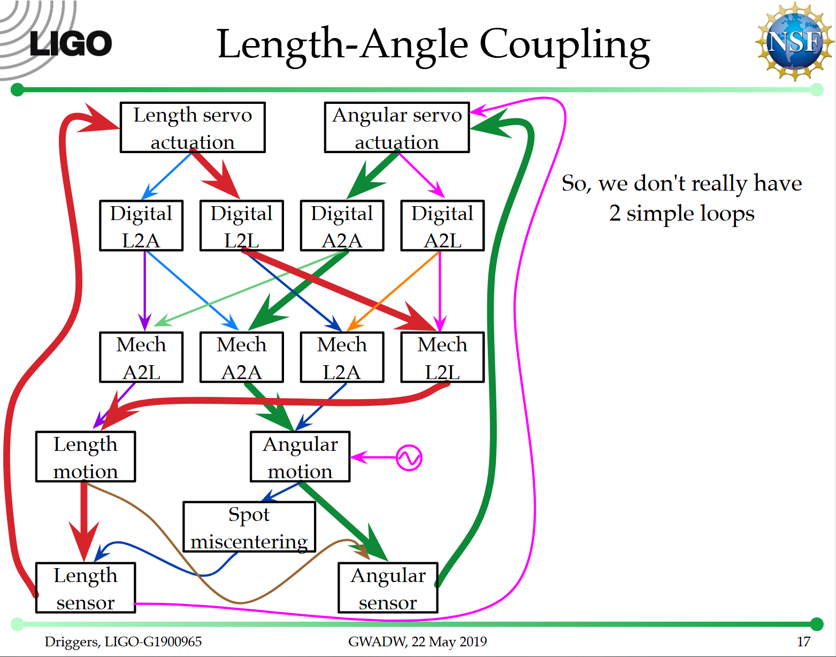
Isn’t this just a controls issue?

Slide 5
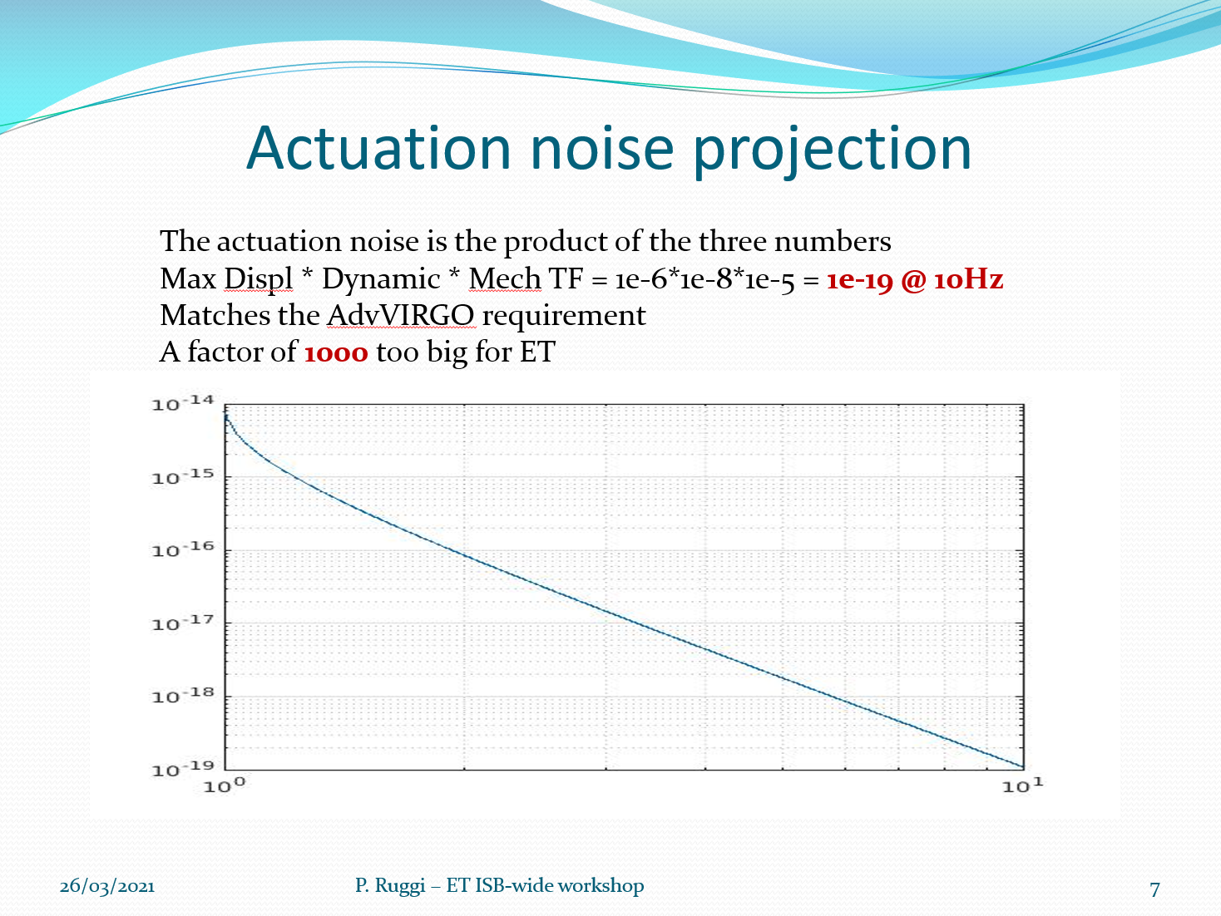
When technical noise becomes fundamental

Slide 6
Q1: IFO requirements
Daniel Brown, (Julia Casanueva)
What are the length and angular motion requirements for ET-LF in science mode?
    RMS length and alignment fluctuations in the arms
    RMS length and alignment fluctuations in wider ISC (MICH, SRCL, PRCL)
    Auxilliary degrees of freedom, especially input beam jitter and squeezing
    Maximum motion before non-linearity/lock-loss
These requirements drive many crucial
sensing and control decisions

Slide 7
Q2: Angular controls
(Paolo Ruggi), (Kate Dooley), Conor Mow-Lowry
Which lessons can we learn from Advanced detectors for the quadrant detectors (WFS in LIGO)?
    Where does the noise (starting from 3 Hz) seen by the quadrants come from (electronic noise, scattered light, beam jitter wrt sensor, phase noise, ...)?
    Which handles do we have to reduce it for ET?
    Which degrees of freedom are most problematic?
    Unsensed/uncontrolled DoFs?
    Sidles/Sigg limits to WFS UGFs - what is the Hard-mode frequency? (should be tracked in, eg GWINC)
    What don't we know or understand yet in the LVK instruments?

Slide 8
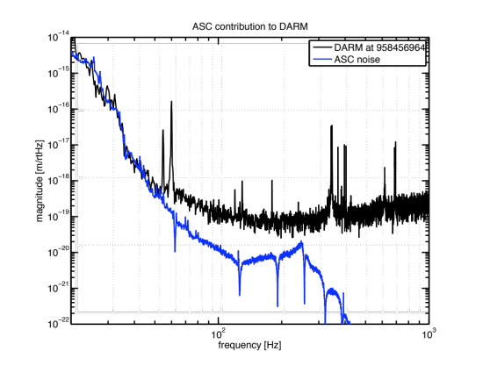
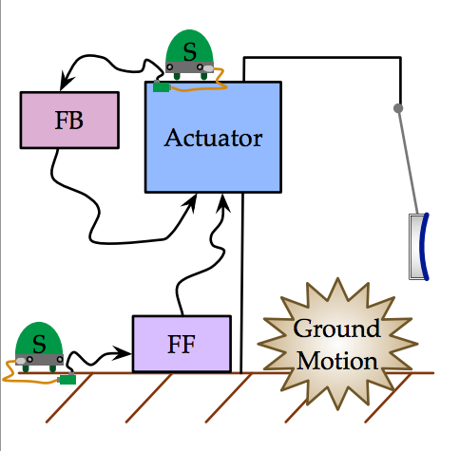









An example problem
3. The length drive is necessary because the isolation tables aren’t perfectly quiet…
1. Angular control is a limiting noise source
Reaction Chain
Main (test) Chain
Driggers, G1500001
Dooley, P1100125
4. Due in part to tilt-to-translation coupling in seismometers
2. Coupling mechanisms, including suspension coupling from length drive to angle, and back to DARM
$$(a)$$
$$(b)$$
$$θ_{0}$$
$$δ_{0}$$
$$δ_{0}$$
$$m$$
$$m$$
(UoB workshop on low-frequency noise, 2018)
https://dcc.ligo.org/LIGO-G1801755
$$x_{0}$$
$$g$$

Slide 9
Q3: Scatter (corner and ends)
Thomas Bretz, Sina Koehlenbeck, Michal Was
Can we mitigate or eliminate scattered light noise between optics, suspension frames, and detection benches?
    Suspending all phase-sensitive elements? What are the boundaries here, set by, eg Input and Output isolators?
    Can we measure and control inter-platform motion with new sensors (eg SPI) or with virtual sensors (eg 'tracking')?
    Can we set a 'speed limit'? (eg sub-radian rms velocity)
Can we keep all our scatterers slow?

Slide 10
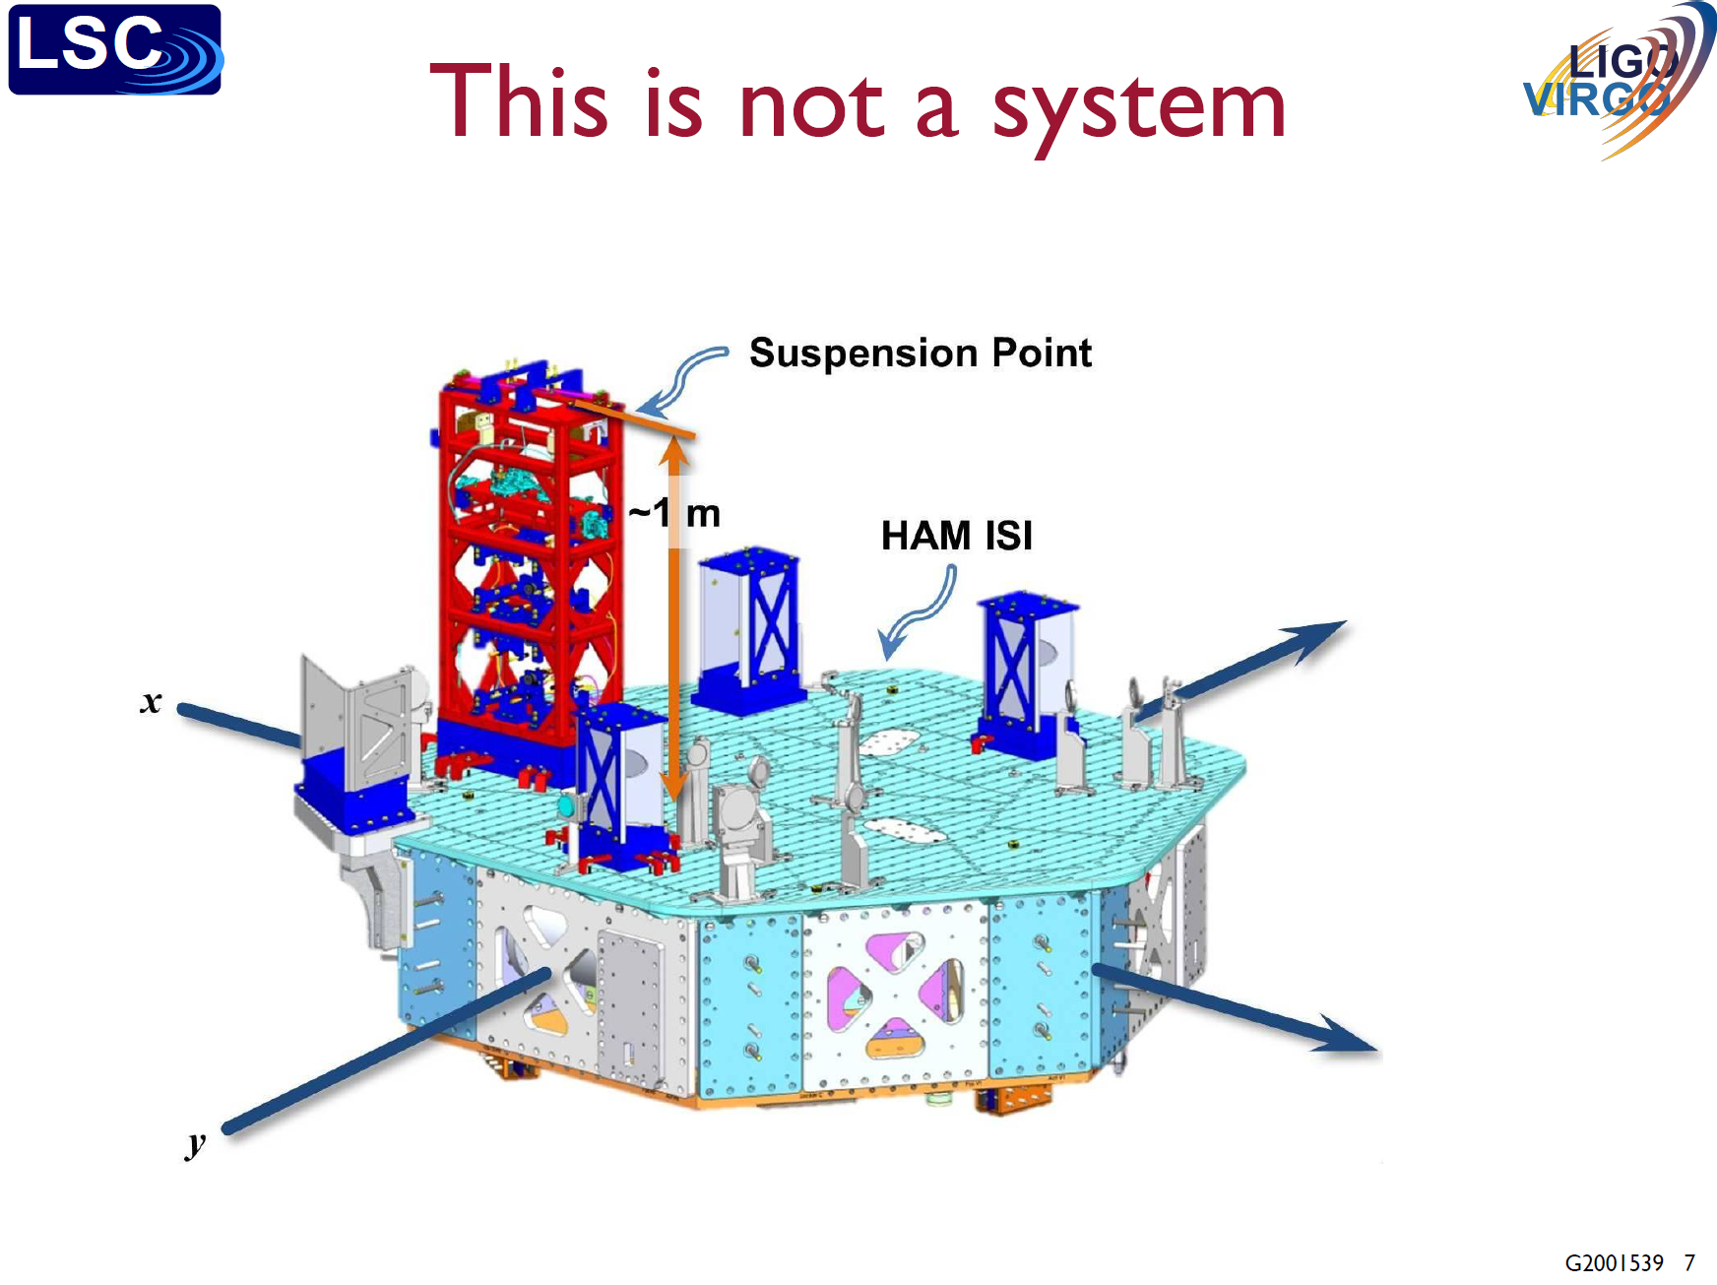
“Systems” considerations in GWDs
Taken from Brian Lantz’s recent LVK talk at:
https://dcc.ligo.org/LIGO-G2001539

Slide 11
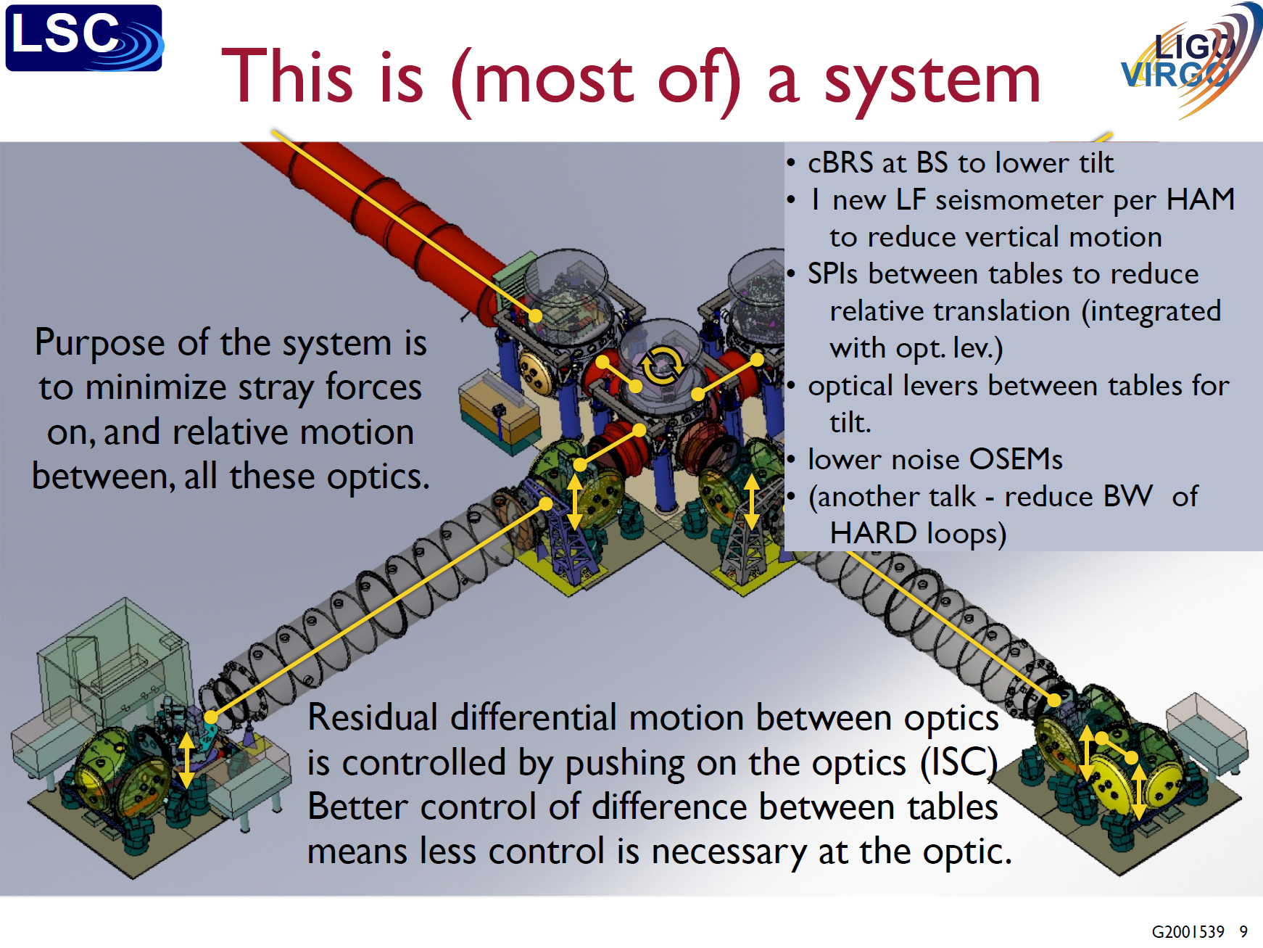
For ET we need to plan, from the beginning, to deal with the auxiliary controls, dynamic range, and realistic considerations of non-linearities.

Slide 12
Q4: Seismic platform and Suspension
Francesco Fidecaro, Oliver Gerberding, Alberto Gennai
What are the requirements for the seismic platform and the suspension?
    Expressed as a spectral density + RMS, not as a transfer-function or attenuation factor.
    What is the achievable performance with a single-stage active platform?
    How can controls be implemented in the chain, and what is the controlled RMS motion?
    What are some of the practical limitations from Advanced instruments, especially concerning tilt and cross-coupling?
Are 12m suspensions sufficient?

Slide 13
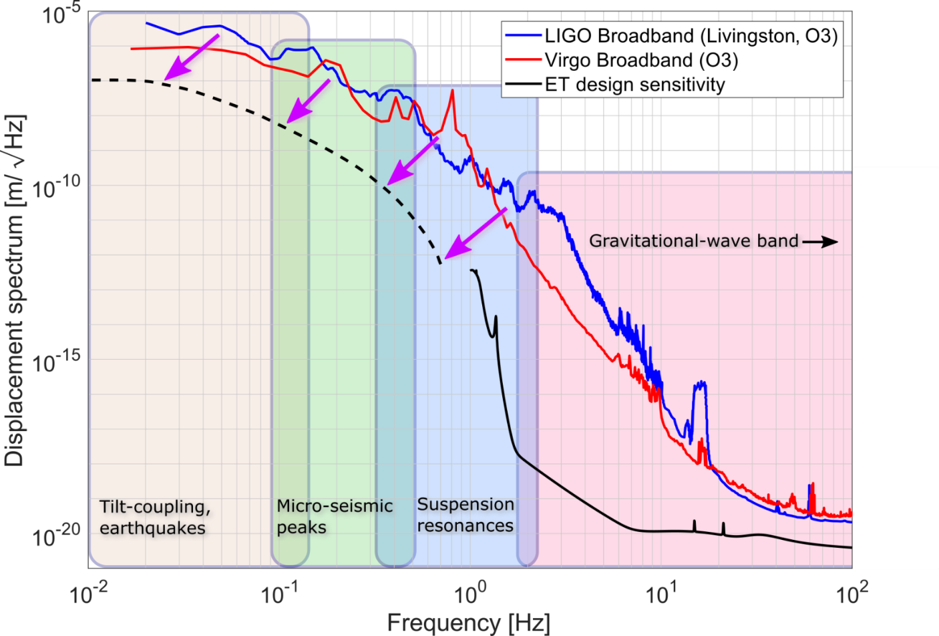
Adopting a baseline target for the seismic platform

Slide 14
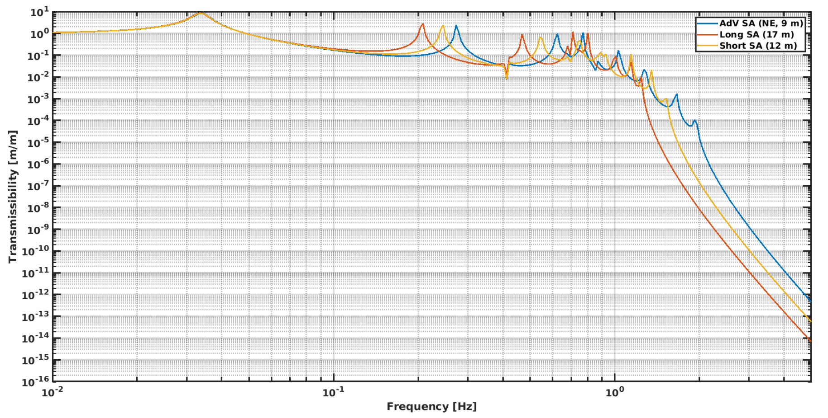
Converting SAT transmissibilities to spectra

Slide 15
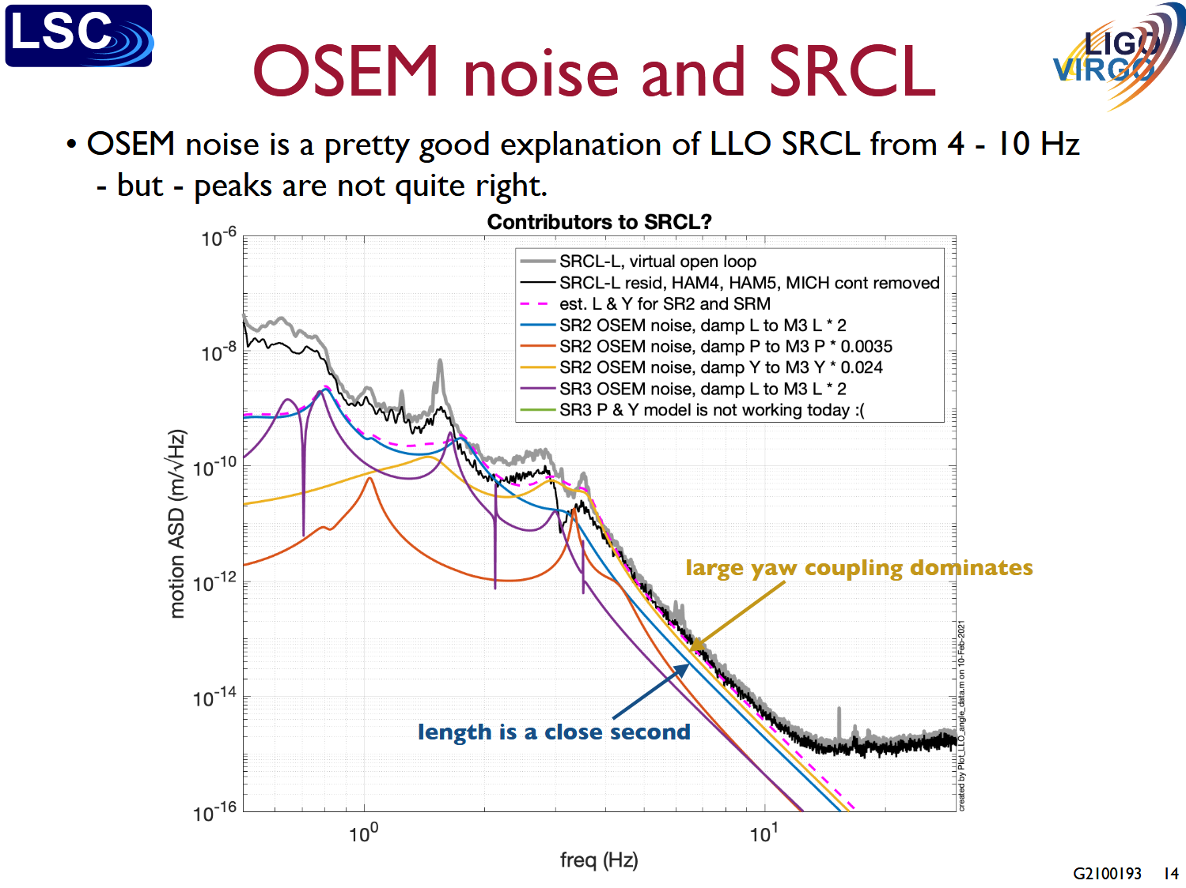
Adding local damping and controls
Undamped peaks dominate RMS
Damping sensors can inject noise in-band
Controllers can add ‘ground’ motion into the chain
Undamped modes reduce operating time
Figure courtesy of B. Lantz

Slide 16
Some ‘concrete’ suggestions
Form a flow of requirements from IFO down
Assemble existing inputs and models
Identify critical unknowns
Make first estimates for controls effects
Anchor simulations and estimations in 2nd gen experience

Slide 17
Where are we now? (random thoughts)
WFS: Good modelling, anchored in Virgo measurements, that suggests a path for stable arm control.
Suspensions: focus on tool development. Big interface problems (cryostat, height, active isolation). A lot of R&D activities with little coordination.
Requirements: many still unclear, but some progress (DAC noise).
SPI: Good R&D progress. Connection to ET still limited.
Scatter? SQZ? ISC Requirements?

Slide 18
Path forward – what is ET Project Work?
If it isn’t in the PBS, it isn’t project work.
If you think it is project work and not in the PBS, put it in.
(Many caveats; we don’t have a WBS.)
What’s in the PBS now?

Slide 19
Current PBS (IPM, LF-Controls)
SPI hardware
  For a chosen design solution. Limited interfaces discussed. Not (yet) a clear path to requirements.
Models and tools
  Ground motion in, drawn from ‘approved’ site data
  Input motion → Optic motion
  Optic motion → ISC DoFs
  Controls models to project to DARM and (thereby) derive upstream requirements.
Is this right?
Is it enough?

Slide 20
This week
…

