Slide 1
ET at 3 Hz
Conor Mow-Lowry
For the ET Instrument Science Board

Slide 2
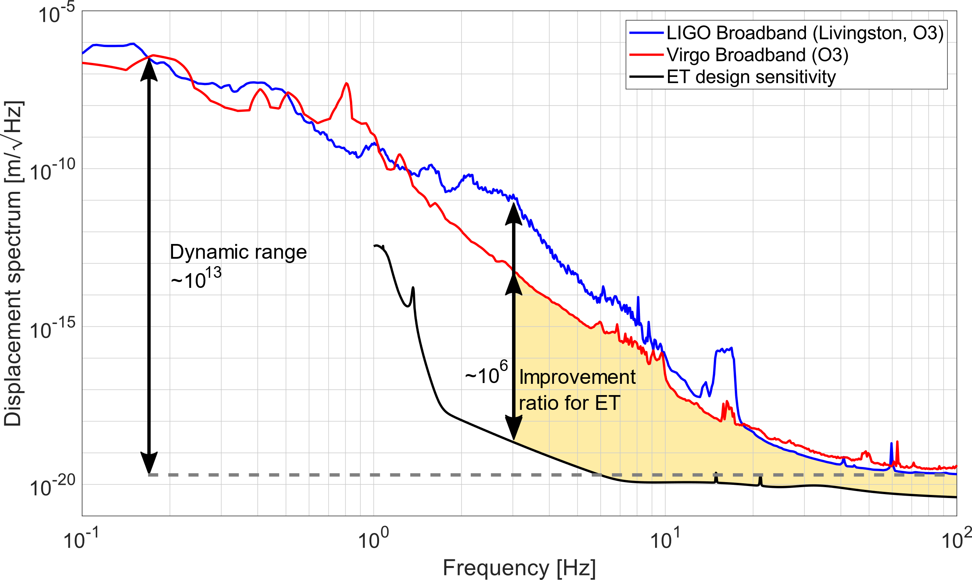
Martynov, Virgo log 37982

Slide 3
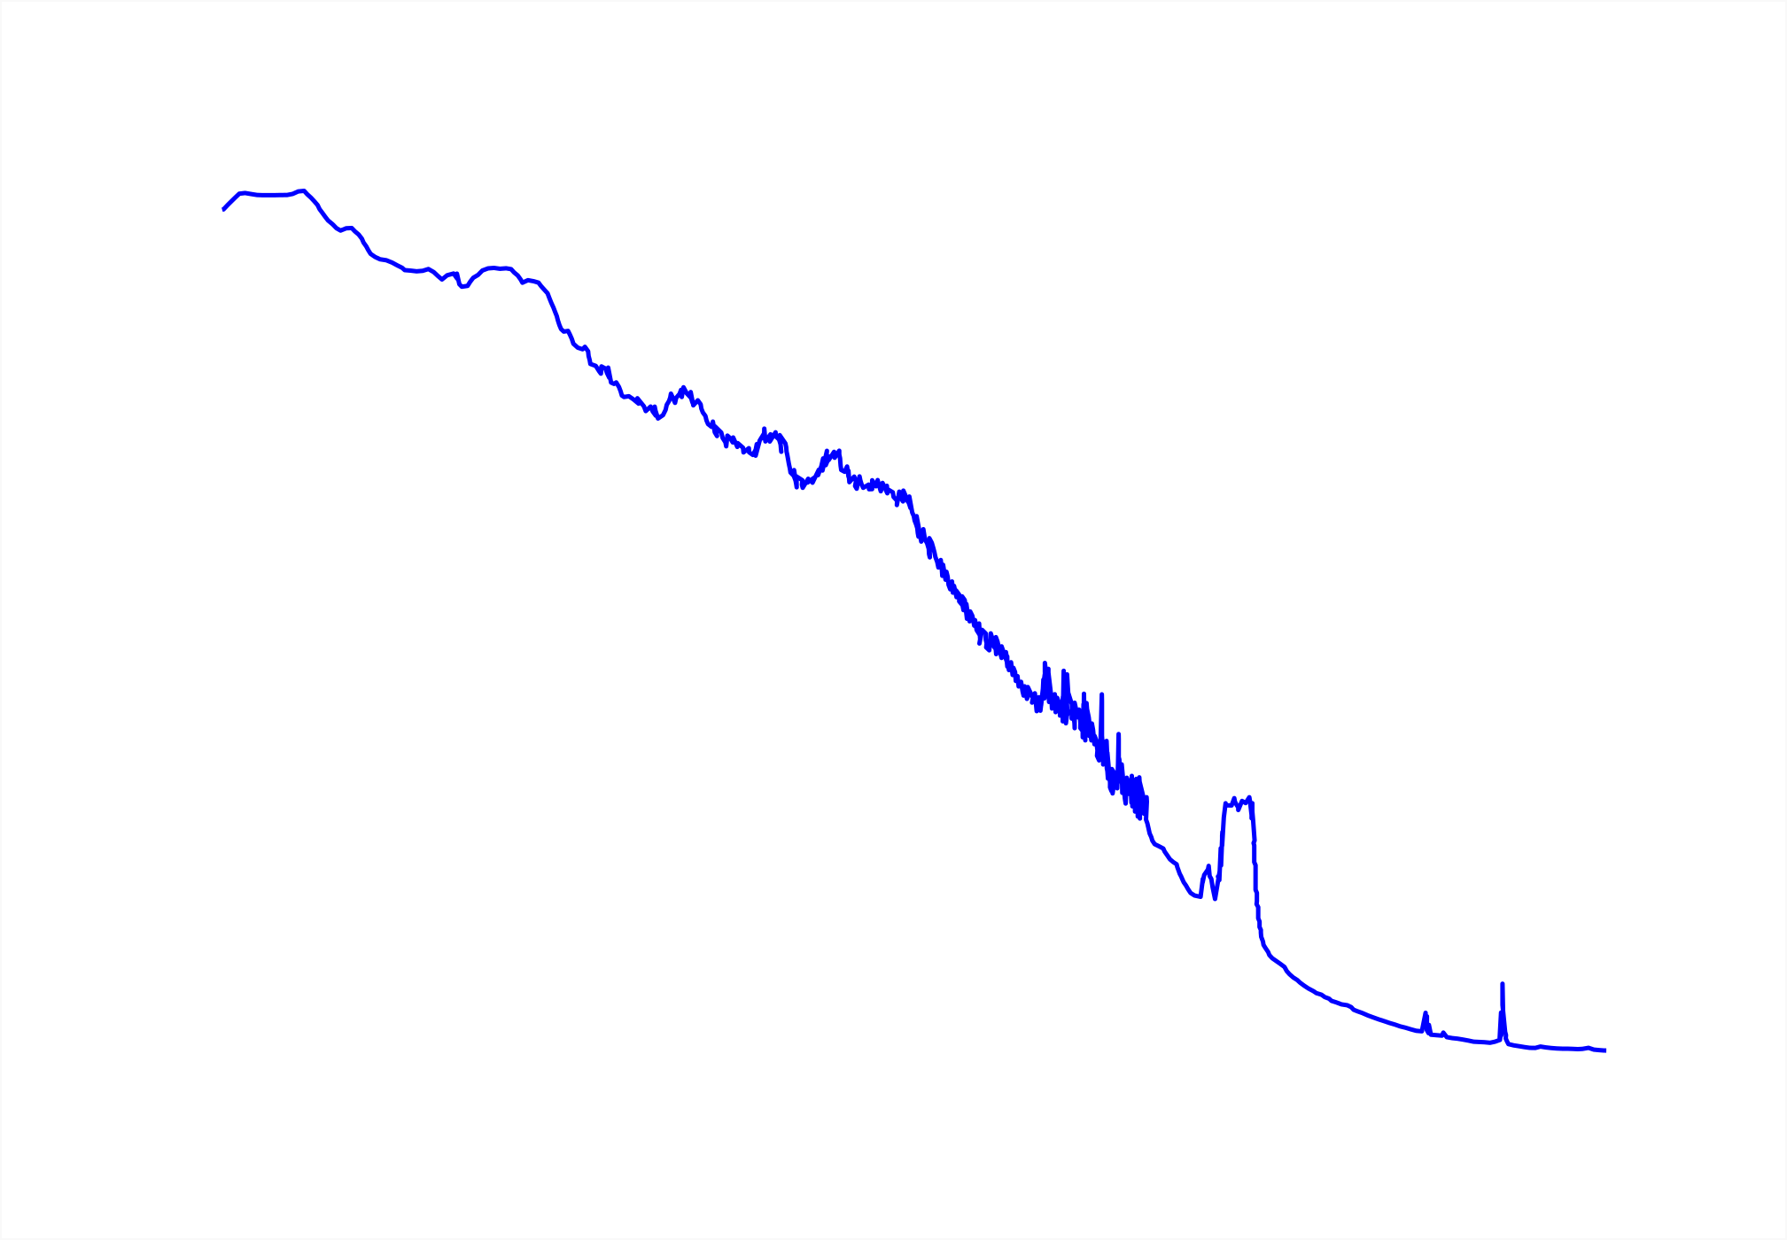
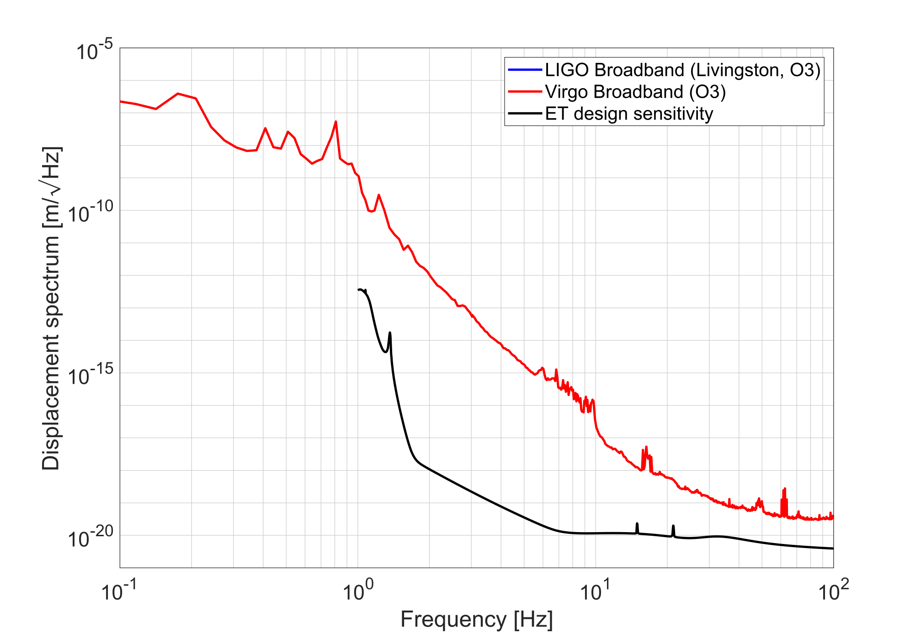

Slide 4
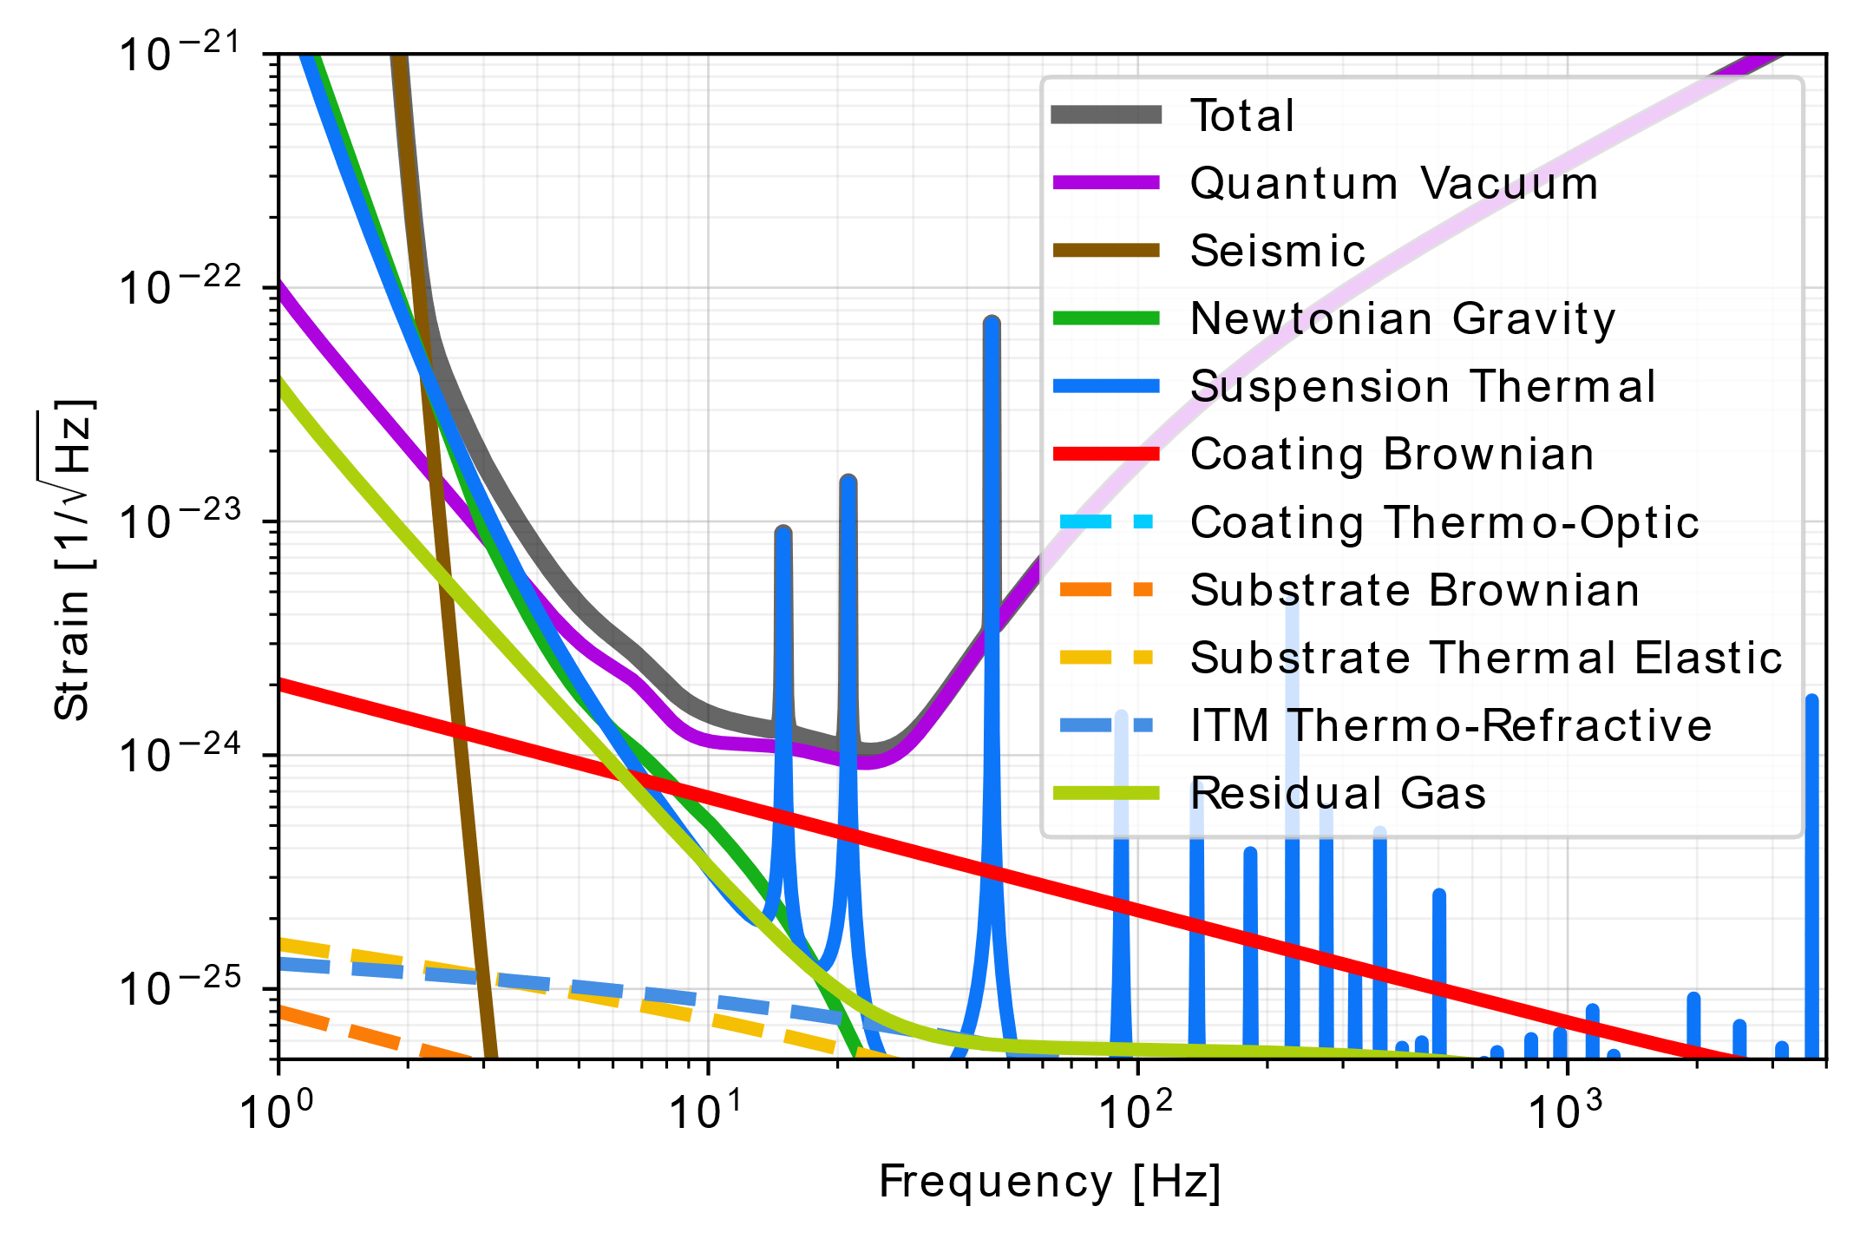
Identifying show-stoppers
‘Fundamental’ noises are not show-stoppers for ET.
Uncertainty about mirror temperature + thermal noise
Newtonian noise needs site-specific models + mitigation models.

Slide 5
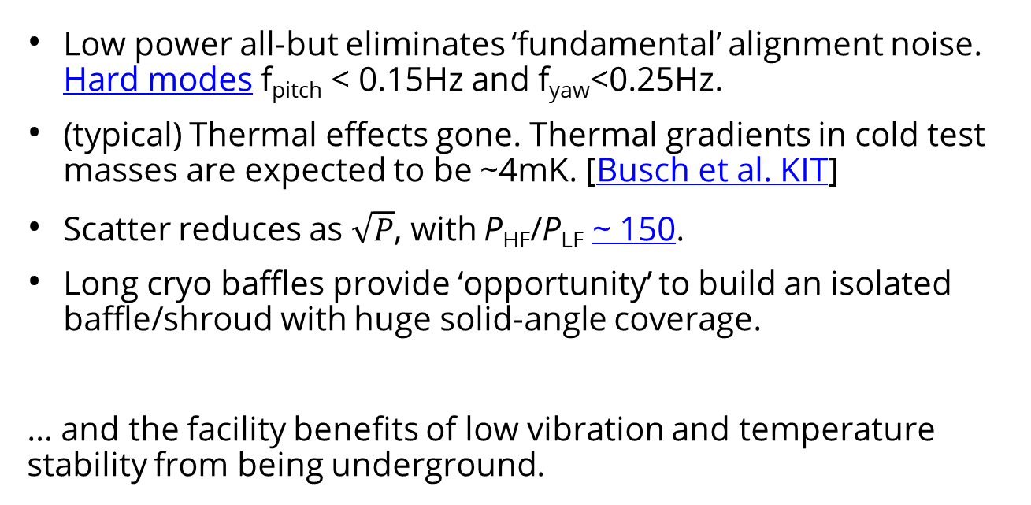
ET-LF, the technical noise benefits
Low power all-but eliminates ‘fundamental’ alignment noise. Hard modes f_{pitch} < 0.15Hz and f_{yaw}<0.25Hz.
(typical) Thermal effects gone. Thermal gradients in cold test masses are expected to be ~4mK. [Busch et al. KIT]
Scatter reduces as $\sqrt{P}$, with P_{HF}/P_{LF} ~ 150.
Long cryo baffles provide ‘opportunity’ to build an isolated baffle/shroud with huge solid-angle coverage.
… and the facility benefits of low vibration and temperature stability from being underground.

Slide 6
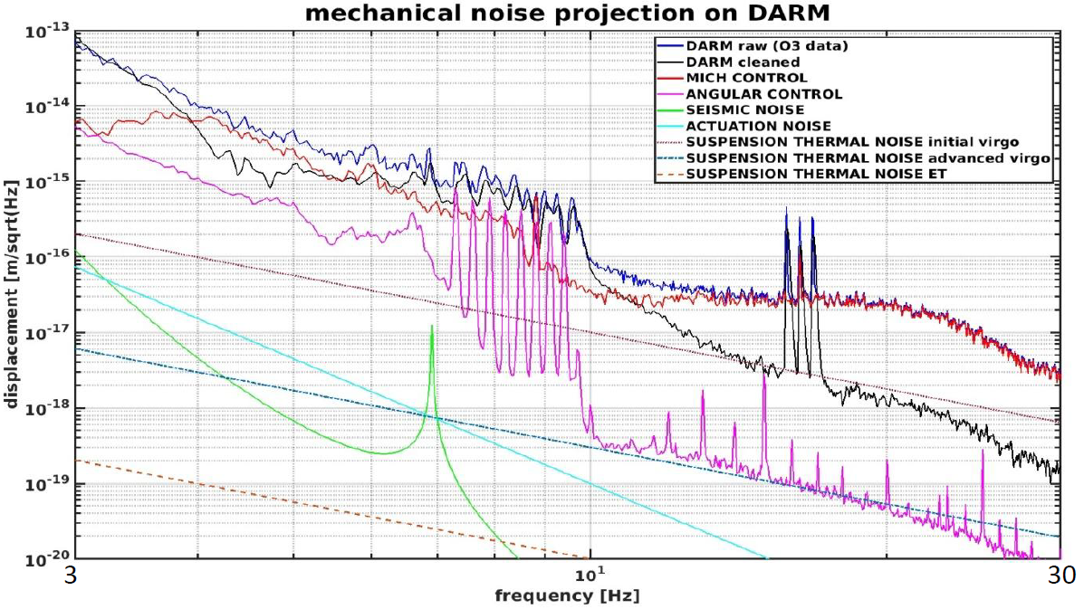
Low-frequency noise in Virgo
ASC does not limit Virgo.
Payload dynamics intrinsically decouple length and angle.
Yaw = 10mHz (single wire)
Pitch = 60mHz (CoM below suspension point)
Relatively low arm cavity power.
DAC noise okay for Virgo, a big problem for ET.
Factor
~300 needed
ASC = SUS-thermal
Paolo Ruggi 'Status of Virgo at LF' at ANM call
Consistent with more detailed 10Hz+ budget:
Michal Was, Virgo at LF, GWADW 2022

Slide 7
ISB kick-off 2020
Breakout Rooms:
Suspension
Angular controls
Interferometer Requirements
Optics
Myriad couplings to DARM
Low-f noise
Interferometer
Achievable isolation
Residual differential motion & scatter
Active Noise Mitigation
Environmental noise

Slide 8
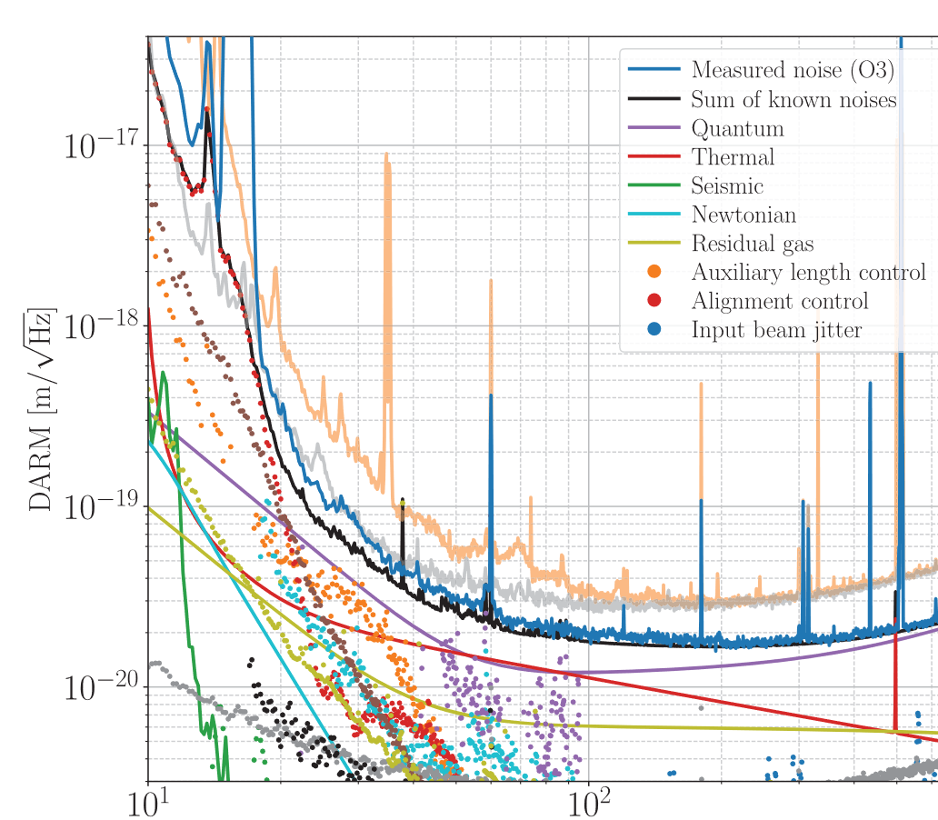
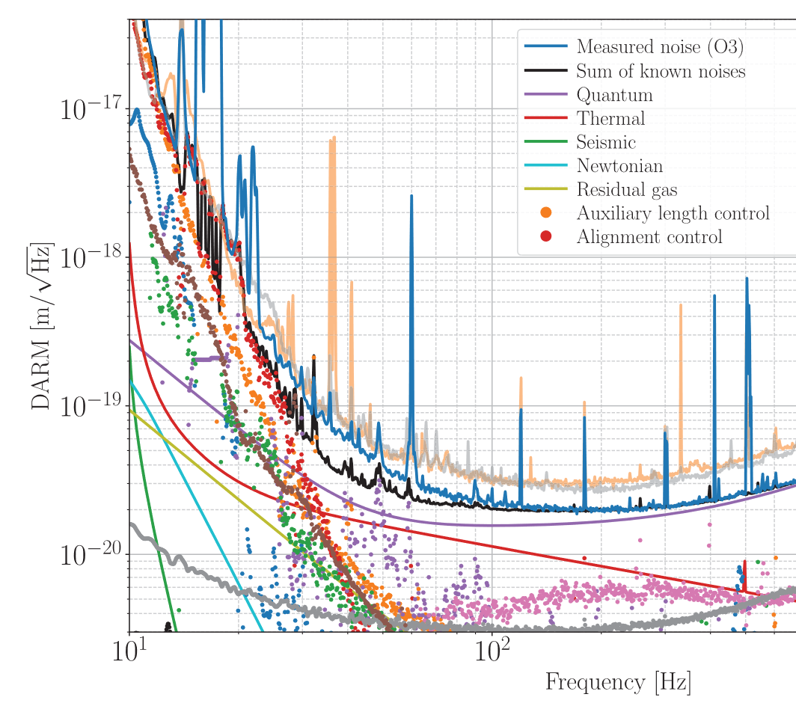
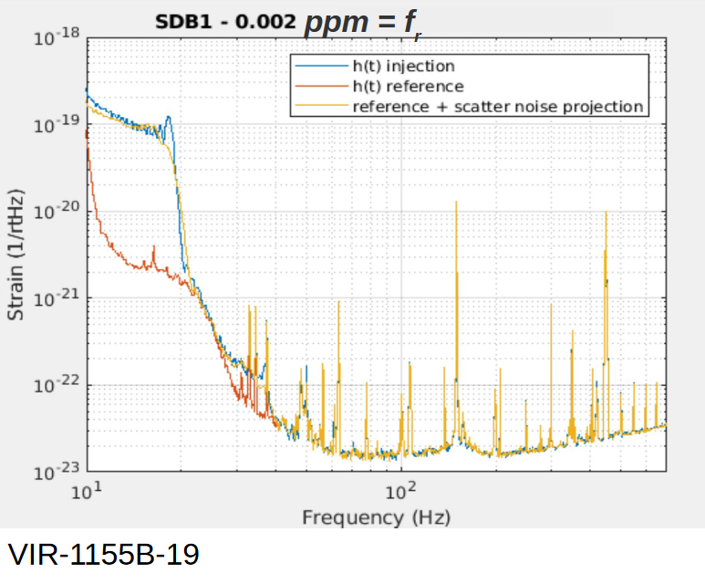
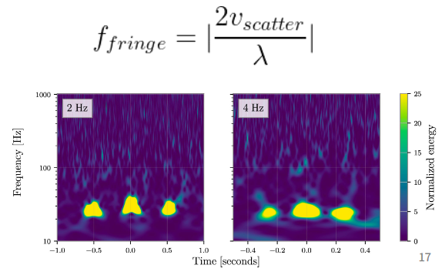
The four horsemen of technical noise
PRD 102, 062003 (2020)
PRD 102, 062003 (2020)
Alignment controls (ASC)
Auxiliary length controls (LSC)
Paolo Ruggi 'Status of Virgo at LF'
Polini GWADW 2022
Siddharth GWADW 2022
Actuation noise (DAC)
Scattered Light

Slide 9
Alignment Sensing and Control
Challenging at LIGO (RP), sub-dominant at Virgo (in O3)
Message for ET
  Low power (18kW) and high mass (200kg)
  → optical torque effects become small.
  Require a payload design that decouples Length and Angle
  → cryogenics complicates design.
ASC should not be a showstopper for ET-LF
Iff the cryogenic payload can meet mechanical requirements.
Further modelling is required.

Slide 10
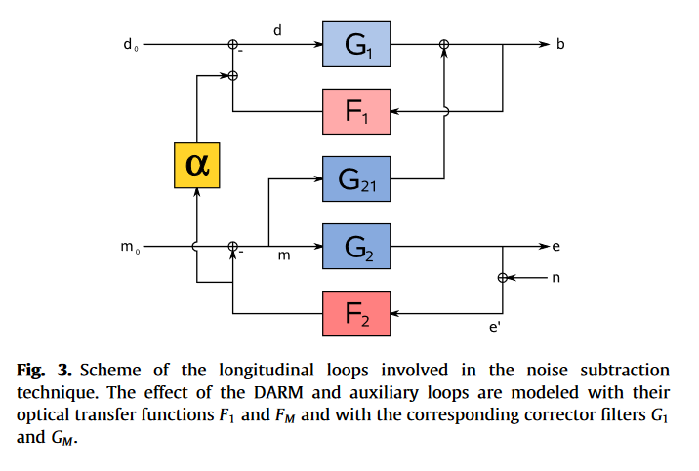
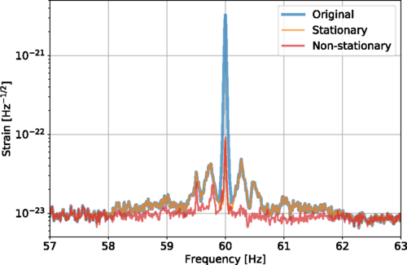
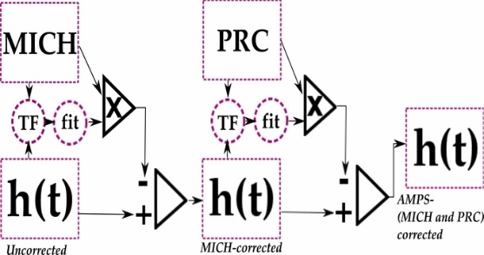
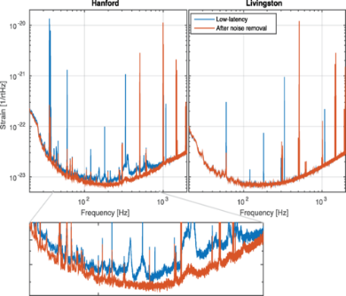
Auxiliary lengths
MICH, PRCL, and SRCL all couple to DARM.
Largely not via ‘intrinsic’ motion, but via
sensing noise → controls → motion → Optical coupling.
Sensing noise is intrinsic, but controls are only required to reach the necessary residual RMS
→ Current strategy is substraction
Vajente, LIGO, 2020
Virgo LSC 2009
Meadors, LIGO, 2014
Driggers, LIGO, 2019

Slide 11
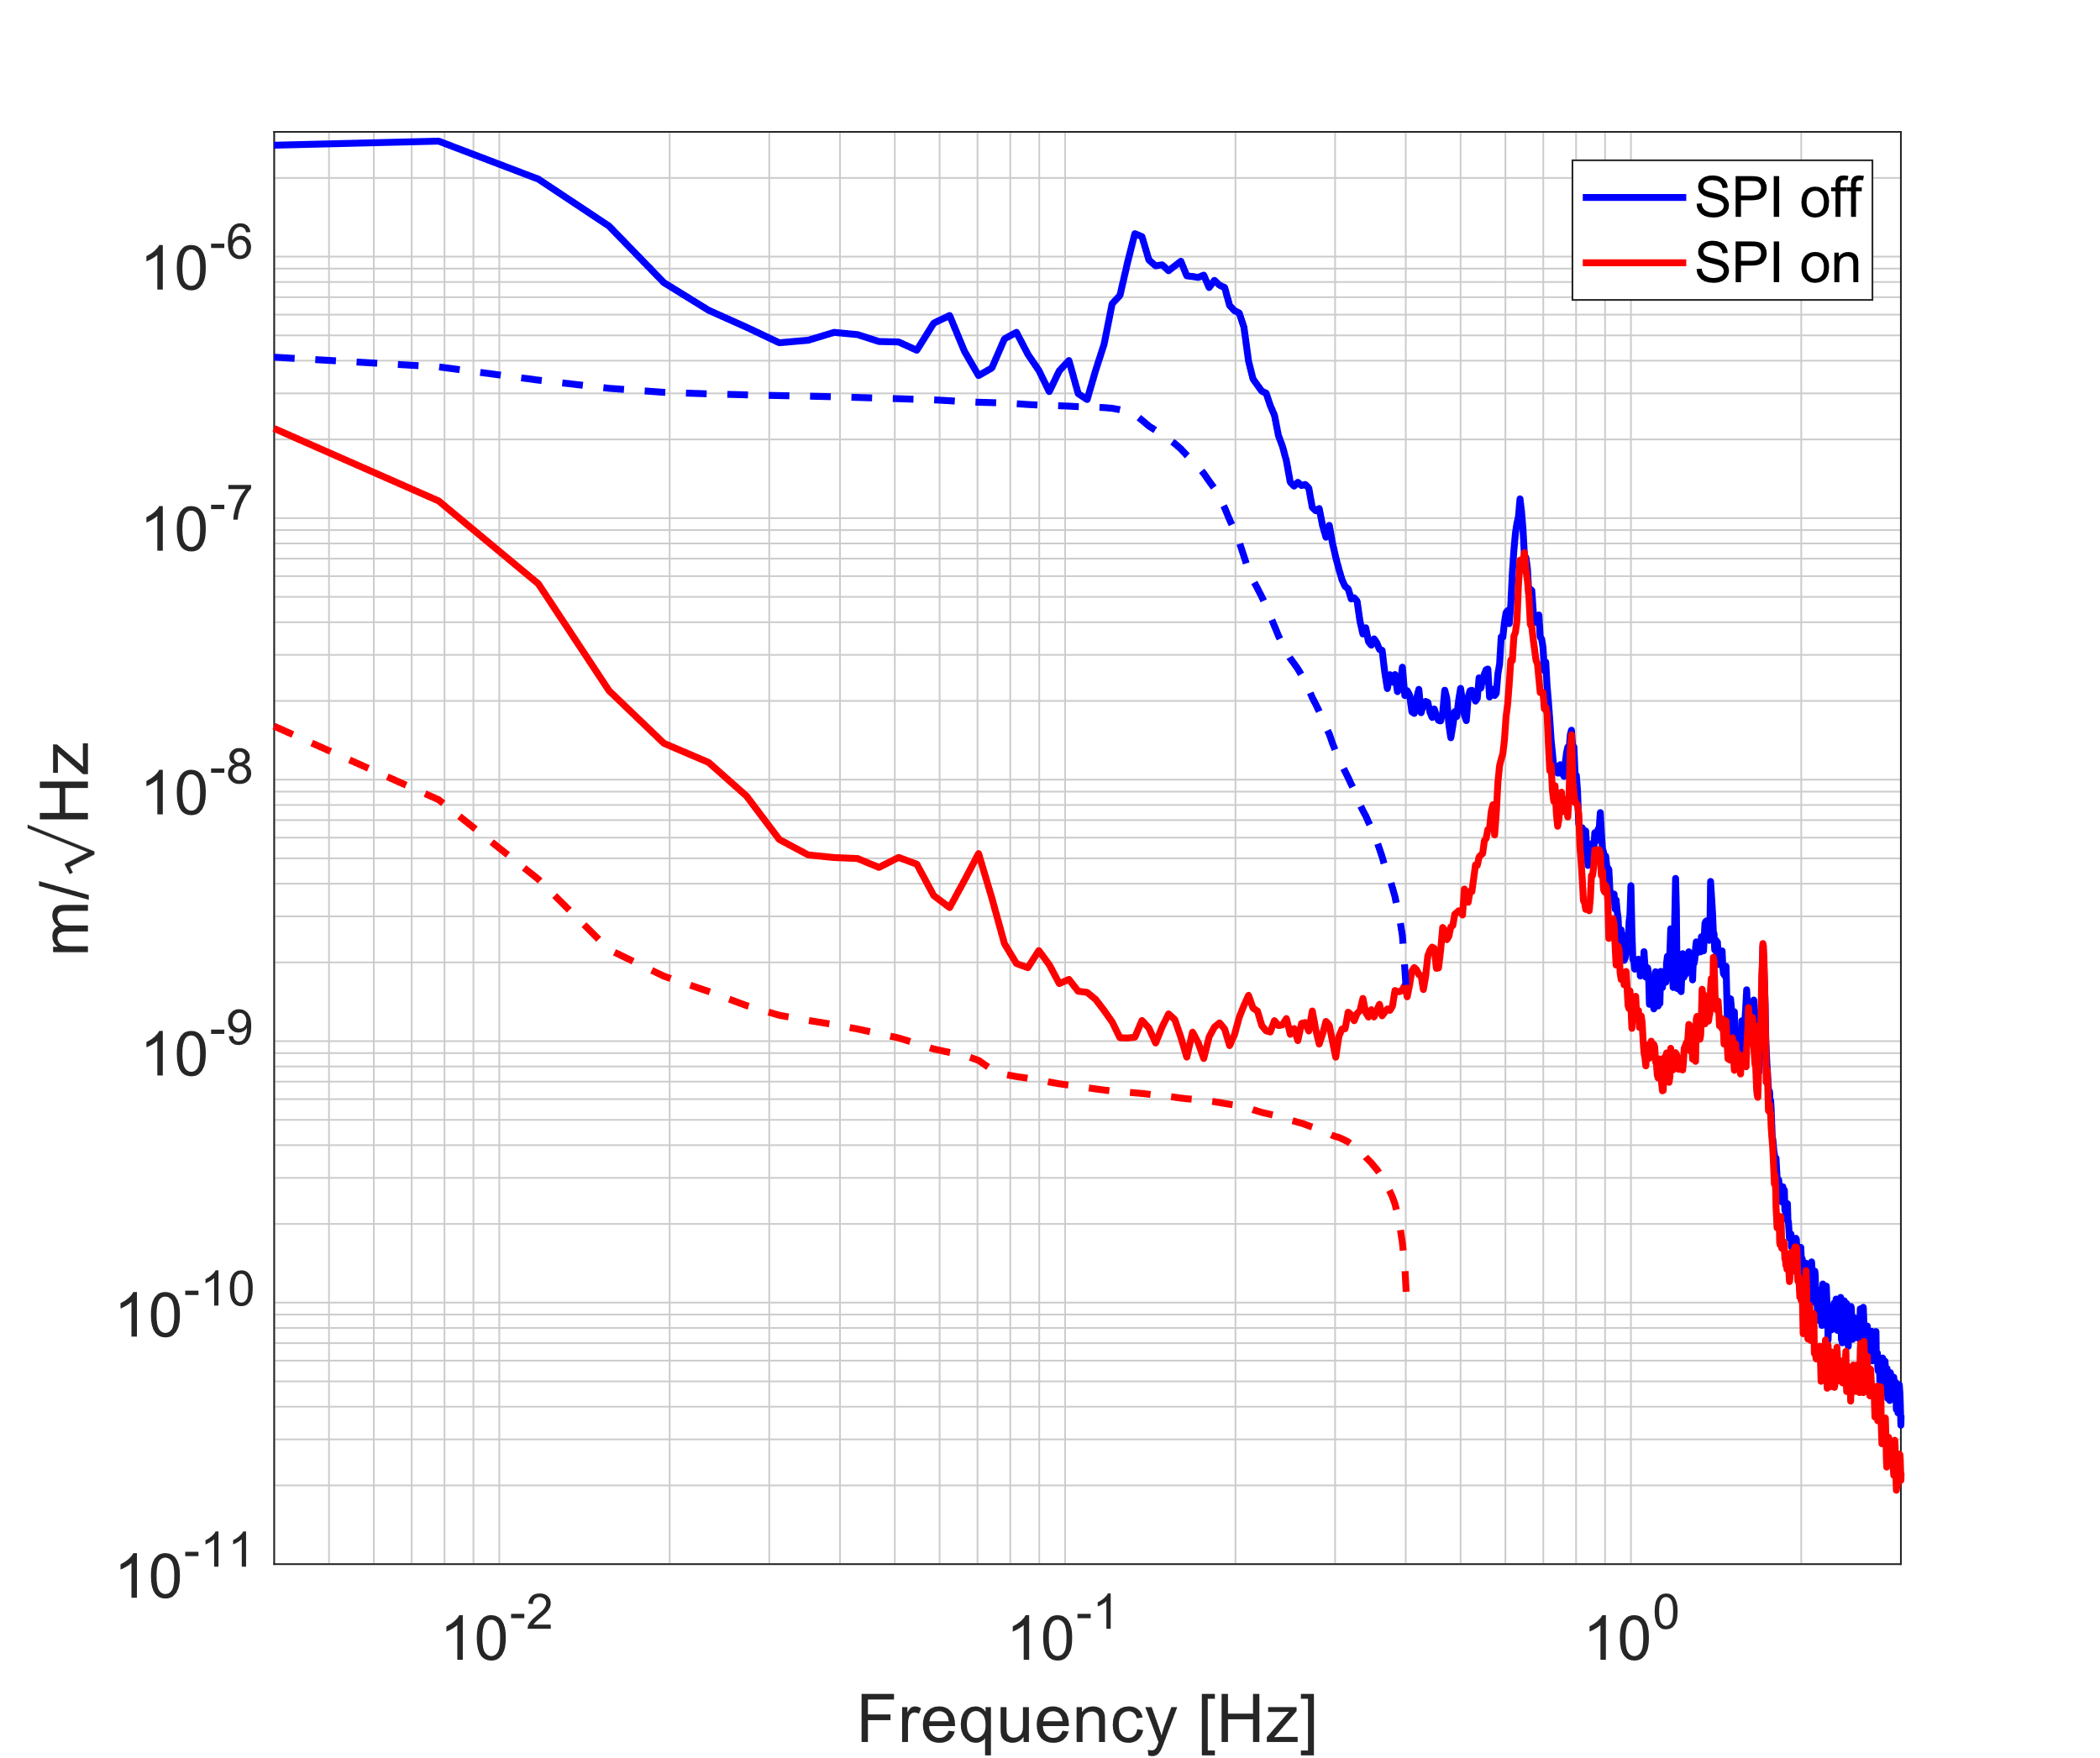
Defeating Auxiliary length
Interferometer Requirements
Achievable isolation
For ET, SPI technology can substantially reduce the input differential RMS motion
Suspension resonances
Factor
~300
AEI 10m reference cavity actuator signal with and without the SPI engaged in Length, Pitch, and Yaw.
Koehlenbeck PhD

Slide 12
Scattered light
ET needs a new design concept to deal with scattered light.
Experience shows that a priori modelling is extremely challenging.
Low power, reduced thermal effects, and longer wavelength all help a lot.

Slide 13
Scatter in the arms
CE beam-tube modelling suggests scatter from the pipes isn’t a fundamental issue [Hall et al., PRD 2021], ET must follow suit.
Virgo payload design provides extreme isolation to the safety structure and reaction mass (Filter 7).
Cryo-shields will need to be extremely quiet both RMS (position controls?) and in-band (isolation).

Slide 14
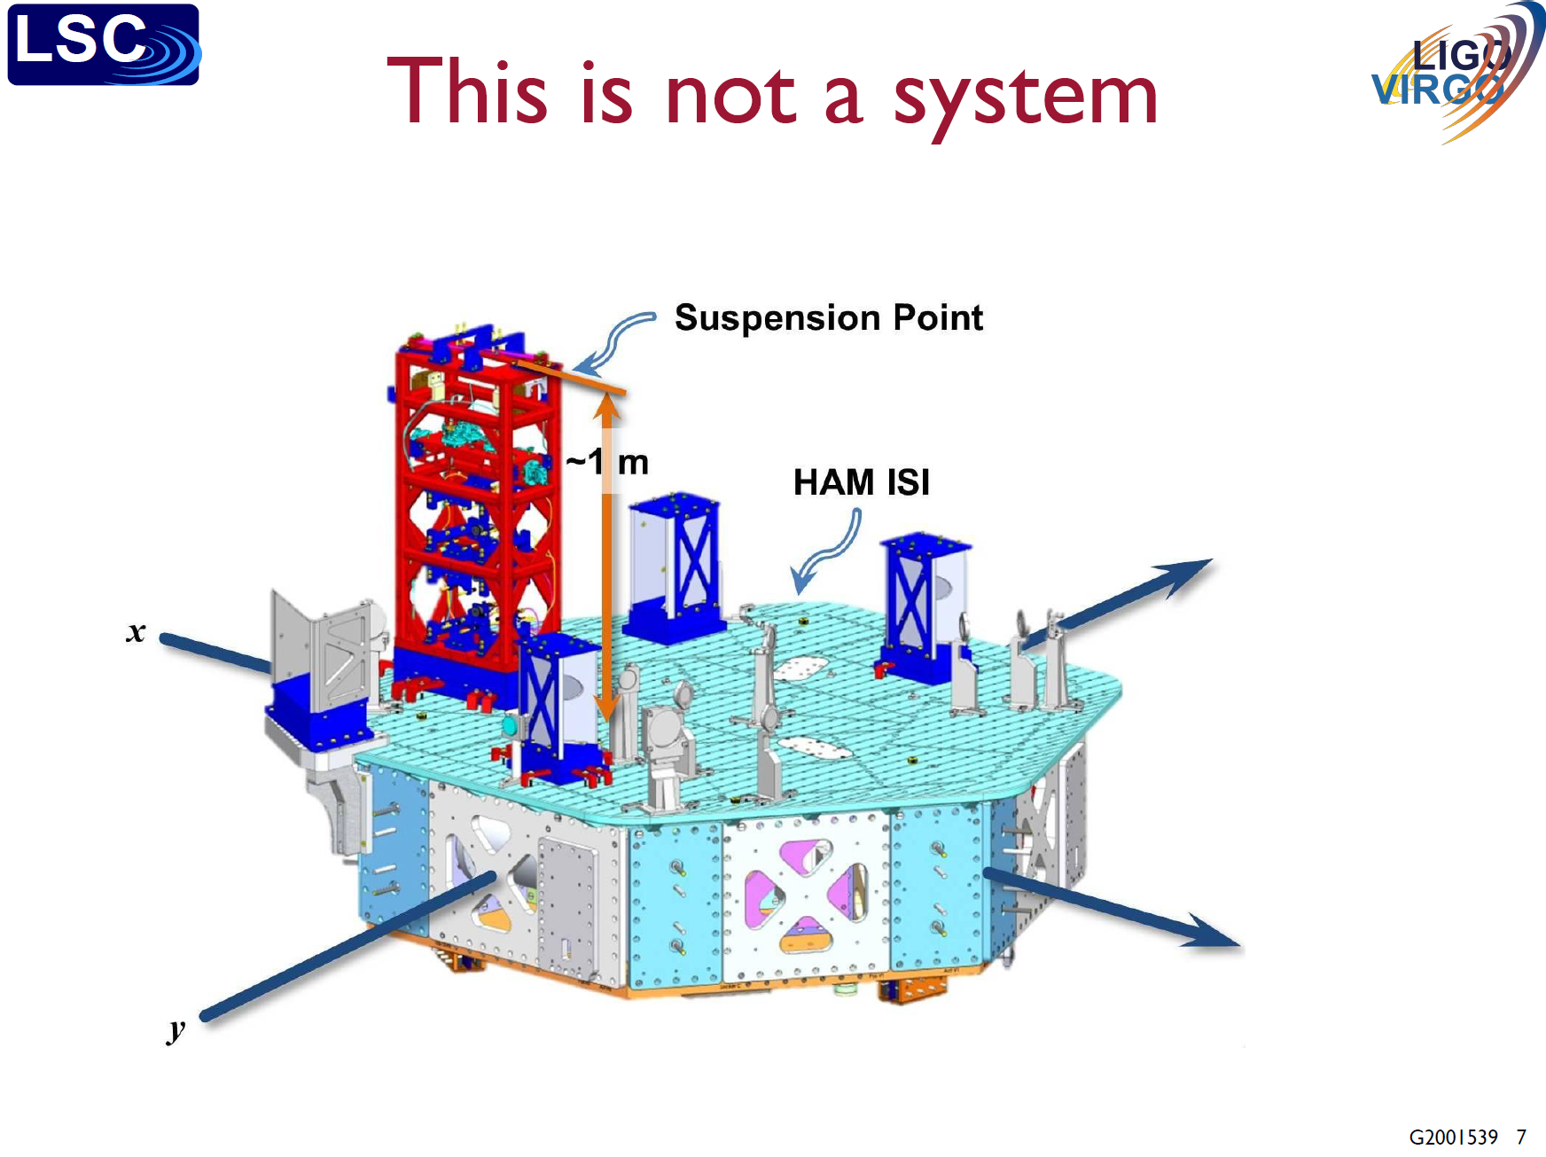
Taken from Brian Lantz’s no-longer-very recent LVK talk at:
https://dcc.ligo.org/LIGO-G2001539

Slide 15
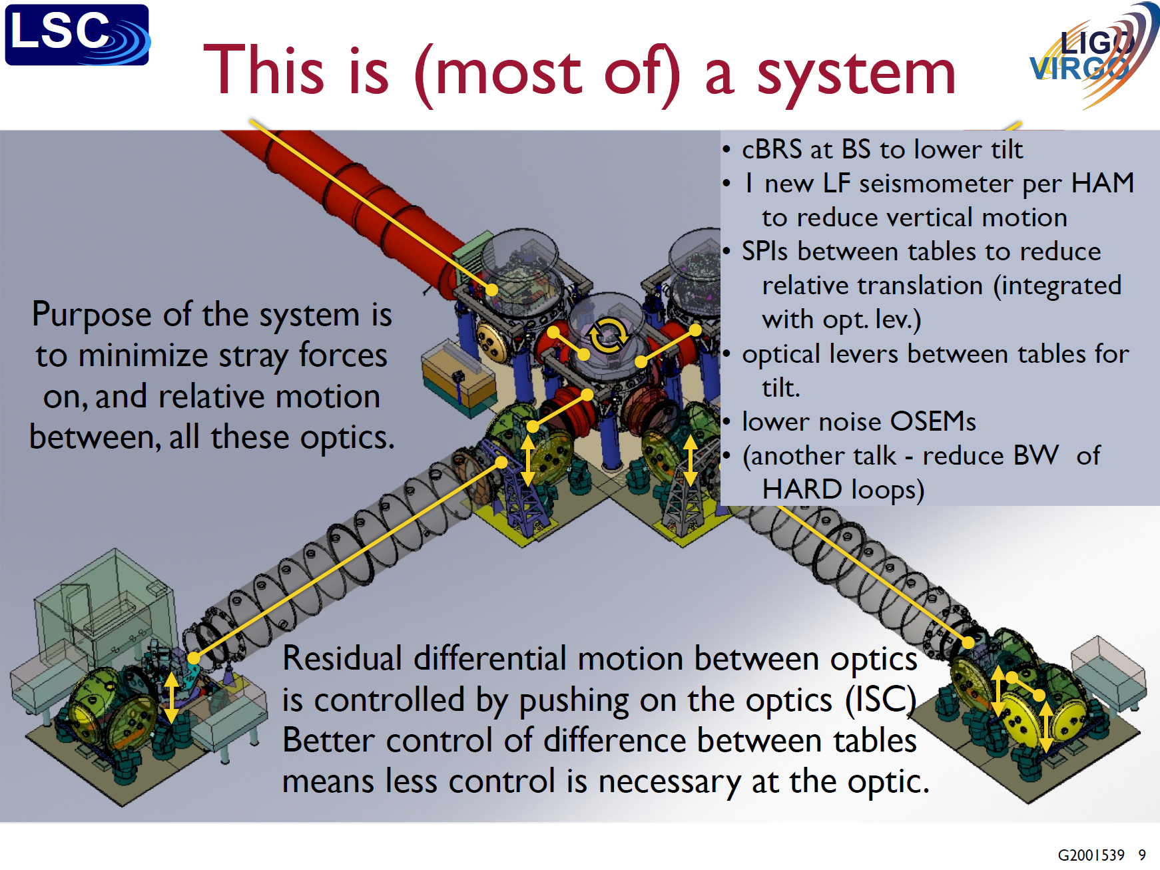
Can we create a single virtual platform, from photon creation to annihilation?
SPIs everywhere? Tracking controls?
LISA method: if nothing is moving, there is no scatter.

Slide 16
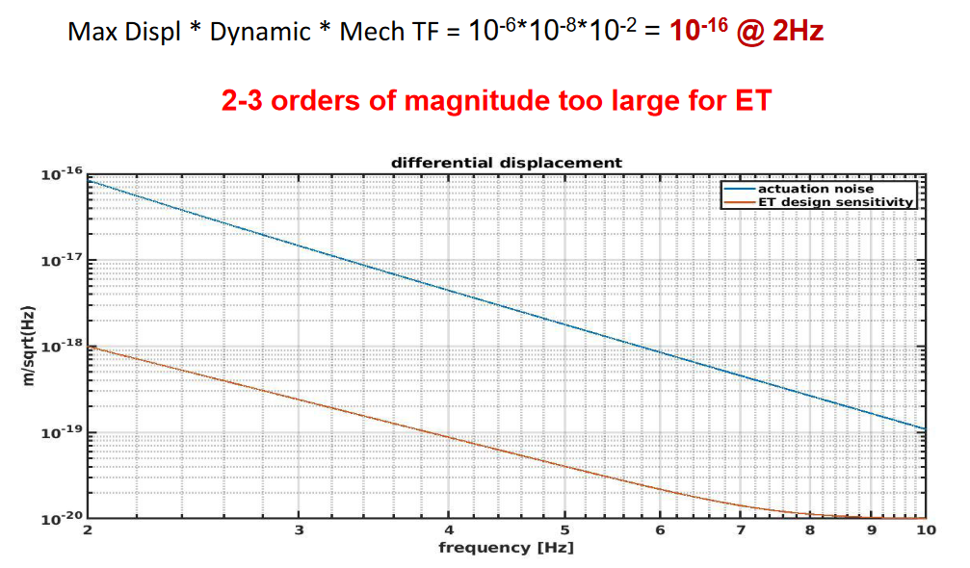
Actuator noise
There is a simple recipe for actuation noise. Using Virgo numbers:
Ruggi, ET-ISB workshop
actuation noise does not seem less ‘fundamental’ then thermal noise

Slide 17
Reducing actuator noise in ET
Mechanical filtering gets harder below 10Hz
DAC and Driver electronics dynamic range gets harder below 10Hz
Underground environment should reduce displacement
This places strict requirements on the performance of the seismic platform and suspension controls.
Ground rotation in ventilated caverns is a major problem
See, eg Badaracco GWADW 2022

Slide 18
Can we eliminate controls noise at 3Hz in ET?
Yes.
I think.
… but there is an enormous amount of modelling, design, and testing needed … deploy new technologies, consider system interactions, avoid mistakes in design…

Slide 19
Recipe for reducing ‘controls’ noise
Input motion
  Underground, seismic platforms, soft suspensions
Mechatronic design
  Payload dynamics, controls co-design, function + performance
Inter-platform motion
  Corner-station DoFs, suspended benches, at least L+P+Y
Flow of requirements
  Iterate with sub-system performance capabilities
‘Proper’ MIMO control
  Accelerate design, use information better before it is entangled.

