Slide 1

Low-frequency controls noise
Urgent tasks and cross-division work
ANM meeting Conor Mow-Lowry
June 10, 2022 Kate Dooley

Slide 2
Recipe for reducing ‘controls’ noise
Input motion
  Underground, seismic platforms, soft suspensions
Mechatronic design
  Payload dynamics, controls co-design, function + performance
Inter-platform motion
  Corner-station DoFs, suspended benches, at least L+P+Y
Flow of requirements
  Iterate with sub-system performance capabilities
‘Proper’ MIMO control
  Accelerate design, use information better before it is entangled.

Slide 3
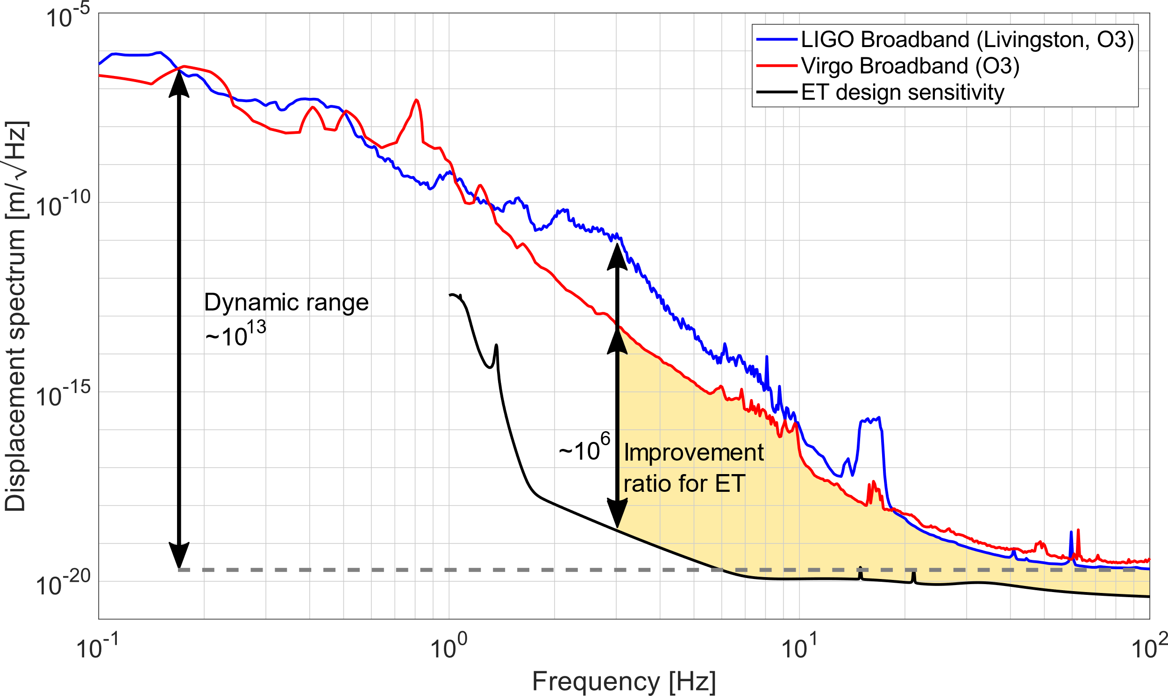
Martynov, Virgo log 37982

Slide 4
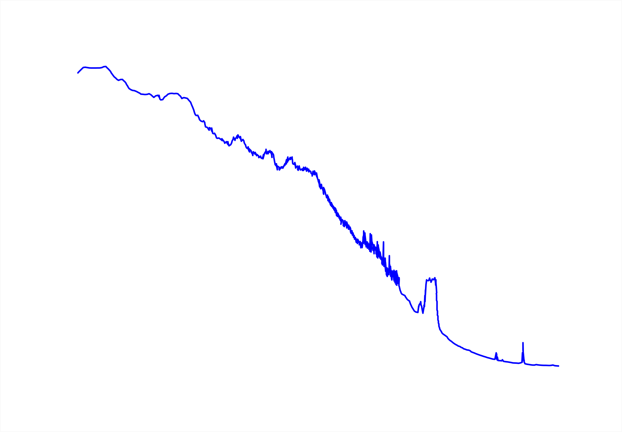
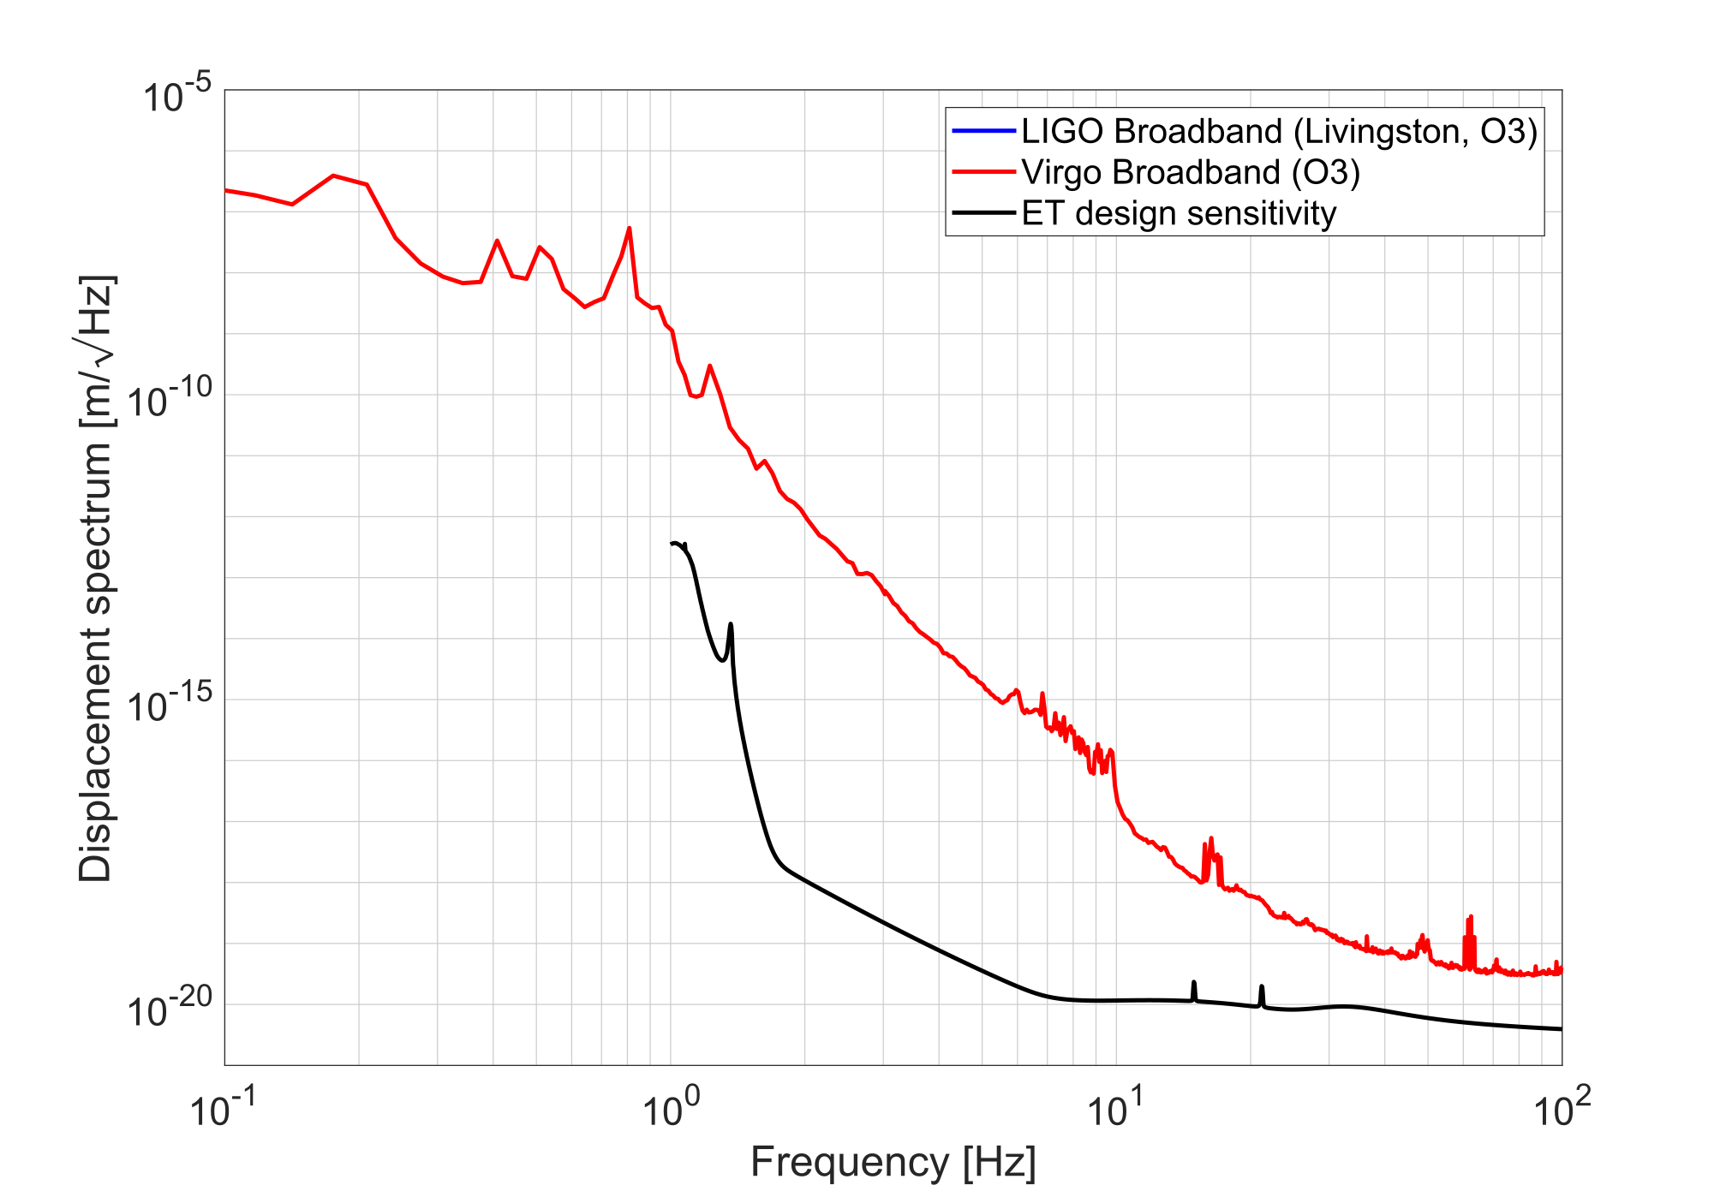

Slide 5
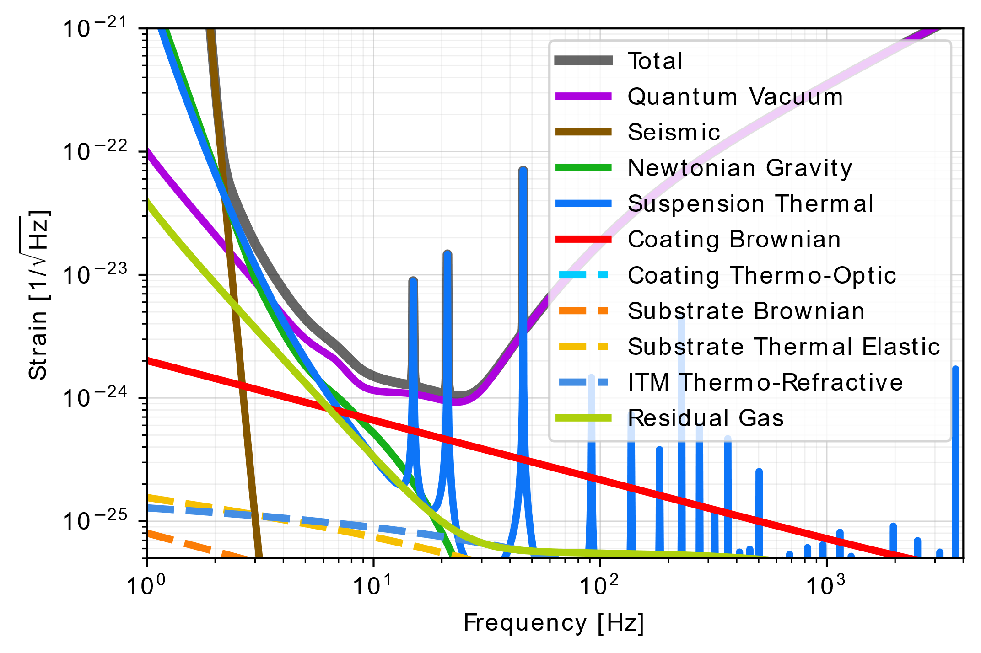
What isn’t Controls Noise
‘Fundamental’ noises are not show-stoppers for ET.
Uncertainty about mirror temperature + thermal noise
Newtonian noise needs site-specific models + mitigation models.

Slide 6
Controls noise and Inter-platform motion
Naturally interlinked topics
IPM focusses more on inputs (noise and motion) and novel sensors
Controls noise focusses more on requirements and control strategies
Both need modelling tools and cross-division engagement

Slide 7
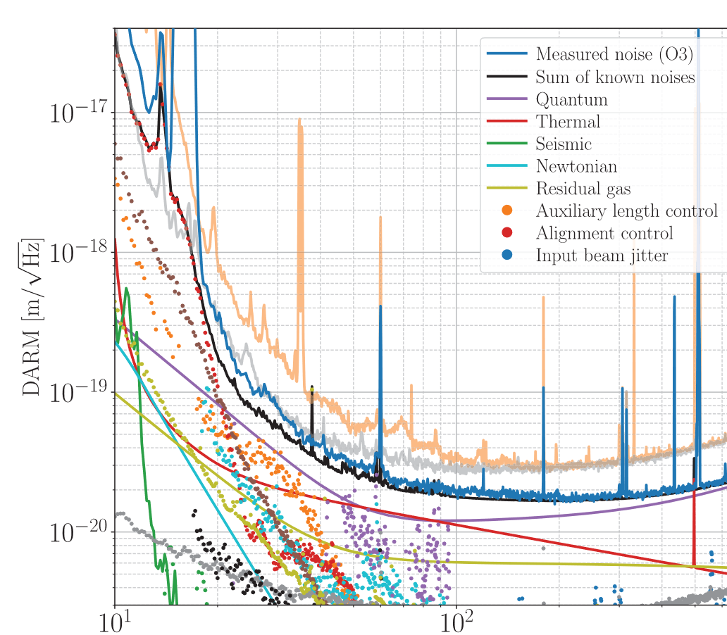
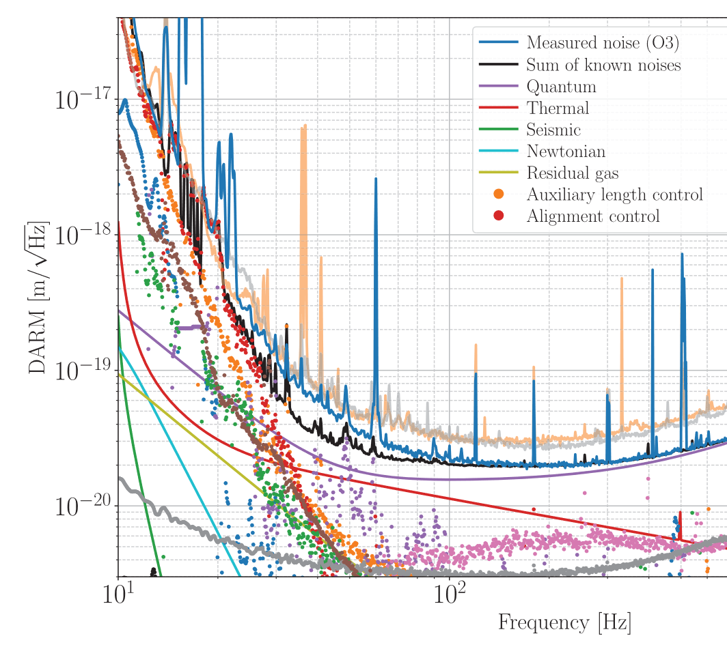
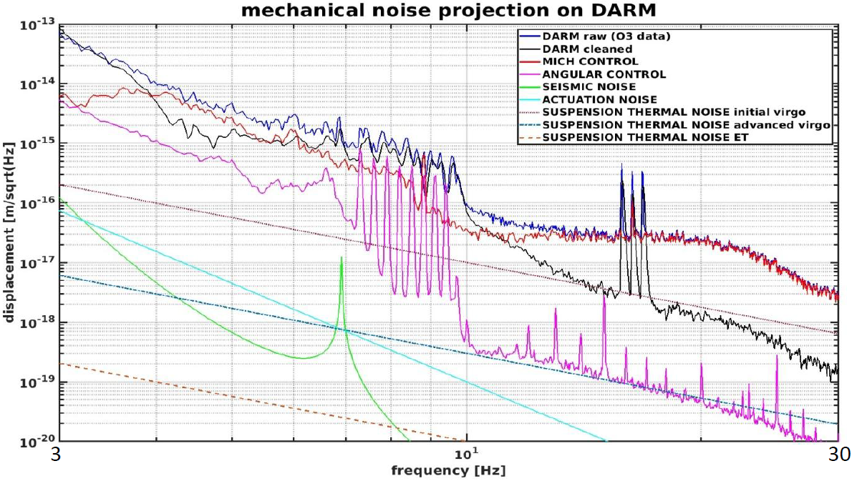
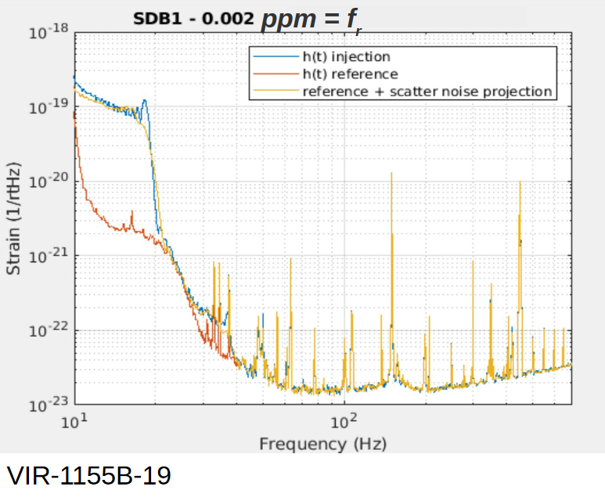
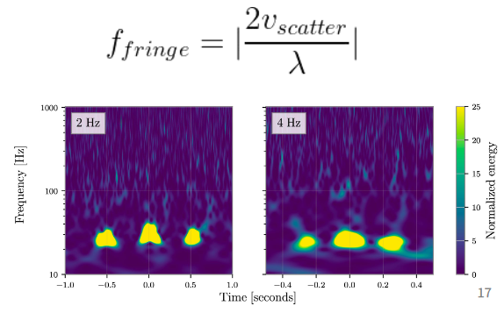
The four horsemen of technical noise
PRD 102, 062003 (2020)
PRD 102, 062003 (2020)
Alignment controls (ASC)
Auxiliary length controls (LSC)
ET at 3 Hz, GWADW
https://apps.et-gw.eu/tds/?content=3&r=17885
Paolo Ruggi 'Status of Virgo at LF'
Polini GWADW 2022
Siddharth GWADW 2022
Actuation noise (DAC)
Scattered Light

Slide 8
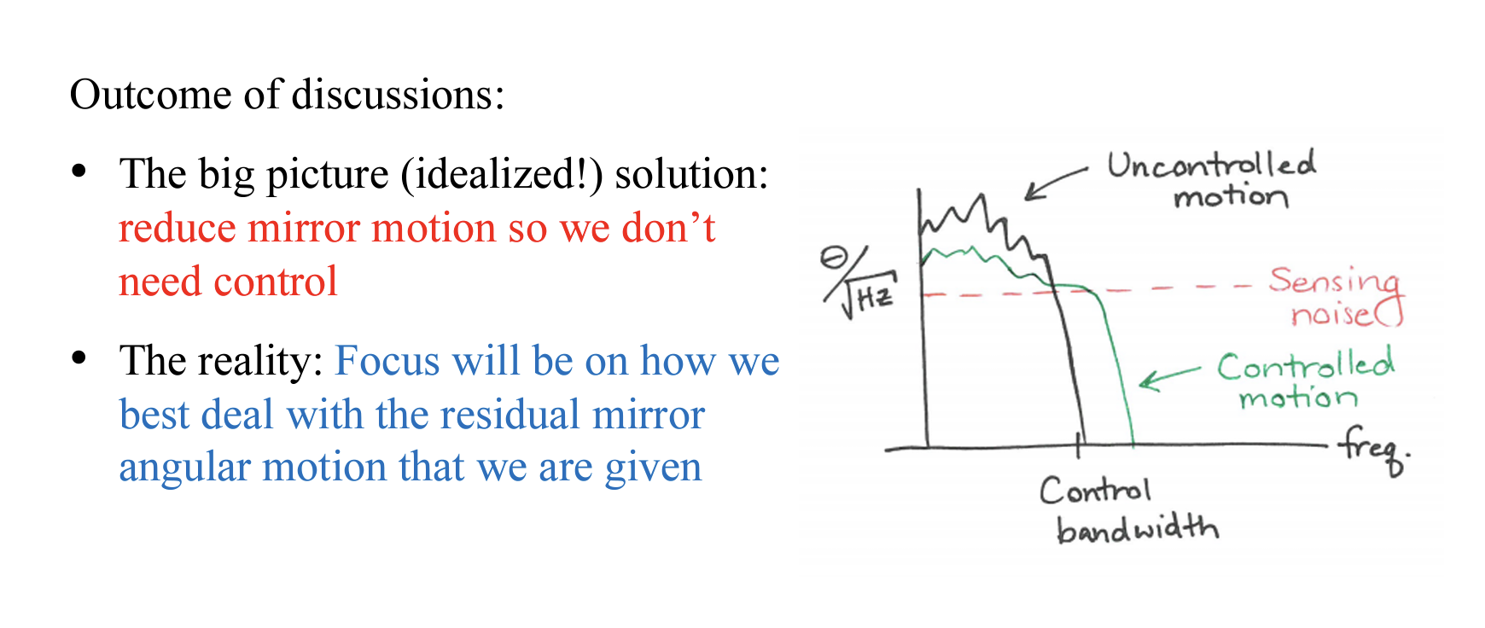
Angular Sensing and Control
Summary (Part I) of Apr. 2021 ET-LF workshop
G2101104-v1

Slide 9
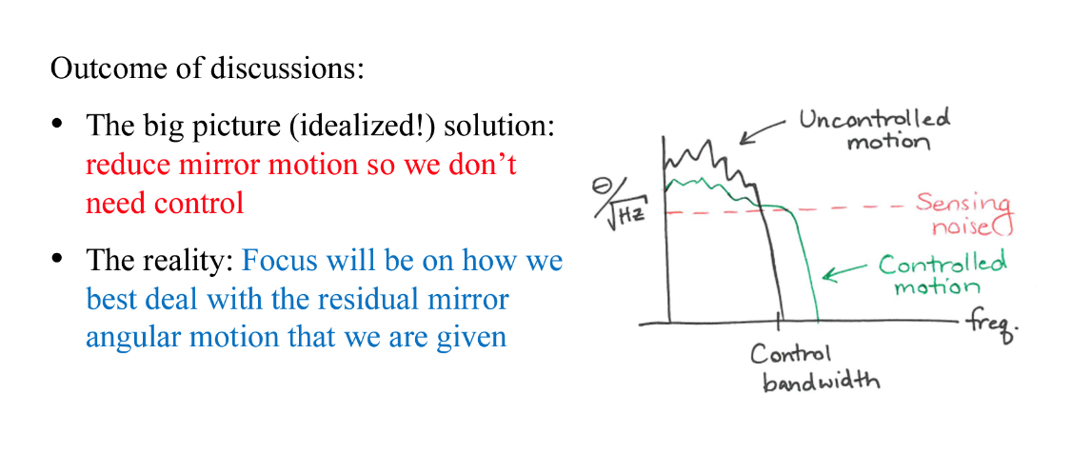
Angular Sensing and Control
Summary (Part I) of Apr. 2021 ET-LF workshop
The thinking since last year has evolved
We now understand we can reduce mirror motion so much that barely any angular control is needed

Slide 10
ASC noise did not limit Virgo in O3
Payload dynamics intrinsically decouple length and angle.
Yaw = 10mHz (single wire)
Pitch = 60mHz (CoM below suspension point)
Relatively low arm cavity power.
Factor
~300 needed
ASC = SUS-thermal
Paolo Ruggi 'Status of Virgo at LF' at ANM call
Consistent with more detailed 10Hz+ budget:
Michal Was, Virgo at LF, GWADW 2022

Slide 11
Angular Sensing and Control
Summary (Part I) of Apr. 2021 ET-LF workshop
One of the more straightforward projects that could be carried out now is to design a control loop for ET ASC

Slide 12
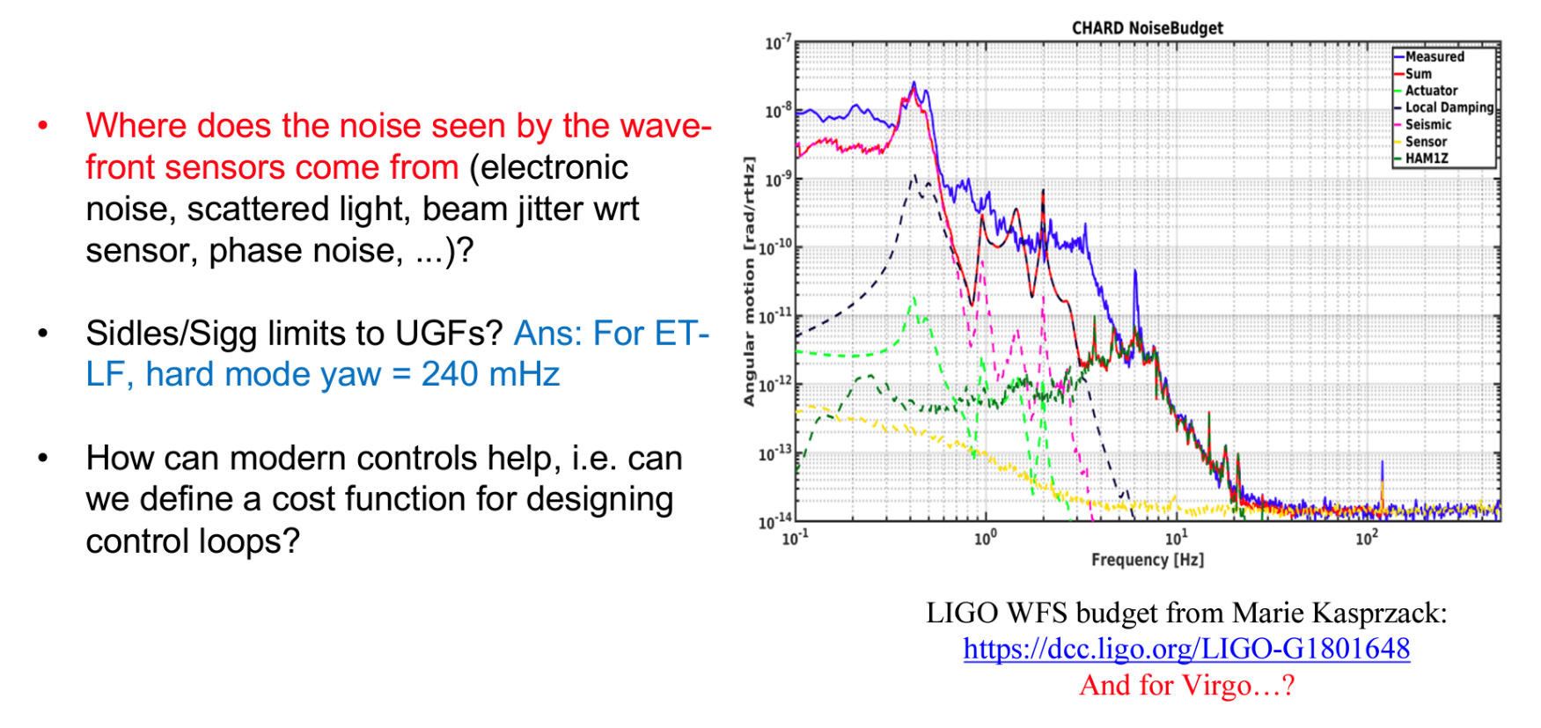
Angular Sensing and Control
Summary (Part II) of Apr. 2021 ET-LF workshop

Slide 13

Angular Sensing and Control
Summary (Part II) of Apr. 2021 ET-LF workshop
A Virgo WFS noise budget will help below 1Hz.
What assumptions should we use for first ET calculations?
  Spot position, WFS noise…

Slide 14
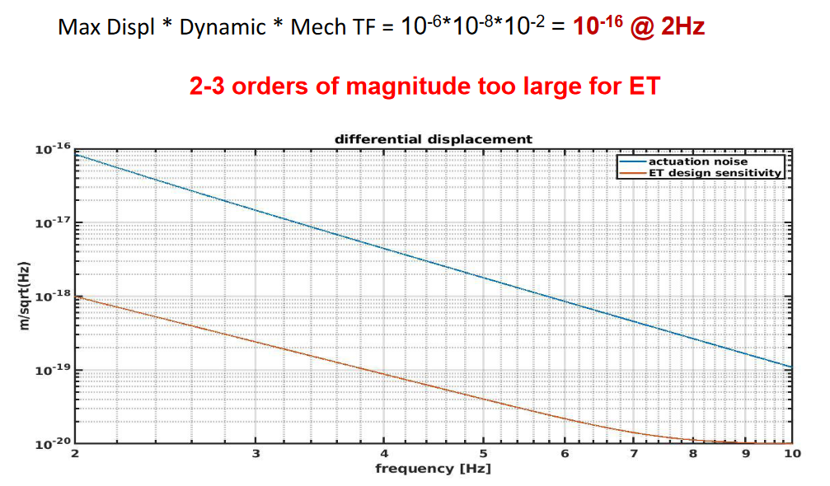
Actuator (DAC) noise
There is a simple recipe for actuation noise. Using Virgo numbers:
Ruggi, ET-ISB workshop
actuation noise does not seem less ‘fundamental’ then thermal noise

Slide 15
Reducing actuator noise in ET
Mechanical filtering gets harder below 10Hz
DAC and Driver electronics dynamic range gets harder below 10Hz
Underground environment should reduce displacement
This places strict requirements on the performance of the seismic platform and suspension controls.
Ground rotation in ventilated caverns is a major problem
See, eg Badaracco GWADW 2022

Slide 16
Can we eliminate controls noise at 3Hz in ET?
Yes.
I think.
… but there is an enormous amount of modelling, design, and testing needed … deploy new technologies, consider system interactions, avoid mistakes in design…

Slide 17
Possible R&D projects
Slide from Nov. 2021 ANM presentation (ET-0451A-21)
Tools:
Automated controls designer: to design blending filters / controllers etc.
Low-frequency noise budgeting tool (drawing from SUS, IFO, OPT inputs, among others)
Modeling:
Suspension-chain actuation analysis, with an aim of minimizing cross-couplings
ASC control loops
Calculations:
Spectral requirements for seismic platform motion
Intrinsic technical noises (i.e. DAC limit, bilinear angular coupling, …)

Slide 18
Low-frequency Controls - Tasks
ASC modelling
  Produce a preliminary model of expected ASC loop gain and noise for ET-LF. Requires many assumptions (payload, spot centering)
  Starts from Sigg-Sidles resonances
DAC noise
  Following Paolo’s recipe, assumptions and communication with Payload, determine Maximum Displacement in DARM at the optics.
  Do we need small-range actuation nearer the optic? Determine max displacement allowable.

Slide 19
Low-frequency Controls - Tasks
Suspension Modelling
  Concatenating Seismic-platform and Suspension models. Link the dynamics and controls, eg ground tilt → mirror motion
  Include MIMO control effects which allows propagation of, eg, accelerometer noise →mirror motion.
Controls design tools (40m: Wipf and Andric and Rollins)
  H-inifity as a starting point?
  SpicyPy?
  Robust controls?

Slide 20
Low-frequency Controls – cross-division work
IFO requirements
  What is DARM RMS requirement? (with IFO) Driven by ?
  Similarly, ASC requirements (radians) and LSC-aux requirements
Suspension and Payload designs
Optical sensor noise(s)
Interplay between requirements and performance
Need liaisons!

Slide 21
Recipe for reducing ‘controls’ noise
Input motion
  Underground, seismic platforms, soft suspensions
Mechatronic design
  Payload dynamics, controls co-design, function + performance
Inter-platform motion
  Corner-station DoFs, suspended benches, at least L+P+Y
Flow of requirements
  Iterate with sub-system performance capabilities
‘Proper’ MIMO control
  Accelerate design, use information better before it is entangled.

