Slide 1
ETpathfinder status update
ET-0166A-23
ET Symposium, May 2023
L. Kranzhoff for ETpathfinder team

Slide 2

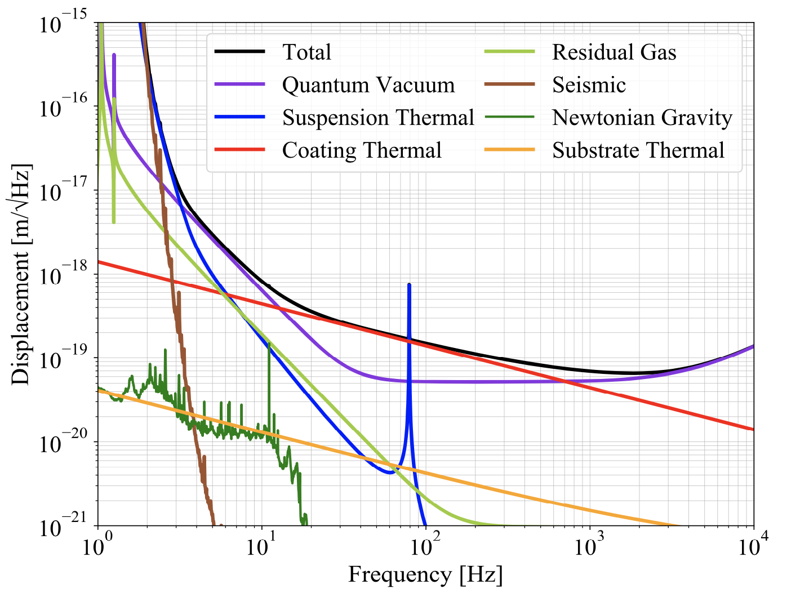
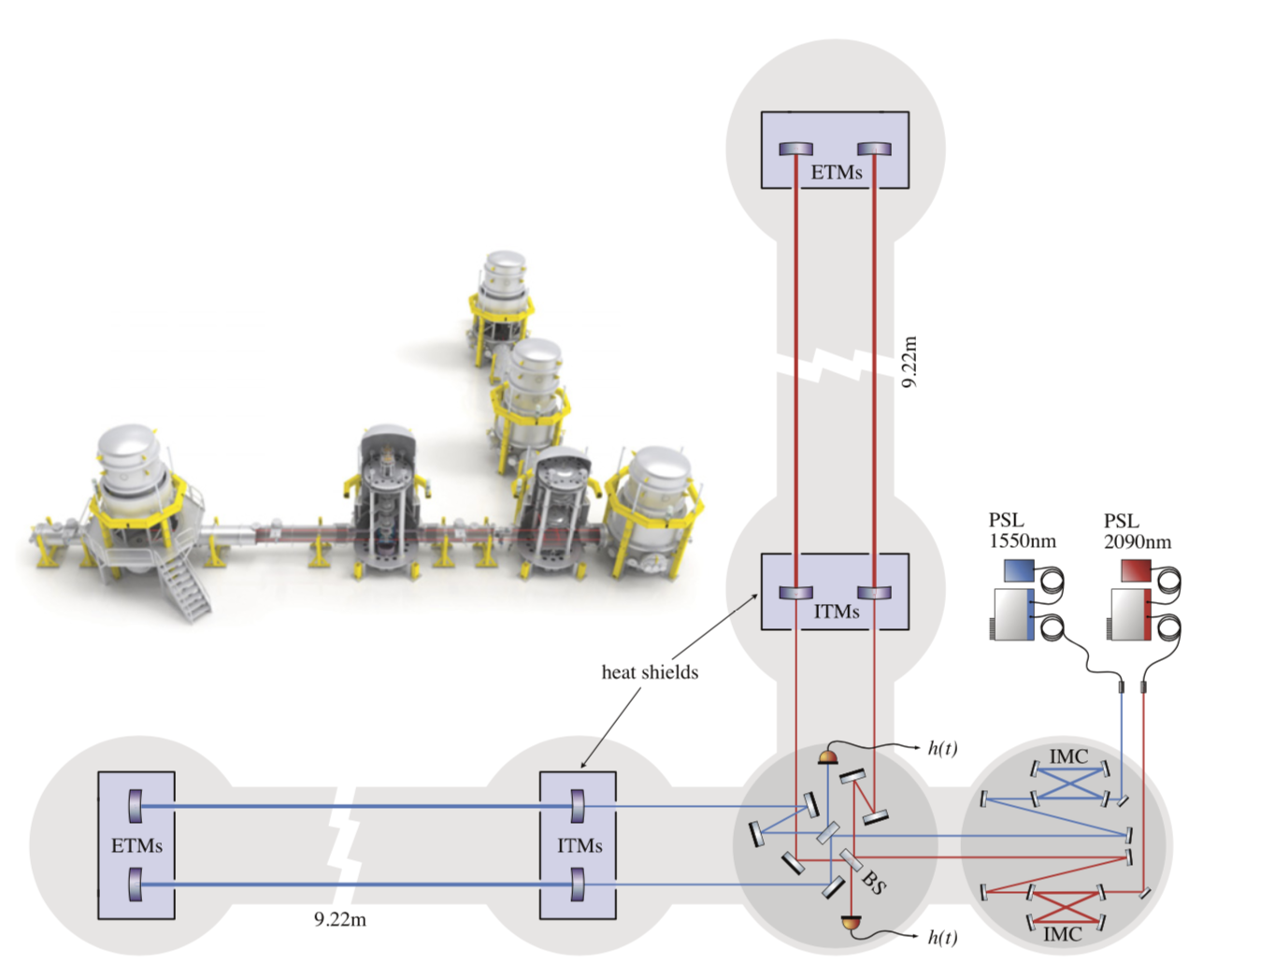
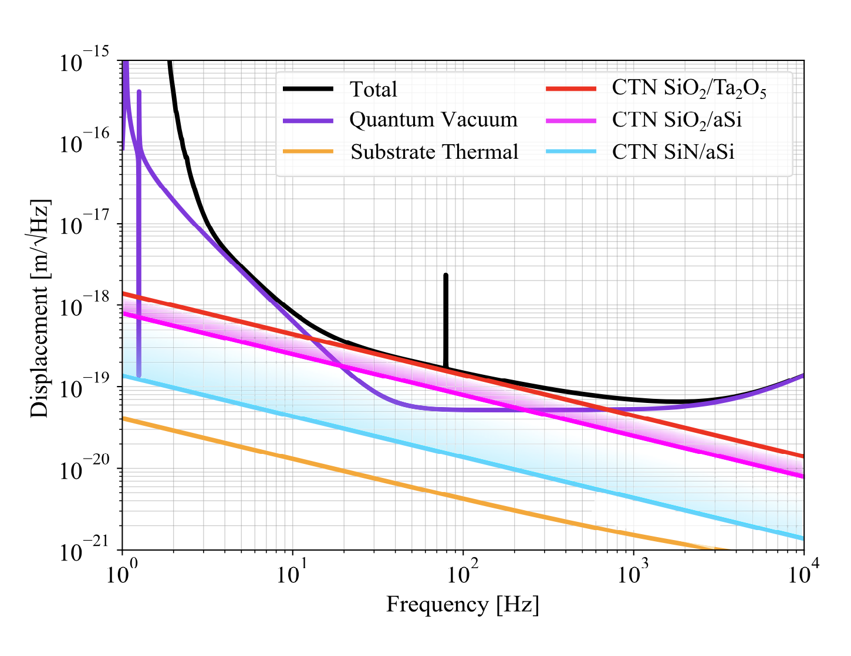
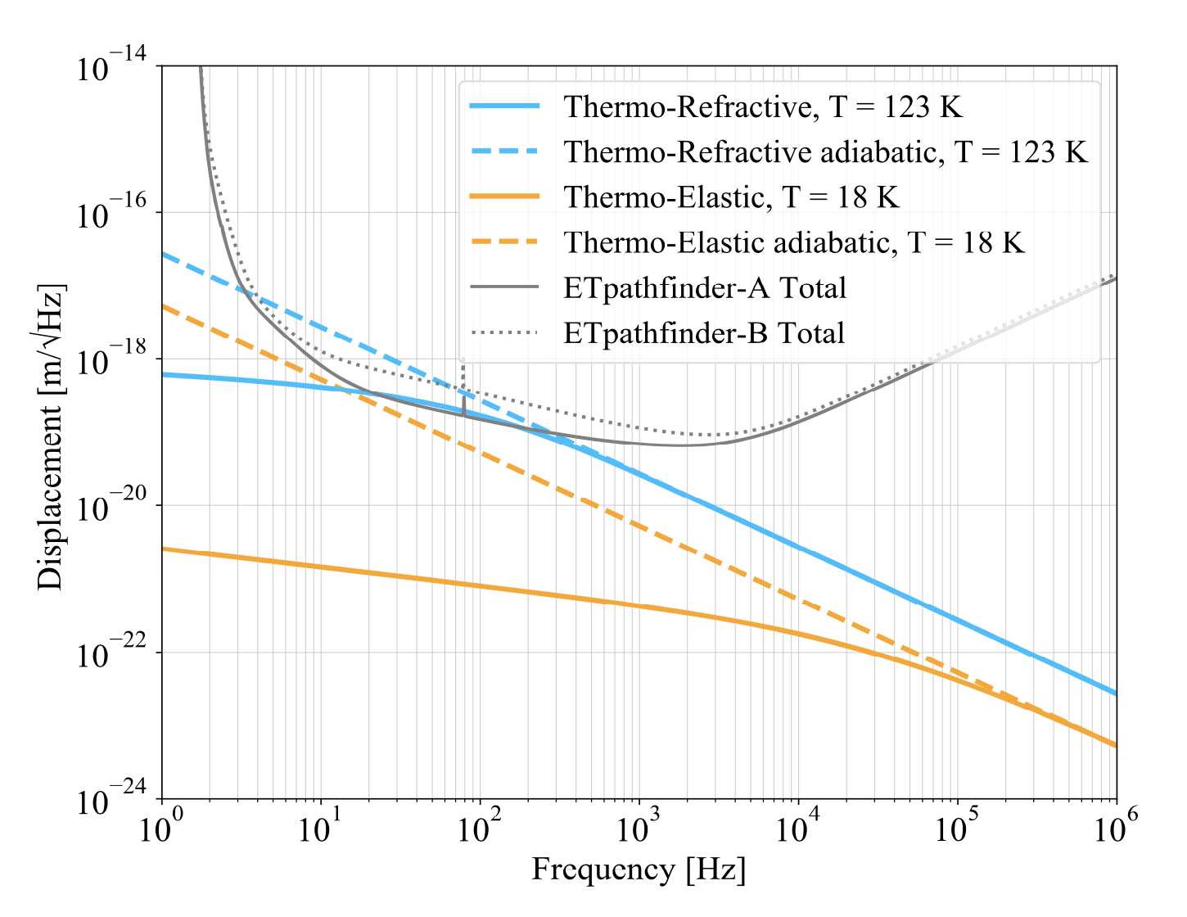
ETpathfinder overview
Main target: provide a testbed for ET technologies/concepts
and qualify them in low-noise environment.
Target: 1e-18m/sqrt(Hz) @10Hz
2 FPMI interferometers:
1550nm @ 18K
2090nm @ 123K

Slide 3
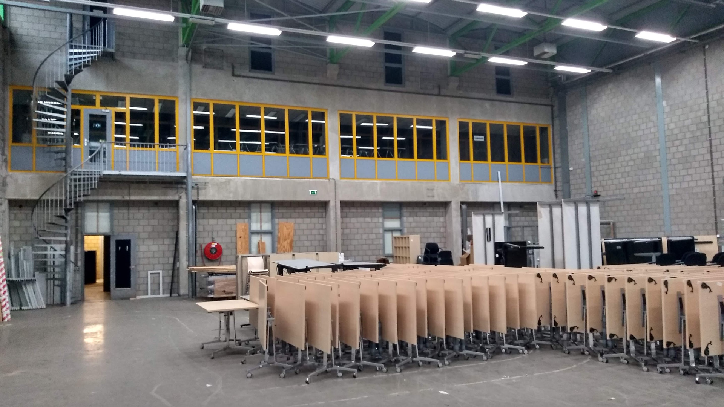
Overview
January 2020

Slide 4
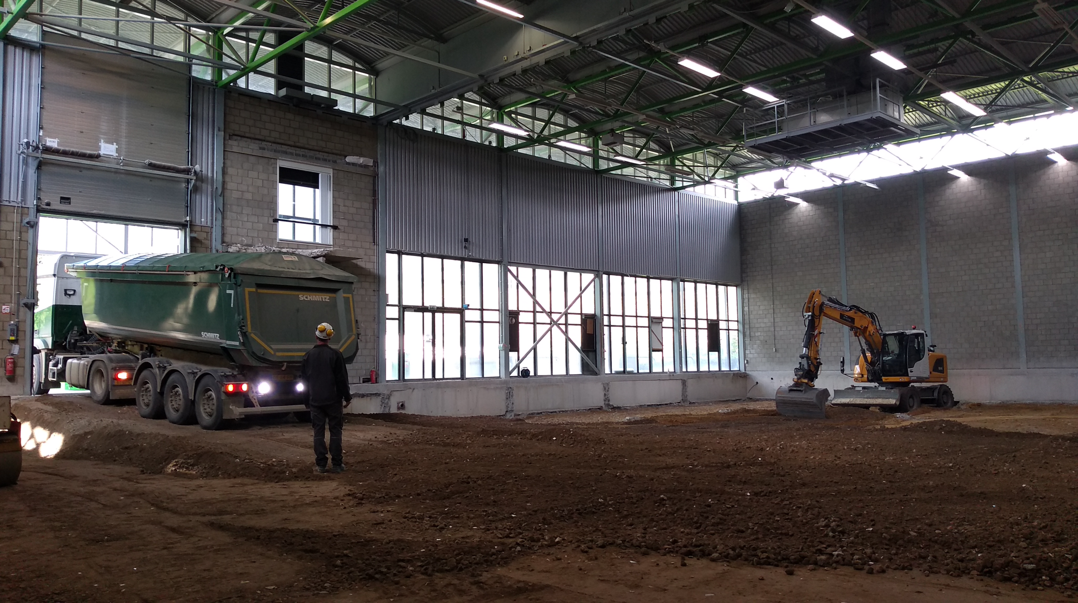
Spring 2020

Slide 5
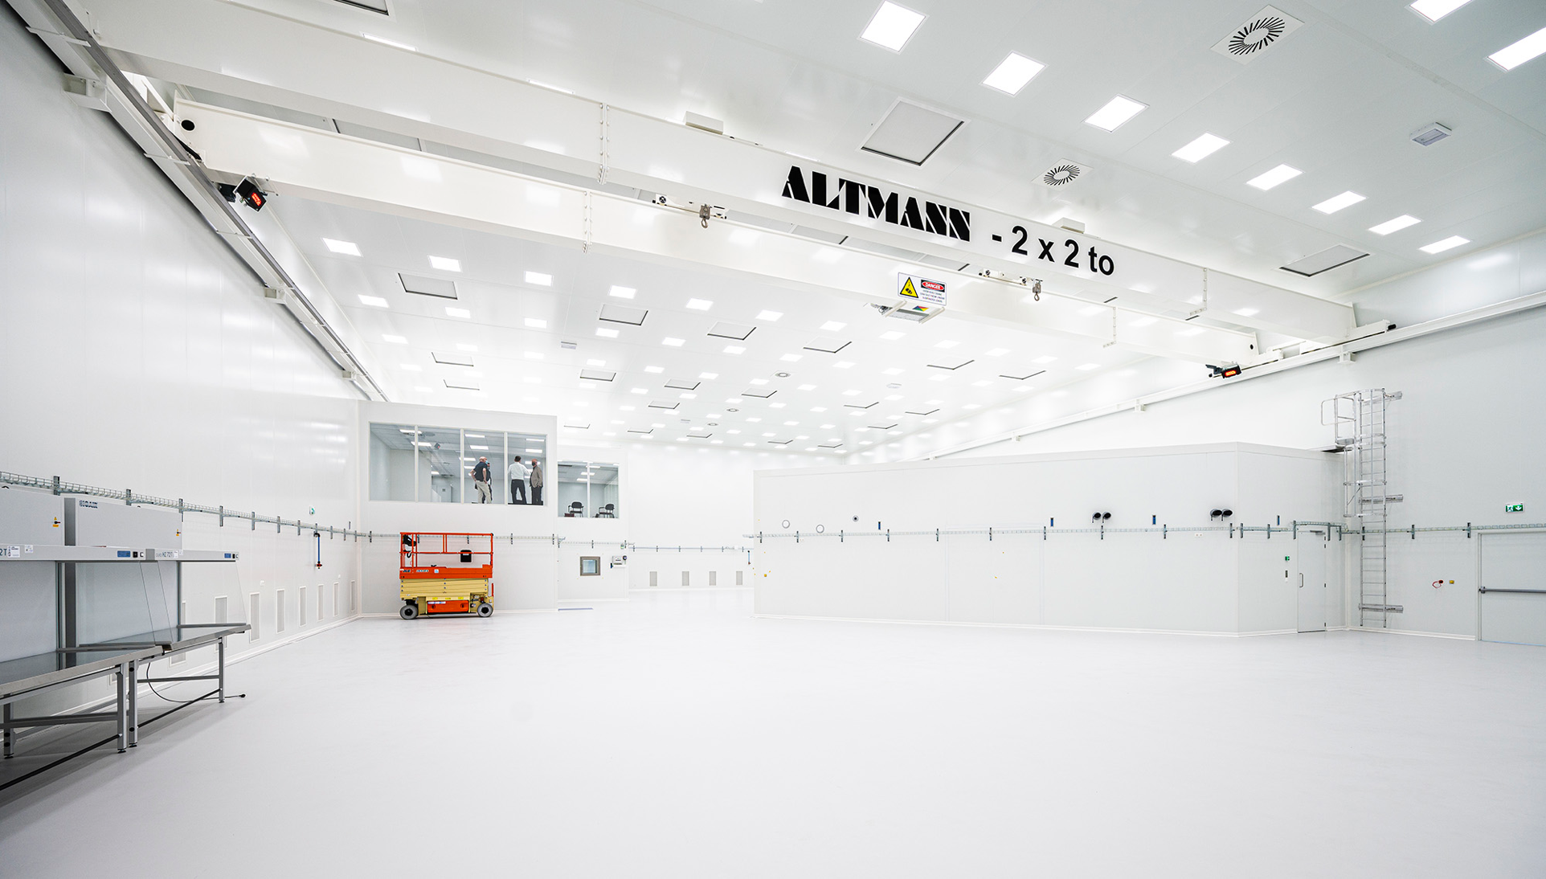
Cleanroom turned out to be clean enough to allow assembly of seismic isolation system outside the tower without any additional pop-up cleanroom tents
Summer 2021

Slide 6
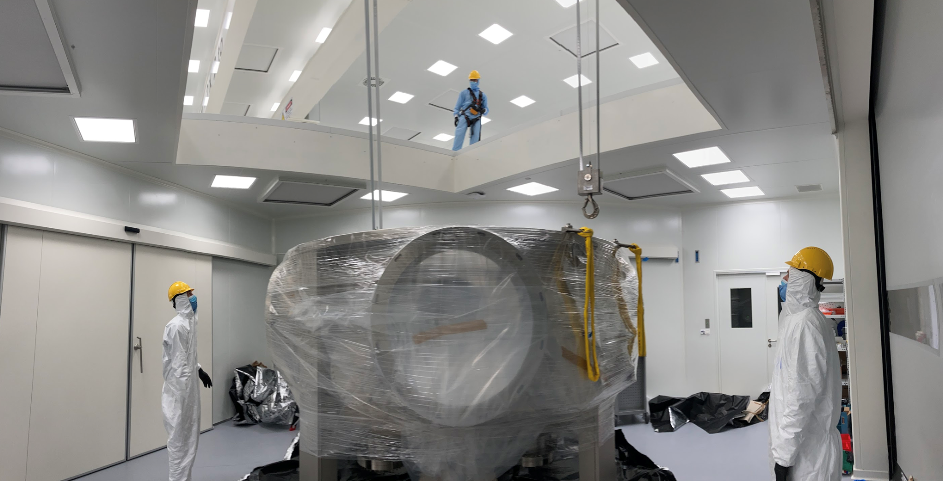
Summer 2021
Spring 2022

Slide 7
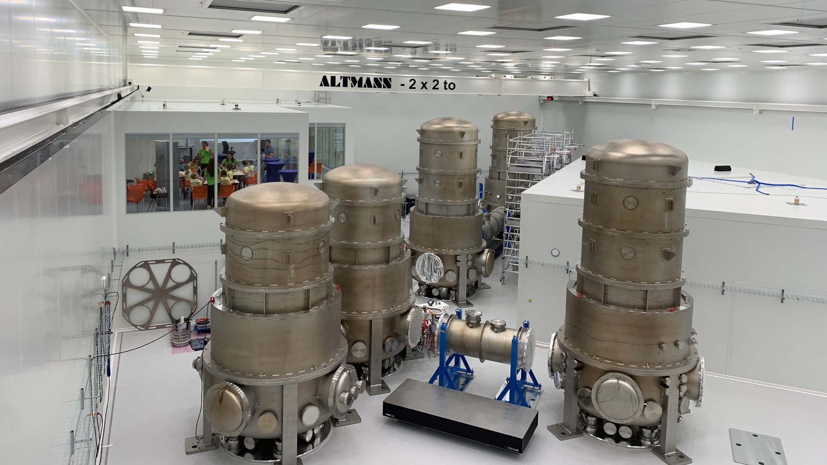
Summer 2022

Slide 8
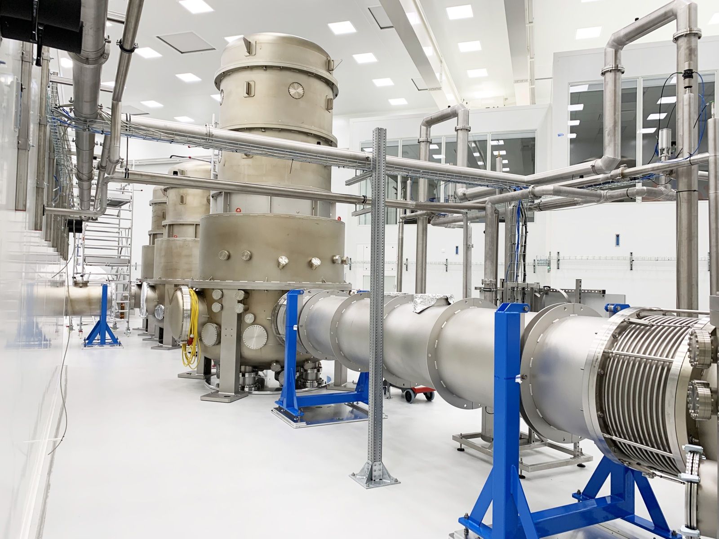
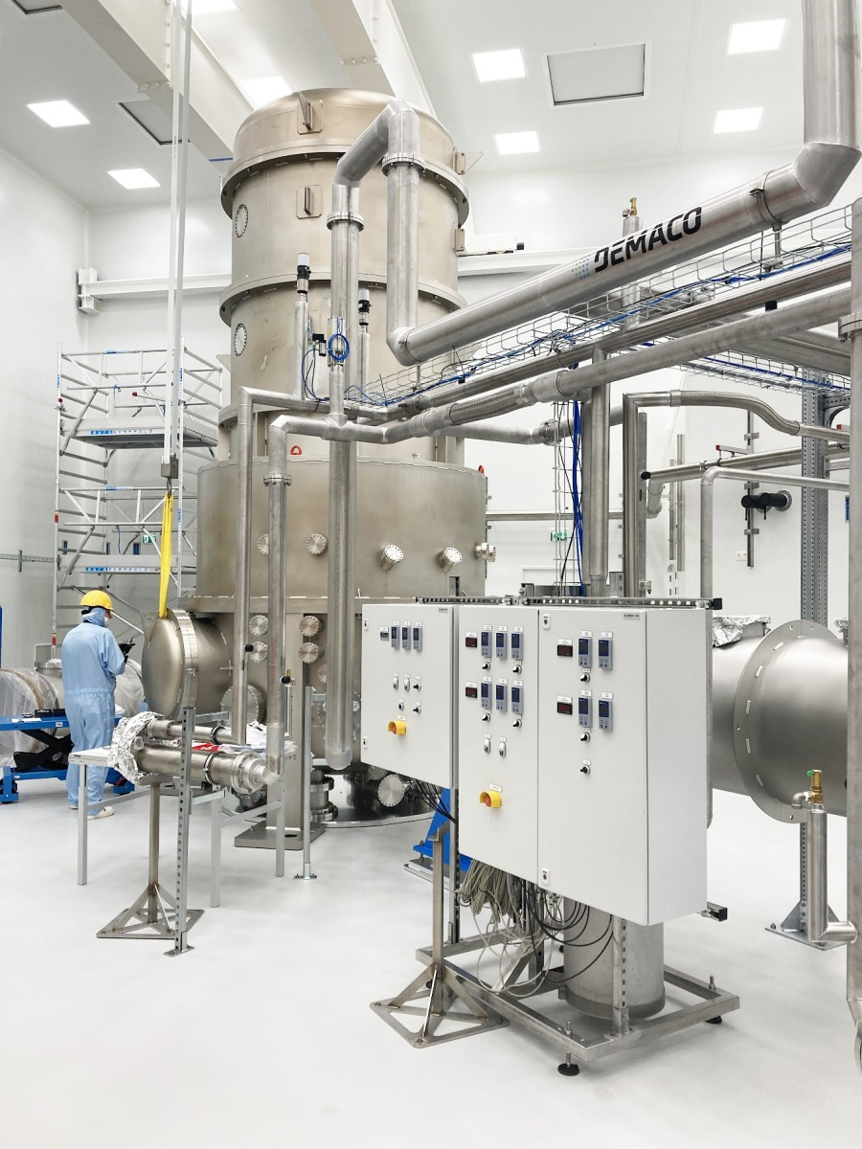
Now

Slide 9
WP4: Vacuum and cryogenics
Vacuum
190 cubic meters of UHV, target pressure <1e-9mbar
status: towers and arms installed, leak chasing
Kurt Lesker gate valves came dirty and UHV-incompatible
empty towers: measured 5e-8 mbar after installation
clean RGA-spectra: hydrogen, water, air components
Cryogenics
LN2 system in Maastricht installed
cryo-shields: design and production drawings (Barcelona)
test of cryogenic system in Twente:
  installation of test vessel and instrumentation (Feb)
  multiple cool-downs of subcooler and test vessel
  problems: moist influx into exhaust line, leakage

Slide 10
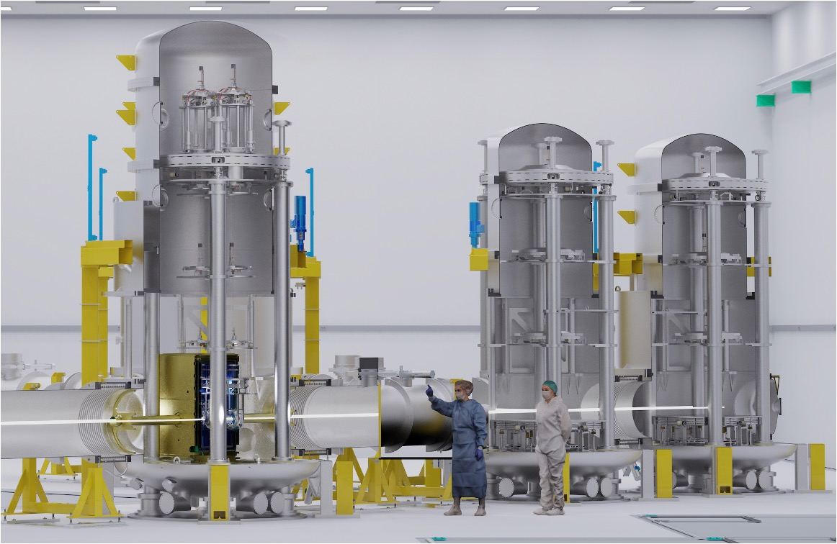

WP5: Seismic isolation
Internal mechanics production
mirror suspension chains, payloads, optical benches, etc. already in the hands of the companies for precision cleaning;
some accessory parts for the in-vacuum benches still being made;
design of blade springs for GAS filters finalized after prototype testing; production is in progress;
detailed workflow/plan for logistics, assembly and storage has been devised.

Slide 11
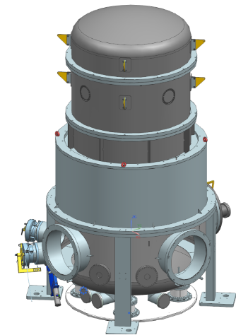
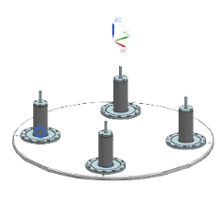
WP5: Seismic isolation
Installation will begin after summer: the Beam Splitter Tower
Dummy IP feet and baseplate for installation

Slide 12
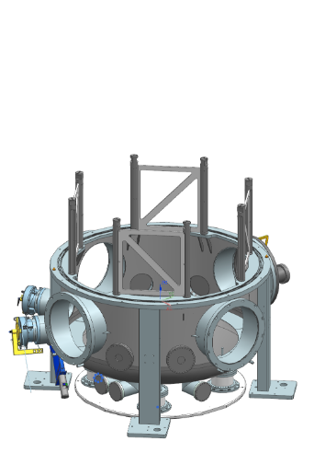
WP5: Seismic isolation
Installation will begin after summer: the Beam Splitter Tower
Dismantle the vacuum tower up to the bottom vessel
Dummy IP feet and baseplate for installation

Slide 13
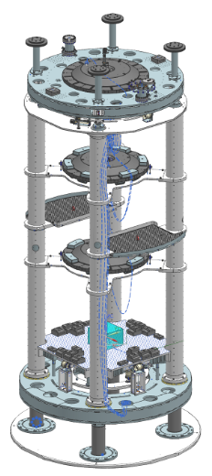
WP5: Seismic isolation
Installation will begin after summer: the Beam Splitter Tower
Build the internal mechanics on dummy IP feet
Dummy IP feet and baseplate for installation

Slide 14


WP5: Seismic isolation
Installation will begin after summer: the Beam Splitter Tower
Hoist the whole assembly into the open vessel
Dummy IP feet and baseplate for installation

Slide 15
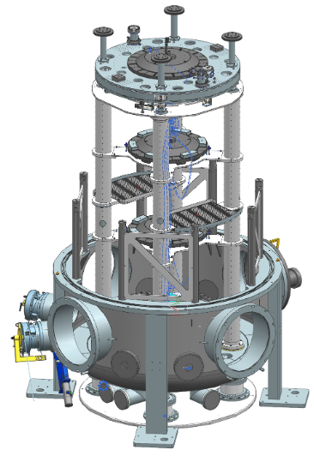
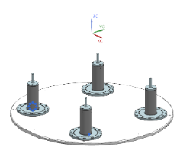
WP5: Seismic isolation
Installation will begin after summer: the Beam Splitter Tower
Hoist the whole assembly into the open vessel
Dummy IP feet and baseplate for installation

Slide 16
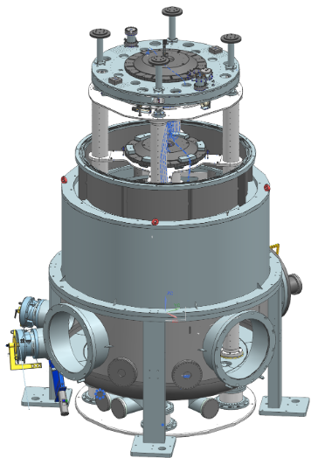
WP5: Seismic isolation
Installation will begin after summer: the Beam Splitter Tower
Close the tower
Dummy IP feet and baseplate for installation

Slide 17
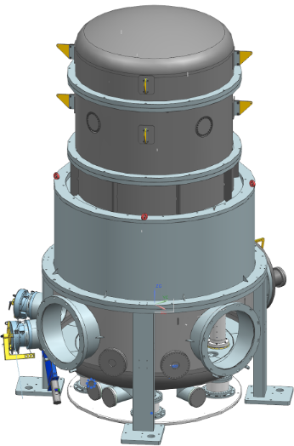
WP5: Seismic isolation
Installation will begin after summer: the Beam Splitter Tower
Hoist the whole assembly into the open vessel
Close the tower
Dummy IP feet and baseplate for installation

Slide 18
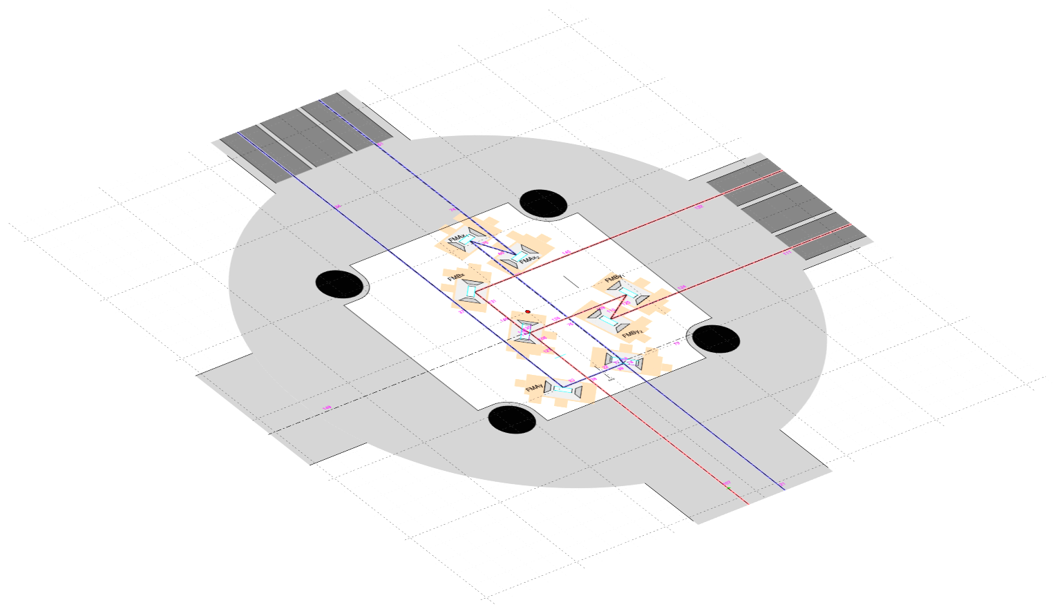
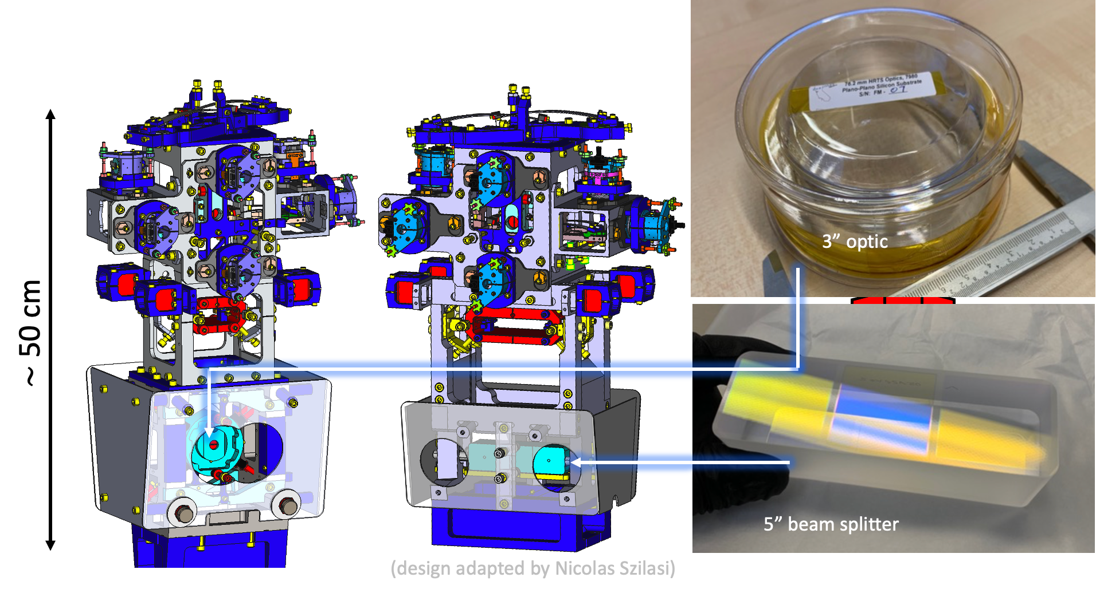
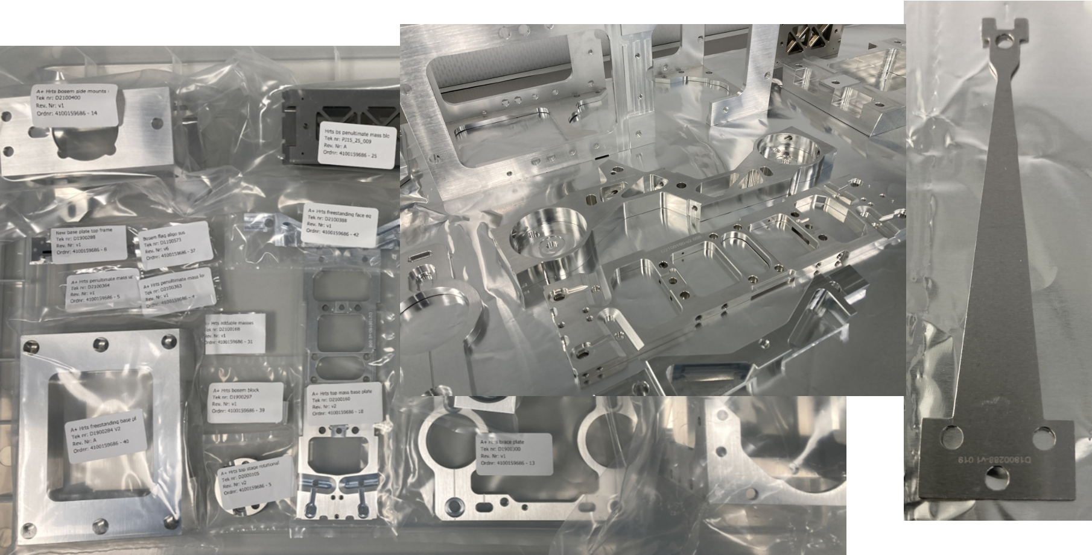
WP5: Seismic isolation
HRTS table-top (triple) suspensions
for the six 3” folding mirrors and the two 5”beam splitters in the Central Tower, HRTSs (LIGO A+ design) and an adapted version
all parts produced, cleaned for UHV and ready for assembly.
First 4 HRTS to be assembled in summer/fall

Slide 19
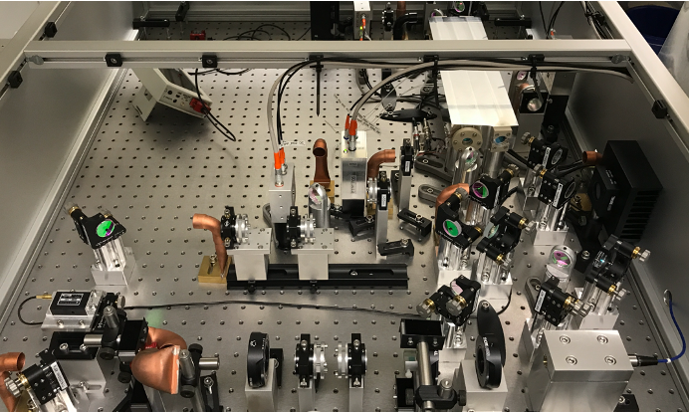
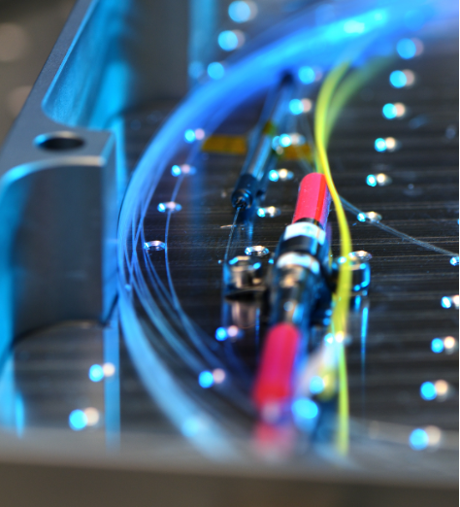
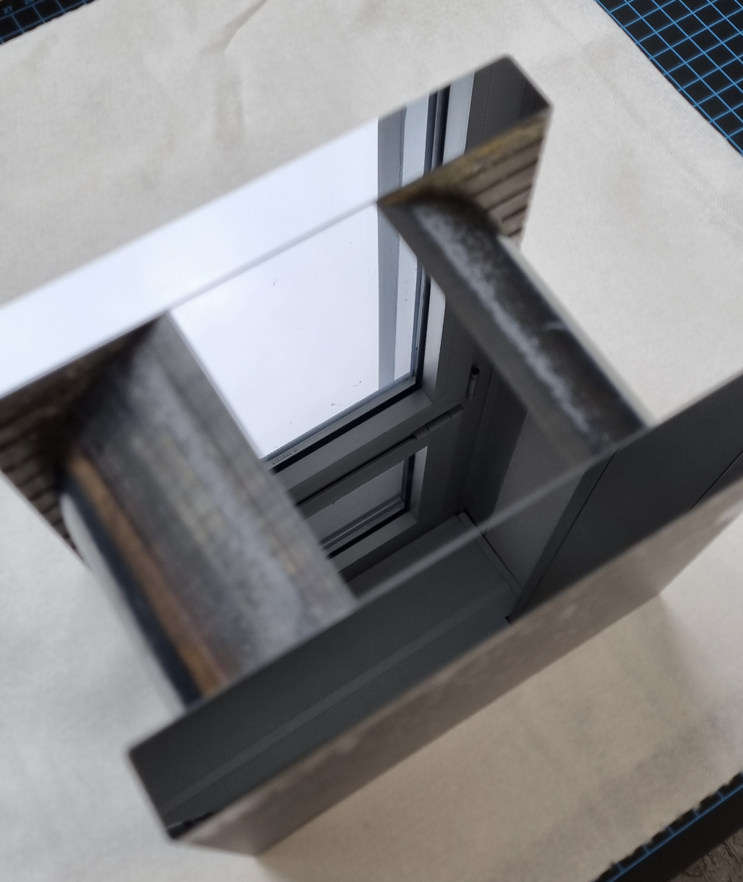
WP6: Optics
1550nm PSL (AEI)
laser sources under development
  1550nm PSL progressing well at AEI
  2090nm commercial seed arrived; 2090nm fibre amplifier almost completed by Fraunhofer ILT
establishing laser corner in cleanroom to be able to start experiments w/o disturbing vacuum system commissioning
two (so far…) silicon main mirrors under
polishing by Zeiss SMT
simulations on locking scheme,
mode matching etc. ongoing
Fibre amplifier (ILT)
Polished silicon

Slide 20
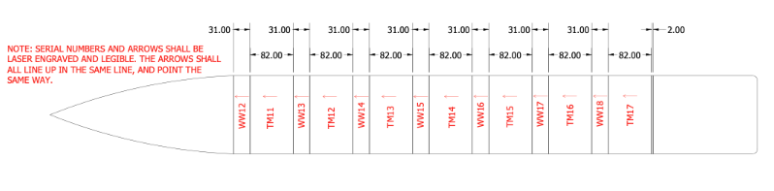
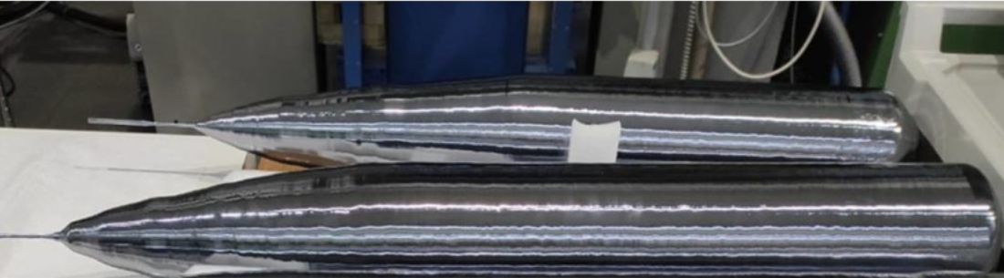
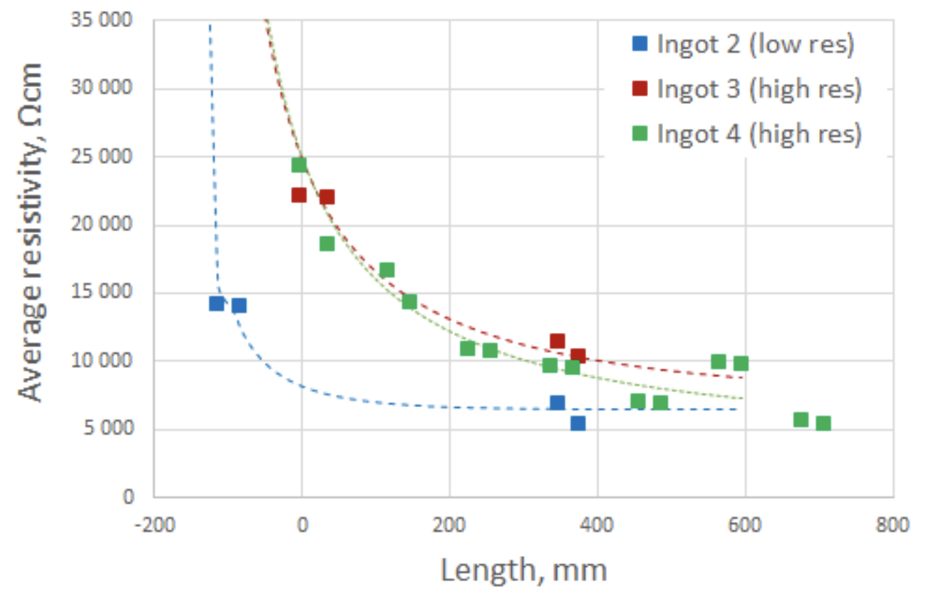
WP6: Optics
next steps for optics:
  integration of 1550nm PSL with LAPP control system
  stabilisation of PSL onto IMC on suspended input bench
  this way, progress on optics does not interfere
  with critical path for cold mirror suspensions
further understanding silicon as optical material
  polishing of small samples for absorption measurements
  correlation of absorption with measured resistivity
  (IKZ - Institute for Crystal Growth, Berlin)
  investigating paths to more and larger test mass mirrors
finalising procurement of remaining optics (e.g. coating of HRTS substrates)
Floatzone silicon (IKZ)

Slide 21
WP7: Controls
suspension electronics
  12x Trillium120 seismometer
  BOSEMs produced by Birmingham, delivered
  readout electronics finished by VU Amsterdam
  stepper motors received, driver design (Nikhef)
  LVDTs and electronics produced by Antwerp
  LVDT coil-winding machine in Maastricht
in-air cabling (DSub25): quality issues, strain reliefs
ordered 15km of in-vacuum cable, connectors (Antwerp)
setting up general computing and network
data acquisition: based on Adv Virgo+ DAQ, not yet running
  received ADCs, DACs, DAQboxes (LAPP), 14 RTPCs
  configured 3 standalone RTPC + DAQbox systems
vacuum control system interface with Siemens PCS7 (KIT)
several sensors for environmental monitoring acquired
now: priorities driven by commissioning of first suspension tower

Slide 22




ETpathfinder Partners

Slide 23
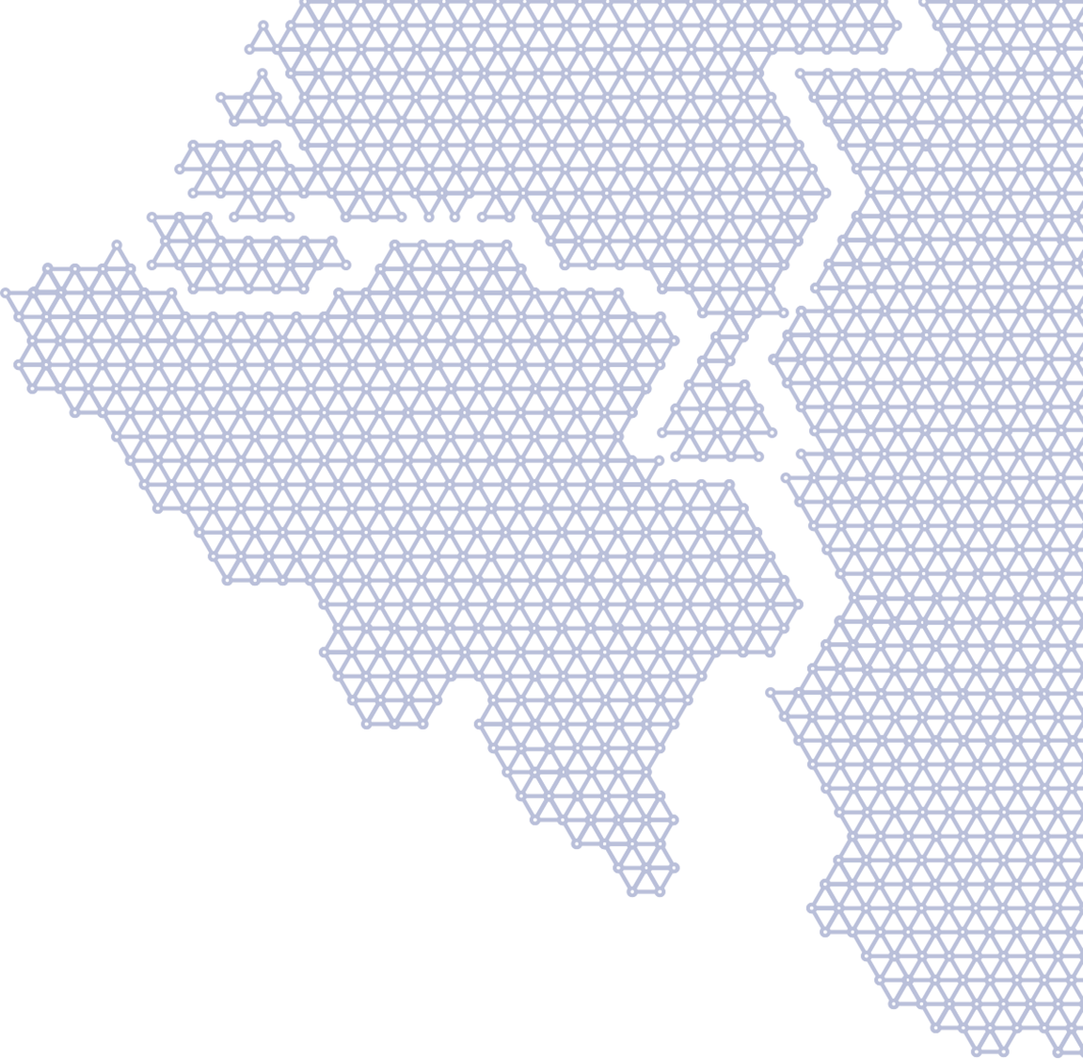


Thanks for your attention!
Questions?
ETpf design report
ETpf sensitivity paper
Research – ETpathfinder
ETpathfinder: a cryogenic testbed for interferometric gravitational-wave detectors - IOPscience

