Slide 1
ET-LF Test-mass towers:
A single-cavern solution
Conor Mow-Lowry, Robin Cornelissen, Michele Valentini, Nathan Holland, Henk-Jan Bulten, Jesse van Dongen, Pooya Saffarieh, Alexandra Mitchell, Sander Sijtsma, Mathijs Baars, Enrico Porcelli, Alessandro Bertolini, Joris van Heijningen, Stefan Hild
Many inputs gathered from the Orsay ET-LF TM Tower Integration meeting.
Thanks to ETO engineers for valuable inputs.
The ETO-Taskforce helped improved requirement and interface definitions.
ET-0244A-25

Slide 2
Low-frequency test-mass towers
Challenging but straight-forward
Residual vibration in-band (3Hz+ passive)
Active isolation and damping for RMS motion + control
Thermal shields and cryo-traps
Vacuum vessel
Extremely difficult/untested
Partial pressure of water
(ice-growth)
Inertial rotation control (in worst-case scenario)
Installation and access maintaining cleanliness
Low-vibration cryogenic links
Integration in a single tower
Civil- and technical- infrastructure (LF impact)

Slide 3
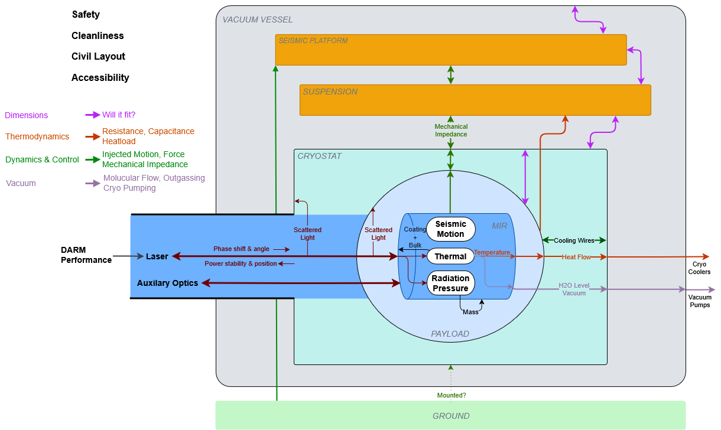
Requirements and interfaces

Slide 4
Many ideas/problems discussed in Orsay
Extreme cryostat vacuum requirements
  ‘Warm’ vacuum quality and effective H₂0 suppression by the thermal shields can be modelled with clear requirements.
  Existing LIGO ETM warm vacuum (10⁻⁹ mbar) is likely sufficient (TBC).
Underfloor access (Virgo) vs lateral access (LIGO)
  We need better quality contamination information before we can define a suitable requirement.
  No clear path to requirements.
Stability of suspension mounting point
  Should be on rock, or at least on the floor. Difficult to model in detail.
  No clear path to requirements.

Slide 5
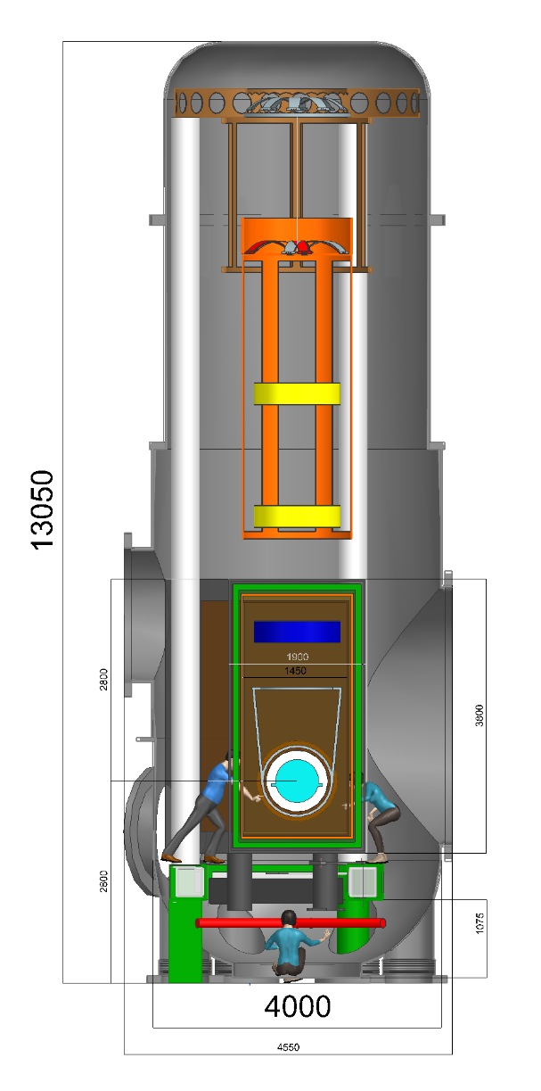
Single-cavern conceptual design
Shrink the thermal shields to allow the seismic platform and IP legs inside the ‘warm’ cryostat vacuum.
Thermal-shield side-panels can be opened to allow installation (via rails) and payload access.
Seismic platforms anchored directly into rock. Simple ‘secondary’ seismic platform allows direct vibration reduction of thermal shields.
Retains low-conductance vacuum-coupling and particulates barrier to upper suspension structures.
No underfloor excavation – smallest plausible excavation volume for simpler and more stable cavern with simpler access + logistics.
Separate mounts to rock for vacuum system and IP safety structure simplifies mechanics and offloads air-pressure effects.

Slide 6
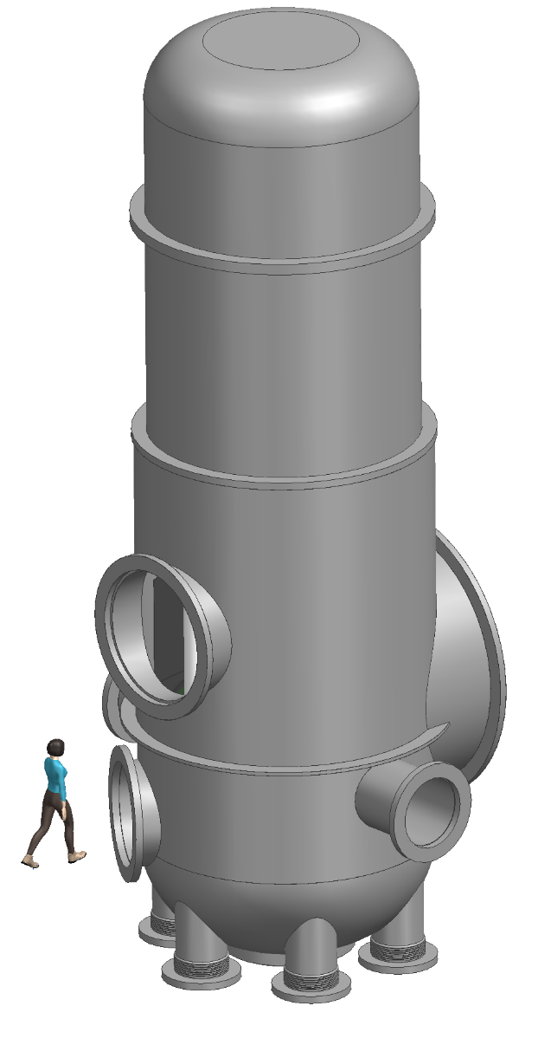
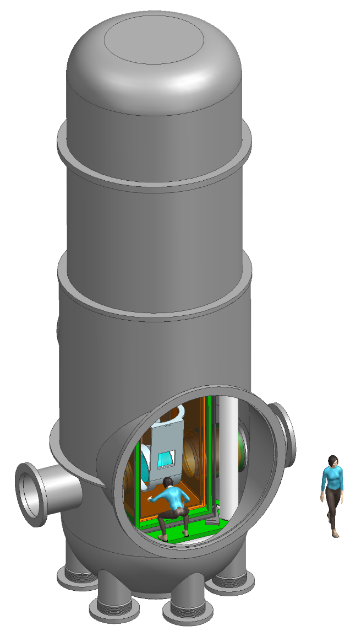
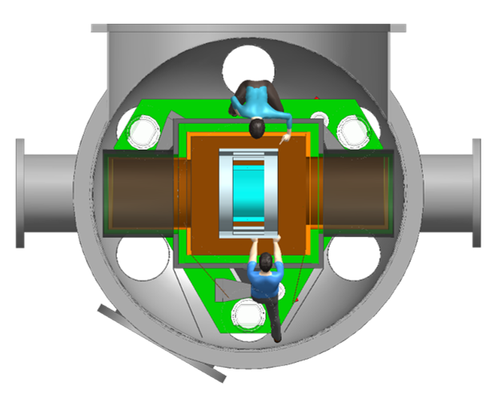
Dimensional CAD
Personnel inside chamber but outside thermal shields
Separate access to instrumentation of seismic platform
Further identification of interfaces, requirements, and engineering challenges required.
Primary
access
Payload Rails
Secondary
Human Access

Slide 7
Suspension chain
Vertical filters, now with
0.175 Hz
0.25 Hz
0.25 Hz
0.7 Hz
IP top ring
1270 kg
Sensing and actuation between F0 and FSM1, and between FSM1 both FSM2 and FSM3.
2 wires on MAS/GAS filters FSM1 to FSM2
  Allows alignment of bending points of incoming and outgoing wires
  Still has minimal coupling in Rx (relates to Z motion)
1 wire with MAS/GAS filter FSM2 to FSM3
  Control rotational damping and drift using actuation against FSM1
  Minimize damping and the amount of complex AS-filters (0.5Hz ~2m blades)
3 wires with long blade-springs going down through cryostat to payload design
  Allows damping of payload modes from warm vacuum
  Connects DC alignment of cold-platform + cage to warm actuators
FSM1
636 kg
FSM2
318 kg
FSM3
318 kg
PAY
MIR
Cryostat

Slide 8
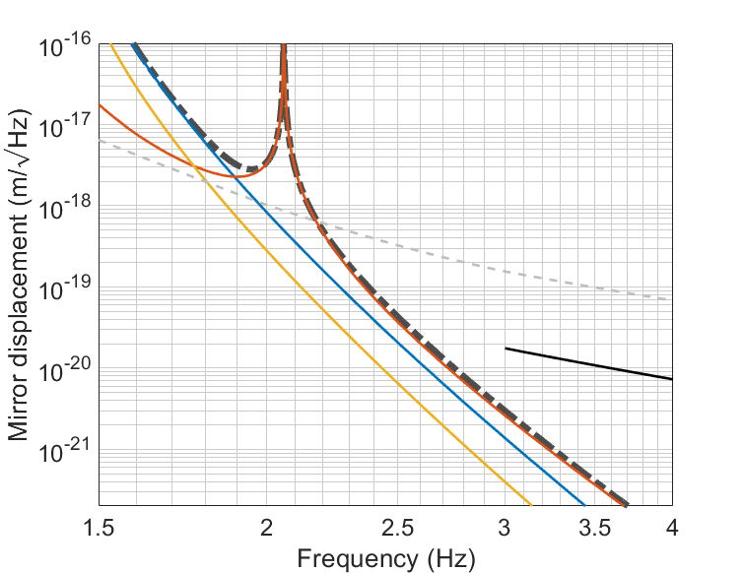
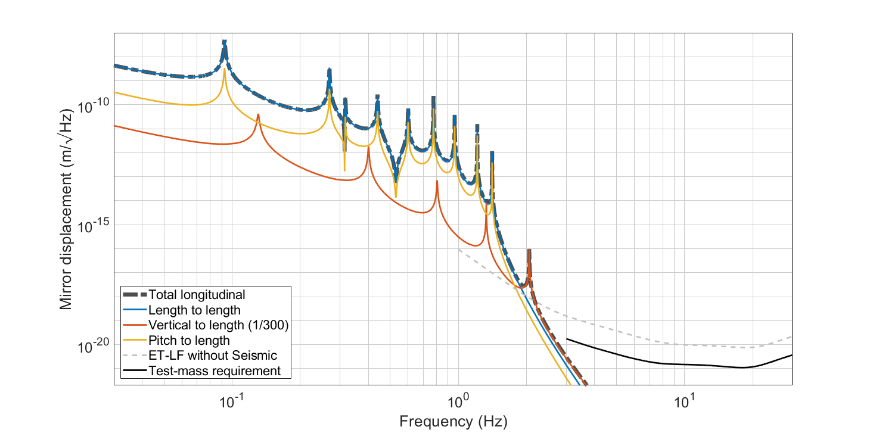
Performance modelling
Requirement drawn from 2-L configuration, which is slightly tighter.
Req. = DARM(no_seis)/8

Slide 9
Modelled performance (suspension)
Consistent with the Suspension-division consensus, residual vibration requirement at 3Hz is ‘easy’ assuming high-performance active control and 3 stages with vertical anti-springs (MAS/GAS).
Requirement updated to a simpler metric from Taskforce models: it should be DARM/4 total, or DARM/8 per test-mass.
Huge reduction of RMS accumulation at suspension-chain eigenmodes from the seismic platform simplifies control and actuation distribution.
First modelling of suspension-chain damping + optimization ongoing.
Since the vertical component dominates, it is possible to reduce the height by a further 2m without degrading total performance (11m total height).

Slide 10
Detailed engineering challenges
Particulate control during payload installation and access
  Simplify installation procedure – minimal in-situ tuning
Temperature gradients on seismic platform and IPs from thermal shields
  Add ‘passive’ thermal shields to reduce thermal load.
  Potentially add active 300k barrier.
Complex seismic platform structure and inertial rotation sensing
  OmniSens, E-TEST, Archimedes, BRS/CRS and others working on R&D
Tidal actuation on active platforms (circa 800um)
  Requires full-scale prototyping

Slide 11
Relative challenge of solutions
 | Bottom access | Cavern above | Single cavern
Stability of suspension mounting point | (-) | ++ | +
In-band vibration | = | + | =
Seismic platform integration | - | ++ | =
Ice-growth rate (vacuum requirements) | = | + | =
Cleanliness during access/tuning | (=) | (?) | (=)
Installation and repair accessibility | = | ++ | =
Excavation cost | - | --- | +
Tunnel access and complexity | - | -- | +
Vibration isolation of cryoshields | (-) | (+) | (=)

Slide 12
Inputs required
Vibration requirements for the thermal shields – potentially a major engineering challenge.
  Scattered light?
  Newtonian noise?
  Direct vibration transmission?
Point absorbers and cleanliness
  Better input from LIGO + Virgo processes and resulting links to performance
  What defines requirement? Scatter, Quantum-noise loss, Beam centering, …

Slide 13
Questions and discussion?

Slide 14
Point absorbers and scatter
LIGO replaced both ETMs (LLO) and ITMY (LHO)
They now operate with ~270kW (LLO) and 360kW (LHO)
LHO still has evidence of point absorbers on ITMX and both ETMs
LLO has no clear evidence (Hartmann sensors) of point absorbers on ETMs, but had higher loss. After first-contact cleaning, ~15% increase in power-recycling gain and a reduction in wide-angle scatter.
Overall: Difficult to draw clear requirements and processes from current data. Likely that point absorbers not a problem for ET-LF with strict protocols. Scatter still TBD.
LIGO O4 instrument
10.1103/PhysRevD.111.062002
10.48550/arXiv.2411.14607

Slide 15
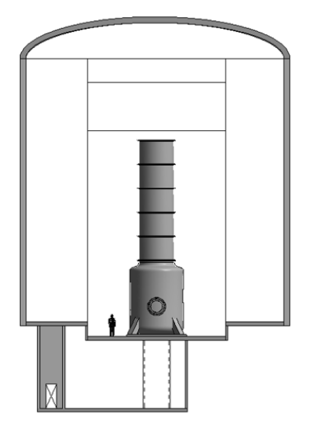
Excavation cost
0.9M€/optic for Bottom Access (rough estimate based only on volume of rock excavated); ~4M€ per LFI.
Considerably more (and more complex) for a Double Cavern solution.
Most expensive and complex is a Double Cavern with Bottom Access.
Same will apply for HF-TMs – there are therefore major infrastructure savings for lateral-access solutions.

