Slide 1
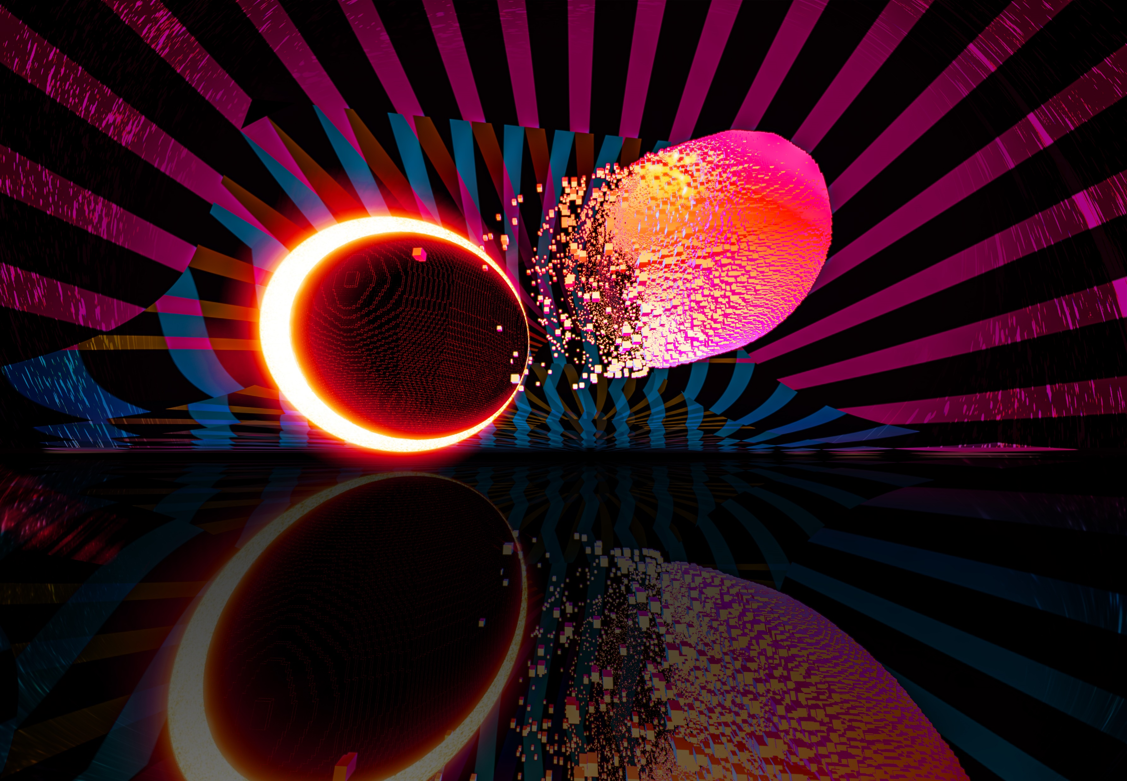
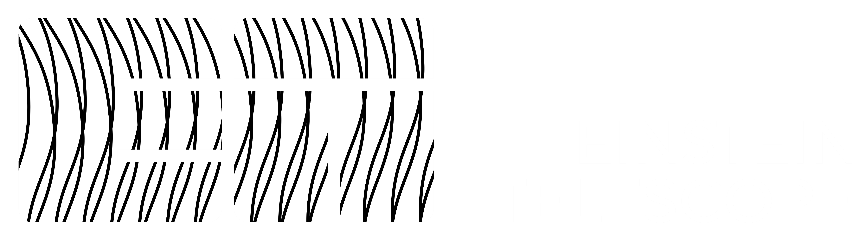
Einstein Telescope
XV ET Symposium | Bologna (26-30 May 2025
XV ET Symposium | Bologna (26-30 May 2025)
Risk management critical role: Risk assessment status and risk management evolution
Ghada Mahmoud – Systems Engineer /Risk Manager - ETO Project Office
ghada.mahmoud@apc.in2p3.fr

Slide 2

Einstein Telescope
XV ET Symposium | Bologna (26-30 May 2025)
Introduction:
This presentation focus on the following points:
Why we perform Risk Management ?
When were Risk Studies performed in ET by the ETO PO ?
          The ETO PO Risk Campaign and examples of outcomes
          (note: detailed outcome examples cannot be shared at this time)
          - The ETO Task Force activities
Additional tools used to support Risk Studies, such as Technology Readiness Level (TRL) assessments and Design Structure Matrix (DSM)
Ghada Mahmoud

Slide 3
Einstein Telescope
XV ET Symposium | Bologna (26-30 May 2025)
Why Risk Management ?
Risk management in the Einstein Telescope (ET) is not an “extra step,” but rather a fundamental engineering and governance backbone. It enables structured decision-making within the context of a complex, multi-partner scientific infrastructure project like ET.
Risks are typically assessed based on their potential impact on three critical areas of the project: cost, schedule, and scope.
These dimensions are also the foundational constraints of all aspects of project management like cost management and many others.
Objectives:
Identify and manage uncertainties : Technical, organizational, scheduling, financial, and more.
Provide a risk response strategy that defines how risks impact cost, schedule, and scope.
Support the policy framework for enabling technology development.
Guide design trade-offs and informed technology choices.
Enhance fundability, credibility, and project resilience.
Ghada Mahmoud

Slide 4
Einstein Telescope
XV ET Symposium | Bologna (26-30 May 2025)
When were Risk Studies performed in ET by the ETO PO ?
Phase | Risk-Related Activity
2024 – 2025 | ETO PO General Risk Campaign ( starting June 2024 ) : First General structured, collaborative risk campaign across technical groups ( All ISB Subsystems : Interferometer Group , Optics Group, Suspension Group , Vacuum and cryogenics Group, ANM Group; and Engineering Department ) It Delivers the First Full Risk Register for ET - TRL Assessments
2025 | - Continuing with the ETO PO General Risk Campaign : Review , other Stakeholders ( ETO ; ETC ; OSB; SCB ) - ETO Taskforce : TRL assessments Comparative risk studies between different Configurations of 2L and Triangle Geometries Flexibility (DSM ) and Penalty of change (trade-off analysis between designs and cost impact evaluation ) studies
Now | Cross-cutting risk integration (identifying, analyzing, and managing risks that affect multiple subsystems, teams, or domains simultaneously) Starting integrating Risks into MBSE ( Jama and 3DX)
Ghada Mahmoud

Slide 5
Einstein Telescope
XV ET Symposium | Bologna (26-30 May 2025)
Outcome of the ETO PO General Risk Campaign
~200 risks ( mostly technical) identified and assessed across major subsystems (Interferometer, Active Noise Mitigation (ANM), Vacuum & Cryogenics, Optics, Suspension, Engineering Department )
Risk identification was strongly collaborated with technical and scientific teams that participated , ensuring ownership and technical accuracy. The availability and participation of ALL the invited groups should be increased,
Identification of other systemic risks :
- Highlighted critical interdependencies between subsystems ( Risks caused by unclear requirement ownership).
- Risks caused by unclear performance specs, undefined interface roles, and incomplete design assumptions .
Moving from Assessing risks only to transforming risk mitigations into real design enabler.
Ghada Mahmoud

Slide 6
Einstein Telescope
XV ET Symposium | Bologna (26-30 May 2025)
Example on a Technical Risk from the ETO PO General Campaign causing a trade off
Risk Description:
A risk that the required specifications for the ET-LF test mass (TM) substrates may not be met.
ET-LF lack of substrate availability in suitable dimensions ( actually 45 cm diameter ) and with suitable optical properties.
Cause:
The test mass substrates must possess both large dimensions and exceptional optical characteristics, including low optical absorption and low birefringence.
At present, materials that meet these criteria (silicon and sapphire ) are not available at the required size and quality.
Birefringence is a particularly significant challenge for sapphire.
Impact:
If the necessary substrates cannot be procured, the ET-LF detector may not be constructed according to its current design.
This would compromise its ability to meet scientific objectives, potentially requiring reductions in beam size and TM mass.
Suggested Mitigations :
Continue parallel R&D efforts into both silicon and sapphire substrates.
Conduct trade-off studies to assess the feasibility of tolerating higher optical absorption levels.
Explore alternative optical layouts that are compatible with smaller mirror sizes.
Investigate the viability of other materials designs.
Factor | Value
Severity | 5 /5
Likelihood | 5/5
Overall Risk | High
Ghada Mahmoud

Slide 7
Einstein Telescope
XV ET Symposium | Bologna (26-30 May 2025)
Impacts analysis - trade off : example on a cost variation scenario
Example :
If we suggest reducing the diameter of LF TM from 45 cm to 35 cm ( to give more time for developing R&D ) then the arm length will be maximum 10 KM → we can’t construct a 2L configuration for ET with 15 KM armlength ( we will be able to construct 10 KM 2L Configuration instead) and the triangle ET Configuration of 10 KM armlength won’t be not affected.
Example on the cost change :
Cost Impact : Cost difference of possible 24,98 % reduction of the excavated volumes with respect to the 2025 2L Configuration (15 KM ) one.
The triangle cost remains unchanged.
The trade off should take into account the impact of the length reduction on the scientific scope, also on the upgradability.
Ghada Mahmoud

Slide 8
Einstein Telescope
XV ET Symposium | Bologna (26-30 May 2025)
ETO TaskForce
The ETO Task Force revised the 2024 Einstein Telescope (ET) layout for both the Triangle and 2L configurations to balance cost and performance.
The updated baseline designs reduce civil infrastructure costs while maintaining scientific objectives and aiming for ensuring flexibility for future development.
A detailed ETO TaskForce study outlines:
The design logic
Alternative configurations
Technical risk assessments
Ghada Mahmoud

Slide 9
Einstein Telescope
XV ET Symposium | Bologna (26-30 May 2025)
ETO TaskForce
To support a comprehensive technical Risk evaluation, the following risk studies and tools were employed:
A Comparative Risk Study between the 2024 Configuration and the 2025 Task Force Baseline Configuration for both geometries (2L 15 km and Triangle 10 km).
A Comparative Risk Study for Alternative configurations and options for the 2025 Taskforce Baseline
A Technology Readiness Level (TRL) Assessment, followed by a Technological Risk Study.
A Design Structure Matrix (DSM) was initiated to analyze system rigidity and interdependencies.
Several trade-off scenarios were analyzed, assessing their cost implications on the overall project.
Ghada Mahmoud

Slide 10
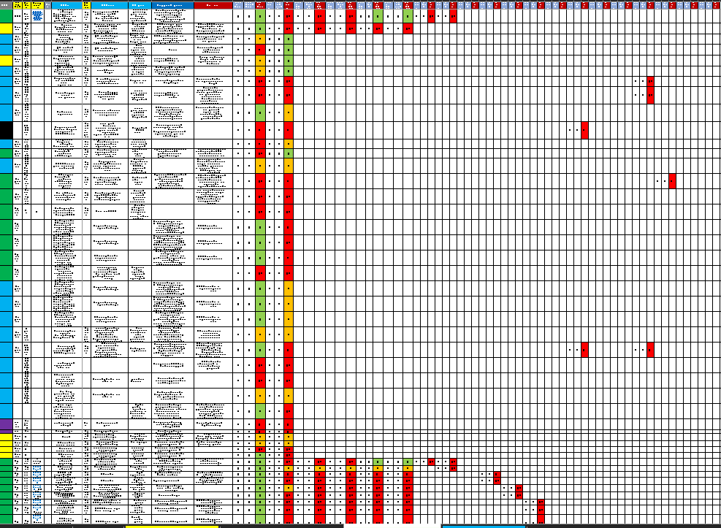
Einstein Telescope
XV ET Symposium | Bologna (26-30 May 2025)
Comparative Risk Study
Ghada Mahmoud

Slide 11
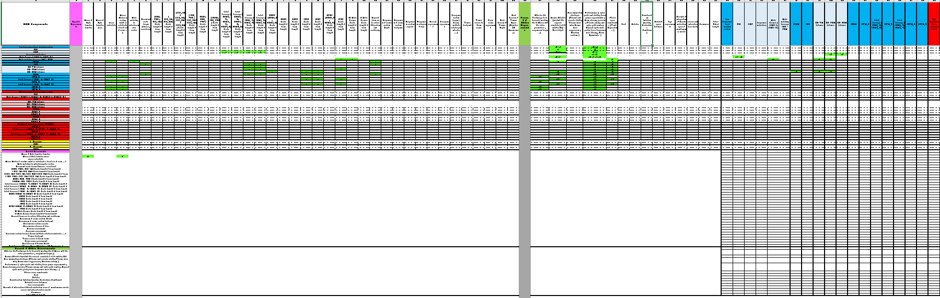
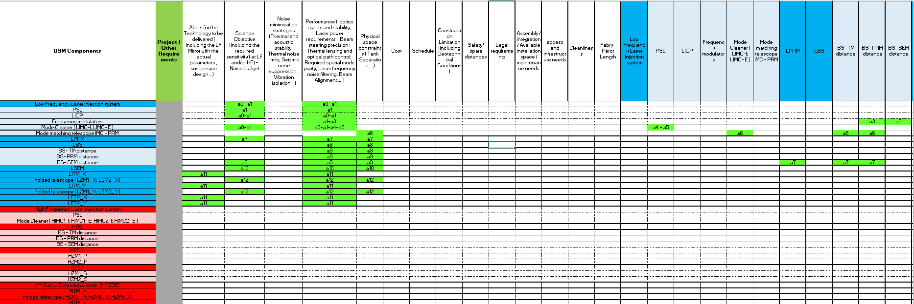
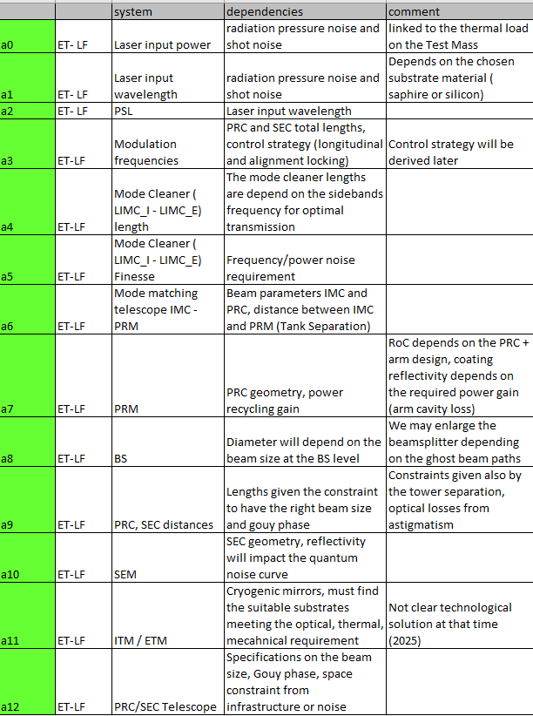
Einstein Telescope
XV ET Symposium | Bologna (26-30 May 2025)
What’s a DSM : ETO Taskforce
A Design Structure Matrix is a visual tool that maps the dependencies and interactions between elements of a complex system. It helps identify how different parts of a project (subsystems, components, requirements) influence each other, either directly or indirectly.
Purpose:
Understand interdependencies
Support smarter design and planning
Benefits:
Identifies rigid vs. flexible areas
Reveals cross-system impacts
Helps sequence design steps efficiently
It’s a Very efficient tool, to be implemented.
Ghada Mahmoud

Slide 12
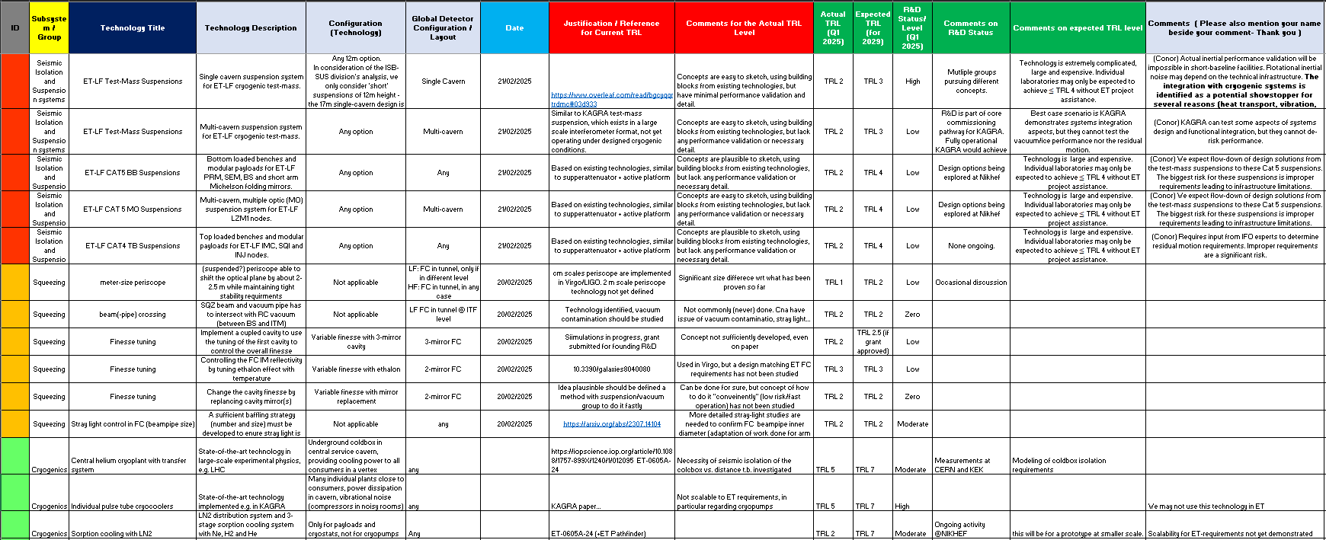
Einstein Telescope
XV ET Symposium | Bologna (26-30 May 2025)
TRL Study
TRL already provides a non-contextualized risk score for technologies.
However, when placed within the ET project context, a structured risk-based analysis of TRLs can offer critical insights.
This approach helps identify gaps, uncertainties, and dependencies in technology development.
It supports the creation of a realistic and informed development plan, aligned with ET’s technical and scientific goals.
Work in Progress
Ghada Mahmoud

Slide 13
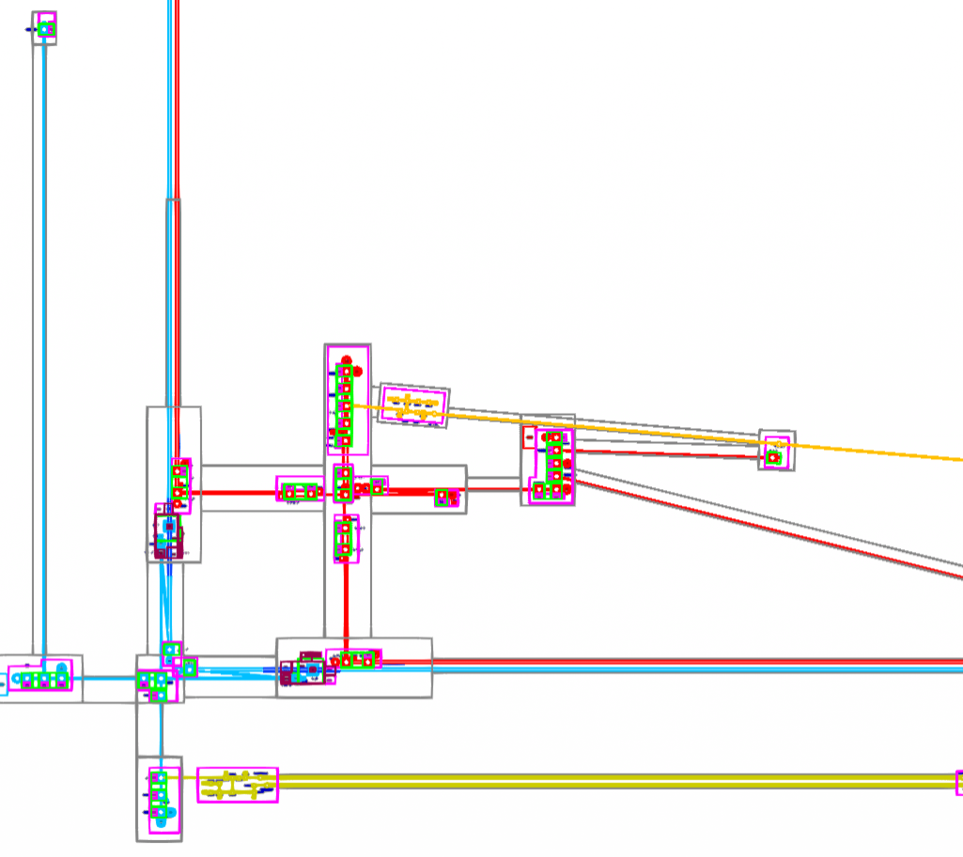
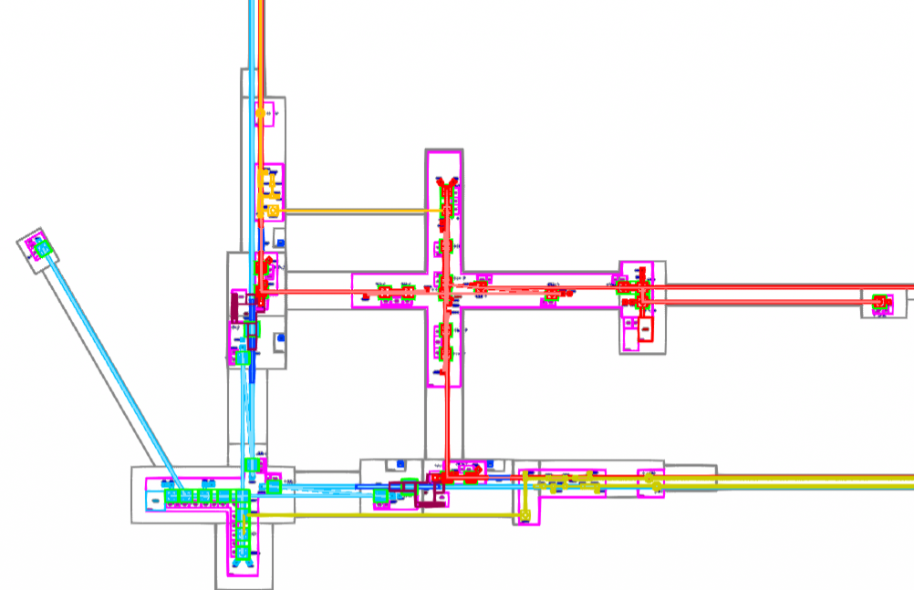
Einstein Telescope
XV ET Symposium | Bologna (26-30 May 2025)
What Changed : (2025 ETO TaskForce Configuration- 2L and Triangle )
LF Squeezing FCs in X arm with Periscope (2m heigh for 2L ; 4m for Triangle ) routed through the LSEM Tower to the LSQI Tower
HF Squeezing FC in Y arm with Periscope directly routed to the HSQI Tower
2- Mirror FC with reduced pipe diameter from 1m to 650 mm
Reduced Length of LF IMC from 300 m to 120 m
Merging HF IMCs in same tunnel
Route BHD through BS in LF Ifo
Other reshuffling in central area to adapt to the new changes
Reduced LF TM susp heigh from 17 m to 13 m Reduced Tower height for other HFI Optics
Reduced footprint of CAT1 Benches
2024 2L Geometry - Configuration
2025 2L Geometry - Configuration
Alternative Options :
Double Cavern
No periscope for LF_FC
Alternative routing for SQZ beam
Bow-tie IMC
Reduced tower heigh for HF TM
Reduced Tower height for LFI Optics
Reduced Cryostat size
Ghada Mahmoud

Slide 14
Einstein Telescope
XV ET Symposium | Bologna (26-30 May 2025)
Risks and impact analysis in the TaskForce
Infrastructure-Based Mitigations
Pros: Often straightforward and effective.
Cons: Can involve higher upfront costs
No-Cost Mitigations with Trade-Offs
Pros: Lower cost.
Cons: could introduce new technical risks or limitations.
Systems Design Changes and R&D-Based Mitigations
Pros: Can lead to innovative, long-term solutions.
Cons: Typically require additional time, cost, and resources, and may introduce schedule delays.
Ghada Mahmoud

Slide 15
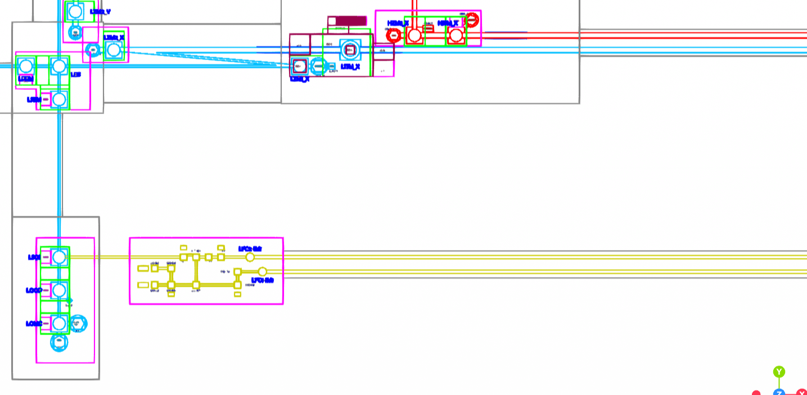
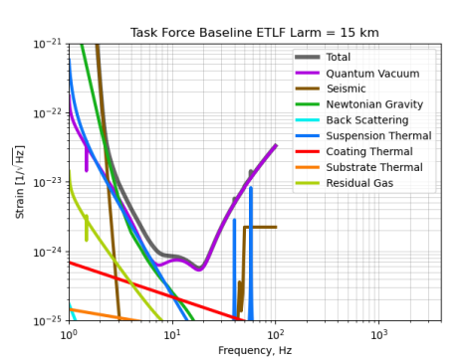
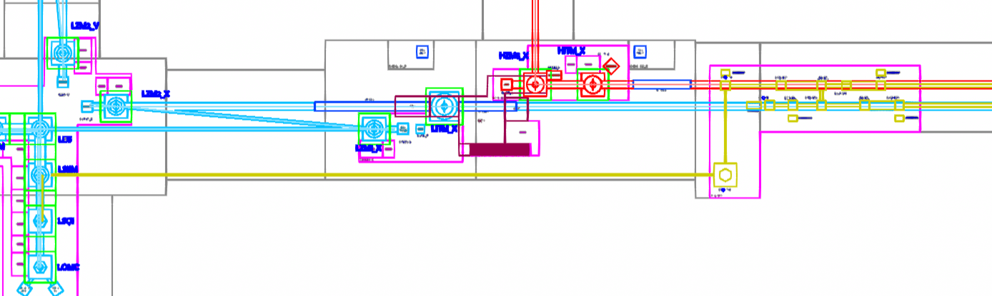
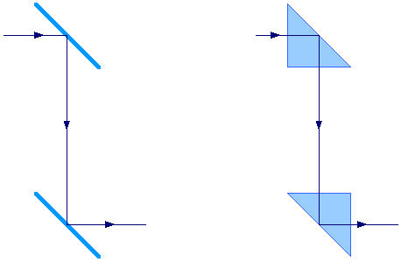
Einstein Telescope
XV ET Symposium | Bologna (26-30 May 2025)
LF Squeezing FCs in X arm with Periscope (2 m heigh for 2L ; 4 m heigh for Triangle ) routed through the LSEM Tower to the LSQI Tower
Risk Description:
Risk of degraded squeezing,
Using a tall (2 m or 4 m ) periscope in the ET-LF filter cavity introduces phase noise into the squeezed light. This degrades the squeezing injected into the interferometer, especially at low frequencies where ET-LF is most sensitive.
Cause:
The periscope can:
Vibrate or flex, leading to mechanical instability → should cause mirror misalignment
→ Introduce phase fluctuations in the squeezed beam path
These effects result in decoherence or loss of squeezing.
Impact:
Reduced squeezing means higher quantum noise → lower sensitivity of ET-LF.
This is more severe at low frequencies (<30 Hz), which are critical for detecting massive black hole mergers.
Suggested Mitigation
1. Remove the Periscope
The best mitigation is architectural: Place the ET-LF interferometer and its squeezing/filter cavity on the same horizontal plane (Less Risky – Trade off scenarios ( from less costly to more costly ) )
2. Prototype Testing (Mechanical stability, Impact on squeezing ) (More Risky – Delay - Cost )
Before ruling out periscopes entirely : Implement a periscope in an existing gravitational-wave detector .
This helps assess whether periscopes could be made stable enough with special materials or isolation systems.
2024 2L Configuration
2025 ETO TaskForce 2L Configuration
Factor | Value 2L | Value Triangle
Severity | 5/5 | 5/5
Likelihood | 3/5 | 4/5
Overall Risk | High | High
Applies to | ET-LF mainly | ET-LF mainly
Less impact on | ET-HF | ET-HF
Ghada Mahmoud

Slide 16
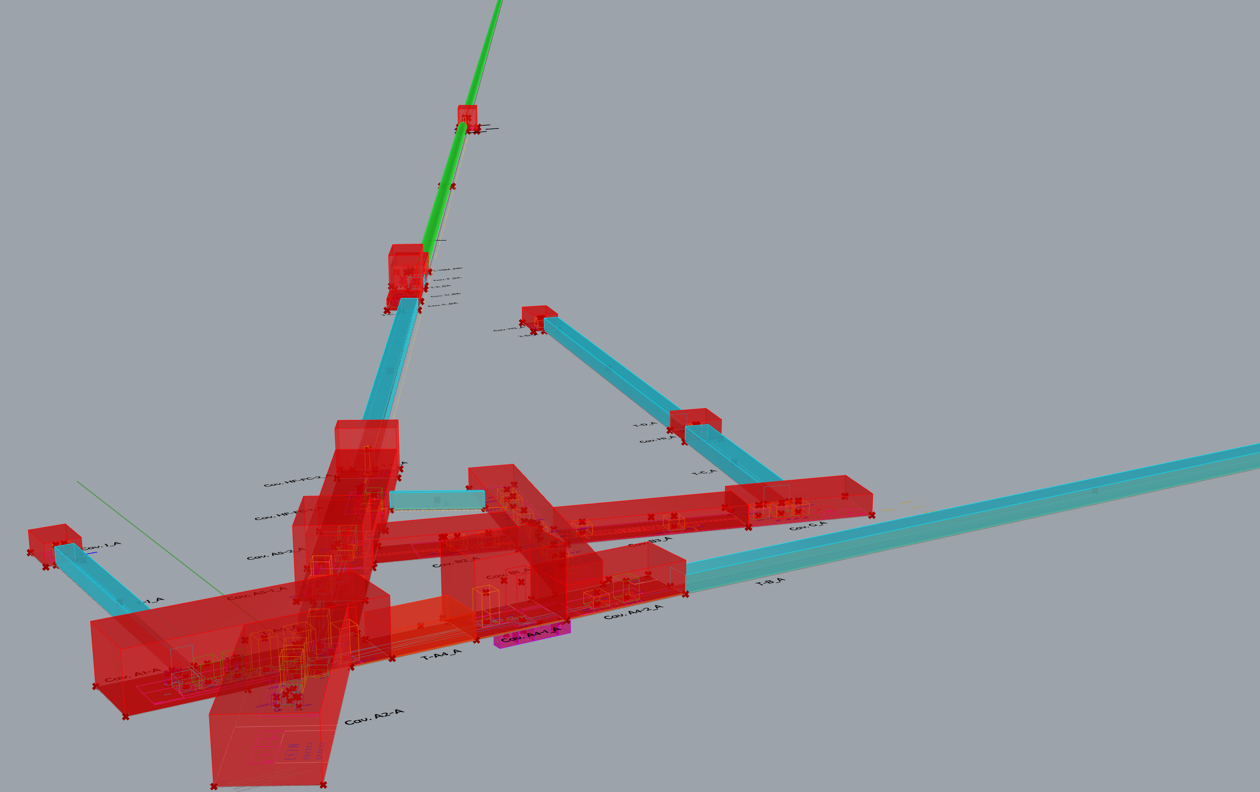
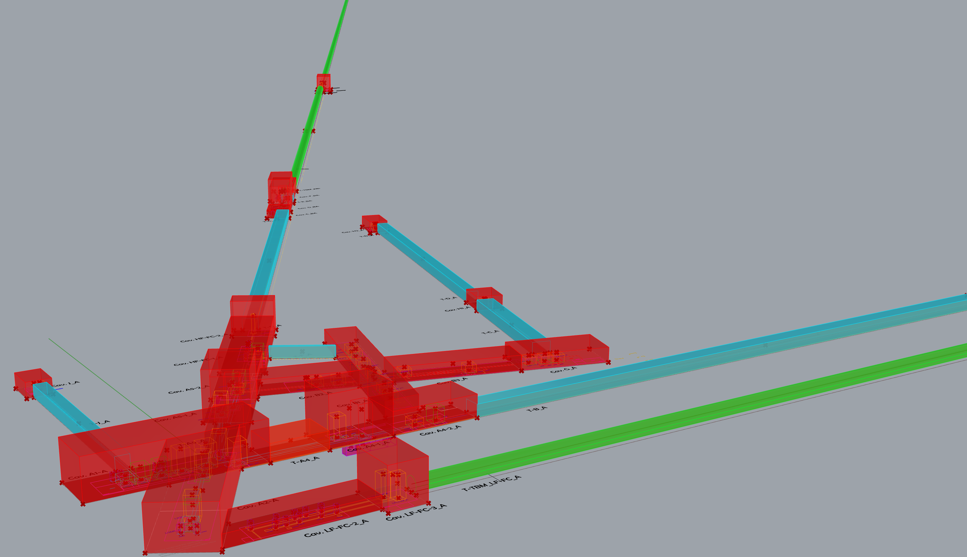
Einstein Telescope
XV ET Symposium | Bologna (26-30 May 2025)
Example – trade off. Cost vs risk minimization
2025 Triangle configuration but considering the 2024 configuration for the LF Filter Cavity ( No periscope for LF FC - no change in HF FC )
Cost Impact : Cost difference of possible +16, 24 % increase of the excavated volumes with respect to the 2025 Triangle Configuration one.
2025 2L configuration but considering the 2024 configuration for the LF Filter Cavity ( No periscope for LF FC - no change in HF FC )
Cost Impact : Cost difference of possible +14, 01 % increase of the excavated volumes with respect to the 2025 2L Configuration one.
Trade off should be analysed between a cost increase and the risk minimization for the performances of the squeezing cavity
Ghada Mahmoud

Slide 17
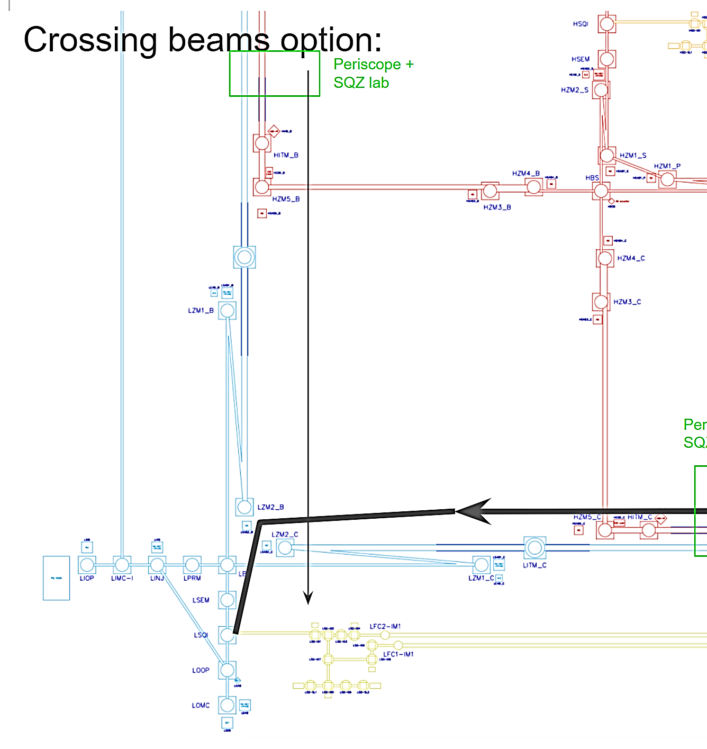
Einstein Telescope
XV ET Symposium | Bologna (26-30 May 2025)
Alternative design options : No Periscope for LF_ FC , the LF_FC is in the main tunnel and is directly routed from the Beam Splitter
Factor | Value 2L and Triangle
Severity | 2/5
Likelihood | 5/5
Overall Risk | High
Impact or Risk Description:
Increase the astigmatism in the y arm recycling arm. Risk not to find a suitable configuration in the design.
Cause:
Movement of the mirror LZM2_Y to allow passage of SQI ⇄ SQZ beam through Beam Splitter
Suggested Mitigation
Optimizing the optical design of the telescope - use of freeform optics
Two scenarios for not considering the periscope in LF : one introduce a risk of astigmatism ( to be mitigated ) and one does not increase the astigmatism ( but increase the cost)
Ghada Mahmoud

Slide 18
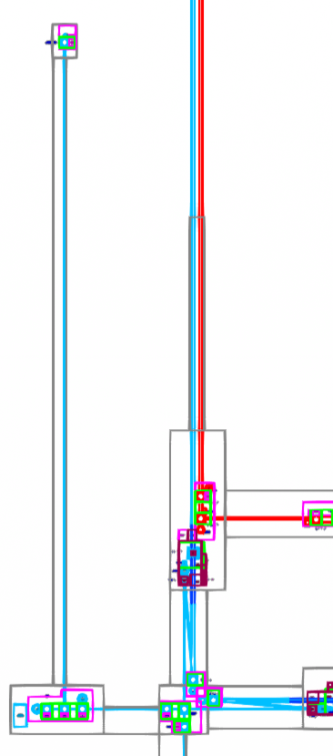
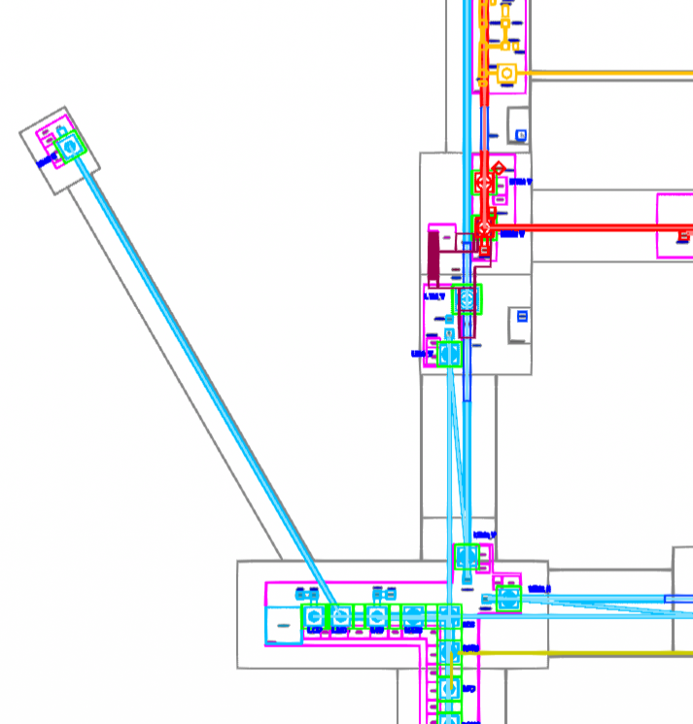
Einstein Telescope
XV ET Symposium | Bologna (26-30 May 2025)
Reduced Length of LF Input Mode Cleaner from 300 m to 120 m
2024 2L Configuration
Impact or Risk Description:
If the IMC is too short (120 m instead of 300 m), it may not effectively filter out high-frequency and high-amplitude noise in the laser beam. This noise then enters the main interferometer and compromises the sensitivity of the detector.
Risk of not be able to implement the design mitigation strategies to maintain the cleaner performance.
Cause:
A shorter IMC:
Has less optical path to average out fluctuations
Cannot suppress high-frequency noise as well
Is less effective at stabilizing the beam's phase, amplitude, and geometry
Impact:
Frequency noise from the laser isn't fully removed
Amplitude noise remains, adding false signals
These noise sources enter the main interferometer
Suggested Mitigation
Use a High-Finesse IMC
This comes at a cost:
More complex control systems are needed
Thermal and optical losses are more sensitive
The system becomes harder to stabilize and maintain
So, while it reduces the risk, it introduces new technical challenges. ( Delay )
2025 ETO TaskForce 2L Configuration
Factor | Value 2L and Traingle
Severity | 5/5
Likelihood | 2/5 – 3/ 5 cost of the trade off
Overall Risk | High
Applies to | ET-LF mainly
Ghada Mahmoud

Slide 19
Einstein Telescope
XV ET Symposium | Bologna (26-30 May 2025)
Example - trade off : cost vs detector performance
2025 Configuration Triangle + 300 m LF Input Mode Cleaner instead of 120m
Cost Impact : Cost difference of possible +1, 31 % increase of the excavated volumes with respect to the 2025 Triangle Configuration one.
2025 Configuration 2L + 300 m LF Input Mode Cleaner instead of 120 m
Cost Impact : Cost difference of possible +0, 81 % increase of the excavated volumes with respect to the 2025 2L Configuration one
Trade off to be analysed between the cost increase and the IMC performance (to be evaluated)
Ghada Mahmoud

Slide 20
Einstein Telescope
XV ET Symposium | Bologna (26-30 May 2025)
Reduced LF TM susp heigh from 17 m to 13 m
Risk Description:
Risk of not find a suitable design fulfilling the LF TM suspension requirements, due to the cavern height available (13m tall LF TM suspension)
Cause:
The actual performance of the suspension is not compliant with the design one (i.e.: not enough pendulum length to observe from 1 Hz to 3 - 4 Hz)
Impact:
Underperforming detector; Reduced scientific reach in the critical 1–10 Hz band
Suggested Mitigation
Keep an adequate safety margin (can be going to 5m) on the caverns height / Update the design adding some active seismic filtering ( platform)
Factor | Value
Severity | 5/5
Likelihood | 2/5 ( the likelihood depends on both the science objective (LF) and the decision on the heigh of the cavern ) the likelihood may increase to 3 or 4
Overall Risk | High
Applies to | ET-LF mainly / TM
Ghada Mahmoud

Slide 21
Einstein Telescope
XV ET Symposium | Bologna (26-30 May 2025)
Trade off : cost vs risk mitigation
2025 Configuration Triangle + 12 Caverns are affected : LF TM Cavern : 5m safety margin ( + 3 m )
Cost Impact : Cost difference of possible +0,78 % increase of the excavated volumes with respect to the 2025 Triangle Configuration one
2025 Configuration 2L + 8 Caverns are affected : LF TM Cavern : 5m safety margin ( + 3 m )
Cost Impact : Cost difference of possible +0, 42 % increase of the excavated volumes with respect to the 2025 Triangle Configuration one
Trade off between cost increase and minimization of the risk associated to the suspensions system technical design
Ghada Mahmoud

Slide 22
Einstein Telescope
XV ET Symposium | Bologna (26-30 May 2025)
Outlook
The ETO PO Risk Campaign will be continued, involving different identified and selected stakeholders
DSM and TRL analysis will be expanded out of the TaskForce context
For professional risk management and risk traceability the risk data will be inserted in JAMA and 3DX in collaboration with Aachen University
Ghada Mahmoud

Slide 23

Einstein Telescope
XV ET Symposium | Bologna (26-30 May 2025
XV ET Symposium | Bologna (26-30 May 2025)
Thank you !

Slide 24
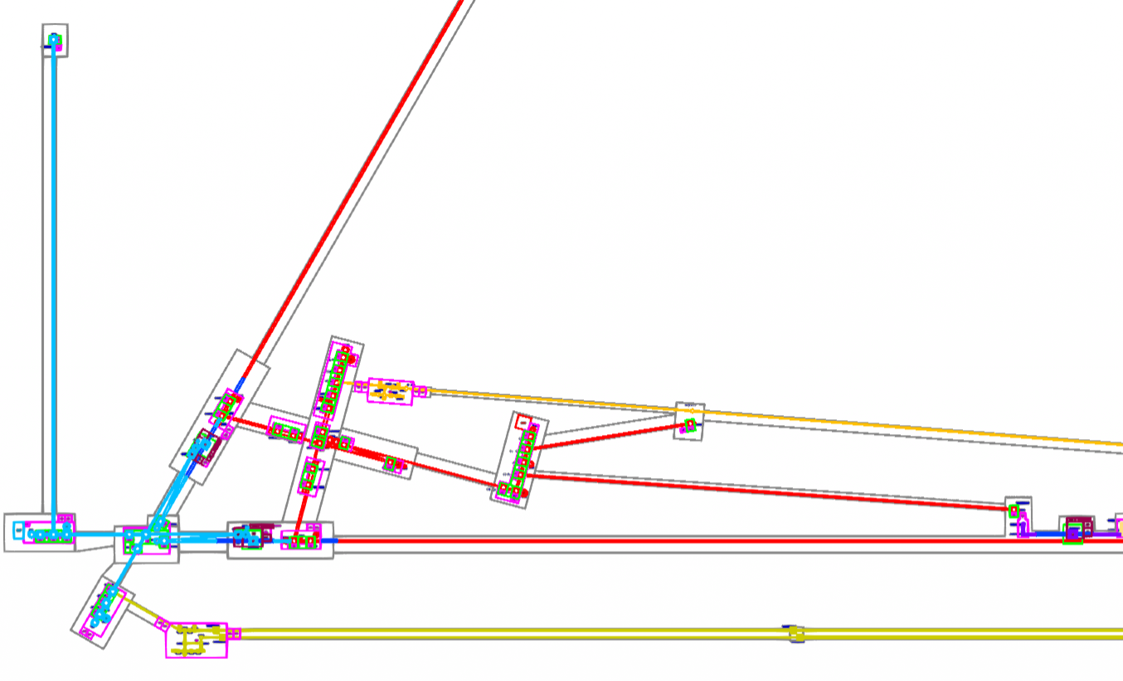
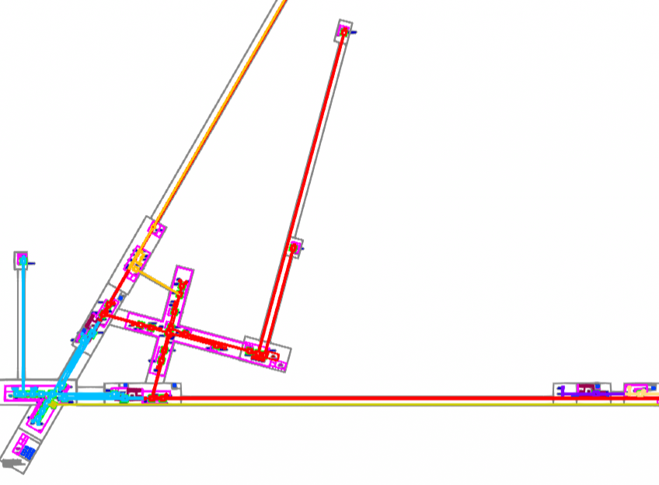
Einstein Telescope
XV ET Symposium | Bologna (26-30 May 2025)
2024 Triangle Geometry - Configuration
2025 Triangle Geometry - Configuration
Ghada Mahmoud

Slide 25
Einstein Telescope
XV ET Symposium | Bologna (26-30 May 2025)
Reduced footprint of CAT1 Benches
Risk Description:
The optical Layout ( Flexibility of choice ) is limited by the super-attenuators capacities / Design no mature
Cause:
Unable to locate sub-modular suspended optics within a single interferometer node.
Impact:
Reduced flexibility for optical layout.
Suggested Mitigation
Significant R&D needed to understand IF it is possible to colocate sub-modularly suspended optics within a single node / May need to Redesign suspension or split the optics into two groups with the seperate vacuum
Factor | Value
Severity | 4/5
Likelihood | 5/5 (Likelihood depends on the results of the R&D needed to verify if we can colocate more optics on the suspended benches)
Overall Risk | High
Ghada Mahmoud

Slide 26
Einstein Telescope
XV ET Symposium | Bologna (26-30 May 2025)
Alternative options analysis : Bow-Tie IMC
Risk Description (design not mature):
Use of bow-tie cavity induced shorter tunnel length / No demonstration of long bow-tie cavity for IMC
Cause:
4 mirrors cavities allows more compact IMC / All current interferometers use linear 3 mirrors cavities for IMC
Impact:
Limitation of the upgradibility if tunnel too short. Not possible to go back to linear 2 cavities. / Degradation of the input beam quality, low transmission due to higher losses
Suggested Mitigation
Optical simulations of the performances
Factor | Value
Severity | 4/5 – 5/5
Likelihood | 4/5 – 3/5
Overall Risk | High
Ghada Mahmoud

Slide 27
Einstein Telescope
XV ET Symposium | Bologna (26-30 May 2025)
Alternative options analysis : Reduced Cryostat size
Risk (design not mature) :
Risk of Not having enough space for the attenuation system within the integrated tower - Reducing the cryostat size reduce the performance of the cryogenic
Cause:
Reducing the cryostat size limits thermal shielding, increases heat load density, restricts cryocooler capacity, and reduces space for vibration isolation and suspension systems
Impact:
This leads to higher thermal noise, reduced cooling efficiency, increased mechanical vibrations, and overall degradation of detector sensitivity
Suggested Mitigation
Redesign and Prototype of the cryostat ( and maybe the integrated tower ) - Reducing size is possible if the design / prototyping / testing are took into consideration , it requires an adapted design to increase the performance ( R&D )
Factor | Value
Severity | 4/5
Likelihood | 5/5
Overall Risk | High
Ghada Mahmoud

Slide 28
Einstein Telescope
XV ET Symposium | Bologna (26-30 May 2025)
Alternative options analysis : Double Cavern ( TM LF)
Issue:
Increase in cost
Cause:
the construction of double cavern / and the access to the top cavern is technically more complex and increase the cost because it needs additional volume to be excavated
Comment
Double cavern or compact cryostat is the solution for Mechanical Interference between inverted pendulum and cryostat Affecting the sensitivity due to vibrational noise especially in the low frequency
Factor | Value
Severity | 3/5
Likelihood | 4/5
Overall Risk | High
Ghada Mahmoud

