Slide 1
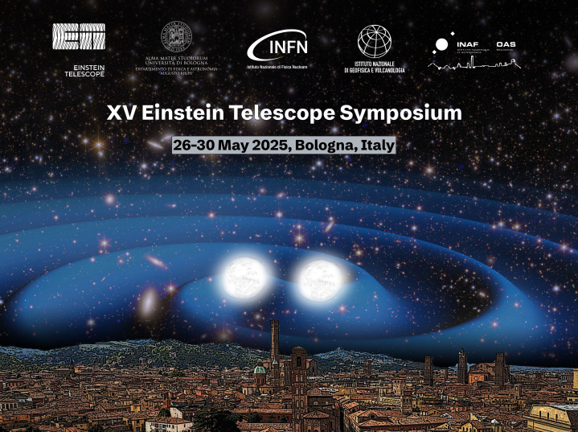
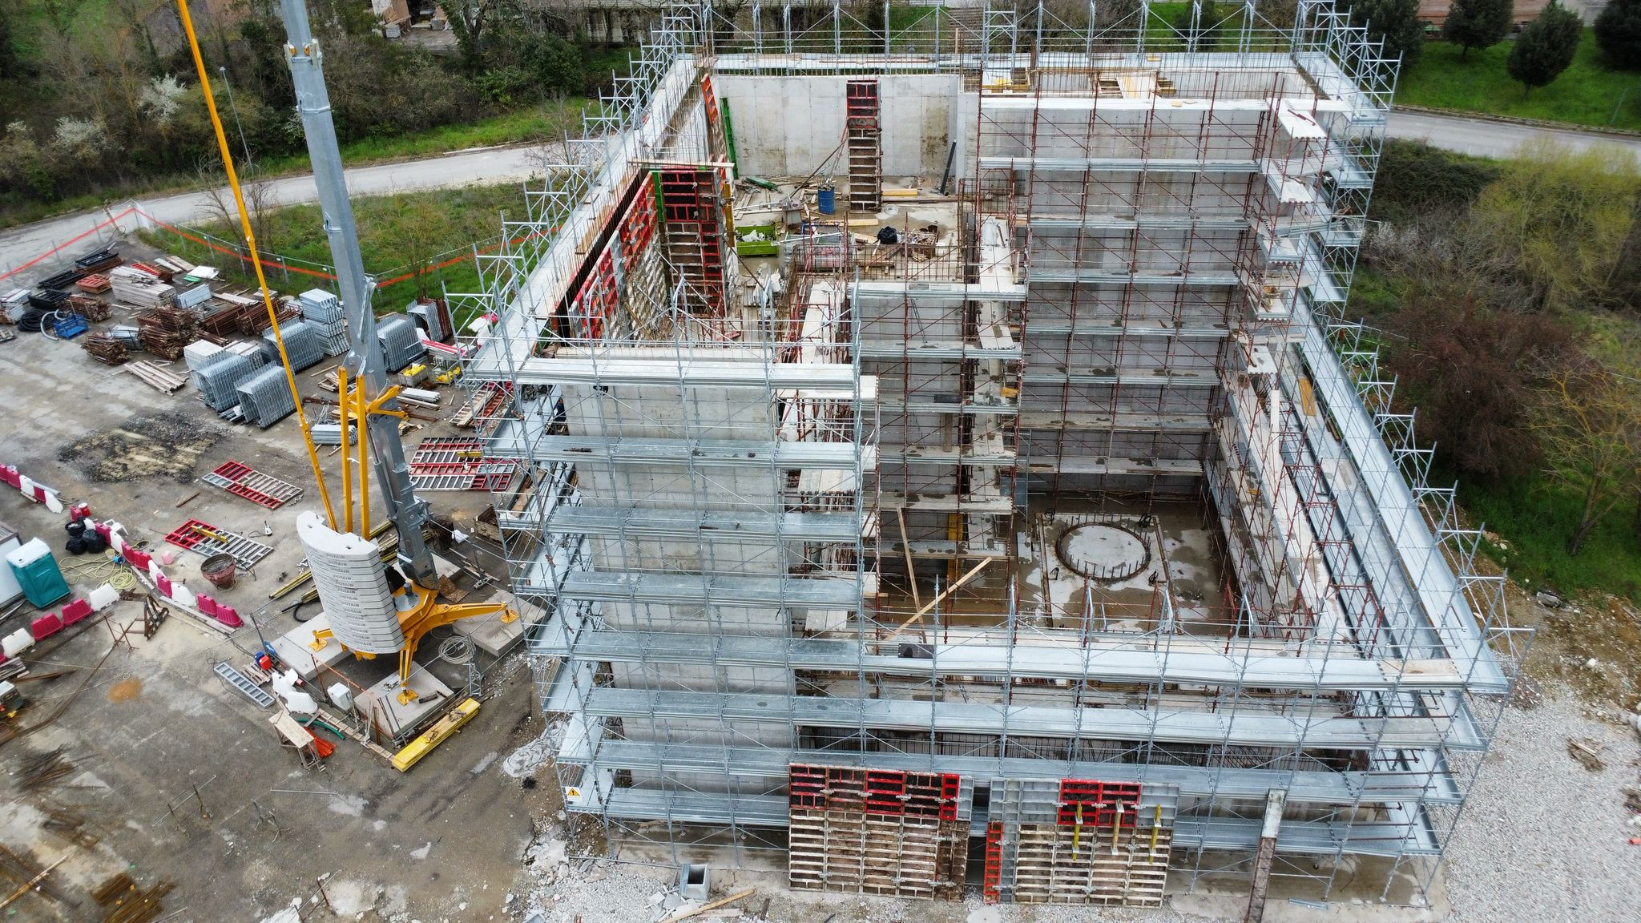
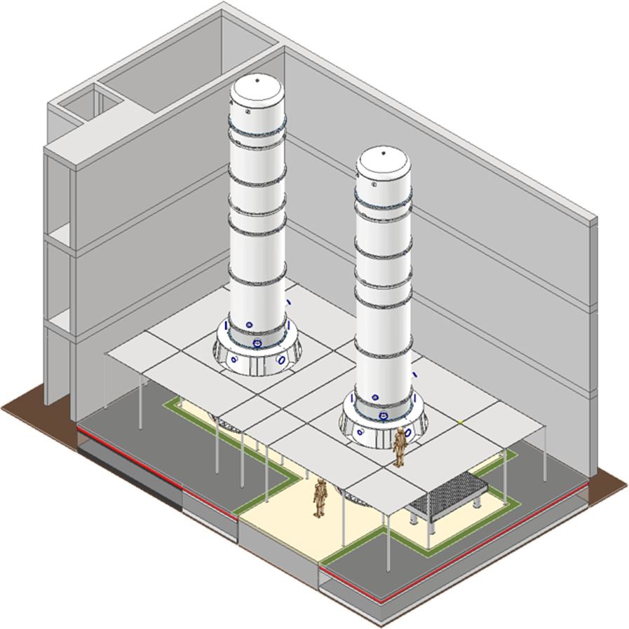
The status of CAOS laboratory
Alberto Gennai (INFN - Pisa)
Alessandro Parisi (University of Perugia)
Alessio Stollo (University of Perugia)
Andrea Paoli (EGO)
Aniello Grado (University of Perugia)
Antonio Pasqualetti (EGO)
Carlo Fabozzi (EGO)
Ettore Majorana (University of Rome La Sapienza)
Flavio Travasso (University of Camerino)
Francesco Bianchi (INFN-Perugia)
Franco Frasconi (INFN - Pisa)
Gabriele Capoccia (INFN-Perugia)
Helios Vocca (University of Perugia)
Jan Harms (GSSI)
Leonardo Lucchesi (INFN - Pisa)
Leonardo Orsini (INFN - Pisa)
Luca Naticchioni (University of Rome La Sapienza)
Mateusz Bawaj (University of Perugia)
Nicolo Baldicchi (University of Perugia)
Piero Chessa (University of Perugia)
Riccardo Romboli (EGO)
Riccardo Travaglini (INFN - Bologna)
Takayuki Tomaru (NAOJ)
Tommaso Chiarusi (INFN - Bologna)
Einstein Telescope Infrastructure Consortium (ETIC - IR0000004)
PNRR M4, C2, Investimento 3.1

Slide 2
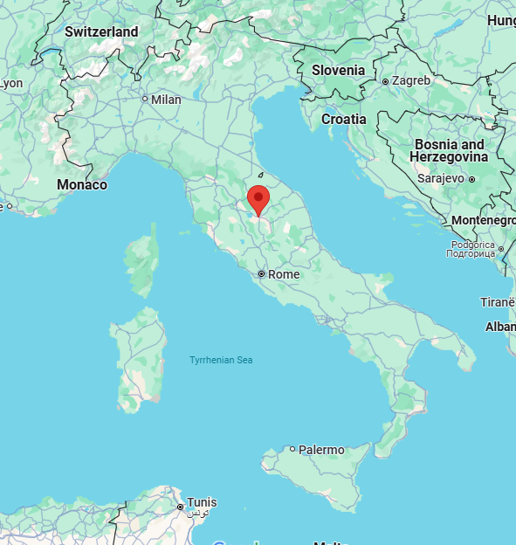
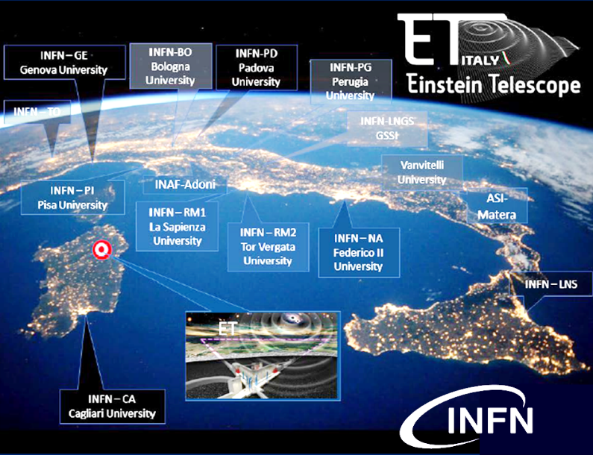
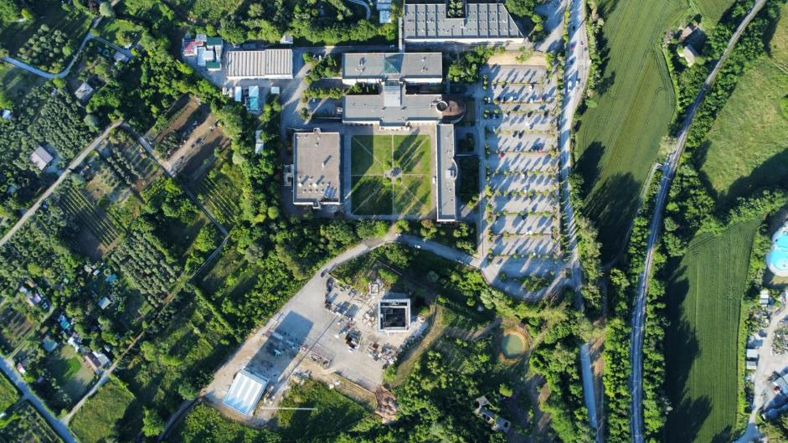
What is CAOS
CAOS is one of the ETIC infrastructure facilities, located in Perugia.
This unique international facility specialises in developing new seismic filtering technology and low-noise controls using full-size ET vacuum towers and superattenuators (SAs).
The expertise acquired at CAOS will contribute to the development of technology for third-generation gravitational wave detectors, as well as having applications in other fields, particularly seismology and early warning systems.
ETIC (Einstein Telescope Infrastructure Consortium)

Slide 3
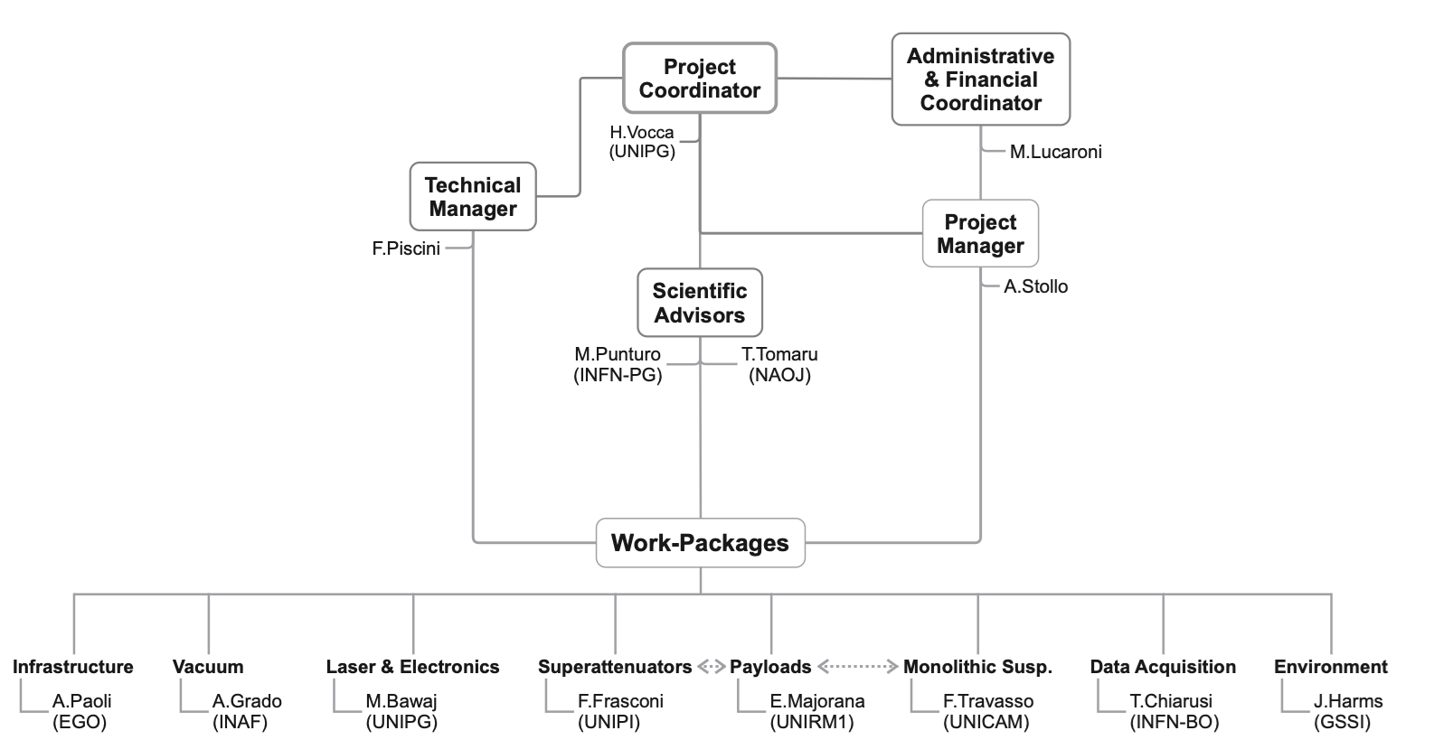

CAOS Centro per Applicazioni sulle Onde gravitazionali e la Sismologia
Organisation chart
CAOS (Center for Applications in Gravitational Waves and Seismology) will house two 15-metre-high vacuum towers, enabling us to test suspensions at room temperature (1:1 ET-HF scale suspensions).
Although the laboratory belongs to the Physics and Geology Department at UNIPG, its proximity to the Mechanical and Electronics Engineering Department will make it an attractive destination for young people, new collaborations and new ideas.
The project draws on the expertise of the Italian and international gravitational wave community. It will be a testing facility suited to worldwide collaborations, like a sort of gym for GW technologies.
(UNIPG)
Einstein Telescope Infrastructure Consortium (ETIC - IR0000004)
PNRR M4, C2, Investimento 3.1

Slide 4
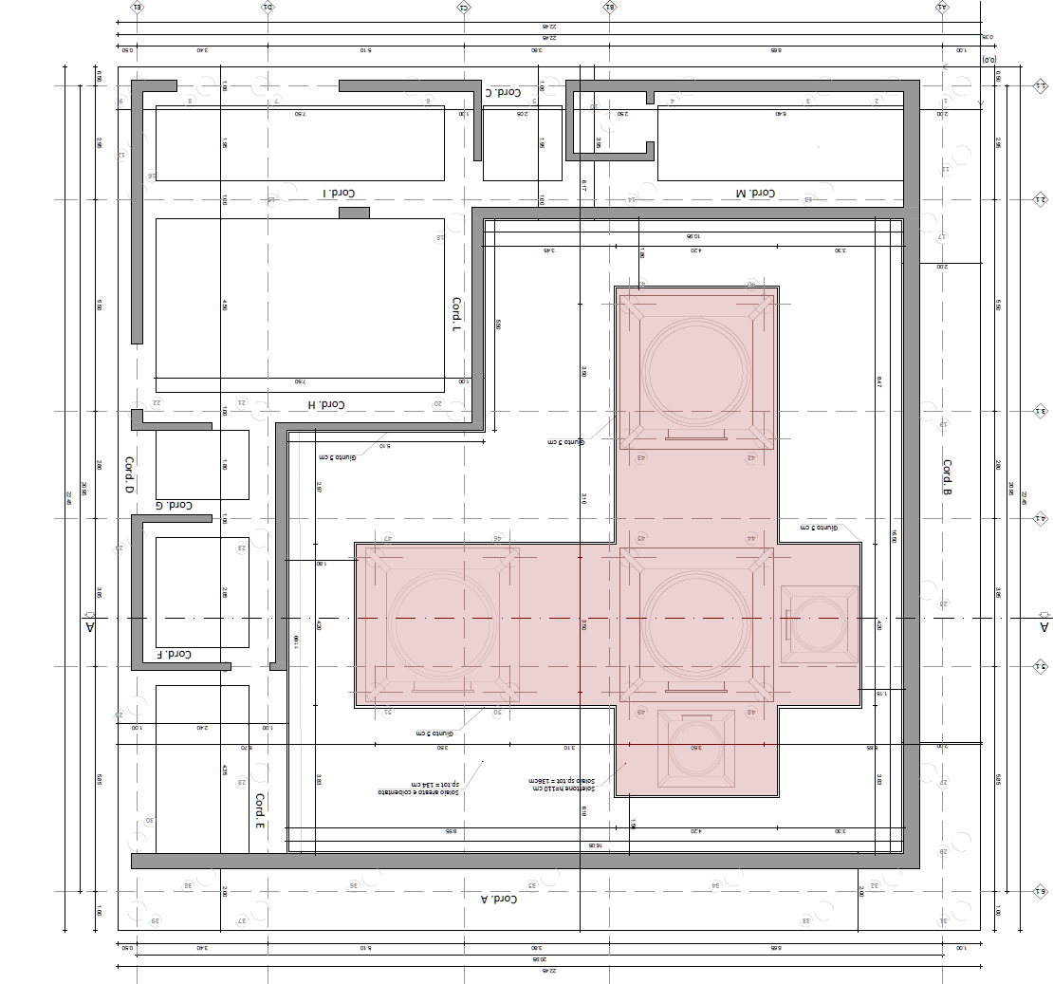
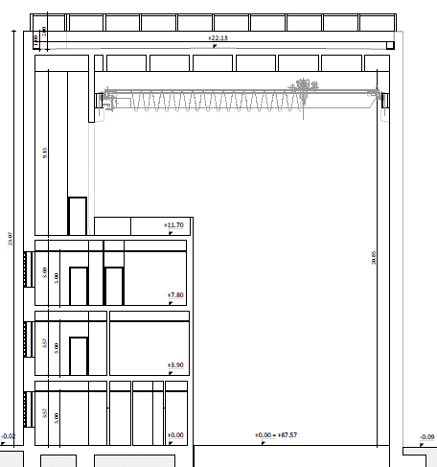







CAOS
Centro per Applicazioni sulle Onde gravitazionali e la Sismologia
Infrastructure
Vacuum
Laser & electronics
Superattenuators
Payload
Monolytic suspension
DAQ
Environment
Experimental Room
Mechanical workshop
Control Room
Electronic laboratory
Offices
Interferometer
Area
Total internal area: 441 m²
Height (int.): 19.5 m
Einstein Telescope Infrastructure Consortium (ETIC - IR0000004)
PNRR M4, C2, Investimento 3.1

Slide 5
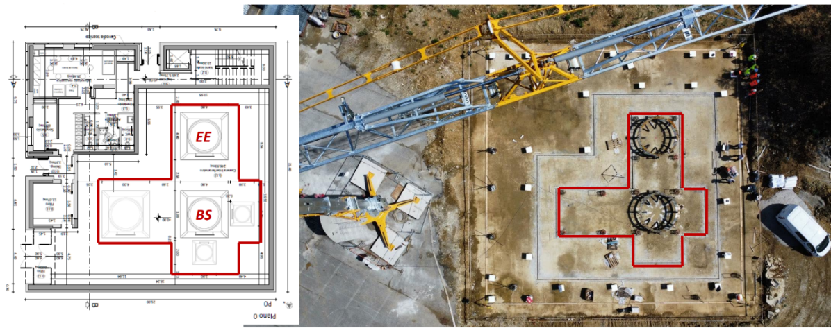
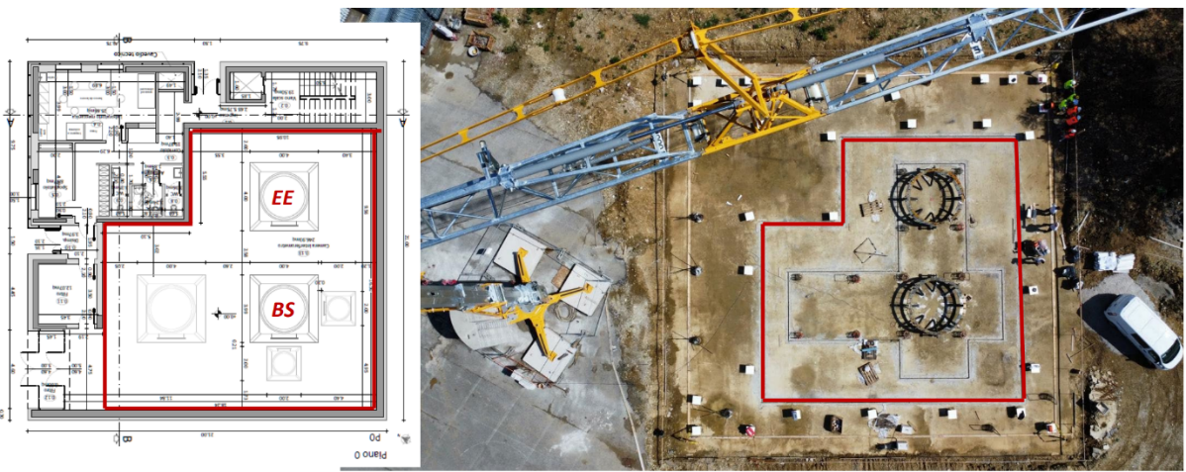

CAOS
Centro per Applicazioni sulle Onde gravitazionali e la Sismologia
Infrastructure
Vacuum
Laser & electronics
Superattenuators
Payload
Monolytic suspension
DAQ
Environment
Particular attention has been given to the foundations to minimise seismic noise.
Since the first layer of concrete was laid for the foundations, three zones in the laboratory have had separate foundations with a 5 cm gap.
Einstein Telescope Infrastructure Consortium (ETIC - IR0000004)
PNRR M4, C2, Investimento 3.1

Slide 6
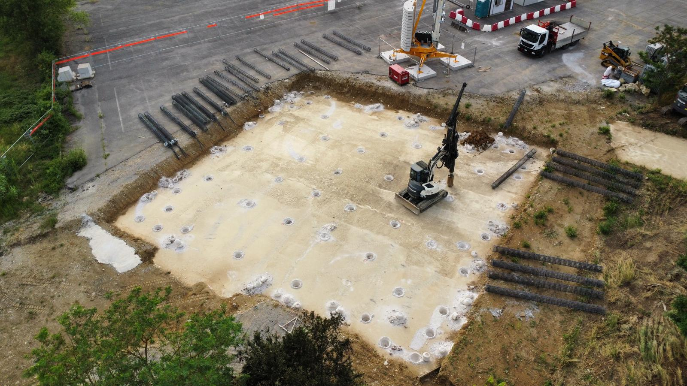
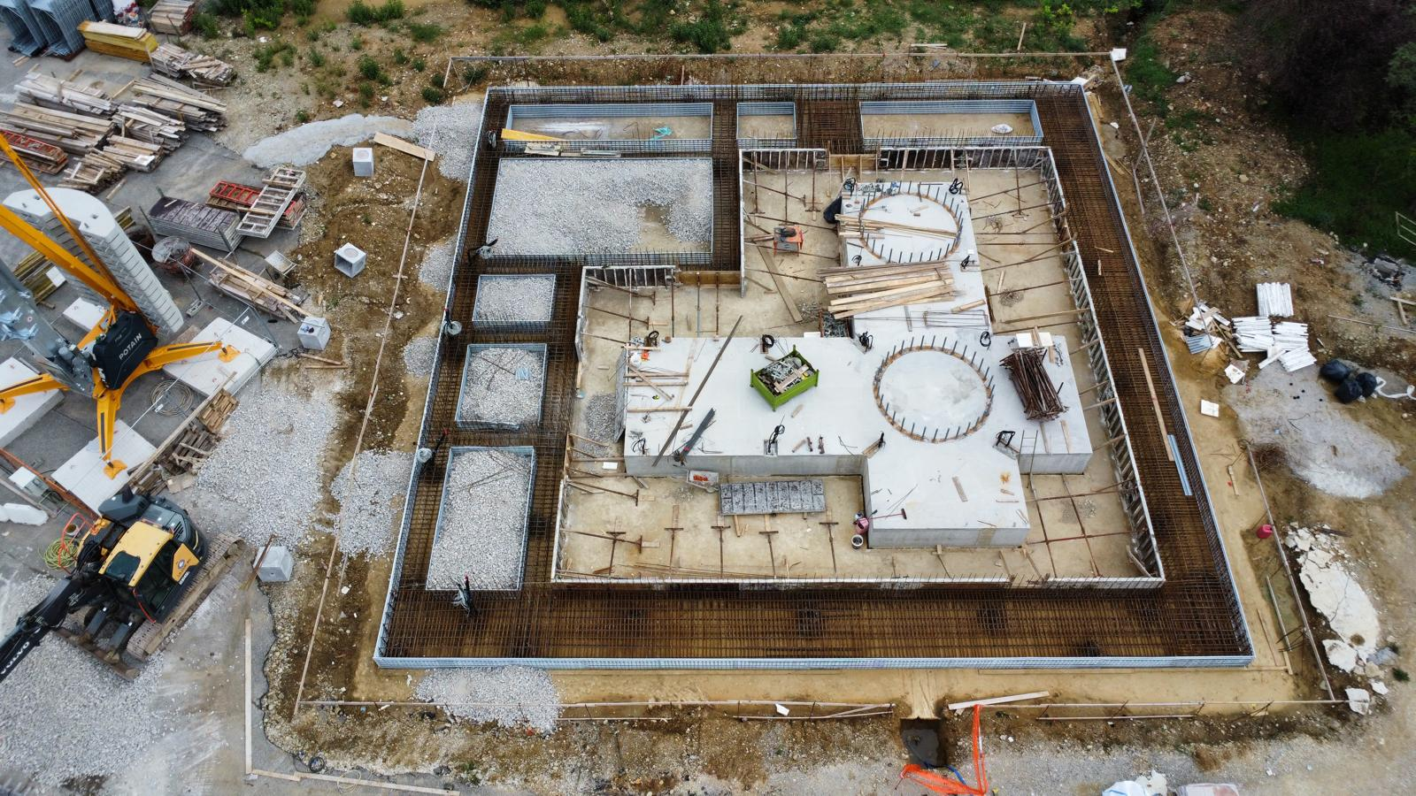
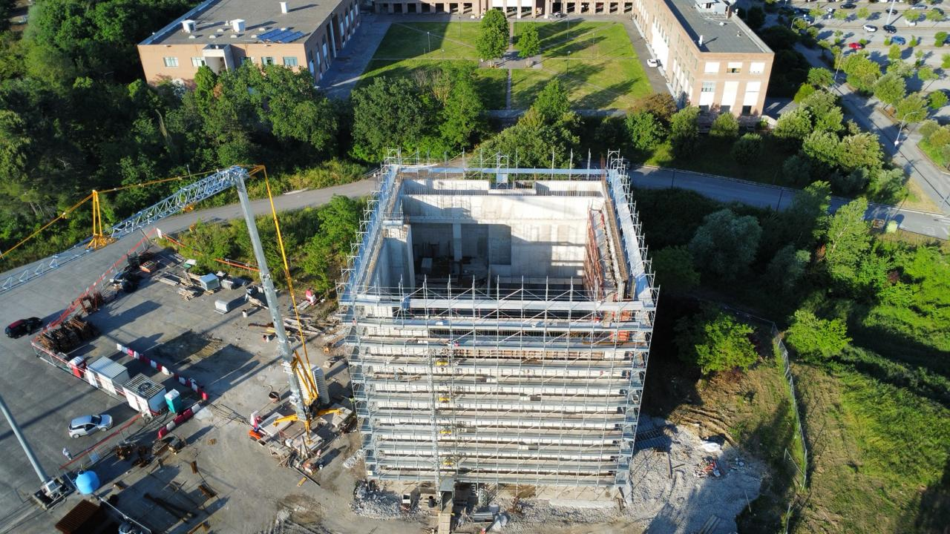
CAOS
Centro per Applicazioni sulle Onde gravitazionali e la Sismologia
Infrastructure
Vacuum
Laser & electronics
Superattenuators
Payload
Monolytic suspension
DAQ
Environment
June 2025 the roof will be completed.
October 2025 the access to the experimental room will be possible
June 2024
October 2024
March 2025
May 2025
Einstein Telescope Infrastructure Consortium (ETIC - IR0000004)
PNRR M4, C2, Investimento 3.1

Slide 7
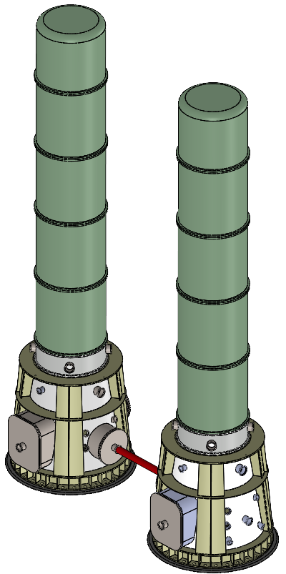

CAOS
Centro per Applicazioni sulle Onde gravitazionali e la Sismologia
Infrastructure
Vacuum
Laser & electronics
Superattenuators
Payload
Monolytic suspension
DAQ
Environment
The CAOS base towers are based on the VIRGO base tower and are approximately 3.4 m tall. They have a conical shape towards the ET solution.
The towers are positioned to create a Fabry–Pérot cavity. The experimental area is prepared to accommodate a third tower, which will complete the Michelson interferometer.
BS: Beam Splitter
EE: Est End
≈7 mt
Tower EE
Space for third tower
≈15 mt
Tower BS
3.4 mt
Einstein Telescope Infrastructure Consortium (ETIC - IR0000004)
PNRR M4, C2, Investimento 3.1

Slide 8
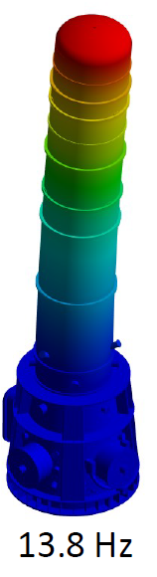
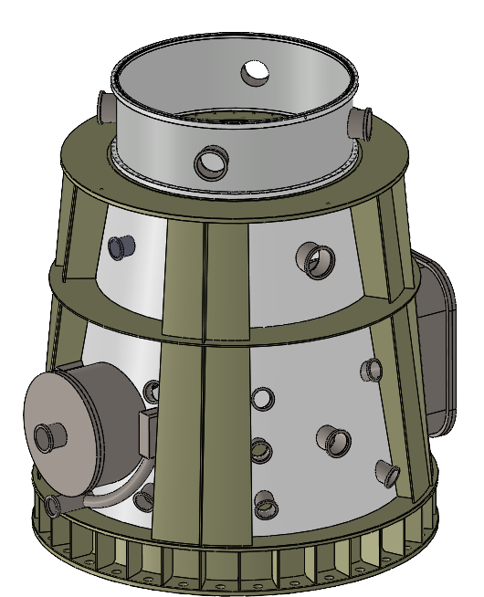
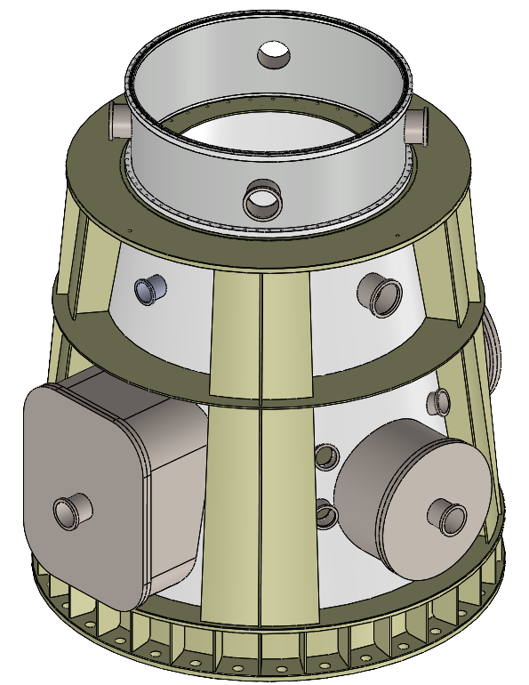








CAOS
Centro per Applicazioni sulle Onde gravitazionali e la Sismologia
Infrastructure
Vacuum
Laser & electronics
Superattenuators
Payload
Monolytic suspension
DAQ
Environment
Several solutions have been implemented in the base towers following a thorough study, as well as FEM analysis to increase the natural frequencies. More details will be provided in Gabriele Capoccia's talk on Wednesday at 11:45 during the ISB session.
Lateral Access
Air inlet system
Horizontal viewports
The towers are in production.
They will be ready around
Nov/Dec 2025
Einstein Telescope Infrastructure Consortium (ETIC - IR0000004)
PNRR M4, C2, Investimento 3.1

Slide 9
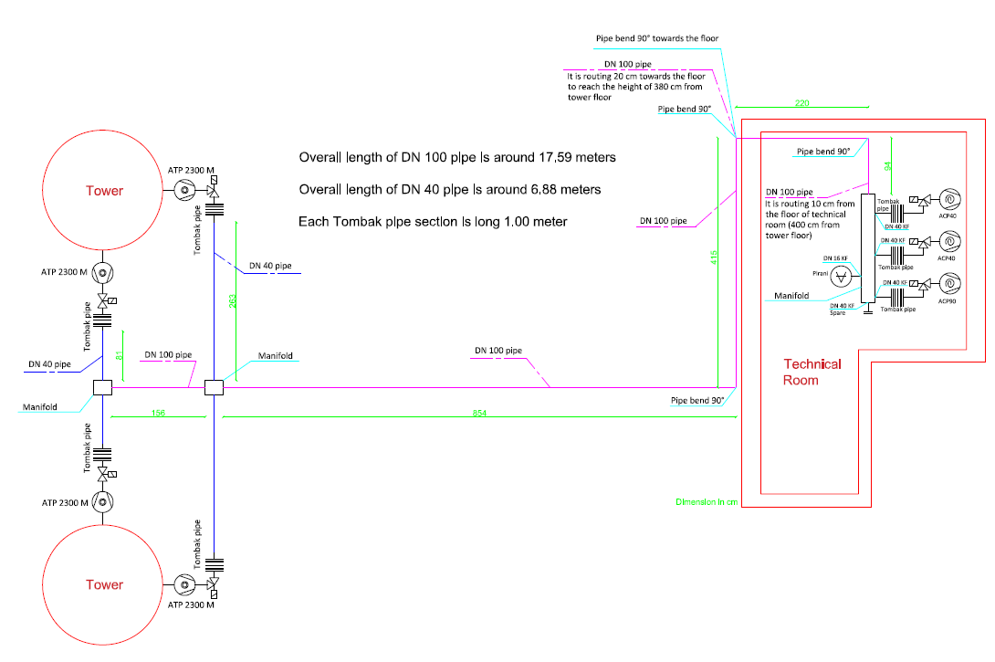
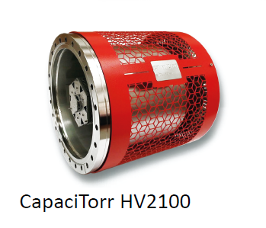
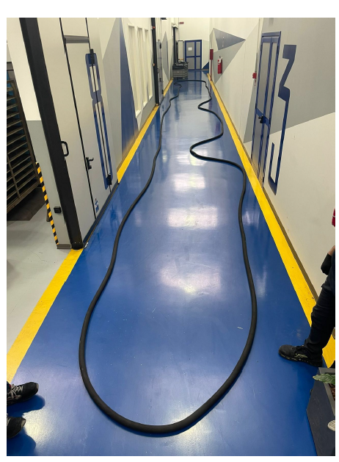
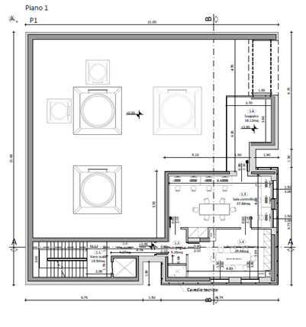


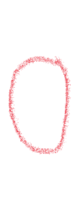



CAOS
Centro per Applicazioni sulle Onde gravitazionali e la Sismologia
Infrastructure
Vacuum
Laser & electronics
Superattenuators
Payload
Monolytic suspension
DAQ
Environment
Scheme of CAOS vacuum plant
NEG pump
O-ring
Einstein Telescope Infrastructure Consortium (ETIC - IR0000004)
PNRR M4, C2, Investimento 3.1

Slide 10
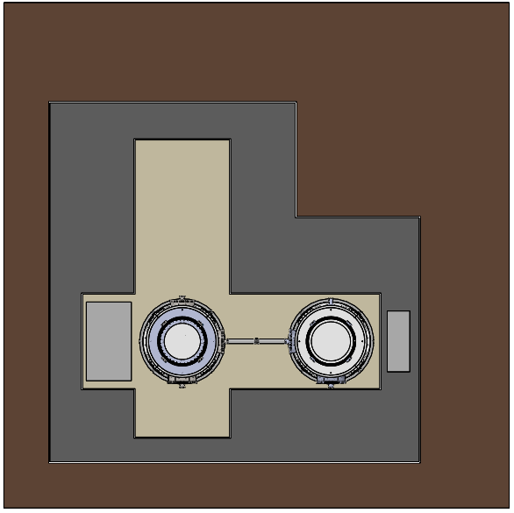
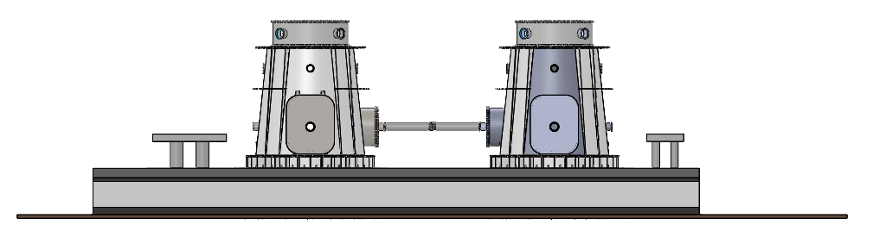
CAOS
Centro per Applicazioni sulle Onde gravitazionali e la Sismologia
Infrastructure
Vacuum
Laser & electronics
Superattenuators
Payload
Monolytic suspension
DAQ
Environment
In the next weeks we are going to order two optical benches with cover and protection:
BS - Injection – Detection 3.5 x 2.0 m
EE – 2.7 x 2.0
Lasers, laser amplifiers, optical components, mirrors with a standard coating, filters and other accessories for the optics will be acquired in the near future.
Einstein Telescope Infrastructure Consortium (ETIC - IR0000004)
PNRR M4, C2, Investimento 3.1

Slide 11
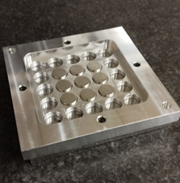
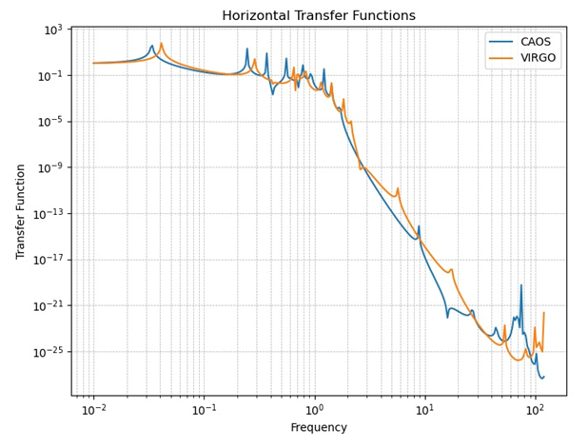
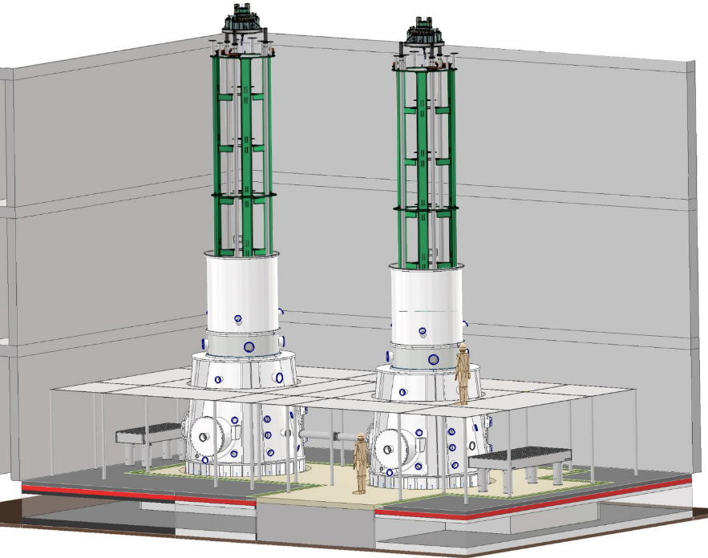
CAOS
Centro per Applicazioni sulle Onde gravitazionali e la Sismologia
Infrastructure
Vacuum
Laser & electronics
Superattenuators
Payload
Monolytic suspension
DAQ
Environment
The “Beam Splitter” (BS) SA will be very similar to the present AdV one (except for the height);
The “East End” (EE) SA will be used to perform dedicated R&Ds on them. So far we foresee to test:
    New active platform – IP basering
    New accelerometers
    Filter 0 different approach
    New filters crossbar
    New epicycloidal Vertical Hoist
All the mechanical filters for both SAs will be equipped with new Magnetic Anti Springs (nMAS);
Studies are ongoing to explore new materials for vertical attenuation (blades) due to the difficulty of finding maraging steel.
Einstein Telescope Infrastructure Consortium (ETIC - IR0000004)
PNRR M4, C2, Investimento 3.1

Slide 12
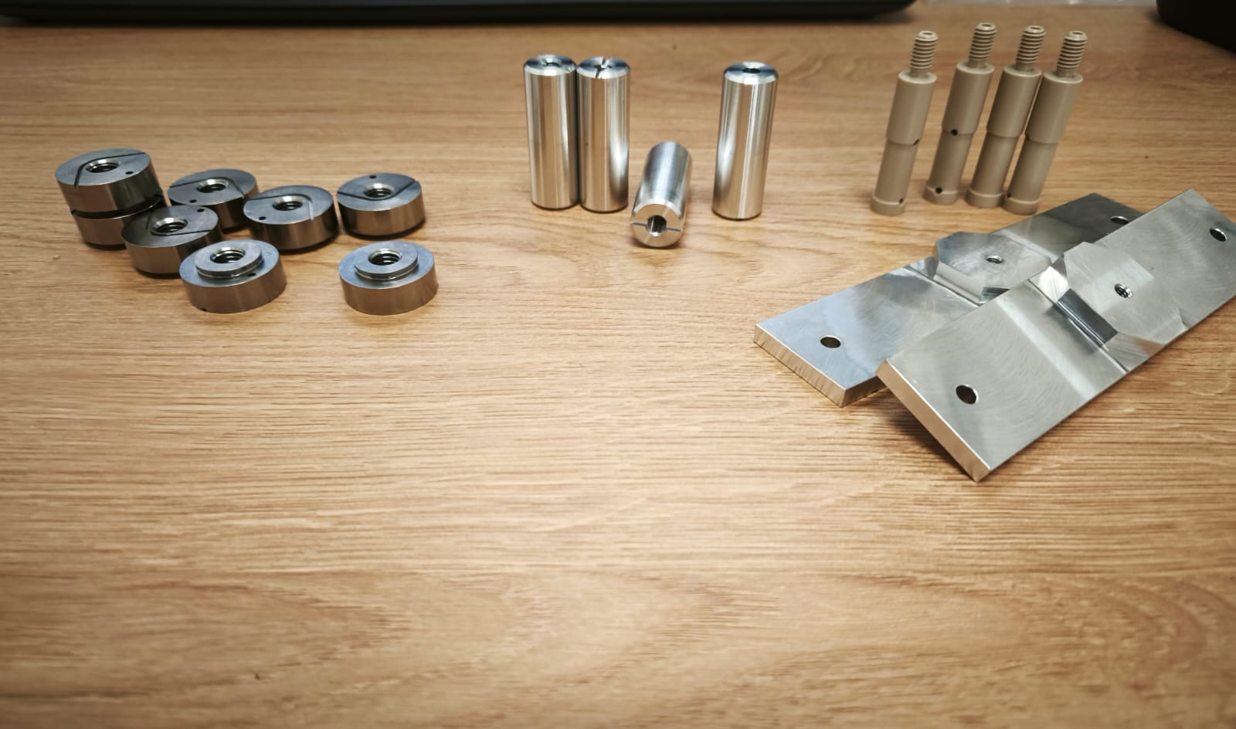
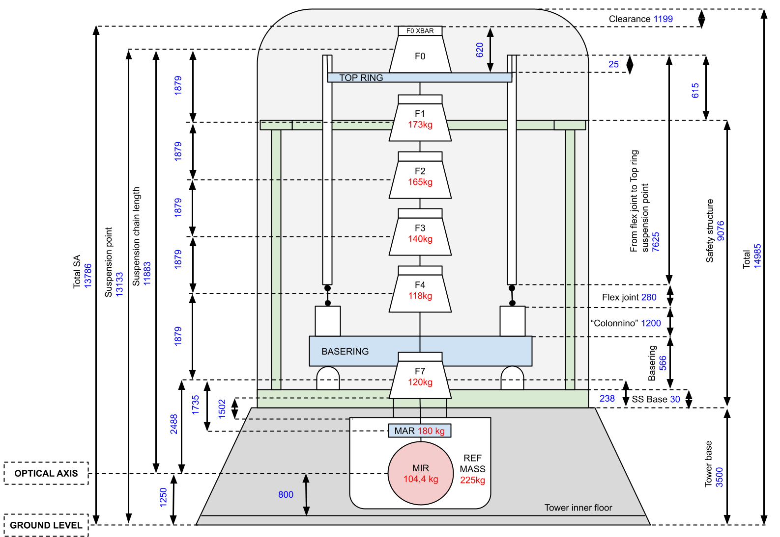
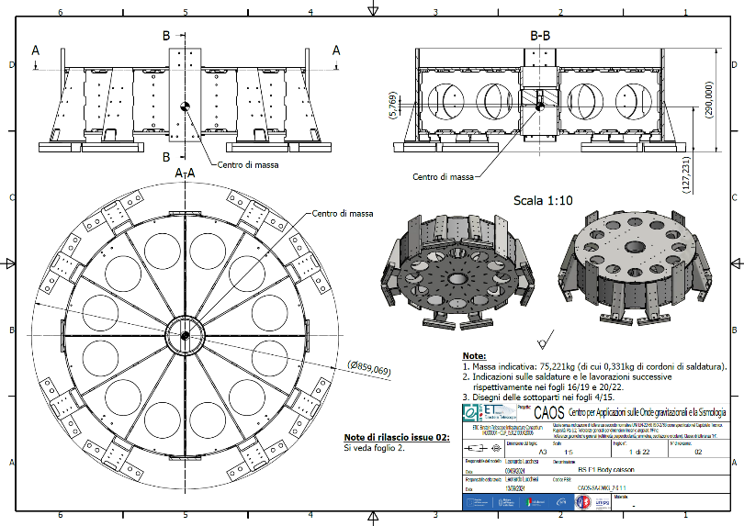
CAOS
Centro per Applicazioni sulle Onde gravitazionali e la Sismologia
Infrastructure
Vacuum
Laser & electronics
Superattenuators
Payload
Monolytic suspension
DAQ
Environment
Product Breakdown Structure (PBS) and WBS applied to the drawing and realization of the two SAs for CAOS. Several drawings already sent to Galli & Morelli for the production. Scaffolding and cleanrooms are under study.
Further information can be found in the poster by Leonardo Lucchesi et al. #157.
Einstein Telescope Infrastructure Consortium (ETIC - IR0000004)
PNRR M4, C2, Investimento 3.1

Slide 13
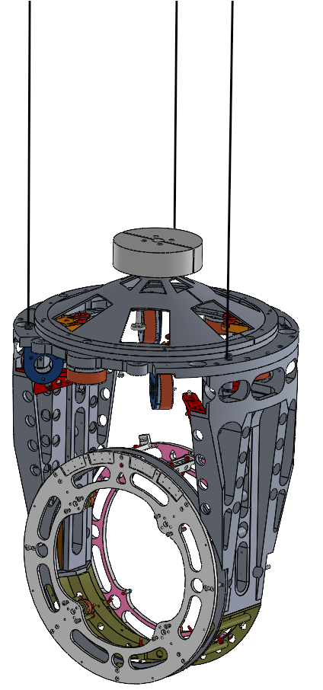
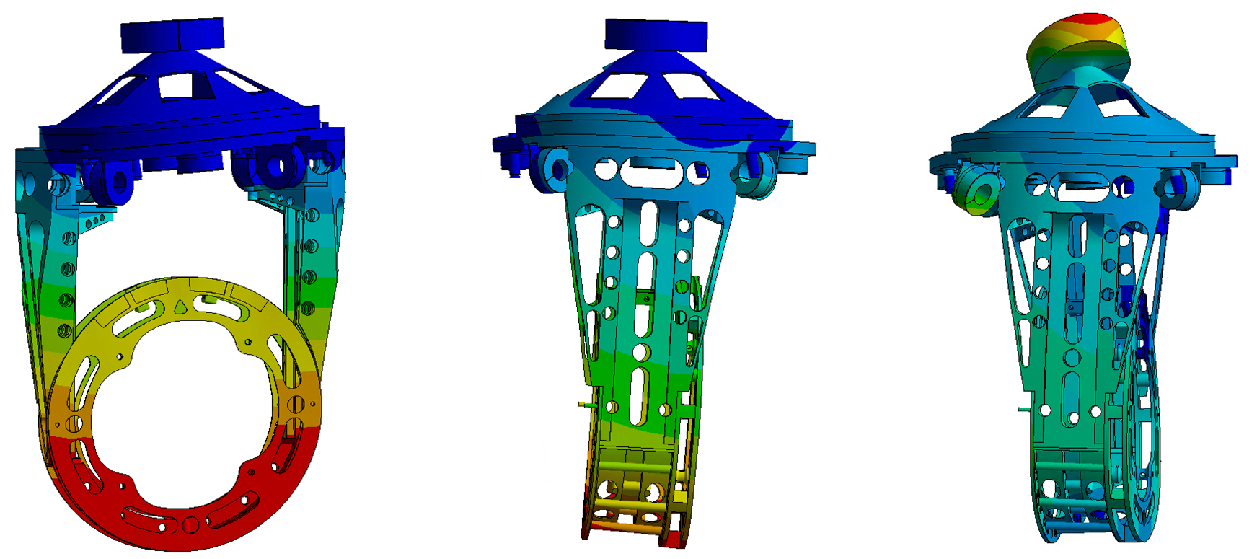
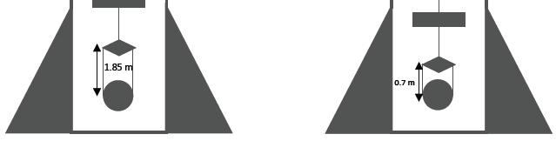
CAOS
Centro per Applicazioni sulle Onde gravitazionali e la Sismologia
Infrastructure
Vacuum
Laser & electronics
Superattenuators
Payload
Monolytic suspension
DAQ
Environment
Filter 7
The payload is under study, based on Maurizio Perciballi's drawings of a solution involving large masses. The idea is to suspend the reaction mass from filter 7 using three wires.
Integration, modal studies and simulation analyses (OCTOPUS) are ongoing. Please refer to Piero Chessa et al. Poster #98.
63 Hz
78 Hz
88 Hz
The Perugia Group has extensive experience in mirror monolithic suspension. The base towers and payload will be prepared to accommodate 0.7 m and 1.0 m fibres.
1.0 m
Einstein Telescope Infrastructure Consortium (ETIC - IR0000004)
PNRR M4, C2, Investimento 3.1

Slide 14
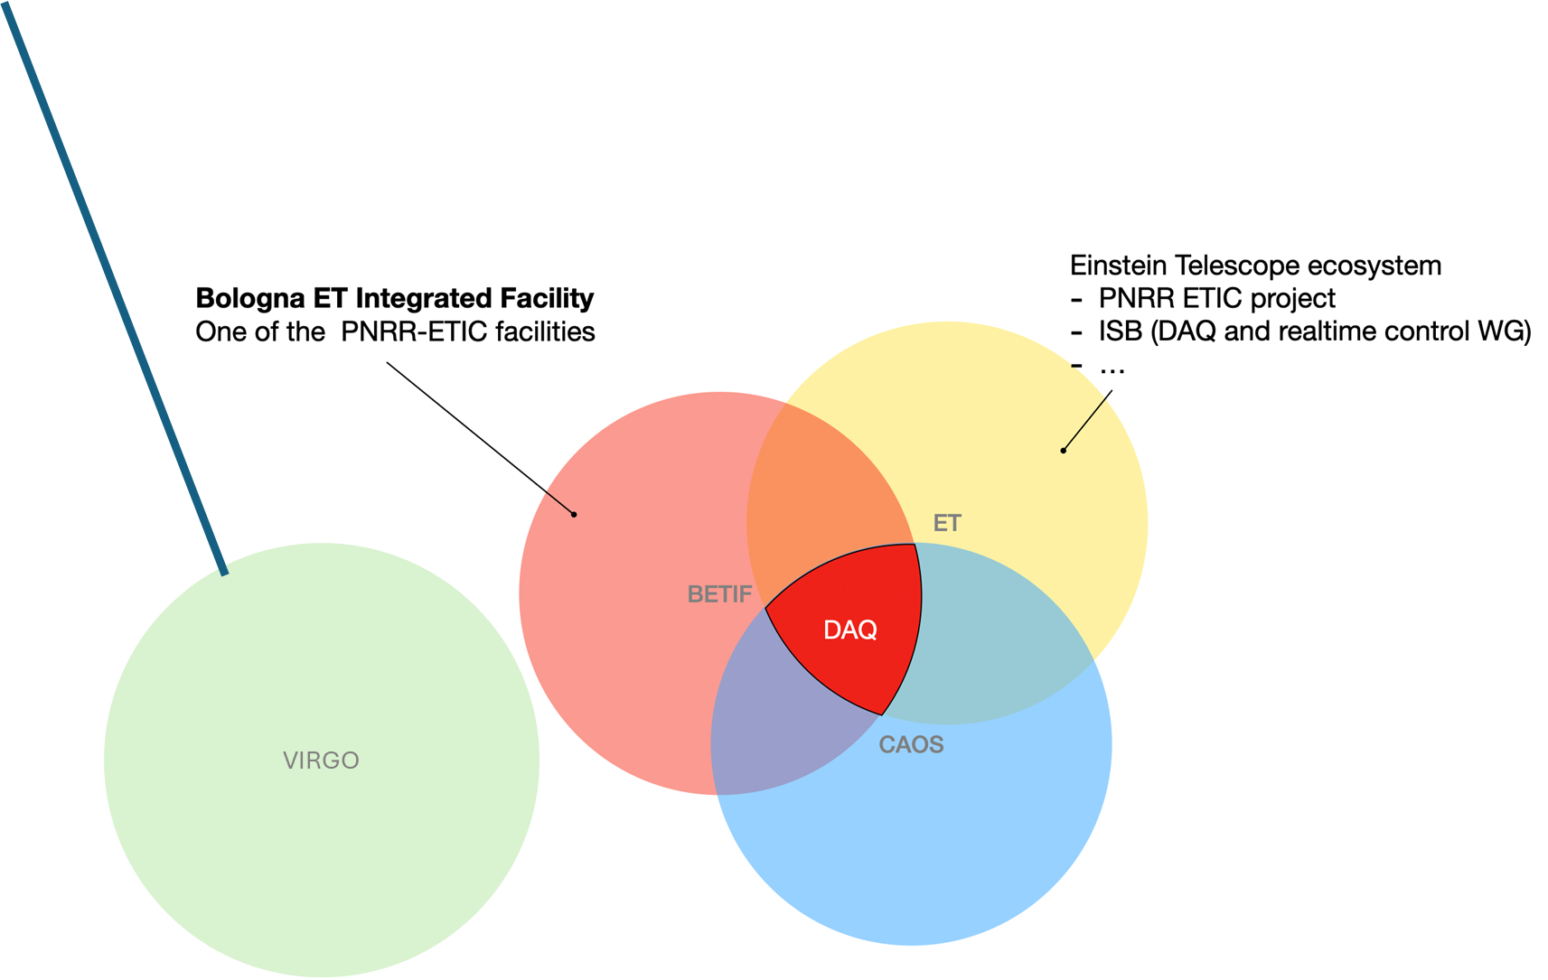
CAOS
Centro per Applicazioni sulle Onde gravitazionali e la Sismologia
Infrastructure
Vacuum
Laser & electronics
Superattenuators
Payload
Monolytic suspension
DAQ
Environment
Electronics
setting up a heterogeneous FPGA facility
implement and test “matched filter “on FPGA;
implement a FPGA based pipelines, also exploiting AI-based approaches, for data pre-processing (raw data reduction, data managing);
Performance benchmarks of PTP distribution with FPGA-based accelerators (with/without WR).
Developing control systems including the WR protocol for timing;
Developing firmware and hardware for WR-based instrumented node (sensors / actuators)
Timing
Implementing a local network which harmonises a White Rabbit part together with a standard network infrastructure
Implementing the WR PTP Core block of the White Rabbit firmware and embedded software (OHWR project), on FPGA that are used for DAQ boards
Calibrating the WR devices,
Updating the driver and the firmware for the SPEC board, to get a WR carrier board pluggable via PCIe on standard devices
Online/Realtime computing/networking
FPGA/GPU AI-based predictive maintenance
Networking infrastructure (low latency: which technologies?)
Several componets are already ordered and delivered: Racks, server, workstations,….
Einstein Telescope Infrastructure Consortium (ETIC - IR0000004)
PNRR M4, C2, Investimento 3.1

Slide 15
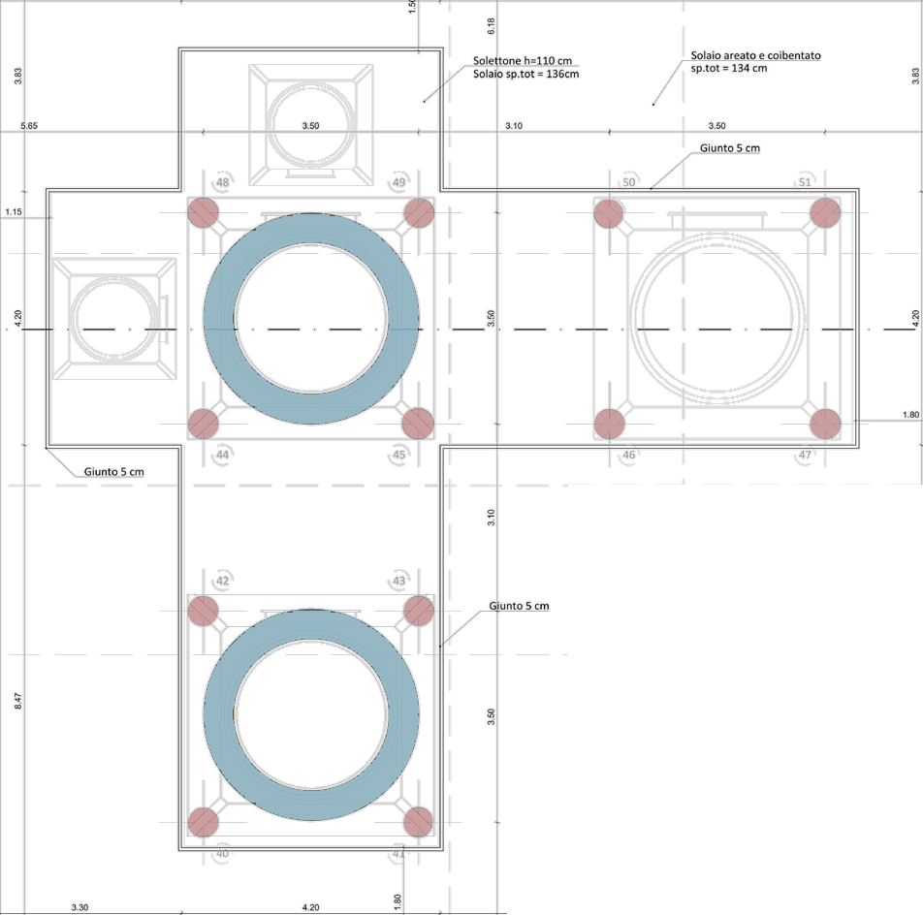
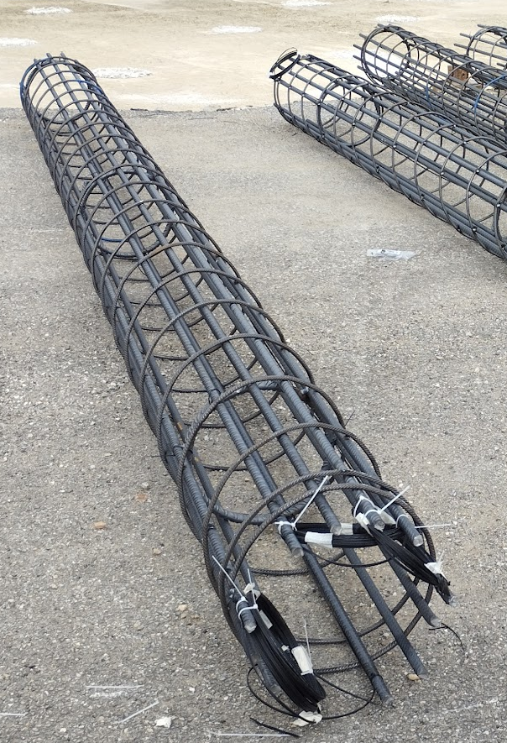
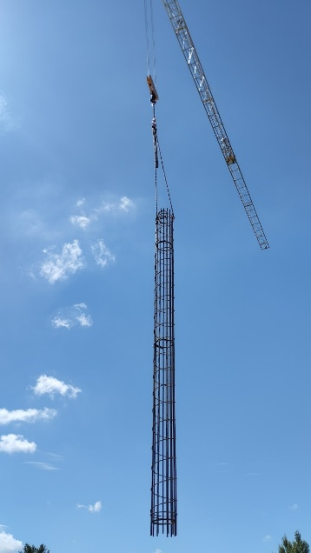
CAOS
Centro per Applicazioni sulle Onde gravitazionali e la Sismologia
Infrastructure
Vacuum
Laser & electronics
Superattenuators
Payload
Monolytic suspension
DAQ
Environment
The boreholes in the interferometer area were instrumented with optical fibres.
These will be laid on the floor of the interferometer area over the next few months, before the base tower is installed.
Pink areas ( ): foundation poles with fibers
Blue areas ( ): vacuum tower footprints
Einstein Telescope Infrastructure Consortium (ETIC - IR0000004)
PNRR M4, C2, Investimento 3.1

Slide 16
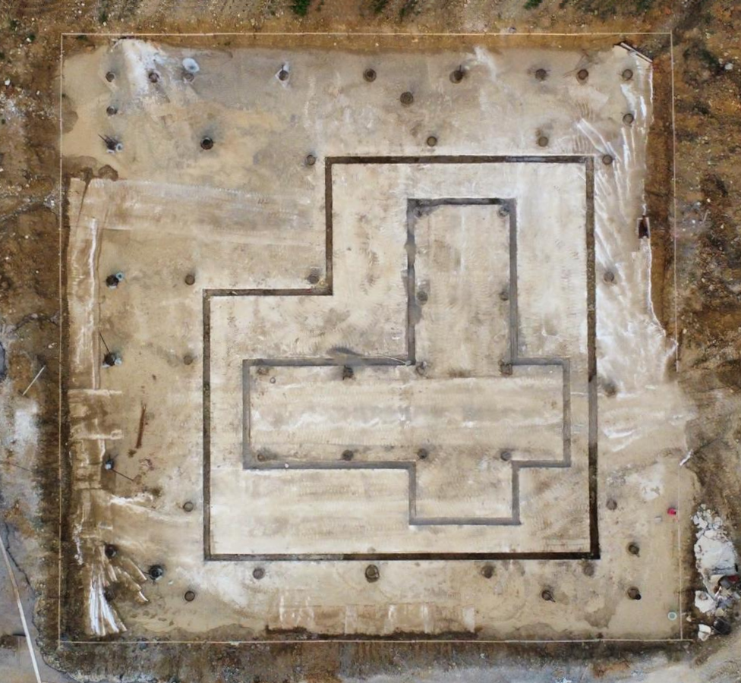
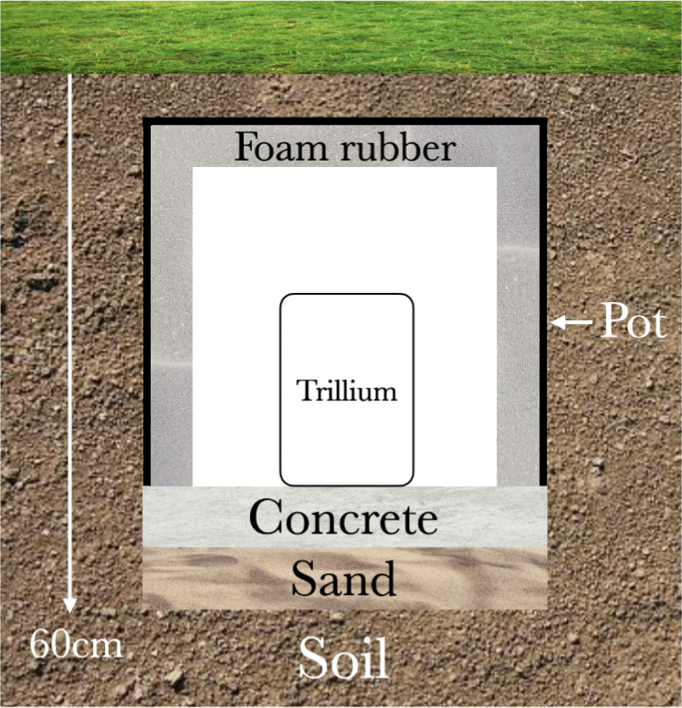
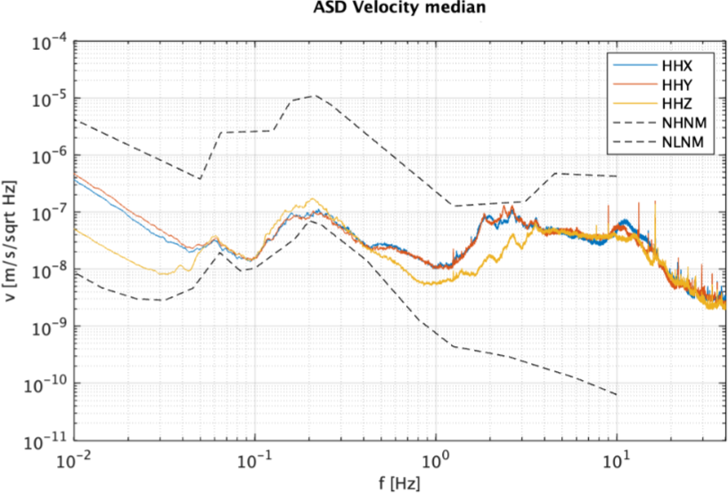
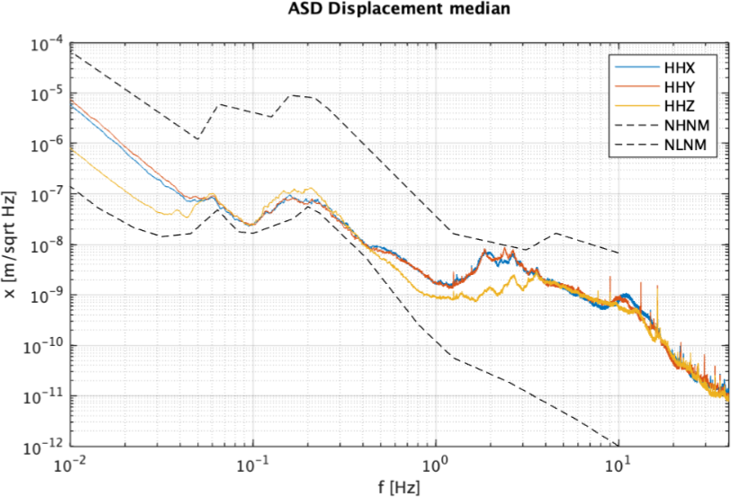



CAOS
Centro per Applicazioni sulle Onde gravitazionali e la Sismologia
Infrastructure
Vacuum
Laser & electronics
Superattenuators
Payload
Monolytic suspension
DAQ
Environment
Seismic data was acquired over seven days in July 2024 using a Horizon Trillium 360.
The location of the instrument is shown in the picture on the right (along with the state of the construction at the time).
The instrument was buried, as shown on the left.
Please refer to N. Baldicchi document in the TDS https://apps.et-gw.eu/tds/ql/?c=17756 and Alessandro Parisi et al. Poster #85.
Einstein Telescope Infrastructure Consortium (ETIC - IR0000004)
PNRR M4, C2, Investimento 3.1

Slide 17
Conclusions
The CAOS laboratory is one of the ETIC infrastructure.
Thanks to the broad collaboration, the laboratory is growing in all of its work packages.
The CAOS laboratory is part of the ETIC infrastructure.Technologies and solutions for ET towers and superattenuators will be tested very soon.
The laboratory's ethos is to be a place where new ideas, young people and collaboration can flourish for the third generation of gravitational wave interferometers

Slide 18
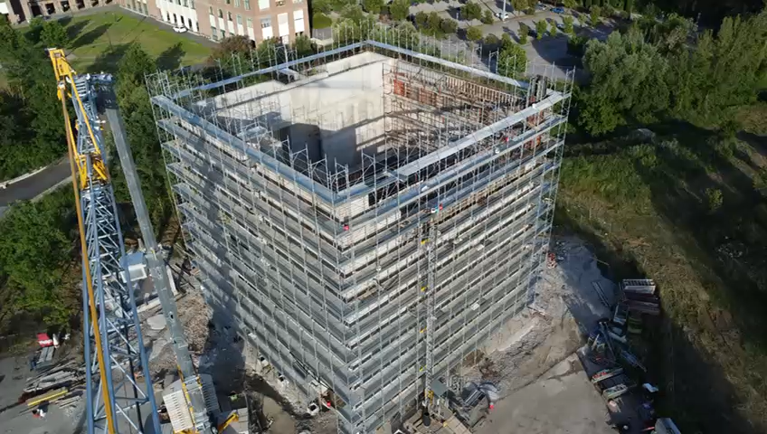
Thank you
Credits Helios Vocca
Einstein Telescope Infrastructure Consortium (ETIC - IR0000004)
PNRR M4, C2, Investimento 3.1

