Slide 1


ET Collaboration
Activities and plans
Michele Punturo
Harald Lück

Slide 2
Code of Conduct
The Code of Conduct defines the behaviour of people within the ET collaboration. It is the foundation of the Collaboration.
The ET Collaboration strives for workplaces free from discrimination and harassment. It is the policy of the Collaborations that all members will conduct themselves in a professional manner that is welcoming to all participants and free from any form of discrimination, harassment, or retaliation. Members will treat each other with respect and consideration to create a collegial, inclusive, and professional environment. Creating a supportive environment to enable scientific discourse is the responsibility of all members. Members will avoid any inappropriate actions or statements based on individual characteristics such as age, race, ethnicity, sexual orientation, gender identity, gender expression, marital status, nationality, political affiliation, ability status, or educational background. Disruptive or harassing behaviour of any kind will not be tolerated. Harassment includes but is not limited to inappropriate or intimidating behaviour and language, unwelcome jokes or comments, unwanted touching or attention, offensive images, unwelcome photography, and stalking. Disruptive behaviour includes instances of disrespect and lack of civility in interactions with colleagues. All members are expected at all times to deal with and address their fellow colleagues with respect and courtesy. This includes but is not limited to, behaviour in in-person meetings, virtual (remote) meetings, chats, social media, email communication and other communication formats.
Any professional relationship or action that may result in a conflict of interest in the context of ET must be fully disclosed. When objectivity and effectiveness cannot be maintained, the activity should be avoided or discontinued.
The ET Collaboration also will not tolerate instances of scientific misconduct, which is characterised by any of fabrication, falsification, or plagiarism in proposing or performing research in the ET Collaboration. Fabrication means making up data or results. Falsification means manipulating research materials, equipment, or processes, or changing or omitting data or results such that the research is not accurately represented in the research record. Knowingly reporting or reproducing fabricated or falsified results of others is also considered as misconduct. Plagiarism means the appropriation of another person’s ideas, processes, results, or words without giving appropriate credit.
Violations of this code of conduct policy should be reported as soon as possible to meeting organisers, working group chairs, or the ET Leadership – whatever is most appropriate in the situation. If desired/required, the Ombudsperson (see section F) can be called on and assist in finding an appropriate complaints procedure.
Any violations of the Code of Conduct will be pursued through discussion with the party or parties involved, if desired, with the help of a mediator chosen by the disputing parties. Significant violations can result in immediate consequences in access to ET Collaboration activities; repeated marginal violations will also be addressed. Sanctions for violations of this Code of Conduct will be determined following the grievance procedure and may result, in severe cases, in the permanent exclusion of an individual or group from the ET collaboration. Conflicts which cannot be resolved through collaboration procedures will be referred to the institution of the person(s) who may have violated the Code of Conduct. The Collaboration may take action based on the institution’s findings. Retaliation for complaints of inappropriate conduct will not be tolerated. If a member observes inappropriate comments or actions and personal intervention seems appropriate and safe, they should be considerate of all parties before intervening. This Code of Conduct is the defining document for the ET Collaboration.

Slide 3
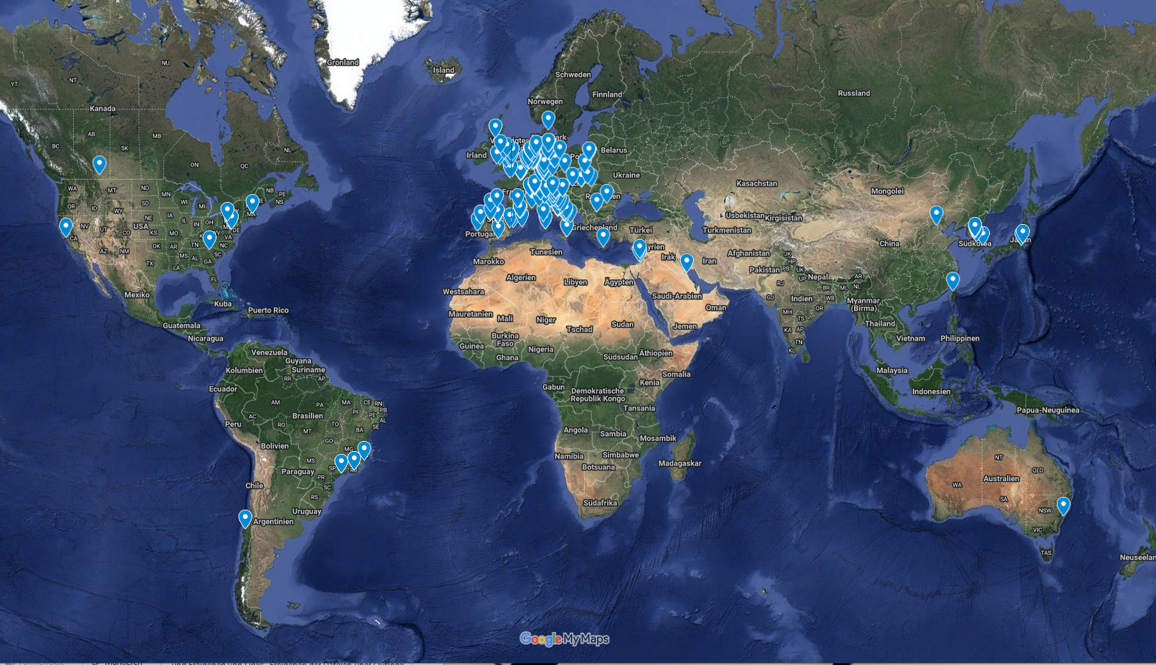
ET Member‘s Affiliation Map
1662 members (8.5.2024, 23:00)
88 Research Units
Total: 239 Institutions
in 28 Countries
Collaboration Founding
8.6.2022
Notes:
https://www.google.com/maps/d/u/0/edit?mid=1GZXaOjNPYvHeVi_1EKBrwX9kkploa8M&ll=3.7269142217833036%2C0&z=3

Slide 4
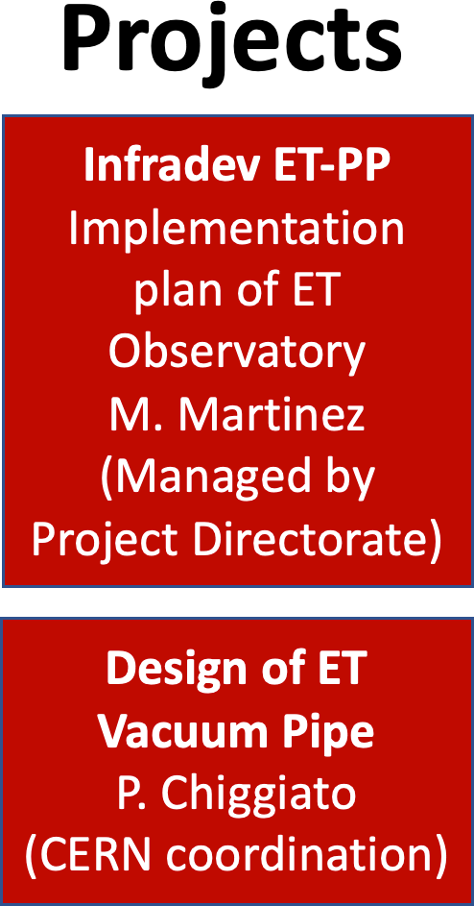


Completion of the ET Structure
ETO: ET Organization
ET Collaboration
ET Proto-Council
ESFRI
Coordinators
S. Bentvelsen
A. Zoccoli
BGR
Board of Government Representatives
Spokesperson: M. Punturo Deputy: H.Lück
CB
Collaboration Board
BSR
Board of Scientific Representatives
EB
Executive Board
SSB
Standard & Services Board
ISB
Instrument Science Board
EIB
E-Infrastructure Board
External Advisory Bodies
ET Project Directorate
A.Freise, F.Ferroni
M. Martinez
Civil Engineering
(CERN advisory)
OSB
Observational Science Board
SPB/SCB
Site Preparation/ Characterization
Administration Offices
Engineering Department
Project
Office
Communication
Office
National Host Teams
EMR
Host Team
Private companies
Sardinia Host Team
Private companies

Slide 5
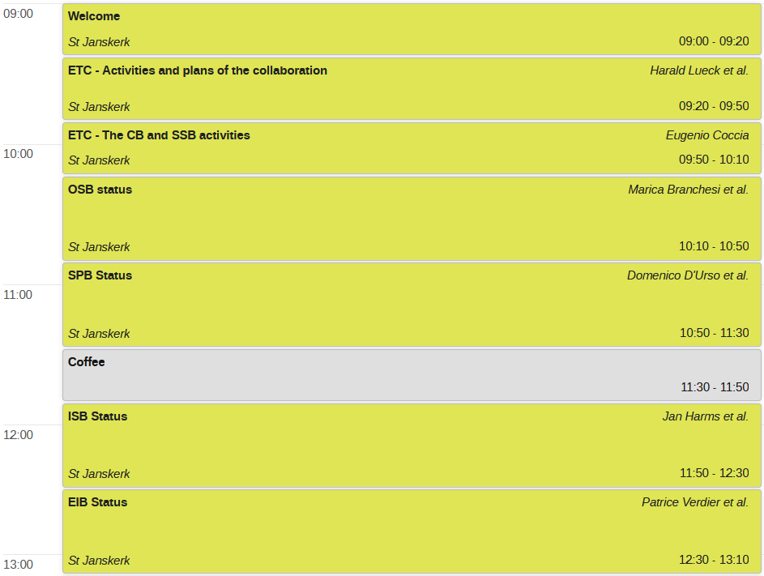
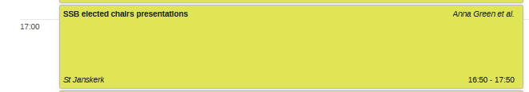
Separate reports on specific boards and SSB

Slide 6
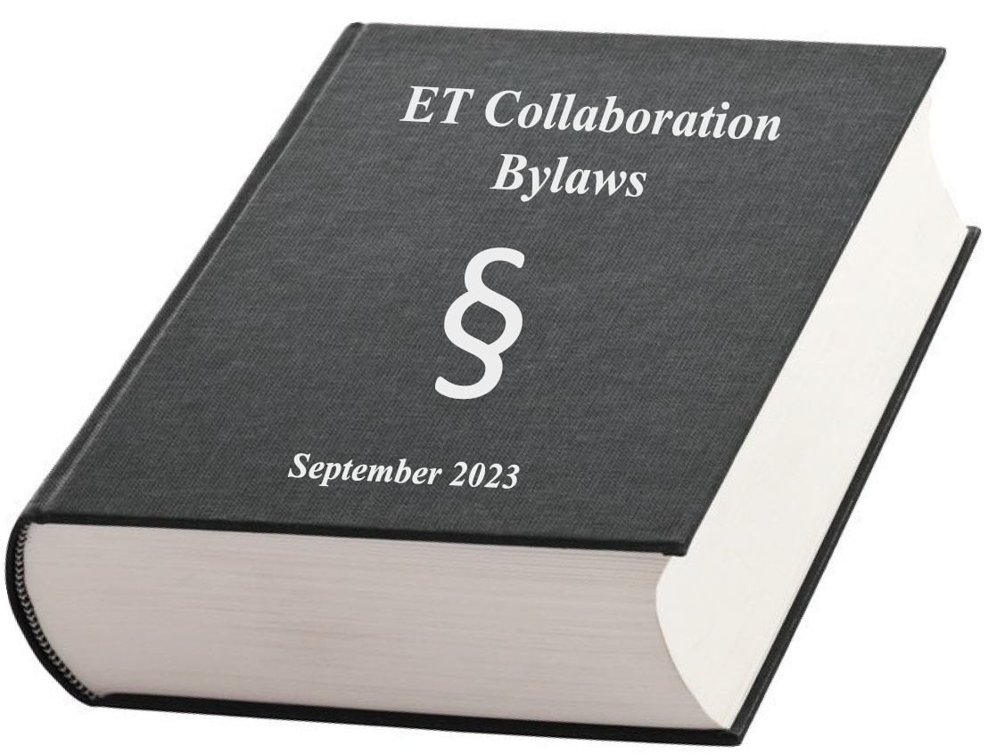
The ET Collaboration essential committees in the process of being established
Service and Standards Board:
the elected Committee Chairs
Project Program Committee (PPC)
  Ettore Majorana (ET-Roma1)
Early Career Scientists Support Committee (ECSS)
  Anna Green (Vrije Universiteit Amsterdam)
Member Conduct and Ethics Committee (EMCC)
  Monique Bossi (INFN Perugia)
Speakers and Awards Committee (SAC)
  Luca Naticchioni (ET-Roma1)
Editorial Committee (EC)
  Paola Leaci (ET-Roma1)
Election, Voting, and Membership Committee (EVMC)
  Mariafelicia De Laurentis (Napoli)
Meetings and Symposia Committee (MSC)
  Jessica Steinlechner (Maastricht University)
Communications and Education Committee (CEC)
  Susanne Milde (Hannover)
Bylaws Updating Committee (BUC)
  Harald Lück (Hannover)
https://apps.et-gw.eu/tds/?content=3&r=18634

Slide 7
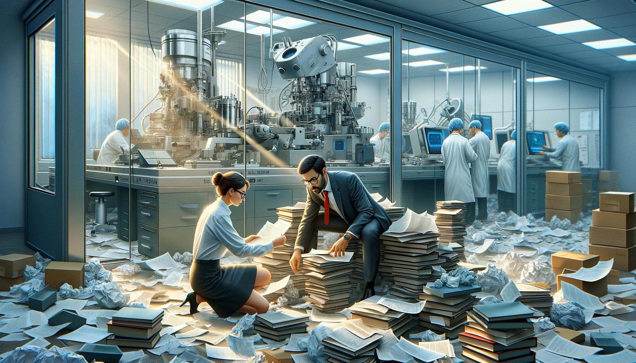
Collaboration tools & Documentation
List of E-tools can be found here: https://wiki.et-gw.eu/EIB/WebHome
ETO
ED
PO
PD
ET-PP (b2drop,…)
TDS (apps.et-gw.eu/tds/)
Wiki (wiki.et-gw.eu)
Website(s)
ETMD (apps.et-gw.eu/etmd/)
Git repositories (gitlab.et-gw.eu, github)
Various servers &clouds
  istnazfisnucl-my.sharepoint.com
  MS Teams
  docs.google.com
  Wolke7
  Many different Indico servers
    EGO
    CERN
    IN2P3
    INFN
    IFAE
    Nikhef
    DESY
    Scc
    …
…
→ very hard to find information
OpenAI. (2024). ChatGPT [Large language model]. /g/g-pmuQfob8d-image-generator

Slide 8
ET Member Data Base (ETMDB)
ETMDB-how-to
https://wiki.et-gw.eu/Main/ETMD
Activate here: https://userprofile.ego-gw.it/
EGO Active Directory account needed, with which to access the ET web services.
Apply for an account here:
https://userprofile.ego-gw.it/accountrequest.aspx
choosing the 'ET member' option.
For those who have an account, but are unable to access their ETMD profile,
please reset your password associated to the account, here:
https://userprofile.ego-gw.it/resetpwd.aspx
For all else - queries or general issues regarding the accounts or accessing any of the web services -
please send an email to service@ego-gw.it.
Maintain your profile!
Declare activities. There are still many members with no clear declared activities.
The Specific Boards report a lack of manpower;
pledged activities in ETMD do not match reported activites from WGs

Slide 9
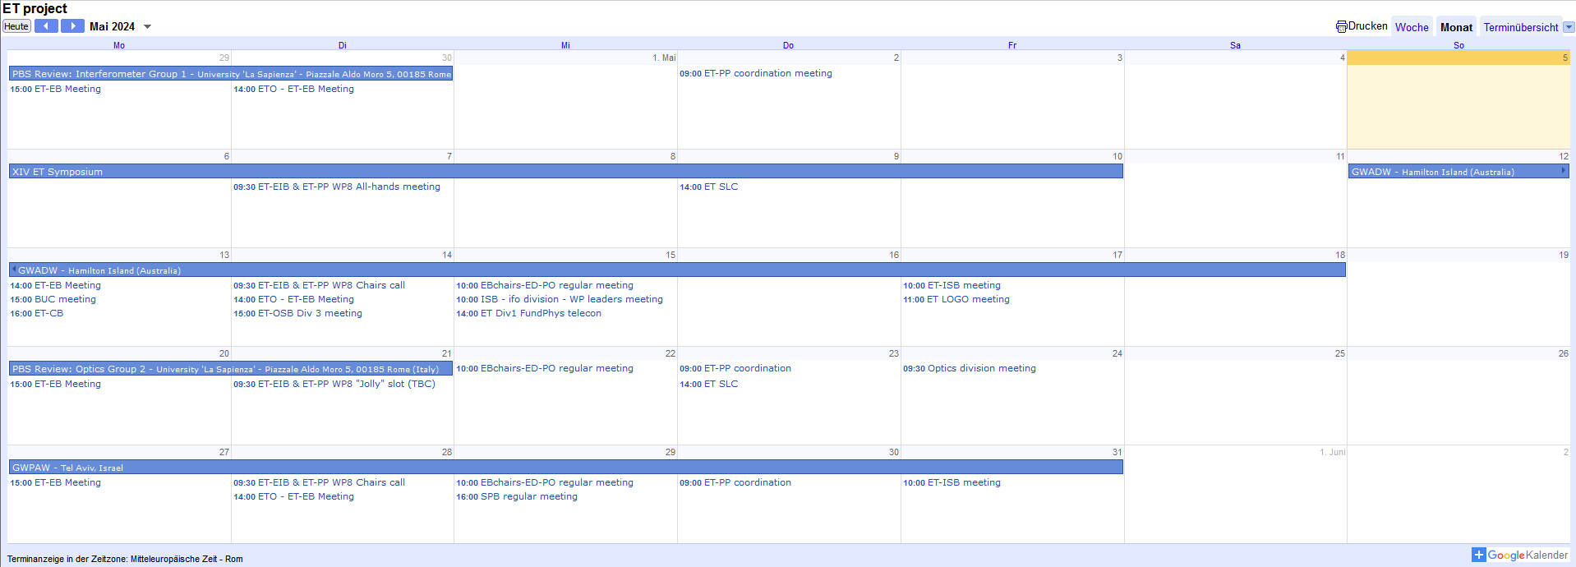
ET Calendar
https://calendar.google.com/calendar/u/0/embed?src=c4rt0eqfj201tt2scv3l3jl8a4@group.calendar.google.com&ctz=Europe/Rome

Slide 10
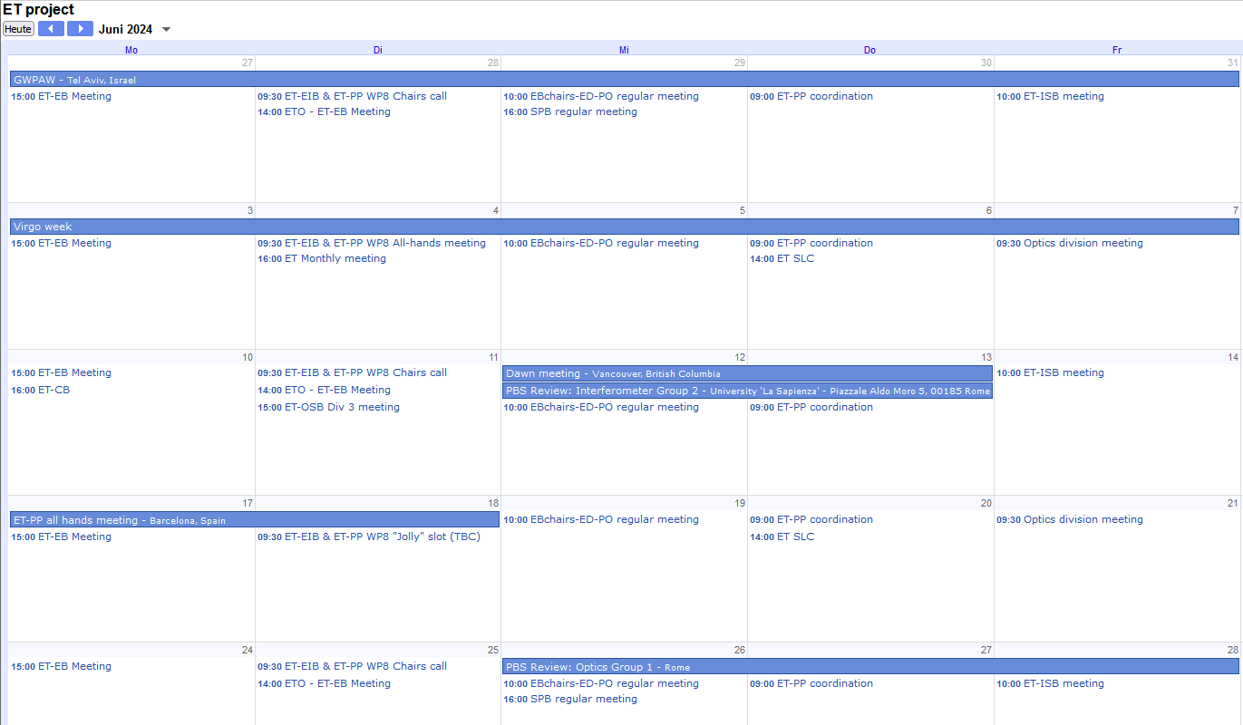
ET Monthly Meetings
Participation in
monthly meetings ~5%

Slide 11
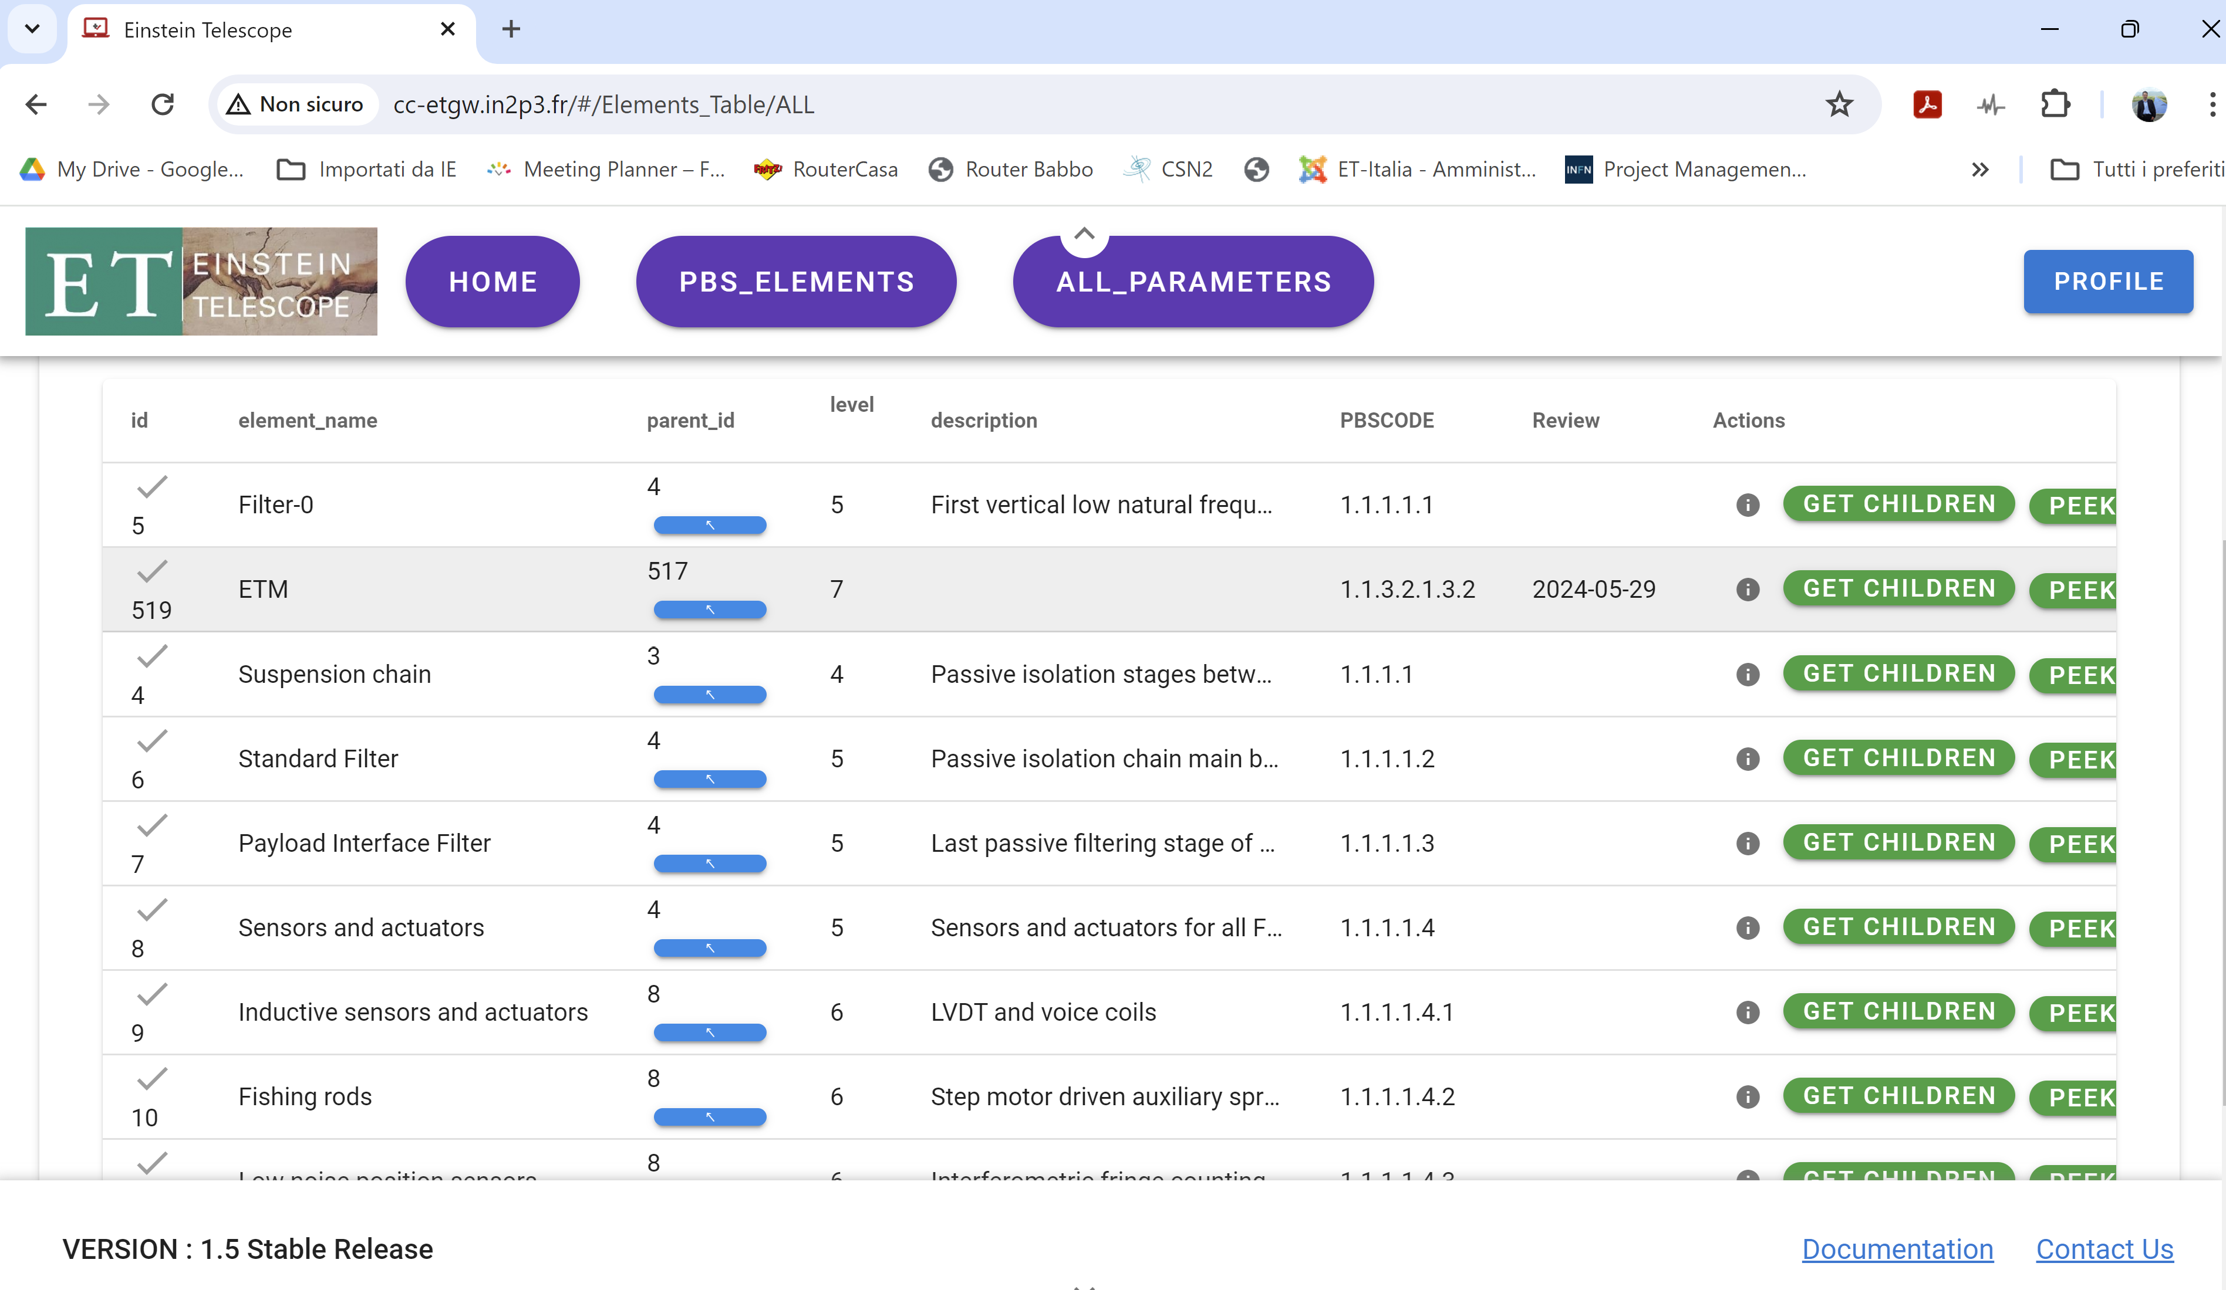
ET DB: PBS elements and parameters
The ISB members of the collaboration, under the coordination of the PO, created a huge number of excel files containing the PBS structure and the PBS parameters
The PO (thanks to Oussama El-Mecherfi and P.Verdier) created a Database that can read all these files
Added json output to DB
(hierarchical human & computer readable format)
[{"id":24430,
"another_id":"1",
"created_at":"2024-04-05T14:08:27.487Z",
"updated_at":"2024-04-14T21:45:23.382Z",
"pbs_element_id":105,
"paramName":"Material ?",
"paramValue":"Fused Silica",
"paramUnit":"",
"paramMargin":"",
"paramType":"Constraint specific",
"description":"",
"ref":"ET-0007B-20 table 6.1 p95",
"comment":"",
"flag":"",
"identity":"FUNCTIONAL",
"impact_or_zaxis":"",
"author":"Jessica Steinlechner",
"verified_by":"",
"custom_fields":null,
"pbs_element_id__PBSCODE":"1.1.2.1.1.1"}

Slide 12
PBS & Database status
PBS review meetings organised by PO:
several in-person PBS review meetings are going on in Rome.
Imported into relational database
database is operational
only ca. 35% (638 / 1824) of all parameter files have been submitted.
1824 PBS elements have 9243 parameters. Many more to come.
„has an impact on“ is rarely filled in the database (229/9243) = 2.5%.
Actions needed:
We need to pick up (even more) speed
Quality improvement
Fullfil the 100% rule

Slide 13
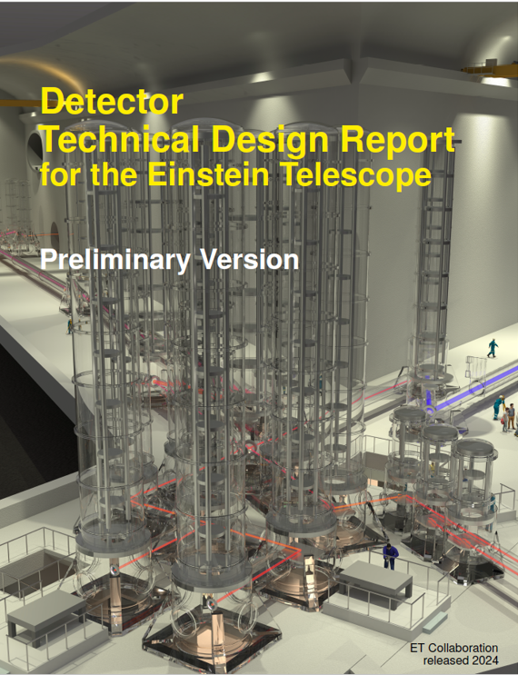
TDRs
Different aspects of the ET project need to be designed
These TDRs are interlaced:
  We need to start with a preliminary phase
  and then proceed in iterations
Detector
Vacuum System
Civil Infrastructure
E-Infrastructure
Notes:
Examples:
Physical detector dimensions influence infrastructure. the cryostats needed for the detectors have an influence on the lateral tube spacing in the tunnels.
Required laser jitter supression determines the number of IMC required.
Sensors in the tunnels (pressure gauges, RGAs, safety systems, etc.) may influence the E-infrastructure.
<the required data exchange rate between distant locations for control systems influences E-infrastructure.

Slide 14
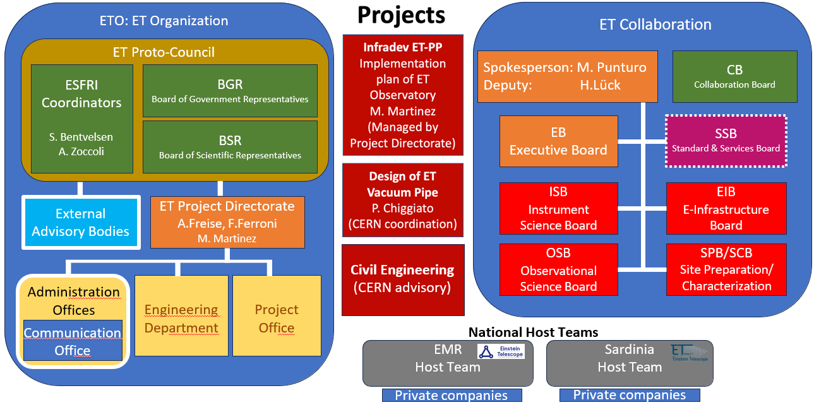
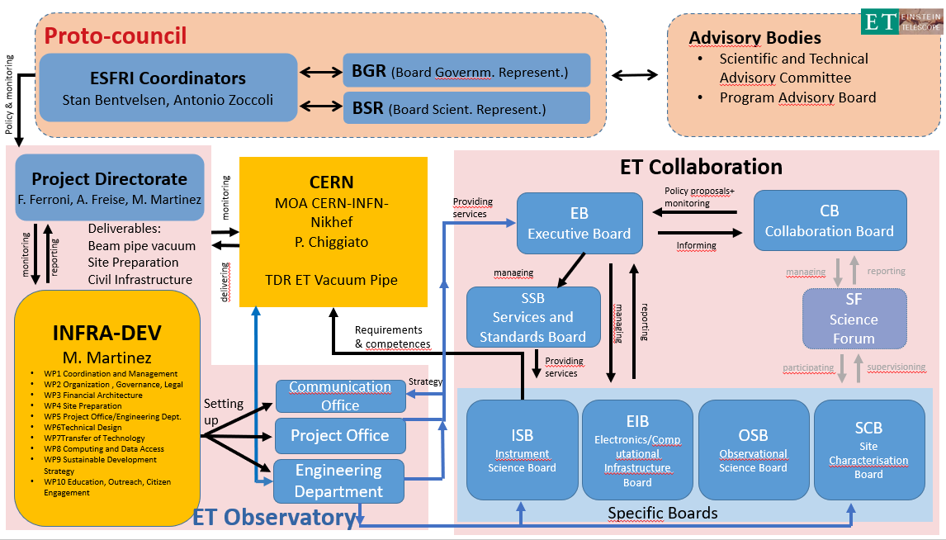
Role of ETC in ET
Better define the role of the Collaboration within ET,
interaction procedures with ETO and responsibilities
Introduce more project management elements
(and the mental approach)
into the work of the Collaboration
(clear mandates, deliverables, milestones, responsibilities)
MOAs/MOUs with the RUs: core business guidelines
Program Committee chaired by Ettore Majorana
Collaboration input for defining the ET roadmap

Slide 15
R&D Coordination
TRL management of the ET technologies:
The technologies used in ET cover a wide variety
and are at very different maturity levels.
  assess and document the technology readiness levels (TRLs)
  of ALL systems and elements
  manage R&D to bring them to the required level at the right time.
  Set timelines for all items.
  Consider and exploit world-wide synergies

Slide 16


Communication
External communication is one common task of the ET Project
not separate ones for ETO and ETC
To the outside world
Voices in the halls:
„Lots of positive feedback from the discussions and progress presented in the parallel sessions“
Yet, there is need for more communication between
boards (e.g. OSB- EIB), divisions, WGs
♫♪♫
_{co}mm^{uni}ca_{tion}
_{co}mm^{uni}ca_{tion}
_{co}mm^{uni}ca_{tion}
…
♫♪♫

Slide 17
Next ET-all Meetings where?
Annual ET Meeting in November 2024
XV ET Symposium Spring 2025
We have got a Meeting and Symposia committee being developed now.
Meetings and Symposia Committee (MSC)
Jessica Steinlechner (Maastricht University)
Need volunteers for hosting and a LOC.
Deadlines for volunteers:
Mid June for the annual meeting
End of August for XV ET Symposium

Slide 18
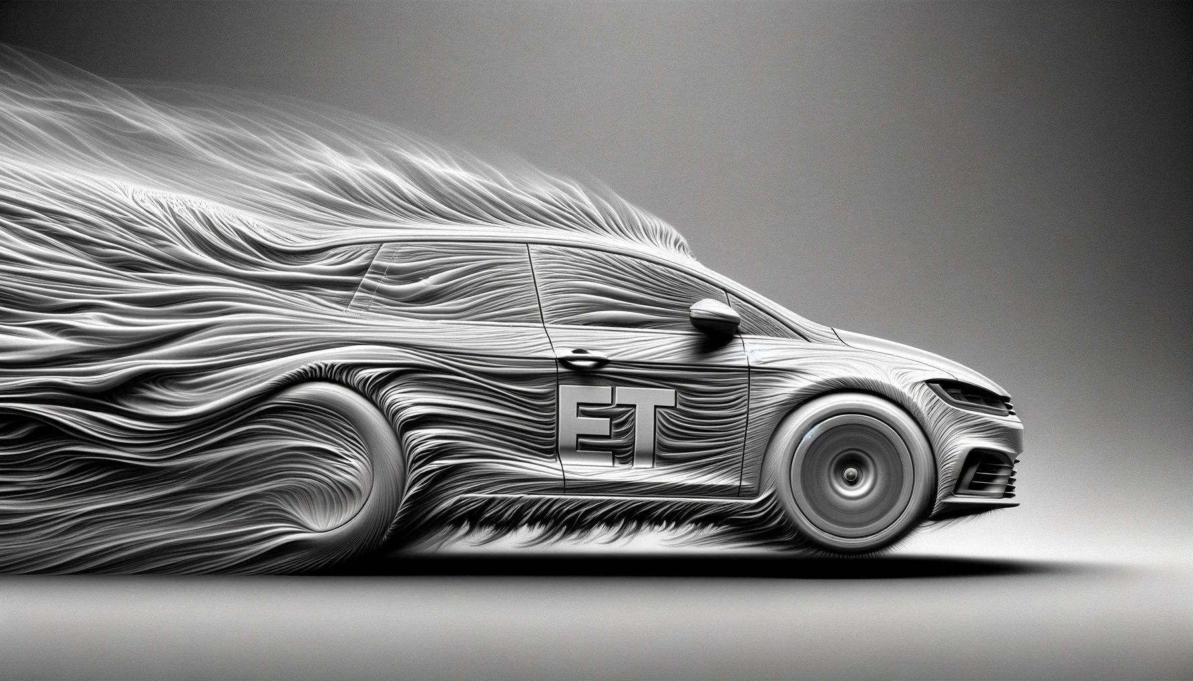
Finally…
Michele Punturo:
ET is currently going at very high speed, so it is only natural that there are some turbulences
But … turbulances also cause drag
OpenAI. (2024)

