Slide 1
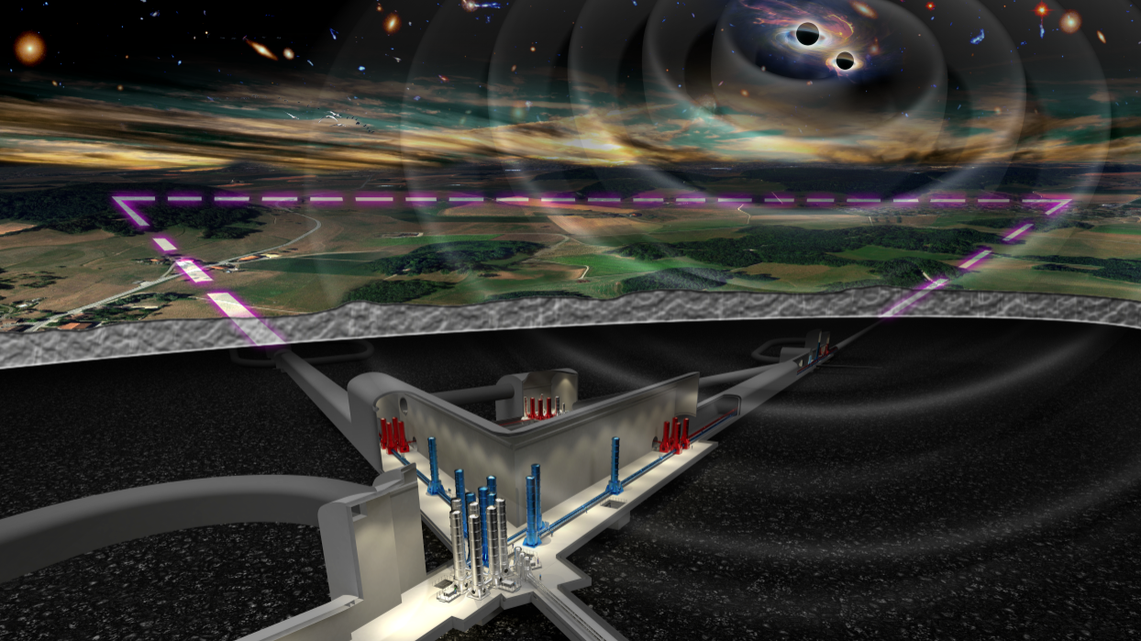


Einstein Telescope
Cosmic Explorer
Coordination
ET-0310A-23
Michele Punturo (& Harald Lueck)
Matthew Evans

Slide 2
Coordination
ET and CE management initiated in the past months a coordination action based on regular meetings:
  Michele Punturo, Harald Lueck for ET
  Matthew Evans, Lisa Barsotti for CE
  Chaired by David Shoemaker
Reporting the status of the projects
Discussion on the possible synergies and common actions

Slide 3
Identification common interest items
Technology, Developments and Design
  Infrastructures
    Vacuum:
      “Joint” project ET-CE-CERN
        Provides ET vacuum pipe design
        R&D on materials
    Civil Engineering:
      ET and CE have different civil engineering solution (underground vs surface) but there are common issues to be explored and solved
        Electromagnetic noise mitigation
        Acoustic and vibrational noise mitigation
    Environmental noises:
      Wind turbines
      Trains
      …

Slide 4
Identification common interest items
Technology, Developments and Design
  Detector technologies (starting from 2G GWD)
    Coatings
    Controls
    Optical component cleanliness
    Optical design
    Lasers
    Simulation and modeling
    Thermal compensation
    Electronics
    …
  Data handling and data analysis
    Role of 3G in IGWIN
    Common or at least compatible computing model
    Unified data analysis methods (starting from 2G)
    Global organization (federation tools, standards, …)
    …

Slide 5
Identification common interest items
Governance
  Analysis of the current global model (Collaboration of Collaborations)
    Strength and weakness
    Possible improvements in coordination
    Timing
    …

Slide 6
How/What to implement?
Regular (monthly?) top management meetings
  We have already; if/how to improve them?
Regular (6 months) Joint development meetings
  Instrument science and detector technologies
  Infrastructures
  Standards (from 2G to 3G)
    Data handling
    Data analysis
    Computing
    Electronics
    …

