Slide 1


ET-LF Sensitivity limitations from vertical thermal noise
Matteo Baratti, Emerald Gingell, Jesus Leonardo Gonzalez, Nelson Leon, Fabián Peña Arellano, Harry Themann, Riccardo De Salvo
California State University, Los Angeles

Slide 2
The Low Frequency interferometer of the Einstein Telescope will use cryogenic mirror suspensions with long pendulum providing horizontal attenuation to filter out the horizontal thermal noise generated by the seismic attenuation chain and by the heat links. They will be made of crystalline materials to minimize their own thermal noise generation.
It is almost impossible to make passive springs for low-frequency vertical attenuation with the crystalline materials necessary to limit their own internal thermal noise generation. As a result, the large vertical thermal noise injected on the upper mass of the cryogenic suspensions will be directly transmitted to the mirror.
Due to Earth’s limited radius, even if the 10 km long beamlines were perfectly horizontal at the center, a minimum of 0.16% of that thermal noise will be transmitted to the interferometer direction and severely limit ET-LF sensitivity. This fraction grows significantly if the tunnels are longer and/or tilted, or if the mirror suspensions are not perfectly longitudinally symmetric.
A method to soften silicon springs using active feedback between an optical sensor and an electrostatic actuator is presented as a possible solution.

Slide 3
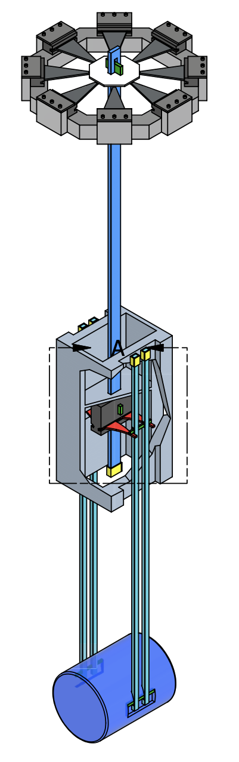
Introduction
Suspension with flexures operating in compression:
Are mechanically robust with mechanical safety factor of 6
Are easy to assemble inside the cryostat
Allow rapid cooldown and extraction of 0.5 W
Can lock the interferometer without the need of recoil mass
Soft, high Q flexures for ultra low horizontal thermal noise.
Mechanically rigid in vertical direction
https://apps.et-gw.eu/tds/ql/?c=17764

Slide 4

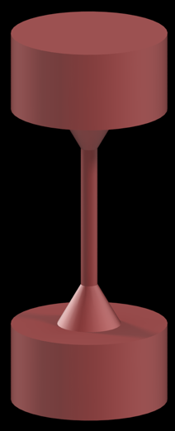
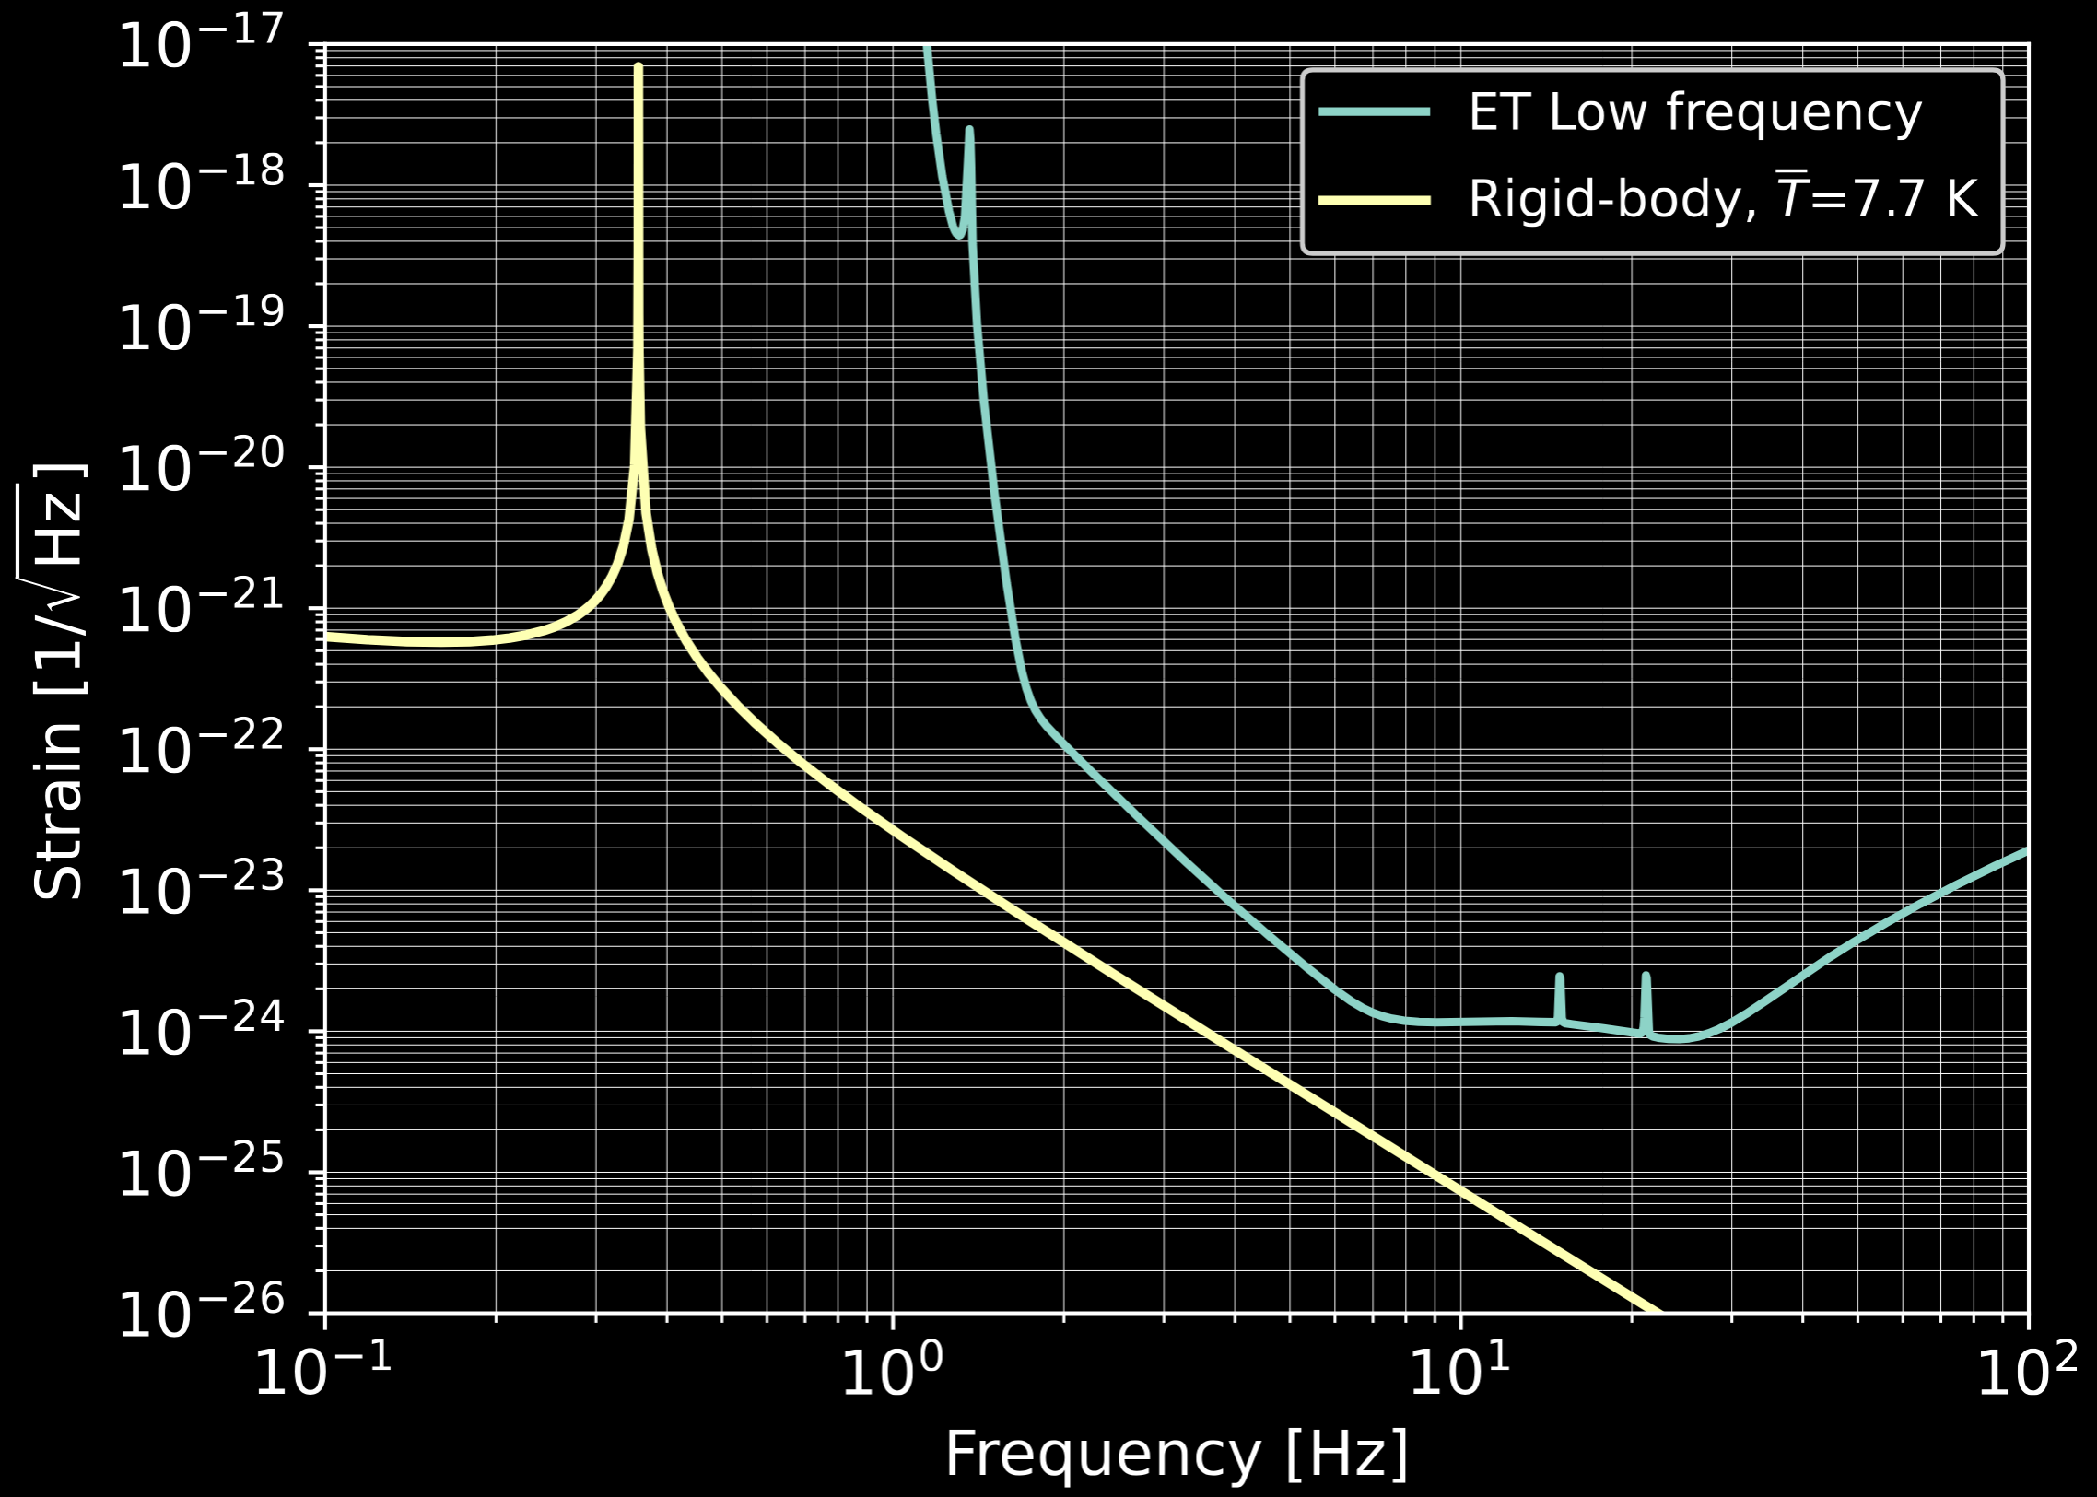
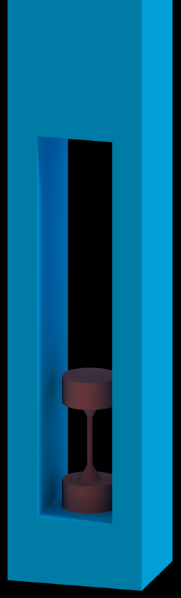
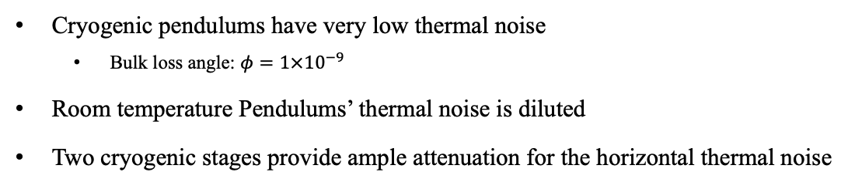
Horizontal Thermal Noise - OK
Cryogenic pendulums have very low thermal noise
  Bulk loss angle: $φ=1×{10}^{−9}$
Room temperature Pendulums’ thermal noise is diluted
Two cryogenic stages provide ample attenuation for the horizontal thermal noise
Soft silicon
flexures
Fixed support
$$S=\sqrt{\frac{4k_{B}T}{ω^{2}}Re\left(\frac{V}{F}\right)}$$
Input: force
Output: velocity

Slide 5
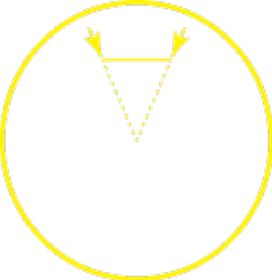
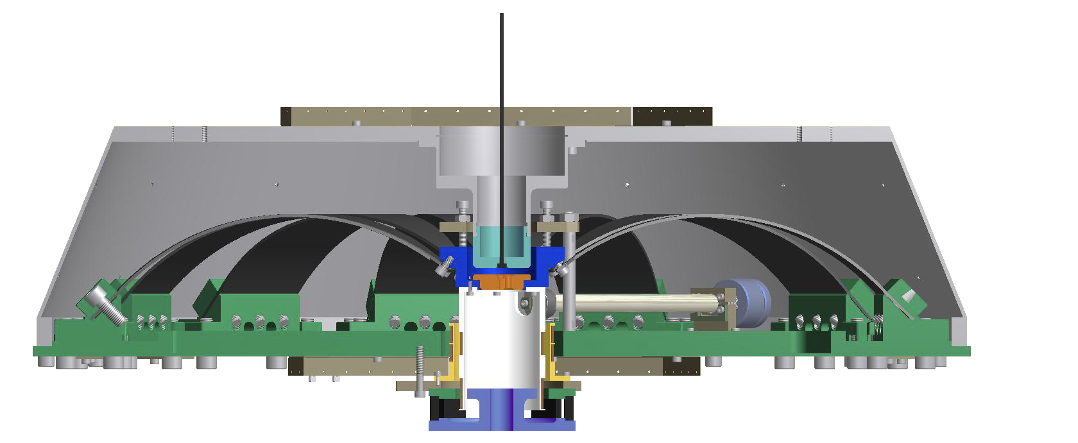
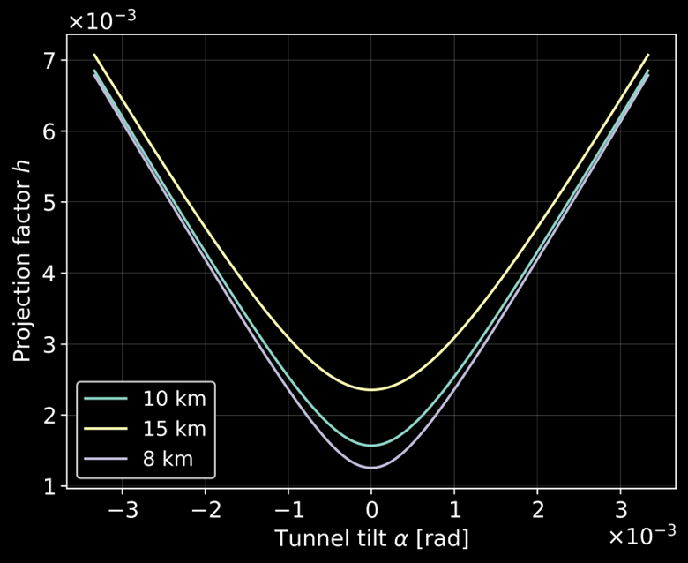
Why do we care of Vertical thermal noise ?
The seismic attenuation filters that have low quality factor and work at 300K
Have very large, undiluted
vertical thermal noise
A fraction L_{interferometer}/2 R_{earth} of the noise is projects on the interferometer’s axis
The problem gets worse: for longer or tilted interferometer arms or for any longitudinal suspension asymmetry
40 km
20 km

Slide 6
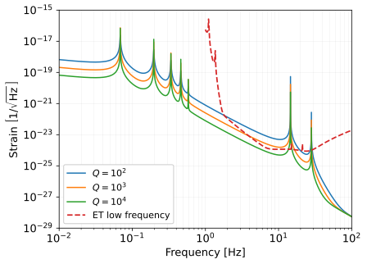
Transmitted Vertical Thermal Noise
GAS filter
resonances
Vertical Thermal Noise is mostly contributed by Quality factor of the lowermost the GAS seismic attenuation filter
Noise evaluated for the 10 km Fabry Perot beams flat at center
Vertical Thermal Noise can severely limit the ET sensitivity
What Q-factor to consider?
Silicon blade
resonances

Slide 7
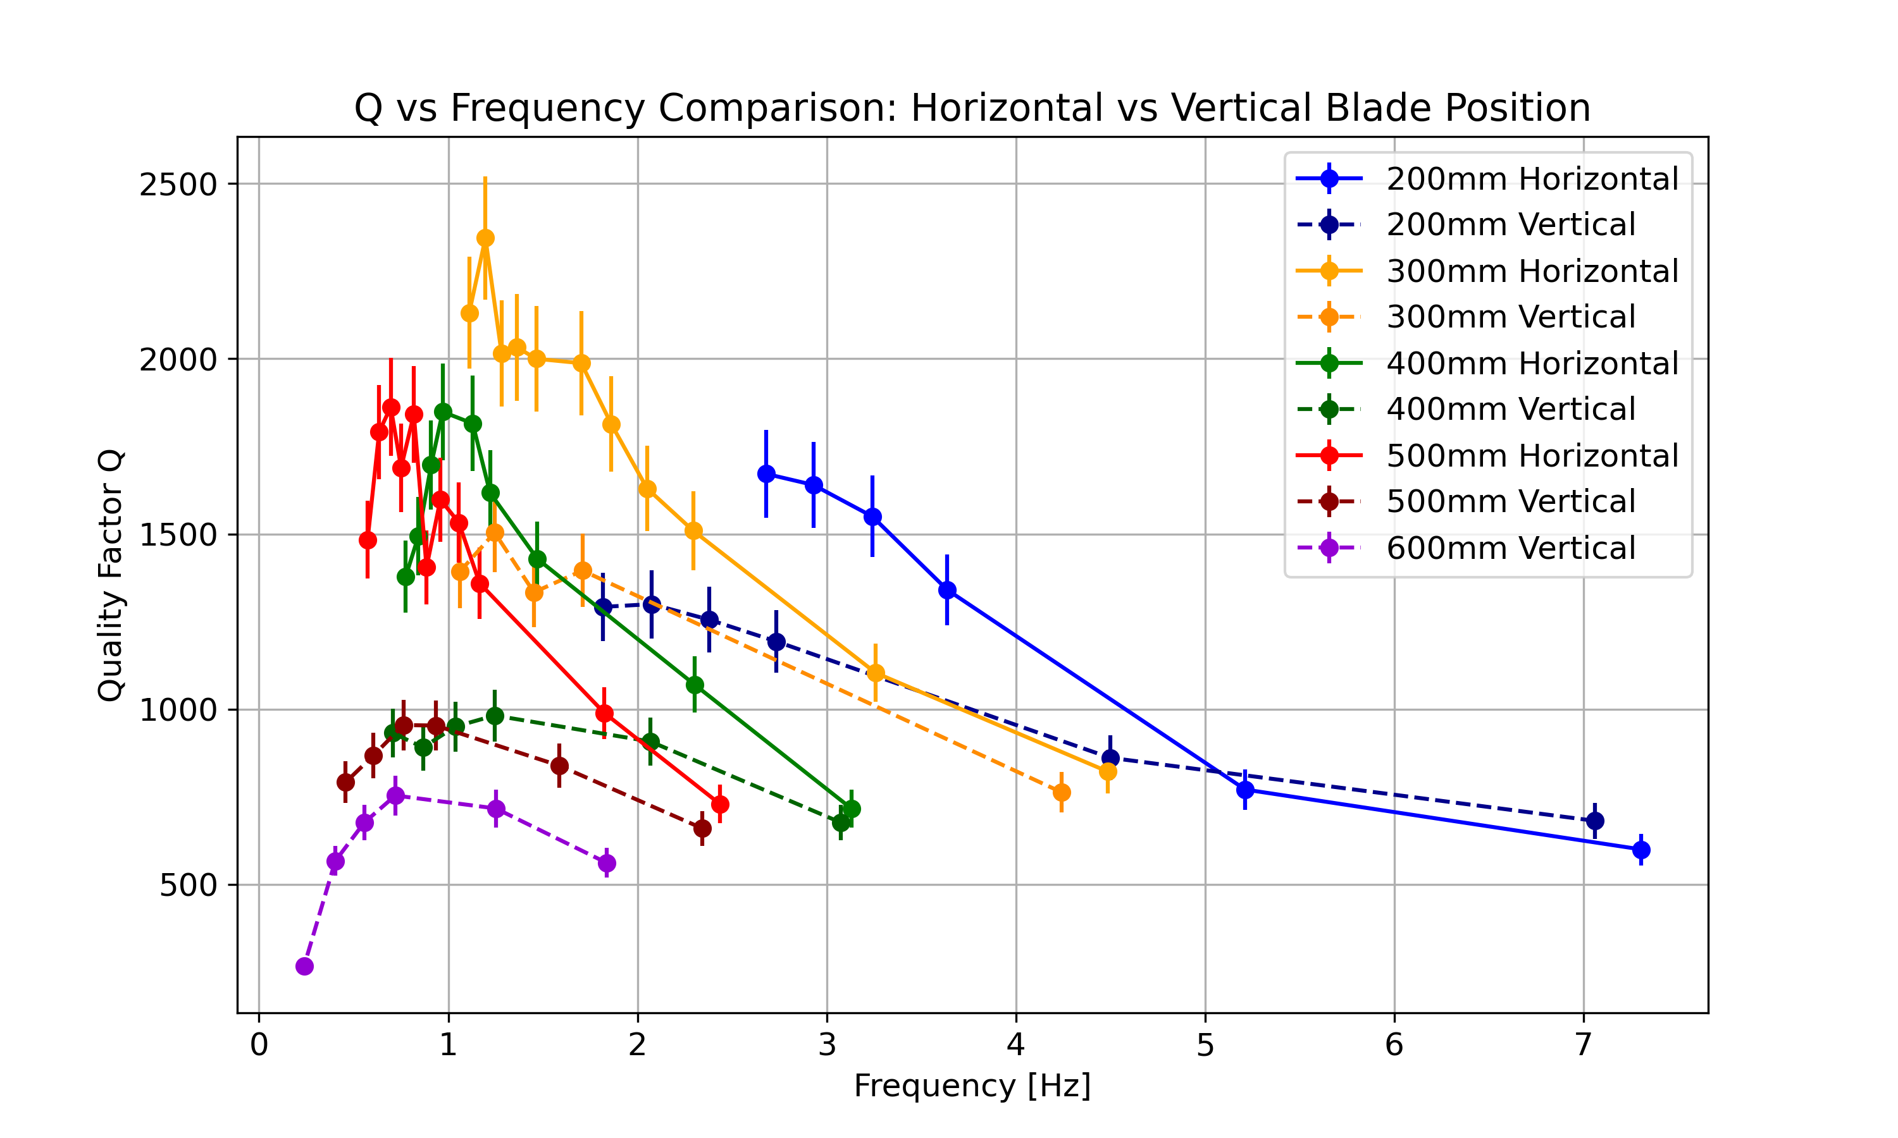
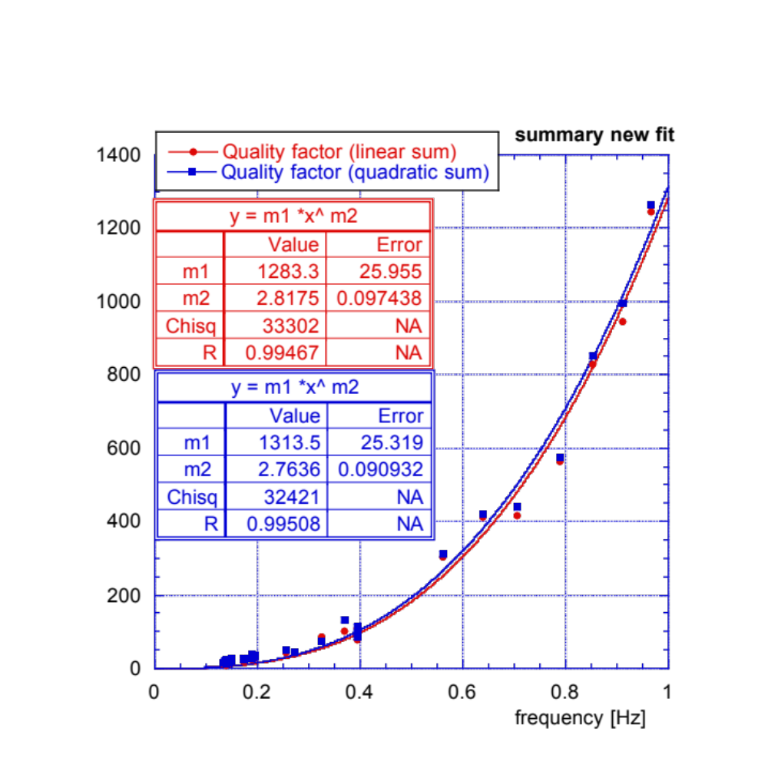
Quality factor measurements
KAGRA GAS filters Thin Free blades
450.
386.
321.
257.
193.
129.
064.
Resonant frequency [Hz}

Slide 8
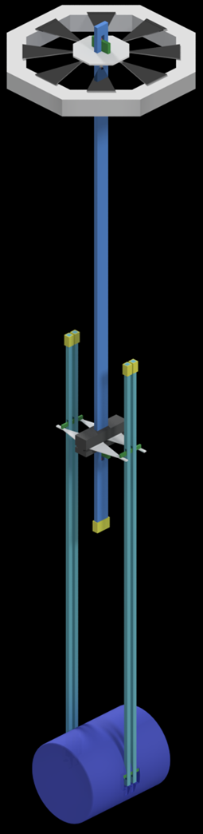
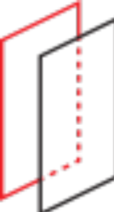
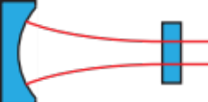
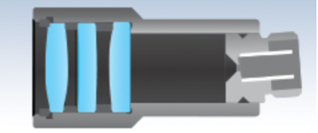
Vertical compliance
Sensing
and actuation
Spring blades
Cryogenic suspensions have two levels of silicon blades
Equalize the stress but are almost flat and are resonant at > 13 Hz
Useless for vertical noise attenuation ! !
Only Low-thermal-noise springs with large gain active anti springs can provide vertical attenuation
Development of high sensitivity, ultra low noise optical displacement sensor is necessary.
Sensing
and actuation
Spring blades

Slide 9
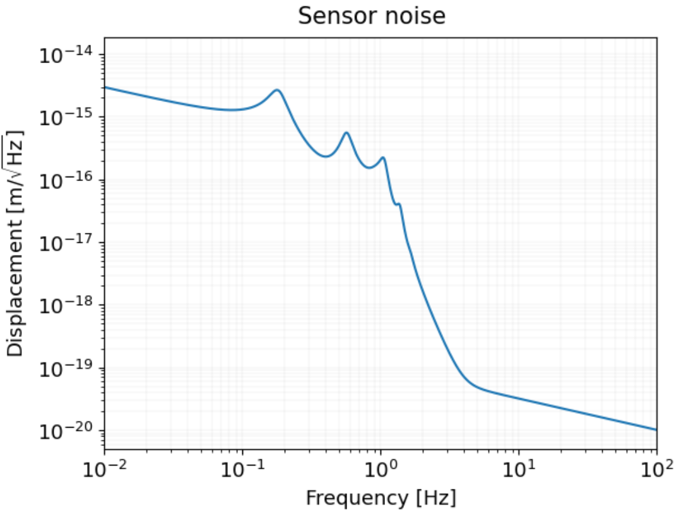
Taming Vertical thermal noise
The cryogenic suspensions must filter the vertical thermal noise, to avoid limiting the sensitivity.
To soften the silicon blade springs cannot provide filtering the sensitivity requirement for the vertical displacement sensor is comparable to ET-LF interferometer.
If active anti-springs with sufficiently low noise are possible the problem may be mitigated
Max. required
sensor noise
Short, fiber-fed,
high Finesse
Fabry-Perot
100 times worse than ET
Can be done?
< pm Dynamic
range

Slide 10
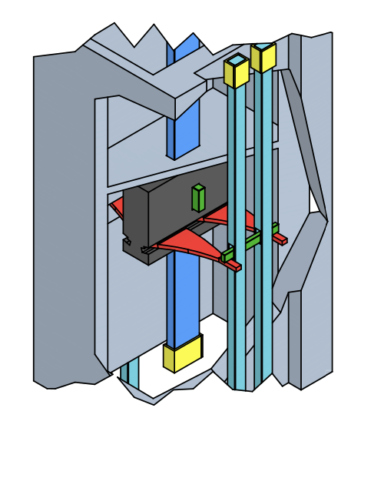
Where to apply the anti-spring Sensor/actuator pairs?
Fiber-fed Fabry Perot
Length sensor
Capacitive actuator

Slide 11
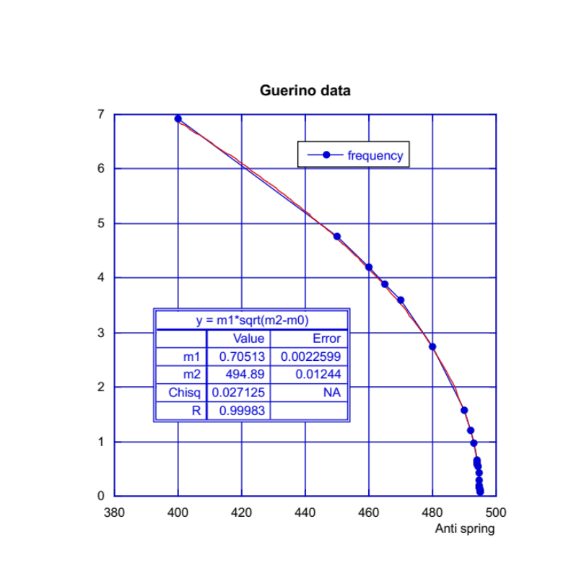
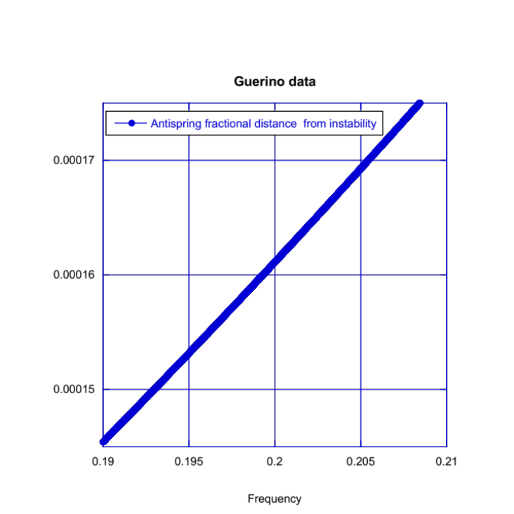
Anti-spring filters are difficult
Frequency (Hz)
Very low noise length sensing is needed
The low frequency is approached with a square root function, very sensitive to gain value
To go from 13 to 0.15 Hz, the gain must be stable to one part in 10⁴ or adaptive
Antispring constant (N/m)
Fractional distance from
Instability of anti spring
coefficient
Vertical resonance frequency (Hz)

Slide 12
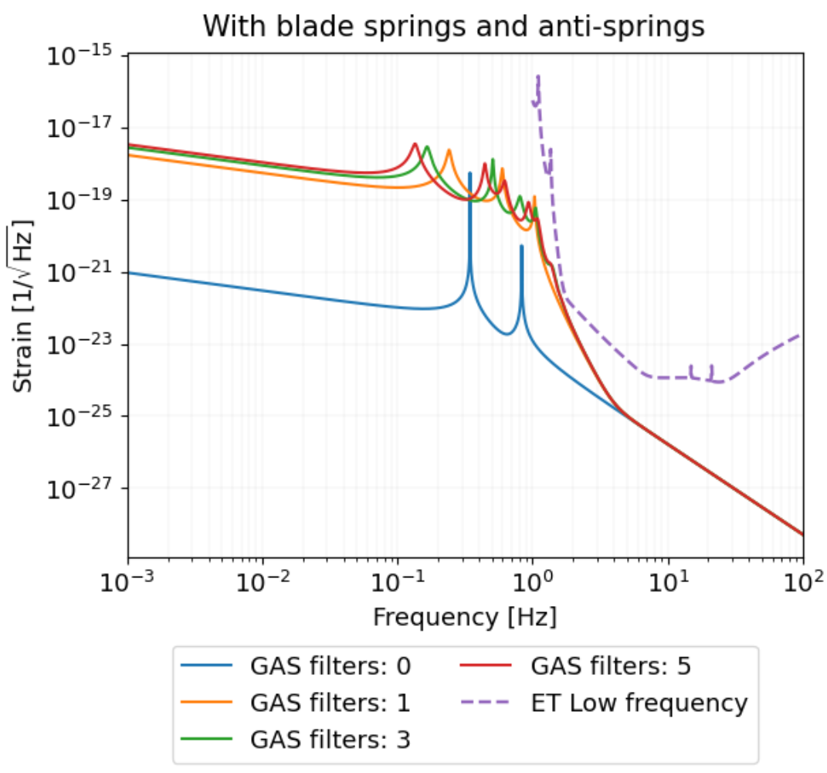
What does the anti-spring buy?
Tuning of the GAS filters can drive the vertical seismic attenuation frequencies to lower frequency
Tuning the anti-springs drives the resonance of the cryogenic silicon springs to lower frequency, attenuates the thermal noise of GAS filters
The projection of the vertical thermal noise can be pushed out of the picture
Beware of quality factors !
gain

Slide 13
Failure to filter Vertical Thermal Noise
GAS filter
resonances
we are stuck with a serious limitation of ET-LF sensitivity
Gets worse with longer arms, tilted beams and payload asymmetries
Silicon blade
resonances
40 km
20 km

Slide 14
Additional slides

Slide 15

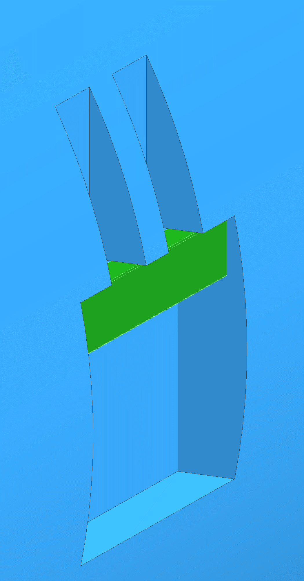
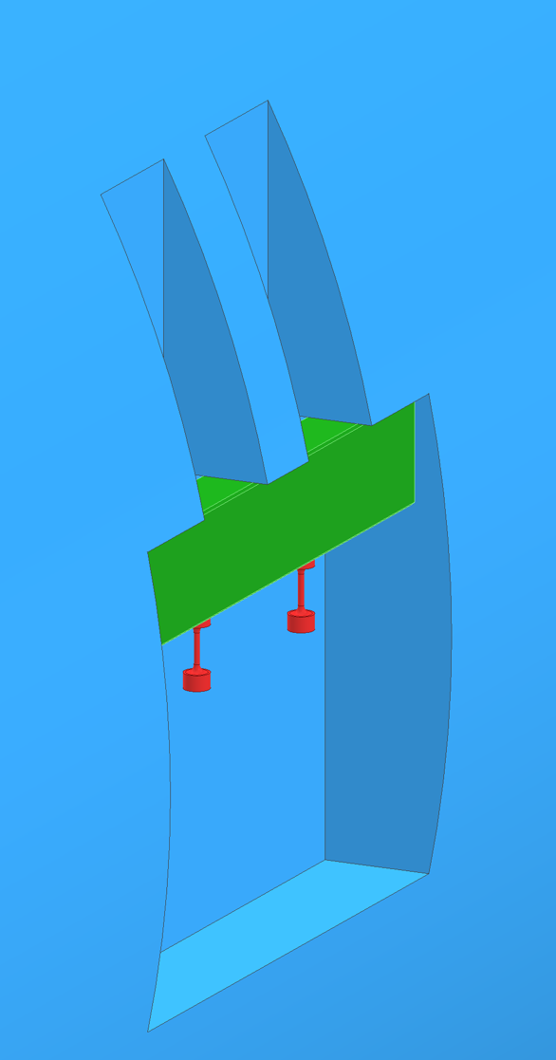
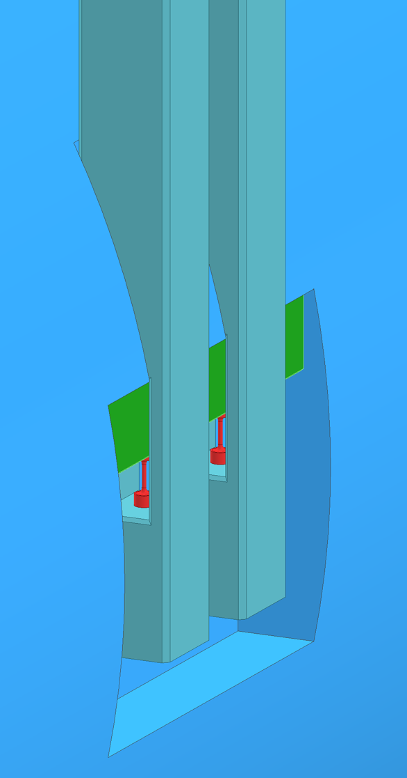
Hardware configuration
● Mirror
● Cross beam
● Side Feature
● Flexures
● Suspension beams
Side view
Front cross section view
Mirror side 3D-CAD

Slide 16
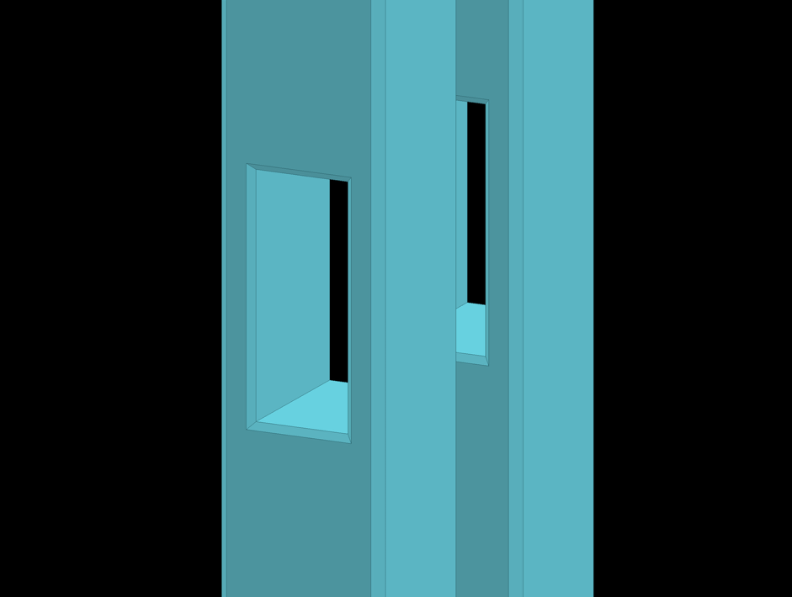
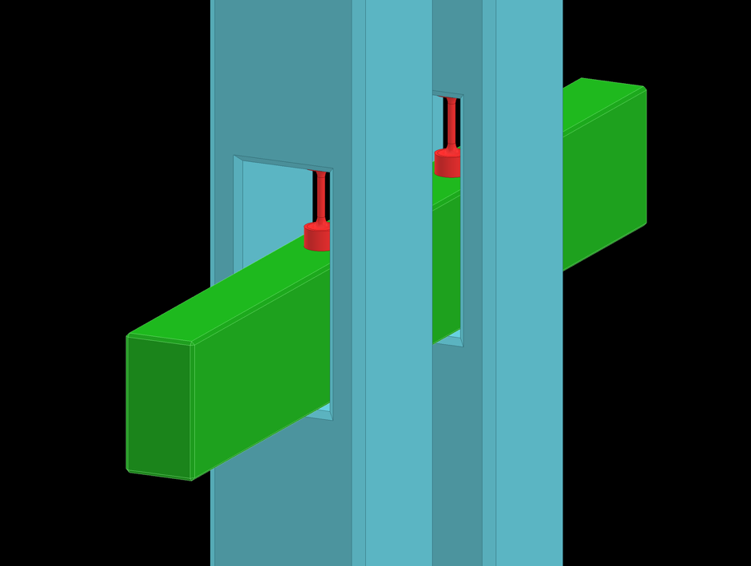
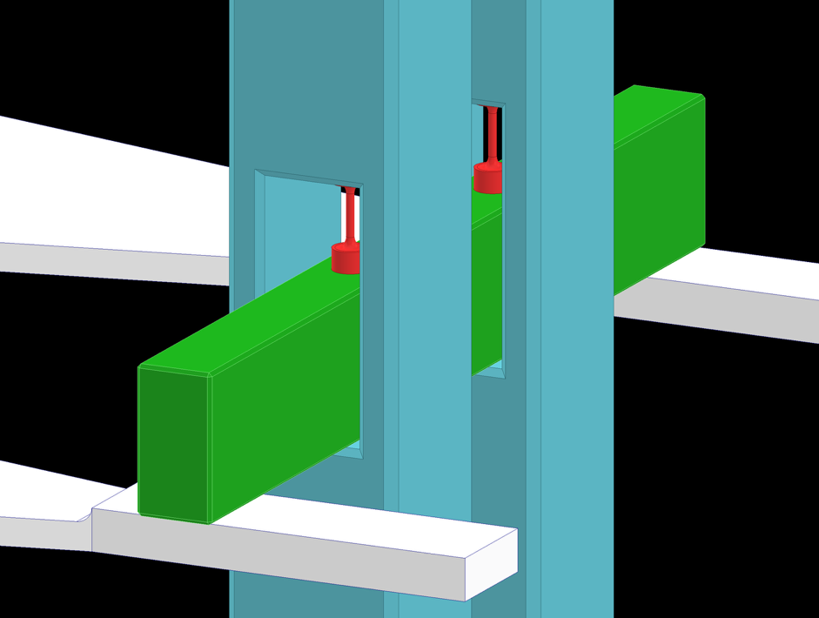
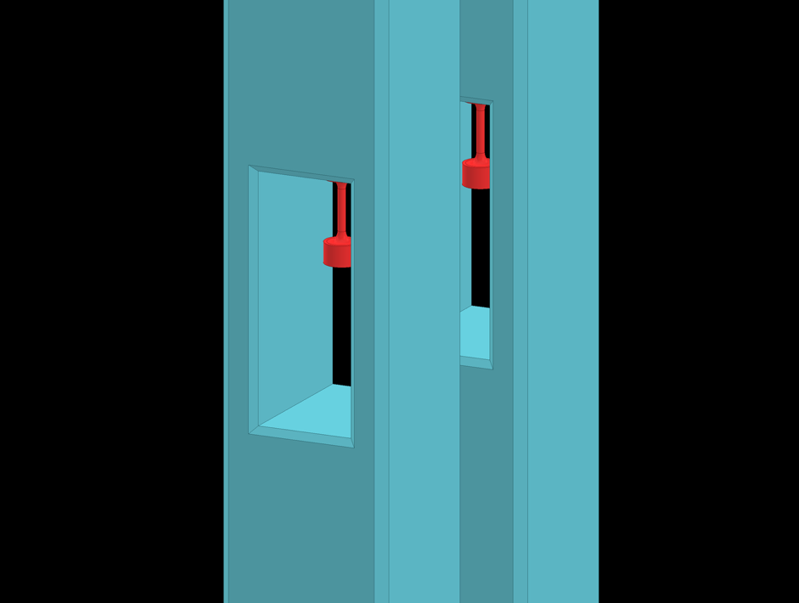
Hardware configuration
● Suspension beams
● Cross beam
● Counterweight
● Spring blades
● Flexures
● Intermediate body
● Cross beam
● Flexure
● Suspension beam
● Counterweight
3D-CAD

Slide 17
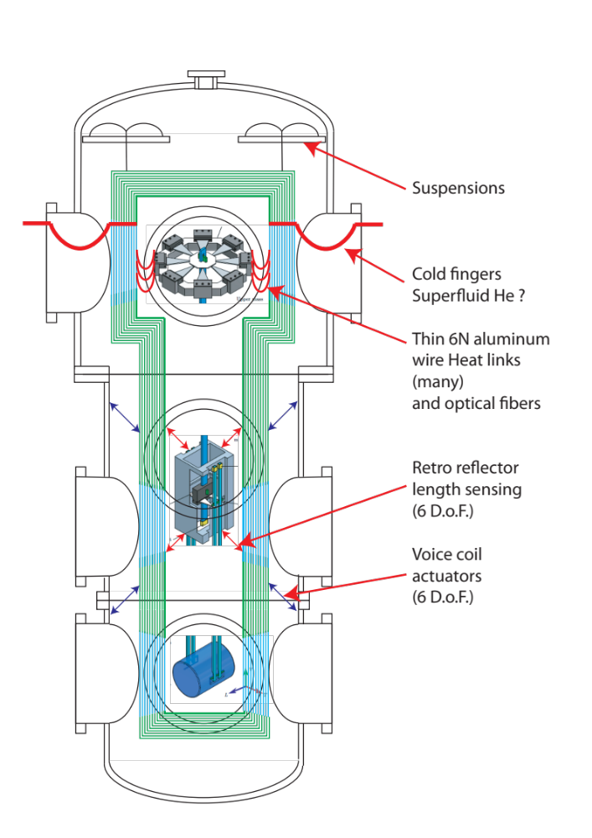
Cold links and
Suspended cryostat
The mechanical noise from the chillers must be filtered out
A solution: a rigid suspended cryostat
Slaved in 6 D. o. F. to the intermediate mass with optical length sensors and external voice coils
Thin tubes carry cryogenic fluids and thin heat links departing from cryostat connect to upper mass
Signal, naked optical fibers anchored to cryostat

Slide 18
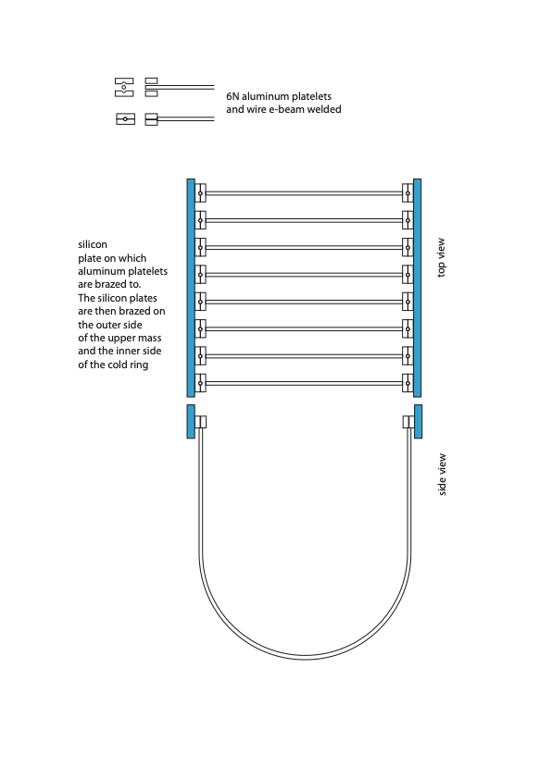

Use cold links to feed in voltages and signals
Heat links between the cryostat and the upper mass would be combs of U-shaped 6N aluminum wires
By silver brazing them on a silicon bar they stay separated and can be used as electrical conductors
  (Si is an insulator at 10K)
Optical fibers would follow the same path.
Silicon bars
E-beam welded
Nail heads

